Slide 1
MPEG-DASH 6th Edition Features
DASH-IF Special Session, April 5, 2024
Editors of ISO/IEC 23009-1 6th edition
Alex Giladi, Comcast, Thomas Stockhammer, Qualcomm, Iraj Sodagar, Tencent

Slide 2
Agenda
Timeline and status
Recap of DASH – Principles and 5th edition
6th Edition
Overview of Features
L3D-DASH: Low-Latency Low-Delay Extensions
Media Presentation Insertion
Patterns in Segment Timeline
Support for CMCD
Support for Content Steering
Addressable Resource Index Tracks
DASH-IF related impacts (IOP guidelines and reference tools)
Q&A

Slide 3

Editions, Parts and Editors
1 | 2011 | ISO/IEC 23009-1 Media Presentation Description and Segment Formats | Thomas Stockhammer and Per Fröjdh
1 | 2012 | ISO/IEC 23009-1:201x 2nd edition | Thomas Stockhammer, Per Fröjdh
1 | 2013 | ISO/IEC 23009-1:2014 AMD 1 Extended profiles and time synchronization | Thomas Stockhammer, Alex Giladi
1 | 2014 | 23009-1:2014 AMD 2 Spatial Relationship Description, Generalized URL parameters and other extensions | Emmanuel Thomas, Sylvain Kervadec, Cyril Concolato
1 | 2014 | 23009-1:2014 AMD 3 Authentication, Access Control and multiple MPDs | Thomas Stockhammer, Alexander Giladi
1 | 2014 | 23009-1:2014 AMD 4 Segment Independent SAP Signalling, MPD chaining and other extensions | Thomas Stockhammer, Iraj Sodagar, Alex Giladi
1 | 2015 | 23009-1 3rd edition Media presentation description and segment formats | Thomas Stockhammer
1 | 2016 | 23009-1 3rd edition AMD 1 on device information and other extension | Ali C. Begen, Thomas Stockhammer
1 | 2019 | 23009-1 4th edition
1 | 2020 | 23009-1 4th edition AMD 1 CMAF support, events processing model and other extensions | Iraj Sodagar, Thomas Stockhammer, Mike Dolan
1 | 2022 | 23009-1 5th edition | Thomas Stockhammer, Mike Dolan
2 | 2012 | ISO/IEC 23009-2 DASH Conformance and reference software | Thomas Stockhammer and Christian Timmerer
2 | 2017 | 23009-2 2nd edition DASH Conformance and reference software | Christian Timmerer, Waqar Zia, Brendan Long
2 | 2017 | 23009-2 AMD 1 Conformance vectors and reference software for SRD, SAND and Server Push | Emmanuel Thomas
2 | 2020 | 23009-2 3rd edition
3 | 2012 | 23009-3 DASH Implementation Guidelines | Yuriy Reznik, Kilroy Hughes, Thomas Stockhammer
3 | 2014 | 23009-3 2nd edition DASH Implementation Guidelines | Thomas Stockhammer, Alex Giladi
3 | 2014 | 23009-3 2nd edition AMD 1 DASH Implementation Guidelines | Iraj Sodagar
3 | 2015 | 23009-3 3rd edition DASH Implementation Guidelines | Ali C. Begen
4 | 2013 | ISO/IEC 23009-4 Segment encryption and authentication | Alex Giladi
4 | 2018 | 23009-4 2nd edition Segment encryption and authentication | Alex Giladi and Yasser Syed
5 | 2017 | 23009-5 Server and Network Assisted DASH | Mary-Luc Champel, Emmanuel Thomas
5 | 2020 | 23009-5 AMD 1 Improvements on SAND messages | Mary-Luc Champel
6 | 2017 | 23009-6 DASH with Server Push and WebSockets | Viswanathan (Vishy) Swaminathan, Kevin Streeter, Imed Bouzazi, and Franck Denoual
7 | 2023 | 23009-7 Delivery of CMAF contents with DASH | Iraj Sodagar
8 | 2020 | 23009-8 Session based DASH operation | Ali C. Begen, Iraj Sodagar, Alex Giladi
8 | 2022 | 23009-8 AMD 1 URL customization other extensions | Iraj Sodagar

Slide 4
5th Edition Extensions
DASH profiles for using Common Media Application Format (CMAF) are added;
the concept Resynchronization is added in order to identify stream access points in Segments;
MPD patching is updated to support explicit MPD updates of smaller size, not only as inband messages;
a client processing model for Event Streams and Timed Metadata tracks is introduced;
Extensions are added to content protection for efficient signalling and to support robustness levels.
A descriptor is added in order to describe the minimum required device output protection security.
More flexible bandwidth signalling is provided to signal variable bitrate encoding.

Slide 5
Status ISO/IEC 23009-1
ISO/IEC 23009-1:2022 ed.5, Edition date 2022-08
  http://standards.iso.org/ittf/PubliclyAvailableStandards
ISO/IEC DIS 23009-1 ed.6
  Revises (1)
    ISO/IEC 23009-1:2022
  Merge of (3)
    ISO/IEC 23009-1:2022/DAmd 1
    ISO/IEC 23009-1:2022/CD Amd 2
    ISO/IEC 23009-1:2022/CD Amd 3
  Timeline
  Editors
  Dolan Michael Mr (Pearl TV)
  Giladi Alex Mr (Comcast)
  Higgs Paul (Huawei)
  Sodagar Iraj Dr (Tencent)
  Stockhammer Thomas Mr Dr. (Qualcomm)
  Wang Ye-Kui Dr (Bytedance)
Description | Target date | Started
DIS registered | 2024-04-30 | 2024-02-23
DIS ballot initiated | 2024-04-26
Close of voting | 2024-07-19
Final text received or FDIS registered for formal approval | 2024-11-08
International Standard published | 2025-02-23

Slide 6
Recap – core aspects of Live DASH
MPD work flow & Low-Latency DASH

Slide 7
Core Principles of DASH
CDN and Cache friendly
Stateless Server
Client-driven
Low manifest traffic (small size and low update frequency)
Carrying ISO BMFF and CMAF
Late Binding
Works with HTML-5 and MSE
Live and On-Demand
HLS Convergence

Slide 8
DASH Manifest for Live
Key issue for reducing latency is the reduction of segment duration w/o losing scalability
HLS Manifest states what is available on the server and only provides information on the past, which results in the following
      Client sending uplink requests for Manifest prior to each Segment request
      A full new manifest needs to be delivered for each new Segment (which also grows over time, so short Segments and Late Binding are more difficult to realize)
      The manifest needs to be parsed and processed by client for every request
      For each new segment, a new Manifest needs to be written on the server
DASH MPD provides information of the past and permits promises for the future
  If used properly, several or all of the above can be mitigated or at least reduced
  Functions to support this:
    Templates in URLs and predictive segment availability times ➔ small manifests and lower segment sizes
    Flexible MPD validity expiration mechanisms ➔ MPD updates only when necessary
    Time-synchronized server and client ➔ no requests are necessary

Slide 9
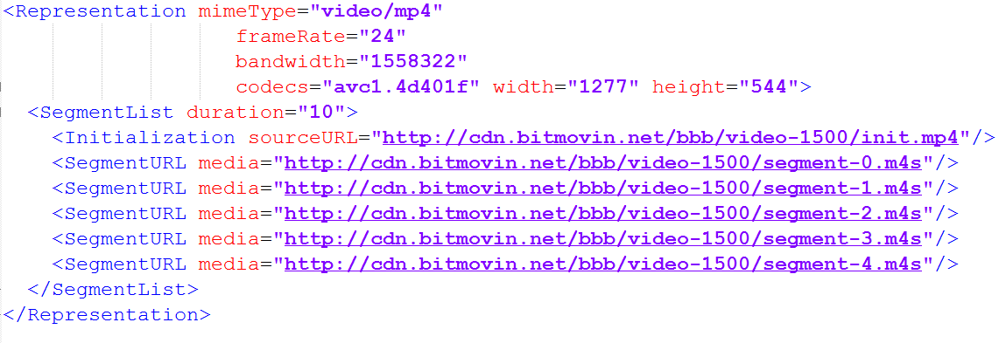
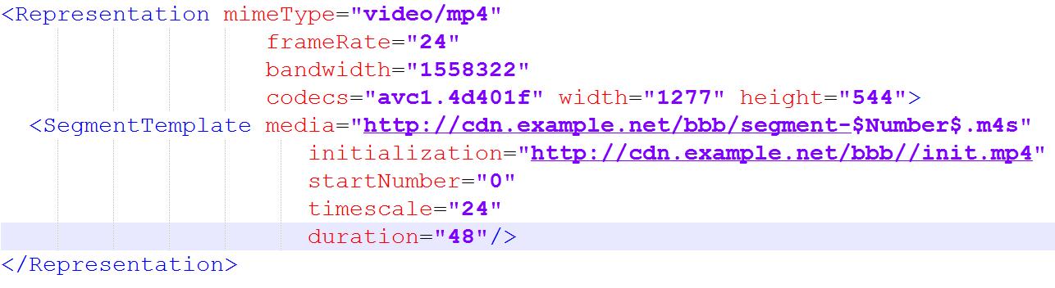
Segment Addressing
List
Number template
Segment-0
Segment-1
Segment-2
......

Slide 10
Server
availabilityStartTime
mediaPresentationDuration
availabilityEndTime
timeShiftBufferDepth
timeShiftBufferDepth=4
1
2
3
4
5
6
7
8
9
MPD(1)
minimumUpdatePeriod
MPD(2)
Client
Playout
suggestedPresentationDelay
1
2
3
4
5
6
7
8
9
MPD Info
1
2
3
4
5
6
7
8
9
FetchMPD(1)
FetchMPD(1)
FetchMPD(2)
1
1
1
1
1
1
1
1
1
1
2
2
2
2
2
2
2
2
2
2
3
3
3
3
3
3
3
3
3
3
4
4
4
4
4
4
4
4
4
4
5
5
5
5
5
5
6
6
6
6
6
6
7
7
7
7
7
7
8
8
8
8
8
8
9
9
9

Slide 11
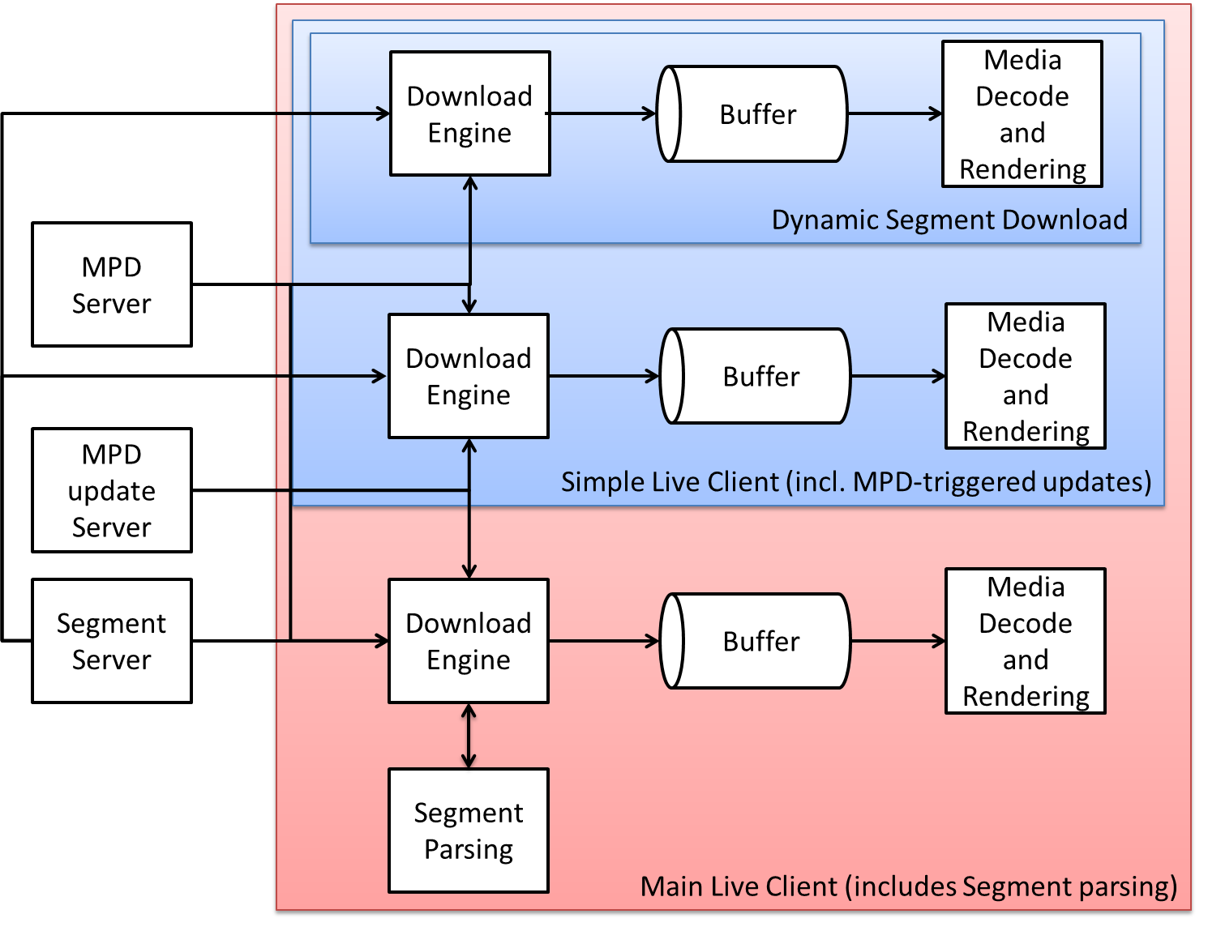
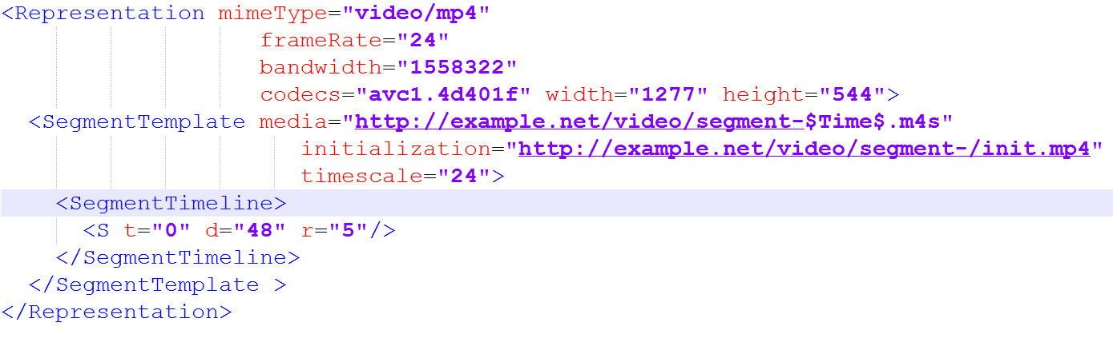
Advanced Client
<InbandEventStream MPD Validity Expiration>
Segment-0
Segment-48
Segment-92
......

Slide 12
Server
availabilityStartTime
mediaPresentationDuration
availabilityEndTime
timeShiftBufferDepth=4
timeShiftBufferDepth
1
5
6
7
8
9
1
2
2
3
4
Inband Events
MPD(1)
MPD(1)
minimumUpdatePeriod = 0
MPD(2)
Client
Playout
suggestedPresentationDelay
1
2
3
4
5
6
7
8
9
MPD Info
8
9
1
2
3
4
5
6
7
FetchMPD(2)
FetchMPD(1)
Download
1
2
3
4
5
6
7
8
9
1
1
1
1
1
1
1
1
1
1
2
2
2
2
2
2
2
2
2
2
3
3
3
3
3
3
3
3
3
3
4
4
4
4
4
4
4
4
4
4
5
5
5
5
5
6
6
6
6
7
7
7
8
8
9

Slide 13
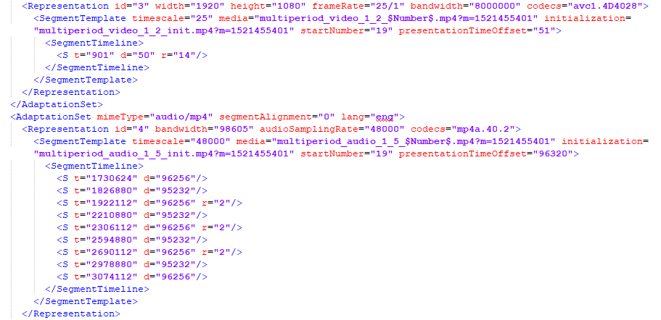
Segment Timeline

Slide 14
Low-Latency Streaming with Chunking
MPD
Service
Description
IS
Encoder
0.5s
CNC
CNC
CIC
CNC
CNC
CIC
CH
DASH Packager
DASH Segment
4 s
HTTP
Chunk
HTTP
Chunk
CH = CMAF Header
CNC
CNC
CIC
CNC
CNC
CIC
CNC = CMAF non-initial chunk
CIC = CMAF initial chunk
CDN stores Segments
10s
Regular
DASH
Client
Segments
Many technical details are in DASH-IF IOP v5
http://www.dashif.org/guidelines
3s
Low-Latency
DASH
Client
Chunks

Slide 15
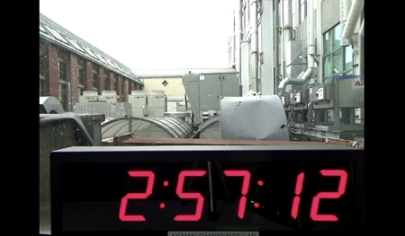
Chunked Segment Distribution
ENCODER
CDN
PLAYER
MDAT
MDAT
MDAT
MOOF
MOOF
MOOF
MDAT
MDAT
MDAT
MDAT
MDAT
MDAT
MDAT
MDAT
MDAT
MDAT
MDAT
MDAT
MOOF
MOOF
MOOF
MOOF
MOOF
MOOF
MOOF
MOOF
MOOF
MOOF
MOOF
MOOF

Slide 16
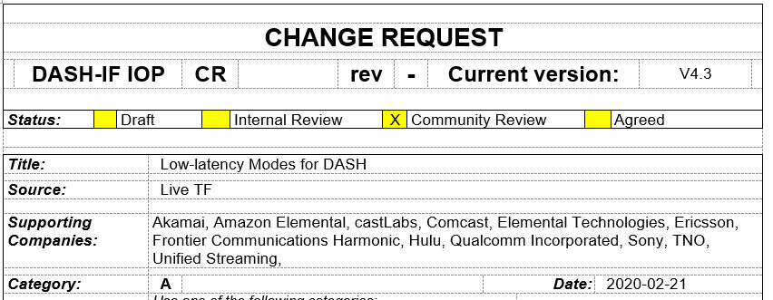
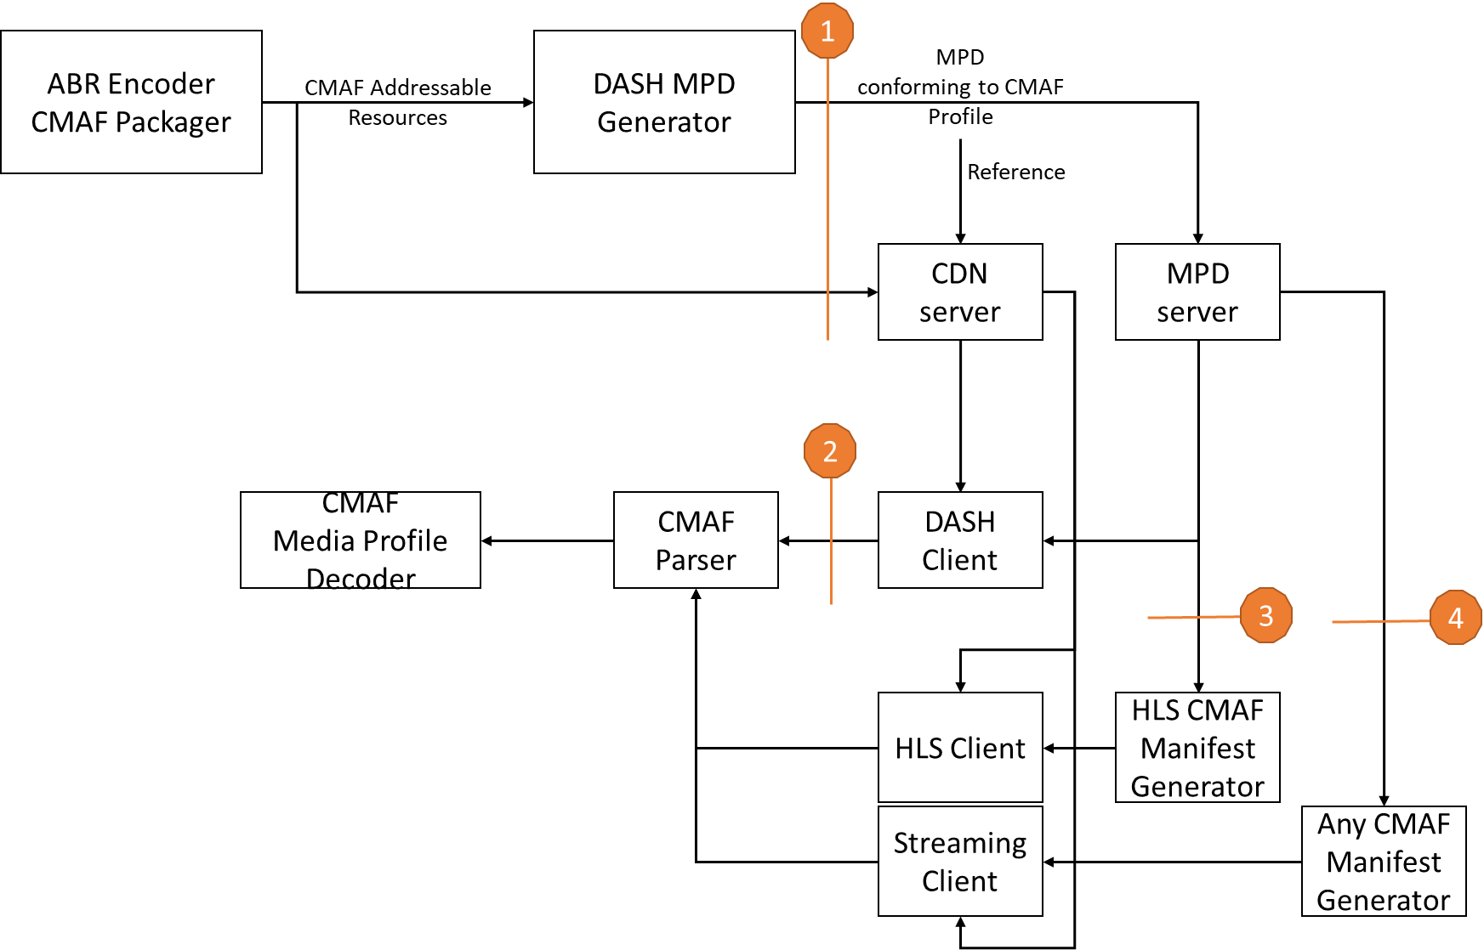
MPEG DASH supporting work
As part of ISO/IEC 23009-1 4th and 5th edition
Producer Reference Time in MPD and segments
  Enables media encoding including wall-clock anchor times
  Permits DASH client to determine, monitor and control latency.
Service Description
  Addresses service provider’s
  influence on DASH client operation
  Target Latencies, Playback Control
Updates on Event Processing
DASH Profile for CMAF Content
Resynchronization
  Enables chunk signaling
  Enables fast downswitching and random access

Slide 17

Advantages of Chunked Segments
Legacy Player Support with the same content/infra
CDN friendly: Cacheability and Scalability
Decoupling of latency from segment duration
Reuse or Automatic support of existing DVB-DASH
  Codecs and formats
  Common Encryption
  Ad Insertion
  Events
Standards-based and promise for convergence
Works also with ABR Multicast and Broadcast

Slide 18
6th edition extensions
Overview

Slide 19
MPEG 6th Edition – Overview of Features
Support for Content Steering
Alternative MPD Events for Client Side/Server Guided Ad Insertion
Nonlinear playback
Addressable Resource Index Track
DASH Period Event
Amendment 2 Rolled into DIS 6th ed
Amendment 1 – FDAM complete
Amendment 3 Rolled into DIS 6th ed
Support for CMCD Signaling
Segment Sequences for improved latency and switching
Support for status in Event scheme
Support for extended dependent random access point representations
Support for advanced Picture-in-Picture signaling (using VVC subpictures)
Improvements to Segment Timeline for Patterns and tolerance

Slide 20
6th edition extensions
Extensions to Segment Signaling (Alex)

Slide 21
L3D-DASH: Low-Latency Low-Delay Extensions
Motivation
Low-delay operation
  Start playback faster – do not wait for up to 2 seconds
  Faster switching to avoid buffering
  Independency of joining latency, switching latency and segment duration
Ad insertion w/o stream conditioning
  Return from ad break to an arbitrary place – not necessarily an IDR
LL-HLS compatibility
  Reuse LL-HLS partial segments
  Use DASH templates to keep same MPD update efficiency
21

Slide 22
Low-delay mode: theory of operation
Partial Segments
  Segment broken into sequence of partial segments (“segment sequence”)
  Partial segments start with IDR
  Special-purpose representations for fine-grain random access
  Segment Sequences are templated
  ”this segment sequence contains k partial sequences”
Normal representation
S(i)
S(i+1)
Low-delay 1
S(i,0)
S(i,1)
S(i,2)
S(i,3)
S(i,4)
S(i+1,0)
S(i+1,1)
S(i+1,2)
S(i+1,3)
S(i+1,4)
Segment Sequence
Low-delay 0
22

Slide 23
Low-latency mode: theory of operation
Partial Segments
  LL-HLS partial segments (no byte ranges)
  Partial segments do not need to start with IDR
  Partial segments may contain events
  Segment Sequences are templated
  ” Same MPD update frequency as in non-LL DASH
Live edge
Time-shifted representation
S(i)
Live-edge representation
S(i,0)
S(i,1)
S(i,2)
S(i,3)
S(i,4)
S(i+1,0)
S(i+1,1)
S(i+1,2)
S(i+1,3)
S(i+1,4)
23

Slide 24
L3D: Low-Latency Low-Delay DASH
Beyond low-latency and low-delay
  Efficient use of HTTP/3
  Each HTTP/3 response is a QUIC stream
  Parallelize transmission of extremely short partial segments
    … some of the MoQ goodness using ye aulde DASH
Compression efficiency
  Enables scene-boundary aligned segments
  Mini-GOP-sized partial segments for random access and events
Trick modes
  Small partial segments can be used for smoother trick play
24

Slide 25
<?xml version="1.0" encoding="UTF-8"?> <MPD xmlns="urn:mpeg:dash:schema:mpd:2011" type="dynamic" id="7399610060681366163" profiles="urn:mpeg:dash:profile:isoff-live:2011" minBufferTime="PT2.000S" maxSegmentDuration="PT0H0M2.016S" minimumUpdatePeriod="PT0H0M2.002S" availabilityStartTime="1977-05-25T18:00:00.000Z" timeShiftBufferDepth="PT0H0M30.000S" publishTime="2021-11-10T20:44:07.025Z"> <ServiceDescription> <Latency min="750" max="4200" target="1250" referenceId="7"/> <PlaybackRate min="0.96" max="1.04"/> </ServiceDescription> <Period id="817467999" start="PT389761H2M15.535S"> <ProducerReferenceTime id="7" wallClockTime="2019-08-06T13:44:12Z" presentationTime="158400"/> <AdaptationSet id="1" contentType="video" mimeType="video/mp4" segmentAlignment="true" startWithSAP="0"> <Role schemeIdUri="urn:mpeg:dash:role:2011" value="main"/> <EssentialProperty schemeIdUri="urn:mpeg:dash:ssr:2023" /> <!—Segment Sequence Representations where partial segments with subnumber > 1 are not expected to have any kind of random access / bitstream switching The first partial segment starts with SAP = 1 --> <SegmentSequenceProperties> <SAP type="1"/> </SegmentSequenceProperties> <SegmentTemplate initialization="$RepresentationID$/init.mp4" media="$RepresentationID$/segment_$Number$_part_$SubNumber$.mp4" timescale="90000" startNumber="817472154" presentationTimeOffset="135158"> <SegmentTimeline> <!-- 1.92s segment with 6-frame partial segments, compatible with LL-HLS--> <S t="546975158" d="172800" r="14" k="16"/> </SegmentTimeline> </SegmentTemplate> <Representation id="l3d_540p" bandwidth="1502000" codecs="hvc1.2.4.L93.B0" width="960" height="540" frameRate="50"/> <Representation id="l3d_720p" bandwidth="2166000" codecs="hvc1.2.4.L93.B0" width=”1280” height=”720” framerate=”50”/> <Representation id=”l3d_1080p” bandwidth=”6202000” codecs=”hvc1.2.4.L123.B0" width="1920" height="1080" frameRate="50"/> <Representation id="l3d_1440p" bandwidth="12741200" codecs="hvc1.2.4.L153.B0" width=”2560” height=”1440” framerate=”50”/> <Representation id=”l3d_2160p” bandwidth=”18667200” codecs=”hvc1.2.4.H153.B0" width="3840" height="2160" frameRate="50"/> </AdaptationSet> </Period> </MPD>

Slide 26
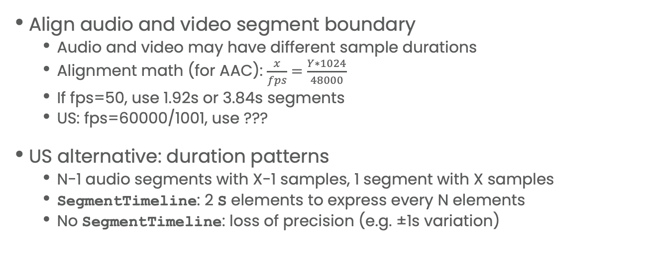
Patterns in Segment Timeline
Problem
Align audio and video segment boundary
  Audio and video may have different sample durations
  Alignment math (for AAC): $\frac{x}{fps}=\frac{Y∗1024}{48000}$
  If fps=50, use 1.92s or 3.84s segments
  US: fps=60000/1001, use ???
US alternative: duration patterns
  N-1 audio segments with X-1 samples, 1 segment with X samples
  SegmentTimeline: 2 S elements to express every N elements
  No SegmentTimeline: loss of precision (e.g. ±1s variation)
26

Slide 27
Segment duration patterns in 6th edition
Increase precision
  Explicit tolerance signaling (e.g. ± 1 sample)
  E.g., “this audio segment duration is between 1980ms and 2020ms”.
Use duration pattern
  Explicitly describe a pattern separately from individual segments
  Signal pattern and entry point in SegmentTimeline.S element
  Timing always precise
S(i)
S(i)
S(i+2)
S(i+3)
S(i+5)
S(i+6)
S(i+7)
S(i+8)
S(i)
S(i+1)
S(i+4)
S(i+9)
Pattern:
4 N-sample segments
1 M-sample segment
27

Slide 28
<?xml version="1.0" encoding="UTF-8"?> <MPD xmlns="urn:mpeg:dash:schema:mpd:2011" type="dynamic" id="7399610060681366163" minBufferTime="PT2.000S" maxSegmentDuration="PT0H0M2.016S" minimumUpdatePeriod="PT0H0M2.002S" timeShiftBufferDepth="PT0H0M30.000S" publishTime="2021-11-10T20:44:07.025Z" availabilityStartTime="1977-05-25T18:00:00.000Z"> <Period id="817467999" start="PT389761H2M15.535S"> <AdaptationSet id="1" contentType="audio" mimeType="audio/mp4" segmentAlignment="true" startWithSAP="1" audioSamplingRate="24000"> <Role schemeIdUri="urn:mpeg:dash:role:2011" value="main"/> <EssentialProperty schemeIdUri="urn:mpeg:dash:pattern:2024"/> <SegmentTemplate initialization="$RepresentationID$/init.mp4" media="$RepresentationID$/segment_$Time$.mp4" timescale="90000" startNumber="817472154" presentationTimeOffset="135158"> <Pattern id="1"> <P d=" 180480" r="11"/> <P d="176640"/> </Pattern> <SegmentTimeline> <S t="546975158" r="164" p="1" pE="3"/> </SegmentTimeline> </SegmentTemplate> <Representation id="eng_2ch" bandwidth="112000" codecs="mp4a.40.5"/> </AdaptationSet> </Period> </MPD>

Slide 29
6th edition extensions
Support for Advanced Ad Insertion (Iraj)

Slide 30
DASH-IF Ad Insertion Architecture: SSAI/SGAI
Independent Content Generation
What about
Client-Side
Ad Insertion?
Main
Content
CMAF
Spliced Content
CMAF
Ad Content
CMAF

Slide 31
Media Presentation Insertion
Problem
We have tens of thousands of “canned” ad MPDs
  How do we reuse them in context of linear?
  How do we interrupt them asynchronously (e.g., “breaking news”)
    “Return to network” in SCTE-speak
Wasn’t XLink supposed to solve these?
  onRequest timing model is undefined
  Re-resolution on every MPD update
  Convoluted asynchronous termination
  New solution simpler than another redesign
Simple support for most alternate content problems
  ”Regular” ad ecosystem
  Combination of ads and blackouts
D

Slide 32
Media Presentation Insertion
”Start playing alternate MPD, come back when done”
  Carries a URL of a new MPD
  Event’s start ST and duration define the time interval for switching to Alternate MPD
  Play for the actual duration of alternate MPD duration D
    If was alternative MPD was intended to run for 15s but ran for 5s then D=5.
Modes
  “insert”: return to the starting point, timing shifting the original content
  “replace”: return to ST+D replacing the original content
  “replace+listen”: same as “replace”, but listen to events from the main presentation
  “return” signals early termination, and immediate return to the main presentation
Alternate MD event
“return”
Main (“entertainment”) MPD
ST
“replace+listen”
“Insert”
“replace”
Alternative (“ad”) MPD
D

Slide 33
DASH Media Presentation Insertion vs HLS Interstitials
Feature | HLS | DASH
Opening new Media Presentation | EXT-X-DATERANGE CLASS = “com.apple.hls.interstitial” | Alternative MPD event (carried in MPD or segments)
Query Parameters | Named query parameters (Annex D.4) | Extended query parameters (Annex I.3)
Resumption point | X-RESUME-OFFSET 0: resume at the same point Absent: resume when interstitial terminates T: resume in T seconds | Event@value “insert”: resume at the same point “replace”: resume when alternative presentation terminates Custom duration via MPD Anchors (Annex C.4)
Termination | Interstitial duration Stated duration | Alternative presentation duration Stated duration Asynchronous, e.g. early termination and more
Nesting | No | Yes

Slide 34
<?xml version="1.0" encoding="utf-8"?> <MPD xmlns="urn:mpeg:dash:schema:mpd:2011" xmlns:xsi="http://www.w3.org/2001/XMLSchema-instance" xsi:schemaLocation="urn:mpeg:dash:schema:mpd:2011 DASH-MPD.xsd" availabilityStartTime="1970-01-01T00:00:00Z" maxSegmentDuration="PT6S" minBufferTime="PT2S" minimumUpdatePeriod="PT5M" profiles="urn:mpeg:dash:profile:isoff-live:2011" publishTime="2019-03-12T01:17:30Z" timeShiftBufferDepth="PT8M20S" type="dynamic"> <Period id="p0" start="PT0S"> <EventStream schemeIdUri="urn:mpeg:dash:event:alternative:2022S" value="replace"> <Event presentationTime="PT60S" duration="10000000">http://acmeadsertver.com/preroll.mpd</Event> </EventStream> <BaseURL>http://liveserver.com/live/live1/</BaseURL> <AdaptationSet contentType="video" maxHeight="1920" maxWidth="1080" mimeType="video/mp4" par="16:9" segmentAlignment="true" startWithSAP="1"> <SegmentTemplate duration="2" initialization="$RepresentationID$/init.mp4" media="$RepresentationID$/$Number$.m4s" startNumber="0"/> <Representation id="V300" bandwidth="300000" codecs="avc1.64001e" frameRate="60/2"/> <Representation id="V600" bandwidth="600000" codecs="avc1.64001e" frameRate="60/2"/> </AdaptationSet> </Period> </MPD>

Slide 35
Open questions
Restrict trick play in a “canned” MPD
  HLS Interstitials have a SKIP parameter passed to the alternative player
Allow personalized beaconing while maintaining “canned” ad MPDs?
  Beaconing may be application-specific (e.g. VAST) or Callback events
Prevent events from being triggered during rewind or when encountered for the 2nd time

Slide 36
6th edition extensions
DASH Support for CMCD, Content Steering and ARI Track

Slide 37
Service Description: Annex K of ISO/IEC 23009-1
Sending client configuration information in MPD

Slide 38
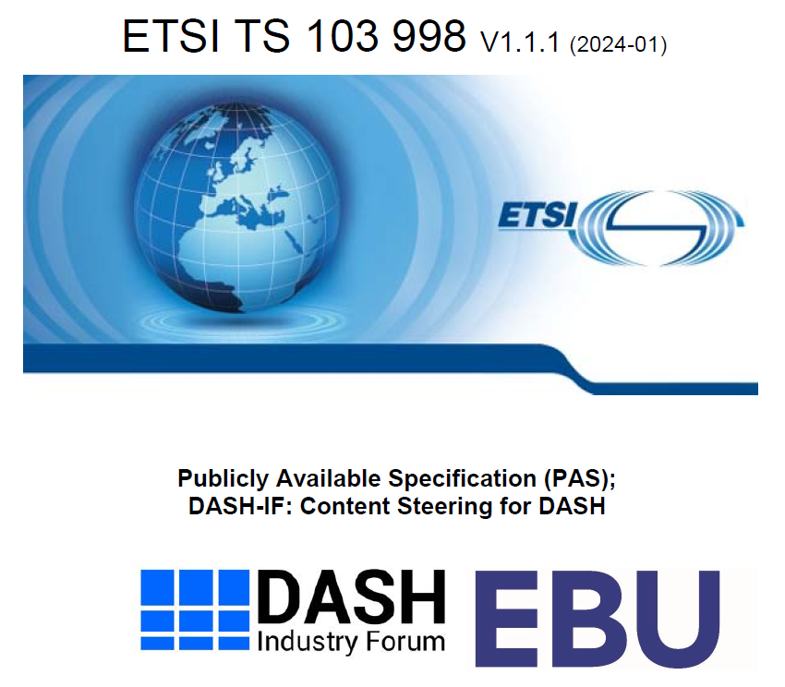
What is Content Steering?

Slide 39
Content Steering Signaling in DASH
Definition of Service Location
  collection of network resources that share commonalities and can be referred to by a common label
Can be assigned to
  Location
  PatchLocation
  BaseURL
Can be referenced by external, including
Key | Type | Description
ContentSteeringServer | URI | A URL that can be used to access the Content Steering server. The URL shall reference to a DASH Content Steering Manifest (DCSM) as defined in ETSI TS 103 998. If the resolved resource is not a Content Steering Manifest (DCSM), the resource is ignored.
defaultServiceLocation | string | This attribute specifies a space-separated list of Service Locations as defined in subclause 5.6.6 that the client should use to access the selected resources, in case multiple access exist. This for example applies, when no content steering server is available, or before a valid response from a content steering server is available.
queryBeforeStart | Boolean | If true, indicates that the player is expected to resolve the response from the Steering Server prior to starting playback. Default value is false.
clientRequirement | Boolean | If true, indicates that the client, if it is in the context of the Service Description shall follow the content steering rules as defined in ETSI TS 103 998. If false, indicates to client that the DASH client is expected to either (i) ignore the Content Steering instructions, or (ii) follow the requirements as if this flag is set to TRUE. Default value is true.

Slide 40
Content Steering
<MPD xmlns:xsi="http://www.w3.org/2001/XMLSchema-instance" xmlns="urn:mpeg:dash:schema:mpd:2011" xsi:schemaLocation="urn:mpeg:dash:schema:mpd:2011 DASH-MPD.xsd" type="dynamic" minimumUpdatePeriod="PT30S" timeShiftBufferDepth="PT30M" availabilityStartTime="2022-02-25T12:30:00" minBufferTime="PT4S" profiles="urn:mpeg:dash:profile:isoff-live:2011">
<Location serviceLocation="alpha">https://cdn1.example.com/newMPD.mpd</Location>
<ServiceDescription>
<Latency min="750" max="4200" target="1250" referenceId="7"/>
<PlaybackRate min="0.96" max="1.04"/>
<ContentSteering defaultServiceLocation="beta" queryBeforeStart="true">https://steeringservice.com/app/instance12345</ContentSteering>
</ServiceDescription>
<BaseURL serviceLocation="alpha">https://cdn1.example.com/</BaseURL>
<BaseURL serviceLocation="beta">https://cdn2.example.com/</BaseURL>
<Period id="1">
<AdaptationSet mimeType="video/mp4" codecs="avc1.4D401F" frameRate="30000/1001" segmentAlignment="true" startWithSAP="1">
<BaseURL>video/</BaseURL>
…
</AdaptationSet>
</Period>
</MPD>
{
"VERSION": 1,
"TTL": 250,
"RELOAD-URI": "https://steeringservice.com/instance12345?session=abc"
"PATHWAY-PRIORITY": ["alpha","beta"]
}

Slide 41
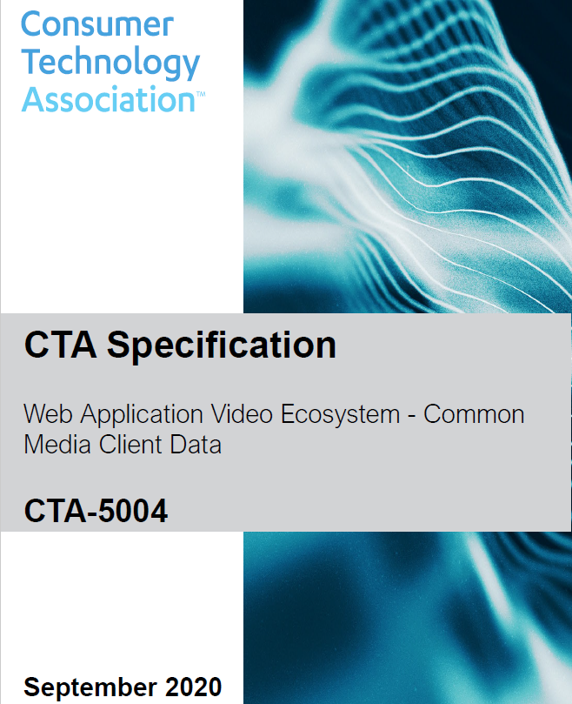
What is CMCD?
A defined set of structured key/value pairs communicating mutually beneficial media-related information from a player to a CDN via either
  A set of custom headers
  A query arg
  A JSON object
Common because the same data structure can be used across all players and all CDNs.
Resources
  Available for free at https://tinyurl.com/cta5004spec
  DASH-IF Special Session available from Will Law
Version 2 is happening as we speak

Slide 42
CMCD Signaling in DASH
Key | Type | Description
version | unsigned int | specifies the highest CMCD version as defined in CTA-5004 that is accepted by the reporting server.
mode | string | specifies the data transition mode how the media client shall send the media client data as defined in clause 2 of CTA-5004. The two options are "query" and "header". "header" refers to the mode defined in clause 2.1 of CTA-5004. "query" refers to the mode defined in clause 2.2 of CTA-5004.
includeInRequests | string | specifies which HTTP GET requests that shall include CMCD data. The semantics are identical to the @includeInRequests attribute in Table I.3.
keys | string | specifies a space-delimited list of the CMCD keys which shall be reported as a part of CMCD reporting. Values of the keys are listed in CTA-5004. Keys not defined in CTA-5004 should not be present. Unidentified key shall be ignored by the client.
contentID | string | specifies the value of the Content ID cid key in CMCD reporting, if cid is present in the keys attribute. The value shall be restricted to maximum of 64 characters.
sessionID | string | specifies the value of the Session ID sid key in CMCD reporting, if sid is present in the keys attribute. The value shall be restricted to maximum 64 characters.
Key | Type | Description
serviceLocations | string | specifies a space-delimited list of Service Locations as defined in subclause 5.6.6 for which reporting is enabled. If the attribute is absent, then it applies to all Service Locations specified in the MPD.
adaptationSets | string | specifies a space-delimited list of identifiers @id of Adaptation Sets for which reporting is applied. If the attribute is absent, then it applies to all eligible Adaptation Sets. Note that Service Locations and Adaptation Sets filters are applied jointly addressing the intersection of the two.
ReportingSystem | descriptor | Defines the reporting system and configuration to send back client data for the above Service Locations and and Adaptation Sets.

Slide 43
<MPD xmlns:xsi="http://www.w3.org/2001/XMLSchema-instance" xmlns="urn:mpeg:dash:schema:mpd:2011" xsi:schemaLocation="urn:mpeg:dash:schema:mpd:2011 DASH-MPD.xsd" type="dynamic" minimumUpdatePeriod="PT30S" timeShiftBufferDepth="PT30M" availabilityStartTime="2022-02-25T12:30:00" minBufferTime="PT4S" profiles="urn:mpeg:dash:profile:isoff-live:2011"> <ServiceDescription> <Latency min="750" max="4200" target="1250" referenceId="7"/> <PlaybackRate min="0.96" max="1.04"/> <ClientDataReporting scheme="urn:mpeg:dash:cta-5004:2023" serviceLocations="beta" adaptationSets="video"> <CMCDParameters mode="header" includeInRequests="*" keys="br,bl,cid,dl,mtp,nor,ot,sf,v"/> </ClientDataReporting> </ServiceDescription> <BaseURL serviceLocation="alpha">https://cdn1.example.com/</BaseURL> <BaseURL serviceLocation="beta">https://cdn2.example.com/</BaseURL> <Period id="1"> <AdaptationSet id="video" mimeType="video/mp4" codecs="avc1.4D401F" frameRate="30000/1001" segmentAlignment="true" startWithSAP="1"> <BaseURL>video/</BaseURL> … </AdaptationSet> </Period> </MPD>

Slide 45
DASH-IF Impact
IOP Guidelines & dash.js

Slide 46
Overview of features and support in DASH-IF
Features (5th and 6th edition) | IOP Status | Dash.js status | Test/Live Sim status
CMAF Profile | Part of DASH-IF v5, part 2, 4, 5 | Handled through MSE/browser | CTA WAVE Test content
Low-Latency DASH | Part of DASH-IF v5, part 4 | Supported | Supported in live sim
MPD Patching | Not yet added | Supported | Initial version available, WIP
Event Streams | DASH-IF v5 part 10 | Supported | Rudementary in Live sim, more work needed
Advanced Content Protection | Not yet in part 6 | Not yet supported | Not yet supported
Alternative MPD Event | Considered for part 5, not yet started | No | no
Content Steering | ETSI spec, but not yet in IOP | Basic support Service description | Nothing available
CMCD | CTA spec, not yet in IOP | Supported in v1 MPD parsing in progress | Nothing available
L3D and Segment Sequences | In progress for v5.1 part 4 | Not yet started | Not yet started
Pattern signaling | Not yet stated | Not yet stated | Not yet stated
ARI Track | Not yet stated | Not yet stated | Not yet stated

Slide 47
Next Steps

Slide 48
Thanks
Q&A

