Slide 1
Bringing Standards to Life on Qualcomm platforms in Collaboration with Open Source Media Community
Qualcomm Open Source Summit 2024
November 7, 2024
Thomas Stockhammer, Senior Director Technical Standards
Imed Bouazizi, Director Technical Standards
Qualcomm Standards and Industry Organization (QSIO)
with support from Romain Bouqeau (Motion Spell)

Slide 2




Today’s agenda
# Broader picture
# QSIO in Media Standards
# Bringing standards to products/services
# External Reference Tools Programs
# Unlocking Opportunities
Presenter
Dr. Thomas Stockhammer
Senior Director, Technical Standards
Qualcomm Europe, Inc., IEEE Fellow
Leading and driving among others
DVB: 5G TF, DVB-I
MPEG: MPEG-I, CMAF and DASH
3GPP: XR over 5G, 5G Video, 5GMS
DASH-IF: Interop WG, Test
ETSI & 5G-MAG: 5G Broadcast and 5GMS
CTA WAVE: CMAF Device PB, Test
Metaverse Standards Forum: Chair, Board

Slide 3
Add information about Imed and Romain and whoever else

Slide 4
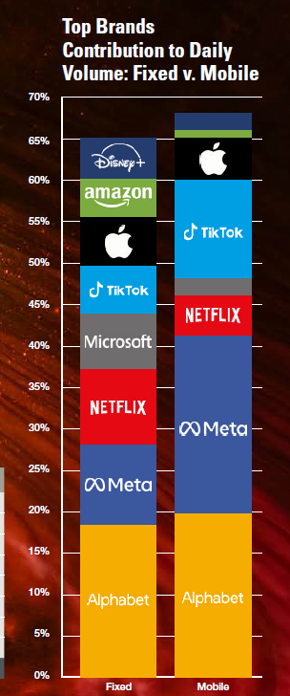
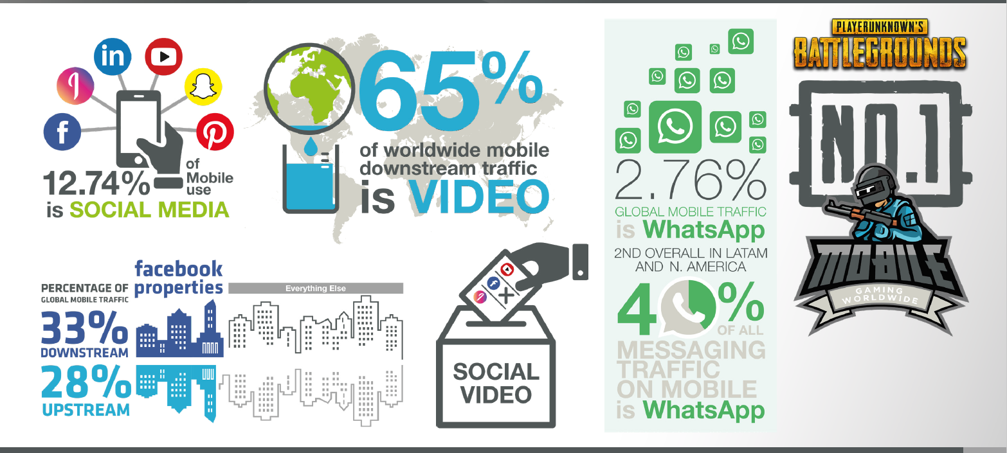
The Mobile Internet Phenomena Report
Sandvine Report from 2020 and 2024

Slide 5
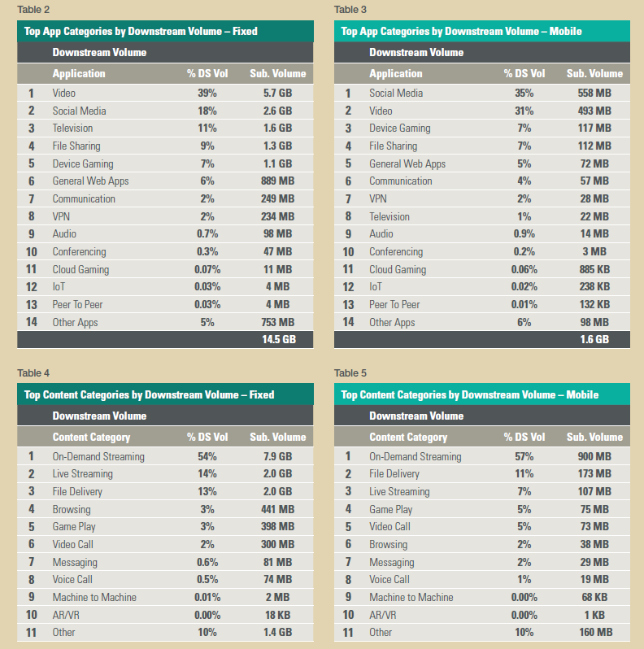
Video dominates ...
.... and streaming is the main category
The 2024 Mobile Internet Phenomena Report [Sandvine] shows that mobile video downstream traffic accounts for more than 70%
In all regions’ downstream traffic, Video is the biggest traffic category for volume,
On-Demand Streaming exerts the greatest volumetric pressure.
Will the average Video consumption per user change from the current 1.4 GB of video per day, and what will contribute to that change, such as video embedded in Social Media, in Communications, Video Calls, Streaming TV, Operator Content, or something else?

Slide 6
WW streaming growth
Streaming Growth from $16.5B in 2014 to $220B in 2024
  Dominated by US-based Services
  Netflix and YouTube still leading
  Traditional providers shifted to streaming
2023 Notable Others
  Disney+, ESPN+, Hotstar India - $13.3B
  WBD (HBO Max, Discovery+…)- $10.5B
  YouTube TV - $5.8B
  Paramount+ - $4.1B
  Peacock - $3.3B
  Apple TV+ - $2.2B
Sources: Business of Apps analysis, Company data

Slide 7


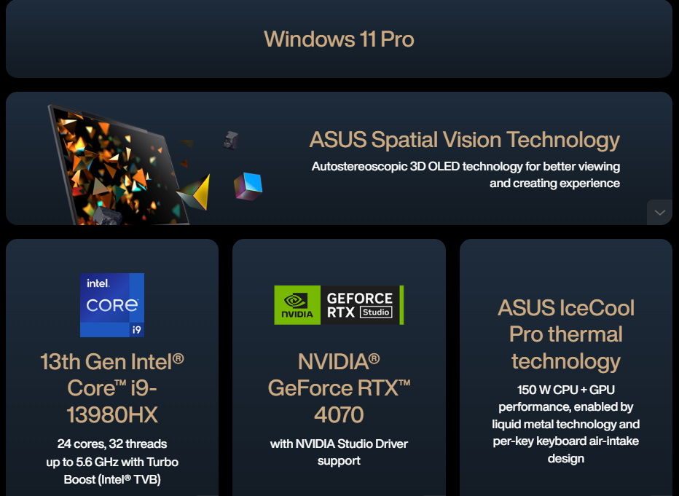

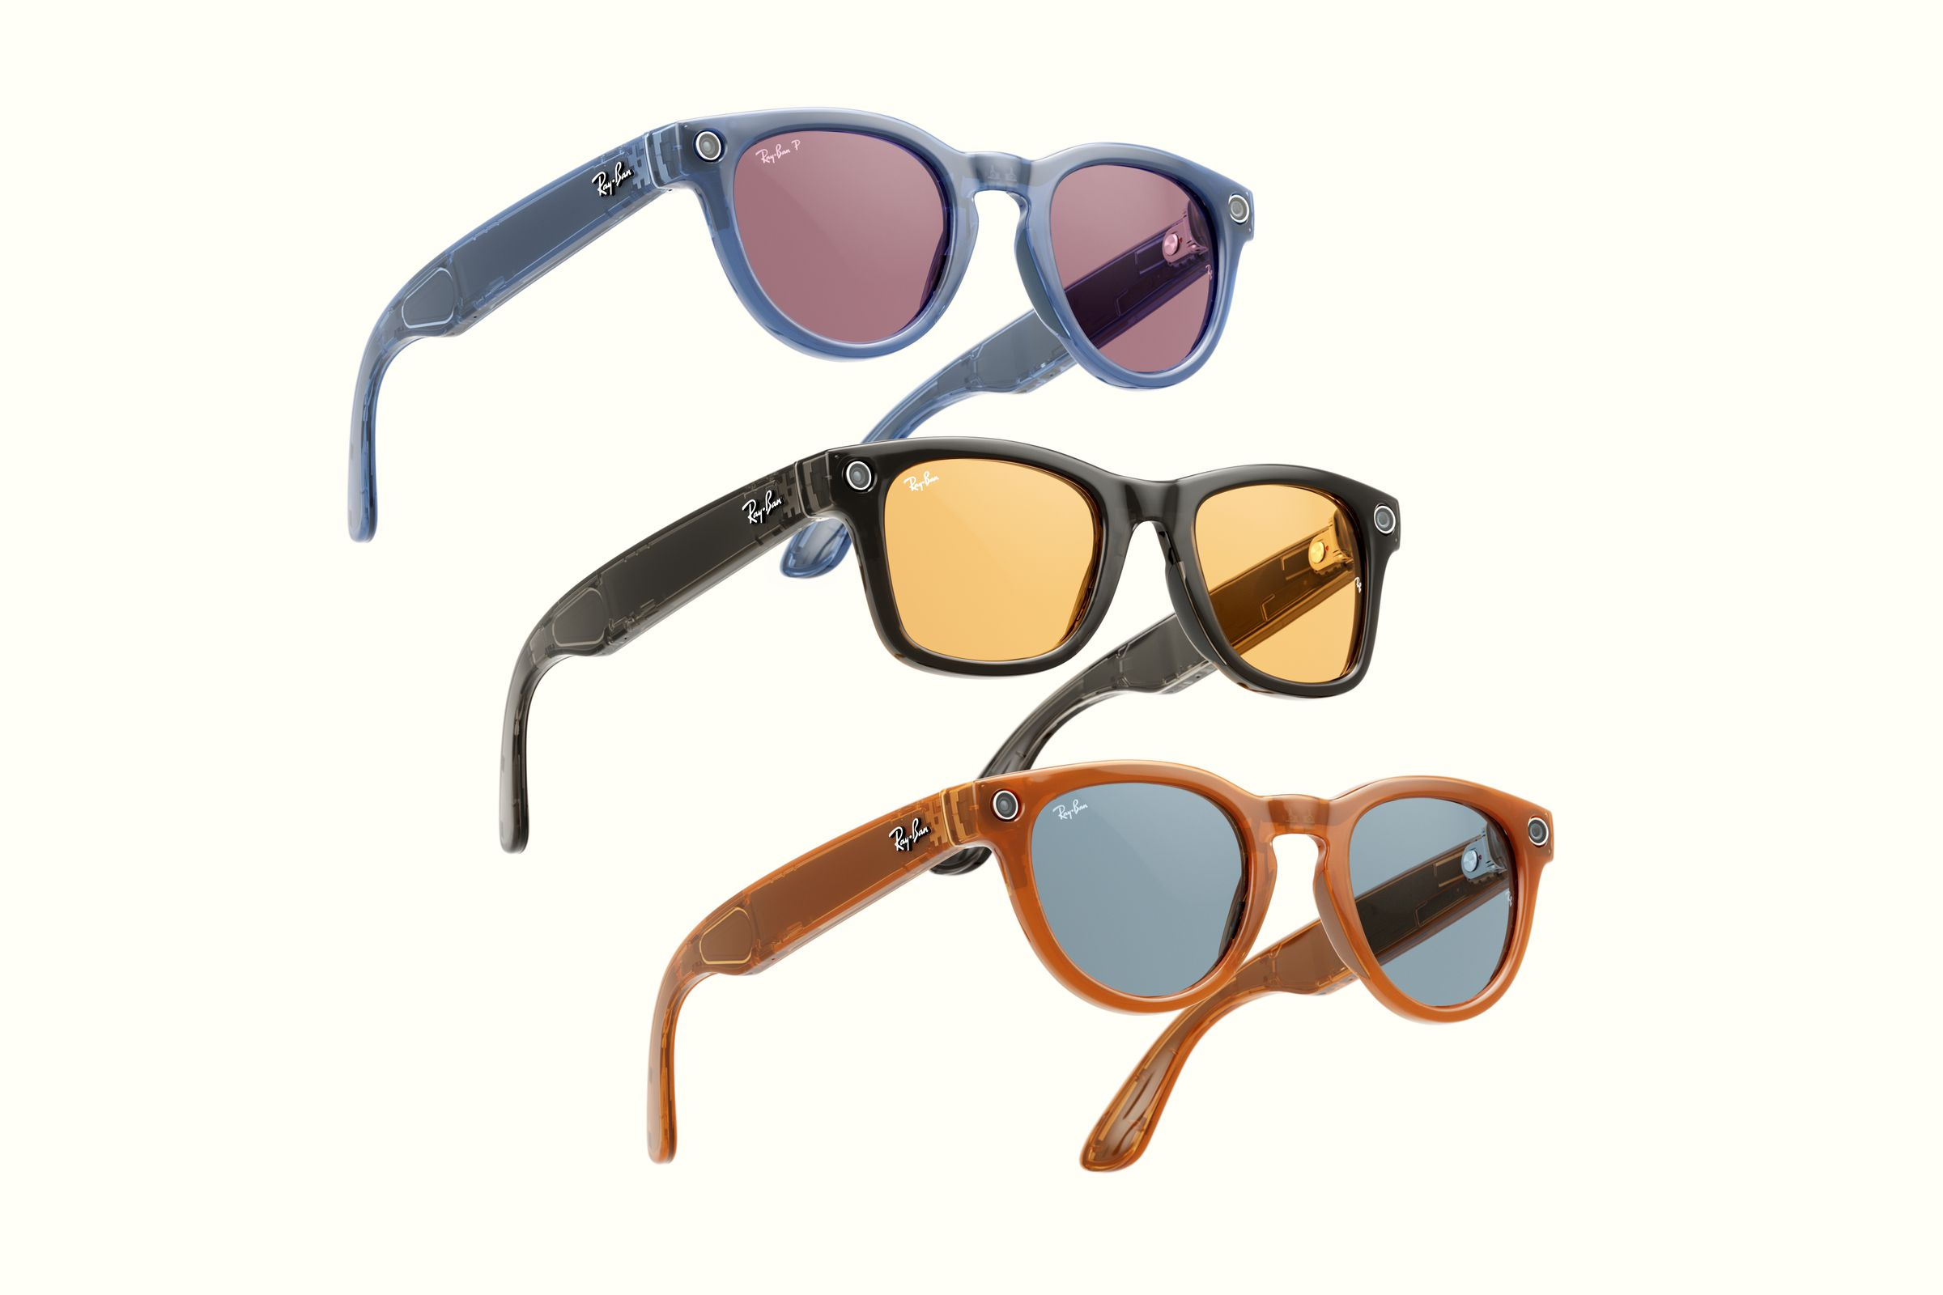
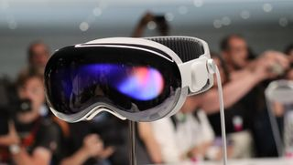
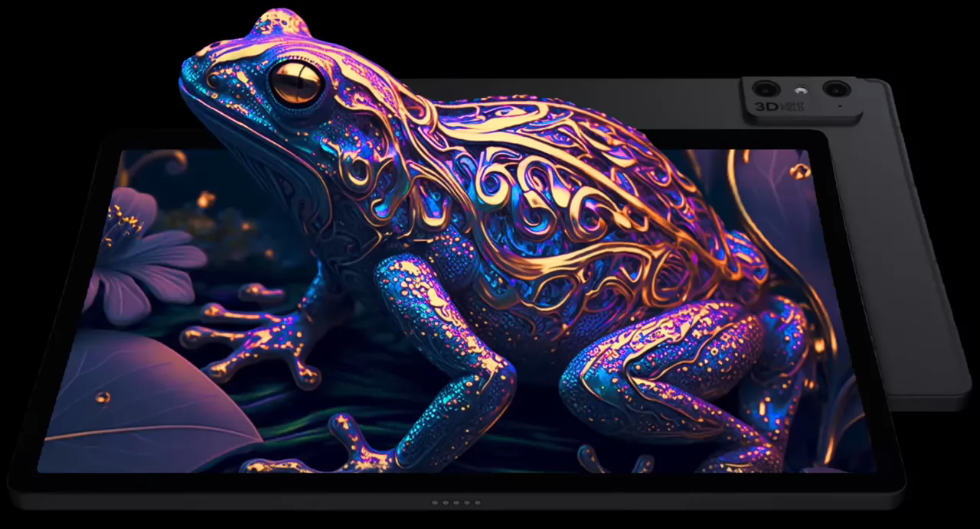
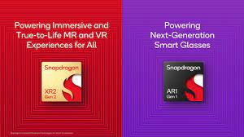
Some Technology Trends and Announcements
Glasses-free 3D Displays
ptMR HMD
Simple Smart
Glasses
Lenticúlar Displays
Eyetracking
Primarily for gaming and enterprise
Adds AR/MR w/ camera see-through
Less is more
Meta’s smart glasses can take calls, play music, and livestream from your face
No visual display
Announced at CES 2023
Not released and may never be
https://lookingglassfactory.com/
https://www.leiainc.com/lume-pad-2

Slide 8
Selected Technologies for Media Services
Codecs and Formats
Content Delivery Protocols
Access and Distribution Technologies
Security and Content Protection
Rendering and Presentation
Quality-of Service
Data collection and Intelligence

Slide 9
















Many services and technology providers use standards
.... and Qualcomm participates
QTL
QCT

Slide 10




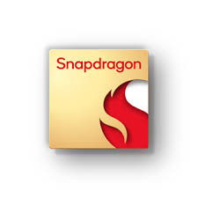


And many services and technology providers use open source
.... On top of Qualcomm platforms or interoperating with Qualcomm Technologies

Slide 11
How do we try to create impact?
…. with very restricted resources in QSIO
Promote and drive globally standardized solutions
Work with the relevant ecosystem players and bring them to standards
Introduce QC Technologies to standards and ecosystems
Support the development of open source and reference tools
Support our product teams
Develop new ecosystems

Slide 12
Technologies and Standards Examples with QC Leadership
DASH/CMAF
Video Codecs
5G Media Streaming
Scene Description
Avatar Communication

Slide 13
DASH

Slide 14



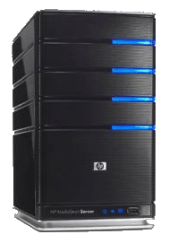

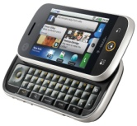
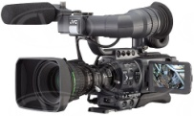

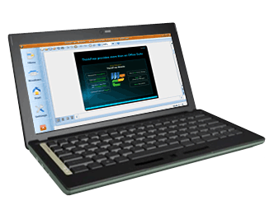
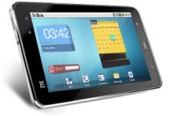
Content Delivery Protocol – Adaptive HTTP Streaming
Encode each media type at multiple bitrates => track
Make each segment addressable via an
HTTP-URL
Client makes decision on which segment to download
Client acquires a license for encrypted content
1
4
5
6
Manifest
Timeline
Resource Addresses HTTP
Codecs
Variants
DRM Server license
Operational information
2
Split each track into small segments
7
Client splices and synchronizes for play back
Application Server
UE
001010100001010
010101010001110
01110100011010101
001010100001010
010101010001110
01110100011010101
001010100001010
010101010001110
01110100011010101
001010100001010
010101010001110
01110100011010101
3
Encrypt each segment
Media Capture
and Encoding
DRM Encryption
Server
Media
Origin
Servers
HTTP/S
Cache
Servers
Client
Devices
DRM
License
Server

Slide 15

DASH Standard - Editions, Parts and Editors
1 | 2011 | ISO/IEC 23009-1 Media Presentation Description and Segment Formats | Thomas Stockhammer and Per Fröjdh
1 | 2012 | ISO/IEC 23009-1:201x 2nd edition | Thomas Stockhammer, Per Fröjdh
1 | 2013 | ISO/IEC 23009-1:2014 AMD 1 Extended profiles and time synchronization | Thomas Stockhammer, Alex Giladi
1 | 2014 | 23009-1:2014 AMD 2 Spatial Relationship Description, Generalized URL parameters and other extensions | Emmanuel Thomas, Sylvain Kervadec, Cyril Concolato
1 | 2014 | 23009-1:2014 AMD 3 Authentication, Access Control and multiple MPDs | Thomas Stockhammer, Alexander Giladi
1 | 2014 | 23009-1:2014 AMD 4 Segment Independent SAP Signalling, MPD chaining and other extensions | Thomas Stockhammer, Iraj Sodagar, Alex Giladi
1 | 2015 | 23009-1 3rd edition Media presentation description and segment formats | Thomas Stockhammer
1 | 2016 | 23009-1 3rd edition AMD 1 on device information and other extension | Ali C. Begen, Thomas Stockhammer
1 | 2019 | 23009-1 4th edition
1 | 2020 | 23009-1 4th edition AMD 1 CMAF support, events processing model and other extensions | Iraj Sodagar, Thomas Stockhammer, Mike Dolan
1 | 2022 | 23009-1 5th edition | Thomas Stockhammer, Mike Dolan
2 | 2012 | ISO/IEC 23009-2 DASH Conformance and reference software | Thomas Stockhammer and Christian Timmerer
2 | 2017 | 23009-2 2nd edition DASH Conformance and reference software | Christian Timmerer, Waqar Zia, Brendan Long
2 | 2017 | 23009-2 AMD 1 Conformance vectors and reference software for SRD, SAND and Server Push | Emmanuel Thomas
2 | 2020 | 23009-2 3rd edition
3 | 2012 | 23009-3 DASH Implementation Guidelines | Yuriy Reznik, Kilroy Hughes, Thomas Stockhammer
3 | 2014 | 23009-3 2nd edition DASH Implementation Guidelines | Thomas Stockhammer, Alex Giladi
3 | 2014 | 23009-3 2nd edition AMD 1 DASH Implementation Guidelines | Iraj Sodagar
3 | 2015 | 23009-3 3rd edition DASH Implementation Guidelines | Ali C. Begen
4 | 2013 | ISO/IEC 23009-4 Segment encryption and authentication | Alex Giladi
4 | 2018 | 23009-4 2nd edition Segment encryption and authentication | Alex Giladi and Yasser Syed
5 | 2017 | 23009-5 Server and Network Assisted DASH | Mary-Luc Champel, Emmanuel Thomas
5 | 2020 | 23009-5 AMD 1 Improvements on SAND messages | Mary-Luc Champel
6 | 2017 | 23009-6 DASH with Server Push and WebSockets | Viswanathan (Vishy) Swaminathan, Kevin Streeter, Imed Bouzazi, and Franck Denoual
7 | 2023 | 23009-7 Delivery of CMAF contents with DASH | Iraj Sodagar
8 | 2020 | 23009-8 Session based DASH operation | Ali C. Begen, Iraj Sodagar, Alex Giladi
8 | 2022 | 23009-8 AMD 1 URL customization other extensions | Iraj Sodagar

Slide 16
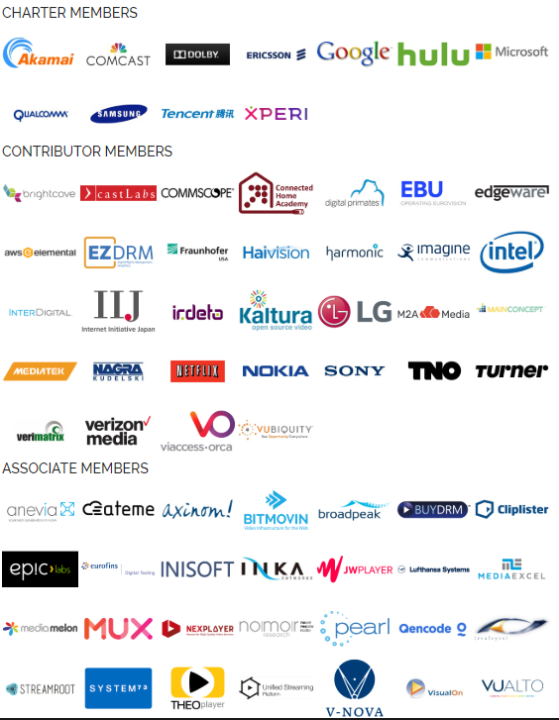
Core Principles of DASH
CDN and Cache friendly
Stateless Server
Client-driven
Low manifest traffic (small size and low update frequency)
Carrying ISO BMFF and CMAF
Late Binding
Works with HTML-5 and MSE
Live and On-Demand
HLS Convergence

Slide 17
More than just specs: Test, Reference and Conformance

Slide 18
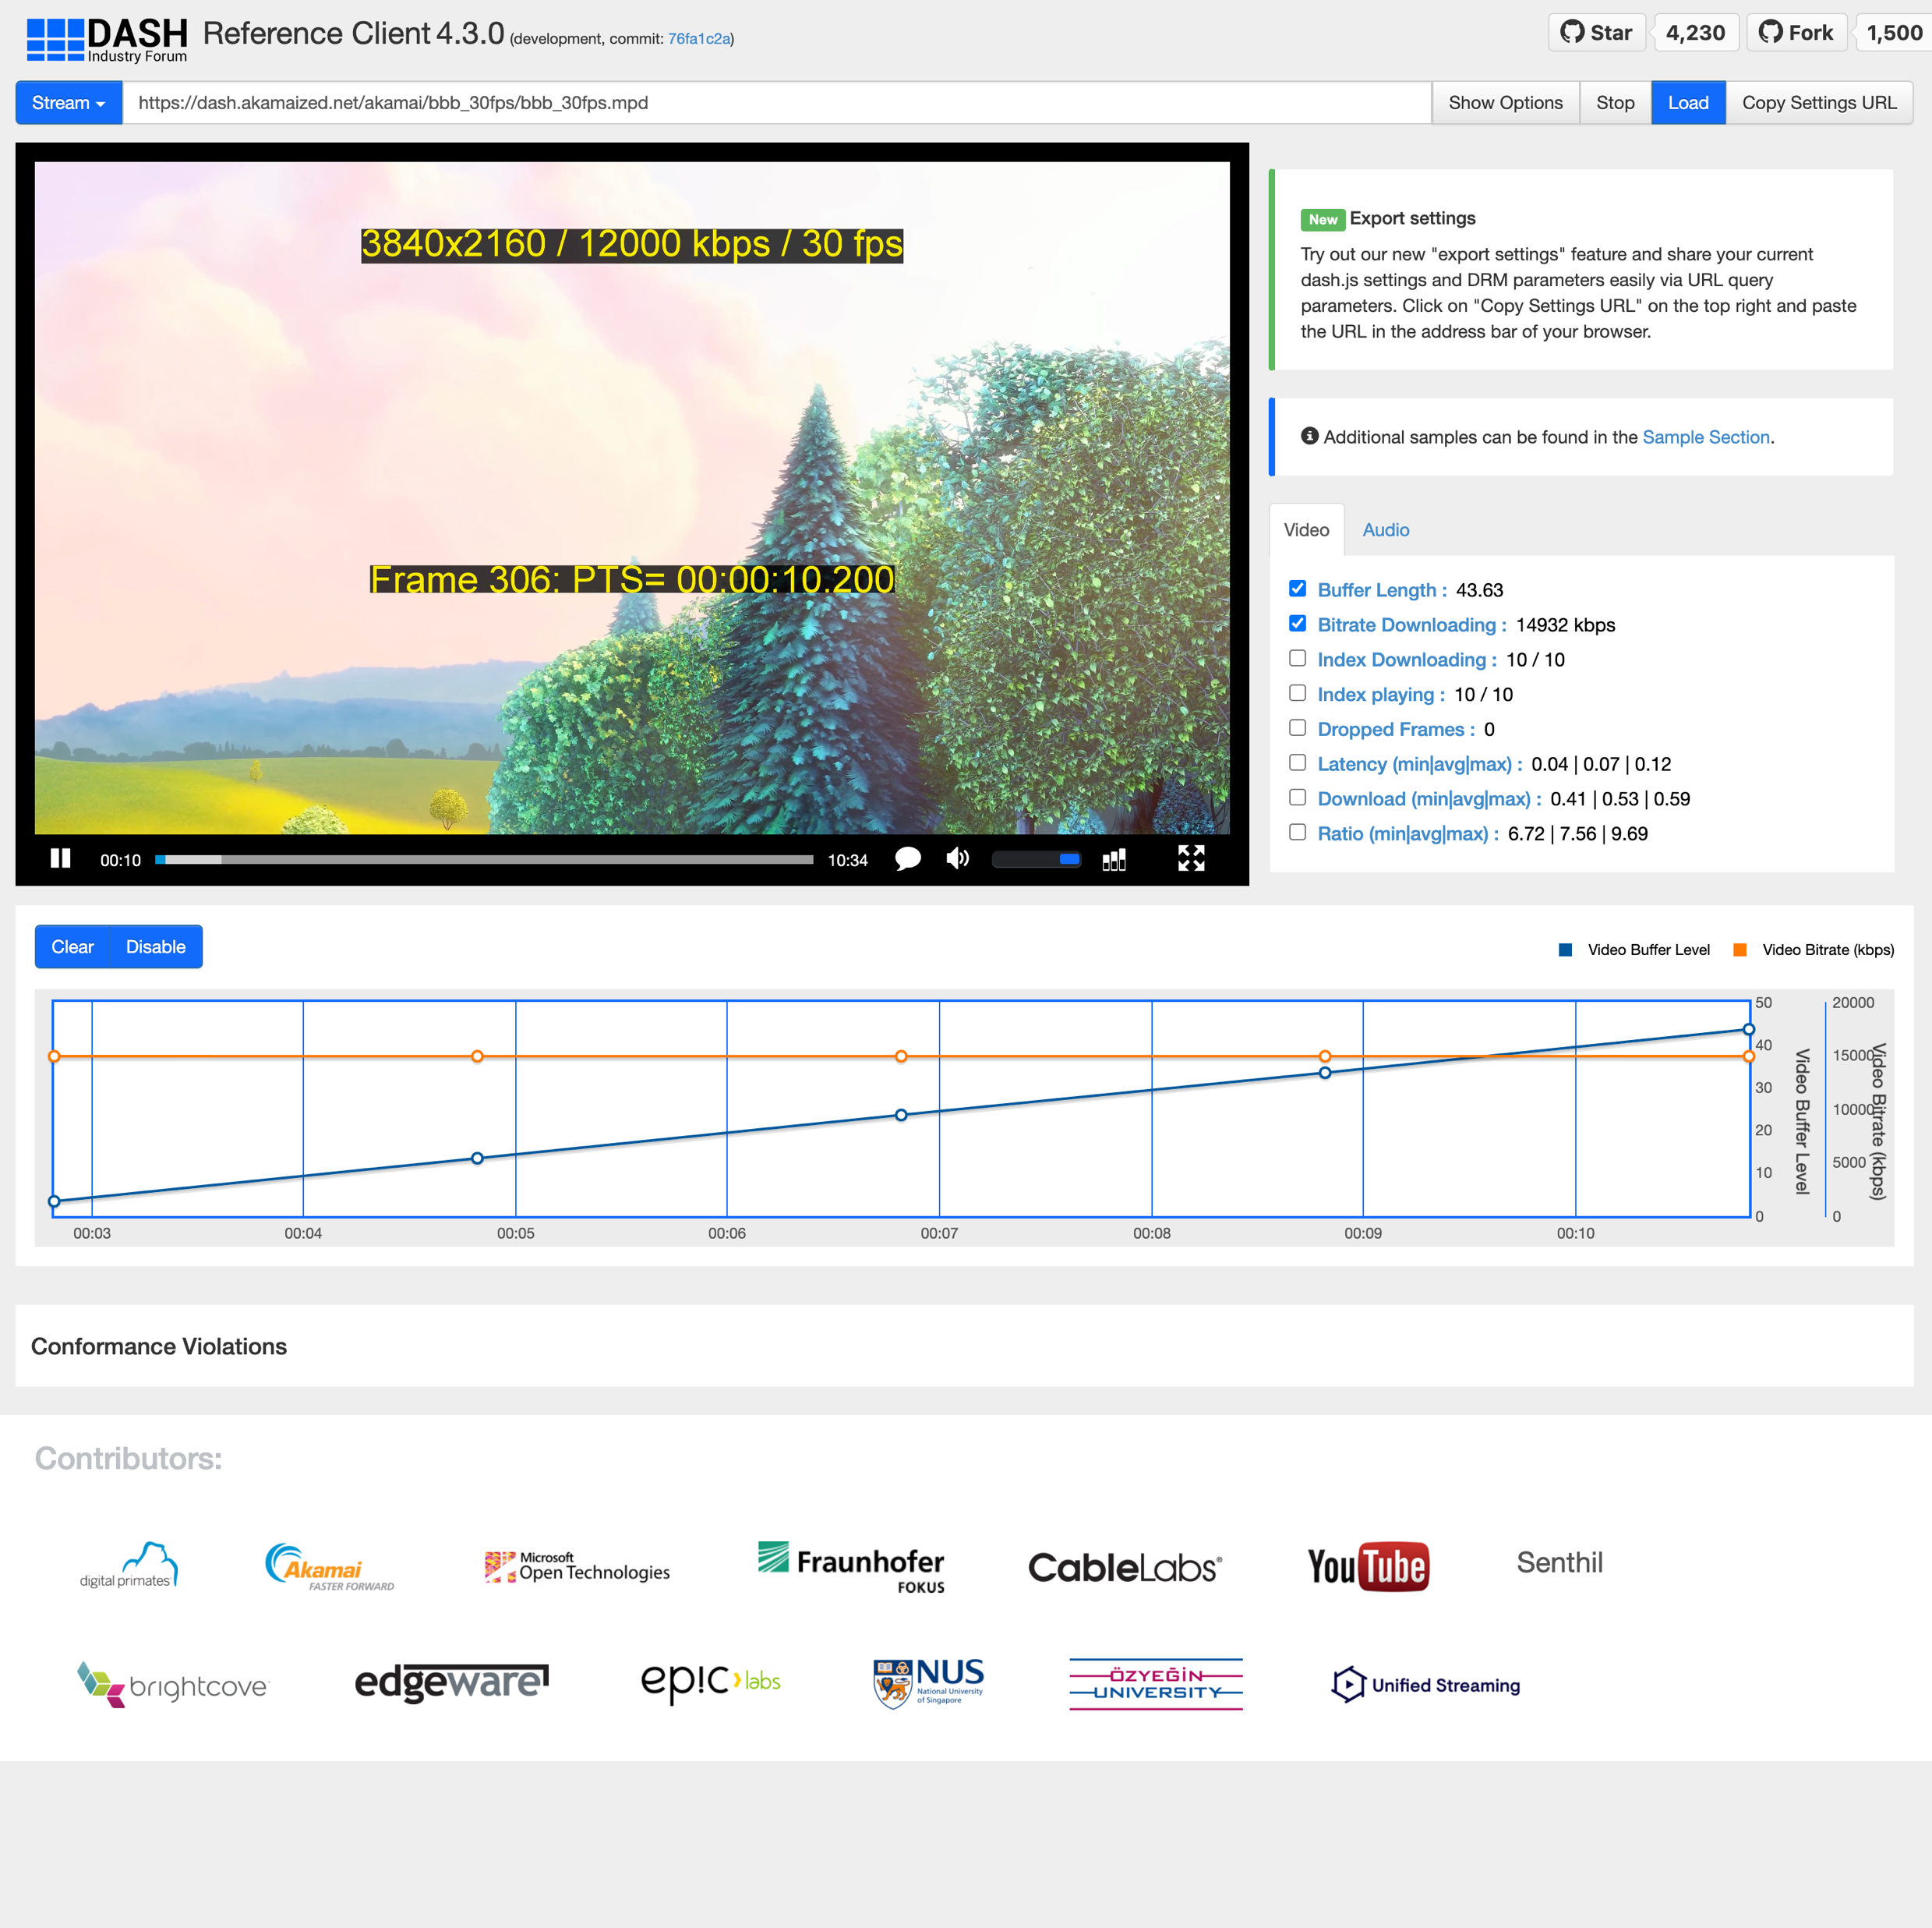
dash.js – Overview & Status
dash.js is the official reference player by the DASH Industry Forum / SVTA for playback of MPEG-DASH content
Maintained by Fraunhofer FOKUS, community driven development
Open-source project on Github - https://github.com/Dash-Industry-Forum/dash.js/ , last released version 4.7.4
Written in JavaScript uses the W3C
Media Source Extensions (MSE) and Encrypted Media Extensions (EME)
Works on all MSE and EME based platforms including Desktop browsers, smartphones, SmartTVs, Set-Top Boxes.
Various features including flexible ABR logic, multiperiod, DRM support, MPD patching, Gap handling, CMCD, CMAF low latency support, support for various subtitle formats (TTML, IMSC1, WebVTT) and many more.
https://reference.dashif.org/dash.js/nightly/samples/dash-if-reference-player/index.html

Slide 19










dash.js – Numbers & Stats & Logistics
55 releases
> 5100 stars
251 watchers
> 1.700 forks
180 contributors
103 dependents
Monthly developer calls
Discussions on
  Slack (1881 members)
  Github
  Google Groups (1206 members)
3.180.000 downloads
2023

Slide 20
dash.js – Application areas
Reference projects
Industry
Research
Implements latest features from DASH-IF IOP guidelines and ISO/IEC specification.
Used by other organizations in their reference implementations
  CTA-WAVE
  DVB-I
  HbbTV
  5G-MAG
  (SVTA)
Used in production for instance by BBC, Deutsche Telekom, ARTE, Mediaset Spain
Used to compare behavior of commercial players against reference player
Used for research purposes, for instance to test and compare new ABR algorithms (Twitch challenge)
Evaluate new features such as MPD patching and CMCD

Slide 21
Video Codecs
Aytac; ???

Slide 22
5G Media Streaming
Thomas adds

Slide 23
5G Broadcast

Slide 24
5G defines two modes of broadcast communication
Focus of this presentation
5G broadcast
Mixed-mode multicast
Broadcast spectrum (e.g. UHF)
No unicast. Downlink – only traffic.
Delivery of linear content (e.g. TV) or IP file delivery
Dedicated broadcast infrastructure (can be high power)
Operator spectrum (IMT)
Integration with unicast network
Efficient delivery of multicast/broadcast traffic (vs unicast)
Reuse of cellular infrastructure (low power).
Single Frequency Network (SFN) for downlink broadcast only
Dynamic switching between broadcast and unicast, e.g., SC-PTM¹
Addressing diverse ecosystem, deployment, and use case requirements

Slide 25
5G Broadcast – Core Features for multiple use cases
SIM-less reception with simplified architecture
Receive-Only Mode (ROM) & Free-to-Air (FTA)
Different spectrum options (e.g. UHF, SDL), as well as SFN/MFN
Various deployment possibilities (e.g. MNOs, BNOs)
Using existing infrastructure (HPHT, MPMT and LPLT)
Highly flexible velocities (up to 250 KM/h Vs up to 300 µS)
Can be combined with existing 4G and 5G features (unicast, PWS)

Slide 26
Significant interests towards 5G broadcast deployment worldwide
Denmark
Tour de France 22 powered by 5GB
Italy
Germany
2018-23: TV delivery with Rel-14/16
HPHT in Aosta and Turin
Russia
2024: European Championship
2020-22: 5G Media2Go Stuttgart/Heilbronn
2017-20: 5G Today in Bavaria
Finland
2022+: 5G Broadcast under investigation as latest broadcast technology
Belgium
2019-22: TV delivery with Rel-14/16
HPHT in 3 sites
CZ
2022-24: 5G BC imec.icon project with 2 HPHT sites
2020-23: Distribution of TV/Radio in Prague
South Korea
UK
Austria
Late 2021: Distribution of live TV using Rel-16 enTV near Seoul
2020-22: VISTA Project with O2 Virgin Media
2020-23: Distribution of TV/Radio with 5G BC Rel-14/16 , with eMBB in Vienna
Europe
France
2023: European broadcasters ink 5G Broadcast MoU
2024: European profile for 5G Broadcast receivers
2018-2022: Live testing of 5G BC in Paris
2024: Olympics
Greece
US
2021-23: Live TV/Radio with 5G BC Rel-14/16 , with 3MHz in Athens
2020+: Growing interest in 5G BC in addition to ATSC 3.0
2023: FCC Approves A Low Power TV Station To Broadcast Over 5G Networks
2023: First 5G Broadcast in the US and first 24/7 5G Broadcast globally
2024: Foundation of 5G Broadcast Collective
Croatia
2022-24: Live 5G BC Rel-14/16
Philippines
2019-22: Direct to mobile Live TV/Radio in Manilla
Spain
Algeria
2020: Distribution of free-to-air linear radio and TV using Rel-14 enTV with HPHT in Barcelona
2022 & 2023: MWC demos
Malaysia
Brazil
2022: Interest towards 5G BC during Mediterranean Games
2024: Report completed – next steps are trials
2020-23: TV 3.0 project calling
for proposals
2019-24: AIB project based on 5G Broadcast under the administration of NRTA¹ and ABS²
2023: 5G Broadcast Chengdu pilot project formally kicked off on July 20th
GATIS' Global 5G Broadcast Summit
Colombia
India
2020-21: Delivery of TV and radio with Rel-14 broadcast trial deployment in Santiago de Tolú
South Africa
2020+: Growing interest
in latest broadcast³ technologies
2023: Discussion on DTM strategy based on market feedback
2019-20: Live testing of Rel-14 in Johannsburg
China
¹ National Radio and Television Administration ² Academy of Broadcast and Science commercia potential ³ Prasar Bharti working jointly with IIT Kanpur on Next Generation Broadcast Technology

Slide 27

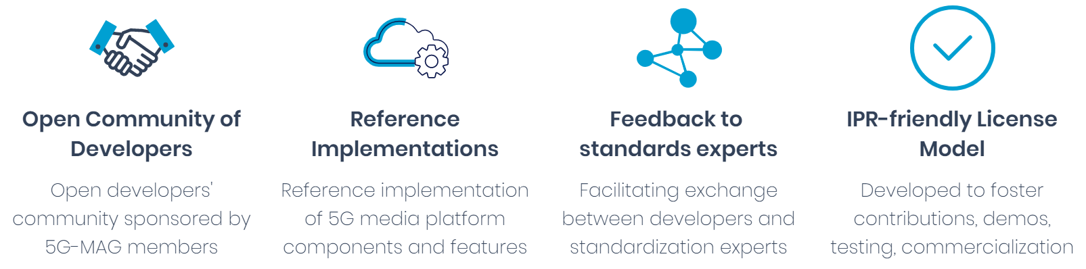

5G-MAG Reference Tools?
  Developer Space
  https://developer.5g-mag.com
Current list of official contributors

Slide 28
3D and XR

Slide 29
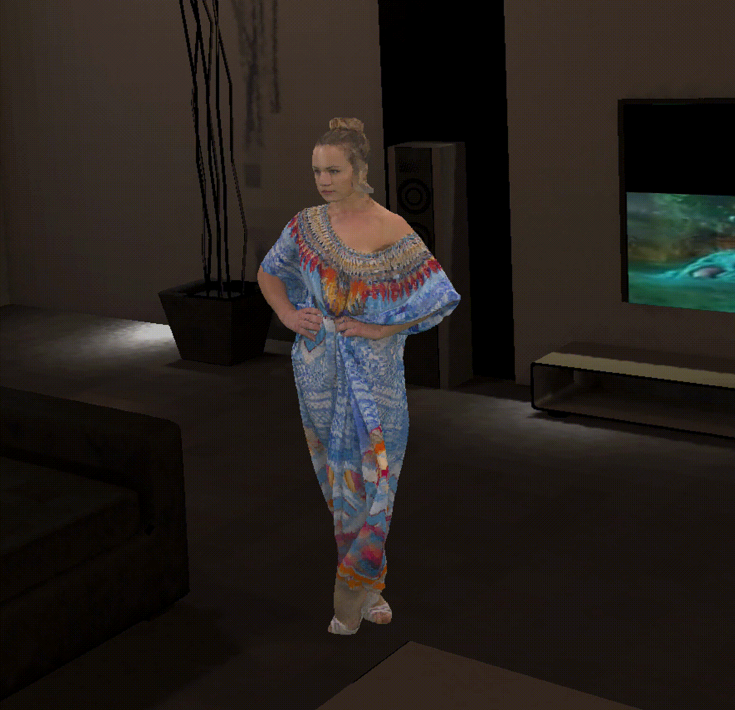
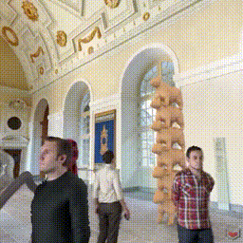
From MPEG-I to Dynamic Scenes
MPEG-I is a collection of representation formats for 2D and 3D objects of different media type
Included technologies in MPEG-I ISO/IEC 23090
File and application formats with metadata
Immersive Audio and Haptics
Video Decoding Interface
  Leverage and optimize 2D decoders for 3D and immersive media
Dynamic Point Clouds and V-Mesh
  Compress 3D formats such as point clouds and dynamic meshes
MPEG Immersive Video
  Support multi-view and
  light field displays
2D Video Compression
  H.266/VVC
  AI/ML-based and VCM
  H.267/ECM
MPEG studied different options in 2019 for Scene Descriptions, including defining its own.
Portable, Dynamic and
Interactive 3D Scenes
Scene Description
How?

Slide 30






Choosing the right format - Considerations
Last Mile
Exchange
Low Complexity
Flat Hierarchy
Compressed components
Adaptive and network friendly
Support for Texture/Light Baking
High fidelity
Superstructure
  Hierarchical
  Distributed
  Preserves author’s intents/choices
  Documents authoring process
Lossless
Preserves asset’s metadata/versioning
Last Mile
Exchange

Slide 31
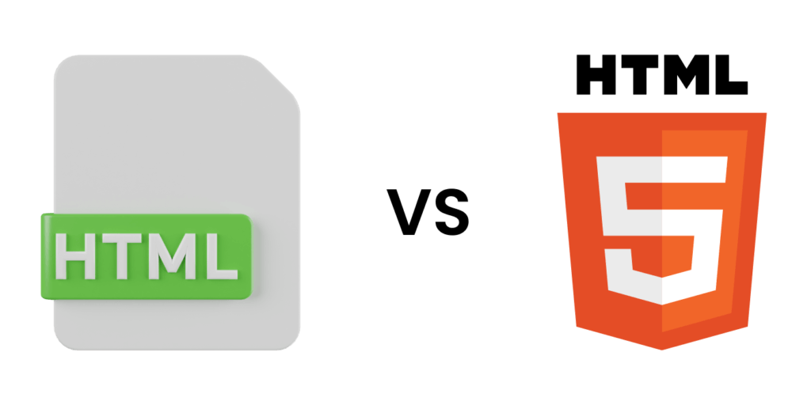
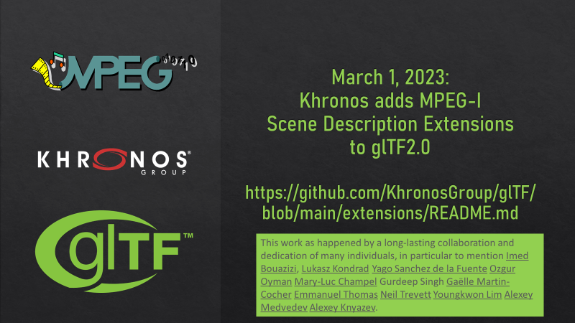
The Idea: Combine glTF and MPEG-I ...
... in order to create the "HTML-5 for XR/Metaverse"
Multimedia Elements
are built-in in HTML5
no plug-ins needed
Streaming and DRM content
Mobile support
User’s Geographical Location
Simplicity
Re-use of hardware codecs
Client Server Communication
full duplex communication client/server
web sockets/webRTC
Advanced Scripting
JavaScript support
Multi-Threading, etc.
Combining glTF and MPEG-I is addressed in MPEG-I Scene Description ISO/IEC 23090-14
  Entry point document to the 3D experience
  From shared experiences to 6DoF content and XR
  Extensions to glTF for networked and real-time media

Slide 32
Second Edition
scene
MPEG_scene_anchor
MPEG_scene_interactivity
node
light
MPEG_node_anchor
MPEG_light_texture_based
camera
MPEG_node_interactivity
MPEG_haptic
MPEG_media
MPEG_node_avatar
MPEG_material_haptic
texture
mesh
animation
material
accessor
sampler
image
skin
technique
Adopted in 3GPP for MeCAR, Split rendering entry point and Messaging Format
bufferView
program
buffer
shader

Slide 33



What is being implemented?
  Content Playback
  Unity and Unreal Engine 5 are widely used for the creation of 3D experiences
  An open-source XR Player based on Unity Plugins is available (an XR Web Player is expected too)
  Player is able to load at runtime a 3D scene and render it to create an immersive experiences
  Open-source will help developers to get started with standardized technologies and their integration into 5G-MAG
  Content Creation
  Blender is an open-source and widely used 3D authoring tool with native support for glTF
  Extended Blender for authoring Metaverse 3D scenes
  Open-source project to close the loop on content creation/consumption
  Project in has recently been released through 5G-MAG
  Enables developers to create content and ship players that can consume it
Slides: https://www.khronos.org/developers/linkto/gltf-2.0-extensions-in-mpeg-and-3gpp-real-time-exchange-formats-for-3d-experiences
Video: https://www.khronos.org/developers/linkto/gltf-2.0-extensions-in-mpeg-and-3gpp-real-time-exchange-formats-for-3d-experiences-vid
White paper: https://mpeg.org/wp-content/uploads/mpeg_meetings/140_Mainz/w22138.zip
33

Slide 34


GitHub Repositories and Projects
Main Repositories
XR Unity Player
rt-xr-unity-player
Media pipelines factory and plugins implementing the Media Access Function (MAF) API
rt-xr-maf-native
Content for the XR Unity Player
rt-xr-content
Blender Exporter
rt-xr-blender-exporter
  Auxiliary repositories
A fork of Unity’s glTF parser
rt-xr-gITFast
Media Access Function (MAF) API Unity3D packager
rt-xr-maf-plugin
5g-mag.github.io/Getting-Started/pages/xr-media-integration-in-5g/repositories.html
5g-mag.github.io/Getting-Started/pages/xr-media-integration-in-5g/projects.html
34

Slide 35

Projects: Development Process
Unity project to load an MPEG-I Scene Description document and render it
github.com/5G-MAG/rt-xr-unity-player
Native implementation of the Media Access Functions API as defined in ISO/IEC 23090-14
github.com/5G-MAG/rt-xr-maf-native
Media Access Function API Unity3D package
github.com/5G-MAG/rt-xr-maf-plugin
Fork of the glTFast project with modifications to parse the MPEG-I Scene Description glTF extension
github.com/5G-MAG/rt-xr-gITFast
Initial set of MPEG-I Scene Description assets
github.com/5G-MAG/rt-xr-content
Initial support for extensions to Blender to generate 3D assets
github.com/5G-MAG/rt-xr-blender-exporter
Scene Viewer
Unity MAF packager
Extensions
SWIG Generation
MAF Plugins
MAF API
Pipeline #1 (LibAV)
Pipeline factory
Pipeline #n
35

Slide 36
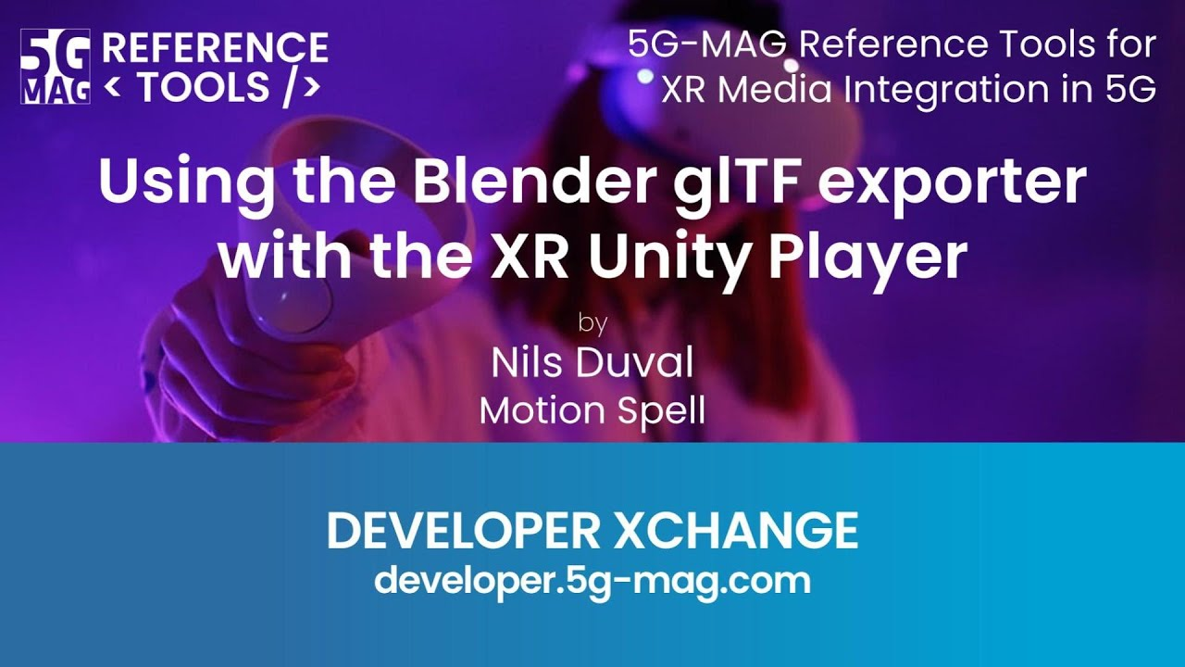
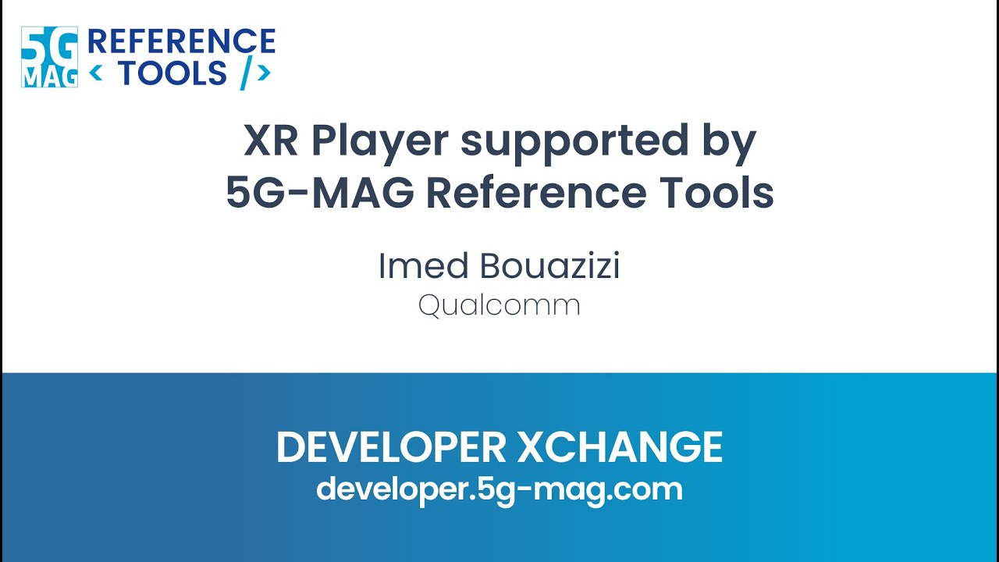
5G-MAG Reference Tools in Use: Tutorials
How to use the tools? Tutorials | 5G-MAG Reference Tools - Documentation
Developer Xchanges, tutorials and updates: 5g-mag.com/tutorials
Video library for XR Media Integration in 5G : https://youtube.com/playlist?list=PLFqKJZ78_IWVk0_h1oeizy9IZ0DmOUXkA

Slide 37
Summary

Slide 38
Summary
Standards-related open source on top of our platform in media is a win-win-win
QSIO is short of resources, but we can support implementor
We strongly encourage that Qualcomm gets involved in media-related open source projects
We have addressed the license questions for the benefit of QCT and QTL
Support may be either of (i) providing own resources (ii) sponsoring external resources – both is beneficial

