Slide 1

Metaverse Standards Forum Updates since MWS Launch Presentation 2022 Neil Trevett NVIDIA | Vice President Developer Ecosystems Metaverse Standards Forum and Khronos | President Thomas Stockhammer Qualcomm Incorporated | Senior Director Technical Standards Metaverse Standards Forum Standards Register WG Chair
Notes:
Hello everyone, I am Neil Trevett, vice president of developer ecosystems at NVIDIA, President of the Khronos Group standards organization for over 20 years, and I am also serving as Chair of the newly formed Metaverse Standards Forum. I am happy to have this chance to give an update on the Forum and how we can work together with Metaverse Japan.

Slide 2
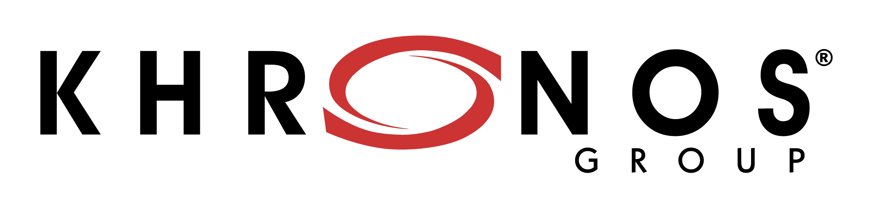

The Metaverse Will be Built on Interoperability
Combining multiple disruptive technologies to work together (AI, GPU, XR, Web3)
Building bridges between applications to scale beyond a series of disconnected silos
Evolving a platform that is open and inclusive for all – an immersive evolution of the web
Depends on Interoperability
Pervasive metaverse interoperability will need a constellation of open standards …
… involving 100s of standards organizations
The Forum incorporates with unanimous agreement from its membership
Independent, self-funded, non-profit industry consortium
The Forum’s mission is to create a wavefront of business opportunities through fostering interoperability ‘brick-by-brick’ on the road to the metaverse
Today
Khronos funds launching the Forum in bootstrap mode to determine industry interest
A venue for cooperation between standards organizations and the wider industry
Straightforward participation agreements with Khronos to enable standardization cooperation and communication
June 2022
Khronos finds increasing interest in its standards for the metaverse…
… but discovers that there is nowhere to coordinate with other standards organizations
End 2021
The Forum grows to over 2400 Member organizations
Multiple Domain Working Groups working to improve interoperability one project at a time
End 2022

Slide 3
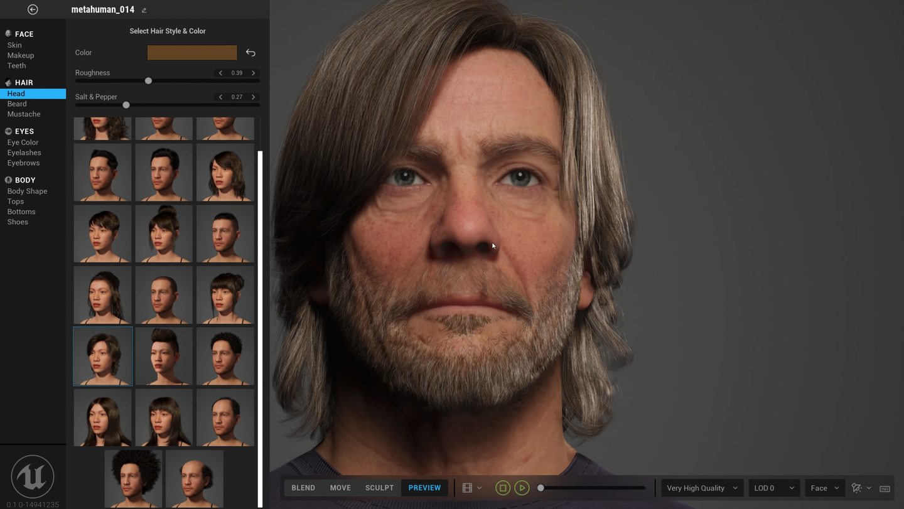

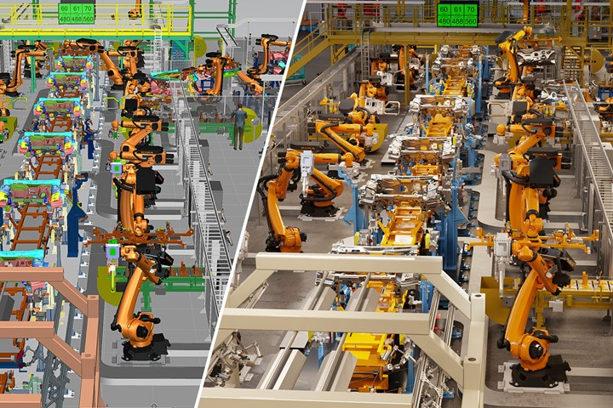
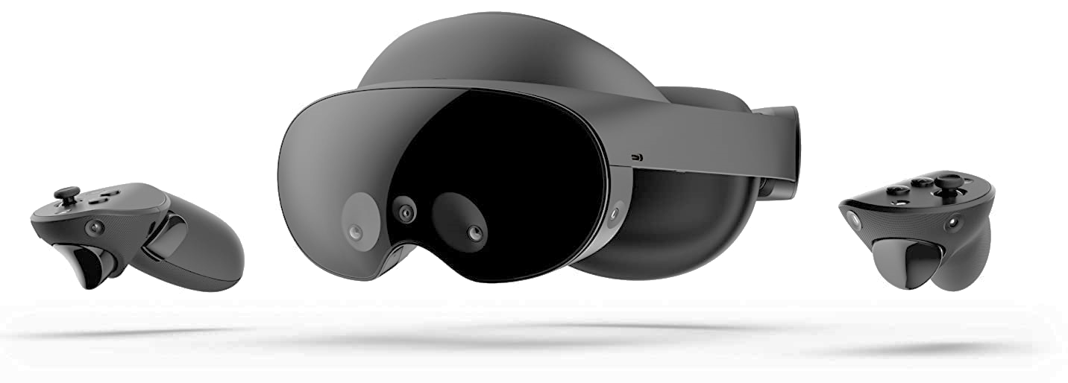
The Metaverse Brings Together Diverse Technologies
The Metaverse combines the connectivity of the Web with the immersiveness of Spatial Computing
Combining multiple disruptive technologies
Advances in GPU-driven real-time photorealistic graphics and simulation
Scenes, avatars and objects
XR – Virtual Reality (VR) and Augmented Reality (AR)
VR for generated environments AR to overlay the real world
Artificial Intelligence (AI) a.k.a. Machine Learning
Natural user interfaces
Semantic scene understanding User generated 3D content
Decentralized Trust and Storage
ID and Reputation
Economic transactions
Persistence
Networking
Edge computing
5G, 6G, 10G
GPU-accelerated photorealistic rendering and simulation
E.g., Epic MetaHumans
Social gaming with end user-generated content
E.g., Roblox
Affordable and accessible XR Devices
E.g., Meta Quest Pro
Digital twins for modeling, monitoring and simulation
e.g., NVIDIA Omniverse
Notes:
The metaverse is combining the connectivity of the web with the immersiveness of spatial computing, by bringing together multiple disruptive technologies. This includes GPU-powered real-time photorealistic graphics and physical simulation, Augmented and Virtual Reality, decentralized trust-and-storage – and possibly most importantly - Artificial intelligence or Machine Learning. It is AI that enables many formerly ‘magical’ capabilities such as natural user interfaces, including speech and gesture recognition, enabling autonomous machines to understand their surroundings, and enabling end users to easily create 3D content for the first time.

Slide 4
Better Metaverse Standards – Sooner!
Coordination and cooperation between Standards Developing Organizations (SDOs) and wider industry
NOT another SDO! All standardization ‘heavy-lifting’ continues at existing SDOs
Open to all, Member access with no participation dues, no NDA, no patent licensing
The Forum exists to accelerate the mission of its members – including SDOs and advocacy organizations
Pragmatic, actionable, projects to
foster metaverse interoperability
Networking, Building Social Norms
Use cases
Requirements
Resources
Expertise
Project funding
Coordinated use case and requirement insights for current or new standards
Standards
Organizations
Industry and
Academia
Standards
Organizations
Standards
Organizations
Industry-wide
Standards Register and Glossary
Domain and Technical Reports
Interoperability prototypes, pilots, testbeds, plugfests
Open- Source Tooling
Best Practices and Guidelines
Accelerated development of standards under existing SDO governance and IP Policies
Notes:
If the Forum is successful, the industry will have more EFFECTIVE metaverse standards and it will have them SOONER! Open to any organization at no cost, the Forum is identifying where lack of interoperability is holding back the deployment of the metaverse - and directing requirements, use cases and implementation insights to standards organizations to help accelerate the evolution and development of needed standards. The Forum will also develop its own deliverables such as a metaverse standards register to help everyone navigate the metaverse standards landscape, together with recommendations and guidelines for DEPLOYING standards. Importantly, the Forum is NOT another standards organization, but a coordination forum to enable pragmatic, action-based projects to accelerate testing and ADOPTION of standards, such as implementation prototyping, pilots and testbeds, plugfests, and open-source tooling. All DEVELOPMENT of standards will continue at existing standards organizations operating under their proven governance models and IP Policies. The Forum has been initiated and bootstrapped by the Khronos Group as part of its non-profit mission to encourage industry interoperability.

Slide 5
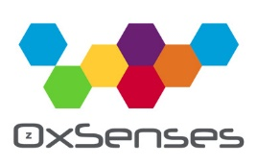


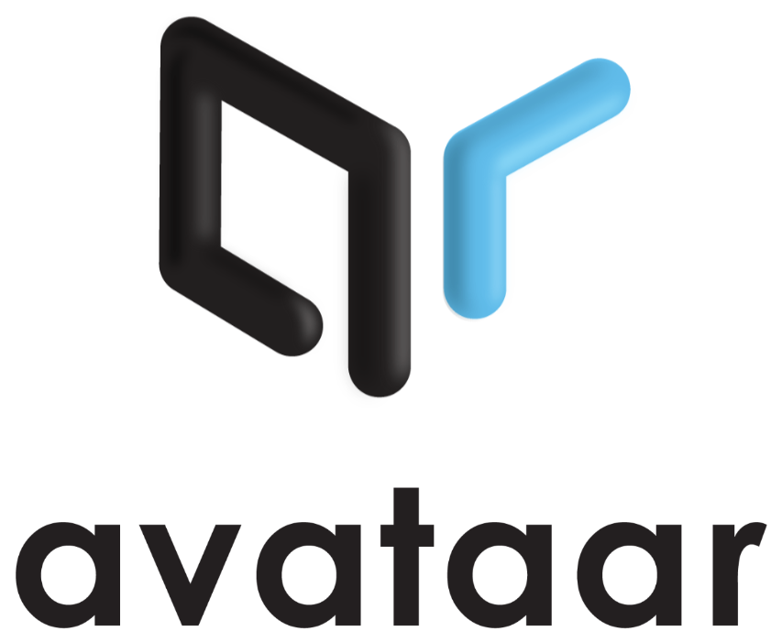







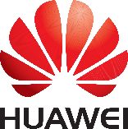
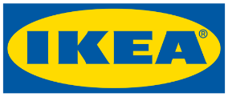








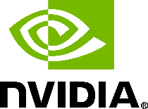




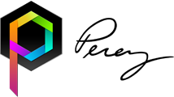








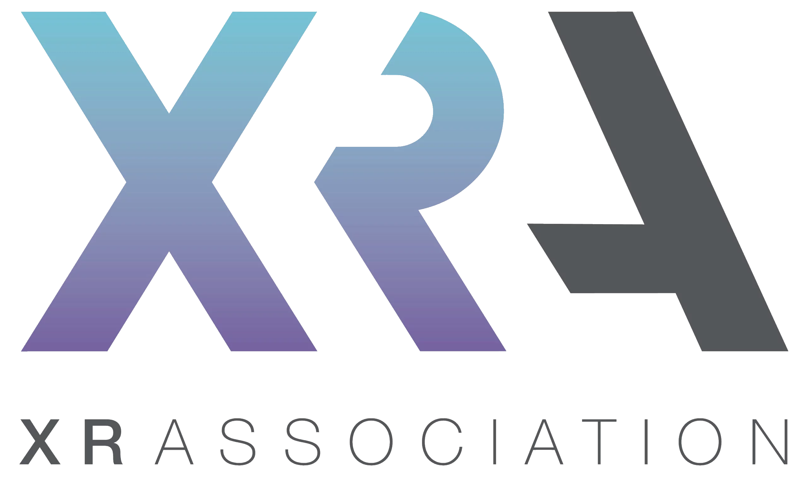

June 2022 - 37 Founding Organizations
Notes:
The Metaverse Standards Forum launched in June 2022, with 37 founding organizations that shared the vision of creating a cooperative venue for metaverse standardization – including Meta, Microsoft and Sony, games engine vendors including Epic and Unity, tools vendors such as Autodesk and Adobe, hardware vendors including NVIDIA and Qualcomm, retailers such as IKEA and Wayfair, Web3 companies including Lamina1, and standards organizations including the World Wide Web Consortium, the Open Geospatial Consortium, the Spatial Web Foundation, and the Khronos Group.

Slide 6
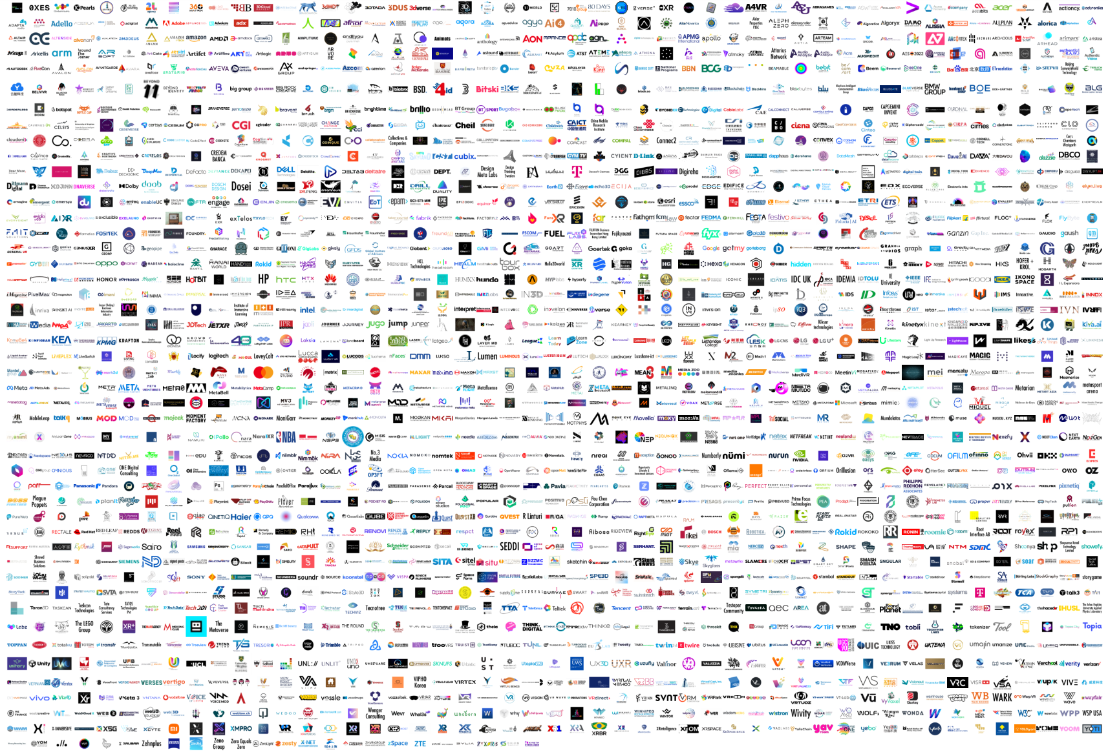
Today - Over 2400 Members and Counting
Wide diversity of organizations, including...
SDOs
Khronos, W3C, Open Geospatial Consortium, IEEE, OMI, ASWF, Spatial Web Foundation, VRM Consortium, XRSI, OMG, Open AR Cloud, OMA3 …
Platforms
Meta, Microsoft, Sony, Google, Baidu, Huawei, General Motors, RedHat, Siemens, Tencent, Mozilla, Paramount …
Tools and Engines
Epic, Unity, Adobe, Autodesk, Otoy, Maxon, Cesium, ESRI, Blackshark.ai, Croquet, Lamina1, Niantic, Ready Player Me, DGG, Manticore …
XR
HTC, Magic Leap, Nreal, Panasonic, Tobii, zSpace …
Hardware
NVIDIA, Intel, AMD, HP, Acer, Dell, Qualcomm, Samsung, Sony, MediaTek, Oppo, Lenovo, ZTE, LG …
Wireless and Networking
China Telecom, Deutsche Telekom, T-Mobile, Verizon, NTT, AT&T, Telefónica, Juniper, Comcast …
3D Commerce
Alibaba, Alvanon, Avataar, CLO, Browzwear, IKEA, VNTANA, Metaverse Fashion Council, Target, Wayfair …
Universities and Institutes
Stanford, John Hopkins, Yale (XRP), Queens University Belfast, University Salford, New York Institute Technology, APMG …
Advocacy
XRSI, AREA, XR Association, VRAR Association, XR Guild, Web3 Marketing Association, International Virtual Reality Healthcare, Swiss Institute for Disruptive Innovation, IOT Consortium, Metaverse Japan, RIAA …
Notes:
Since launch, interest in the Forum has been stronger than we ever imagined, with now over 2000 members and counting! New members include Google and General Motors, XR hardware companies such as HTC and Magic Leap, wireless operators such as China Mobile, Verizon, and T-Mobile and leading universities including Stanford, John Hopkins, and Yale, together with many leading advocacy organizations. This level of interest is a strong indication that the industry DOES believe that the metaverse needs to be based on a foundation of open standards, and that we need cooperation to build those standards effectively.

Slide 7
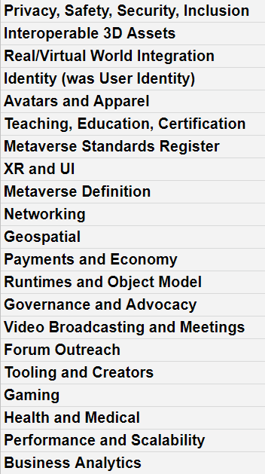
Organizing for Effective Forum Action
1. Gather interoperability Topics from all members
Online input from all members on actionable topics that need improvement today!
2. Organize Topics into Domains
Consensus on member interest AND where the Forum can add industry value
3. Create Domain Working Groups
Make recommendations and work products publicly available
Topics naturally falling into Domains
Any Forum member can propose and participate in a Domain Working Group
Forum Working Groups focus on short-term pragmatic projects to create a wavefront of business opportunities
Domain and technical reports
Use case and requirements recommendations
Pilots, testbeds and plugfests
Open-source tooling
Best practices and guidelines
Other interoperability data, insights and visibility
Etc.
Over 200 topics suggested and counting, for example..
Database of metaverse standards
Taking 3D assets between worlds
Asset LODs
glTF / USD interoperability
Avatar customization / animation
3D Apparel and Fashion
Cloth Simulation
Metaverse traversal
Geospatial ontologies
Geospatial streaming
Decentralized User ID
Ethical framework
User privacy
Child safety
Payment frameworks
Etc. etc..
Notes:
Having over 2200 members in the Forum is a unique opportunity to create widespread visibility, and drive cooperation on metaverse standards with a meaningful participation that can make a significant difference in the industry. But of course, it also creates interesting challenges to ORGANIZE for effective action and decision making. The Forum is following a three-step process to identify which topics the Forum membership wishes to focus on, to organize those topics into Domains, and then establish WORKING GROUPS to execute projects focused on solving interoperability issues IN those Domains. ALL data and results generated by Forum Working Groups will be made publicly and openly available. The Forum will prioritize Domain Working Groups with strong member expertise and where we can identify.

Slide 8
Forum Domain Group Pipeline
Metaverse Standards Register
Publicly available database mapping the landscape of metaverse-relevant standardization activities
glTF/USD 3D Asset Interoperability (visuals, behaviors)
Cooperation between USD and glTF to increase synergy and reduce duplication of effort, gaps, fragmentation and industry confusion
Real/Virtual World Integration (Digital twins, IOT)
Constructs to describe and integrate the physical world and created representations
Asset Management (web3, protection, digital rights)
Digital rights, protection, portability, access, availability
Interoperable Avatars
Cross-platform avatars and characters for film, gaming, fashion and social platforms
Digital Fashion/Wearables
Clothing (including layering), shoes, hats, accessories
Network Requirements and Capabilities to Support Metaverse Applications
Industry requirements for seamlessly transitioning traffic on multiple wireline and wireless technologies for deploying metaverse applications at scale
Privacy, Cybersecurity & Identity
Recommendations for responsible innovation that mitigates human and societal harm from objective and subjective privacy risks – including cybersecurity and identity risk management
Technical Interoperability and End-User Troubleshooting Enabling end-users to ensure reliable metaverse experiences
3D Web Interoperability
Enable the broadest possible interoperability of Metaverse Content using the Web
Ownership and Identity
Accessibility
Best Practices for Living and Working in the Metaverse
https://metaverse-standards.org/domain-groups/
Key
Working Groups
Exploratory Groups
Exploratory Group Proposals
Notes:
The first Domain Working Groups are already up and running, and include creating a public Database, or Register, of metaverse-related standards to help EVERYONE to navigate the metaverse standards landscape, two working groups focused on 3D asset interoperability – from both the 3D graphics AND asset management perspectives, standardization around avatars and the apparel they will wear, geospatial and digital twin standards to connect the real and virtual worlds, AND I am very glad to report there is very strong interest in, and a working group focused on, end user Privacy and Security.

Slide 9
Metaverse Standards Register Working Group
Providing insights into the metaverse standardization landscape
https://register.metaverse-standards.org/
Publications and projects information
Register Database
Glossary Terms
Standards-related Publications and Projects
Pre-qualified Organizations and Groups
Standardization-related organizations
Standardization-related organizations
Standardization related organizations
Publicly-accessible searching and filtering
Approve qualified organizations
Standards Register Working Group
Glossary Terms and QA/oversight
Commencing outreach for standards organizations to apply to be qualified to enter data on their initiatives into the Register database

Slide 10


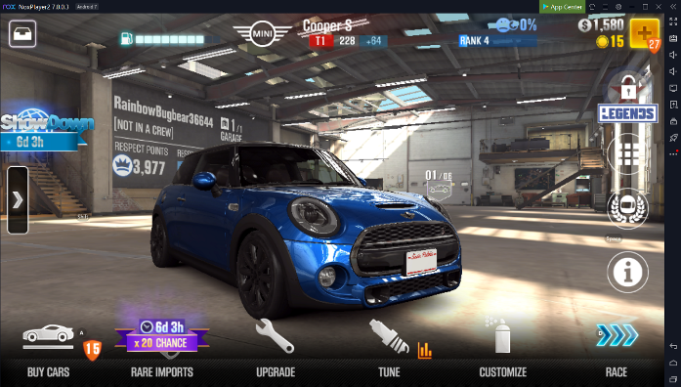














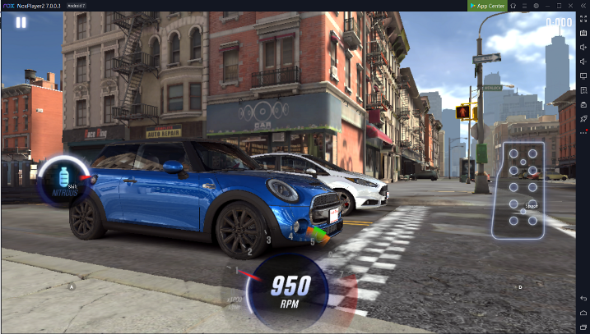


USD glTF Interoperability Potential Testbed Project
Goals
Confirm asset behaviours and attributes satisfy use cases
Test publishing and transmission pipeline
Exercise interoperable behaviours in multiple runtimes
All tool engine and platform vendors invited to participate
Whether or not they are Forum Members
Cooperative shared open-source and assets
USD-based tools Author assets and
publish into glTF
DISTILL
Web-based Configurator
Material variants
TRANSMIT
Runtime Demos
Open door, start engine Drive course with physics simulation
Tools create assets
using open standards
Run time engines ingest and process assets
Notes:
An important Forum principle is that it will focus on pragmatic, actionable, short-term projects to enhance metaverse interoperability. An example of such a high-impact project is to test the interoperability between two important 3D standards for the metaverse, USD and glTF. USD is a Pixar open-source 3D format and run time system that enables sophisticated AUTHORING of 3D content. glTF is a Khronos open standard 3D asset format that is designed for pervasive DELIVERY of 3D content, the 3D analogy to the JPEG format for images. Many 3D content pipelines will use USD to author 3D content that is then distilled to glTF for efficient run-time delivery and deployment. As both USD and glTF begin incorporating metaverse behaviors and attributes, it is becoming ESSENTIAL to test USD to glTF distillation in practice, by creating real-word assets, making them freely available, and discovering functionality and performance gaps and issues to inform the evolution of BOTH formats AND the tools and engines that use them.

Slide 11
Metaverse Standards Forum Inc.
The Forum is now incorporated as an independent non-profit industry consortium!
Delaware 501(c)(6) non-profit, non-stock corporation bylaws - financially and legally independent
The goals and daily operation of the Forum are unchanged for a seamless transition
We are STILL not an SDO, there is no NDA for Forum activities, consensus-based with one vote per organization
Still two membership levels ‘Participants’ and ‘Principals’ plus and now and elected Board
Participant membership remains free and provides access to all Domain Group activities
Principals continue to be key to Forum oversight: participation in Oversight Committee and Board Elections
Board Directors serve two-year terms
COPP Advisory Panel Open to any Principal with COPP designation
Non-voting Board meeting participation
To encourage participation by a broad diversity of standardization organizations the Forum designates some members as ‘COPP’s with reduced or waived fees
‘Collaborative Organization with Public Products’ produce publicly available, specifications, policies, recommendations, or open-source software through a collaborative member-driven process.
A COPP may stand for election to the COPP Advisory Panel for non-voting Board meeting participation
Election
Election
Principal Members (Paid)
Nominate to stand for Board or COPP Advisory Panel elections
Voting participation in plenary meetings and elections
Full Domain Group participation and voting rights
Priority participation in Forum outreach and marketing
Oversight Committee Voting participation to manage Domain Group Pipeline
Dues
Participant Members (Free)
Non-voting participation in plenary meetings
Full Domain Group participation and voting rights
Participate in Forum outreach and marketing
Domain Groups Any member can propose, lead, and participate
Domain Groups Any member can propose, lead, and
Domain Groups Any member can propose, lead, and
Domain Groups Any member can propose, lead, and

Slide 12
Principal Dues
Principal Annual Membership dues introduced for self-sufficient funding of operations and projects
Principal fees tiered on member size to enable participation by organizations of all sizes and geographies
All Principals can cast one vote in decisions and elections, regardless of dues paid
Avoid any concerns over inappropriate ‘buying of influence’
Principal dues capped at $999 for COPPs and accredited academic institutions
COPPs and non-profits may apply for a due waiver to $0
Size and Type of Organization | Principal Dues (US$)
COPPs and Non-profits approved for Principal Fee Waiver Invited Industry Experts (individuals) and Liaison Orgs | $0
Micro Enterprises (< 10 emp. AND <$2M revenue/assets) | $50 per employee
Small Enterprises (< 50 emp. AND <$10M revenue/assets) Accredited Academic Institutions COPPs without fee waiver | $999
Medium Enterprises (< 250 emp. AND <$50M revenue/assets) | $4,999
Large Enterprises (>250 emp. OR > $50M revenue/assets) | $9,999

Slide 13
Post Incorporation FAQ
Is the Forum now going to try to ‘define and solve the metaverse’?
No! The focus remains on practical, actionable interoperability projects that can create a wavefront of short-term opportunity. We are ‘baking the open standard bricks’ for the metaverse, not trying to ‘build the whole cathedral’
Is the Forum now a new standards organization?
No, the Forum remains a unique venue to coordinate requirements and support for existing SDOs developing standards relevant to the metaverse, complementing existing standards bodies
Is the Forum competing with other metaverse-related organizations?
No! We welcome other organizations to join the Forum, and we hope that the opportunity for wider visibility and cooperation can help them further their mission
Why did Khronos acting as host and bootstrap the Forum?
Promoting industry cooperation is part of Khronos’ non-profit mission, our membership requested we help create an open, neutral forum for the benefit of all. Khronos is delighted to see the ongoing success for the Forum and for it to become an independent incorporated consortium
Now Principals pay dues, will larger companies be able to ‘buy outsized influence’?
No, Forum processes mandate on vote per organization, regardless of the size of paid dues to encourage decisions to continue to be made by consensus
Notes:
So, to begin wrapping up, I would like to re-emphasize a few key points. Firstly, the Forum is not trying ‘solve’ the whole metaverse, but is focusing on practical, actionable projects to help solve real-world interoperability issues, and create commercial opportunities TODAY - we like to say we are ‘baking the open standard bricks’ for the metaverse, not trying to ‘build the whole metaverse cathedral.’ Secondly, the Forum is not a new standards organization, it won’t create standards itself, rather it is a unique venue for enabling cooperation that we hope will enable MULTIPLE standards organizations to build standards that better meet the needs of the industry - sooner. Thirdly, there are many organizations being formed around the industry to work on metaverse topics, the Forum does not wish to compete with their good work – indeed, if any of those organizations are interested in open STANDARDS, they are welcome to join the Forum and we hope that the opportunity for wider cooperation can help further THEIR mission too. And lastly, the Khronos Group has helped bootstrap the Forum, as fostering standards cooperation is consistent with Khronos’ non-profit mission, but in Forum meetings, Khronos is happy to be just one more Forum member among many others.

Slide 14
Call for Participation in Unique Cooperative Opportunity
Broad global participation in the Forum enables a unique opportunity for metaverse standards cooperation, coordination and leadership
for Forum members to accelerate their organizations objectives https://metaverse-standards.org/
Any Forum member can propose, lead, contribute to, participate in, or monitor Domain Working Groups
Comprehensive, international gathering of industry requirements and expertise in Forum Working Groups
Wide visibility and adoption of Forum initiatives
Notes:
So, that’s the end of my presentation. Such wide participation in the Forum is providing a unique opportunity for cooperation in the industry to build the metaverse standards that we ALL need, by providing BOTH significant expertise to gather meaningful industry INPUTS and requirements AND to enable broad visibility, consensus, and adoption of Forum outputs. Any Forum member can propose, lead, participate in, or monitor Forum Working Groups that are helpful in accelerating their own objectives. We warmly invite any organization to join the Forum – for although we can’t know PRECISELY what form the metaverse is going to take, I do believe it will be far better if we build it together. Thank you!

Slide 15
Background Materials

Slide 16
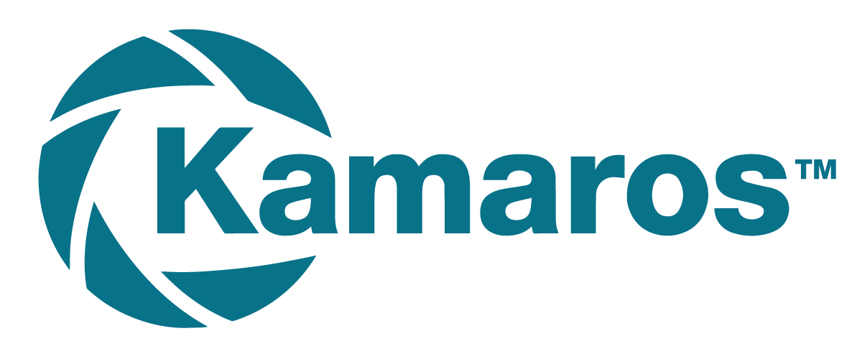


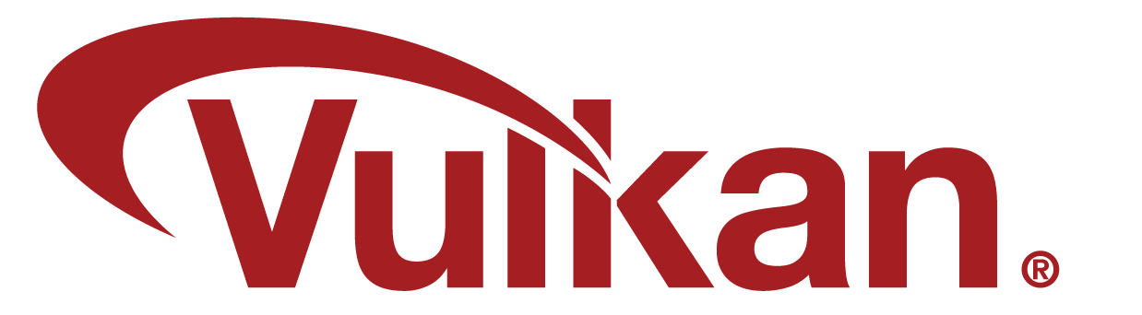

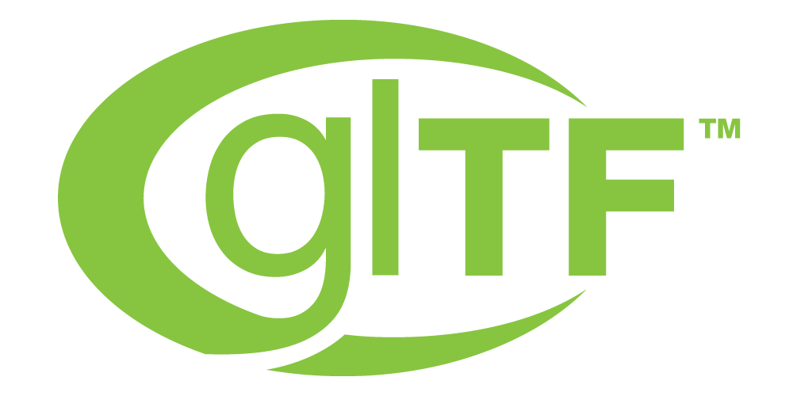
Khronos “Connects Software to Silicon”
Standards Organization founded in 2000 ~200 Members ~ 40% US, 30% Europe, 30% Asia
Non-profit, member-driven, open to any company
Well-defined multi-company governance and IP Framework
Open, royalty-free interoperability standards to harness the power of GPUs, multiprocessors and XR hardware
3D graphics, augmented and virtual reality, parallel programming, inferencing and vision acceleration
Runtime Control
Runtime Control
Runtime Control
Runtime Control
Embedded camera, sensor and ISP
Sensor Stream
Vision and inferencing acceleration
Pose and scene data
XR displays and devices
Pixels
3D rendering acceleration
Augmentation 3D Assets
Khronos APIs used for XR (augmented or virtual reality)
Notes:
Let’s start with the Khronos Group. Khronos is an international, non-profit standards consortium that is open to all, and all our standards are royalty-free for the industry to use. Our focus is enabling applications to access the power of 3D graphics, virtual and augmented reality, and parallel computation, including machine learning acceleration. Khronos’s 200 member companies around the world strongly believe in the power of open standards to grow market opportunities for all. But open standards cannot be effective without the support of market leaders such as Huawei - and so we are honored that Huawei is a Promoter member on Khronos’ Board of Directors

Slide 17
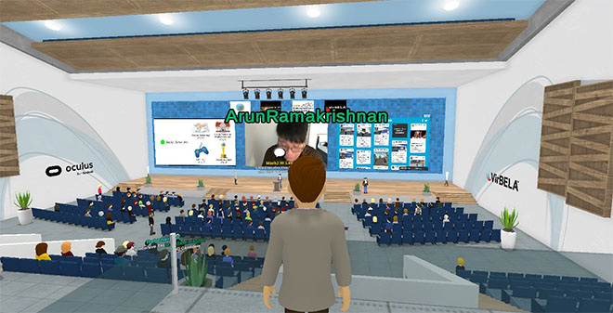

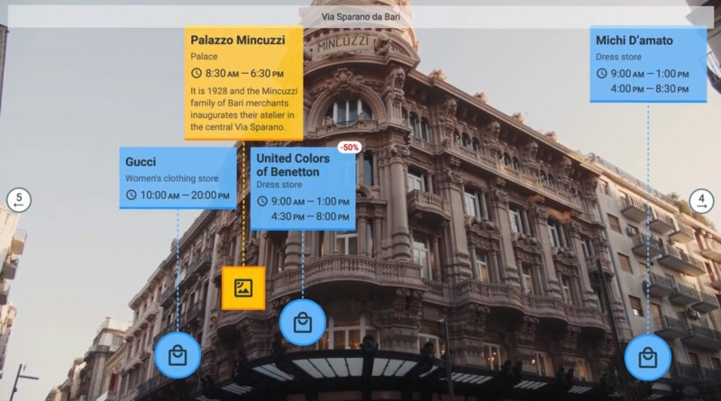



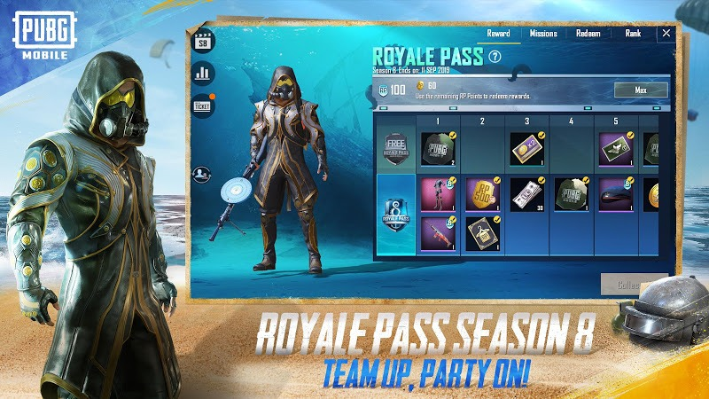


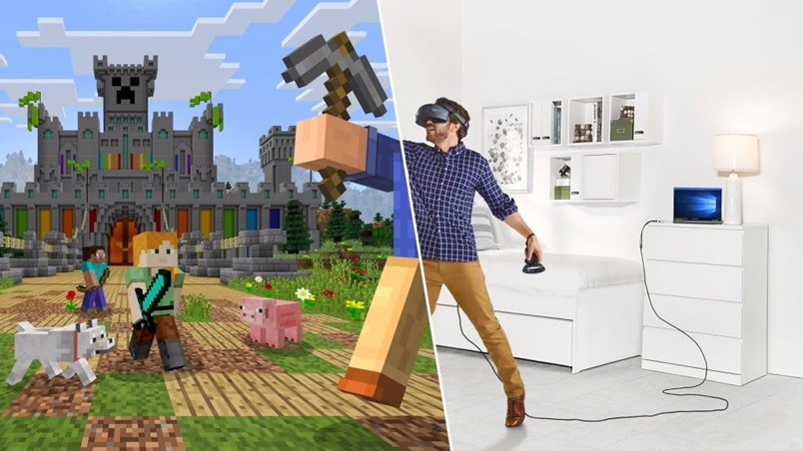
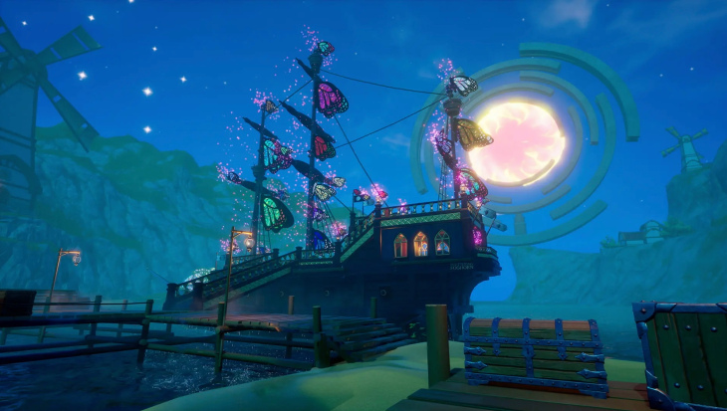
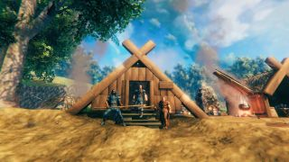
Proto-Metaverse Consumer Use Cases
Forbes, iLRN, Virbela
Open AR Cloud, Niantic
Microsoft Flight Simulator
Augmenting Reality with persistent geo-locking, linking, occlusion and realistic scene illumination
Enhanced student learning and engagement by transforming how educational content is delivered
Realistic environments where users can import their own authored assets
Fortnight, PUBG, Valheim
Roblox, Minecraft, Manticore
Realtime, multi-user gaming and socialization
Virtual spaces where gamers create their own content
Notes:
Exploring how to use and combine these disruptive technologies into compelling and useful online experiences will happen incrementally, the metaverse will be built over a number of years. But we can already see some of the promise of the metaverse in TODAY’S games and consumer applications. From Microsoft Flight Simulator that models the entire world, to Minecraft and Roblox where millions of users create and play online 3D games every day, to companies like Niantic that brings the magic of Harry Potter and Pokémon into the real world through increasingly sophisticated augmented reality.

Slide 18



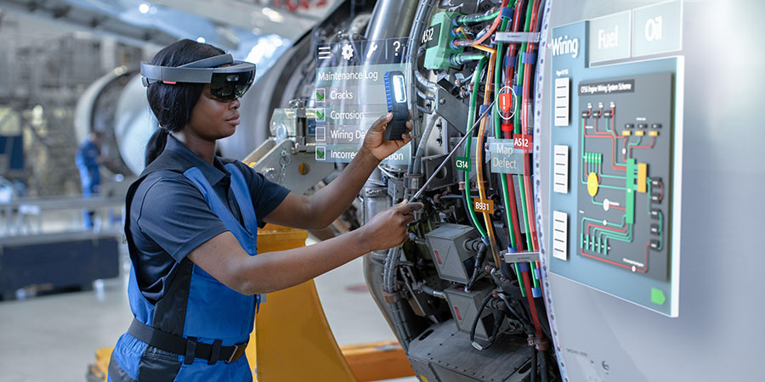

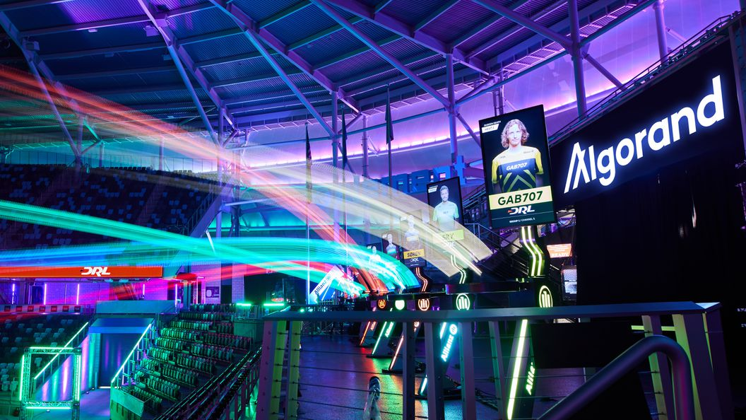
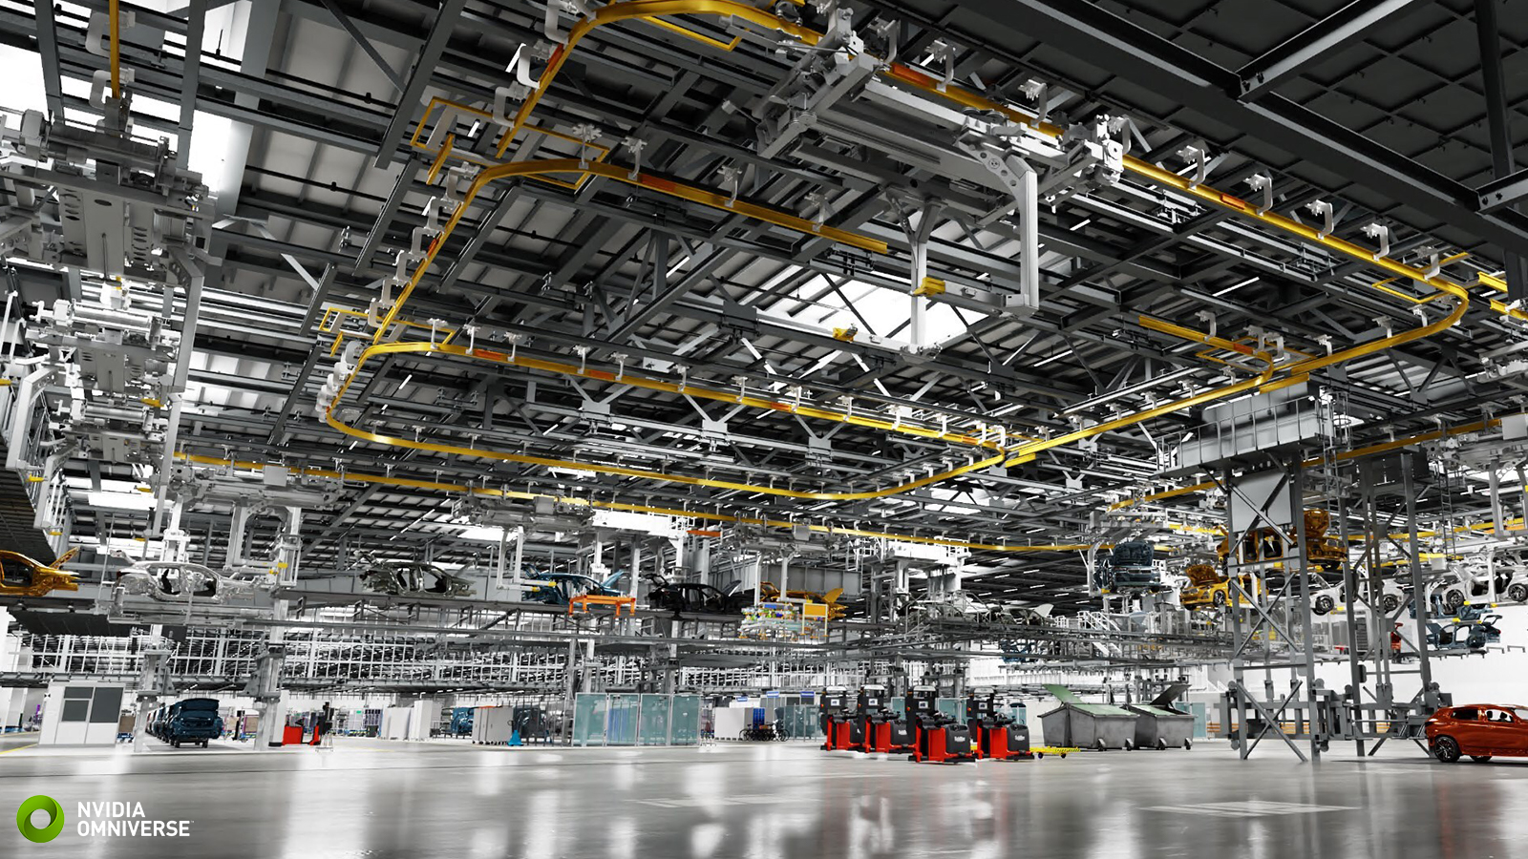


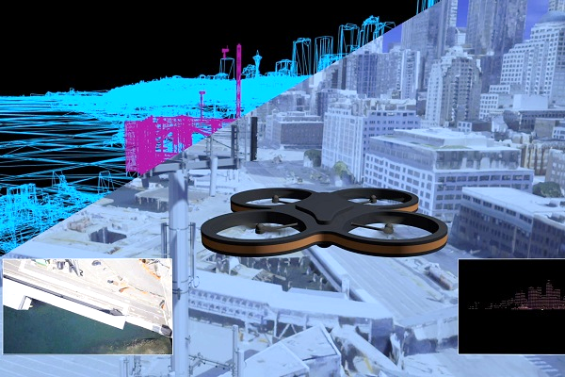
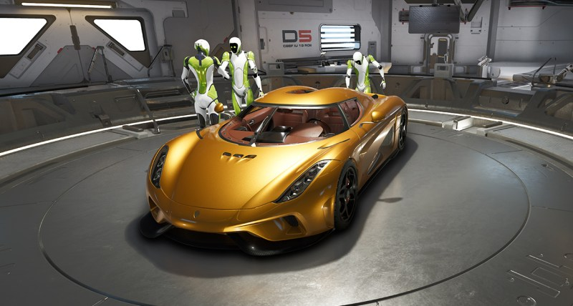
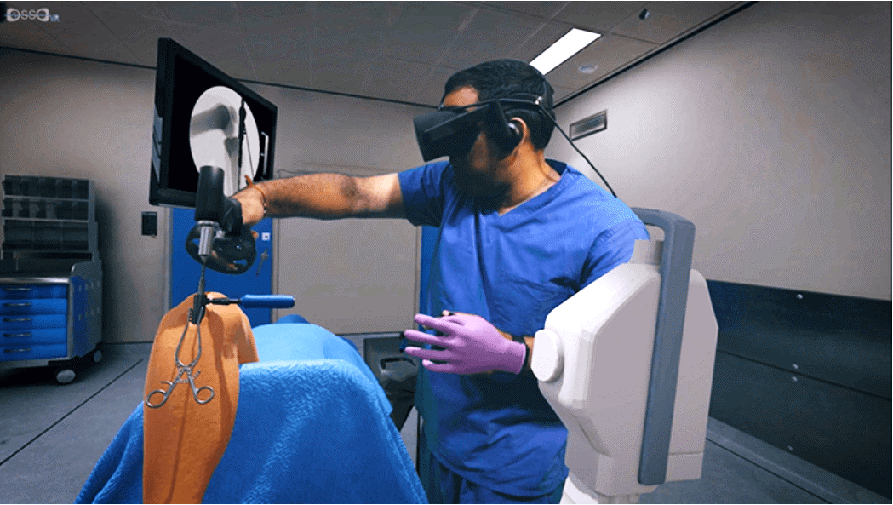
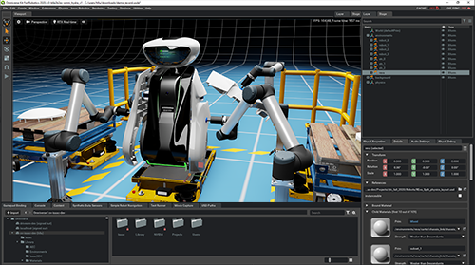
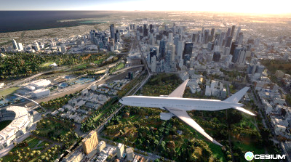
Enterprise Proto-Metaverse Use Cases
PTC, AREA
GE, Siemens, Bentley, NVIDIA
Algorand, Sports Tomorrow
Augmented Reality used in guided tasks and remote assistance are proven to boost productivity
Digital twins - virtual representation of a product, process, or place that measures mirrors and its physical counterpart – for monitoring, optimizing and prediction
Virtual Sports Leagues and immersive viewing of sports events
OGC, Cesium, NVIDIA
Microsoft, Google
NVIDIA Omniverse
Immersive Training significantly increases understanding and retention
Spatially indexing and streaming the digitized world for planning, visualization and simulation
3D application interoperability for real-time immersive collaborative simulation and design
Notes:
Businesses are also beginning to see the value of connecting the power of spatial computing with the Web. Augmented reality use cases including ‘guided task’ and ‘remote assistance’ are saving significant costs and increasing product quality today. NVIDIA’s Omniverse platform supports fully simulated virtual environments, enabling multi-user collaborative design and interaction in real-time - together with sophisticated digital twins that mirror their physical counterparts, for monitoring and simulation, already being widely deployed.

Slide 19
The Promise of Metaverse Interoperability
Interoperability is the key to the metaverse scaling beyond a series of disconnected silos
Decentralized trust and storage Enable any service to access and confirm ID, reputation, payments, and ownership with a persistent history
Interoperable 3D objects and avatars Take your personal avatar and objects you have earned, built or purchased seamlessly across multiple services
Travel between different spaces With minimal friction and consistent user interface but with agreed ‘border customs’ to respect IP ownership, business models, age appropriateness, gameplay, rendering style etc.
and much more…..
If achieved, this level of interoperability would escalate the economy and utility of the metaverse beyond any single space or service
Notes:
It is open standards that hold the promise of services and experiences interoperating through sharing data to enable the metaverse to scale in functionality and scope far beyond any single experience, creating a network effect to build a significant social and economic opportunity for all. One of the first interoperability opportunities is to be able to use your avatar, and any digital goods you have purchased across multiple worlds in the metaverse. Defining this kind of interoperability though is a multi-layer challenge – as just in the real world you are not permitted to take ANY object ANYWHERE in the world – we will need metaverse standards to enable ‘border customs’ between worlds to ensure IP ownership, business models, age appropriateness, gameplay, and rendering styles are respected. To take a gaming example, it wouldn’t be fair to enable a laser rifle purchased in a space sim to be taken into a medieval battle recreation.

Slide 20
Metaverse Reality vs. Hype
There is only one Metaverse The metaverse is a platform - just as there is only one Web The metaverse will enable diverse ‘worlds’, spaces’ and ‘experiences’ etc. Just as the Web enables ‘pages’ and ‘apps’ etc.
The Hype
The Reality
We will live our lives in the metaverse!
We will choose to use the metaverse when and if it is engaging, insightful and educational – and perhaps more productively than the average of 3 hours a day we on average spend watching TV today
You will need to plug into a VR headset to access the metaverse
Although VR will deliver some of the most immersive and AR could eventually replace mobile phones, there will be many ways to use Metaverse applications - including phones, tablets and PCs
The Metaverse will be a wild west of crypto currencies and NFTs
Web3 is a young area of innovation – and is still evolving how to enable systems of decentralized trust for ID, reputation and economic transactions that will be essential to the metaverse
The Metaverse market will be worth Trillions of dollars $ in the next few years
As with many transformative technologies, its evolution will take longer than we think, but its impact will likely be larger than we first imagined
Notes:
But there is also confusion and skepticism about the term “the metaverse” since it started getting widely used about one year ago. One big debate has been - is there is a single “metaverse” or multiple “metaverses”. Personally, I think it is most useful to think of the metaverse as an underlying platform that enables multiple ‘worlds’ or ‘experiences’ etc. just as we have just one world wide web that enables multiple ‘pages’ and ‘apps.’ Many articles state that we will spend significant portions of our life “in the metaverse” and to many this sounds dystopian - where technology is further disconnecting us from the real world. But I hope that the metaverse will be used when it is engaging – and perhaps be more interactive than the hours we spend today passively watching TV or games. Some make it sound that you MUST use a VR helmet to use the metaverse, and although that will often provide the most immersive experience - I think many people will not want or need to be isolated from their surrounding and access metaverse apps through phones and PCs – as they do with games today. Many have associated the Metaverse with the wild west of crypto currencies and NFTs, but they are not essential for a spatial web – and we should remember the field of “web3” is much younger than 3D graphics, XR or AI – and so be patient as more time is needed to evolve reliable systems for decentralized trust and payments. And lastly, there have been some rather exaggerated market forecasts for the metaverse – before we even know what the metaverse it is going to be! So, I suggest ignoring the hype – and focus instead on how metaverse technologies can begin to help your business or organization TODAY.

Slide 21
Open Standards Make Technology Pervasive
INTEROPERABILITY standards define precise COMMUNICATION
E.g., software to hardware, client to server, organization to organization
Open Standard = Shared Specification
Contributor
Contributor
Contributor
Contributor
Contributor
Implementation
Implementation
Implementation
Implementation
Open Source =
Shared Implementation
Implementation
Open standards with rigorous conformance testing enable consistency across multiple implementations that can meet the needs of diverse markets, price points, and use cases
Open standards often use open source to spread the implementation effort for sample implementations, tools, samples, conformance tests, validators etc…
Notes:
So how DO open standards enable proven technologies to be pervasive? What is their superpower? The answer is that an open STANDARD is a shared specification, together with rigorous conformance tests that defines precise COMMUNICATION - for example between hardware and software, client to server or between worlds on the metaverse. This enables reliable implementations that know how to communicate to be built and shipped by MULTIPLE companies to meet the needs of diverse markets, price points, and use cases - enabling that technology to fan out WIDELY across the industry. By contrast, open-SOURCE projects enable multiple contributors to cooperate in building a single SHARED implementation. Both open source and open standards are powerful tools, and open-source projects are often used to enable open standard ecosystems, but the two are often confused. It is important to understand the different strengths of open standards and open source to be able to select the RIGHT tool for the job at hand.

Slide 22
Open Standard Why’s, When's and How’s
Why
Grow Markets By reducing consumer confusion and increasing capabilities and usability | Reduce Costs By sharing ecosystem development between many companies and driving volume
Speed Time to Market With well-proven functionality, testing and interoperability | Enable Innovation Free companies compete on value differentiators: quality, performance, power etc.
When
Proven Technologies Don’t do R&D by standards committee | Consensus Need The downside of not having a standard is clear to all
How
Multi-company governance Avoid single-company control or dependency | Well-defined IPR Policy Royalty-free standards have clearer path to wide adoption
With Extensibility Enable a responsive innovation pipeline to meet customer and market needs | Thoughtful Abstraction Focus on interoperability and avoid over specifying implementation which stifles innovation
Notes:
So just what IS an open standard? The term typically refers to specifications defining INTEROPERABILITY – enabling precise communication, such as an API for a software application to drive a hardware device. The tech industry uses thousands of hardware and software interoperability standards - they are essential to remove industry friction and to grow market opportunities for everyone. Well-designed open standards are careful to precisely define interoperability, but NOT to over-prescribe implementation details. This is really key – a good standard unleashes the power of innovation and healthy competition between implementations - effective standardization does NOT mean a race to the lowest common denominator. Also, truly OPEN standards are NOT controlled by any SINGLE company – and THAT means we need industry cooperation to create and evolve them. The industry uses Standards Developing Organizations – of which Khronos is one - to enable MULTIPLE companies to work together to develop a shared consensus on open standards that move the industry forward. Effective SDOs have well-defined multi-company governance and Intellectual Property frameworks - and each of these organizations typically has a specific area of expertise. As a general rule the more inclusive the governance model - and the wider the consensus built during the standardization process – the better the chance that a standard will be widely adopted.

Slide 23
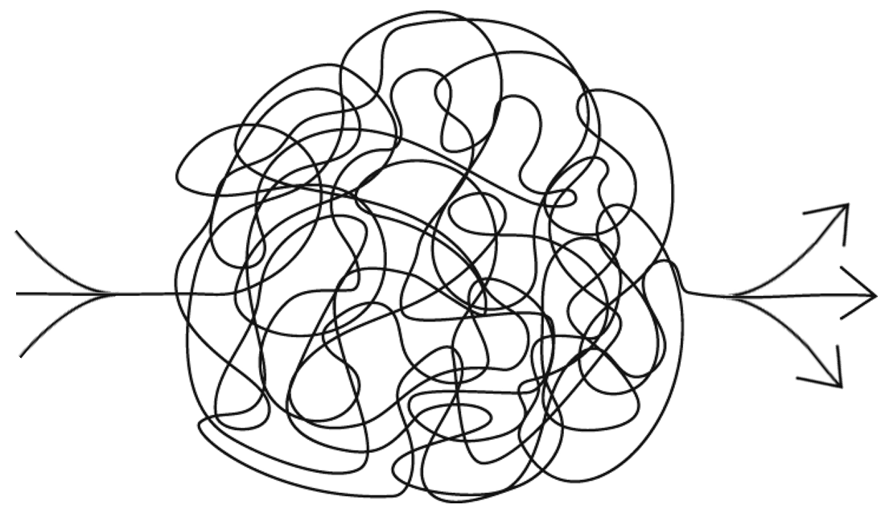
How Will the Metaverse Evolve?
The World Wide Web changed the world
But in ways that were hard to predict when it was first invented
The development of the metaverse will be equally hard to forecast
Diverse emerging technologies are being brought together in novel ways
Synthesized visual reality
Universally portable 3D assets
Practical XR optics
Real-time environment scanning and semantics
End-user 3D content creation tooling
Accurate physical simulations
Realistic avatars
Online personas and social connections
Machine learning for semantic understanding and assisted content creation
User identity, security and privacy
Effective remote social interactions
Streaming of vast geospatial data sets
Real-world geo-anchoring with persistence
IOT sensor networks
Universal digital twins
Servers scaling to millions of simultaneous users
Interoperable run-times
Online economies and currencies
Pervasive low-latency wireless connectivity
and much more …
Technologies working together at pervasive scale need interoperability standards!
Standards accelerate market opportunities and drive increased volume
Reduce consumer confusion
Increase product capabilities and usability
Enable focus on differentiated innovation
Reduce costs and speed time to market
Pervasive metaverse interoperability will need a constellation of open standards from 100s of standards bodies
Darwinian Evolution
Elevates technologies and services that gain market success
Creating a wavefront of commercial opportunities as the metaverse emerges incrementally
Notes:
With so many diverse technologies being combined at new levels of scale, I don’t think it is possible for any one company to construct a strategic top-down plan for the entire metaverse. Instead, the metaverse will evolve through a chaotic, bottom-up Darwinian process that elevates the products and services that provide customer value, creating a ‘wavefront’ of innovation and business opportunity that will unfold over many years. As successful technologies bubble to the surface, open standards will be essential to enable their widespread use, accelerating business opportunities by removing friction points to REDUCE costs and ACCELERATE time to market.

Slide 24

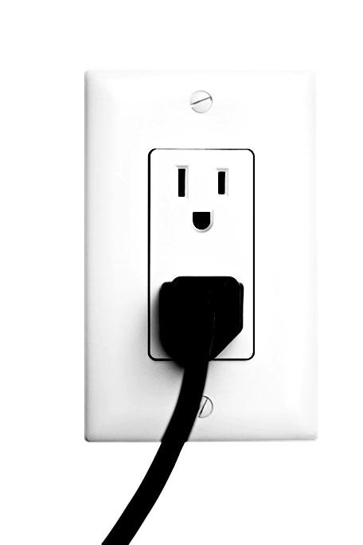




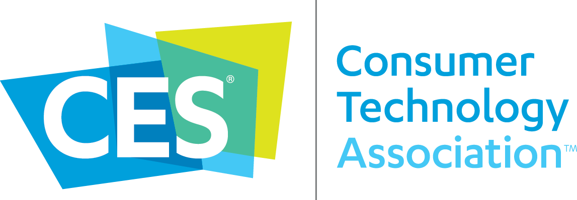
















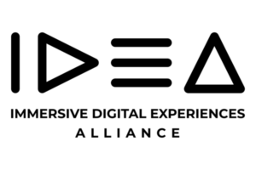








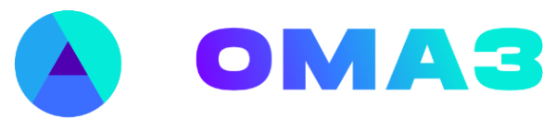





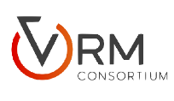




Ubiquitous Standards for the Metaverse
Industry Standards
Standards are the basis for ubiquitous infrastructure
Multiple Standards
Widely adopted platforms require many hardware and software standards
Constellation of Standards
An open and inclusive metaverse at pervasive scale will need the right standards at the right time – from MANY standards organizations!
IEC 60038 Standard voltages
IEC 60228 Conductors of insulated cables
IEC 60269 Low-voltage power fuses
IEC 60320 C13 Connectors and C14 Inlets
IEC 60884 Household Plugs And Socket-Outlets
IEC 61970 APIs for energy management
Notes:
So, standards will be essential to deploying the metaverse at GLOBAL scale, as they are an effective way to make technology truly ubiquitous. Computing platforms such as the PC use hundreds of hardware and software standards to ship at scale and create a thriving ecosystem. Indeed, the act of plugging your PC into the wall outlet takes another WHOLE interoperability ecosystem that has become SO deeply embedded in our daily lives that we just take it for granted! If the metaverse is to reach its full potential, many of the technologies necessary to build it will need to become so ubiquitous that people take THEM for granted too. But bringing together so many diverse technologies is going to take an UNPRECEDENTED level of interoperability between different platforms and products – and THAT means we will need a CONSTELLATION of standards from MANY international standards organizations – just some of which are shown here. And this was the genesis of the Metaverse Standards Forum – up to now there has been no single venue to bring together standards organizations and companies constructing the metaverse, leading to potential misalignment and duplication of effort across the industry. Companies that wish to use open metaverse standards have needed to interact with dozens of standards organizations to try and understand a complex standards landscape, often with gaps and incompatibilities.

Slide 25
Typical Domain Group Activities
Action
Initiate Projects to generate and publish work products that foster interoperability
Publish ‘Domain Interoperability Reports’ to build industry understanding and consensus on the need and benefit of increased interoperability
Establish subgroups to deep dive and generate and publish use cases and requirements for needed standardization work
Initiate testbed/plugfest projects to encourage real-world testing, and publicly release assets and tools for ongoing compatibility
Promote and publish Domain Group results
Analysis Identify where there are interoperability gaps or misalignments
What are the clearest problems or opportunities where communication and cooperation can make a difference today?
Are there standardization organizations working and willing to fill standardization gaps?
Are industry players willing to cooperate on better alignment on creation and use of best practices or standards?
Awareness Understand the standardization landscape in this Domain
Create a Group-maintained list of key players: companies, organizations
Invite key players to join the Forum
Invite key players to present to the Domain Group on their activities – as members or guests
Charter Approved and Working Group Formed
Exploratory Group
Ongoing blend of Awareness, Analysis, and Action as the group transitions and grows
Working Group

Slide 26
Membership Transition
Six-month transition period for all members to execute updated membership agreement
For agreement terms consistency between all members
10% off membership dues for members executing new membership agreement in initial 90 days following incorporation public announcement
All members retain current level of membership without payment for three months EXCEPT no Board election nomination or voting rights unless execute new Principal agreement
Incorporation Publicly Announced
Members that have not executed a new membership agreement are provided Participant-only membership for an additional 3 months
Announcement +3 Months
Members that have not executed a new Participant or Principal membership agreement and paid dues (if required) are terminated
Announcement +6 Months
New Principals may request to be elected to an Initial Board
Initial 90 Days

Slide 27
Post-Incorporation Board Timeline
Board processes for quorum and actions as per bylaws
Initial Board
Officers serving until first AGM after 9 months
Neil Trevett: President and Secretary
Emily Stearns: Executive Director and Treasurer
Directors serving for 90 days until first Board Elections
Ulrich Dropmann, Nokia
Paul Higgs, Huawei
Yu Yuan, Versemaker (IEEE SA President)
Matt White, Berkeley Synthetic Inc.
Aditya Mani, YOLOgram
Initial Board Consent
Khronos President and Managing Director elected as Directors Terms through to Interim Board Election
Officers Elections Khronos President as President and Secretary
Khronos Managing Director as Executive Director and Treasurer
Forum President and Executive Director Officer terms through to Full Board Election for continuity
Incorporation Publicly Announced April 18th, 2023
Board may elect up to 5 additional Directors At least one seat reserved for non-Large Enterprises. Terms through to Interim Board Election
Board may elect Secretary and Treasurer Officers from Directors Terms through to Interim Board Election
Initial Board
Interim Board Election
Up to total 11 Directors elected by and from Principals Up to 3 seats reserved for non-Large Enterprises. Terms through to Full Board Election
Announcement +3 Months
Full Board Election AGM
Up to total 19 Directors elected by and from Principals 5 seats reserved for non-Large Enterprises. Staggered two year terms
Announcement +9 Months
Board elects Secretary and Treasurer Officers Terms through to Full Board Election
Interim Board
Board elects all Officers Terms through to upcoming AGMs
Full Board

