Slide 1
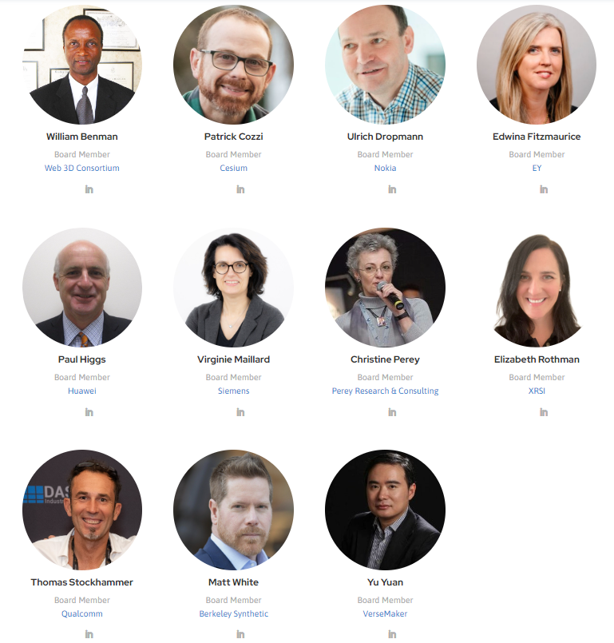

Overview Metaverse Standards Forum Neil Trevett NVIDIA | Vice President Developer Ecosystems Metaverse Standards Forum and Khronos | President Thomas Stockhammer Qualcomm Incorporated | Senior Director Technical Standards Metaverse Standards Forum Standards Register WG Chair, Board Member
Notes:
Hello everyone, I am Neil Trevett, vice president of developer ecosystems at NVIDIA, President of the Khronos Group standards organization for over 20 years, and I am also serving as Chair of the newly formed Metaverse Standards Forum. I am happy to have this chance to give an update on the Forum and how we can work together with Metaverse Japan.

Slide 2


The Metaverse Will be Built on Interoperability
Combining multiple disruptive technologies to work together (AI, GPU, XR, Web3)
Building bridges between applications to scale beyond a series of disconnected silos
Evolving a platform that is open and inclusive for all – an immersive evolution of the web
Depends on Interoperability
Pervasive metaverse interoperability will need a constellation of open standards …
… involving 100s of standards organizations
The Forum incorporates with unanimous agreement from its membership
Independent, self-funded, non-profit industry consortium
The Forum’s mission is to create a wavefront of business opportunities through fostering interoperability ‘brick-by-brick’ on the road to the metaverse
Today
Khronos funds launching the Forum in bootstrap mode to determine industry interest
A venue for cooperation between standards organizations and the wider industry
Straightforward participation agreements with Khronos to enable standardization cooperation and communication
June 2022
Khronos finds increasing interest in its standards for the metaverse…
… but discovers that there is nowhere to coordinate with other standards organizations
End 2021
The Forum grows to over 2400 Member organizations
Multiple Domain Working Groups working to improve interoperability one project at a time
End 2022

Slide 3
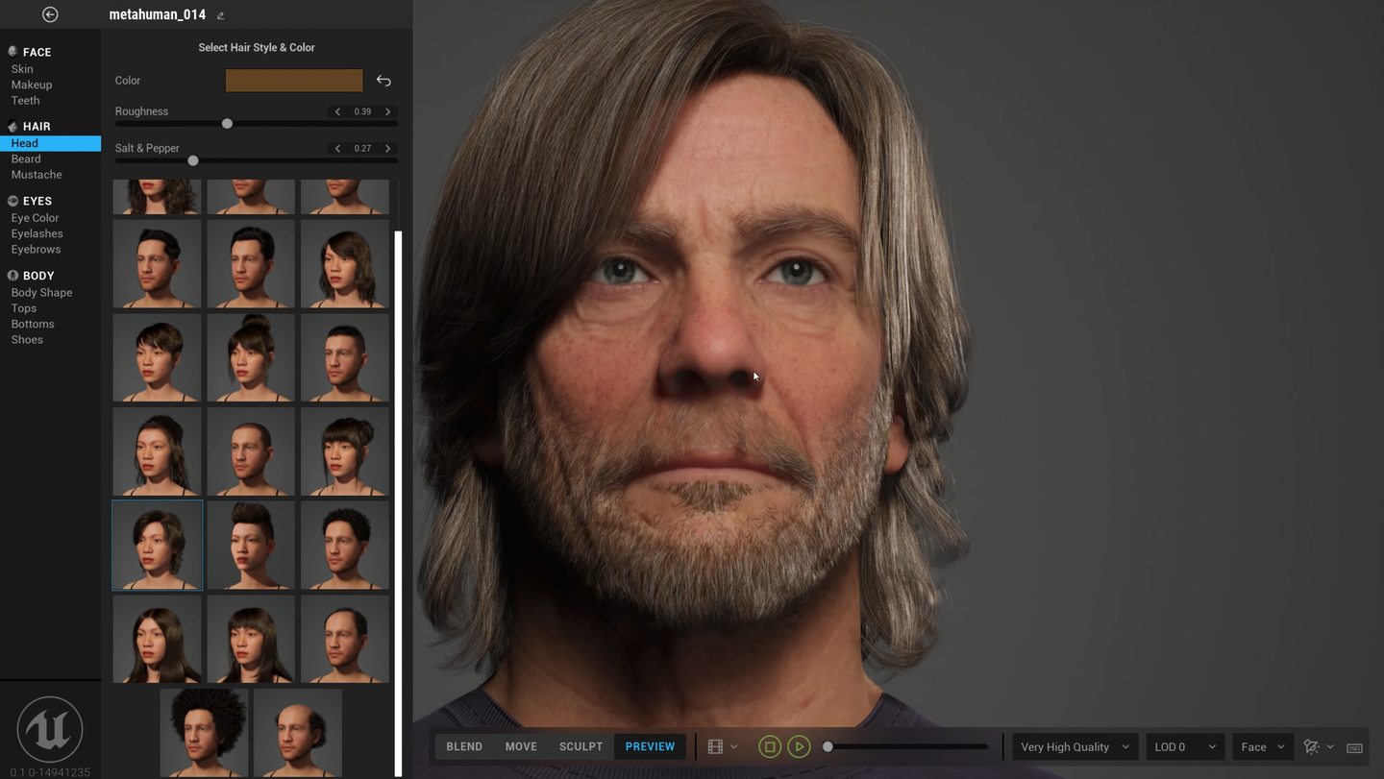

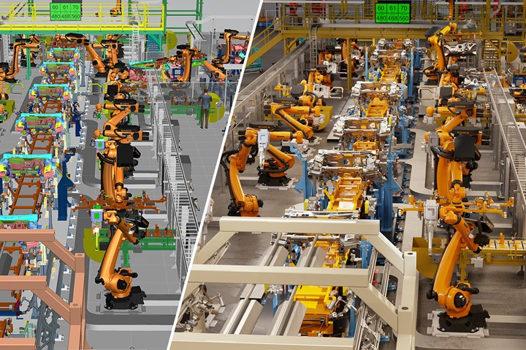
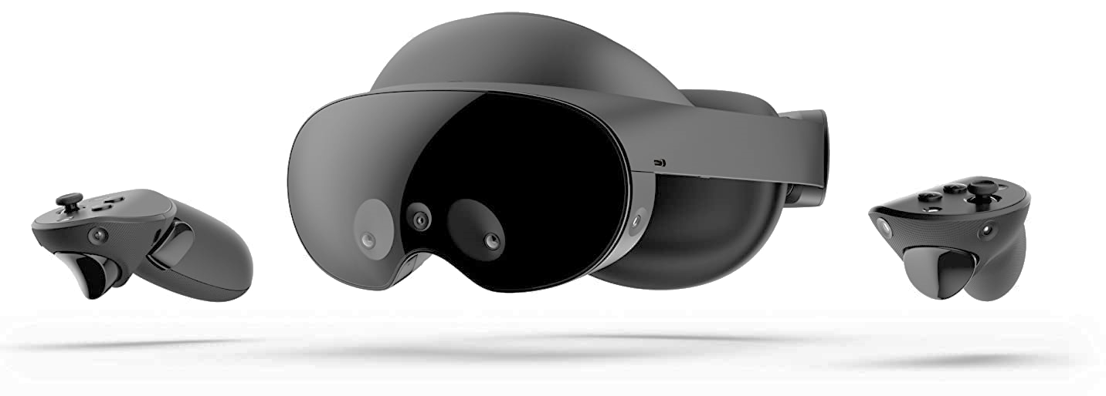
The Metaverse Brings Together Diverse Technologies
The Metaverse combines the connectivity of the Web with the immersiveness of Spatial Computing
Combining multiple disruptive technologies
Advances in GPU-driven real-time photorealistic graphics and simulation
Scenes, avatars and objects
XR – Virtual Reality (VR) and Augmented Reality (AR)
VR for generated environments AR to overlay the real world
Artificial Intelligence (AI) a.k.a. Machine Learning
Natural user interfaces
Semantic scene understanding User generated 3D content
Decentralized Trust and Storage
ID and Reputation
Economic transactions
Persistence
Networking
Edge computing
5G, 6G, 10G
GPU-accelerated photorealistic rendering and simulation
E.g., Epic MetaHumans
Social gaming with end user-generated content
E.g., Roblox
Affordable and accessible XR Devices
E.g., Meta Quest Pro
Digital twins for modeling, monitoring and simulation
e.g., NVIDIA Omniverse
Notes:
The metaverse is combining the connectivity of the web with the immersiveness of spatial computing, by bringing together multiple disruptive technologies. This includes GPU-powered real-time photorealistic graphics and physical simulation, Augmented and Virtual Reality, decentralized trust-and-storage – and possibly most importantly - Artificial intelligence or Machine Learning. It is AI that enables many formerly ‘magical’ capabilities such as natural user interfaces, including speech and gesture recognition, enabling autonomous machines to understand their surroundings, and enabling end users to easily create 3D content for the first time.

Slide 4
Better Metaverse Standards – Sooner!
Coordination and cooperation between Standards Developing Organizations (SDOs) and wider industry
NOT another SDO! All standardization ‘heavy-lifting’ continues at existing SDOs
Open to all, Member access with no participation dues, no NDA, no patent licensing
The Forum exists to accelerate the mission of its members – including SDOs and advocacy organizations
Pragmatic, actionable, projects to
foster metaverse interoperability
Networking, Building Social Norms
Use cases
Requirements
Resources
Expertise
Project funding
Coordinated use case and requirement insights for current or new standards
Standards
Organizations
Industry and
Academia
Standards
Organizations
Standards
Organizations
Industry-wide
Standards Register and Glossary
Domain and Technical Reports
Interoperability prototypes, pilots, testbeds, plugfests
Open- Source Tooling
Best Practices and Guidelines
Accelerated development of standards under existing SDO governance and IP Policies
Notes:
If the Forum is successful, the industry will have more EFFECTIVE metaverse standards and it will have them SOONER! Open to any organization at no cost, the Forum is identifying where lack of interoperability is holding back the deployment of the metaverse - and directing requirements, use cases and implementation insights to standards organizations to help accelerate the evolution and development of needed standards. The Forum will also develop its own deliverables such as a metaverse standards register to help everyone navigate the metaverse standards landscape, together with recommendations and guidelines for DEPLOYING standards. Importantly, the Forum is NOT another standards organization, but a coordination forum to enable pragmatic, action-based projects to accelerate testing and ADOPTION of standards, such as implementation prototyping, pilots and testbeds, plugfests, and open-source tooling. All DEVELOPMENT of standards will continue at existing standards organizations operating under their proven governance models and IP Policies. The Forum has been initiated and bootstrapped by the Khronos Group as part of its non-profit mission to encourage industry interoperability.

Slide 5
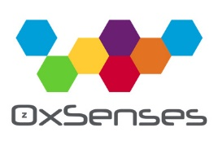


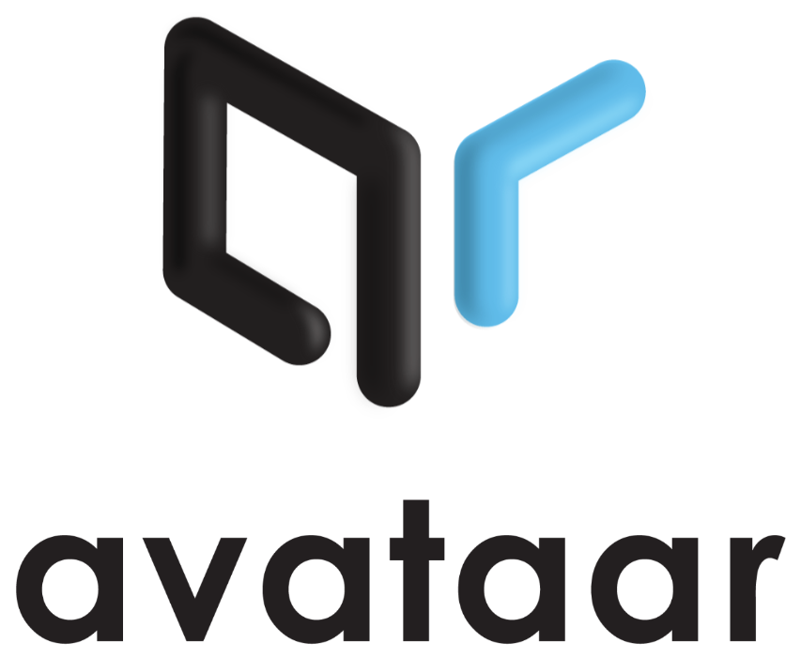







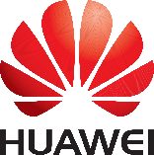









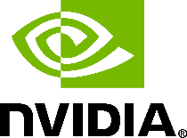




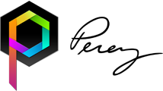










June 2022 - 37 Founding Organizations
Notes:
The Metaverse Standards Forum launched in June 2022, with 37 founding organizations that shared the vision of creating a cooperative venue for metaverse standardization – including Meta, Microsoft and Sony, games engine vendors including Epic and Unity, tools vendors such as Autodesk and Adobe, hardware vendors including NVIDIA and Qualcomm, retailers such as IKEA and Wayfair, Web3 companies including Lamina1, and standards organizations including the World Wide Web Consortium, the Open Geospatial Consortium, the Spatial Web Foundation, and the Khronos Group.

Slide 6
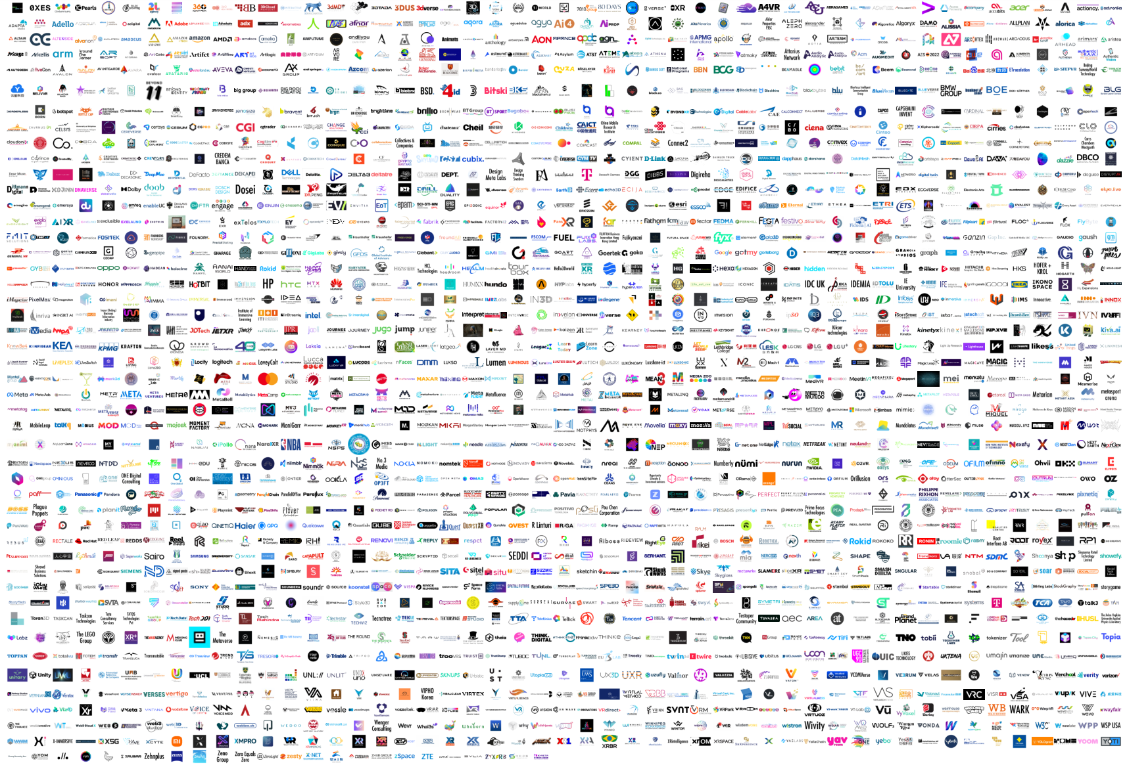
Today - Over 2400 Members and Counting
Wide diversity of organizations, including...
SDOs
Khronos, W3C, Open Geospatial Consortium, IEEE, OMI, ASWF, Spatial Web Foundation, VRM Consortium, XRSI, OMG, Open AR Cloud, OMA3 …
Platforms
Meta, Microsoft, Sony, Google, Baidu, Huawei, General Motors, RedHat, Siemens, Tencent, Mozilla, Paramount …
Tools and Engines
Epic, Unity, Adobe, Autodesk, Otoy, Maxon, Cesium, ESRI, Blackshark.ai, Croquet, Lamina1, Niantic, Ready Player Me, DGG, Manticore …
XR
HTC, Magic Leap, Nreal, Panasonic, Tobii, zSpace …
Hardware
NVIDIA, Intel, AMD, HP, Acer, Dell, Qualcomm, Samsung, Sony, MediaTek, Oppo, Lenovo, ZTE, LG …
Wireless and Networking
China Telecom, Deutsche Telekom, T-Mobile, Verizon, NTT, AT&T, Telefónica, Juniper, Comcast …
3D Commerce
Alibaba, Alvanon, Avataar, CLO, Browzwear, IKEA, VNTANA, Metaverse Fashion Council, Target, Wayfair …
Universities and Institutes
Stanford, John Hopkins, Yale (XRP), Queens University Belfast, University Salford, New York Institute Technology, APMG …
Advocacy
XRSI, AREA, XR Association, VRAR Association, XR Guild, Web3 Marketing Association, International Virtual Reality Healthcare, Swiss Institute for Disruptive Innovation, IOT Consortium, Metaverse Japan, RIAA …
Notes:
Since launch, interest in the Forum has been stronger than we ever imagined, with now over 2000 members and counting! New members include Google and General Motors, XR hardware companies such as HTC and Magic Leap, wireless operators such as China Mobile, Verizon, and T-Mobile and leading universities including Stanford, John Hopkins, and Yale, together with many leading advocacy organizations. This level of interest is a strong indication that the industry DOES believe that the metaverse needs to be based on a foundation of open standards, and that we need cooperation to build those standards effectively.

Slide 7
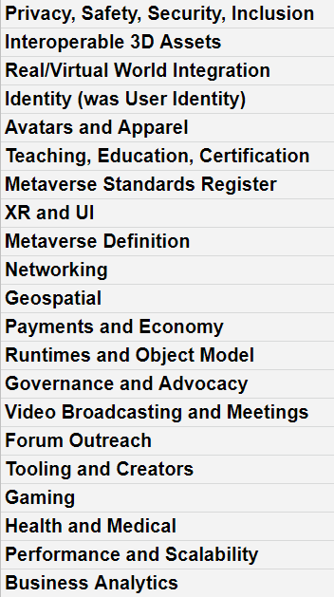
Organizing for Effective Forum Action
1. Gather interoperability Topics from all members
Online input from all members on actionable topics that need improvement today!
2. Organize Topics into Domains
Consensus on member interest AND where the Forum can add industry value
3. Create Domain Working Groups
Make recommendations and work products publicly available
Topics naturally falling into Domains
Any Forum member can propose and participate in a Domain Working Group
Forum Working Groups focus on short-term pragmatic projects to create a wavefront of business opportunities
Domain and technical reports
Use case and requirements recommendations
Pilots, testbeds and plugfests
Open-source tooling
Best practices and guidelines
Other interoperability data, insights and visibility
Etc.
Over 200 topics suggested and counting, for example..
Database of metaverse standards
Taking 3D assets between worlds
Asset LODs
glTF / USD interoperability
Avatar customization / animation
3D Apparel and Fashion
Cloth Simulation
Metaverse traversal
Geospatial ontologies
Geospatial streaming
Decentralized User ID
Ethical framework
User privacy
Child safety
Payment frameworks
Etc. etc..
Notes:
Having over 2200 members in the Forum is a unique opportunity to create widespread visibility, and drive cooperation on metaverse standards with a meaningful participation that can make a significant difference in the industry. But of course, it also creates interesting challenges to ORGANIZE for effective action and decision making. The Forum is following a three-step process to identify which topics the Forum membership wishes to focus on, to organize those topics into Domains, and then establish WORKING GROUPS to execute projects focused on solving interoperability issues IN those Domains. ALL data and results generated by Forum Working Groups will be made publicly and openly available. The Forum will prioritize Domain Working Groups with strong member expertise and where we can identify.

Slide 8
Forum Domain Group Pipeline
Metaverse Standards Register
Publicly available database mapping the landscape of metaverse-relevant standardization activities
glTF/USD 3D Asset Interoperability (visuals, behaviors)
Cooperation between USD and glTF to increase synergy and reduce duplication of effort, gaps, fragmentation and industry confusion
Real/Virtual World Integration (Digital twins, IOT)
Constructs to describe and integrate the physical world and created representations
Asset Management (web3, protection, digital rights)
Digital rights, protection, portability, access, availability
Network Requirements and Capabilities to Support Metaverse Applications
Industry requirements for seamlessly transitioning traffic on multiple wireline and wireless technologies for deploying metaverse applications at scale
Interoperable Avatars
Cross-platform avatars and characters for film, gaming, fashion and social platforms
Privacy, Cybersecurity & Identity
Recommendations for responsible innovation that mitigates human and societal harm from objective and subjective privacy risks – including cybersecurity and identity risk management
End-User Technical Troubleshooting Enabling end-users to ensure reliable metaverse experiences
3D Web Interoperability
Enable the broadest possible interoperability of Metaverse Content using the Web
Digital Fashion/Wearables
Clothing (including layering), shoes, hats, accessories
Ownership and Identity
Accessibility
Best Practices for Living and Working in the Metaverse
Academia & Research
Ethical principles for the metaverse and their implementation
Industrial Metaverse
https://metaverse-standards.org/domain-groups/
Key
Working Groups
Exploratory Groups
Exploratory Group Proposals

Slide 9
Metaverse Standards Register Working Group
Providing insights into the metaverse standardization landscape
https://register.metaverse-standards.org/
Publications and projects information
Register Database
Glossary Terms
Standards-related Publications and Projects
Pre-qualified Organizations and Groups
Standardization-related organizations
Standardization-related organizations
Standardization related organizations
Publicly-accessible searching and filtering
Approve qualified organizations
Standards Register Working Group
Glossary Terms and QA/oversight
Commencing outreach for standards organizations to apply to be qualified to enter data on their initiatives into the Register database

Slide 10


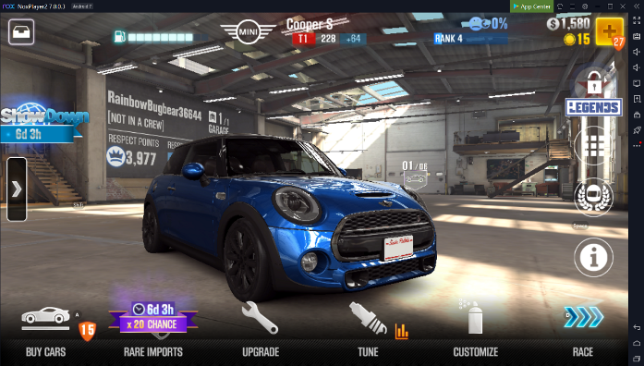














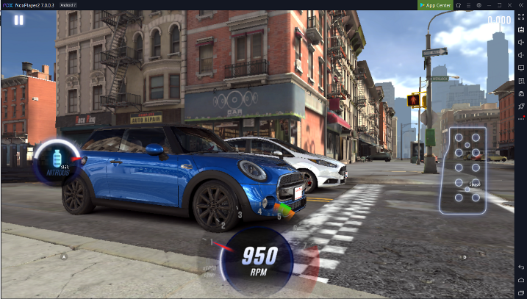


USD glTF Interoperability Potential Testbed Project
Goals
Confirm asset behaviours and attributes satisfy use cases
Test publishing and transmission pipeline
Exercise interoperable behaviours in multiple runtimes
All tool engine and platform vendors invited to participate
Whether or not they are Forum Members
Cooperative shared open-source and assets
USD-based tools Author assets and
publish into glTF
DISTILL
Web-based Configurator
Material variants
TRANSMIT
Runtime Demos
Open door, start engine Drive course with physics simulation
Tools create assets
using open standards
Run time engines ingest and process assets
Notes:
An important Forum principle is that it will focus on pragmatic, actionable, short-term projects to enhance metaverse interoperability. An example of such a high-impact project is to test the interoperability between two important 3D standards for the metaverse, USD and glTF. USD is a Pixar open-source 3D format and run time system that enables sophisticated AUTHORING of 3D content. glTF is a Khronos open standard 3D asset format that is designed for pervasive DELIVERY of 3D content, the 3D analogy to the JPEG format for images. Many 3D content pipelines will use USD to author 3D content that is then distilled to glTF for efficient run-time delivery and deployment. As both USD and glTF begin incorporating metaverse behaviors and attributes, it is becoming ESSENTIAL to test USD to glTF distillation in practice, by creating real-word assets, making them freely available, and discovering functionality and performance gaps and issues to inform the evolution of BOTH formats AND the tools and engines that use them.

Slide 11
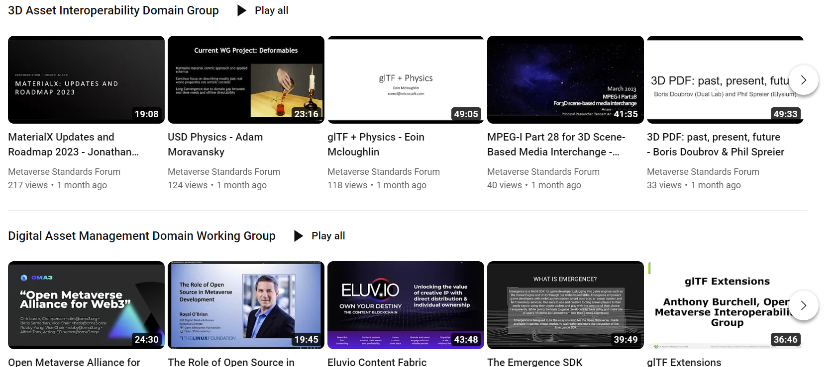
Video Presentation Library
Invited speakers at Forum Domain Groups are posted to a growing public video library https://www.youtube.com/@metaversestandardsforum

Slide 12
Forum Organization Since Incorporation
Participant Membership is free
Access to all Domain Group activities
Principal Members oversee Forum priorities and operations
Participate in Oversight Committee and elected Forum Board of Directors
Membership fees from $50 to $10K
Principal dues are waived for standards-related organizations and non-profits
No NDA or IPR Framework is needed
Forum is not a standards organization
All Forum-generated materials are made publicly available
Board Directors serve two-year terms
Advisory Panel Open to standards-related organizations
Non-voting Board meeting participation
Election
Election
Principal Members (Paid)
Nominate to stand for Board or Standards Body Advisory Panel elections
Voting participation in plenary meetings and elections
Full Domain Group participation and voting rights
Priority participation in Forum outreach and marketing
Oversight Committee Voting to manage Domain Group Pipeline
The Metaverse Standards Forum is an independent non-profit 501(c)(6) industry consortium that welcomes global participation
Dues
Participant Members (Free)
Non-voting participation in plenary meetings
Full Domain Group participation and voting rights
Participate in Forum outreach and marketing
Domain Groups Any member can propose, lead, and participate
Domain Groups Any member can propose, lead, and
Domain Groups Any member can propose, lead, and
Domain Groups Any member can propose, lead, and
Notes:
This is the structure of the Forum since we have recently incorporated. Any organization can join to become a Participant member for free to participate in any Forum Domain Groups that interest them. Organizations that wish to have a voice and vote in the management and direction of the Forum can become Principal members through paying a membership fee that scales from $50 for a single person company up to $10K for the largest corporation. Principal members may participate in oversight of the Domain Group Pipeline and stand for election and vote in Board elections. The Forum is a non-profit and so any membership dues are used to fund Forum operations and projects. To enable participation by diverse organizations, membership fees are waived for non-profits and standardization organizations – and the Forum is enabled through its bylaws to create liaisons with standards bodies that may be unable to join another organization directly.

Slide 13
Principal Dues
Principal Annual Membership dues introduced for self-sufficient funding of operations and projects
Principal fees tiered on member size to enable participation by organizations of all sizes and geographies
All Principals can cast one vote in decisions and elections, regardless of dues paid
Avoid any concerns over inappropriate ‘buying of influence’
Principal dues capped at $999 for COPPs and accredited academic institutions
COPPs and non-profits may apply for a due waiver to $0
Size and Type of Organization | Principal Dues (US$)
COPPs and Non-profits approved for Principal Fee Waiver Invited Industry Experts (individuals) and Liaison Orgs | $0
Micro Enterprises (< 10 emp. AND <$2M revenue/assets) | $50 per employee
Small Enterprises (< 50 emp. AND <$10M revenue/assets) Accredited Academic Institutions COPPs without fee waiver | $999
Medium Enterprises (< 250 emp. AND <$50M revenue/assets) | $4,999
Large Enterprises (>250 emp. OR > $50M revenue/assets) | $9,999

Slide 14
Post Incorporation FAQ
Is the Forum now going to try to ‘define and solve the metaverse’?
No! The focus remains on practical, actionable interoperability projects that can create a wavefront of short-term opportunity. We are ‘baking the open standard bricks’ for the metaverse, not trying to ‘build the whole cathedral’
Is the Forum now a new standards organization?
No, the Forum remains a unique venue to coordinate requirements and support for existing SDOs developing standards relevant to the metaverse, complementing existing standards bodies
Is the Forum competing with other metaverse-related organizations?
No! We welcome other organizations to join the Forum, and we hope that the opportunity for wider visibility and cooperation can help them further their mission
Why did Khronos acting as host and bootstrap the Forum?
Promoting industry cooperation is part of Khronos’ non-profit mission, our membership requested we help create an open, neutral forum for the benefit of all. Khronos is delighted to see the ongoing success for the Forum and for it to become an independent incorporated consortium
Now Principals pay dues, will larger companies be able to ‘buy outsized influence’?
No, Forum processes mandate on vote per organization, regardless of the size of paid dues to encourage decisions to continue to be made by consensus
Notes:
So, to begin wrapping up, I would like to re-emphasize a few key points. Firstly, the Forum is not trying ‘solve’ the whole metaverse, but is focusing on practical, actionable projects to help solve real-world interoperability issues, and create commercial opportunities TODAY - we like to say we are ‘baking the open standard bricks’ for the metaverse, not trying to ‘build the whole metaverse cathedral.’ Secondly, the Forum is not a new standards organization, it won’t create standards itself, rather it is a unique venue for enabling cooperation that we hope will enable MULTIPLE standards organizations to build standards that better meet the needs of the industry - sooner. Thirdly, there are many organizations being formed around the industry to work on metaverse topics, the Forum does not wish to compete with their good work – indeed, if any of those organizations are interested in open STANDARDS, they are welcome to join the Forum and we hope that the opportunity for wider cooperation can help further THEIR mission too. And lastly, the Khronos Group has helped bootstrap the Forum, as fostering standards cooperation is consistent with Khronos’ non-profit mission, but in Forum meetings, Khronos is happy to be just one more Forum member among many others.

Slide 15
Call for Participation in Unique Cooperative Opportunity
Broad global participation in the Forum enables a unique opportunity for metaverse standards cooperation, coordination and leadership
for Forum members to accelerate their organizations objectives https://metaverse-standards.org/
Any Forum member can propose, lead, contribute to, participate in, or monitor Domain Working Groups
Comprehensive, international gathering of industry requirements and expertise in Forum Working Groups
Wide visibility and adoption of Forum initiatives
Notes:
So, that’s the end of my presentation. Such wide participation in the Forum is providing a unique opportunity for cooperation in the industry to build the metaverse standards that we ALL need, by providing BOTH significant expertise to gather meaningful industry INPUTS and requirements AND to enable broad visibility, consensus, and adoption of Forum outputs. Any Forum member can propose, lead, participate in, or monitor Forum Working Groups that are helpful in accelerating their own objectives. We warmly invite any organization to join the Forum – for although we can’t know PRECISELY what form the metaverse is going to take, I do believe it will be far better if we build it together. Thank you!

