Slide 1
MPEG Overview
Media Web Symposium 2023 – Standards Panel

Slide 2



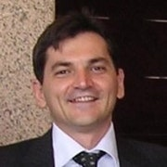




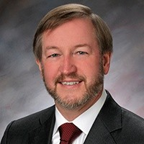



MPEG organization under ISO/IEC JTC1/ SC29
WG 5
Joint Video Coding Team with ITU
WG 7
MPEG Coding for 3D
Graphics and Haptics
Jörn Ostermann, AG2 Convenor
AG 2
MPEG Technical
Coordination
WG 2
MPEG Technical Requirements
Igor Curcio,
WG2
Convenor
Jens-Rainer Ohm, WG5 Convenor
Marius Preda, WG7 Convenor
Kyuheon Kim, AG3 Convenor
AG 3
MPEG Liaison and Communication
WG 3
MPEG
Systems
Youngkwon
Lim,
WG3
Convenor
WG 6
MPEG Audio Coding
WG 8
MPEG Genomic
Coding
Peter Schelkens, AG4 Convenor
AG 4
JPEG and MPEG collaboration
Schuyler QuackenbushWG6 Convenor
Marco Mattavelli, WG8 Convenor
WG 4
MPEG Video Coding
Lu Yu,
WG4 Convenor
Mathias Wien, AG5 Convenor
AG 5
MPEG Visual Quality Assessment
SC 29
Gary Sullivan, SC29 Chairman

Slide 3
2022
2023
2024
2025
2026
MPEG meeting:
137
138
139
140
141
142
143
144
145
146
147
148
149
150
151
152
153
6 DoF Audio
MPEG Immersive Video v.2
Dynamic Mesh Compression
Media Coding
Geometry PCC v.2 (advanced compression tools)
Compression of LIDAR
Feature-rich variable colour fonts
Video Coding for Machines
Haptics v.1
Carriage of Haptics
Open Font Format v.5
Green metadata v.3
Systems and Tools
Redundant Encoding and Packaging
Omnidirectional MediA Format (OMAF) – Server Side Dynamic Adaptation
Immersive Multi-User Interactivity
Scene Description with Advanced Interactivity
Video Decoding Interface
Delivery of 6DoF Media
Holographic media to renderers
Smart Contracts for Media
DASH v.6
File Format (ISOBMFF) v.9
Beyond Media
CMAF v.3
NNC for Multimedia v.2
Genome Compression v.2

Slide 4
Streaming Related Topics
CMAF 23000-19
Third Edition complete adding 8K HEVC, VVC and EVC
Amd.1 in progress to address LC-EVC integration
DASH
23009-1 Media presentation description and segment formats
Media Presentation Insertion for Preroll and Midroll
DASH Period Event
Non-linear playback
Addressable Ressource Index Tracks for metadata
Content Steering
23009-7 Delivery of CMAF content with DASH
Effort to align terminology and concepts across FF, CMAF and DASH
23009-9 Redundant encoding and packaging for segmented live media (REAP)

Slide 5
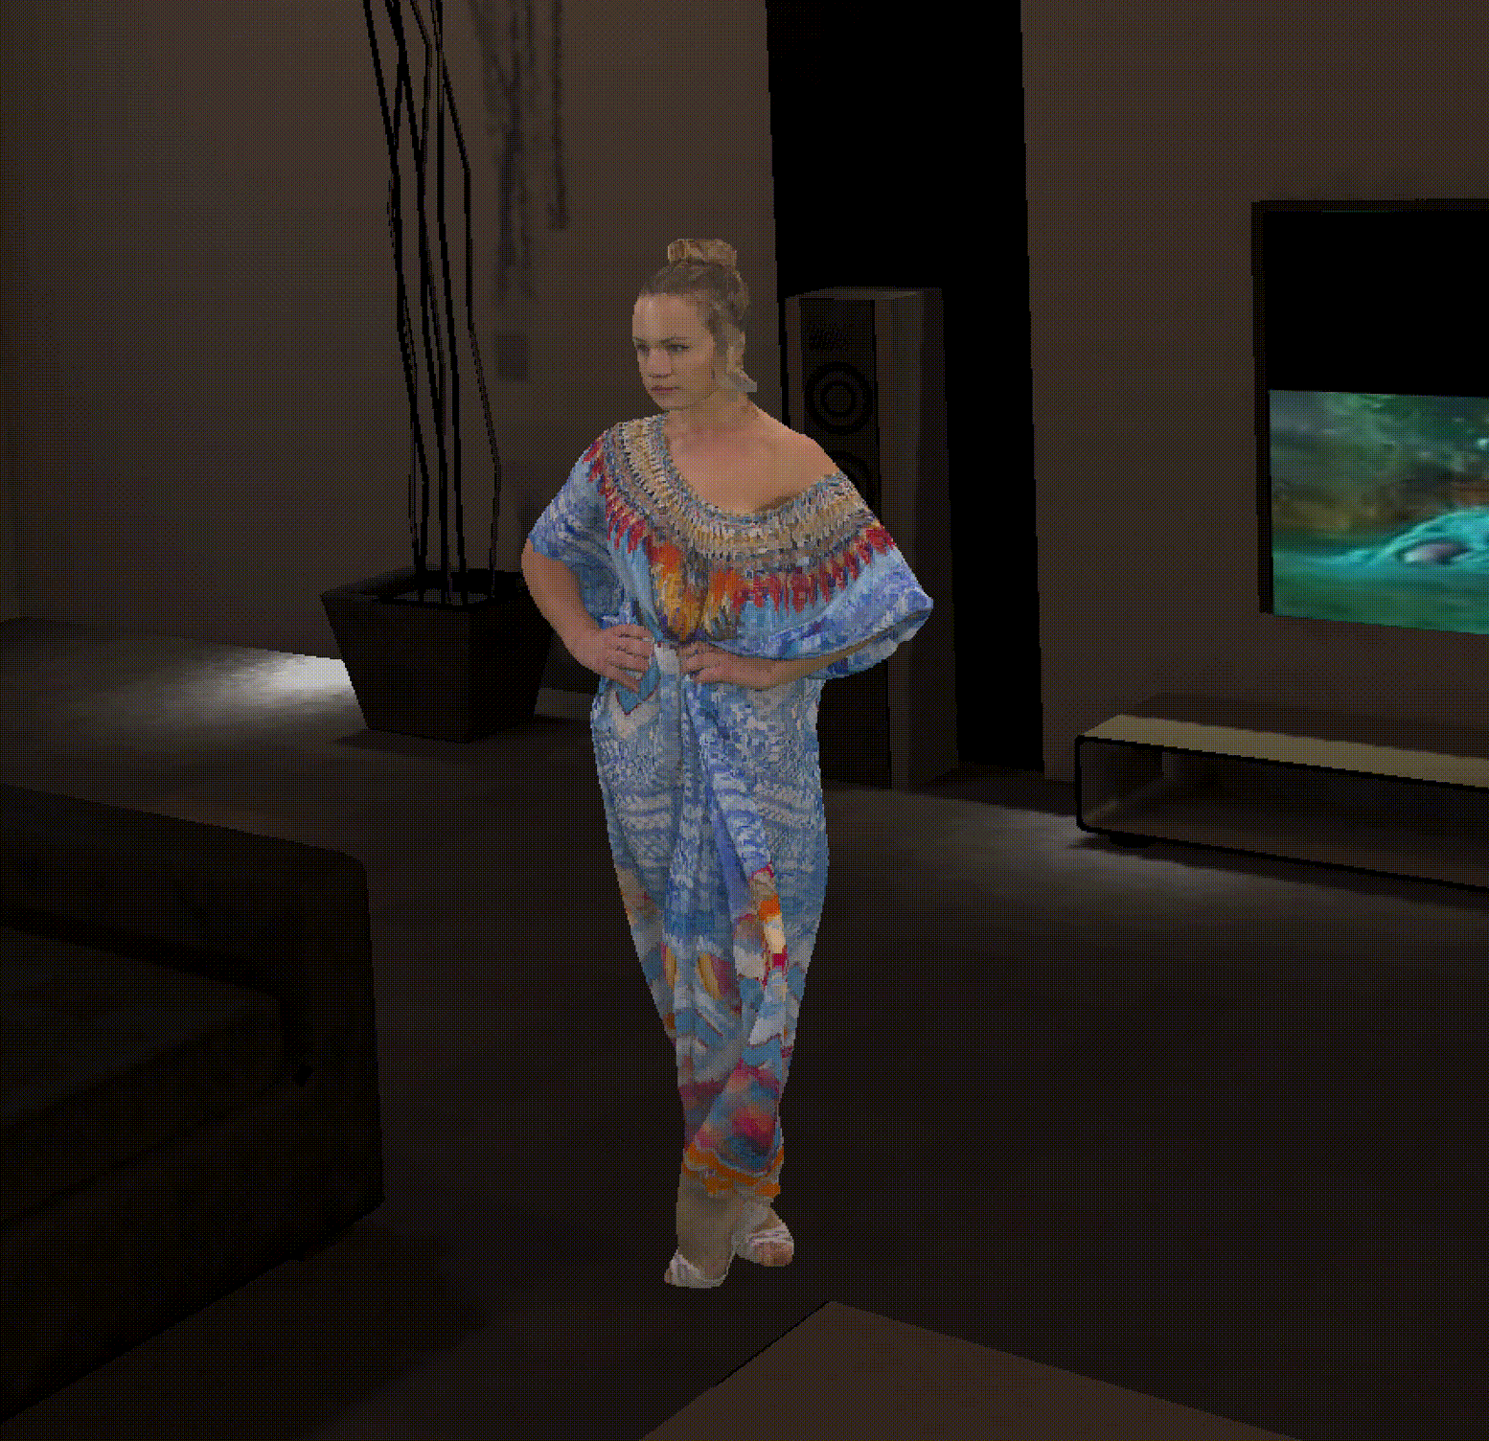
Towards the MPEG of 3D
Dynamic 6DoF Scenes
Time Dimension

Slide 6
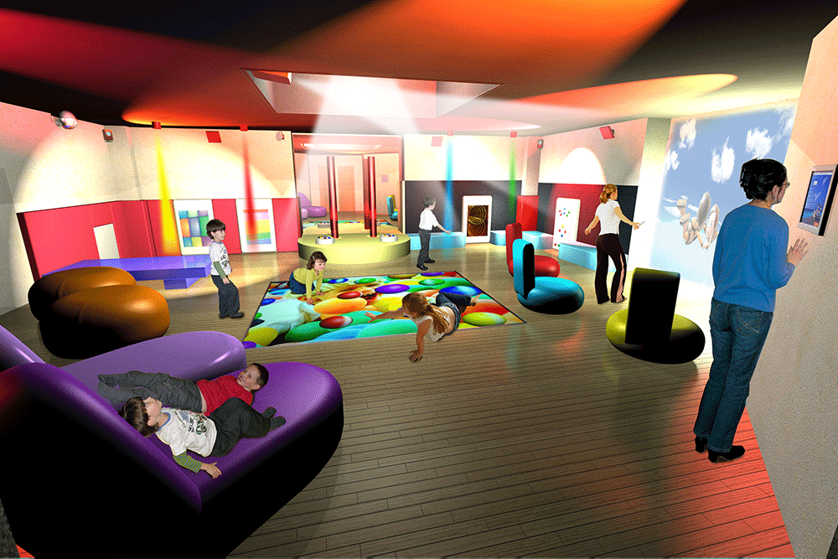
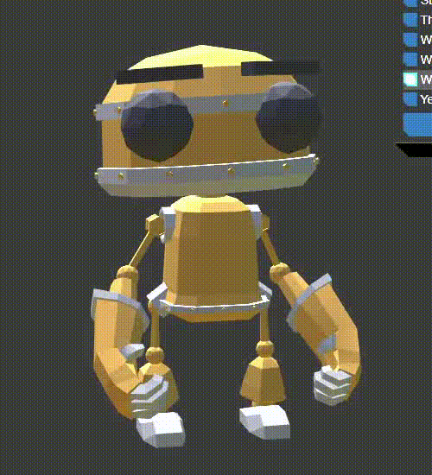
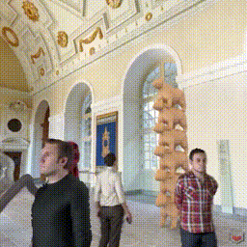
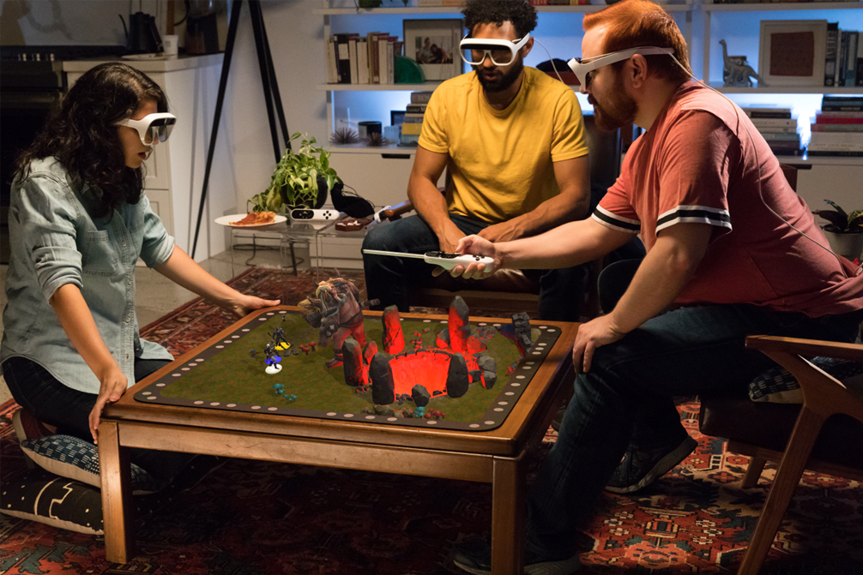
MPEG-I Standards to power the Metaverse
Scene Description
Entry point to the 3D experience
From shared experiences to 6DoF content and XR
Extensions to glTF for networked and real-time media
Immersive Audio and Haptics
Video Decoding Interface
Leverage and optimize 2D decoders for 3D and immersive media
Dynamic Point Clouds and V-Mesh
Compress 3D formats such as point clouds and dynamic meshes
MPEG Immersive Video
Support multi-view and light field displays
Video Compression
AI/ML-based and VCM
H.267/ECM
Avatar
Interactivity
AR Anchoring

Slide 7
Ressources and more reading
Public web site https://www.mpeg.org/
Standards: https://www.mpeg.org/standards/
Published by ISO/IEC and generally
Meetings: https://www.mpeg.org/meetings/
MPEG#142 - April 2023, Antalya, Turkey
MPEG#143 – July 2023, Geneva, Switzerland
MPEG#144 – October 2023, Hannover, Germany
MPEG#145 – January 2024, online
White Papers https://www.mpeg.org/whitepapers/

