Slide 1




glTF 2.0 Extensions in MPEG and 3GPP – Real-time exchange formats for 3D Experiences
7/13/2023
Imed Bouazizi
Thomas Stockhammer

Slide 2

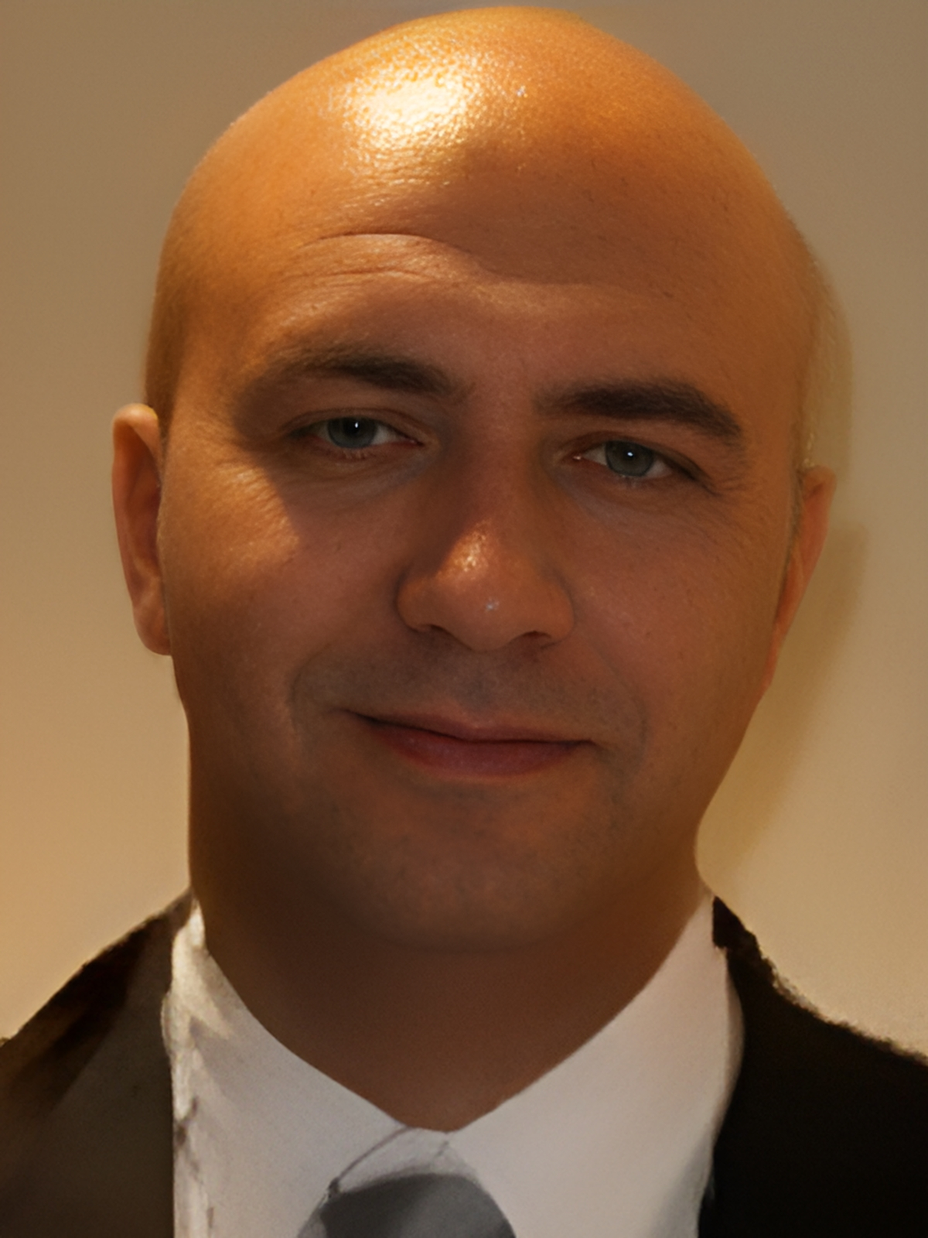


Today’s agenda
# Some Motivation: Use Case and Solution
# Immersive exchange format considerations
# MPEG Immersive Architecture
# MPEG extensions to glTF 2.0
# Demo
# MPEG phase 2 extensions
Presenter
Dr. Imed Bouazizi
Director, Technical Standards, Qualcomm
Delegate to 3GPP SA4, MPEG, and Khronos
Dr. Thomas Stockhammer
Senior Director, Technical Standards
Qualcomm Europe, Inc., IEEE Fellow
Leading and driving among others
MPEG: MPEG-I, CMAF and DASH
3GPP: XR over 5G, 5G Video, 5GMS
DASH-IF, CTA WAVE: Interop WG, Test
DVB, ETSI & 5G-MAG: 5G Broadcast and 5GMS
Metaverse Standards Forum Lead

Slide 3
Selected Use Cases and Designs for Portable Dynamic 3D Scenes
(among others, inspired by 3GPP use cases)

Slide 4
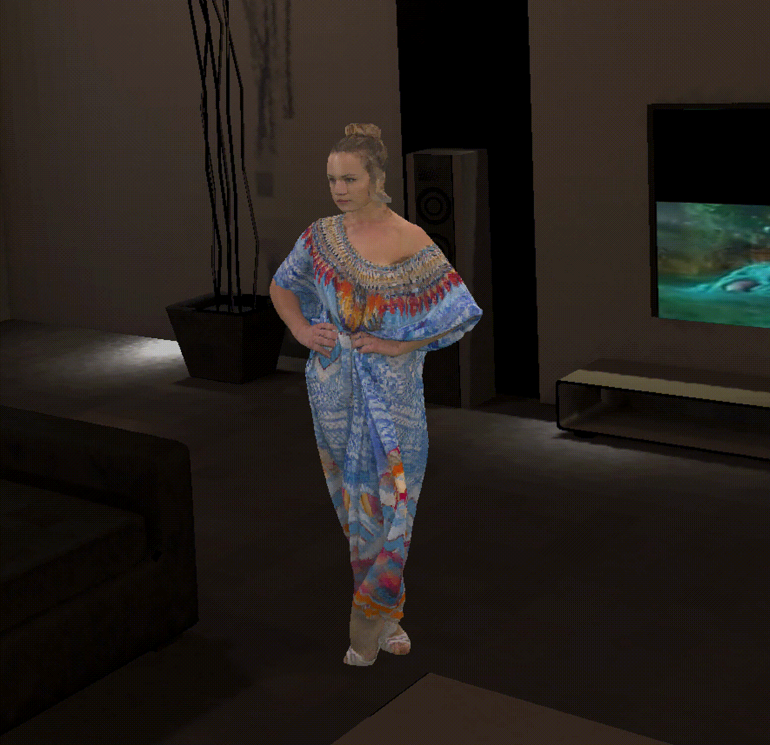
Use Case 1 – Accessing Dynamic and Interactive 3D Scenes for AR/MR/VR
Examples: Live Entertainment, Movies, Games, etc.
Typically,
Collection of static and dynamic objects to be accessed and presented in parallel
huge volume and data sizes
Interactive and immersive
Different media types
Access through download, or preferably smart streaming
Adaptation to device capabilities

Slide 5
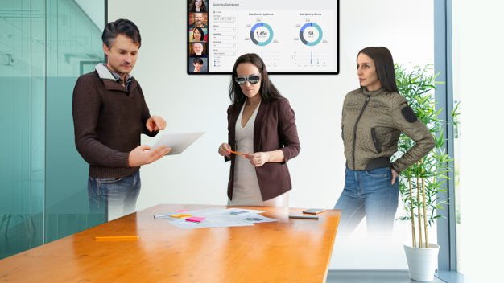
Use Case 2 - AR Call/Conferencing
Extend existing IMS and WebRTC-based telephony services
Multi-party calls and conferencing with AR
Users join with realistic avatars and contribute 2D/3D content
Create shared spaces where call participants can interact

Slide 6
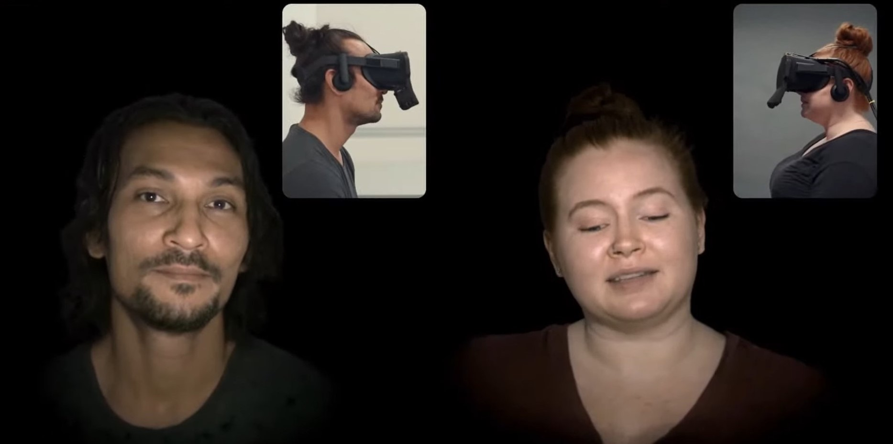

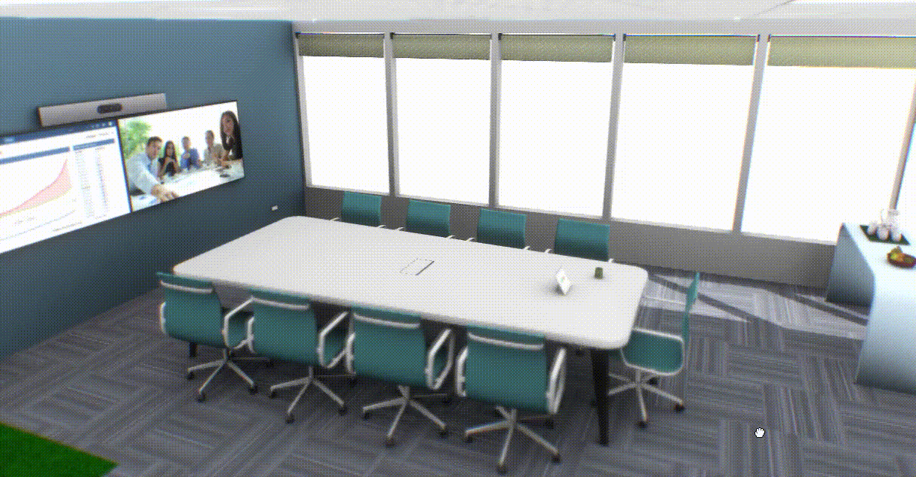
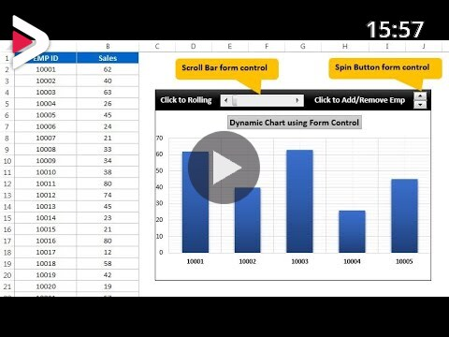
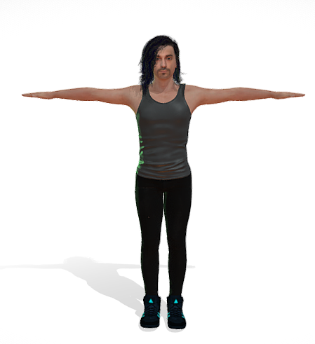
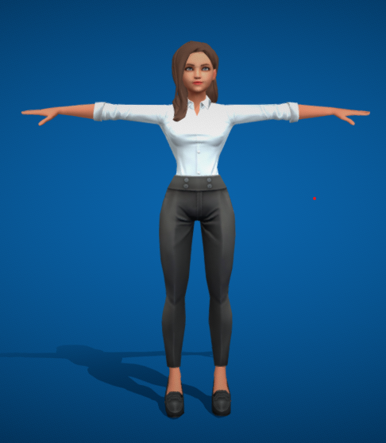
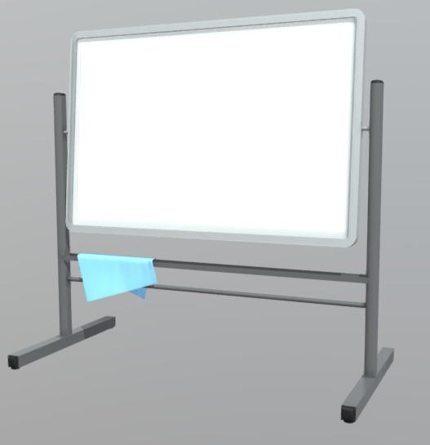
High Level Procedure
Scene of shared space
Scene of shared space
Add nodes to scene
Add nodes to scene
Send scene updates
Send scene updates
Pose and animation updates
Pose and animation updates
Update
Loop
Send scene updates
Send scene updates

Slide 7
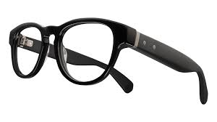











3GPP Baseline Architecture for AR/MR
Eye Tracking + Camera/Sensor Aggregator
SoC Media
Defining baseline requirements for an lightweight AR and XR device
Connectivity
Requirements include
OpenXR Core APIs
rendering capabilities
capturing capabilities
audio and video codecs
scene description
Wire formats for metadata
Profiles for split rendering and stand-alone rendering
Additional work
Split Rendering
XR Metrics
5G system optimizations for XR QoS and power consumption
Hinge

Slide 8



A distributed compute architecture enables rich XR user experience
Application
Perception algorithms
Post processing (ATW, error concealment, …)
6DoF HMD pose, controller, eye/hand tracking
Game engine
Motion-to-render-to-photon latency
M2R2P
Interop for Split Rendering
Encoder
Decoder
Compressed rendered frames
M2R2P = Edge processing + 5G round-trip time + Device processing
Entry format needed to setup split rendering workflows
Notes:
A distributed compute architecture enables rich XR user experience
So how does boundless XR work in reality? Boundless XR distributes the computation between edge cloud server and device to deliver truly immersive XR over 5G.
The XR headset provides power-efficient, latency-sensitive on-device rendering and tracking.
The Edge cloud server provides computationally intensive processing and graphics rendering.
5G provides the high bandwidth and low latency connectivity.

Slide 9
Interchange Formats for Portable Dynamic and Interactive 3D Scenes
MPEG is developing core compression and representation formats and the distribution/system integration of those

Slide 10







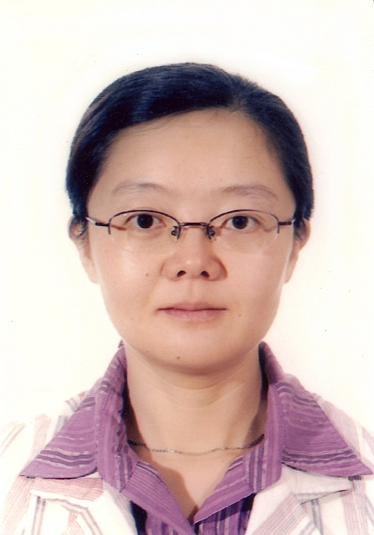




MPEG organization under ISO/IEC JTC1/ SC29
WG 5
Joint Video Coding Team with ITU
WG 7
MPEG Coding for 3D
Graphics and Haptics
Jörn Ostermann, AG2 Convenor
AG 2
MPEG Technical
Coordination
WG 2
MPEG Technical Requirements
Igor Curcio,
WG2
Convenor
Jens-Rainer Ohm, WG5 Convenor
Marius Preda, WG7 Convenor
Kyuheon Kim, AG3 Convenor
AG 3
MPEG Liaison and Communication
WG 3
MPEG
Systems
Youngkwon
Lim,
WG3
Convenor
WG 6
MPEG Audio Coding
WG 8
MPEG Genomic
Coding
Peter Schelkens, AG4 Convenor
AG 4
JPEG and MPEG collaboration
Schuyler QuackenbushWG6 Convenor
Marco Mattavelli, WG8 Convenor
WG 4
MPEG Video Coding
Lu Yu,
WG4 Convenor
Mathias Wien, AG5 Convenor
AG 5
MPEG Visual Quality Assessment
SC 29
Gary Sullivan, SC29 Chairman

Slide 11
2022
2023
2024
2025
2026
MPEG meeting:
137
138
139
140
141
142
143
144
145
146
147
148
149
150
151
152
153
6 DoF Audio
MPEG Immersive Video v.2
Dynamic Mesh Compression
Media Coding
Geometry PCC v.2 (advanced compression tools)
Compression of LIDAR
Feature-rich variable colour fonts
Video Coding for Machines
Haptics v.1
Carriage of Haptics
Open Font Format v.5
Green metadata v.3
Systems and Tools
Redundant Encoding and Packaging
Omnidirectional MediA Format (OMAF) – Server Side Dynamic Adaptation
Immersive Multi-User Interactivity
Scene Description with Advanced Interactivity
Video Decoding Interface
Delivery of 6DoF Media
Holographic media to renderers
Smart Contracts for Media
DASH v.6
File Format (ISOBMFF) v.9
Beyond Media
CMAF v.3
NNC for Multimedia v.2
Genome Compression v.2

Slide 12
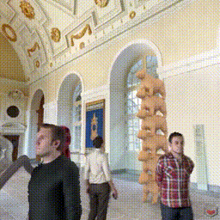
From MPEG-I to Dynamic Scenes
MPEG-I is a collection of representation formats for 2D and 3D objects of different media type
Included technologies in MPEG-I ISO/IEC 23090
File and application formats with metadata
Immersive Audio and Haptics
Video Decoding Interface
Leverage and optimize 2D decoders for 3D and immersive media
Dynamic Point Clouds and V-Mesh
Compress 3D formats such as point clouds and dynamic meshes
MPEG Immersive Video
Support multi-view and light field displays
2D Video Compression
H.266/VVC
AI/ML-based and VCM
H.267/ECM
MPEG studied different options in 2019 for Scene Descriptions, including defining its own.
Portable, Dynamic and Interactive 3D Scenes
Scene Description
How?

Slide 13



Choosing the right format - Considerations
Last Mile
Exchange
Low Complexity
Flat Hierarchy
Compressed components
Adaptive and network friendly
Support for Texture/Light Baking
High fidelity
Superstructure
Hierarchical
Distributed
Preserves author’s intents/choices
Documents authoring process
Lossless
Preserves asset’s metadata/versioning
Last Mile
Exchange

Slide 14
From glTF to Dynamic Scenes
glTF is a standard file format for three-dimensional scenes and models. An open standard developed and maintained by the Khronos Group, it supports 3D model geometry, appearance, scene graph hierarchy, and animation. It is intended to be a streamlined, interoperable format for the delivery of 3D assets, while minimizing file size and runtime processing by apps. As such, its creators have described it as the "JPEG of 3D."
Portable, Dynamic and Interactive 3D Scenes
Time Dimension
How ???

Slide 15

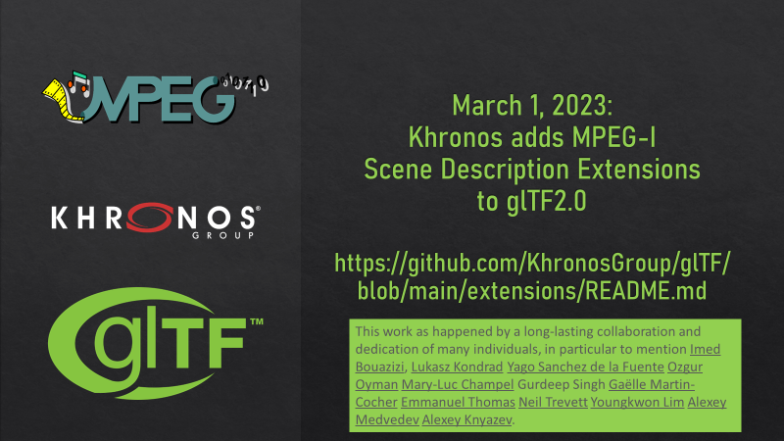
The Idea: Combine glTF and MPEG-I ...
... in order to create the "HTML-5 for XR/Metaverse"
Multimedia Elements
are built-in in HTML5
no plug-ins needed
Streaming and DRM content
Mobile support
User’s Geographical Location
Simplicity
Re-use of hardware codecs
Client Server Communication
full duplex communication client/server
web sockets/webRTC
Advanced Scripting
JavaScript support
Multi-Threading, etc.
Combining glTF and MPEG-I is addressed in MPEG-I Scene Description ISO/IEC 23090-14
Entry point document to the 3D experience
From shared experiences to 6DoF content and XR
Extensions to glTF for networked and real-time media

Slide 16
MPEG Immersive Media Architecture

Slide 17
Interfaces

Slide 18
Scene Description Architecture
MAF API
scene description document
Buffer
API
Buffer
API
Buffer Management
Buffer
Cloud
Media Access Function
Presentation Engine
Media
Requests
pipeline
Buffer
pipeline
Media
Access
…
Local Storage
Buffer
pipeline
Synchronization
Rendering

Slide 19
Media Access Function (MAF) API
Media Access Function API
Media Resource References
Timing Information
Spatial Information
Media consumption information
Sync Information
Shader Information
Support for wide range of formats through Plugins
Endpoint for the Media Access Function API
Optimized Media Fetching
Random spatial and temporal access
Partial delivery matching Presentation Engine needs
Integration with Cloud and Edge media processing
Presentation Engine
i-m Interface
Manifest, Index, …
Cloud
Protocol Plugin
Media
Access
Function
Format Plugin
Decoder
Circular Buffer
Media Requests
Sync
Rendering
Local Storage

Slide 20
Media Pipelines
The MAF instantiates and manages Media Pipelines
A media pipeline typically handles content of an attribute/component of an object/mesh
It produces content in the format indicated by the glTF file
The formatted frame is then pushed into the circular buffer
Media Pipelines are highly optimized and customized for the type and format of media that is being fetched
Media Pipeline maintains sync information (time and space) and passes that information as buffer metadata
MAF API
Media Access Function
Buffer API
Buffer
Presentation Engine
Media Pipeline
Attribute Stream
Media Decoder
Processing

Slide 21
MPEG-I Scene Description

Slide 22
Node Hierarchy
scene
MPEG_scene_dynamic
MPEG_media
MPEG_viewport _recommended
MPEG_animation_timing
camera
node
light
MPEG_audio_spatial
MPEG_audio_spatial
Core Extensions
mesh
texture
material
MPEG_mesh_linking
MPEG_texture_video
animation
accessor
technique
source
image
skin
MPEG_accessor_timed
program
bufferView
buffer
shader
MPEG_buffer_circular

Slide 23
External Media References
MPEG_media extension
{ "extensions": { "MPEG_media": { media: [ { "name": "source 0", "renderingRate": 25.0, "timeOffset": 0.0, "autoplay": "true", "loop": "true", "alternatives": [ { "mimeType": "application/dash+xml", "uri":”https://www.foo.com/manifest.mpd", "tracks": [ { "track": "#track=1" } ] } ] } ] } } }
Top-level extension to glTF 2.0
Allows referencing all types of media
Timed and non-timed
Compressed and non-compressed
MPEG and non-MPEG
It supports different types of delivery
DASH & CMAF
WebRTC
HLS & CMAF
Local Storage (ISO BMFF, MP4)
Orthogonal Functions: encryption,etc.
This extension decouples Media Access Function from Presentation Engine in the Scene Graph

Slide 24
Describing how to access data
MPEG_accessor_timed and MPEG_buffer_circular extensions
Circular Buffer
glTF accesses data through accessors
They define the components of the data and their data types (e.g. a VEC3 of floats)
Semantics are provided by the referencing attribute/property (e.g. position)
The accessor points into a bufferView, which defines how the data is packed in the referenced buffer
No support for timed data
MPEG_accessor_timed
Extension to accessor
Used to access all types of dynamic and timed media (audio, visual, volumetric, …)
Backwards compatible: in case of no support, fallback to static data
MPEG_buffer_circular
Extension to buffer
Dynamic variable-size swap chain buffer for exchange of media data for rendering
Acts as the interface between the Presentation Engine and MAF. All requested data through MAF API is delivered through a Buffer or Circular Buffer
Header is used to propagate metadata such as timestamps
Circular Buffer references MPEG_media
read pointer
buffer 0
buffer 1
x
buffer 7
buffer 2
buffer 6
buffer 3
buffer 5
buffer 4
write pointer

Slide 25
Static Buffer Usage
buffer {0}
byteLength:1024
data
bufferView {0}
buffer:0
byteOffset:0
byteLength:512
bufferView {1}
buffer:0
byteOffset:512
byteLength:512
accessor
bufferView:0
componentType: 5120 (BYTE)
count: 512
type: "SCALAR"
accessor
bufferView:1
componentType: 5126 (FLOAT)
count: 32
type: "VEC4"
meshes, skins, and animations etc.

Slide 26
Dynamic Buffer Usage
buffer {0}
byteLength:1024
MPEG_buffer_circular
source:0
MPEG_media
media[
{ …
mimeType:”application/dash+xml”
uri: https://foo.net/foo.mpd
…},
{ …
mimeType:”application/mp4”
uri: /local/file.mp4
…}
]
header
data
bufferView {0}
buffer:0
byteOffset:0
byteLength:512
bufferView {1}
buffer:0
byteOffset:512
byteLength:512
accessor
bufferView:1
componentType: 5120 (BYTE)
count: 512
type: "SCALAR”
MPEG_accessor_timed
immutable:FALSE
bufferView:0
MPEG_texture_video
MPEG_audio_spatial
MPEG_mesh_linking
MPEG_viewport_recommended
MPEG_animation_timing

Slide 27
Timed accessor header infromation
Mutable Information in Buffer View and Accessor
Accessor information that may change over time
componentType
bufferView
type
normalized
byteOffset
count
max
min
bufferView information that may change over time
bufferViewByteOffset
bufferViewByteLength
bufferViewByteStride

Slide 28
Video Textures
MPEG_texture_video extension
Materials in the scene may make use of textures
A texture in glTF 2.0 only supports references to images of format JPEG or PNG
MPEG_texture_video adds support for dynamic textures such as atlases
Point into a timed accessor instead of an image
Keep the image pointer as fallback
To support dynamic atlases, texture coordinates themselves are dynamic and fed through a timed accessor as well
{ "textures": [ { "sampler": 0, "source": 1, "extensions": { "MPEG_texture_video": { "accessor": 2, "width": 2048, "height": 2048, “format": "RGB" } } } ] }

Slide 29
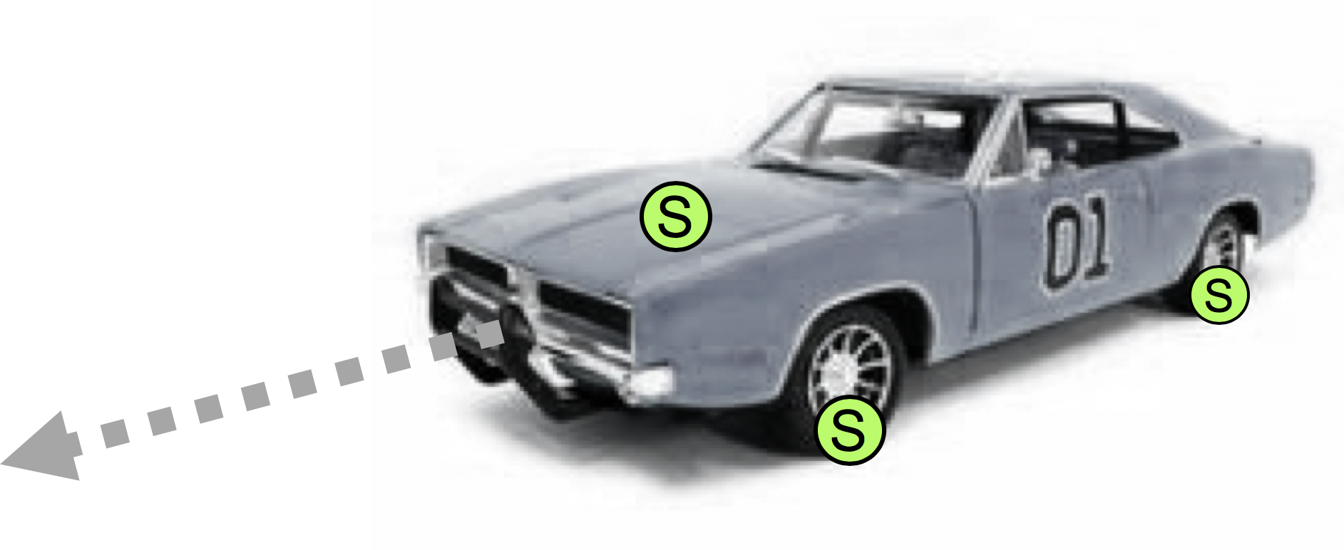
Spatial Audio
MPEG_audio_spatial extension
glTF has no support for audio
The MPEG_audio_spatial extension:
Audio Sources can be coupled to visual nodes to share the same transformations
Supports 3 types of nodes:
Audio Source: emits audio signals. Simple mono and HOA sources are supported
Audio Effect: a reverb zone effect is currently supported
Audio Listener: provides the position of the listener
The Audio Listener may be linked to the scene camera to allow for an immersive spatial experience. The listener will move together with the camera.
Actual rendering is not defined.
It is up to the Audio Rendering Engine to convert the signals that are received at the audio listener into a format that matches the actual speaker setup.
For example, binauralization is done for users wearing an HMD.

Slide 30
Other extensions
MPEG_scene_dynamic
Provides the possibility to indicate that the scene description document will be updated
Updates are provided through JSON patch protocol
Patch sample is an atomic update operation (all patch operations part of one transaction)
Consistency/Validity of scene after application of a patch is the responsibility of the author
MPEG_viewport_recommended
provides dynamically changing information which includes translation and rotation of the node which includes the camera object, as well as the intrinsic camera parameter of the camera object.
MPEG_animation_timing
provides alignment between MPEG media timelines and animation timeline defined by glTF 2.0

Slide 31
Demo Unity Player

Slide 32
MPEG-I Scene Description Phase 2 Extensions

Slide 33
New Phase 2 Extensions
scene
MPEG_scene_anchor
MPEG_scene_interactivity
node
light
MPEG_node_anchor
MPEG_light_texture_based
camera
MPEG_node_interactivity
MPEG_haptic
MPEG_media
MPEG_node_avatar
MPEG_material_haptic
texture
mesh
animation
material
accessor
sampler
image
skin
technique
bufferView
program
buffer
shader

Slide 34
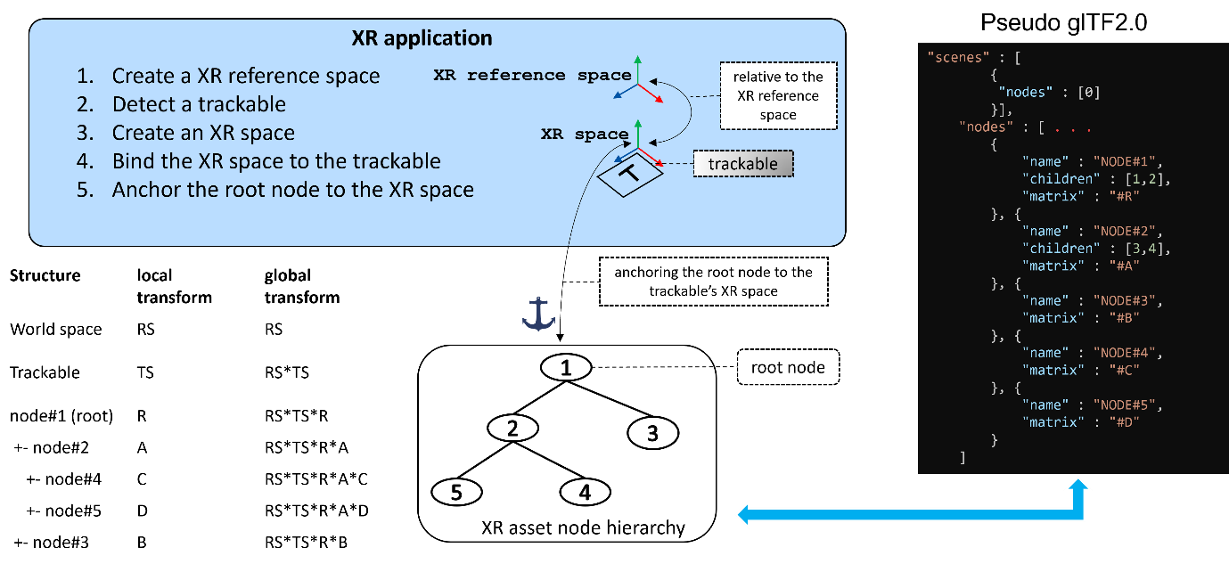
AR Anchoring
Extension to allow anchoring a scene or a root node to a trackable
Trackables can be reference trackables or application-defined trackables

Slide 35
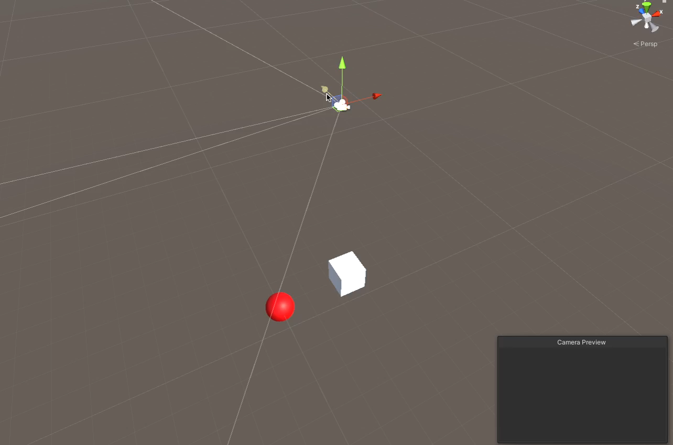
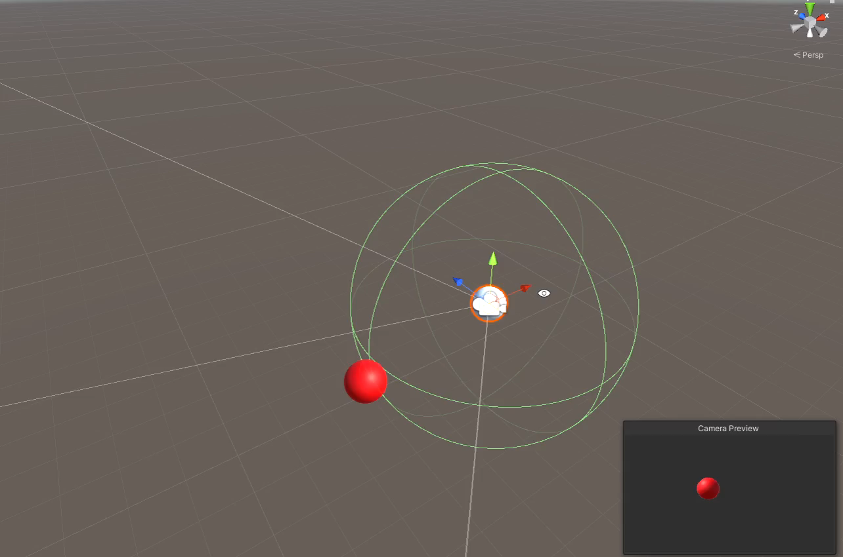
Interactivity
Simple Trigger-Action interactivity
Triggers: collision, proximity, user input, visibility
Actions: activate, transform, block, animation, media, manipulate, set material, set haptic

Slide 36
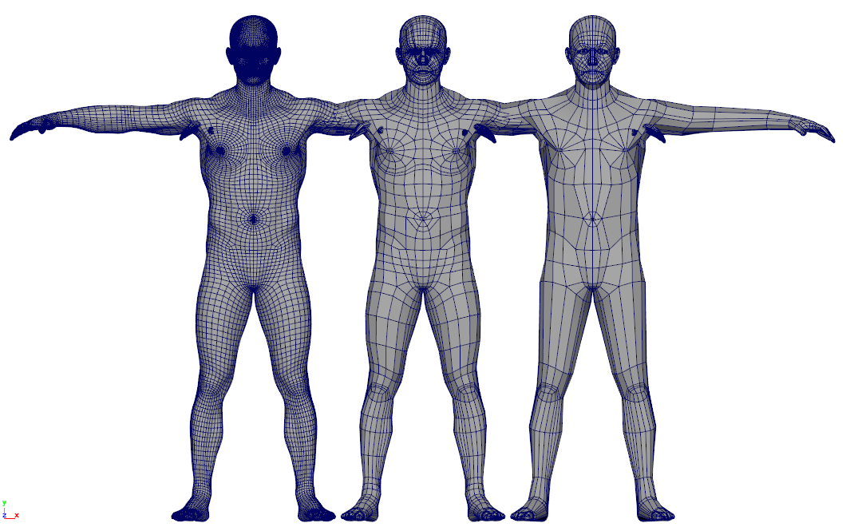
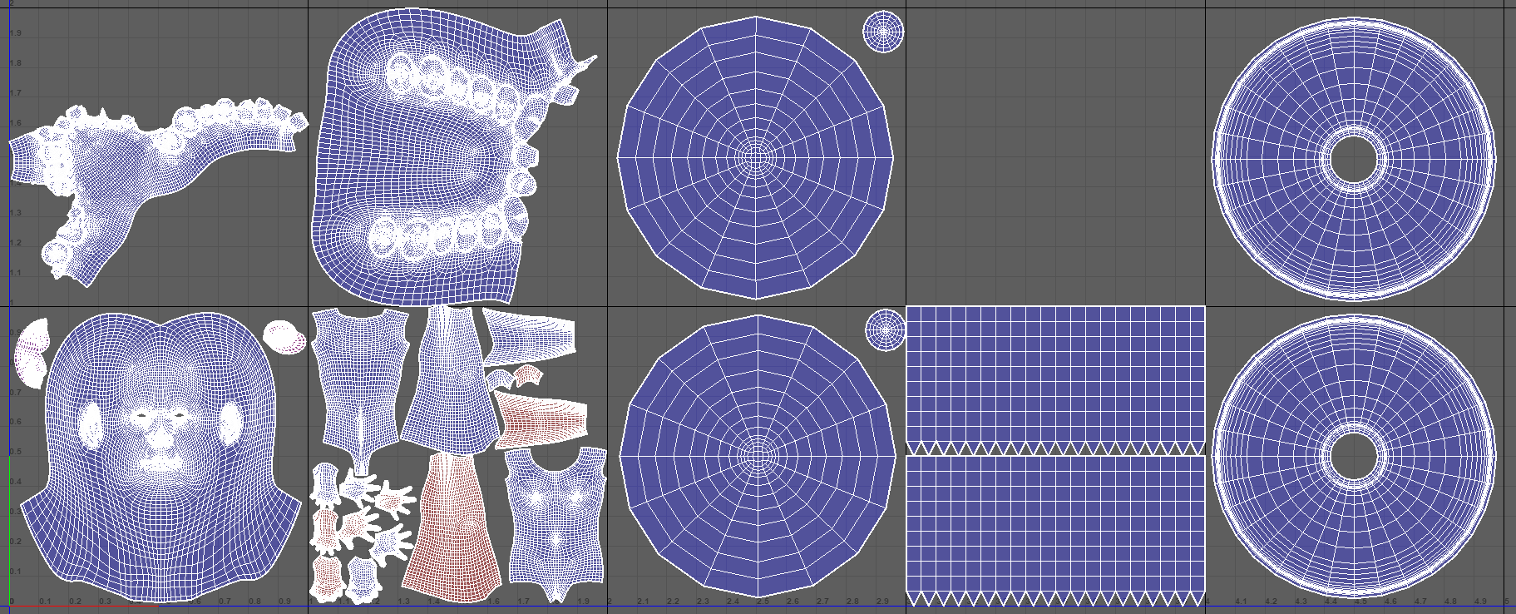
Avatars
Reference avatar with UV maps and Blendshapes
Extension to signal nodes that carry Avatars and their breakdown
Interactivity triggers can be associated with certain segments of the Avatar, e.g. hand
Avatars may result from real-time animation streams

Slide 37
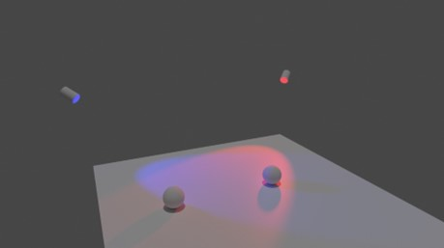

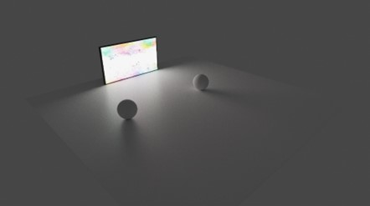
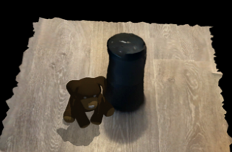
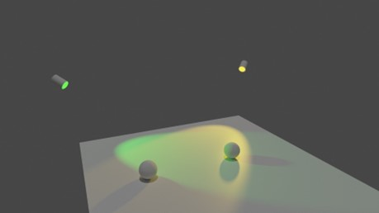

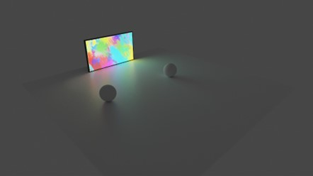
Dynamic Lights
real table
virtual
teddy bear
real speaker
time-evolving punctual light
time-evolving environment light
time-evolving area light
Coherent real/virtual lighting for AR applications

Slide 38
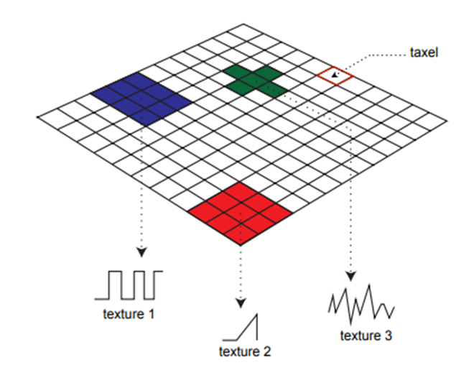
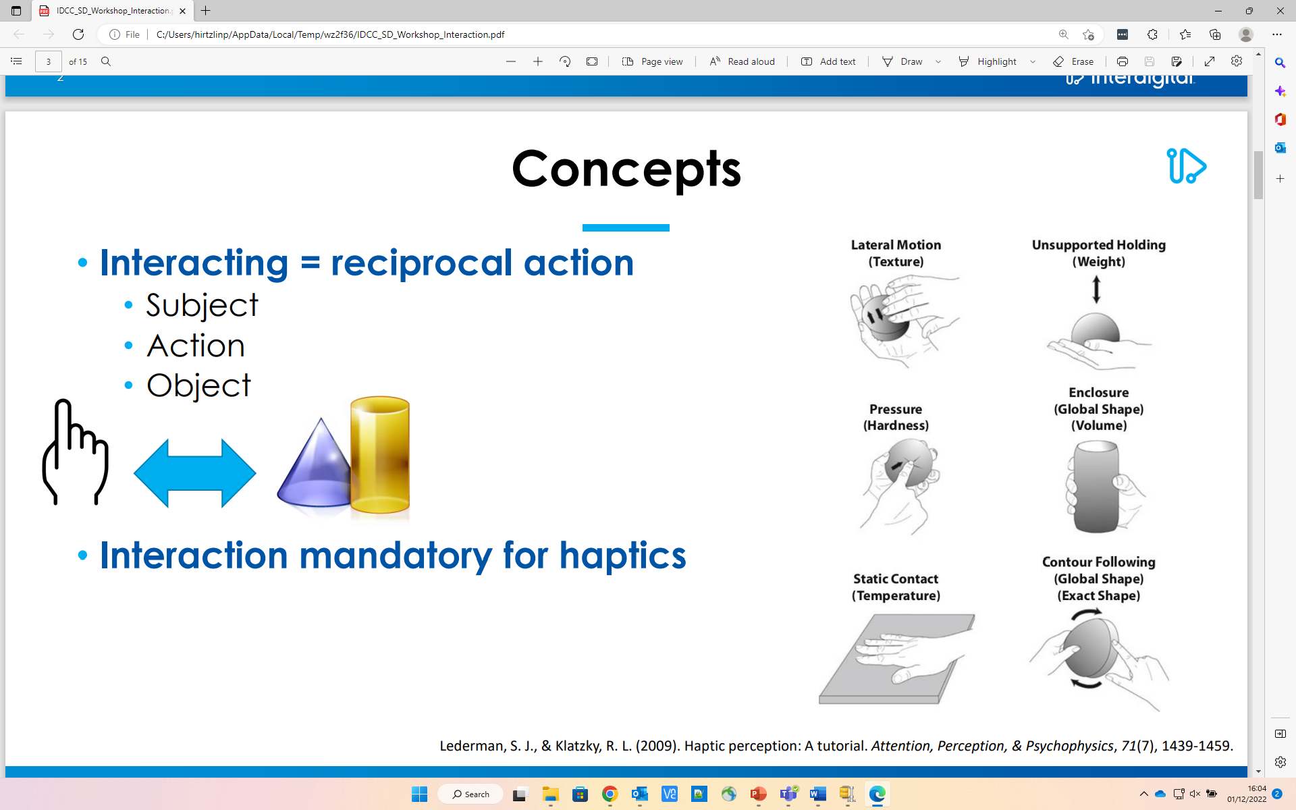
Haptics
Extension to define Haptics materials
Integrates with Interactivity
Supports: stiffness, friction, vibrotactile, temperature, vibration, and custom haptic maps

Slide 39
References
MPEG Vendor Extensions
https://github.com/KhronosGroup/glTF/tree/main/extensions/2.0/Vendor
GitHub Repo for collecting issues
https://github.com/MPEGGroup/glTF
MPEG-I Scene Description Whitepaper
https://www.mpeg.org/wp-content/uploads/mpeg_meetings/140_Mainz/w22138.zip
Reference Player:
Will be available soon
https://www.5g-mag.com/reference-tools

Slide 40
Questions

