Slide 1


DVB & 5G Broadcast: A dynamic duo
Moderator: Thomas Stockhammer (Qualcomm)
Presenters:
Johann Mika (Big Blue Marble/ORS)
Javier Rodriguez Fernandes (Qualcomm)

Slide 2
Overview
Intro: 5G Broadcast at IBC#2025
5G Broadcast: Challenges from an operator POV (Johann)
DVB-T2 and 5G Broadcast on the same carrier (Javier)
Latest performance updates including TFI (Javier)
Demo (Johann and colleagues)

Slide 3

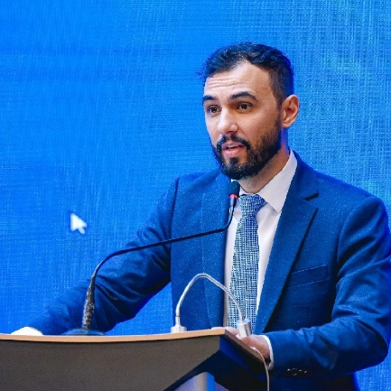





5G Broadcast - Ready for launch?
Where: Main IBC Conference Center Room E102
When: Saturday, September 13, 12:15 - 13:00
#FMT

Slide 4






Multi-vendor Interoperability
Infra vendor
SOC vendor
BNO
Consumer
Johann Mika
CINO @ Big Blue Marble/ORS
Device vendor
Broadcaster Content Owner

Slide 5


Multi-Player Business Model
Infra vendor
SOC vendor
BNO
Aytac Biber
Qualcomm Product Management
Consumer
Device vendor
Broadcaster Content Owner
Markus Schneider
5G BC Business TF Media Broadcast

Slide 6
POPULATION COVERAGE PLANNING EU MARKETS COMBINED
Content Provider’s customers
78%
5G BC Pop Coverage
OEM Devices
125M*
39,2M**
*
All numbers are assumptions of major BNOs in their countries, based on the precondition of market readiness.
* Numbers for Italy refer to the pre-commercial transmissions started in 2024. No concrete plans yet in Italy.
** Current reports indicate that 40% of all streaming is performed on mobile devices

Slide 7
Outlook for Silicon and Commercial Device
5G Broadcast is considered a new feature for 3GPP cellular modem
No plan for broadcast-only silicon, feature is added to cellular modem
Major development to add bands, new numerology, concurrency etc.
Forward looking, feature only available with new released devices
Initial targets are Mobile and FWA devices with integrated and standalone modems
Feature scoping is underway
Business Case Development
Secure alignment with mobile OEMs on commercial feature set and availability
Launch timeline (Contingent on OEM alignment)
On track to support first wave of mobile devices in Q1/28
Test devices will be available to OEMs in Q3/27
Flagship phone models in first year
Waterfall to mid and low tier phone SOCs following years
Also, waterfalling to verticals like automotive
based on receiver profile established by 5G-MAG

Slide 8


Frederico Siqueira (Minister of Communications of Brazil)
Wilson Wellisch (Secretário Nacional de Comunicação Social Eletrônica do Ministério das Comunicações)

Slide 9

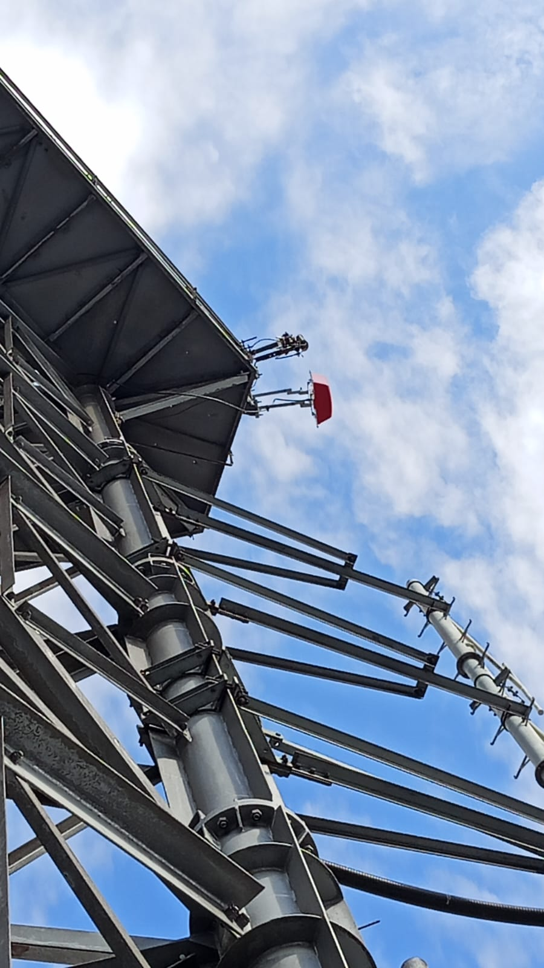
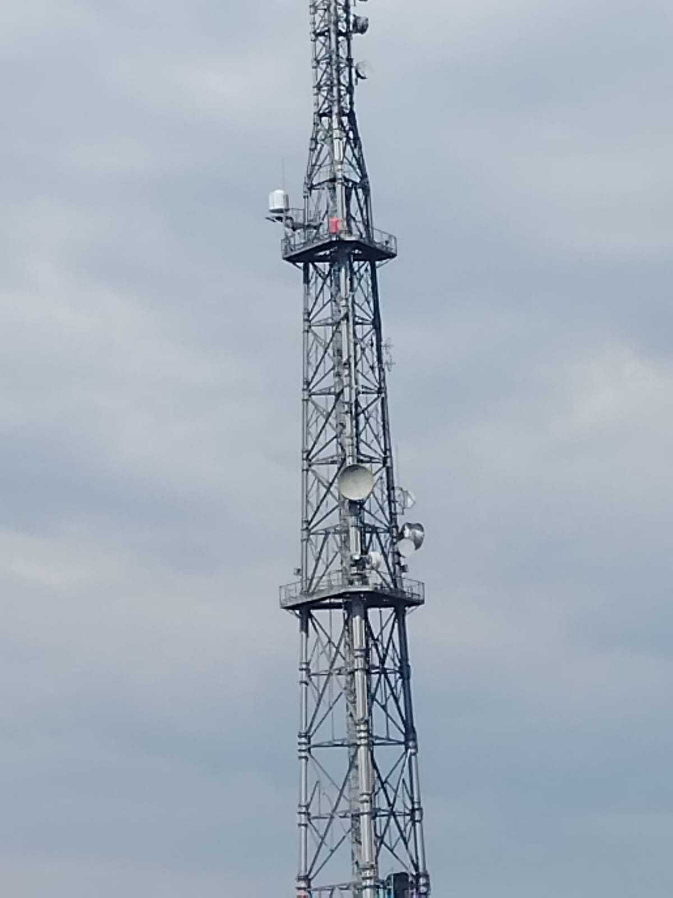
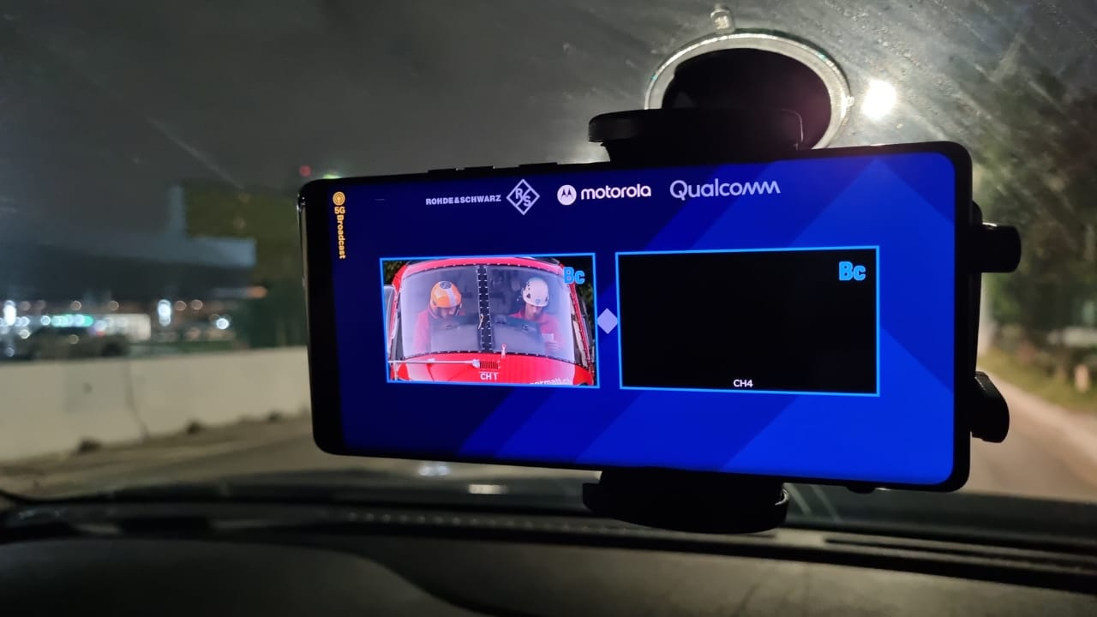
5G Broadcast Tests

Slide 10
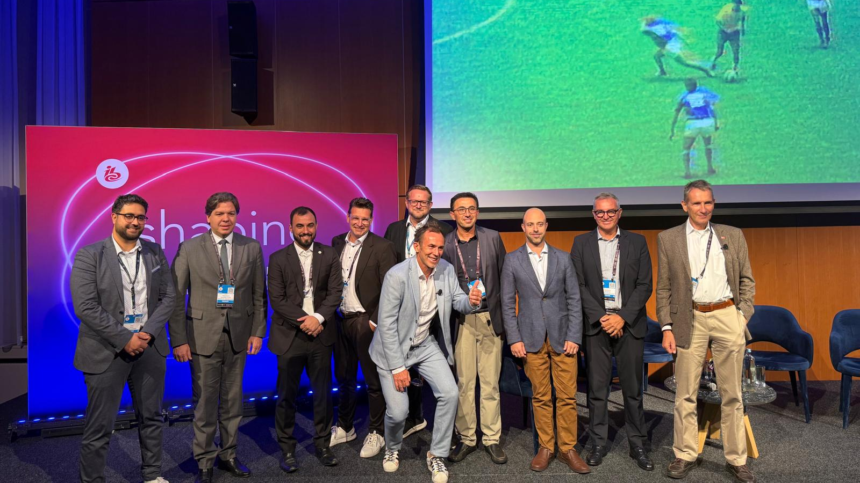

Slide 11

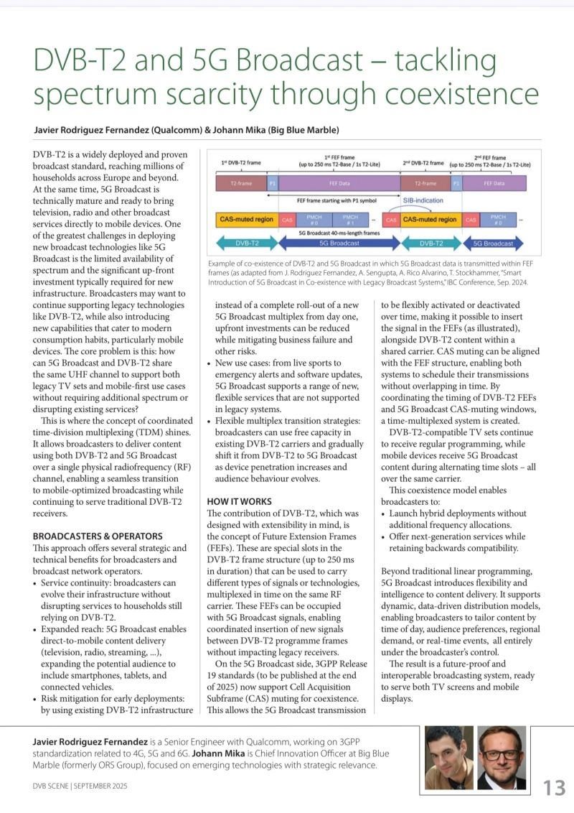

Slide 12
5G defines two modes of broadcast communication
Focus of this presentation
5G broadcast
Mixed-mode multicast
Broadcast spectrum (e.g. UHF)
No unicast. Downlink – only traffic.
Delivery of linear content (e.g. TV) or IP file delivery
Dedicated broadcast infrastructure (can be high power)
Operator spectrum (IMT)
Integration with unicast network
Efficient delivery of multicast/broadcast traffic (vs unicast)
Reuse of cellular infrastructure (low power).
Single Frequency Network (SFN) for downlink broadcast only
Dynamic switching between broadcast and unicast, e.g., SC-PTM¹
Addressing diverse ecosystem, deployment, and use case requirements

Slide 13



5G Broadcast – what is it?
3GPP could have taken a radical approach to define a clean slate radio system to meet the broadcasters’ requirements, instead a more pragmatic route was chosen. Experiences from the past with dedicated modems such as MediaFLO or DVB-H, and the need for easy integration into mainstream mobile devices, led to the decision to evolve eMBMS to LTE-based 5G Broadcast instead of any radical new designs.
3GPP could have taken a radical approach to define a clean slate radio system to meet the broadcasters’ requirements, instead a more pragmatic route was chosen. Experiences from the past with dedicated modems such as MediaFLO or DVB-H, and the need for easy integration into mainstream mobile devices, led to the decision to evolve eMBMS to LTE-based 5G Broadcast instead of any radical new designs.
Building upon a strong 3GPP technology foundation
5G
Further enhancements⁵
to fully satisfy 5G
broadcast requirements
LTE
LTE-A
LTE eMBMS/enTV
in 3GPP Rel-14
eMBMS defined for LTE starting in Rel-8/Rel-9, improving coverage and efficiency
eMBMS enhancements in Rel-12 include MOOD and expansion to MCPTT
Enabling terrestrial broadcast and expanding to new services; Meeting 7/10 5G Broadcast requirements in Rel-14
Enabling terrestrial broadcast and expanding to new services; Meeting all 5G Broadcast requirements in Rel-16
3GPP Rel-14 (completed)
3GPP Rel-16 (completed)
Target market focused on
Cellular operators
Target market expanded to
Broadcasters
5G broadcast is a “broadcast standard” (same target as DVB or ATSC) based on 3GPP silicon and ecosystem.

Slide 14

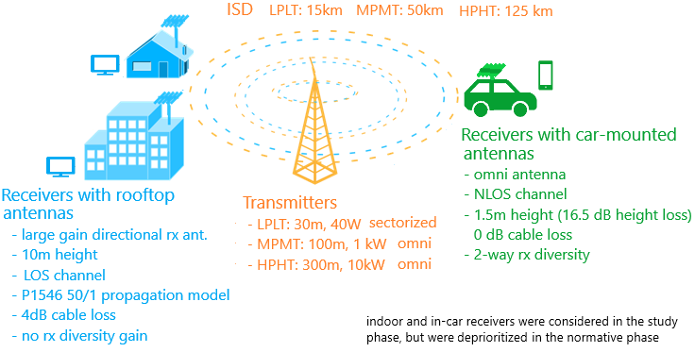


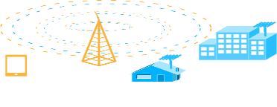
RAN: MBMS ➔ 5G Broadcast Evolution
Release 19
Release 17/18
T/F interleaving for 1.25, 2.5, 7.5 and 15 kHz numerologies
CAS muting
Introduction of two new UHF subbands within Band 108
Release 16
6/7/8 MHz channel bandwidth to support common global channel bandwidth for broadcast systems
Introduction of UHF Band 108 to address RF transmitter and receiver requirements
Release 14
New numerologies to target rooftop reception with up to 125 km ISD
High mobility reception: fixed, portable and mobile receivers up to 250 km/h
Enhancements to CAS—increased PDCCH agg. Level, PBCH repetition, CFI in MIB
Release 13
Longer cyclic prefixes for support of larger ISD
Up to 100% of subframes for MBSFN transmission on a dedicated carrier
Subframes fully dedicated to MBSFN transmission
Targeting rooftop and car-mounted antennas, handheld receivers
Release 9
Single-cell transmission (SC-PTM)
Transmission on PDSCH with new group identities
Non-synchronized transmitters
Mixed unicast/MBMS carrier
15 kHz numerology
Extended CP of 16.7us
Multi-cell transmission only (MBSFN)
Up to 60% of subframes for MBSFN transmission
> 15 km
“Operator controlled” MBMS
“Broadcaster controlled” MBMS

Slide 15
5G Broadcast – Core Features for multiple use cases
SIM-less reception with simplified architecture
Receive-Only Mode (ROM) & Free-to-Air (FTA)
Different spectrum options (e.g. UHF, SDL), as well as SFN/MFN
Various deployment possibilities (e.g. MNOs, BNOs)
Using existing infrastructure (HPHT, MPMT and LPLT)
Highly flexible velocities (up to 250 km/h Vs up to 300 µs)
Can be combined with existing 4G and 5G features (e.g. unicast)
Flexible time interleaving depths and multiplexing patterns

Slide 16
DVB & 5G Broadcast: A dynamic duo
Johann Mika, CINO

Slide 17


5G Broadcast: Challenges from an operator POV
Lack of customers (and devices)
Interoperability of infrastructure
Financial risk of deployment

Slide 18
5G Broadcast: Challenges from an operator POV
Financial risk of deployment
Goal: Reduce the investments at the beginning as much as possible
Use of existing infrastructure: Co-existence of DVB and 5G Broadcast
Increase the robustness of the signal: lower tower density and improved coverage → „Time-Frequency-Interleaving“
2024: Broadcast Networks Europe (BNE) joined efforts with EBU to engange in 3GPP for Release 19

Slide 19
DVB & 5G Broadcast: Why Co-Existence Matters
The Challenges:
Spectrum scarcity: no new UHF bands available
Audiences split:
Millions still rely on DVB-T2 TV sets
Growing demand for mobile-first consumption (smartphones, cars, tablets)
Broadcasters need to innovate without disruption
Our Opportunity:
Use existing DVB-T2 capacity to introduce 5G Broadcast
Deliver TV + Mobile services in parallel on one RF channel

Slide 20
5G Broadcast: Why TFI matters
Robust Reception, Everywhere
Enhances coverage in challenging environments (urban canyons, indoor, high-speed mobility)
Consistent Quality of Service
Reduces risk of service degradation → fewer complaints from viewers
Efficient Deployment
Maximizes spectrum use by improving robustness without needing more transmit power or sites

Slide 21

Bridging the broadcast and cellular worlds: CAS Muting and Time/Frequency Interleaving in Release 19 5G Broadcast
September 14th, 2025
IBC 2025
Javier Rodriguez-Fernandez, Senior Standards Engineer
Qualcomm Technologies, Inc.

Slide 22
Convergence of broadcast and cellular

Slide 23
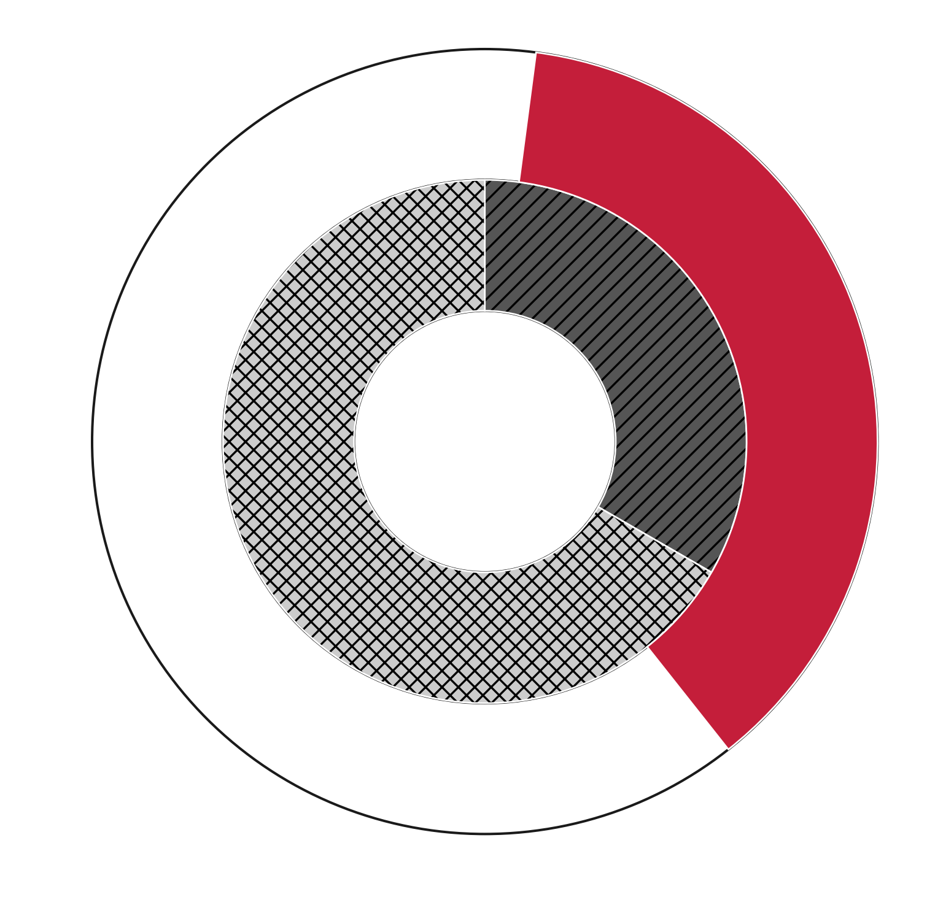



Cellular unicast: mapping data (bits) to a subframe
TB generation and subframe mapping in 3GPP
HARQ buffer
Cellular unicast in 3GPP
Input Transport Block (TB) with size TBS = 25456 bits
Segmentation, CRC, etc
Physical layer mapping (akin to DVB-T2, ATSC 3.0, etc.)
Taken from 3GPP TS 36.213
Modulation (e.g. 16-QAM), channel coding
Pilot (DMRS) pattern
$$RV \#0$$
Systematic bits (extremely important for decoding)
1 subframe with 6 OFDM symbols
Parity bits (“less” important, used to correct errors)

Slide 24
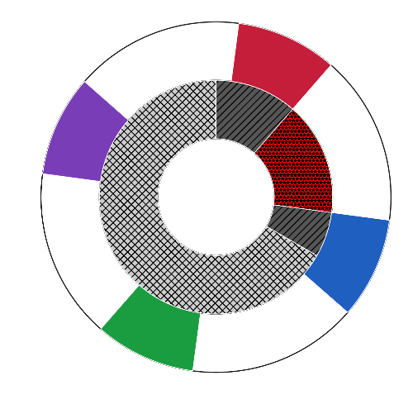
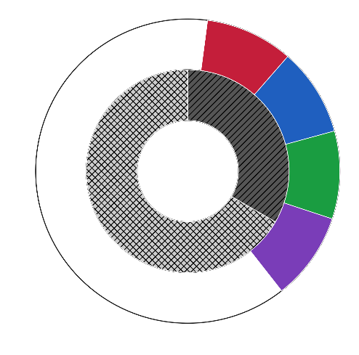





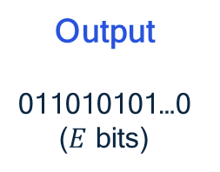

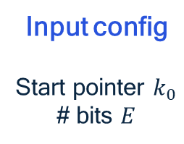



Time interleaving in 3GPP Release 19: continuous RVs
Time interleaving in Release 19
Firmware configuration
Baseline TBS = 25456 bits, $M$ TBs, $N$ RVs
Baseline TBS = 25456 bits, 𝑀 TBs, 𝑁 RVs
Scaling by a factor of $N=4$ and rounding => TBS = 101840 bits
Scaling by a factor of 𝑁=4 and rounding => TBS = 101840 bits
Transmit parts (RVs) of $M=4$ TBs over 16 subframes
Transmit parts (RVs) of 𝑀=4 TBs over 16 subframes
Input config
Start pointer $k_{0}$
# bits $E$
Output
011010101…0 ($E$ bits)
HW
HARQ Buffer
Cellular unicast RVs
5G Broadcast Rel. 19
$$RV \#0$$
$$RV \#0$$
$$RV \#1$$
$$RV \#3$$
$$RV \#2$$
$$RV \#1$$
$$RV \#3$$
RV#0 of 4 TBs
RV#1 of 4 TBs
RV#2 of 4 TBs
RV#3 of 4 TBs
Systematic bits
$$RV \#2$$
Time interleaving depth of
4 TBs x 4 RVs x 1 ms = 16 ms
Parity bits
Punctured bits

Slide 25
Performance analysis methodology

Slide 26
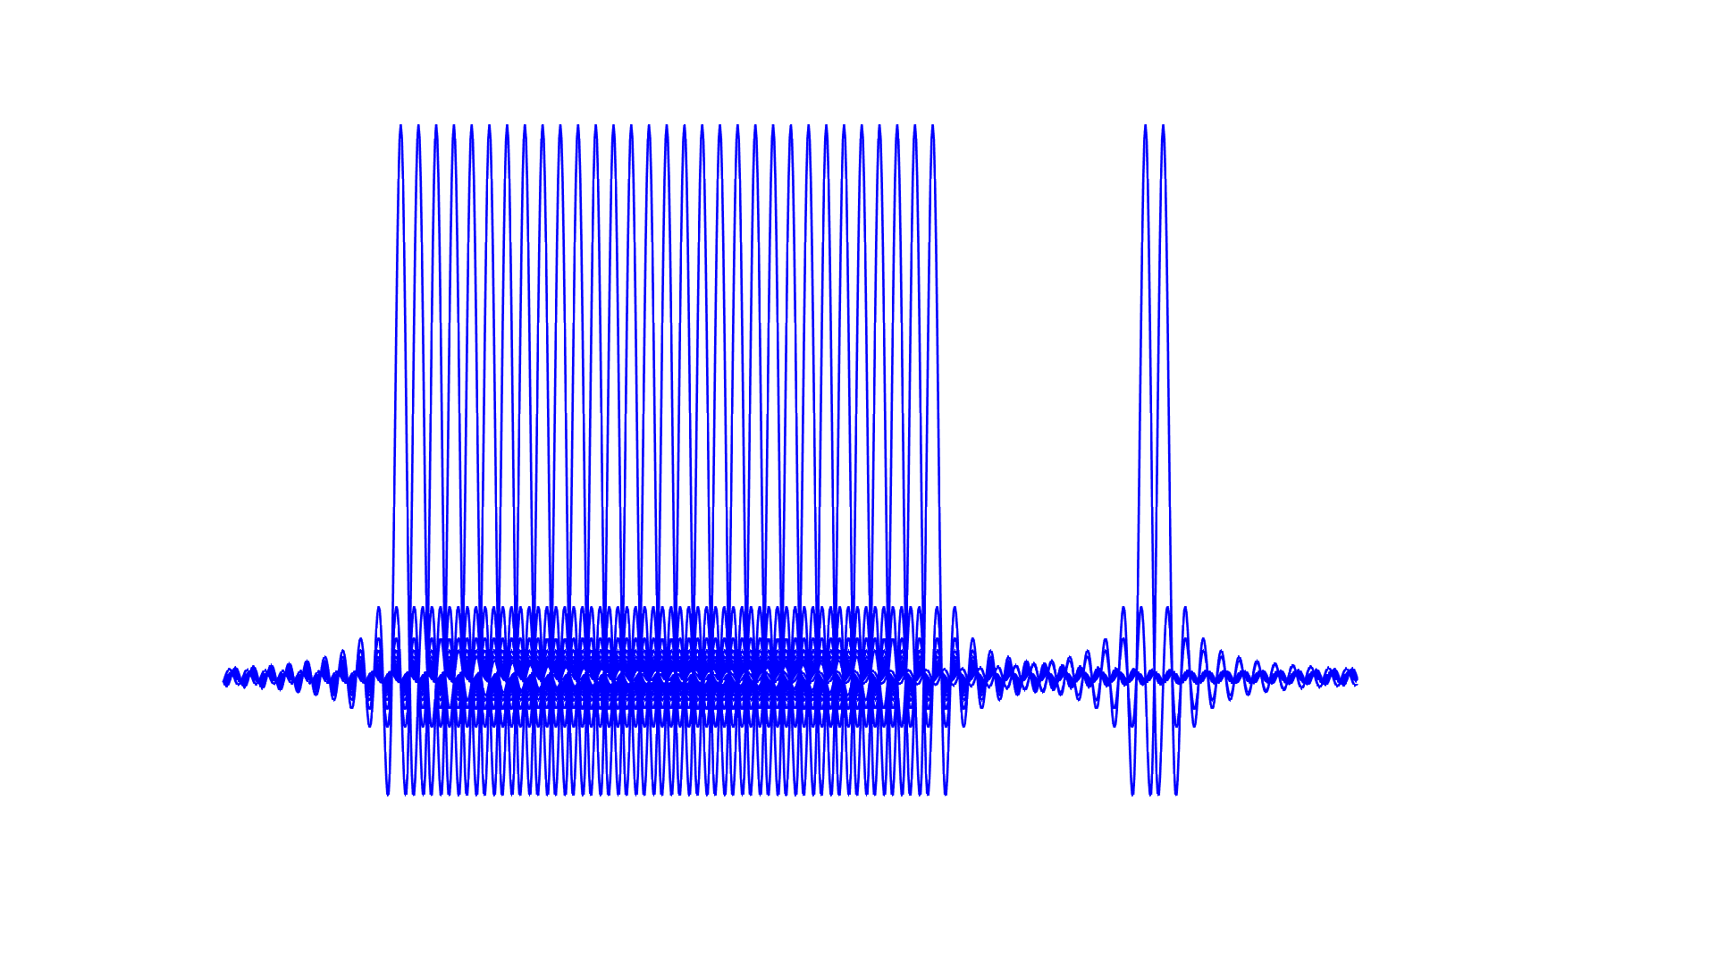
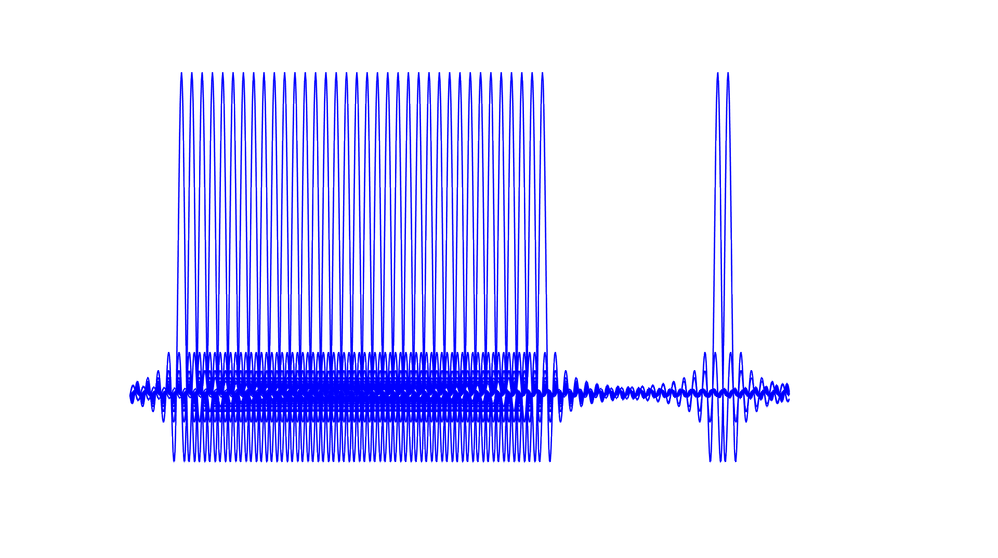

OFDM allocation within 8 MHz channel BW
Different useful BW in 5GB and ATSC 3.0, and LLS operate on an average SNR per tone
ATSC 3.0 power $↑$ for the same system (i.e. SNR) quality
Measure performance over useful BW for each system => ATSC 3.0 still has an advantage due to e.g. more frequency diversity and extra coding rate
5G Broadcast
ATSC 3.0
5760 PMCH + DMRS tones (7.2 MHz)
6913 payload + pilot tones (7.78 MHz)
…
…
.
.
.
.
10% Total guarband
2.8% Total guarband

Slide 27
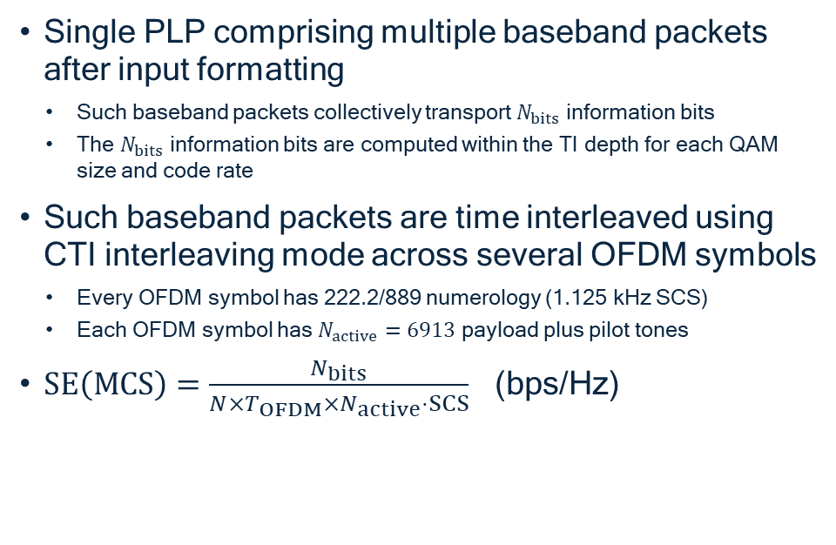
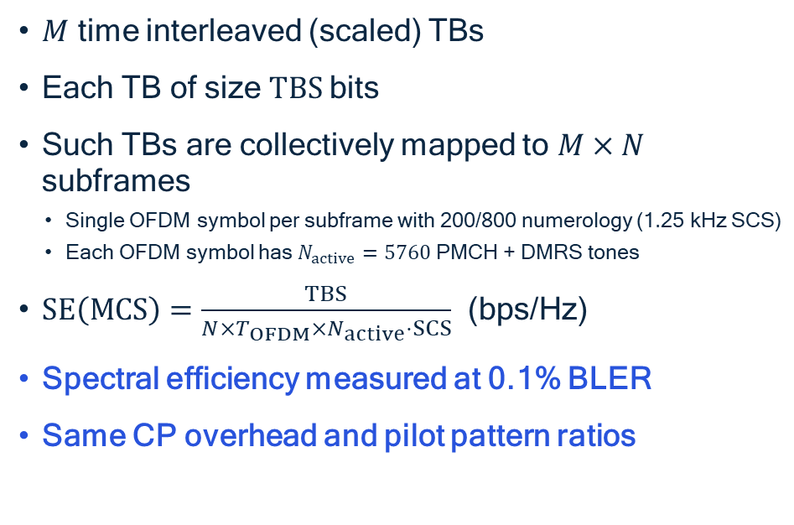
Spectral efficiency computation
5G Broadcast
ATSC 3.0
$M$ time interleaved (scaled) TBs
Each TB of size $TBS$ bits
Such TBs are collectively mapped to $M×N$ subframes
Single OFDM symbol per subframe with 200/800 numerology (1.25 kHz SCS)
Each OFDM symbol has $N_{active}=5760$ PMCH + DMRS tones
$SE\left(MCS\right)=\frac{TBS}{N×T_{OFDM}×N_{active}⋅SCS}$ (bps/Hz)
Spectral efficiency measured at 0.1% BLER
Same CP overhead and pilot pattern ratios
Single PLP comprising multiple baseband packets after input formatting
Such baseband packets collectively transport $N_{bits}$ information bits
The $N_{bits}$ information bits are computed within the TI depth for each QAM size and code rate
Such baseband packets are time interleaved using CTI interleaving mode across several OFDM symbols
Every OFDM symbol has 222.2/889 numerology (1.125 kHz SCS)
Each OFDM symbol has $N_{active}=6913$ payload plus pilot tones
$SE\left(MCS\right)=\frac{N_{bits}}{N×T_{OFDM}×N_{active}⋅SCS}$ (bps/Hz)
Spectral efficiency metric measures effective number of information bits that each standard can carry per time and frequency unit
Numerical simulations conducted for each MCS (i.e. QAM size, code rate, and corresponding TB / baseband packet size for 5G Broadcast and ATSC 3.0)

Slide 28
Numerical performance

Slide 29
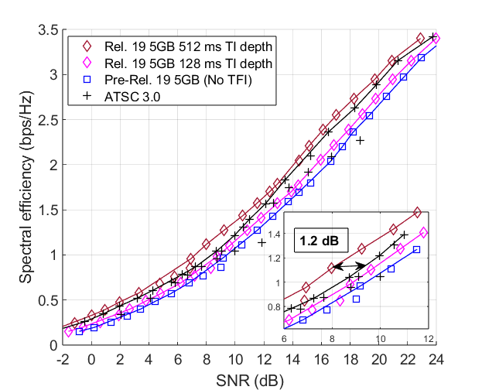
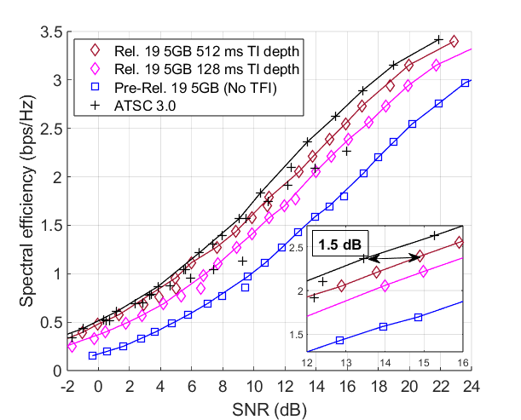
Spectral efficiency results
Key takeaways at low speed (3 km/h)
Performance improvement of 2-3 dB with respect to pre-Rel. 19 5GB
Time-interleaved 5GB shows net performance gain of 0.5-1.2 dB over ATSC 3.0
Extra time diversity outmatches NUC shaping and BICM gains
Key takeaways at higher speed (60 km/h)
Performance improvement of 4-7 dB with respect to pre-Rel. 19 5GB
Time-interleaved 5GB shows small gap of 0.5-1.5 dB versus ATSC 3.0
Combination of continuous time interleaving + NUC shaping gain and BICM

Slide 30
Convergence of broadcast standards: CAS muting

Slide 31
CAS muting as a feature enabling co-existence
1ms
39ms
Rel. 18 5G Broadcast
CAS
PMCH
# 0
PMCH
# 1
…
CAS
PMCH
# 0
PMCH
# 1
…
CAS
PMCH
# 0
…
“Always on” signal sync./scheduling
MBSFN subframes belonging to an MBSFN Area or empty
Main issue: Limited flexibility to transmit legacy standards in the “gap” (39 ms)
Example: ATSC’s recommended frame duration is 250 ms
Now adopted as part of Release 19 features for 5G Broadcast
CAS muting
Enhancement
CAS
PMCH
# 0
PMCH
# 1
…
CAS
CAS
PMCH
# 0
…
CAS-muted region
SIB-indication of muting pattern
Multiples of ~40 ms

Slide 32





DVB-T2 mechanisms for in-band coexistence
$$T_{SF}$$
Super Frame
# $(n−1)$
Super Frame
# $n$
Super Frame
# $(n+1)$
…
FEF interval
FEF length
FEF interval
FEF length
FEF interval
FEF length
T2-frame
# 0
…
T2-frame
# A-1
FEF frame
# 0
T2-frame
# A
…
T2-frame
# A+B-1
FEF frame
# 1
T2-frame
# A+B
…
T2-frame
# A+B+C-1
FEF frame
# 2
A
B
C
FEF type (4 bits): reserved for future use
FEF interval (8 bits): up to 255 T2-frames
FEF length (22 bits): up to 250 ms / 1s
A + B + C = $N_{T2}$ frames
DVB-T2 supports Future Extension Frames (FEF)
A = B = C = FEF interval
DVB-T2 introduces FEF frames to enable coexistence with other broadcasting technologies
L1-signaled FEF interval and FEF length would control the duty-cycle of DVB-T2 and 5G Broadcast
Lots of flexibility to attain different time shares for DVB-T2 and 5G Broadcast
If T2-Lite is also deployed, both the Lite profile and 5G Broadcast can coexist with different time shares

Slide 33
DVB-T2 and 5G Broadcast in-band coexistence
Efficient integration of 5G Broadcast within DVB-T2 superframes
1st FEF frame
(up to 250 ms T2-Base / 1s T2-Lite)
2nd FEF frame
(up to 250 ms T2-Base / 1s T2-Lite)
1st DVB-T2 frame
2nd DVB-T2 frame
DVB-T2
T2-frame
P1
FEF Data containing
5G Broadcast traffic
T2-frame
P1
FEF Data containing
5G Broadcast traffic
FEF frame starting with P1 symbol
SIB-indication
5GB
CAS-muted region
CAS
PMCH
# 0
PMCH
# 1
…
CAS
CAS-muted region
CAS
PMCH
# 0
…
5G Broadcast 40-ms-length frames
DVB-T2
5G Broadcast
DVB-T2
5G Broadcast
DVB-T2 receivers expected to detect FEF frames and ignore the content of FEF data
FEF frame starts with P1 symbol, which should be contained within the 5G Broadcast CAS-muted region
DVB-T2 receivers to keep AGC gain constant during FEF parts to avoid interference
DVB-T2 and 5G Broadcast transmitters need to coordinate for dynamic allocation of resources

Slide 34
Broadcaster and BNO Benefits
Service Continuity
Protect investments, no disruption to households with DVB-T2
Expanded Reach
Direct-to-mobile delivery: smartphones, vehicles, portable devices
Risk Mitigation
No need for full new multiplex rollout → lower upfront investment
➔ Allows smooth integration and lower pre-investment deployment scenarios for Broadcast Network Operators (and faster deployment of Public Warning Services)

Slide 35
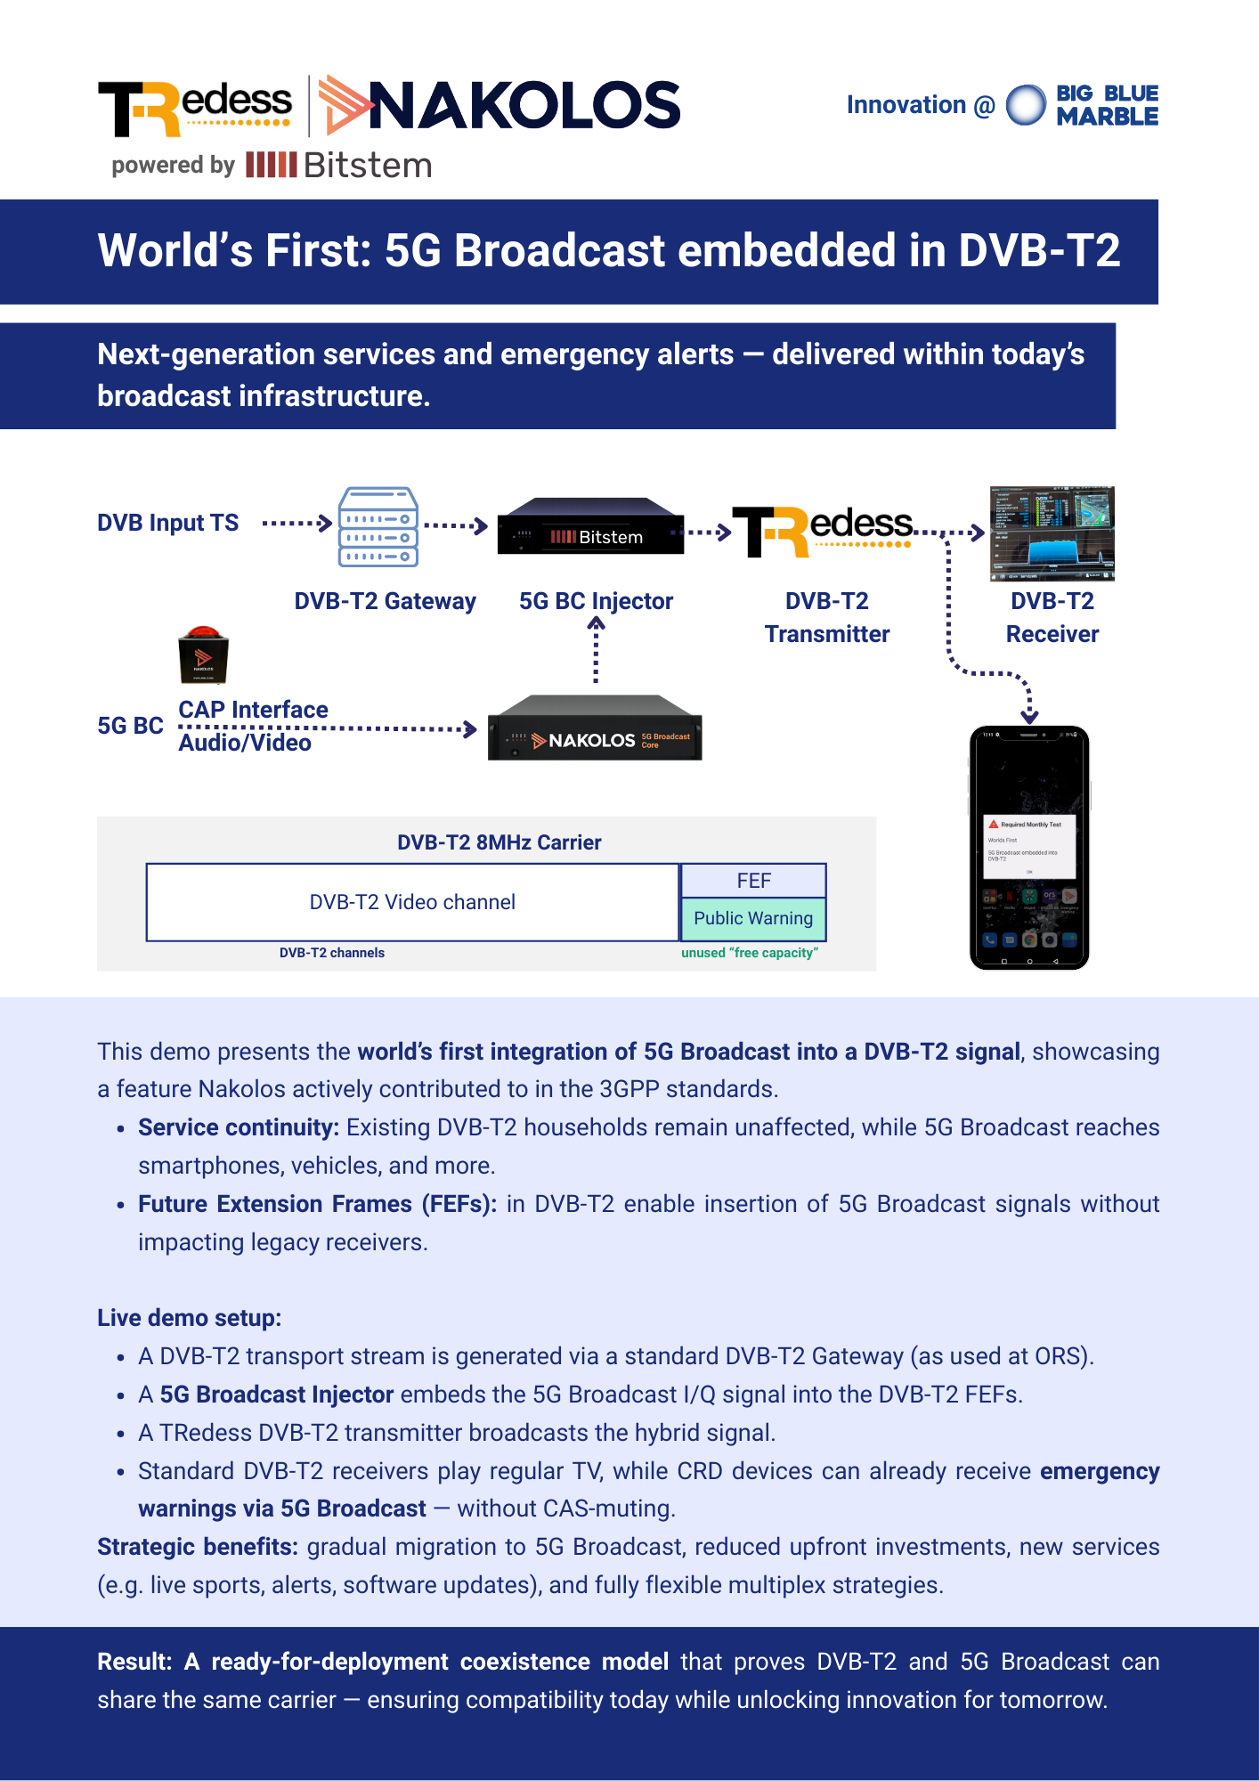
Worlds First: 5G Broadcast embedded in DVB-T2
Benefits for broadcasters and broadcast network operators:
• Service continuity
• Expanded reach
• Risk mitigation for early deployments
• New use cases
• Flexible multiplex transition strategies
Notes:
• Service continuity: broadcasters can evolve their infrastructure without disrupting services to households still relying on DVB-T2.
• Expanded reach: 5G Broadcast enables direct-to-mobile content delivery (television, radio, streaming, ...), expanding the potential audience to include smartphones, tablets, and connected vehicles.
• Risk mitigation for early deployments: by using existing DVB-T2 infrastructure Example of co-existence of DVB-T2 and 5G Broadcast in which 5G Broadcast data is transmitted within FEF frames (as adapted from J. Rodriguez Fernandez, A. Sengupta, A. Rico Alvarino, T. Stockhammer, “Smart Introduction of 5G Broadcast in Co-existence with Legacy Broadcast Systems,” IBC Conference, Sep. 2024. instead of a complete roll-out of a new 5G Broadcast multiplex from day one, upfront investments can be reduced while mitigating business failure and other risks.
• New use cases: from live sports to emergency alerts and software updates, 5G Broadcast supports a range of new, f lexible services that are not supported in legacy systems.
• Flexible multiplex transition strategies: broadcasters can use free capacity in existing DVB-T2 carriers and gradually shift it from DVB-T2 to 5G Broadcast as device penetration increases and audience behaviour evolves.

Slide 36
Worlds First: 5G Broadcast embedded in DVB-T2

Slide 37
Worlds First: 5G Broadcast embedded in DVB-T2
Benefits for broadcasters and broadcast network operators:
• Service continuity
• Expanded reach
• Risk mitigation for early deployments
• New use cases
• Flexible multiplex transition strategies
Result: Ready-for-deployment coexistence model that proves DVB-T2 and 5G Broadcast can share the same carrier – ensuring compatibility today while unlocking innovation for tomorrow.
Notes:
• Service continuity: broadcasters can evolve their infrastructure without disrupting services to households still relying on DVB-T2.
• Expanded reach: 5G Broadcast enables direct-to-mobile content delivery (television, radio, streaming, ...), expanding the potential audience to include smartphones, tablets, and connected vehicles.
• Risk mitigation for early deployments: by using existing DVB-T2 infrastructure Example of co-existence of DVB-T2 and 5G Broadcast in which 5G Broadcast data is transmitted within FEF frames (as adapted from J. Rodriguez Fernandez, A. Sengupta, A. Rico Alvarino, T. Stockhammer, “Smart Introduction of 5G Broadcast in Co-existence with Legacy Broadcast Systems,” IBC Conference, Sep. 2024. instead of a complete roll-out of a new 5G Broadcast multiplex from day one, upfront investments can be reduced while mitigating business failure and other risks.
• New use cases: from live sports to emergency alerts and software updates, 5G Broadcast supports a range of new, f lexible services that are not supported in legacy systems.
• Flexible multiplex transition strategies: broadcasters can use free capacity in existing DVB-T2 carriers and gradually shift it from DVB-T2 to 5G Broadcast as device penetration increases and audience behaviour evolves.

Slide 38
Appendix: Simulation parameters

Slide 39
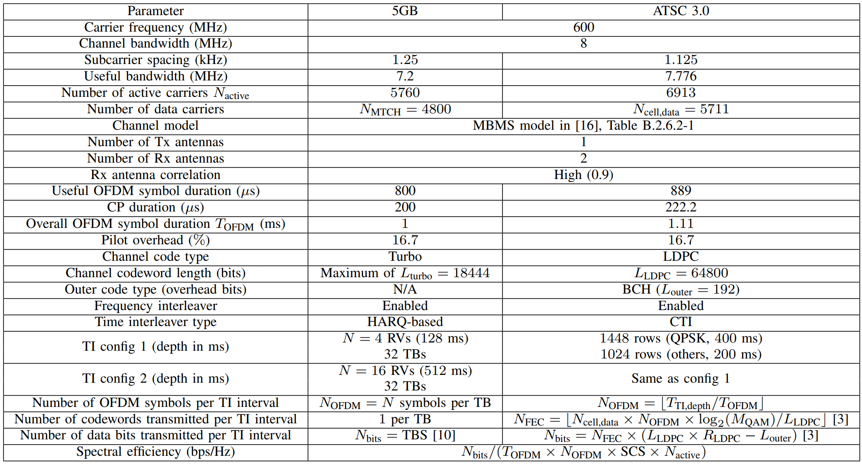
Simulation parameters
Rx ant. related
BICM related
Time Intlv. related
[3] M. Fuentes, D. Mi, H. Chen, E. Garro, J. L. Carcel, D. Vargas,B. Mouhouche, and D. Gomez-Barquero, “Physical Layer PerformanceEvaluation of LTE-Advanced Pro Broadcast and ATSC 3.0 Systems,”IEEE Transactions on Broadcasting, vol. 65, no. 3, pp. 477–488, 2019.
[10] 3GPP, “3rd Generation Partnership Project; Technical SpecificationGroup Radio Access Network; Evolved Universal Terrestrial RadioAccess (E-UTRA); Physical layer procedures (Release 19),” 3GPP,Tech. Rep., Jun. 2025.
[16] 3GPP, “3rd Generation Partnership Project; Technical SpecificationGroup Radio Access Network; Evolved Universal Terrestrial Radio Ac-cess (E-UTRA); User Equipment (UE) radio transmission and reception(Release 18),” 3GPP, Tech. Rep., Jun. 2024.

Slide 40
Appendix: Network planning

Slide 41





Implications of different link budgets of 5G Broadcast and ATSC 3.0
Network planning targets worst-case scenario
5GB
Gap filler
ATSC 3.0
Network planning is usually carried out for the worst-case link-quality scenario
Worst-case link budget differences can be compensated by
Introducing gap-fillers operating at another band
Adjusting the MCS, transmit power
Adjusting the video stream quality
Improving the corresponding standard to reduce link margin differences

