Slide 1

Emmy Tutorial 1: Introduction to MPEG DASH
March 2, 2022
Thomas Stockhammer (Qualcomm Incorporated)
DASH-IF Interoperability WG Chair
Co-editor of MPEG-DASH ISO/IEC 23009-1 1st to 5th edition

Slide 2

Today’s agenda
Chronical Matters and Anecdotes (getting old)
The core principles of DASH
What is new in the 5th edition
DASH-IF Interoperability Guidelines v5
Tools
What‘s next to come
DASH Deployments
Thank you
Presenter
Dr. Thomas Stockhammer
Director, Technical Standards
Qualcomm Europe, Inc.
Leading and driving among others
DVB: 5G TF, DVB-I
MPEG: MPEG-I, CMAF and DASH
3GPP: XR over 5G, 5G Video, 5GMS
DASH-IF: Interop WG, Test
ETSI: 5G Broadcast
CTA WAVE: CMAF Device PB, Test

Slide 3

The history - why a standard?

Slide 4
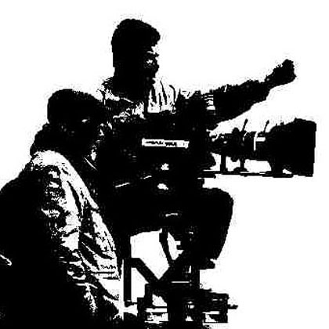

MPEG-DASH
ISO/IEC 23009-1
2012
3GPP
2009
OIPF
2009
MPEG
2010
Apple HLS
2008
MS SS
2008
W3C
others
DASH IF
Adobe HDS
Confidence
Standardized Delivery Format

Slide 5
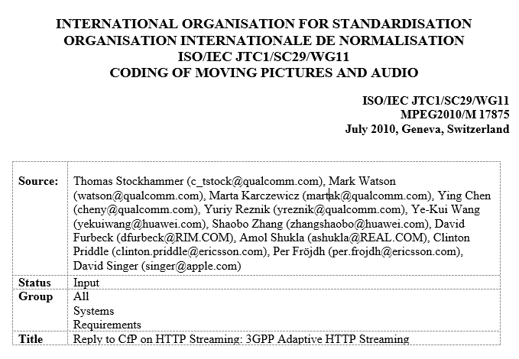
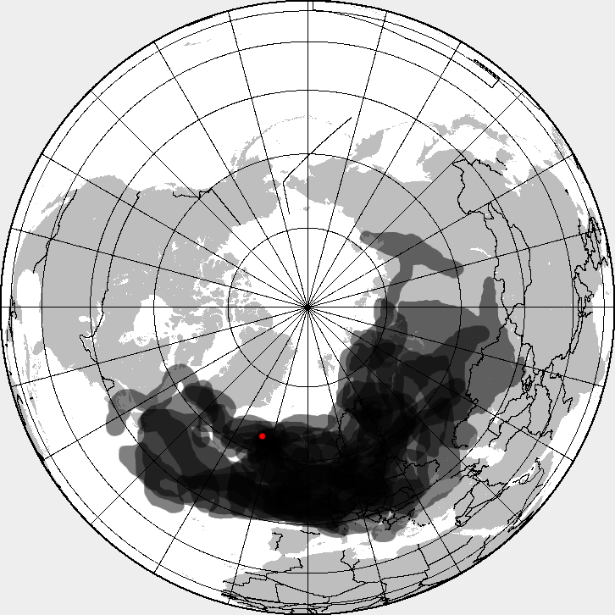
History
MPEG and 3GPP Meetings in 2010/2011:
Geneva, July 2010 => CD
Erlangen, August 2010
Paris, September 2010
Guangzhou, October 2010
Barcelona, November 2010
San Francisco, December 2010
Berlin, January 2011
Daegu, January 2011 => DIS
Sanya, February 2011
Geneva, March 2011
San Diego, April 2011
Berlin, June 2011
Torino, July 2011 => FDIS
CFP Completed April 2010 in Dresden – the Volcano Eyjafjallajökull meeting

Slide 6
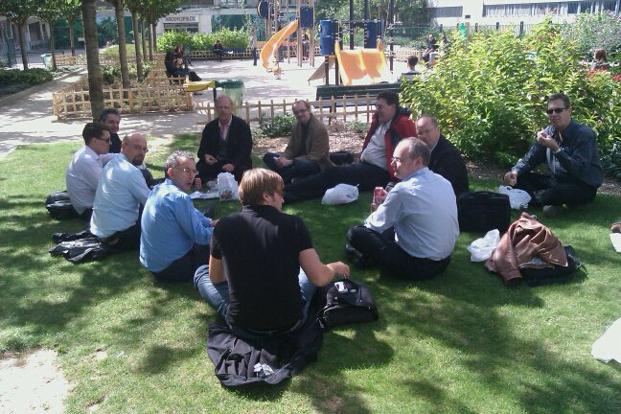



Slide 7
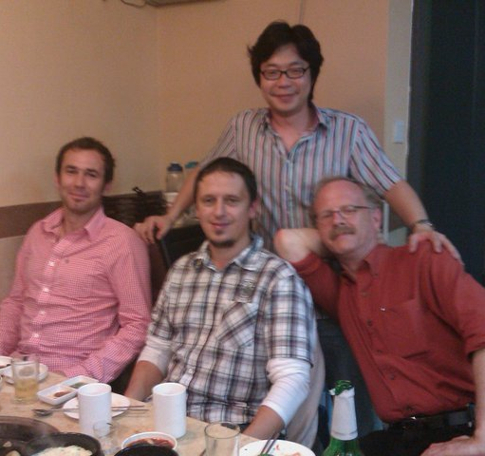
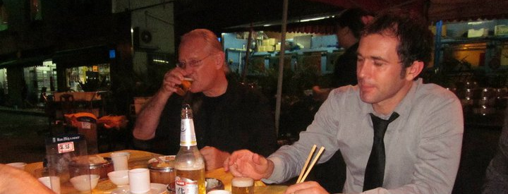
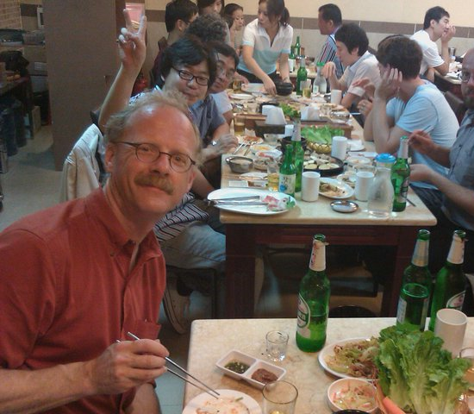
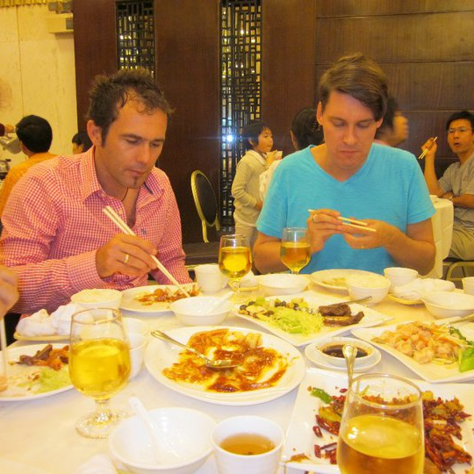


Slide 8
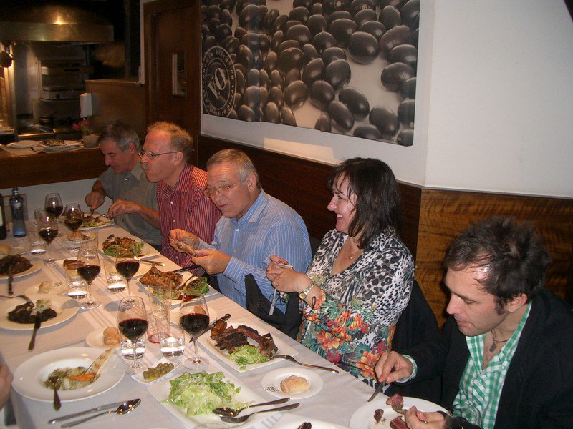
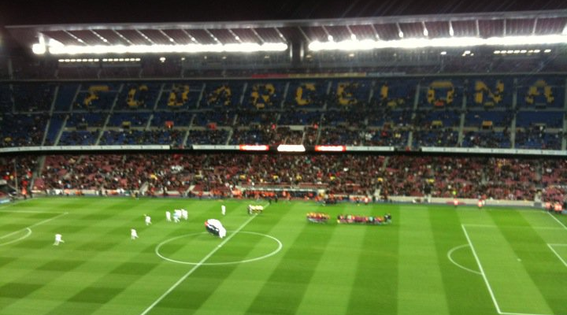
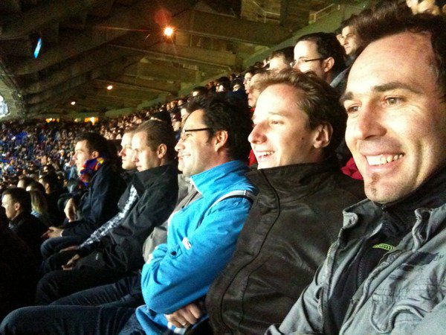

Slide 9
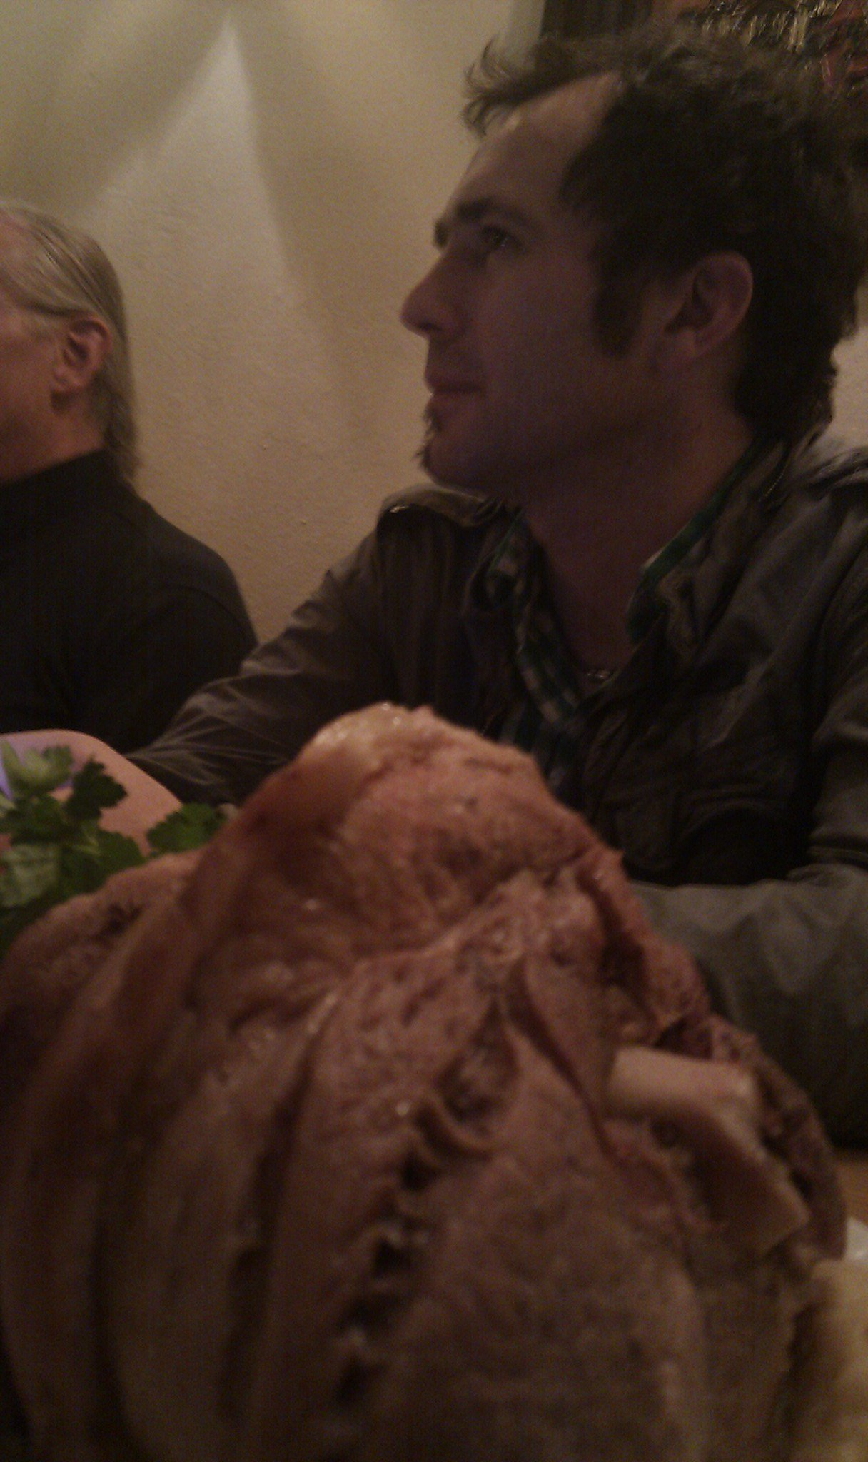
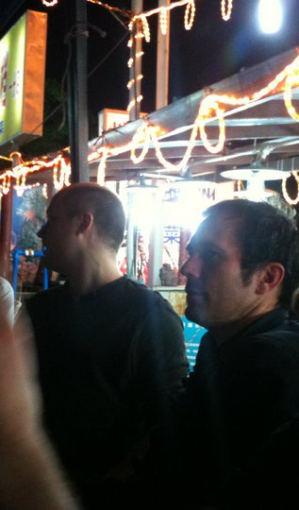
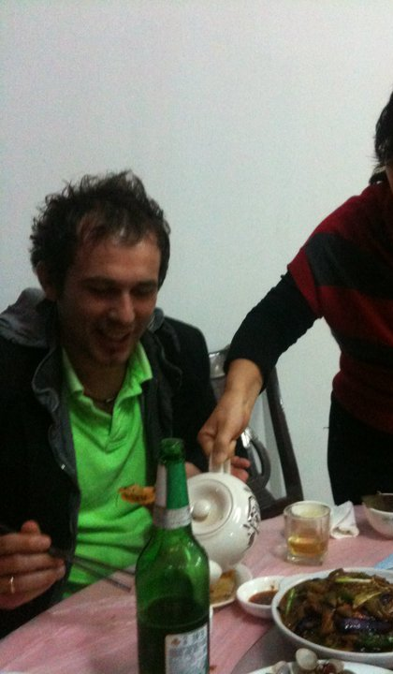

Slide 10
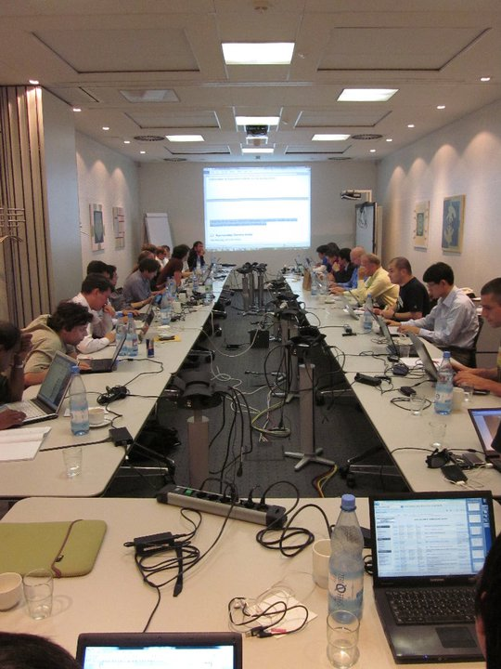
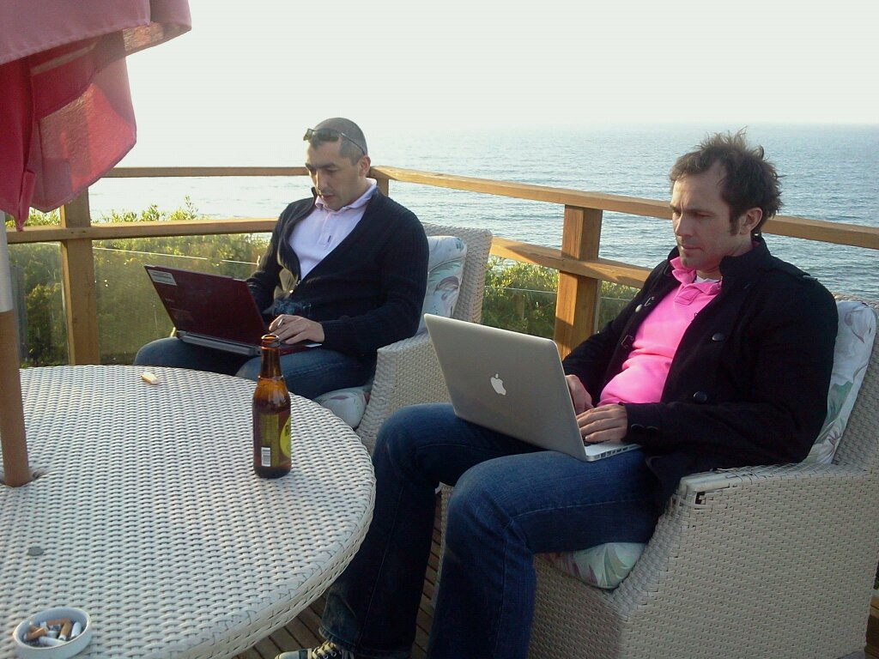

Slide 11
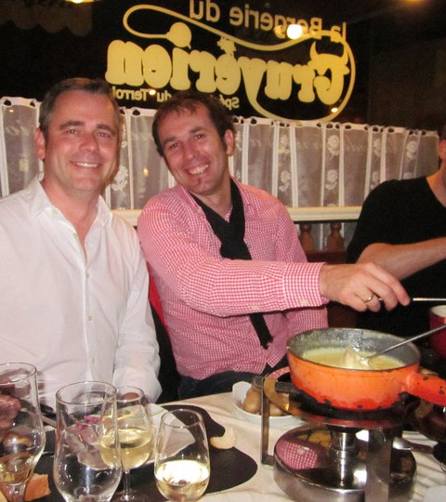
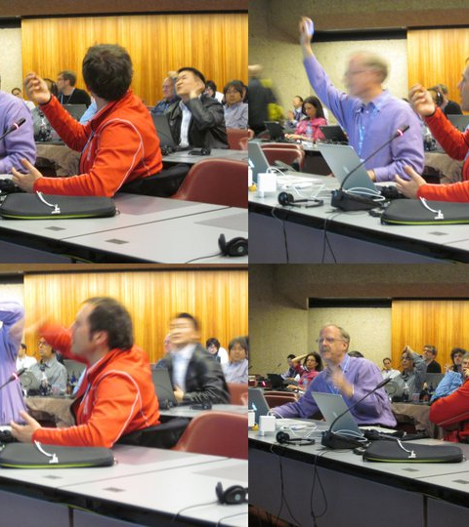

Slide 12
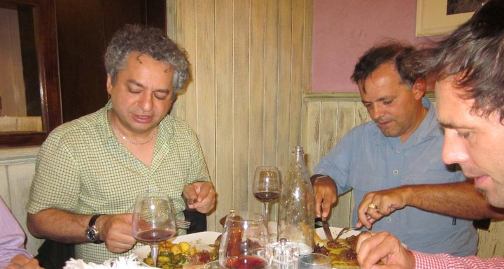
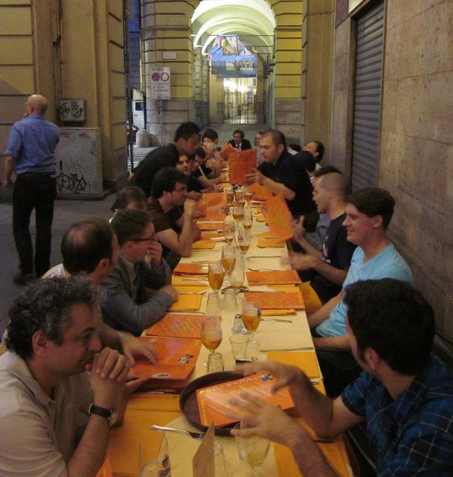
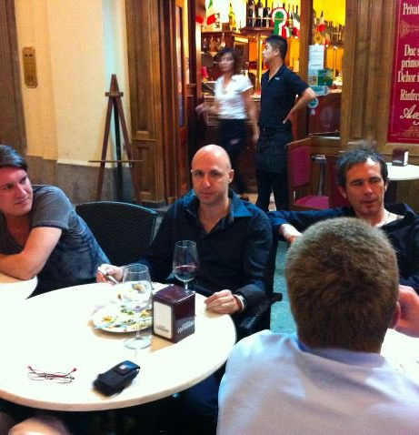
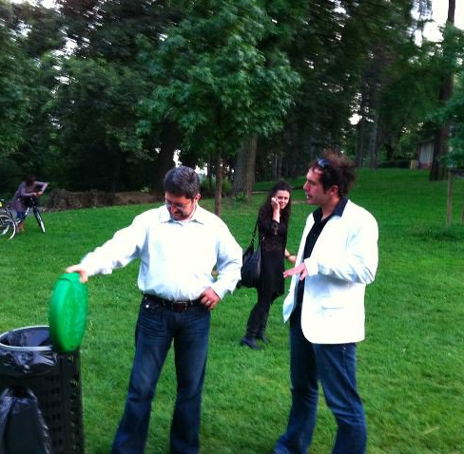

Slide 13
The Standards
Personal Warning: Process
not recommended to be repeated
Based on these efforts and collaboration, MPEG and 3GPP developed jointly the work and published the specifications as
TS 26.247: 3GPP Dynamic Adaptive Streaming over HTTP (3GP-DASH)
ISO/IEC 23009-1: Dynamic Adaptive Streaming over HTTP: Media presentation description and Segment formats
Since then
5 editions of DASH part 1 are completed
The DASH standard has 8 parts
DASH is adopted by many organizations

Slide 14
Editions, Parts and Editors
1 | 2011 | ISO/IEC 23009-1 Media Presentation Description and Segment Formats | Thomas Stockhammer and Per Fröjdh
1 | 2012 | ISO/IEC 23009-1:201x 2nd edition | Thomas Stockhammer, Per Fröjdh
1 | 2013 | ISO/IEC 23009-1:2014 AMD 1 Extended profiles and time synchronization | Thomas Stockhammer, Alex Giladi
1 | 2014 | 23009-1:2014 AMD 2 Spatial Relationship Description, Generalized URL parameters and other extensions | Emmanuel Thomas, Sylvain Kervadec, Cyril Concolato
1 | 2014 | 23009-1:2014 AMD 3 Authentication, Access Control and multiple MPDs | Thomas Stockhammer, Alexander Giladi
1 | 2014 | 23009-1:2014 AMD 4 Segment Independent SAP Signalling, MPD chaining and other extensions | Thomas Stockhammer, Iraj Sodagar, Alex Giladi
1 | 2015 | 23009-1 3rd edition Media presentation description and segment formats | Thomas Stockhammer
1 | 2016 | 23009-1 3rd edition AMD 1 on device information and other extension | Ali C. Begen, Thomas Stockhammer
1 | 2019 | 23009-1 4th edition
1 | 2020 | 23009-1 4th edition AMD 1 CMAF support, events processing model and other extensions | Iraj Sodagar, Thomas Stockhammer, Mike Dolan
1 | 2021 | 23009-1 5th edition | Thomas Stockhammer, Mike Dolan
1 | 2022 | 23009-1 4th edition AMD 2 Preroll, nonlinear playback and other extensions | Iraj Sodagar, Thomas Stockhammer
1 | 2023 | 23009-1 5th edition AMD Extended Dependent Random Access Representations and other extensions | Ye-Kui Wang, Iraj Sodagar
2 | 2012 | ISO/IEC 23009-2 DASH Conformance and reference software | Thomas Stockhammer and Christian Timmerer
2 | 2017 | 23009-2 2nd edition DASH Conformance and reference software | Christian Timmerer, Waqar Zia, Brendan Long
2 | 2017 | 23009-2 AMD 1 Conformance vectors and reference software for SRD, SAND and Server Push | Emmanuel Thomas
2 | 2020 | 23009-2 3rd edition
3 | 2012 | 23009-3 DASH Implementation Guidelines | Yuriy Reznik, Kilroy Hughes, Thomas Stockhammer
3 | 2014 | 23009-3 2nd edition DASH Implementation Guidelines | Thomas Stockhammer, Alex Giladi
3 | 2014 | 23009-3 2nd edition AMD 1 DASH Implementation Guidelines | Iraj Sodagar
3 | 2015 | 23009-3 3rd edition DASH Implementation Guidelines | Ali C. Begen
4 | 2013 | ISO/IEC 23009-4 Segment encryption and authentication | Alex Giladi
4 | 2018 | 23009-4 2nd edition Segment encryption and authentication | Alex Giladi and Yasser Syed
5 | 2017 | 23009-5 Server and Network Assisted DASH | Mary-Luc Champel, Emmanuel Thomas
5 | 2020 | 23009-5 AMD 1 Improvements on SAND messages | Mary-Luc Champel
6 | 2017 | 23009-6 DASH with Server Push and WebSockets | Viswanathan (Vishy) Swaminathan, Kevin Streeter, Imed Bouzazi, and Franck Denoual
7 | 2023 | 23009-7 Delivery of CMAF contents with DASH | Iraj Sodagar
8 | 2020 | 23009-8 Session based DASH operation | Ali C. Begen, Iraj Sodagar, Alex Giladi
8 | 2022 | 23009-8 AMD 1 URL customization other extensions | Iraj Sodagar

Slide 15
A few others on standards development
Jean Le Feuvre
Dave Singer
DF /QC colleagues Mark Watson and Mike Luby
Harry Piles and Paul Higgs – the masters of the XML
Waqar Zia for all of his work on conformance and reference software
The colleagues from DVB and OIPF/HbbTV
The Korean gang who made MASH into DASH
Youngkwon and Leonardo
And many many more

Slide 16
Some Fundamentals of DASH

Slide 17

Core Principles of DASH
CDN and Cache friendly
Stateless Server
Client-driven
Low manifest traffic (small size and low update frequency)
Carrying ISO BMFF and CMAF
Late Binding
Works with HTML-5 and MSE
Live and On-Demand
HLS Convergence

Slide 18






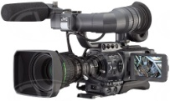

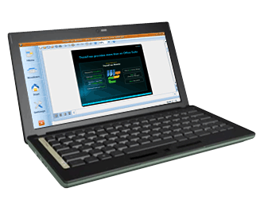

CDN Friendly
Encode each media type at multiple bitrates => track
Make each segment addressable via an
HTTP-URL
Client makes decision on which segment to download
Client acquires a license for encrypted content
1
4
5
6
Manifest
Timeline
Resource Addresses HTTP
Codecs
Variants
DRM Server license
Operational information
2
Split each track into small segments
7
Client splices and synchronizes for play back
Application Server
UE
001010100001010
010101010001110
01110100011010101
001010100001010
010101010001110
01110100011010101
001010100001010
010101010001110
01110100011010101
001010100001010
010101010001110
01110100011010101
3
Encrypt each segment
Media Capture
and Encoding
DRM Encryption
Server
Media
Origin
Servers
HTTP/S
Cache
Servers
Client
Devices
DRM
License
Server

Slide 19
What is specified – and what is not?
Media Presentation on HTTP Server
Media Presentation Description (XML)
DASH Client
Segment
DASH Access
Engine
http requests to get segments
Resources located by
HTTP-URLs
Media Engines
HTTP Access
Client
HTTP/1.1
encapsulated media

Slide 20
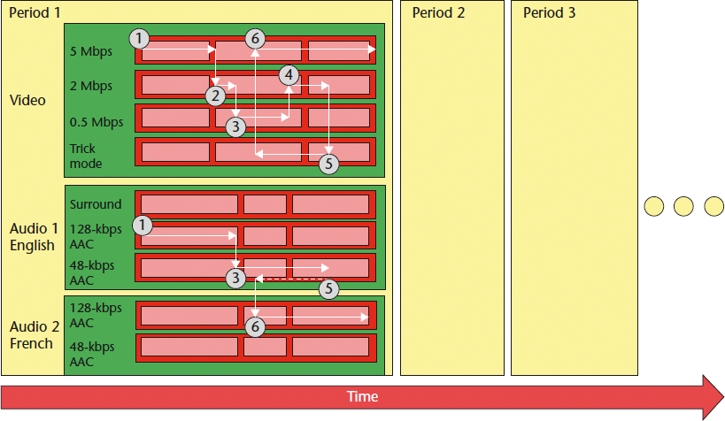
Data Model

Slide 21
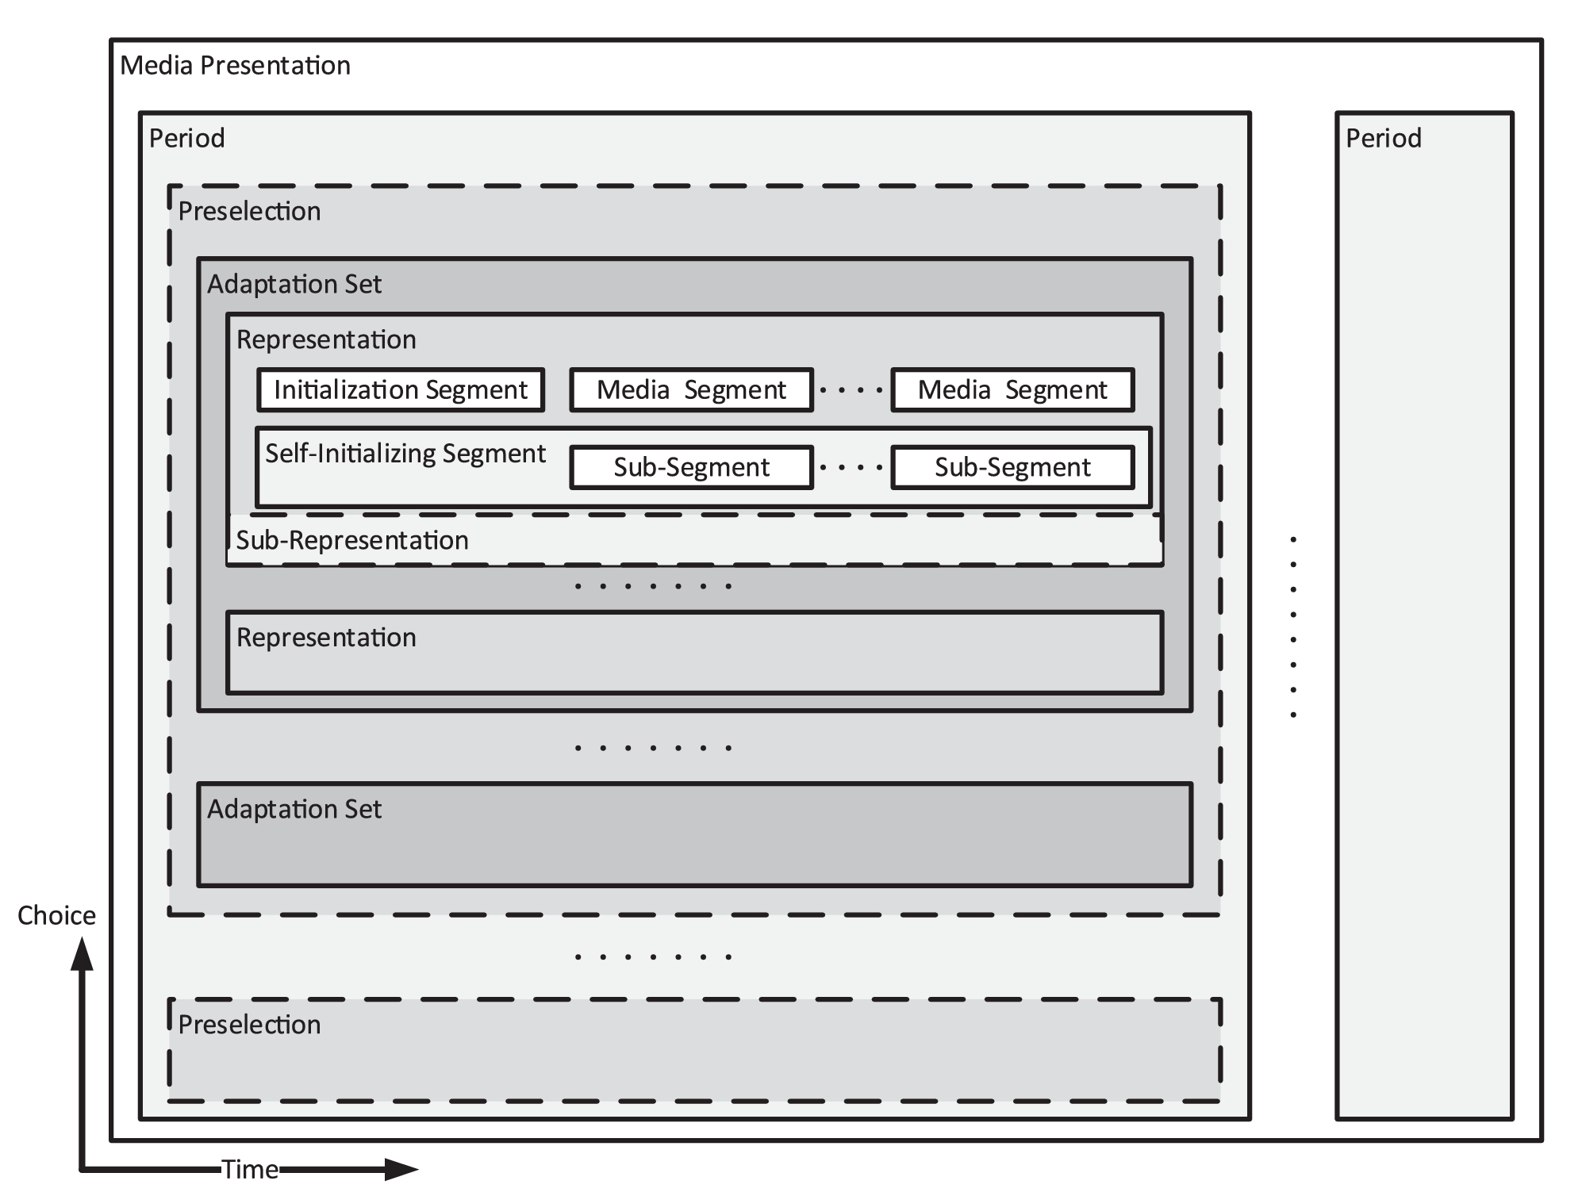
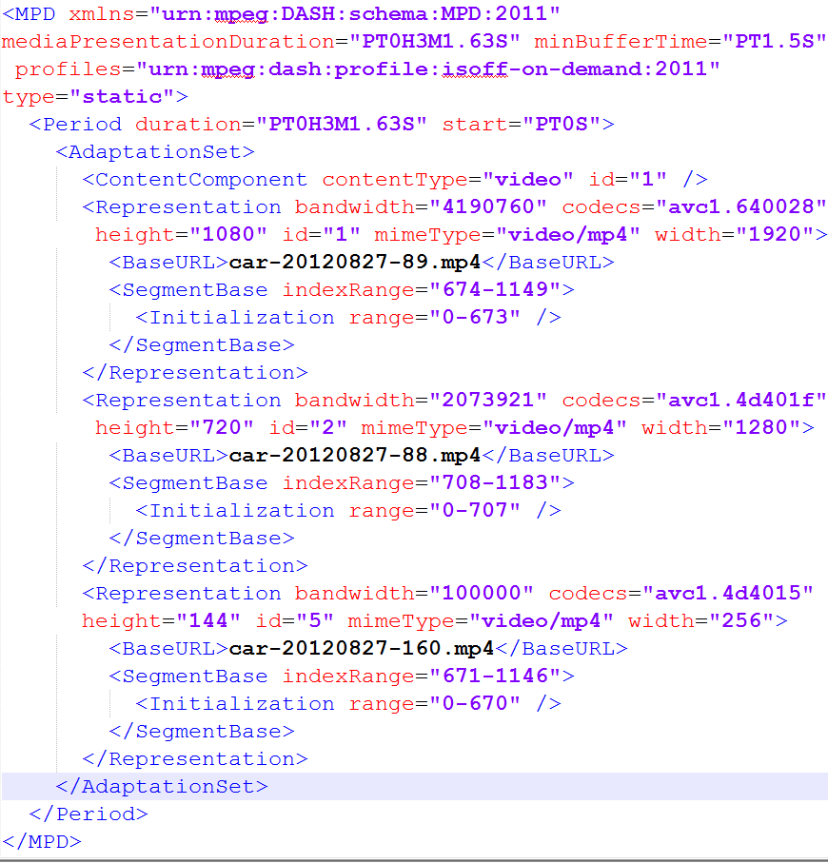
Mapping to DASH

Slide 22
DASH Manifest for Live
Key issue for reducing latency is the reduction of segment duration w/o losing scalability
HLS Manifest states what is available on the server and only provides information on the past, which results in the following
Client sending uplink requests for Manifest prior to each Segment request
A full new manifest needs to be delivered for each new Segment (which also grows over time, so short Segments and Late Binding are more difficult to realize)
The manifest needs to be parsed and processed by client for every request
For each new segment, a new Manifest needs to be written on the server
DASH MPD provides information of the past and permits promises for the future
If used properly, several or all of the above can be mitigated or at least reduced
Functions to support this:
Templates in URLs and predictive segment availability times ➔ small manifests and lower segment sizes
Flexible MPD validity expiration mechanisms ➔ MPD updates only when necessary
Time-synchronized server and client ➔ no requests are necessary

Slide 23
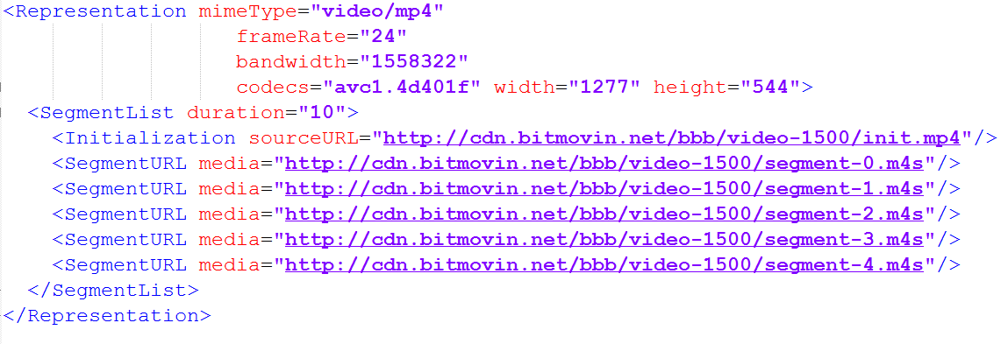
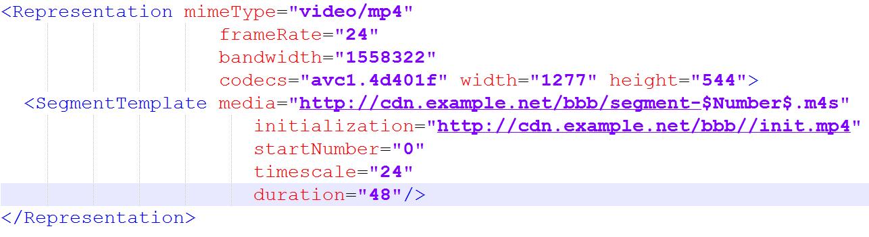
Segment Addressing
List
Number template
Segment-0
Segment-1
Segment-2
......

Slide 24
Server
availabilityStartTime
mediaPresentationDuration
availabilityEndTime
timeShiftBufferDepth
timeShiftBufferDepth=4
1
2
3
4
5
6
7
8
9
MPD(1)
minimumUpdatePeriod
MPD(2)
Client
Playout
suggestedPresentationDelay
1
2
3
4
5
6
7
8
9
MPD Info
1
2
3
4
5
6
7
8
9
FetchMPD(1)
FetchMPD(1)
FetchMPD(2)
1
1
1
1
1
1
1
1
1
1
2
2
2
2
2
2
2
2
2
2
3
3
3
3
3
3
3
3
3
3
4
4
4
4
4
4
4
4
4
4
5
5
5
5
5
5
6
6
6
6
6
6
7
7
7
7
7
7
8
8
8
8
8
8
9
9
9

Slide 25
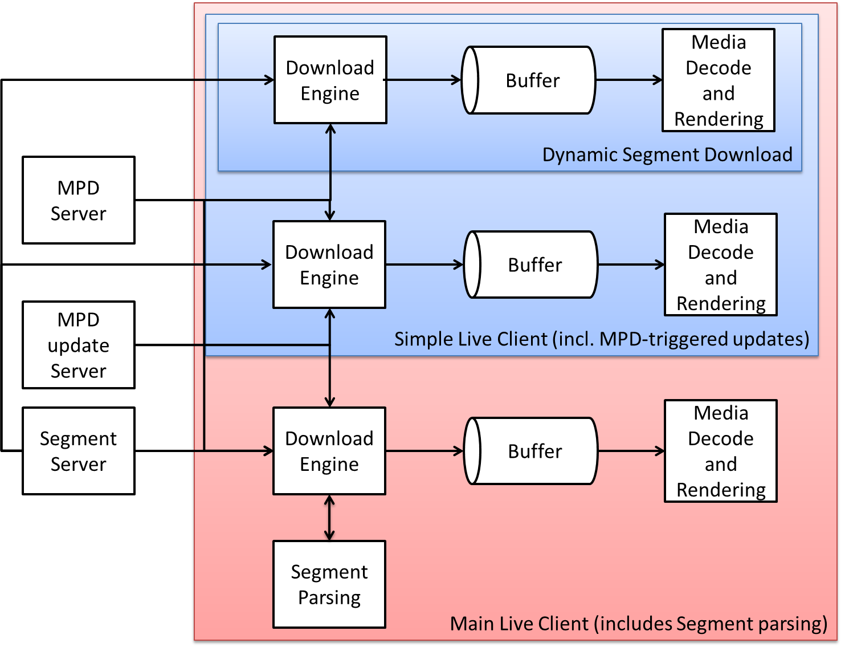
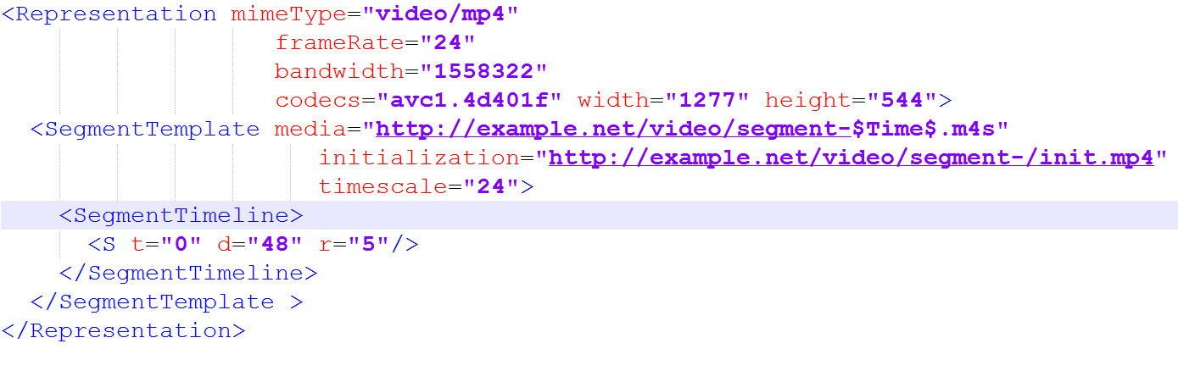
Advanced Client
<InbandEventStream MPD Validity Expiration>
Segment-0
Segment-48
Segment-92
......

Slide 26
Server
availabilityStartTime
mediaPresentationDuration
availabilityEndTime
timeShiftBufferDepth=4
timeShiftBufferDepth
1
5
6
7
8
9
1
2
2
3
4
Inband Events
MPD(1)
MPD(1)
minimumUpdatePeriod = 0
MPD(2)
Client
Playout
suggestedPresentationDelay
1
2
3
4
5
6
7
8
9
MPD Info
8
9
1
2
3
4
5
6
7
FetchMPD(2)
FetchMPD(1)
Download
1
2
3
4
5
6
7
8
9
1
1
1
1
1
1
1
1
1
1
2
2
2
2
2
2
2
2
2
2
3
3
3
3
3
3
3
3
3
3
4
4
4
4
4
4
4
4
4
4
5
5
5
5
5
6
6
6
6
7
7
7
8
8
9

Slide 27
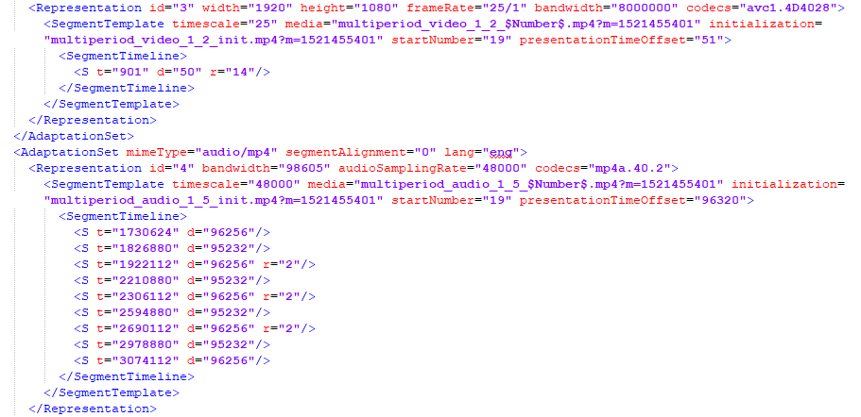
Hybrid Manifests

Slide 28
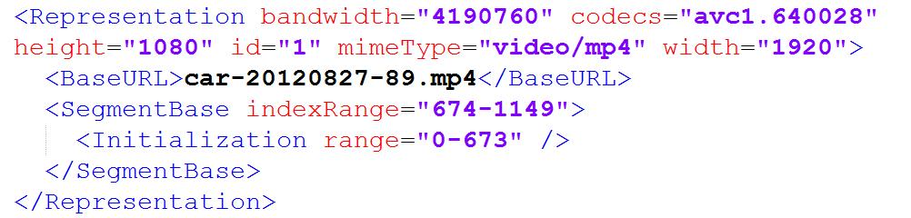
Optimized On-Demand Addressing
Byte range
0
27
673
1149
…
Ftyp
Moov
Sidx
Mdat
Video.mp4
Segment Index is a binary description of accessible units (Fragments/Segments) the Representation
Provides an accurate bitrate over time profile
Can be used by the client for optimized request scheduling

Slide 29
Late Binding
To avoid combinatorial complexity or useless downloads, tracks are offered individually on cloud
Client selects relevant tracks and synchronizes playout
English AAC stereo CMAF Switching Set (single Track)
Audio Selection Set
French AAC stereo CMAF Switching Set (single Track)
English multichannel CMAF Switching Set (single Track)
French multichannel CMAF Switching Set (single Track)
English WebVTT description CMAF Switching Set (single Track)
Subtitle Selection Set
English TTML description CMAF Switching Set (single Track)
French WebVTT dub CMAF Switching Set (single Track)
French TTML dub CMAF Switching Set (single Track)
SD Media Profile CMAF Switching Set (multiple Tracks)
Video Selection Set
HD Media Profile CMAF Switching Set (multiple Tracks)
UHD10 Media Profile CMAF Switching Set (multiple Tracks)

Slide 30
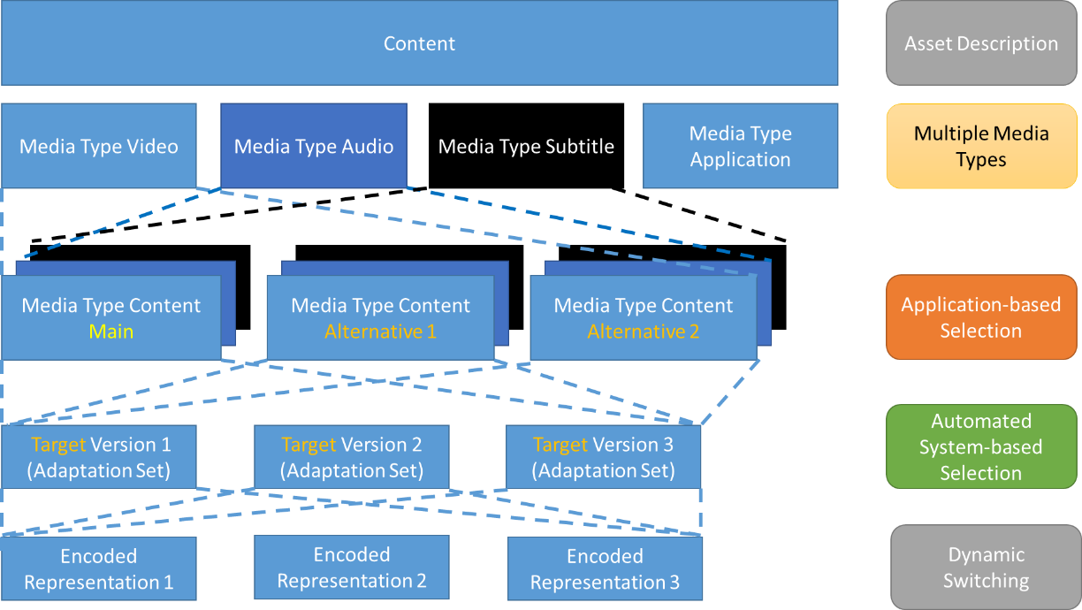
Multitrack Model

Slide 31
Details on Timing Model Across Periods
Element or Attribute Name |  | Use
SegmentTemplate |  | M1,2,3
 | @presentationTimeOffset | OD1,2,3 0
 | @eptDelta | OD1,2,3
 | @pdDelta | OD1,2,3
Element or Attribute Name |  | Use
@type |  | OD
@mediaPresentationDuration |  | O
@availabilityStartTime |  | OD
Period |  | 1 … N
 | @id | OD
 | @start | O
 | @duration | O
Restrictions needed – see later
PST[2] = PST[1] + PD[1]

Slide 32
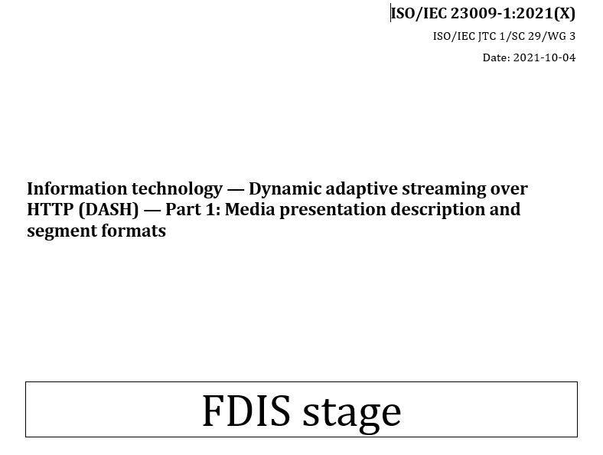
The 5th edition

Slide 33
5th Edition Extensions
DASH profile for using Common Media Application Format (CMAF) are added;
the concept Resynchronization is added in order to identify stream access points in Segments;
MPD patching is updated to support explicit MPD updates of smaller size, not only as inband messages;
a client processing model for Event Streams and Timed Metadata tracks is introduced;
Extensions are added to content protection for efficient signalling and to support robustness levels.
A descriptor is added in order to describe the minimum required device output protection security.
More flexible bandwidth signalling is provided to signal variable bitrate encoding.
Daniel & Zach
Iraj
Alex
Ali

Slide 34
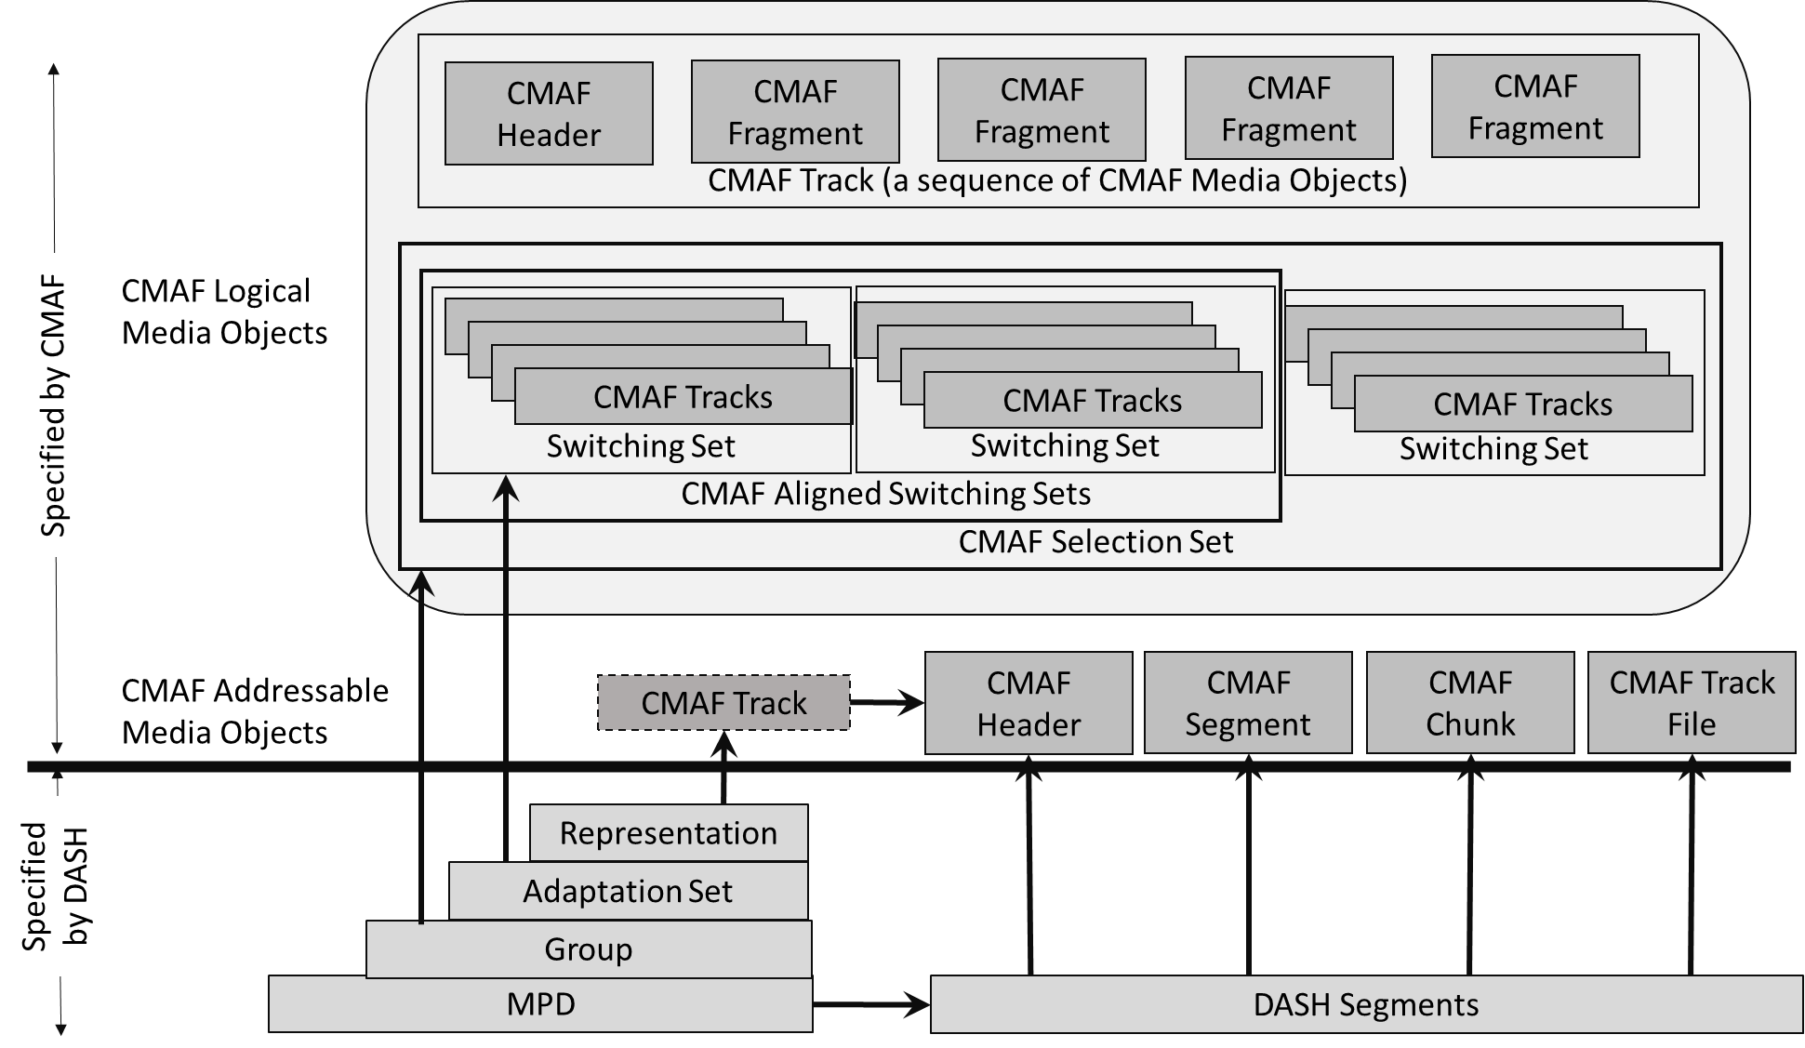
DASH Profiles for CMAF content

Slide 35
Constraints – Documenting the obvious
Segment and Representation Constraints
Mapping of CMAF Resources to DASH Manifest Signaling according to diagram
Adaptation Set Constraints
Mapping of CMAF internal parameters to MPD
Signaling of internal parameters to MPD Adaptation Set parameters for different media type
Content Protection Signaling
Period Constraints
One or multiple CMAF Presentations, differentiated by a Subset
Timeline Mapping including presentation time offset
Multi-Period and Media Presentation Constraints
Detailed sequencing requirements, only overlaps, no gaps
Core Profile: Video Adaptation Set shall be exactly the Period duration
Extended Profile: Video Adaptation Set may overlap at the Period end
MSE and dash.js compatible

Slide 36
Resync – Chunk Signaling
NL 0 | Cardinality | Specification | Constraints | Description
styp | 0/1 | ISO/IEC 14496-12 | DASH/CMAF constraints | Segment Type Signalling compatibility to CMAF Chunk
prft | 0/1 | ISO/IEC 14496-12 | DASH/CMAF constraints | Producer Reference Time
emsg | * | ISO/IEC 23009-1 | DASH/CMAF constraints | Event Message
free | * | ISO/IEC 14496-12 | none | free box
skip | * | ISO/IEC 14496-12 | none | skip box
moof | 1 | ISO/IEC 14496-12 | DASH/CMAF constraints | Movie Fragment box and the boxes it contains
mdat | 1 | ISO/IEC 14496-12 | DASH/CMAF constraints | Media Data container for media samples
signaling the existence of Resynchronization Points in a Media Segment with additional information that permits to easily locate the Resync Point.
Time
Type
Resync
Marker
Resync
Resync
Resync
Index

Slide 37
dT
SAP 1
SAP 1
SAP1
SAP1
SAP <=1
<AdaptationSet id="0" contentType="video" segmentAlignment="true" frameRate="10/1" maxWidth="960" maxHeight="400" par="12:5">
<ProducerReferenceTime id="0" inband="true" type="encoder" wallClockTime="2020-02-19T10:42:02.667Z" presentationTime="0">
<UTCTiming schemeIdUri="urn:mpeg:dash:utc:http-xsdate:2014" value="http://time.akamai.com"/>
</ProducerReferenceTime>
<Resync type="0" dT="500000" dImin="0.03125" dImax="0.09375"/>
<SegmentTemplate timescale="1000000" duration="8000000" availabilityTimeOffset="7.500" availabilityTimeComplete="false" initialization="init-stream$RepresentationID$.m4s" media="chunk-stream$RepresentationID$-$Number%05d$.m4s" startNumber="1"/>
<Representation id="0" mimeType="video/mp4" codecs="avc1.640016" bandwidth="500000" width="960" height="400" sar="1:1" qualityRanking="5"/>
<Representation id="1" mimeType="video/mp4" codecs="avc1.640016" bandwidth="200000" width="720" height="300" sar="1:1" qualityRanking="2"/>
<Representation id="2" mimeType="video/mp4" codecs="avc1.640016" bandwidth="300000" width="720" height="300" sar="1:1" qualityRanking="1">
<Resync type="2" dT="1000000" dImin="0.1" dImax="0.15" marker="true"/>
</Representation>
</AdaptationSet>
dI
dT
SAP 1
SAP 3
SAP 1
SAP 3
SAP1
SAP 3
SAP1
SAP 3
SAP <=3
dI

Slide 38
Resynchronization
Use cases
Low latency streaming and fast access to the service
Fast channel acquisition in broadcast services
Low latency streaming and resynchronization after losses or buffer underruns
Fast down-switching in low duration buffer cases
Fast and efficient seeking to time
Client Processing Resync and Restart
Finding the box structure within the Segment
Finding a proper Resynchronization Point including with all relevant information that are needed to start parsing and decoding
Finding the earliest presentation time that is presented
Processing of Event messages, if applicable
Obtaining all decryption relevant information, if applicable
Start decoding on elementary stream level

Slide 39
Content Protection
Element or Attribute Name |  |  | Use | Description
 | ContentProtection |  |  | specifies information regarding a content protection or encryption scheme used to encrypt and/or protect the associated Representation(s)
 |  | @schemeIdUri | M | identifies a content protection or encryption scheme.
 |  | @value | O | provides additional information specific to the content protection or encryption scheme. For example, it may provide information such as DRM version, encryption mode, etc. For details, refer to 5.8.4.1.6.
 |  | @ref | O | If present, makes this a referencing content protection descriptor that inherits from a “source” content protection descriptor which is identified by the equivalent value of @refId attribute. For details, refer to 5.8.4.1.3. The attribute shall not be present if the @refId attribute is present.
 |  | @refId | O | specifies an identifier of this descriptor. The identifier shall be unique within an MPD. The attribute shall not be present if the @ref attribute is present.
 |  | @robustness | OD | specifies the robustness level required for this content protection scheme for accessing content represented by the associated Representation(s). For more details refer to 5.8.4.1.2 and 5.8.4.1.6. If not present, then the lowest robustness level for the identified content protection scheme applies.

Slide 40
DASH-IF

Slide 41









Who we are?
http://www.dashif.org
DASH Industry Forum (DASH-IF) was founded in 2012 to promote and catalyze the adoption of MPEG-DASH and help transition it from a specification into a real business.
With more than 80 members, DASH-IF represents a large footprint of the ecosystem, including service providers, content delivery network operators and broadcasters, as well as technology providers in different domains, and connects the dots in an otherwise fragmented world of internet streaming services.
DASH-IF also serves as the point of contact for other standards organizations when introducing new DASH-based distribution means.

Slide 42
How do we operate?
Steering Board
General Meeting
Interop WG
Promotion WG
Academic Track
Live TF
Ad Insertion TF
Content Protection and Security TF
Audio TF
Event and Metadata TF (jointly with W3C)
ATSC 3.0 TF (jointly with ATSC)
NAB @ Hofbräuhaus
IBC @ Heineken
Ingest TF
Test Asset TF
Dash.js
Exploration webRTC
We try to be lean, agile, flexible and open …
Weekly or bi-weekly calls in working groups and active task forces. Two annual f2f meetings.
Development of specifications, guidelines, liaison based on work items and github issues
Publication of guidelines through DASH-IF web page: http://www.dashif.org
Community Reviews for public
PAS Agreement with ETSI established to publish specifications.
Commissioning and sponsoring of conformance, reference and test tools

Slide 43
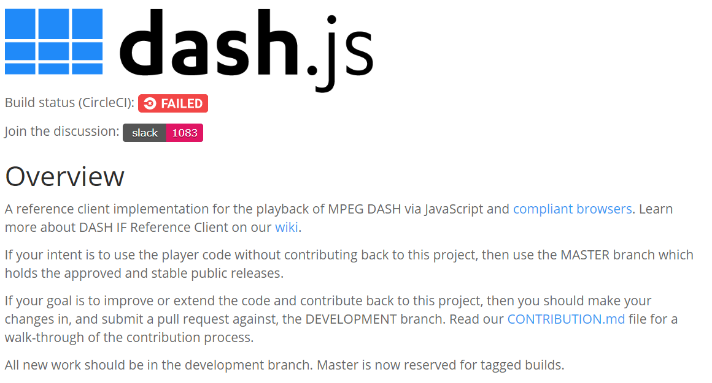
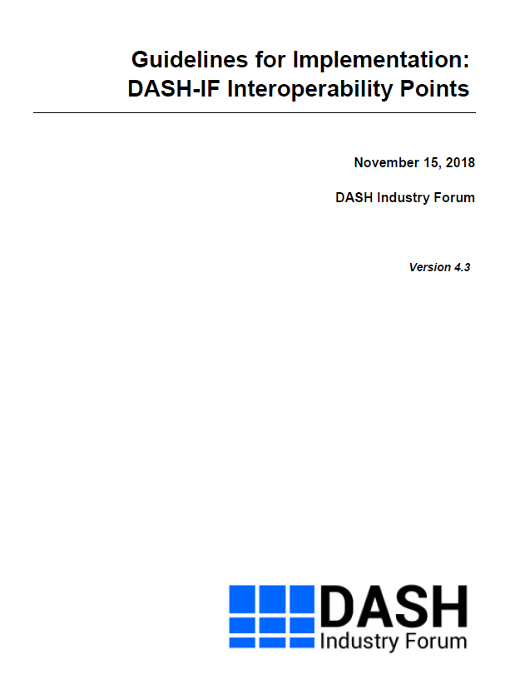
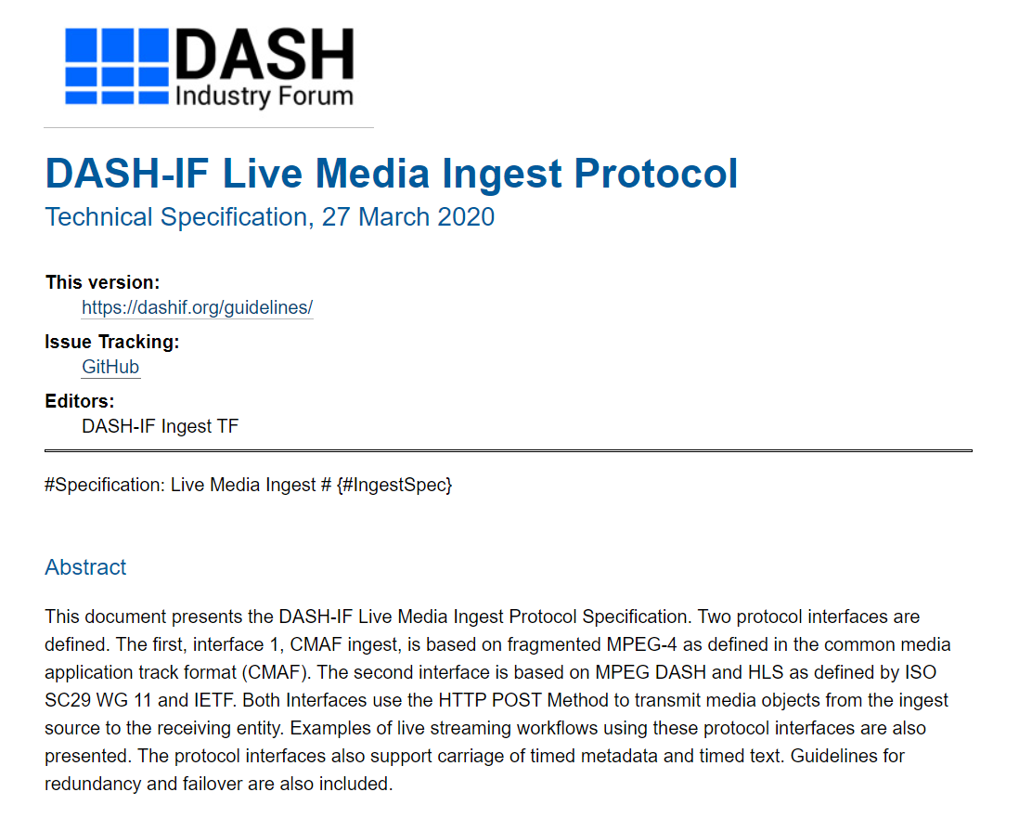
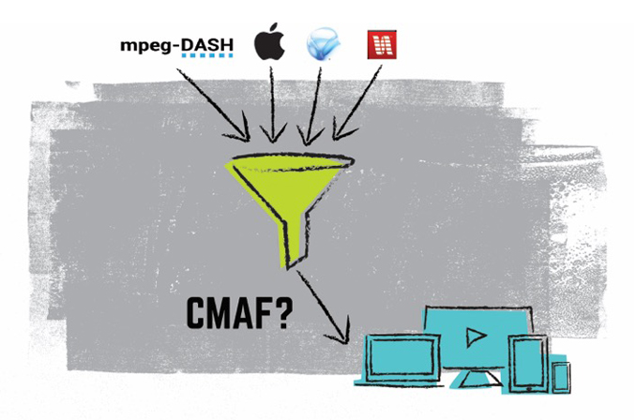
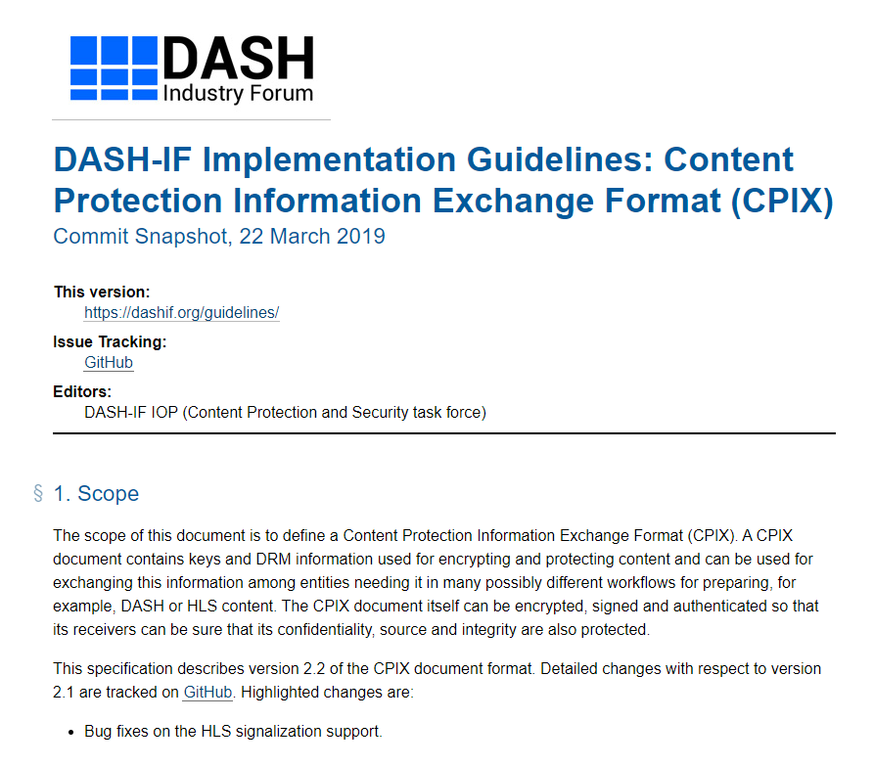
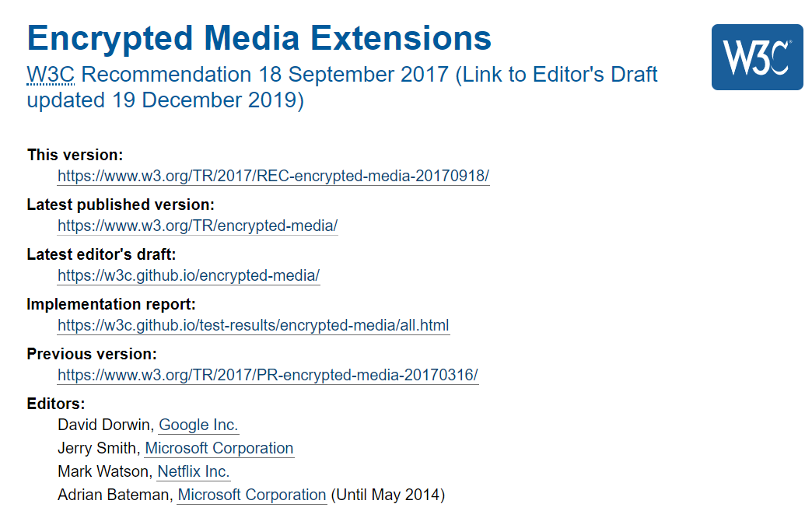
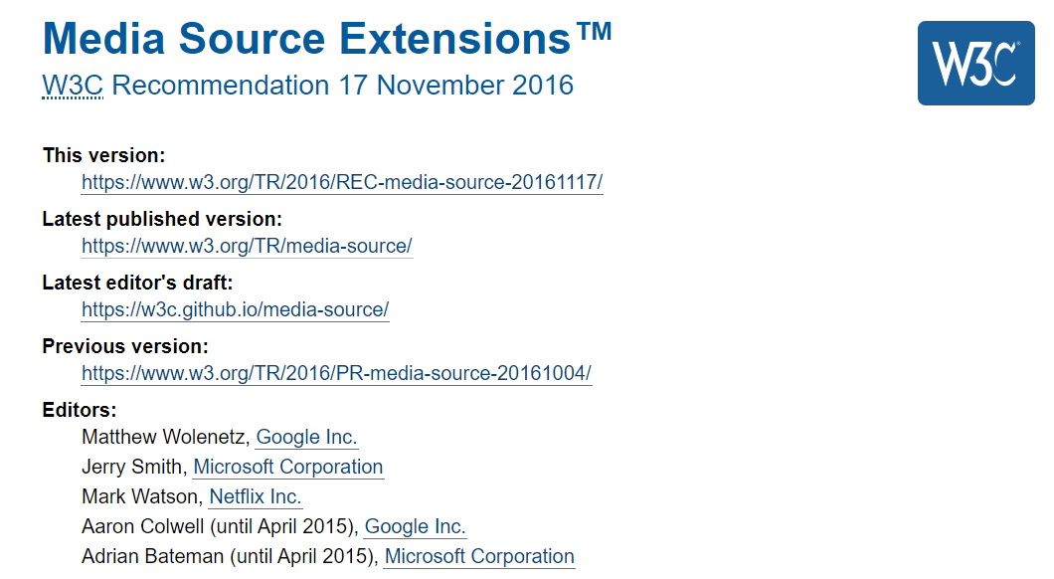
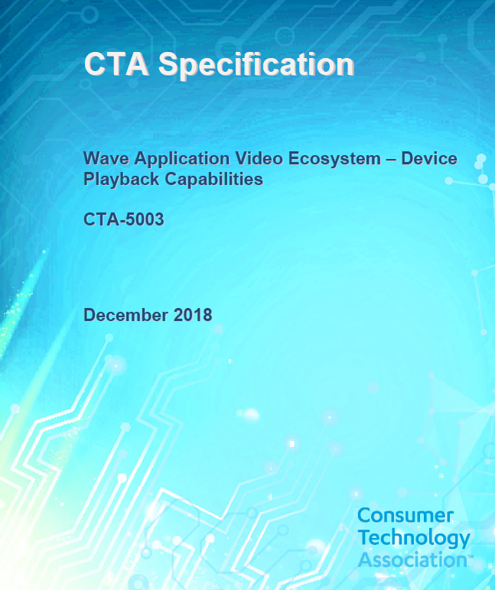
Interoperability – v5
DASH-IF IOP Guidelines

Slide 44
12 parts: https://dashif.org/guidelines/iop-v5/
Part 1: Overview, Architecture and Interfaces
Part 2: Core Principles and CMAF Mapping
Part 3: DASH On-Demand Services
Part 4: DASH Live and Low Latency Services
Part 5: Ad Insertion and Content Replacement
Part 6: Content Protection and Security
Part 7: Video
Part 8: Audio
Part 9: Text
Part 10: Events
Part 11: Additional Technologies
Part 12: Conformance and Reference Software

Slide 45
Low-Latency Streaming with Chunking
MPD
Service Description
IS
Encoder
0.5s
CNC
CNC
CIC
CNC
CNC
CIC
CH
DASH Packager
DASH Segment
4 s
HTTP Chunk
HTTP Chunk
CH = CMAF Header
CNC
CNC
CIC
CNC
CNC
CIC
CNC = CMAF non-initial chunk
CIC = CMAF initial chunk
CDN stores Segments
10s
Regular
DASH Client
Segments
Many technical details are in DASH-IF IOP v5
http://www.dashif.org/guidelines
3s
Low-Latency
DASH Client
Chunks

Slide 46
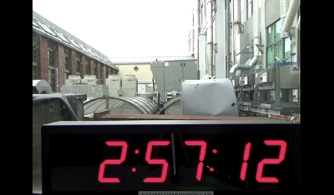
Chunked Segment Distribution
ENCODER
CDN
PLAYER
MDAT
MDAT
MDAT
MOOF
MOOF
MOOF
MDAT
MDAT
MDAT
MDAT
MDAT
MDAT
MDAT
MDAT
MDAT
MDAT
MDAT
MDAT
MOOF
MOOF
MOOF
MOOF
MOOF
MOOF
MOOF
MOOF
MOOF
MOOF
MOOF
MOOF

Slide 47
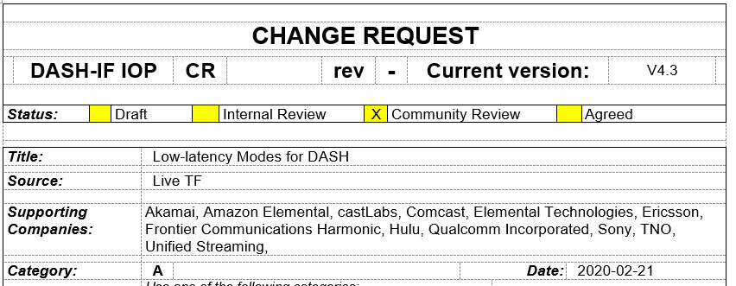
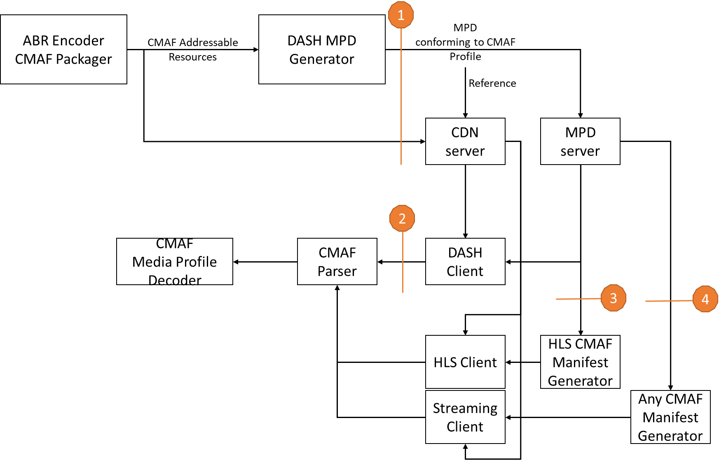
MPEG DASH supporting work
As part of ISO/IEC 23009-1 4th and 5th edition
Producer Reference Time in MPD and segments
Enables media encoding including wall-clock anchor times
Permits DASH client to determine, monitor and control latency.
Service Description
Addresses service provider’s influence on DASH client operation
Target Latencies, Playback Control
Updates on Event Processing
DASH Profile for CMAF Content
Resynchronization
Enables chunk signaling
Enables fast downswitching and random access

Slide 48

Advantages of Chunked Segments
Legacy Player Support with the same content/infra
CDN friendly: Cacheability and Scalability
Decoupling of latency from segment duration
Reuse or Automatic support of existing DVB-DASH
Codecs and formats
Common Encryption
Ad Insertion
Events
Standards-based and promise for convergence
Works also with ABR Multicast and Broadcast

Slide 49
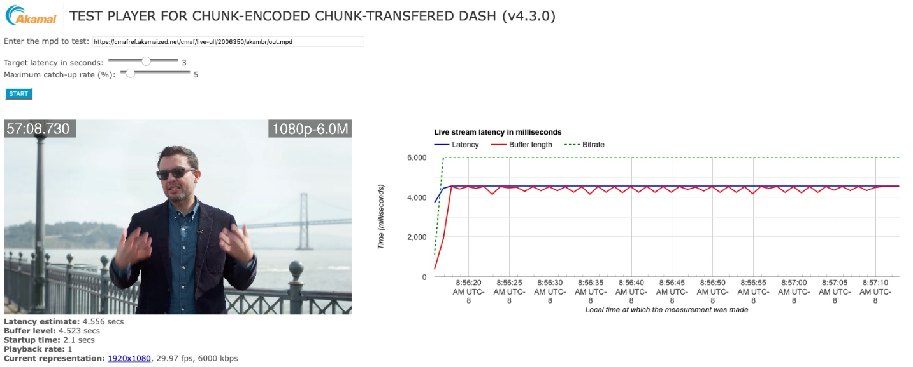
Notes:
http://mediapm.edgesuite.net/will/dash/lowlatency/low-latency-public-variable.html?latency=3&url=https://epicdash.akamaized.net/cmaf/live-ull/2038468/epic/out.mpd
http://mediapm.edgesuite.net/will/dash/lowlatency/low-latency-public-variable.html?latency=3&url=https://cmafref.akamaized.net/cmaf/live-ull/2006350/akambr/out.mpd
These are MBR live DASH streams, played back by dash.js, encoded in Boston and distributed over Akamai CDN. It will start at whatever target latency you set in the query arg, but then while the stream is playing you can drag the latency slider lower and it will adjust in real time.

Slide 50
Example 2: DASH-IF Ad Insertion Architecture
Independent Content Generation
Main
Content
CMAF
Spliced Content
CMAF
Ad Content
CMAF

Slide 51
Other highlights
Content Protection
MPEG CMAF format protected by MPEG CENC
Support of key rotation
Enhanced Clear Key Content Protection (ECCP)
DASH-IF XML schema with elements related to content protection
Audio/Video/Text
Addition of CMAF Profiles
Codecs Registration for DASH: https://dashif.org/codecs/introduction/
Updates to Ingest specifications
Encoder synch based on epoch lock
Manifest description/restriction for CMAF ingest
Encoder input loss and last segment signaling
MPEG-B part 18 support and other improvements signaling emsg and timed metadata
Example reference implementation (e.g., FFmpeg)
Segment per post, several other media restrictions usage of common encryption
Deprecate some smooth legacy (mfra, Streams(), etc.)

Slide 52
More than just specs: Test, Reference and Conformance

Slide 53
Dash.js by Numbers
261
Github watchers
1500
Github forks
1100
Github projects that use dash.js
4.2k
Github Stars
159
Github contributors
42
releases

Slide 54
What‘s next?

Slide 55
MPEG and DASH-IF
Content Steering
Alternative MPD Events for Server Guided Ad Insertion
Nonlinear playback
Addressable Resource Index Track
DASH Period Event
DASH-IF
Low-Latency and Fast Joining using Addressable Resync Representations
Server Guided Ad Insertion
Server-based Watermarking
DASH and webRTC streaming
MPEG Amd.1
Input from other organizations
CTA WAVE and CMAF
3GPP, 5G-MAG, DVB and ATSC

Slide 56
ARI Track
The ARI Track is time-aligned with the tracks of the CMAF Switching Set.
The ARI Track documents properties of all tracks of the CMAF Switching Set
One sample represents a CMAF chunk in a time-aligned manner.
The sample contains detailed information for the chunk in each of the tracks in the switching set
size, timing, SAP types, quality, predictive bitrate into the future
This track may even be used to carry for example Events or Producer Reference time for the Media Presentation.
A client may use the Track for fast random access, optimized scheduling, variable bitrate streaming.
The ARI Track may also be used by network entities to predict bitrate

Slide 57
ARI Track in live mode
DASH Segment
Encoder
HTTP Chunk
HTTP Chunk
CNC
CNC
CIC
CNC
CNC
CIC
CH
DASH Packager
CNC
CNC
CIC
CNC
CNC
CIC
CNC
CNC
CIC
CNC
CNC
CIC
CH
CNC
CNC
CIC
CNC
CNC
CIC
1
Chunking
ARI Track
2
Delay
3
2
1
Segments
Delay
3
2
1
Time-Shift
Delay

Slide 58
Addressable Resync Representation
Issues:
If in low-latency operation, client may need to down-switch
When joining, client may have to wait for segment boundary
In seek mode, the segment duration determines the frequency
Idea:
Add dedicated Addressable Resync representations into Adaptation Sets
In combination with ARI Track, even more advanced operation possible

Slide 59
Content Steering
<MPD xmlns:xsi="http://www.w3.org/2001/XMLSchema-instance" xmlns="urn:mpeg:dash:schema:mpd:2011" xsi:schemaLocation="urn:mpeg:dash:schema:mpd:2011 DASH-MPD.xsd" type="dynamic" minimumUpdatePeriod="PT30S" timeShiftBufferDepth="PT30M" availabilityStartTime="2022-02-25T12:30:00" minBufferTime="PT4S" profiles="urn:mpeg:dash:profile:isoff-live:2011">
<ContentSteering defaultServiceLocation="beta" queryBeforeStart="true">https://steeringservice.com/app/instance12345</ContentSteering>
<BaseURL serviceLocation="alpha">https://cdn1.example.com/</BaseURL>
<BaseURL serviceLocation="beta">https://cdn2.example.com/</BaseURL>
<Period id="1">
<AdaptationSet mimeType="video/mp4" codecs="avc1.4D401F" frameRate="30000/1001" segmentAlignment="true" startWithSAP="1">
<BaseURL>video/</BaseURL>
…
</AdaptationSet>
</Period>
</MPD>
{
"VERSION": 1,
"TTL": 250,
"RELOAD-URI": "https://steeringservice.com/instance12345?session=abc"
"PATHWAY-PRIORITY": ["alpha","beta"]
}

Slide 60
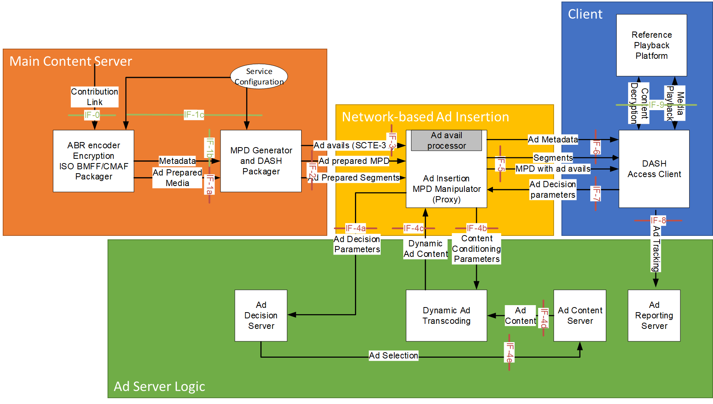
Server Guided Ad Insertion

Slide 61
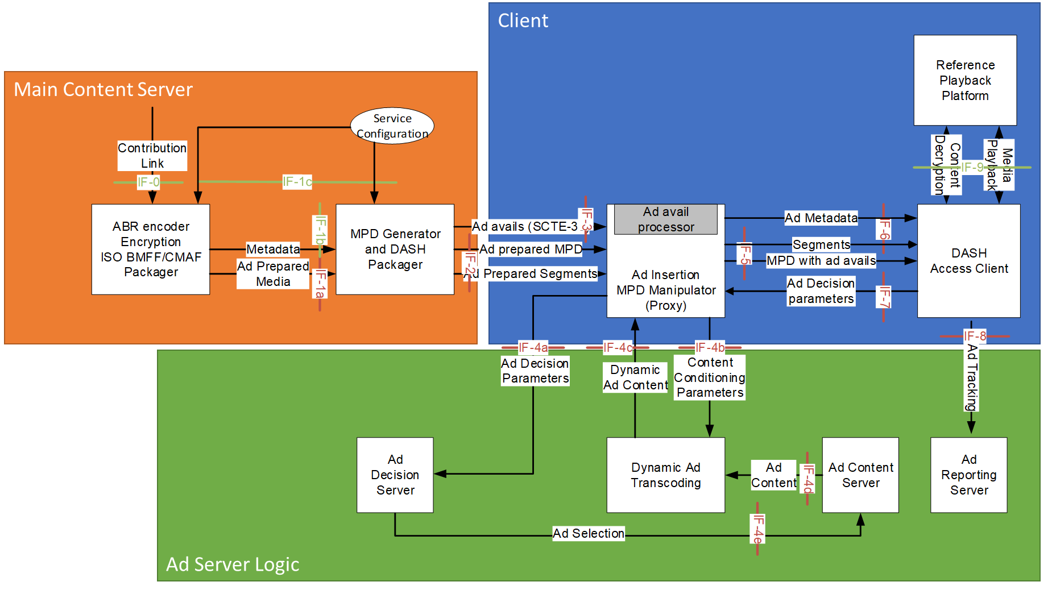
Server Guided Ad Insertion
Instead of comple SCTE-35 logic, simplified Event and processing model

Slide 62

DASH and webRTC
On March 1st, 2022, DASH-IF published a first report on combining DASH and webRTC-based streaming.
This report describes use cases made possible by integrating WebRTC Streaming into the DASH workflows as well as the technical considerations that should be taken into account in order to achieve successful integration. The document is primarily informative and information-collecting.
It serves as a preparation and guidance for future technical work in the context of DASH and webRTC-based Streaming.
The report was developed by public collabortion under the hospices of DASH-IF in an exploration TF lead by Julia Kenyon and Ali C. Begen.
Any comments may be submitted through the github issues.
Based on these recommendations, along with the report, DASH-IF also launched a survey on potential next steps - please respond by April 15, 2022.

Slide 63
Selected other presentations and posters
“Overview of the DASH-HLS Interoperability Specification, 2021 Edition”, Zachary Cava (Disney Streaming)
“Session-Based DASH Streaming: A new MPEG standard for customizing DASH streaming per session”, Iraj Sodagar (Tencent America); Alex Giladi (Comcast)
“Latest Advances in the Development of the Open-Source Player dash.js”, Daniel Silhavy, Stefan Pham, Stefan Arbanowski, Stephan Steglich (Fraunhofer FOKUS); Bjoern Harrer (Deutsche Telekom AG)
Extend CMAF Usage for Large Scale Video Delivery”, Lucas Gregory, Khaled Jerbi, Mickael Raulet, Eric Toullec (ATEME)
“Marrying WebRTC and DASH for Interactive Streaming”, Julia Kenyon (Phenix RTS); Thomas Stockhammer (Qualcomm); Ali C. Begen (Ozyegin University / Networked Media); Ofer Shem Tov (Edgecast); Louay Bassbouss, Daniel Silhavy (Fraunhofer FOKUS)

Slide 64
Wrap up

Slide 65
Market Adoption
DASH used in major companies, very much so in Europe.
Which of the top 10 broadcasters in any country are not using DASH?
In the US, HLS is still quite dominant, but DASH/HLS convergence accelerates DASH
Questions about license and royalty fees for DASH seemed to have vanished.
Significant adoption in application standards: DVB, HbbTV, SCTE, ATSC, 5G, TV 3.0
DASH is a collaborative effort
Not a single sponsor
Coordination across SDOs
Very mature for large scale deployments
Still full of ideas and innovation
Please join us in DASH-IF http://dashif.org

Slide 66




Thank you

