Slide 1

Welcome Workshop: DASH-IF to SVTA
September 17, 2024
Thomas Stockhammer (Qualcomm Incorporated)
DASH-IF Interoperability (IOP) WG Chair ➔ DASH-IF WG Co-chair

Slide 2
Agenda
13:00 Welcome (15min)
Roll Call
Introduction by JT
Introduction by Alex
13:15 DASH-IF Overview (Thomas, 30min)
Working Groups and Task Forces
Working Methodologies (Meetings, Github)
Web Site Intro
Publications:
Guidelines and Specifications
Identifiers
Registries
Partner Organizations
13:45 Test Tools (45min)
Introduction to dash.js (Daniel, 20min)
Live Sim 2 (Tobbe, 15min)
Other Tools (Thomas, 10min)
14:45 Coffee Break
15:00 Emerging Topics
Media/QUIC/DASH (Will, 10min)
C2PA (Thomas)
15:00 Task Force Overview
Content Protection Work (Laurent, 30min)
Live and Ad Insertion (Alex/Thomas/Zach, 20min)
Media: Video and Audio (Stephan/Thomas, 15min)
Ingest, Events, etc. (10min)
16:15 AOB and Wrap up
16:30 Close of Session
Break
17:00 Start of MPEG DASH AHG Session
19:00 End for MPEG-DASH AHG Session

Slide 3

Thank you to SVTA for the warm welcome!
Jason Thibeault, Florencia Dazzi, Hali Morek, Lindsey Richardson

Slide 4
13:00 Welcome (15min)
Roll Call
Introduction by JT
Introduction by Alex

Slide 5
13:15 DASH-IF Overview
Working Groups and Task Forces Working Methodologies (Meetings, Github) Web Site Intro Publications Partner Organizations

Slide 6









Who we are?
http://www.dashif.org
Founded in 2012 to promote and catalyze the adoption of MPEG-DASH and transition it from a standard to a deployed ecosystem.
With up to 80 members, DASH-IF represented a large footprint of the ecosystem:
Service providers and broadcasters
CDN and client implementors
Technology providers
DASH-IF serves as the point of contact/coordinator for other standards organizations using DASH-based distribution.

Slide 7
How do we operate?
Live & Ad Insertion TF
Around 100 calls
just in 2023
Content Protection &
Security TF
We tried to be lean, agile, flexible and open …
Audio TF
Weekly/bi-weekly calls by working groups and various task forces. Two->one annual f2f meetings.
Development of specifications, guidelines, white papers, and collaboration with consortia
Receive community reviews from public before publication
DASH-IF publication are available free of charge to public @ http://www.dashif.org
PAS Agreement with ETSI to publish DASH-IF specifications as ETSI specs.
Renewed in 2023
Commissioning & sponsoring of conformance, reference and test tools, and test vector generation
Ingest TF
Event and Metadata TF
Interop WG
ATSC 3.0 TF
(jointly with ATSC)
Test Asset TF
Joint Conformance Project
Steering Board
dash.js project
(open source)
General Meeting
Live Sim 2
Special Sessions
Liaison
NAB Networking Event
Promotion WG
IBC Networking Event
Academic Track
Workshops

Slide 8

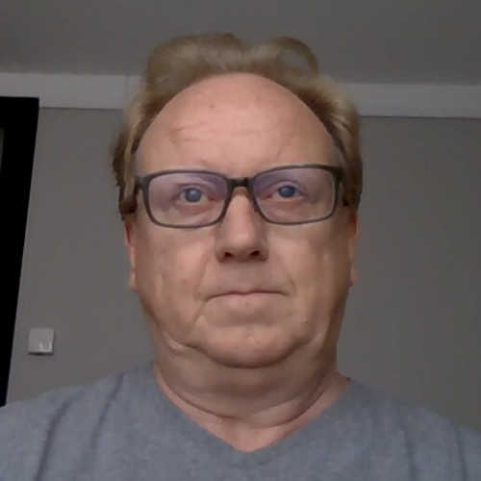
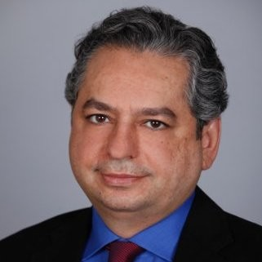

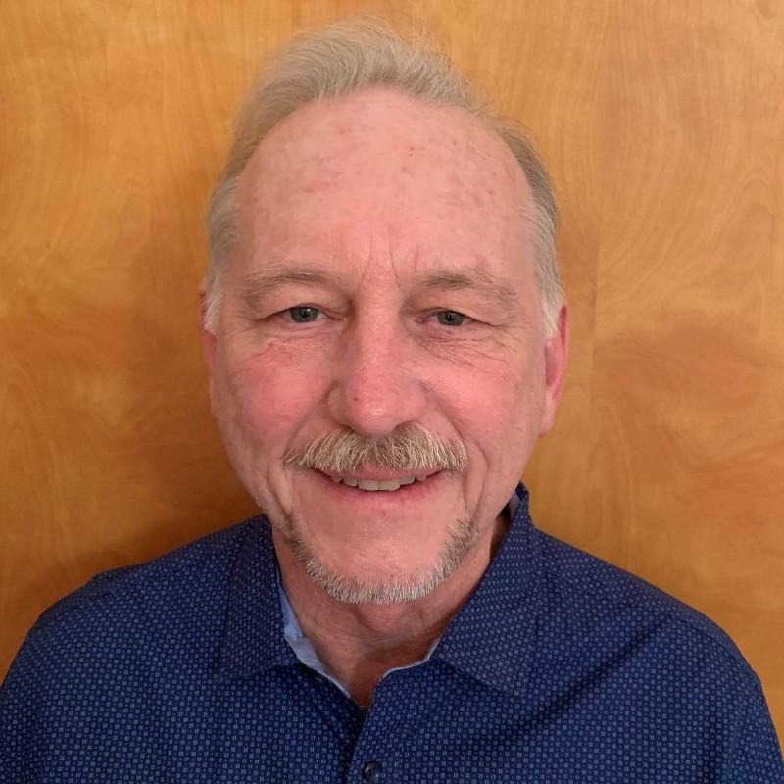


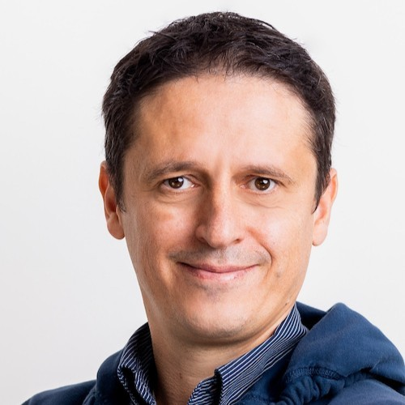

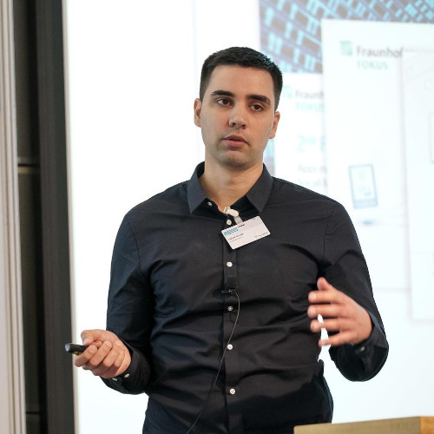
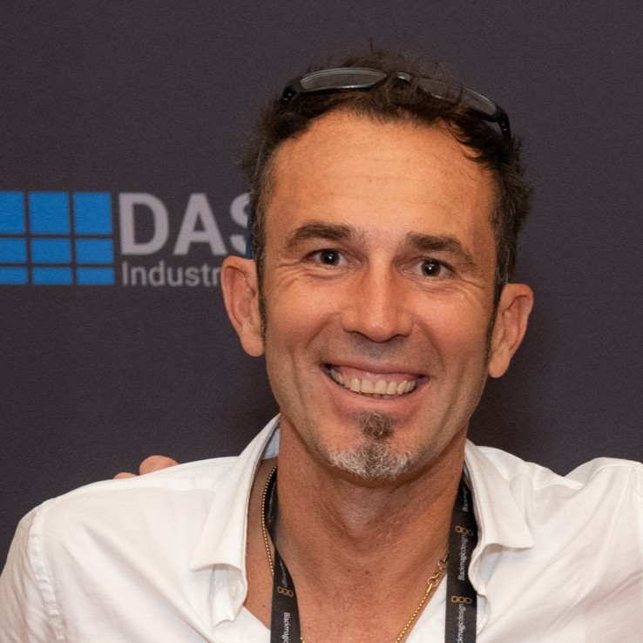

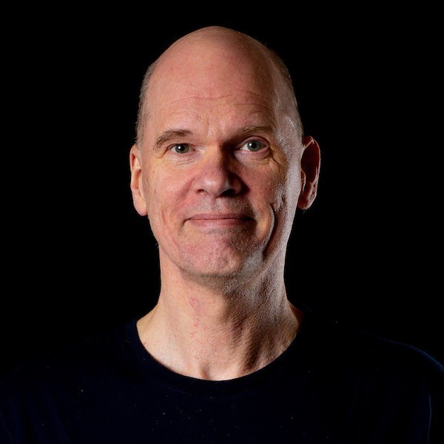


Stephan Schreiner (Dolby)
Philipp Maness (Xperi)
Iraj Sodagar
Ali C. Begen
Michael Dolan
Alex Giladi (Comcast)
Laurent Piron (Nagra)
Christian Timmerer
Will Law (Akamai)
Daniel Silhavy (Fraunhofer)
Thomas Stockhammer (Qualcomm)
Mohammad Raad (Unified Streaming)
Torbjörn Einarsson (Eyevinn)
Zachary Cava (Hulu)
Olga Kornienko(EZDRM)

Slide 9

Since 197x in streaming: Yuriy Reznik

Slide 10

Live & Ad Insertion TF
Content Protection &
Security TF
Audio TF
Ingest TF
Event and Metadata TF
Interop WG
ATSC 3.0 TF
(jointly with ATSC)
Test Asset TF
Joint Conformance Project
Steering Board
Liaison
dash.js project
(open source)
General Meeting
Live Sim 2
Special Sessions
Web site
Promotion WG
IBC Networking Event
Academic Track
Workshops

Slide 11
How is this mapped back to SVTA?
Live & Ad Insertion TF
Content Protection &
Security TF
Audio TF
DASH-IF WG
Live and Ad Insertion
JCCP
Partners
Audio
Video
Dash.js
Live Sim2
Interop Activities
Content Protection and Security SWG
Ingest
Event and Metadata
General
ATSC profile
Special Sessions
SVTA Liaison
SVTA Promotions
Tools
Others
Ingest TF
Event and Metadata TF
Interop WG
ATSC 3.0 TF
(jointly with ATSC)
Test Asset TF
Joint Conformance Project
Steering Board
dash.js project
(open source)
General Meeting
Live Sim 2
Special Sessions
Liaison
NAB Networking Event
Promotion WG
IBC Networking Event
Academic Track
Workshops

Slide 12

Web Page: https://dashif.org
Guidelines => hosts all specifications, more to come
Tools ➔ we will speak about this in the next session
Identifiers: A list of identifiers for Metadata in DASH ➔ more to come
Codecs: Codec Registration for DASH ➔ later session
Academic: summaries the events in academia
Events: ➔ summary of internal and external events
News: regular news about DASH-IF
https://github.com/Dash-Industry-Forum/Dash-Industry-Forum.github.io

Slide 13
Guidelines
https://dashif.org/guidelines/earlier-versions/
Process
Completed Specifications and Guidelines: The documents below are stable and have undergone a community review.
Documents for community review: These documents are technically solid, but public is asked for comments in order to improve details.
Latest version from 2018: Guidelines for Implementation: DASH-IF Interoperability Points V4.3
Low-Latency Modes for DASH | (Bugtracker)
DASH events and timed metadata tracks timing and processing model and client reference model | (Bugtracker)
Audio Amendment to Guidelines for Implementation: DASH-IF Interoperability Points, Version 4.3 | (Bugtracker)
DASH-IF implementation guidelines: content protection and security | (Bugtracker)
Advanced Ad Insertion in DASH(updated Dec 14,2020) | (Bugtracker)
Guidelines for Implementation: DASH-IF Interoperability Point for ATSC 3.0
Additional documents on web site, but have been "deprecated"
Also be aware of the IPR declarations: https://dashif.org/ipr-declarations/

Slide 14
Specifications
https://dashif.org/guidelines/specifications/
DASH-IF has a Publicly Available Specifications (PAS) agreement with the European Telecommunications Standards Institute (ETSI) to publish DASH-IF documents as ETSI specifications. In the process of publishing through ETSI, DASH-IF still provides early drafts of the candidate specifications and runs community reviews and draft publications of candidate specifications. Also, DASH-IF collects errata or smaller updates to ETSI specifications that are then rolled into a new version of an ETSI specification at appropriate time.
DASH-IF Technical Specification (ETSI TS 104 002): DASH-IF Forensic A/B Watermarking
DASH-IF Technical Specification (ETSI TS 103 998): Content Steering for DASH
DASH-IF Technical Specification (ETSI TS 103 799): Content Protection Information Exchange Format

Slide 15
v5
Part 1: Overview, Architecture and Interfaces
Editor: Thomas
Part 2: Core Principles and CMAF Mapping
Editor: Thomas
Part 3: DASH On-Demand Services
Editor: Thomas
Part 4: DASH Live and Low Latency Services
Editor: Thomas
Part 5: Ad Insertion and Content Replacement
Editor: Zach Hulu
Published: https://dashif.org/guidelines/iop-v5/
Part 6: Content Protection and Security
Editor: Laurent Piron
Github: https://github.com/Dash-Industry-Forum/Guidelines-Security
Document: https://members.dashif.org/wg/Interoperability/document/4611
IPR review initiated - ready by Dec 23, 2021
Part 7: Video
Editor: Ye-kui Wang (Bytedance)
Waiting for final implementation of Yekui
Part 8: Audio
Thomas to publish
Part 9: Text
Editor: Mike Dolan
Ready for publication
Part 10: Events
Editor: Iraj Sodagar
https://github.com/Dash-Industry-Forum/Events
Part 11: Additional Technologies
Editor: Nicolas Weil (Elemental)
Thumbnail Tracks
Metadata Tracks
Query and Token mechanism
document what exists in dash.js - application-based
Annex I is not implemented as it seems
Part 12: Conformance and Reference Software
Editor: Mike Dolan, Daniel, Thomas (conformance group)
Completed – needs publication
Editor: Phil Maness
Final edits

Slide 16
Issue with v5
Much legacy in v4.3
Conversion to CMAF happened
Blocks publication of new features

Slide 17
Feature-based specification
Features as defined in part 1 of DASH-IF IOP
MPEG-DASH is defined as an extensible framework to support different deployment scenarios. Over time, additional functionalities were added. In addition, MPEG-DASH defines optional functionalities that may be relevant only for certain deployment scenarios. Based on this, DASH permits different deployment features.
In the context of the DASH-IF Interoperability specifications, such features are introduced. A feature typically consists of different aspects:
the feature description, i.e. what it is used for and how can it be used
the signalling of the feature in the MPD, i.e. how can the feature be enabled
the content authoring requirements, i.e. what needs to be provided by the content authoring such that the DASH media presentation conforms to the feature
the requirements for the client to support the feature
Features in a DASH media presentation may be optional for the DASH client, for example it can ignore the feature if it does not support it. A typical example is, if the same media is provided with two different codecs, but the client only supports one of those, it can ignore the media provided with the other codec. There are other cases, for which the feature is mandatory to be supported by the DASH client in order to present the media presentation. Hence, it is expected that DASH clients support a certain set of features, if they want to consume a Media Presentation.

Slide 18
Feature Documentation
Feature Tags
Status, Contributors, Last Updated, version, classification (live, DRM, on-demand, Ad Insertion), related features, githubs for issues.
Introduction and Motivation, Use Cases
High-level description of the feature
Specification Text
Signaling in the MPD to support the feature
Requirements and Guidelines for Content Authors
Requirements and Guidelines for Client Implementation
References (can be also to our IOP guidelines)
Example MPDs
Reference Implementation (links, status,
Dash.js
Live Sim
Test Vectors
JCCP

Slide 19
Feature documentation
https://github.com/Dash-Industry-Forum/DASH-IF-IOP/
How:
Thasso Griebel has setup an authoring workflow based on github, markdown and bikeshed
Authoring Documentation
Backend: https://github.com/Dash-Industry-Forum/DASH-IF-IOP/Spec
Features
Live to VoD Conversion
MPD Patch
Content Steering
Lower Latency and Switching Delay DASH (L3D)
Common Media Client Metadata (CMCD) in DASH

Slide 20
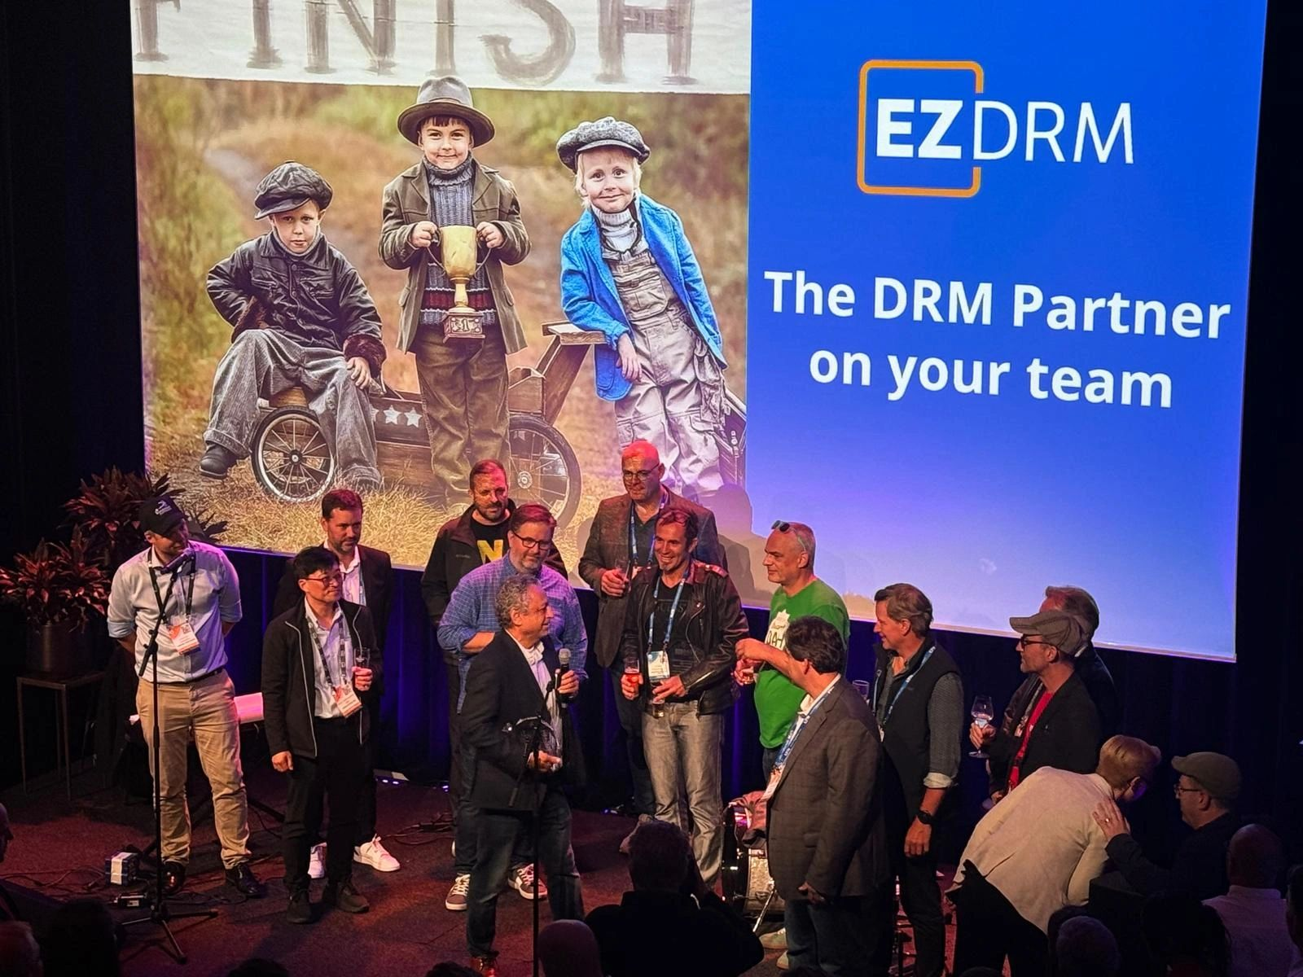

Events
https://dashif.org/events/events/
DASH-IF Social Events at IBC and NAB
Since 2013 we organize social events
In recent years only at IBC - flagship
DASH-IF face-to-face member meetings
In total we had 24 f2f meetings between 2012 and 2024
DASH-IF organized workshops
Dec 9-10, 2019 - Portland, OR, USA: DASH IF Workshop on Media Streaming Meets 5G
Aug 20-12, 2015 - San Diego, CA, USA: Video meets mobile -The 5G Opportunity
DASH-IF supported events (conferences, symposia)
March 31, 2020, Online: DVB World 2020: Joint DVB/DASH-IF Webinar
OSMART#1: https://dvb.org/news/event/osmart-workshop-1/
OSMART#2: https://dvb.org/news/event/osmart-workshop-2/
DASH-IF Special Sessions (Online Events)

Slide 21
Events: Special Sessions – Thoughts for new work
Since pandemic in 2020 we have had special sessions
https://dashif.org/events/special-sessions/
Online events, open to public, invited presentations, 3-4 per year, Friday 7:30am pacific
https://dashif.org/events/special-sessions/#special-sessions-2023
DASH-IF A/B Watermarking
DASH-IF Open Source and Reference Tools - Breaking News on Live-Sim and dash.js
December 1, 2023: Media Over QUIC (MOQ)
https://dashif.org/events/special-sessions/#special-sessions-2024
April 5, 2024: MPEG-DASH 6th Edition Features
June 7, 2024: DASH-IF Special Session: Content Authenticity and Provenance in DASH
Further plans for 2024
Presentation by Dolby on Coded Multisource Media Format (CMMF)
Presentation by CTA WAVE on Streaming Test Suite

Slide 22
Other Aspects
Slack – will be continued
Github: https://github.com/Dash-Industry-Forum/
around 50 repos that will be maintained
Some pruning may be needed at some point in time
Relation to MPEG

Slide 23
13:45 Test Tools (45min)
Introduction to dash.js (Daniel, 20min) Live Sim 2 (Tobbe, 15min) Other Tools (Thomas, 10min)

Slide 24
More than just specs: Reference and Conformance Tools

Slide 25
Conformance and Reference Resources
JCCP
DASH-IF Conformance Validator is used to validate DASH Media Presentations against the requirements and recommendations of a DASH Media Presentation profile
open source software available on GitHub at https://github.com/Dash-Industry-Forum/DASH-IF-Conformance. This tool is also hosted by DASH-IF at https://conformance.dashif.org/
Live validator: http://vm1.dashif.org/DynamicServiceValidator
DASH-IF Reference Player dash.js is a free, open source MPEG-DASH player that serves as a JavaScript reference client for implementing production-grade players
at https://github.com/Dash-Industry-Forum/dash.js and https://reference.dashif.org/dash.js
Public Test assets for client developers (also reference and examples for developers)
Static test assets https://testassets.dashif.org/
DASH-IF live emulator service is at https://livesim.dashif.org
Extensions for FFMPEG to support LL-DASH: https://ffmpeg.org/ffmpeg-formats.html#dash-2
Is this perfect? No! Please help to improve, contribute and consider sponsoring
Excellent
Problematic
Live Sim 2
Nice

Slide 26
dash.js – Status Update
Daniel Silhavy – SVTA Face-to-Face Meeting Antwerp 2024

Slide 27
Agenda
Introduction
Documentation
(Version 4)
Version 5
Main Features
Open Todos
Next steps

Slide 28
Introduction

Slide 29
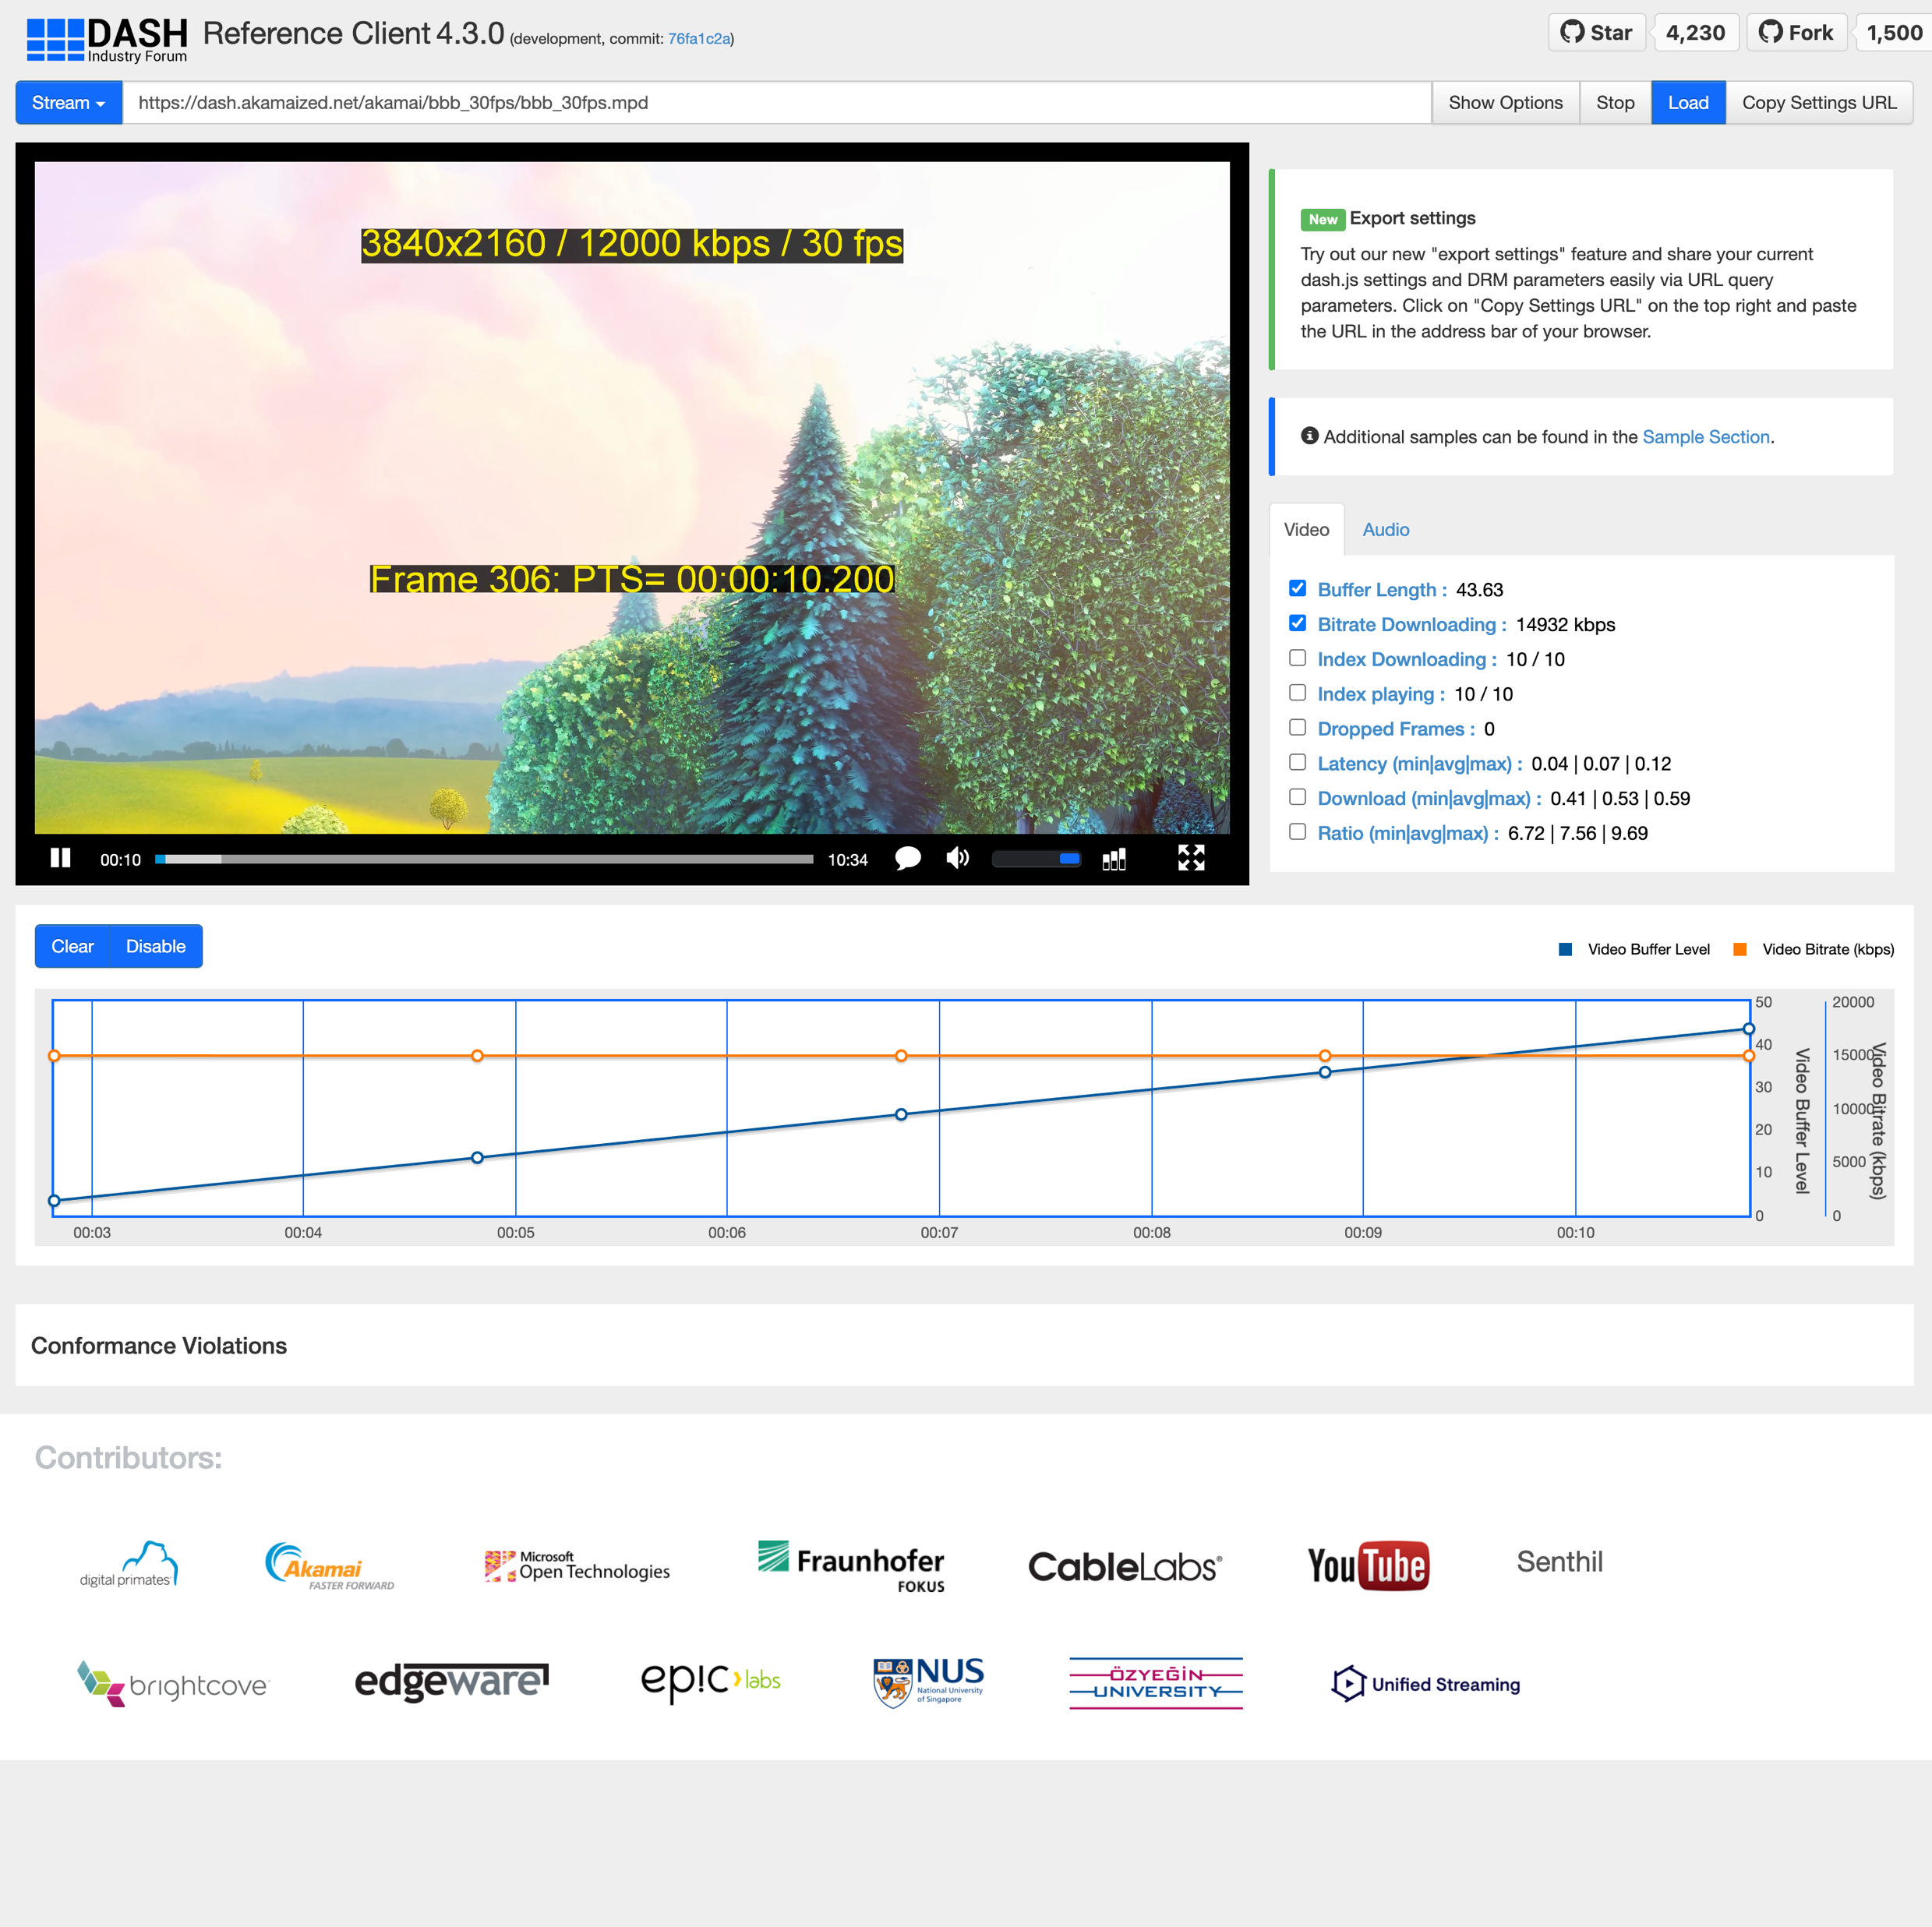
dash.js – Overview & Status
dash.js is the official reference player by the DASH Industry Forum / SVTA for playback of MPEG-DASH content
Maintained by Fraunhofer FOKUS, community driven development
Open-source project on Github - https://github.com/Dash-Industry-Forum/dash.js/ , last released version 4.7.4
Written in JavaScript uses the W3C Media Source Extensions (MSE) and Encrypted Media Extensions (EME)
Works on all MSE and EME based platforms including Desktop browsers, smartphones, SmartTVs, Set-Top Boxes.
Various features including flexible ABR logic, multiperiod, DRM support, MPD patching, Gap handling, CMCD, CMAF low latency support, support for various subtitle formats (TTML, IMSC1, WebVTT) and many more.
https://reference.dashif.org/dash.js/nightly/samples/dash-if-reference-player/index.html

Slide 30










dash.js – Numbers & Stats & Logistics
55 releases
> 5100 stars
251 watchers
> 1.700 forks
180 contributors
103 dependents
Monthly developer calls
Discussions on
Slack (1881 members)
Github
Google Groups (1206 members)
3.180.000 downloads
2023

Slide 31
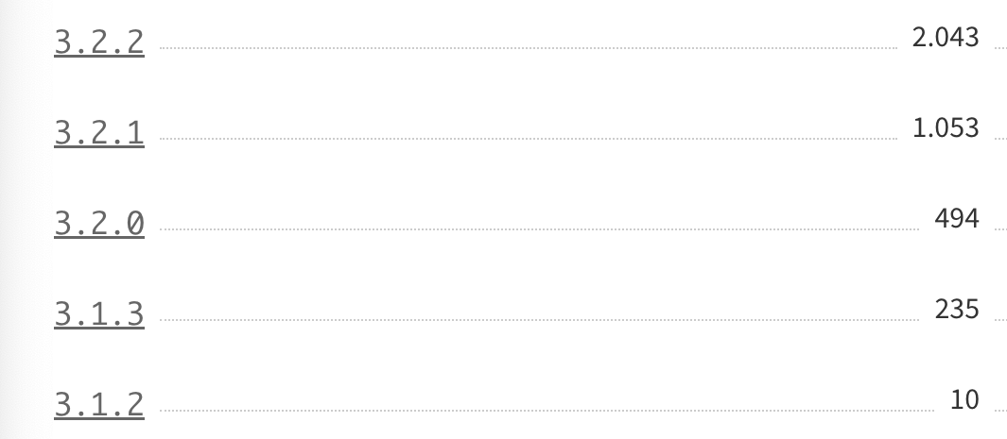
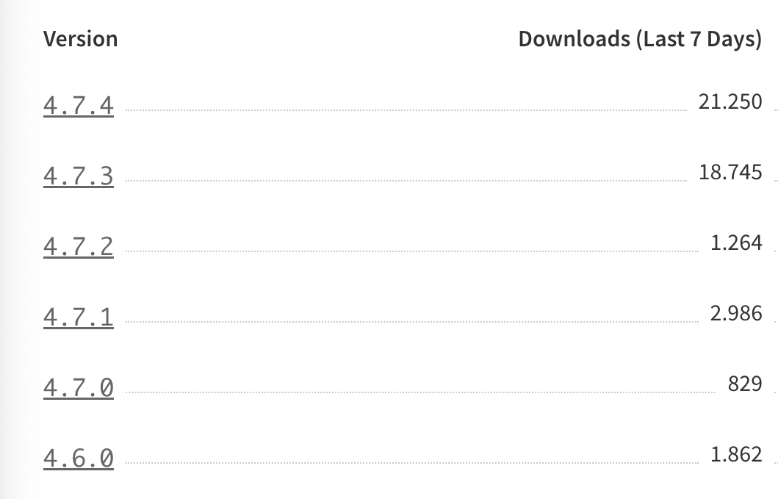
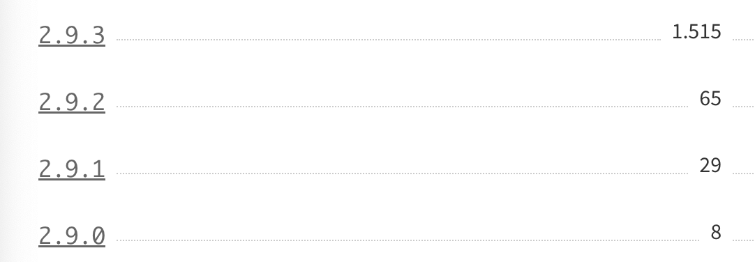
NPM numbers by version (September 2024)
See https://www.npmjs.com/package/dashjs
Most users on latest version of dash.js

Slide 32
dash.js – Application areas
Reference projects
Industry
Research
Implements latest features from DASH-IF IOP guidelines and ISO/IEC specification.
Used by other organizations in their reference implementations
CTA-WAVE
DVB-I
HbbTV
5G-MAG
(SVTA)
Used in production for instance by BBC, Deutsche Telekom, ARTE, Mediaset Spain
Used to compare behavior of commercial players against reference player
Used for research purposes, for instance to test and compare new ABR algorithms (Twitch challenge)
Evaluate new features such as MPD patching and CMCD

Slide 33
Related Open-Source Projects & Activities & Synergy
HbbTV
https://github.com/HbbTV-Association/ReferenceApplication
Media Source Extensions (MSE) support was introduced in the last published HbbTV 2.0.3 Version
Opportunity: Type 3 Reference Player for HbbTV devices
5G-MAG
https://github.com/5G-MAG
Used for playback of DASH content transmitted via broadcast (FLUTE encoded)
Potentially used for 5G Media Streaming on Android Application
Opportunity: Reference Player for 3GPP specifications
DVB
https://github.com/DVBProject/DVB-I-Reference-Client
Playback of DVB-I DASH streams
CTA-WAVE
Expertise from dash.js development to define MSE testcases for DPCAT
Use dash.js as a reference platform to verify content

Slide 34
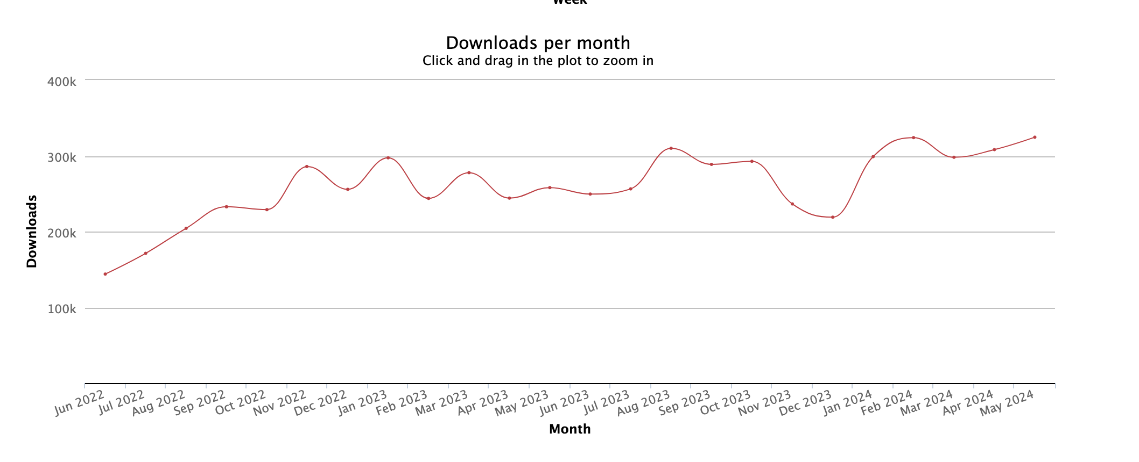
dash.js NPM download statistics

Slide 35
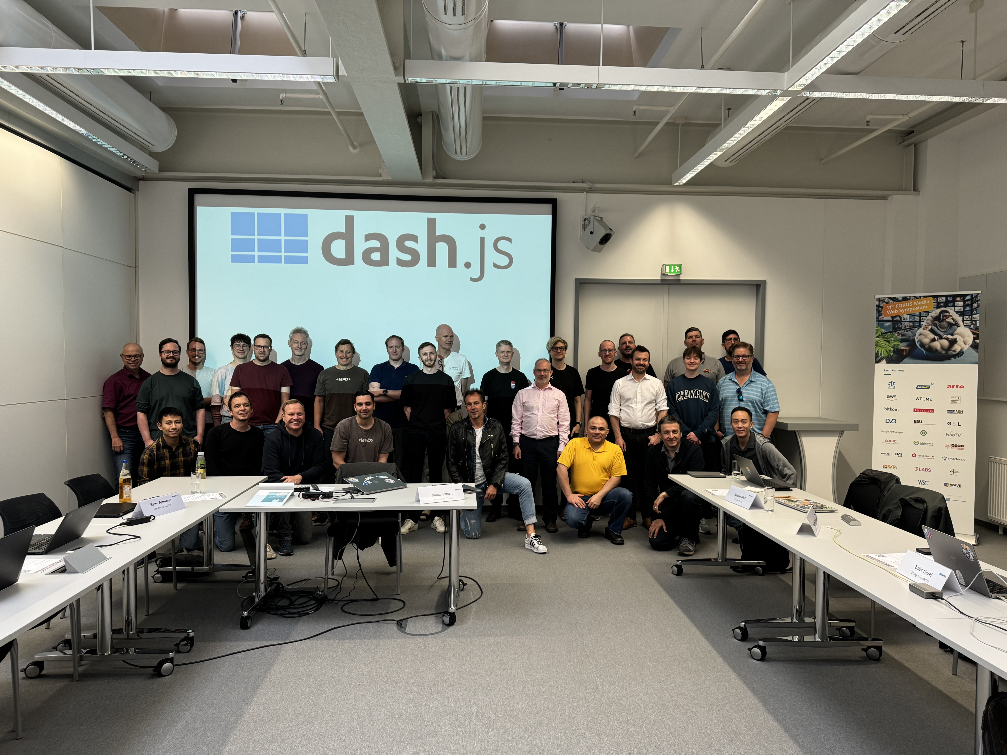
Annual face to face meetings co-located with the Fraunhofer FOKUS MWS and the DASH-IF face to face
More information: https://www.fokus.fraunhofer.de/go/mws/program

Slide 36
Websites and documentation

Slide 37
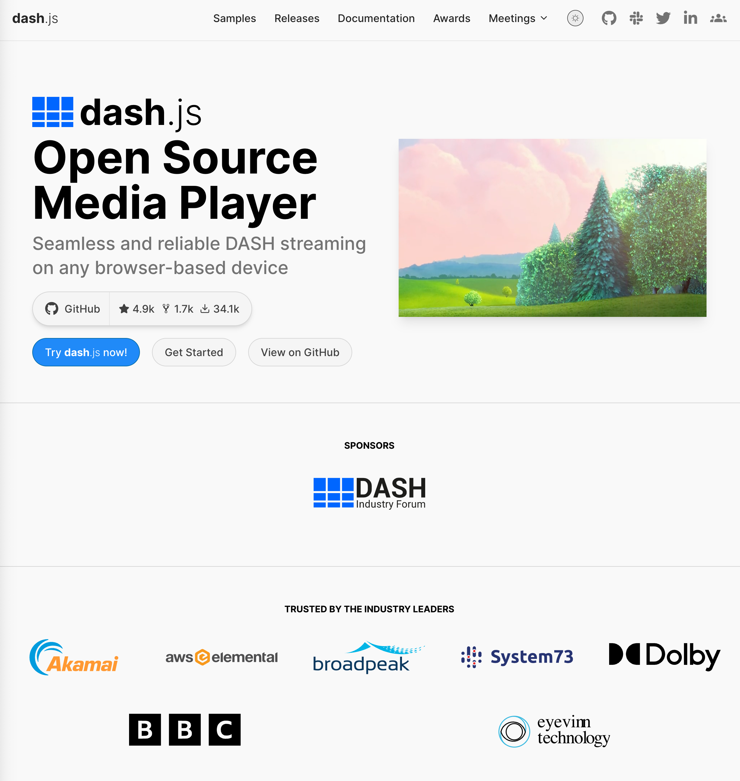
Landing page
https://dashjs.org/
Developed by Deniz Ugur and Ali Begen

Slide 38
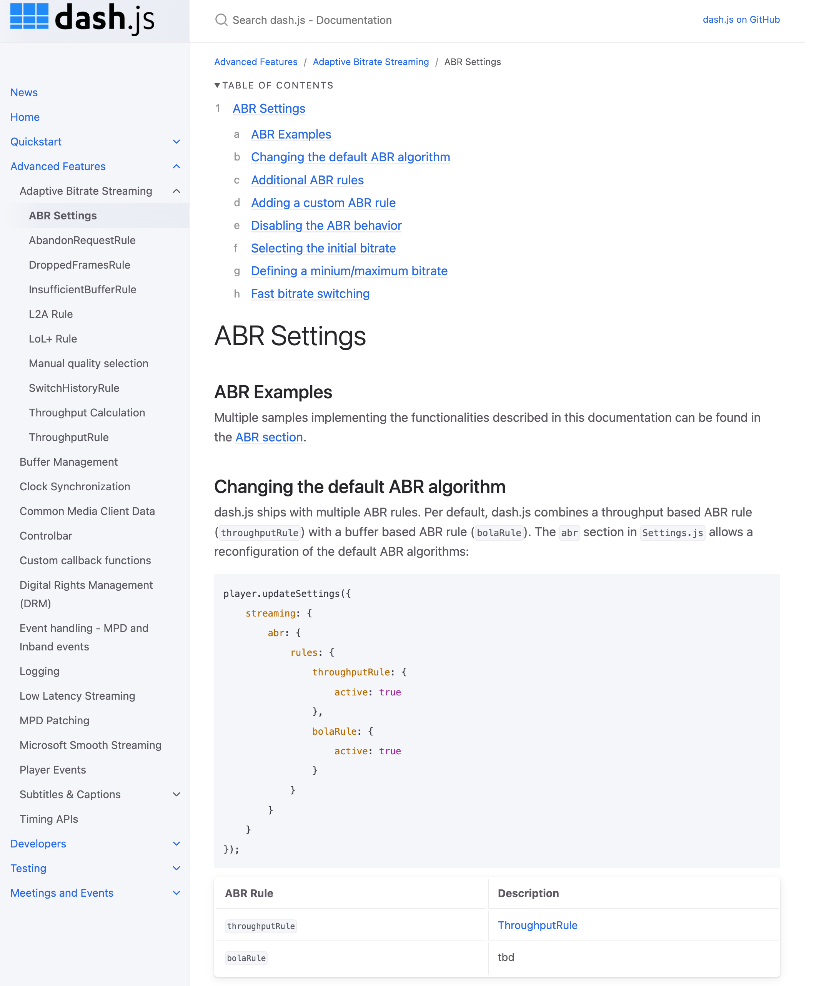
New Documentation page
https://dashif.org/dash.js/
Starting point for every user of dash.js
Documentation is based on version 5 of dash.js and will be announced together with the release of v5

Slide 39
Version 4
Releases and Features: May 23 – June 24

Slide 40
Version 4.7.0
Released on May 5, 2023
Detailed release notes: https://github.com/Dash-Industry-Forum/dash.js/releases/tag/v4.7.0
Support for DASH content steering version 0.9.7 including support for pathway cloning and steering elements
Support for inband prft box parsing
Allow preloading content with a specific start time
Fix blinking cues when segmented over multiple segments or chunks
Add DescriptorType model class to MediaInfo for elements of type viewpoint, role, accessibility, audioChannelConfiguration

Slide 41
Version 4.7.1
Released on June 21, 2023
Detailed release notes: https://github.com/Dash-Industry-Forum/dash.js/releases/tag/v4.7.1
Improvements to L2A algorithm based on MMSys Research Paper by the BBC
Enhancements to the Reference UI to auto start playback and mute playback by default
Bugfixes
Fix reporting of CMCD parameters for SegmentBase range requests
Fix handling of MPDs containing SegmentList

Slide 42
Version 4.7.2
Released on September 28, 2023
Detailed release notes: https://github.com/Dash-Industry-Forum/dash.js/releases/tag/v4.7.2
Adds a functional testsuite based on the Karma framework
Reset MSE when switching codec if changeType() is unstable or unavailable (enabled via settings flag)
Define target web and es5 for webpack to make build files ES5 compliant
Add support for replacing a text node via MPD patching

Slide 43
Version 4.7.3
Released on Dec 8, 2023
Detailed release notes: https://github.com/Dash-Industry-Forum/dash.js/releases/tag/v4.7.3
Add support for playback using the Managed Media Source
Use “onstartstreaming”, “onendstreaming” to start and stop segment scheduling
Update all URLs to Livesim. Use Livesim2 instead of Livesim1
Add new BBC R&D Test Streams to Reference Player
Remove outdated cues from track when adding a new cue to avoid memory leaks

Slide 44
Version 4.7.4
Released on Feb 20, 2024
Detailed release notes: https://github.com/Dash-Industry-Forum/dash.js/releases/tag/v4.7.4
Add support for DVB Font downloads as specified in ETSI TS 103 285 V1.4.1 - Section 7.2 Downloadable Fonts
Add API endpoint to trigger a manifest refresh
Add an event that enables manual rendering of subtitles

Slide 45
Version 5
Features

Slide 46
Version 5 - General
The development progress is tracked on a dedicated project board: https://github.com/orgs/Dash-Industry-Forum/projects/8
The latest changes are visible in the nightly branch: https://reference.dashif.org/dash.js/nightly/samples/dash-if-reference-player/index.html
Release planned for this year

Slide 47
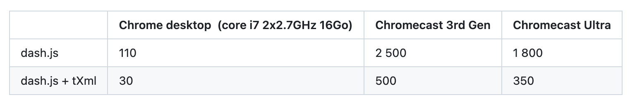
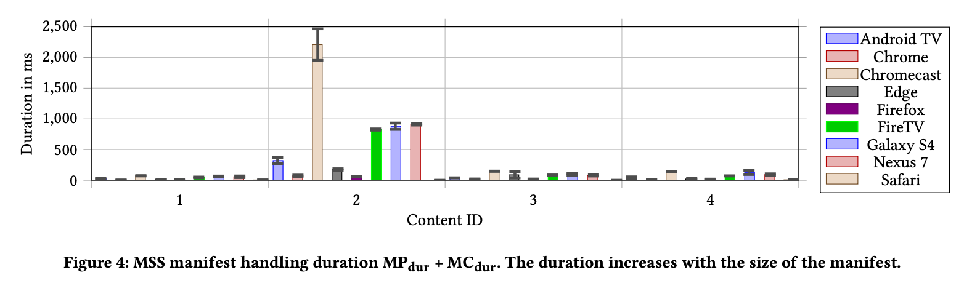
New XML parsing library
Contribution by Bertrand Berthelot
Pull request: https://github.com/Dash-Industry-Forum/dash.js/pull/4180
Integration of tXml parser: https://github.com/TobiasNickel/tXml
Improved parsing times especially on low end devices
240 minutes content having one AdaptationSet with a SegmentTimeline without repeat pattern
https://dl.acm.org/doi/10.1145/3083165.3083172
Notes:
- webworker for parsing?

Slide 48
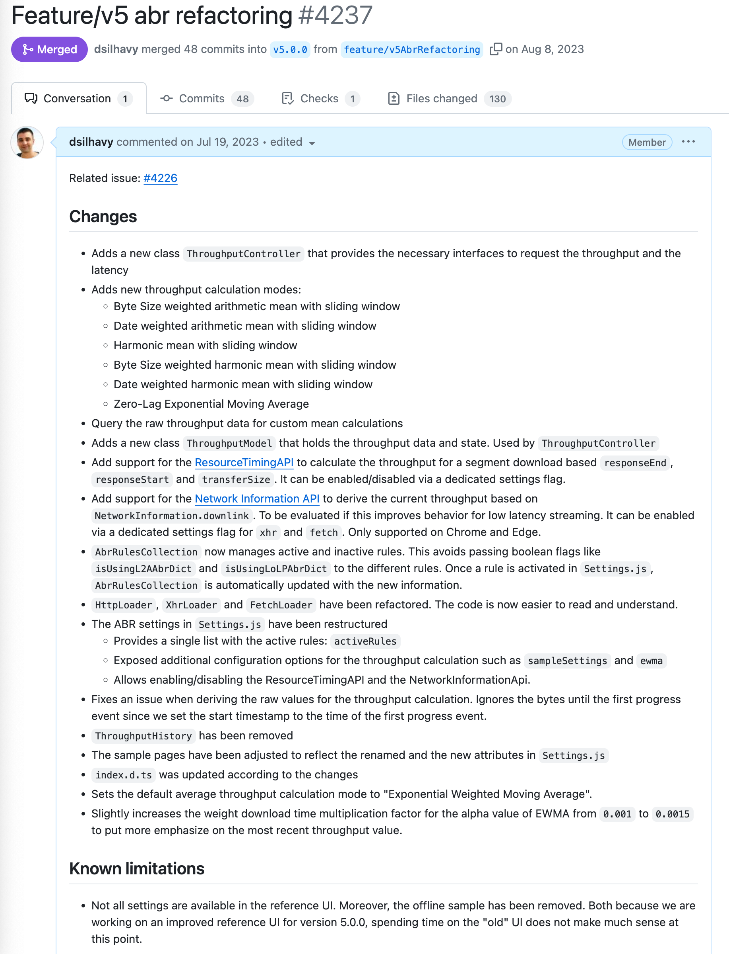
Improve ABR and Throughput Logic
Main pull request: https://github.com/Dash-Industry-Forum/dash.js/pull/4237
Adds new throughput calculation modes
Adds support for the Resource Timing API
Adds support for the Network Information API
Includes major refactoring of the code
Should fix multiple issues related to dash.js not reacting to bandwidth drops

Slide 49
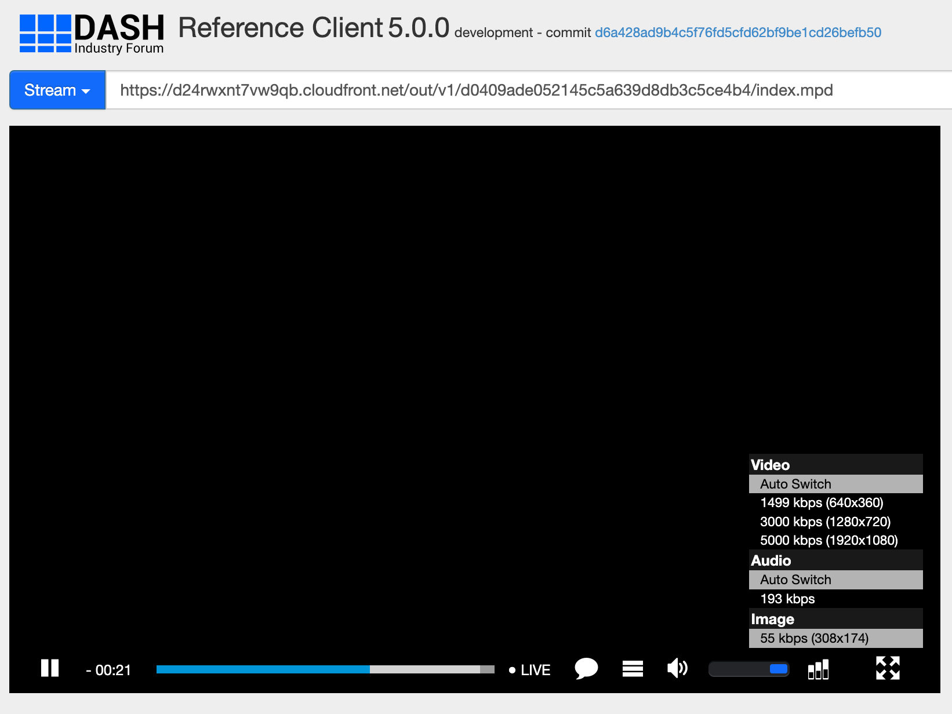
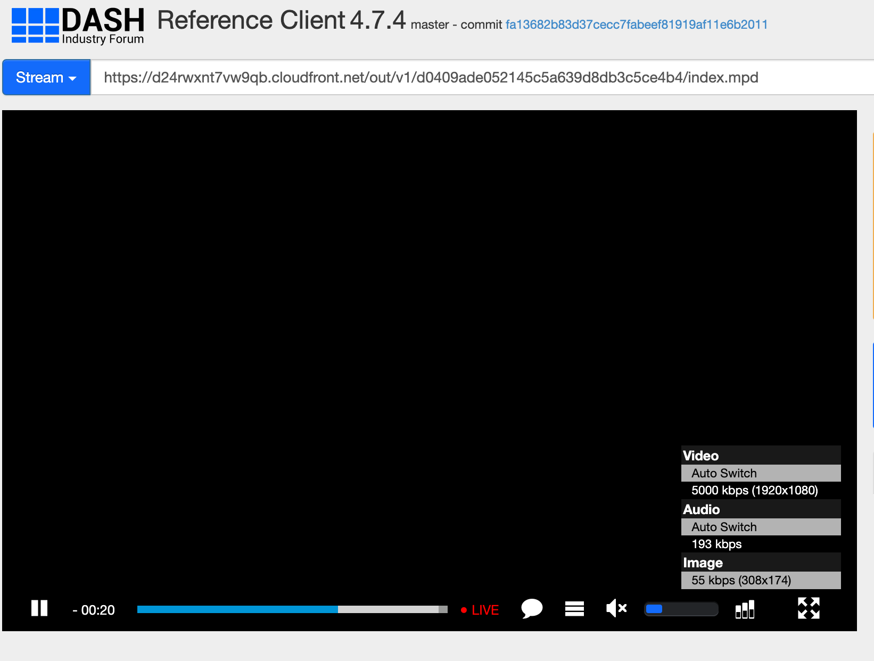
Adaptation-Set Switching
Main pull request: https://github.com/Dash-Industry-Forum/dash.js/pull/4276
Adds support for the Supplemental Property “urn:mpeg:adaptation-set-switching:2016”
The main ABR handling in dash.js was changed to use Representation IDs instead of an index-based approach
Related open issue: https://github.com/Dash-Industry-Forum/dash.js/issues/4313

Slide 50
Key Status Changed Handling
Main pull request: https://github.com/Dash-Industry-Forum/dash.js/pull/4562
Adds handling of keystatuseschange events. If a key is not usable (internal-error or output-restricted) the player switches to a different track.
Only apply changeType() if the codec family has not changed. For instance, if we are switching between avc1 and avc3 we dont need to call changeType().

Slide 51
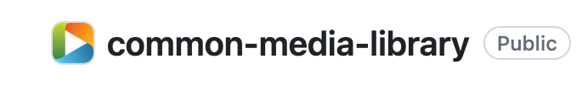
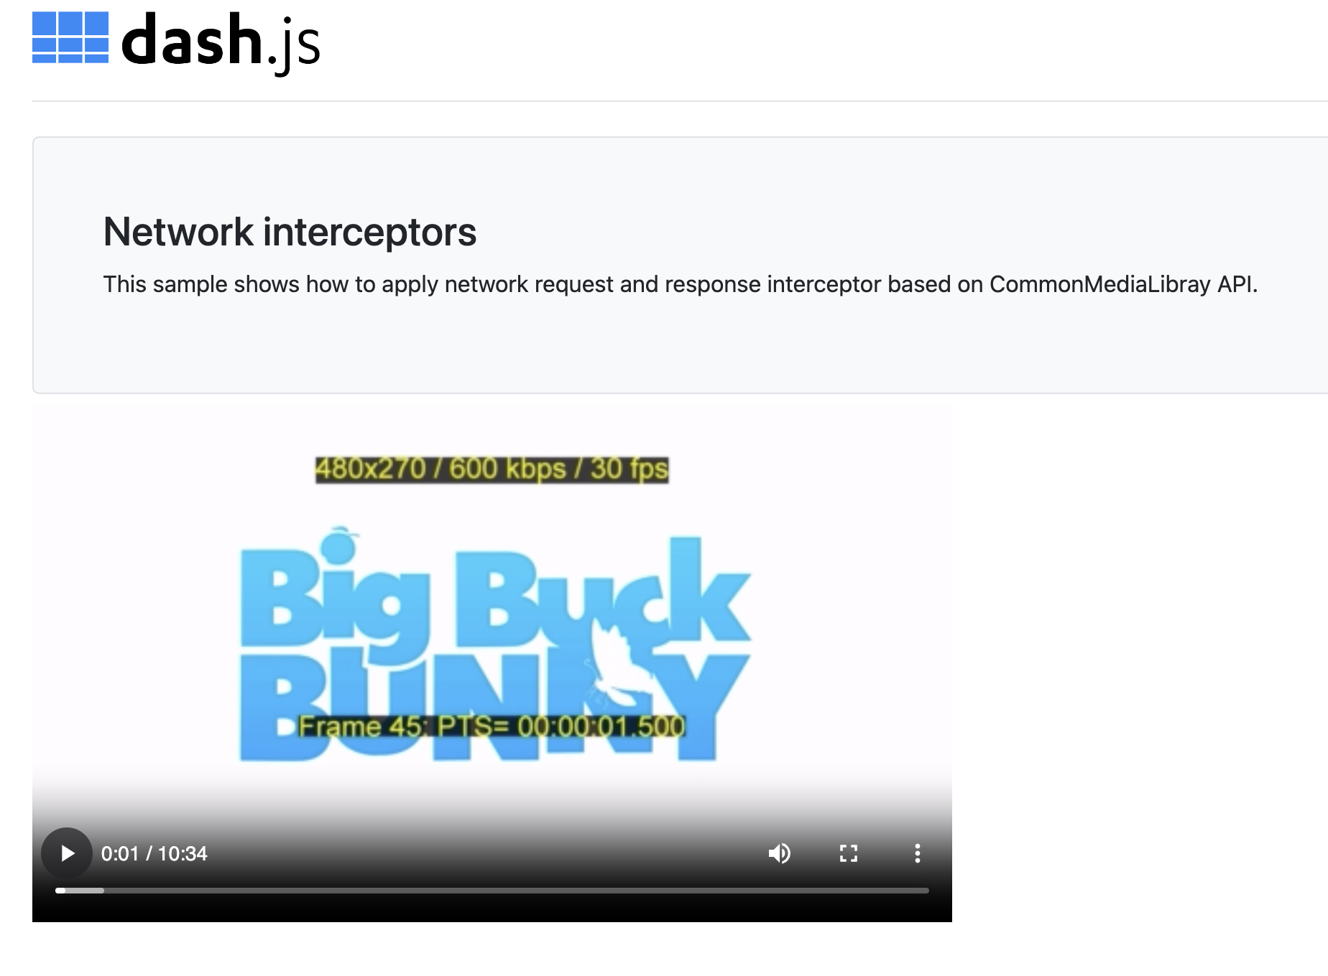
Common Media Library
Contributions by Casey Occhialini and Bertrand Berthelot
Integration of SVTA Common Media Library
https://github.com/streaming-video-technology-alliance/common-media-library
Related changes
Added CommonMediaRequest and CommonMediaResponse
https://github.com/Dash-Industry-Forum/dash.js/pull/4299
Parse ID3 payload for inband events
https://github.com/Dash-Industry-Forum/dash.js/pull/4391
Use CMCD and CMSD utilities
https://github.com/Dash-Industry-Forum/dash.js/pull/4206
https://github.com/Dash-Industry-Forum/dash.js/pull/4351
Support for CEA-608 parsing
https://reference.dashif.org/dash.js/nightly/samples/network-interceptor/index.html

Slide 52
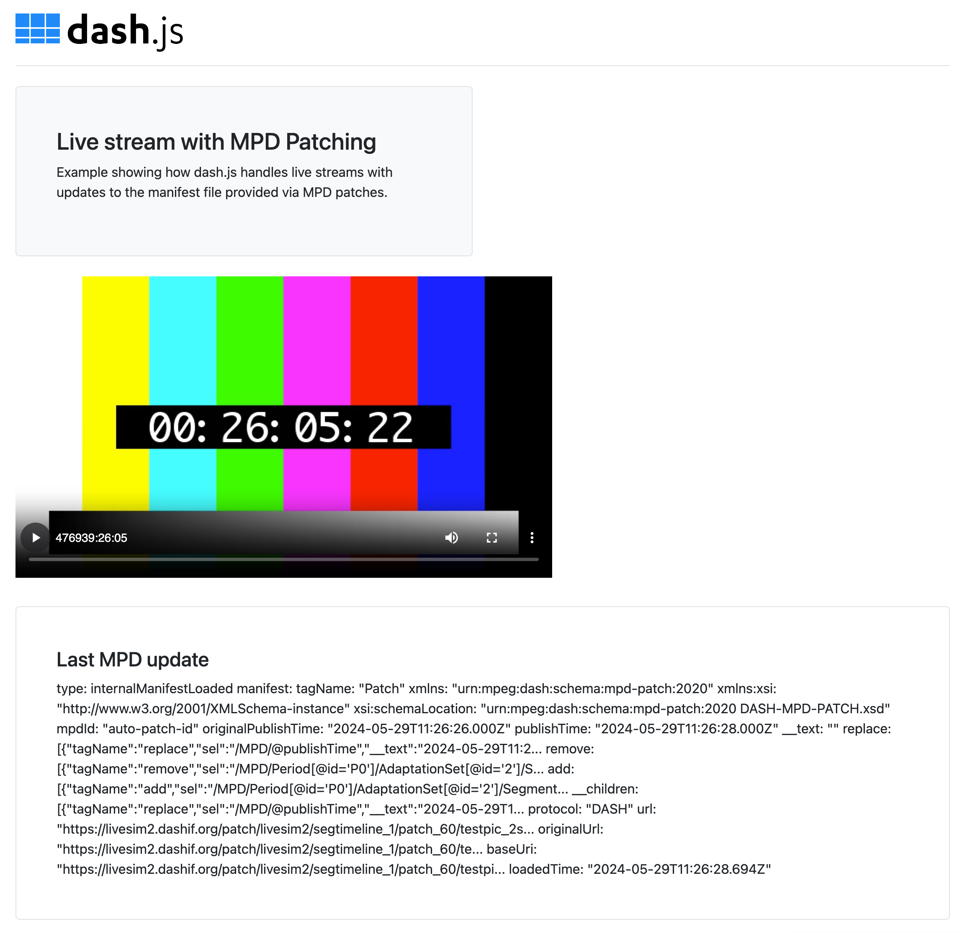
MPD Patching
Contributions by Zachary Cava and Torbjörn Einarsson
DASH-IF LiveSim2 now supports MPD patching
Reference streams from LiveSim2 have been added to dash.js
Required changes to the XML parsing library to make it work:
Add access to the elements in the original order because MPD patching operations need to happen sequentially
Keep the tagName for each node to be able to identify the type of the node
https://reference.dashif.org/dash.js/nightly/samples/live-streaming/mpd-patching.html

Slide 53
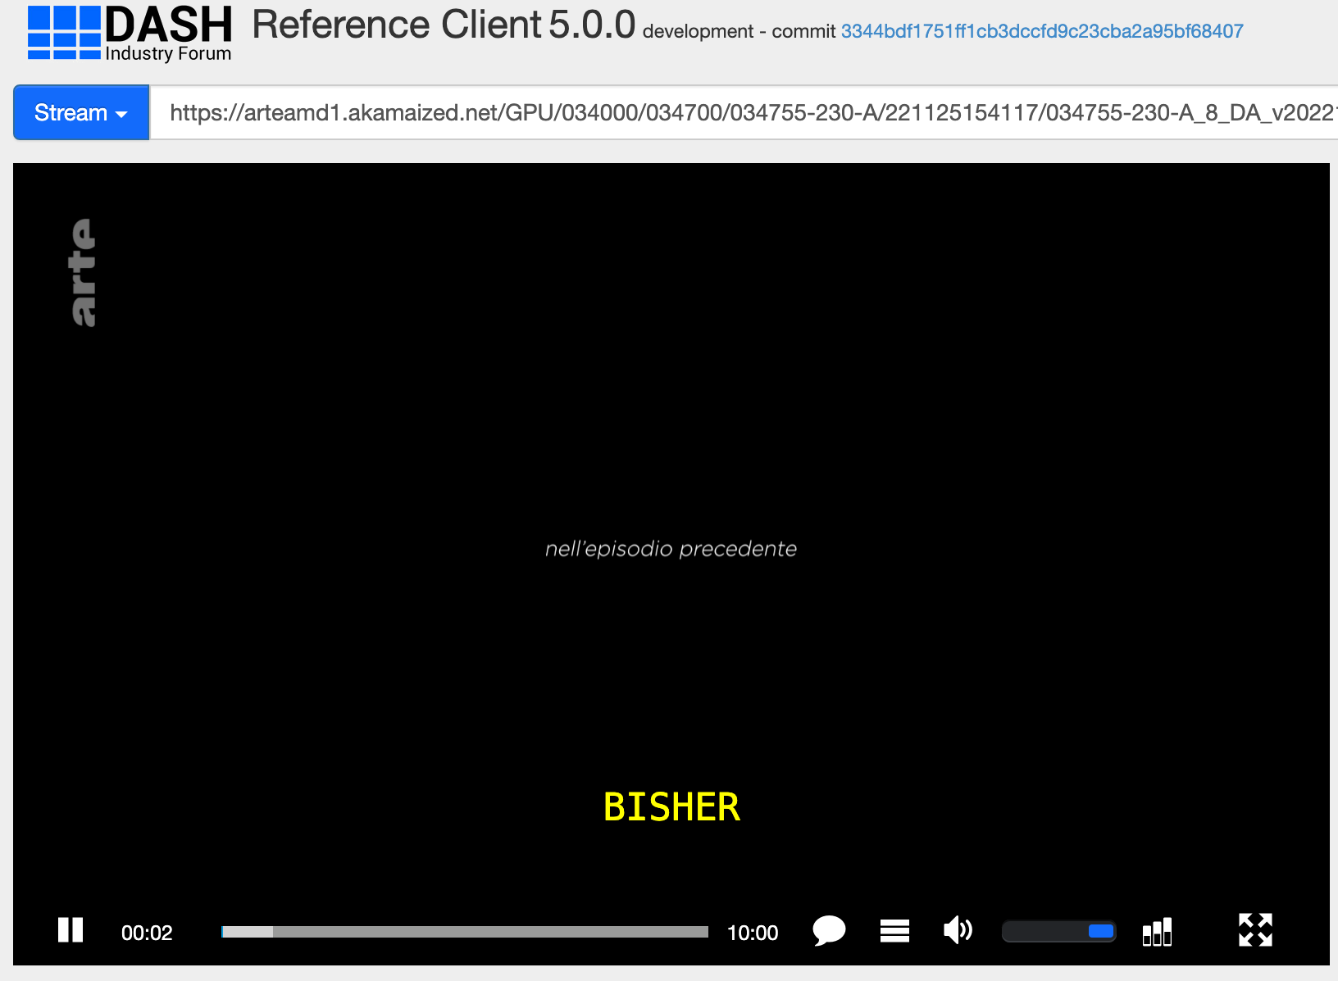
Support for forced subtitles
Pull request: https://github.com/Dash-Industry-Forum/dash.js/pull/4545
If subtitles are deactivated, it checks for a suitable forced-subtitle track. For that reason, the language of the current audio track is compared to the available forced-subtitle language options. If a suitable track is identified, forced subtitles are activated.

Slide 54
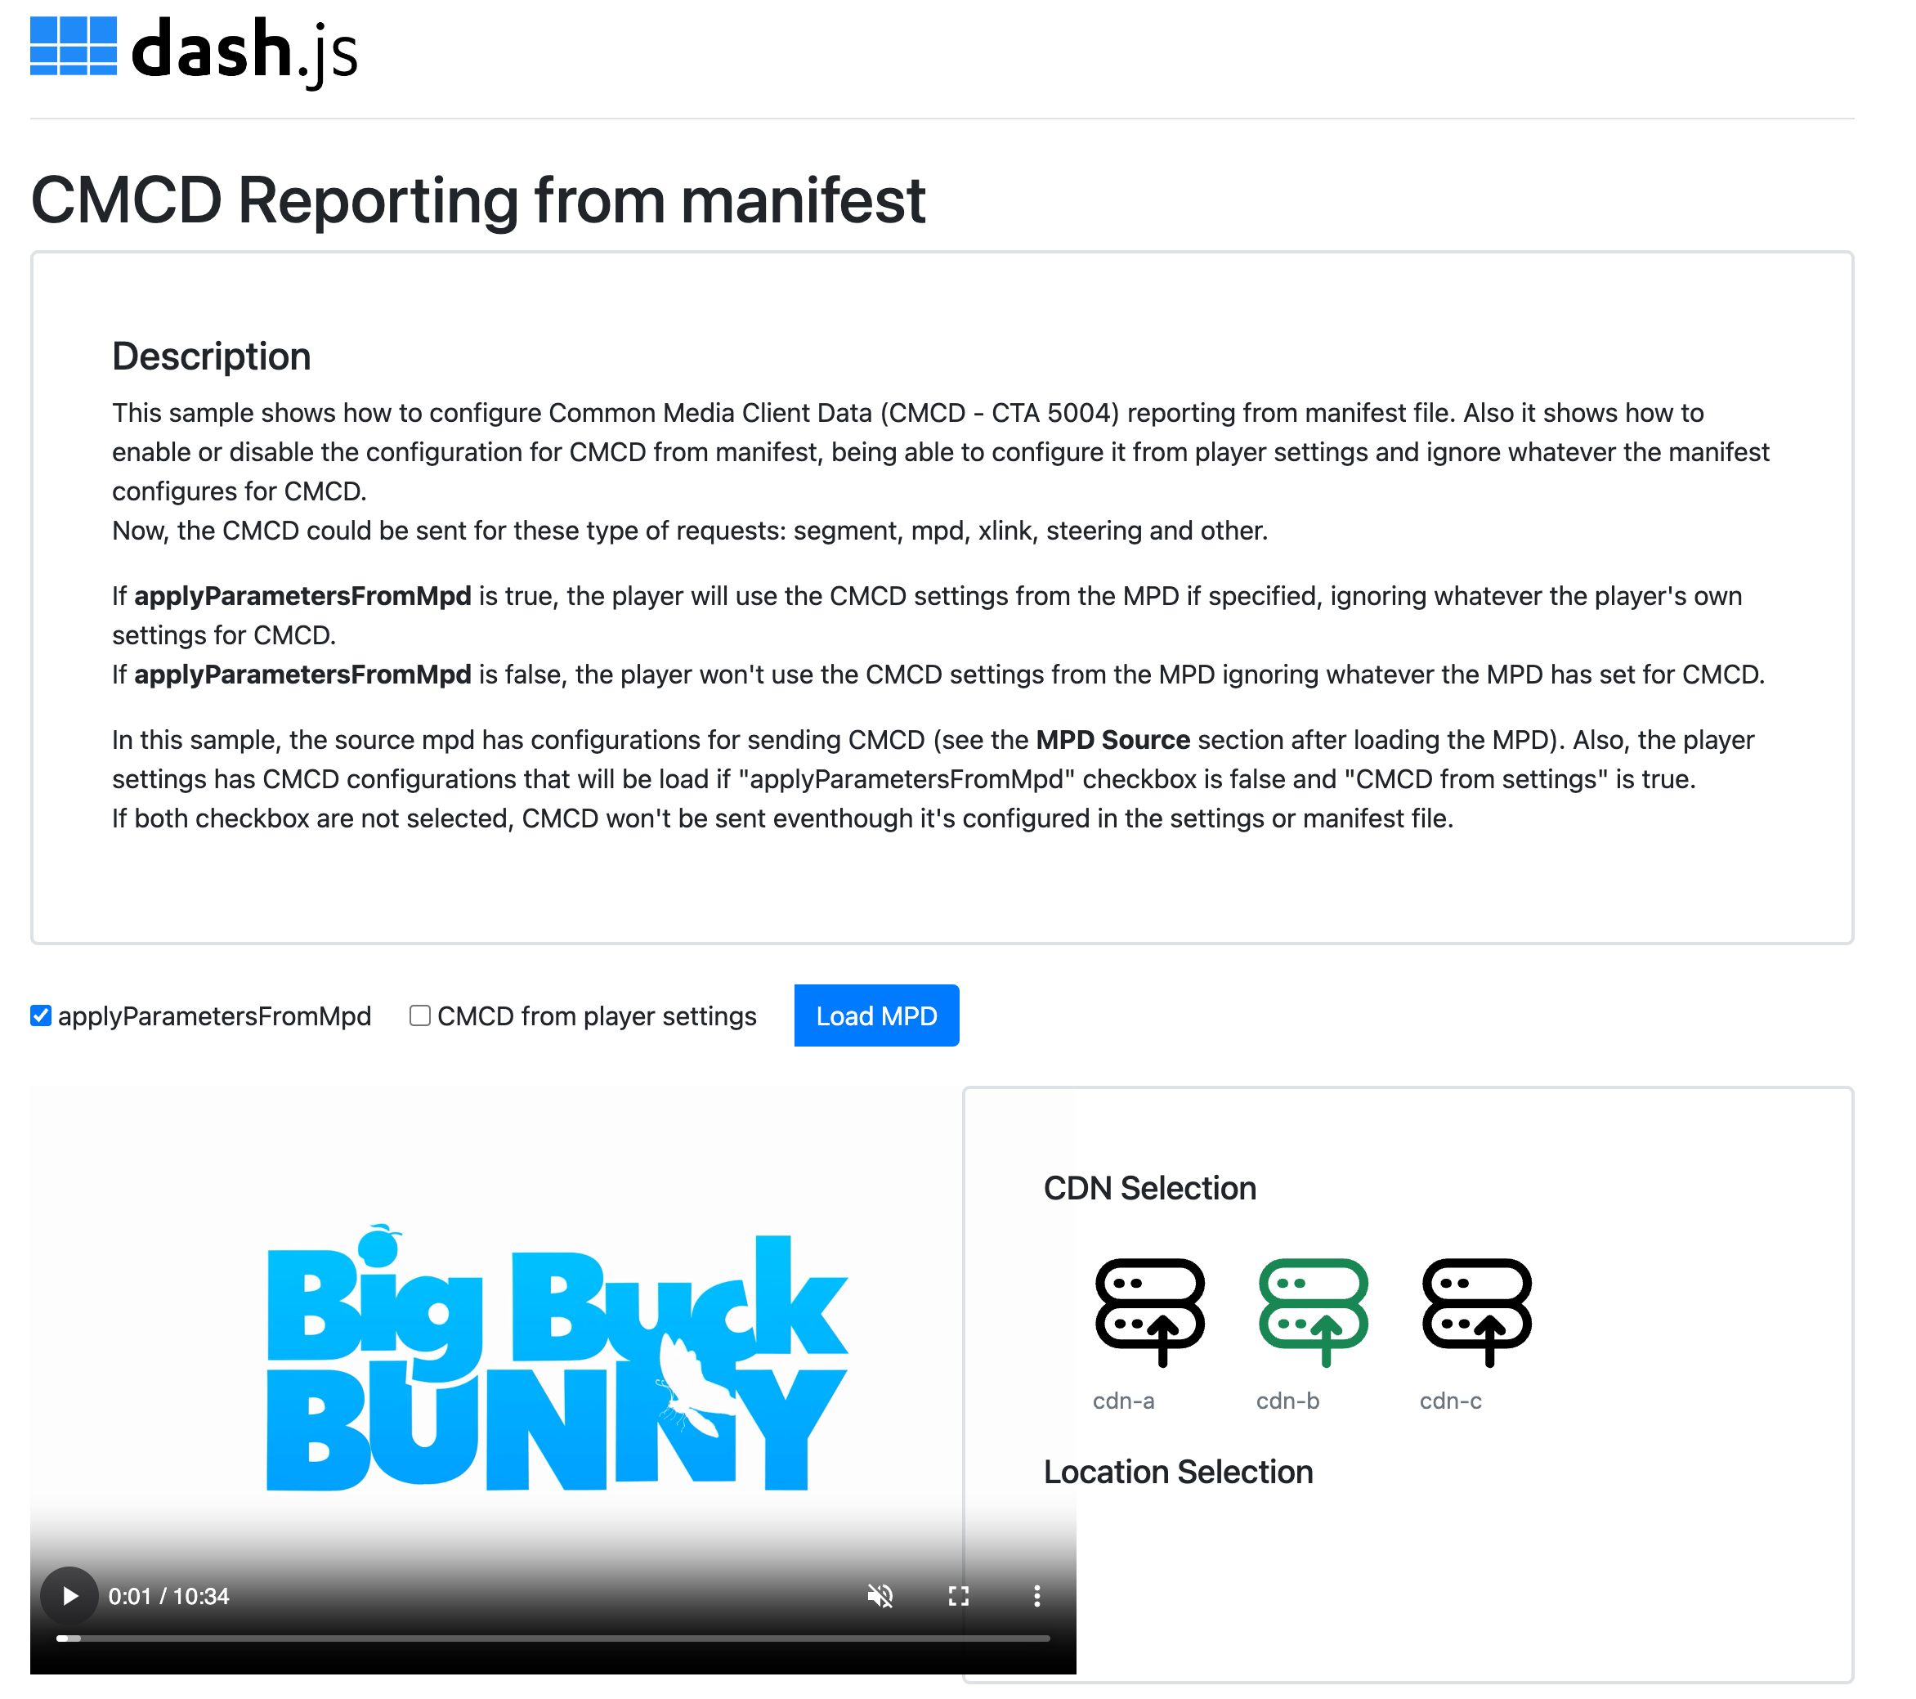
CMCD via MPD
Contribution by Qualabs
Pull request: https://github.com/Dash-Industry-Forum/dash.js/pull/4426
CMCD session initialization based on MPD parameters as specified in the 6th edition of the MPEG-DASH standard
Send CMCD data to the Content Steering Server
https://reference.dashif.org/dash.js/nightly/samples/advanced/cmcd-from-manifest.html

Slide 55
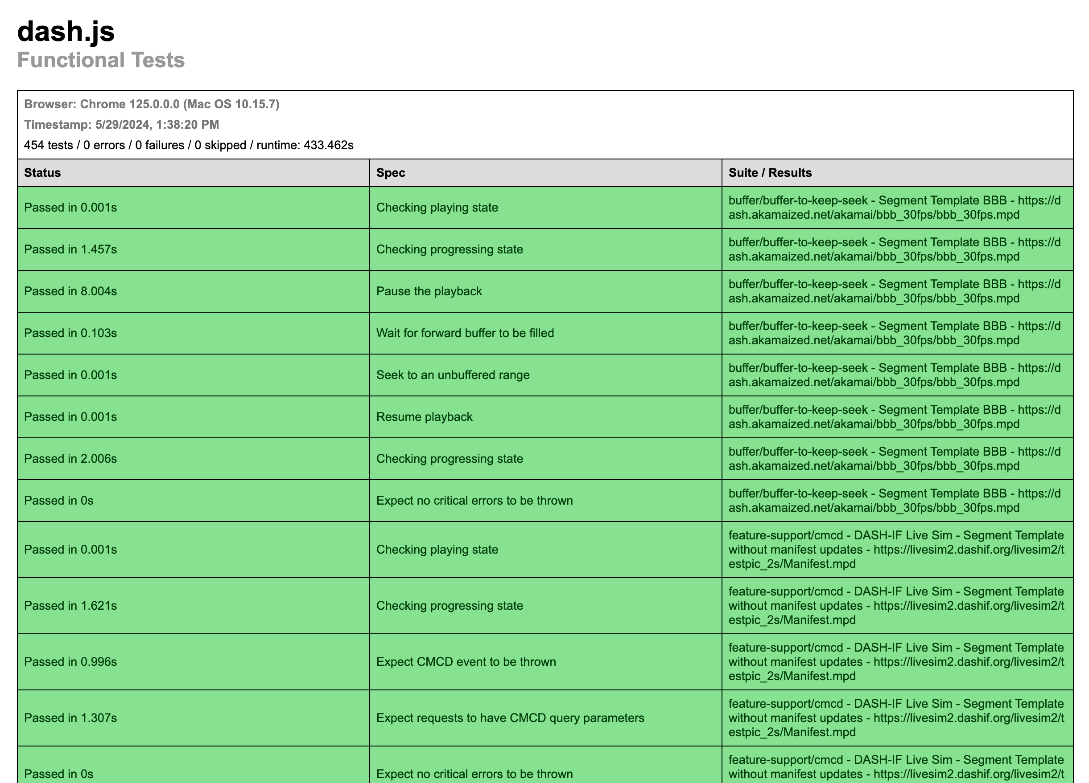
Functional Tests
Extended functional testsuite to support multiple different testcases as documented here: https://dashif.org/dash.js/pages/testing/functional-test.html
Test execution of a set of smoke test vectors automatically performed for each pull request on Browserstack and/or Lambdatest. Example: https://app.circleci.com/pipelines/github/Dash-Industry-Forum/dash.js/3762/workflows/9be68bcd-d24e-45dc-9873-50ecea3ad64f/jobs/7549
Wrote dedicated Karma testrunners for WebOS and Tizen: https://github.com/Dash-Industry-Forum/dash.js/pull/4559
Test report in HTML format

Slide 56
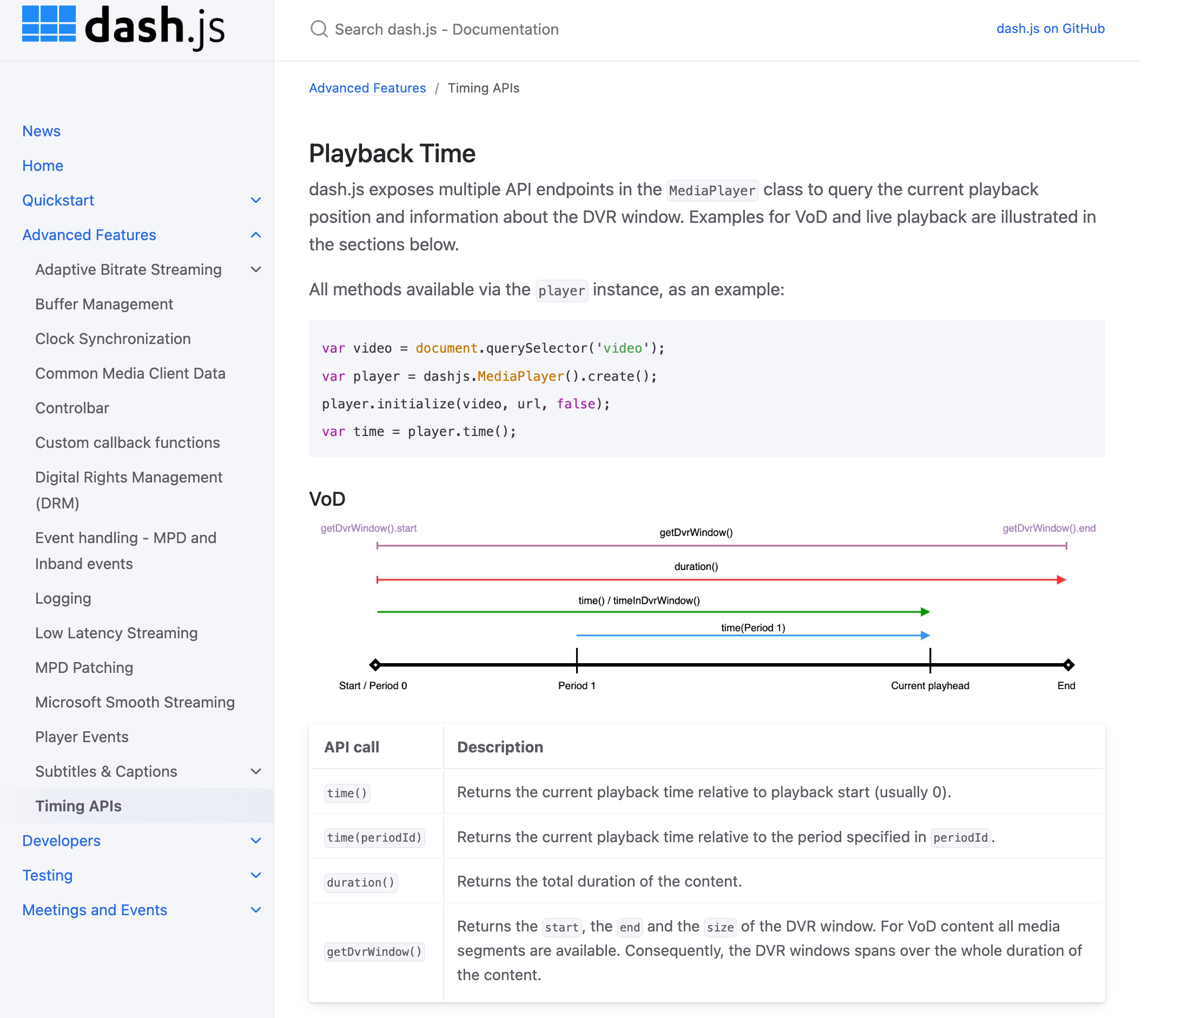
Documentation
New documentation automatically hosted via Github pages: https://dashif.org/dash.js/
Many detailed explanations for dash.js features e.g. ABR rules, DRM, Timing APIs
Discussion Item: Anything missing? What would developers like to see?

Slide 57
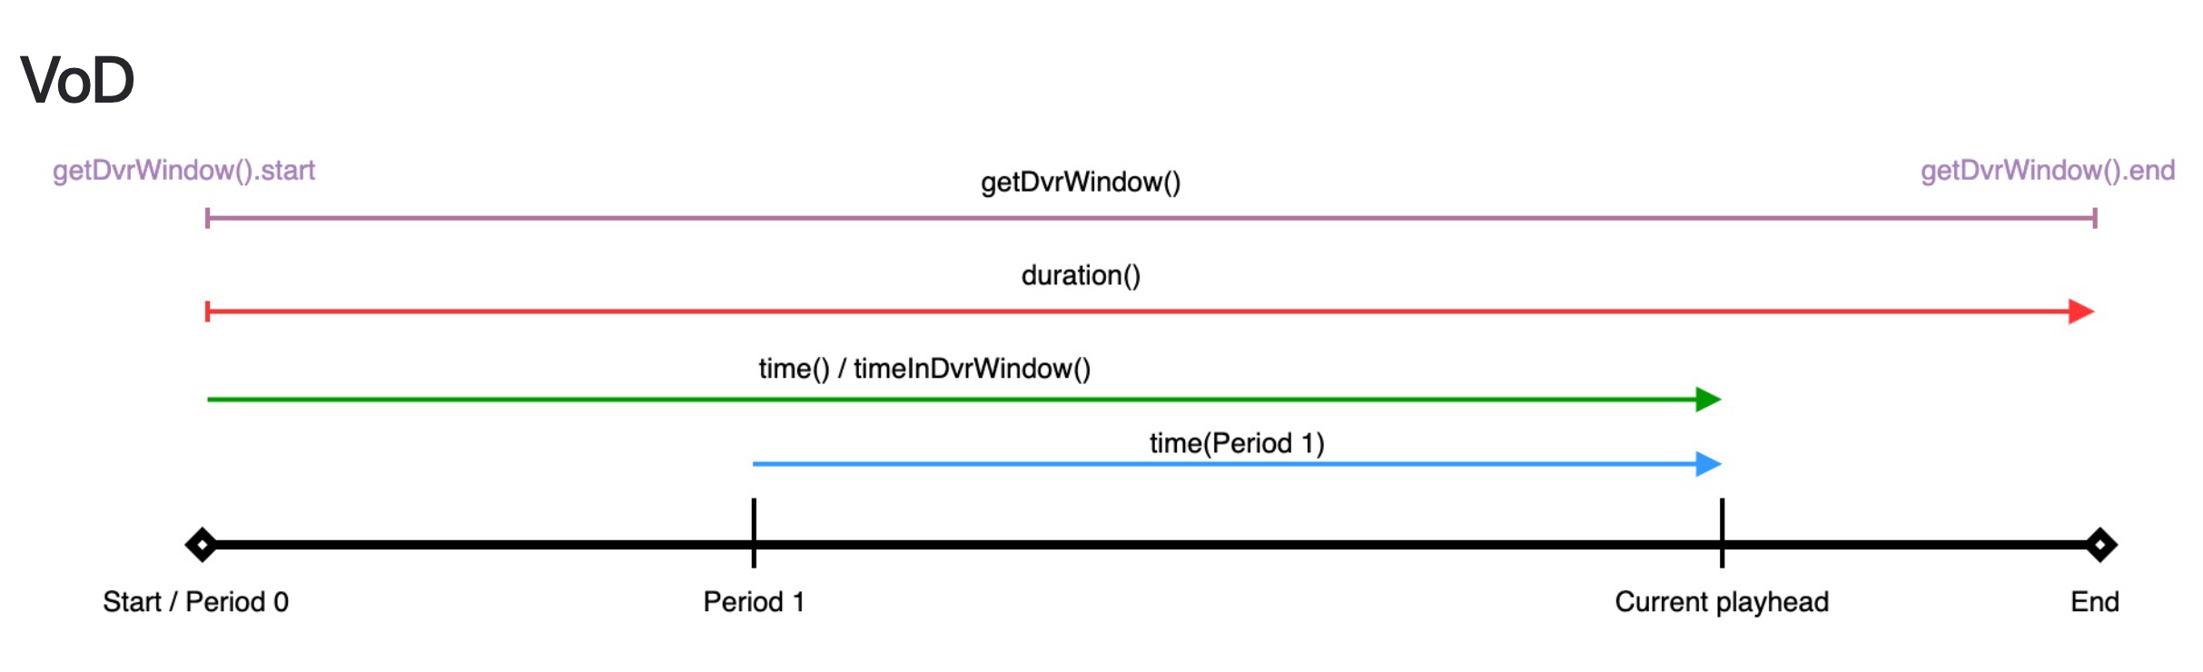
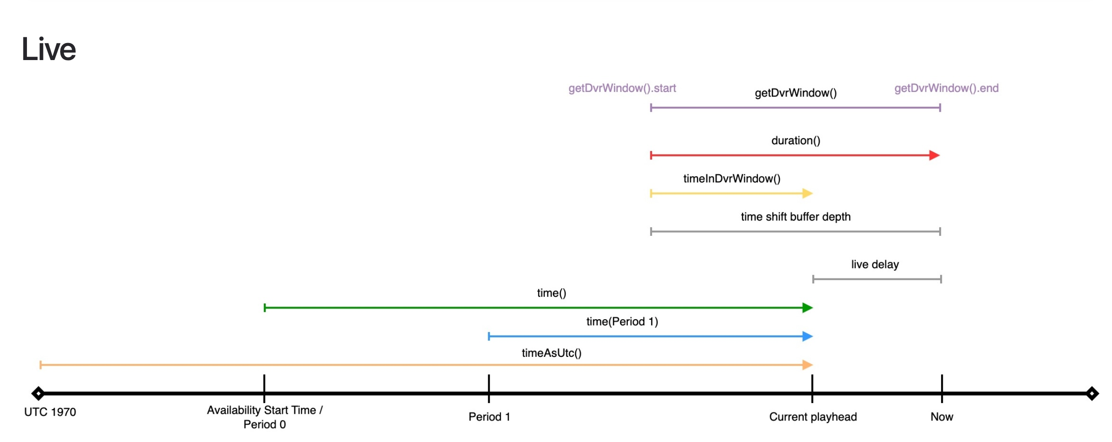
Timing APIs
Adjusted endpoints to query the current playback position and information about the DVR window
Added additional seekToPresentationTime function to use absolute presentation timestamps
See https://dashif.org/dash.js/pages/advanced/timing-apis.html for all the details

Slide 58
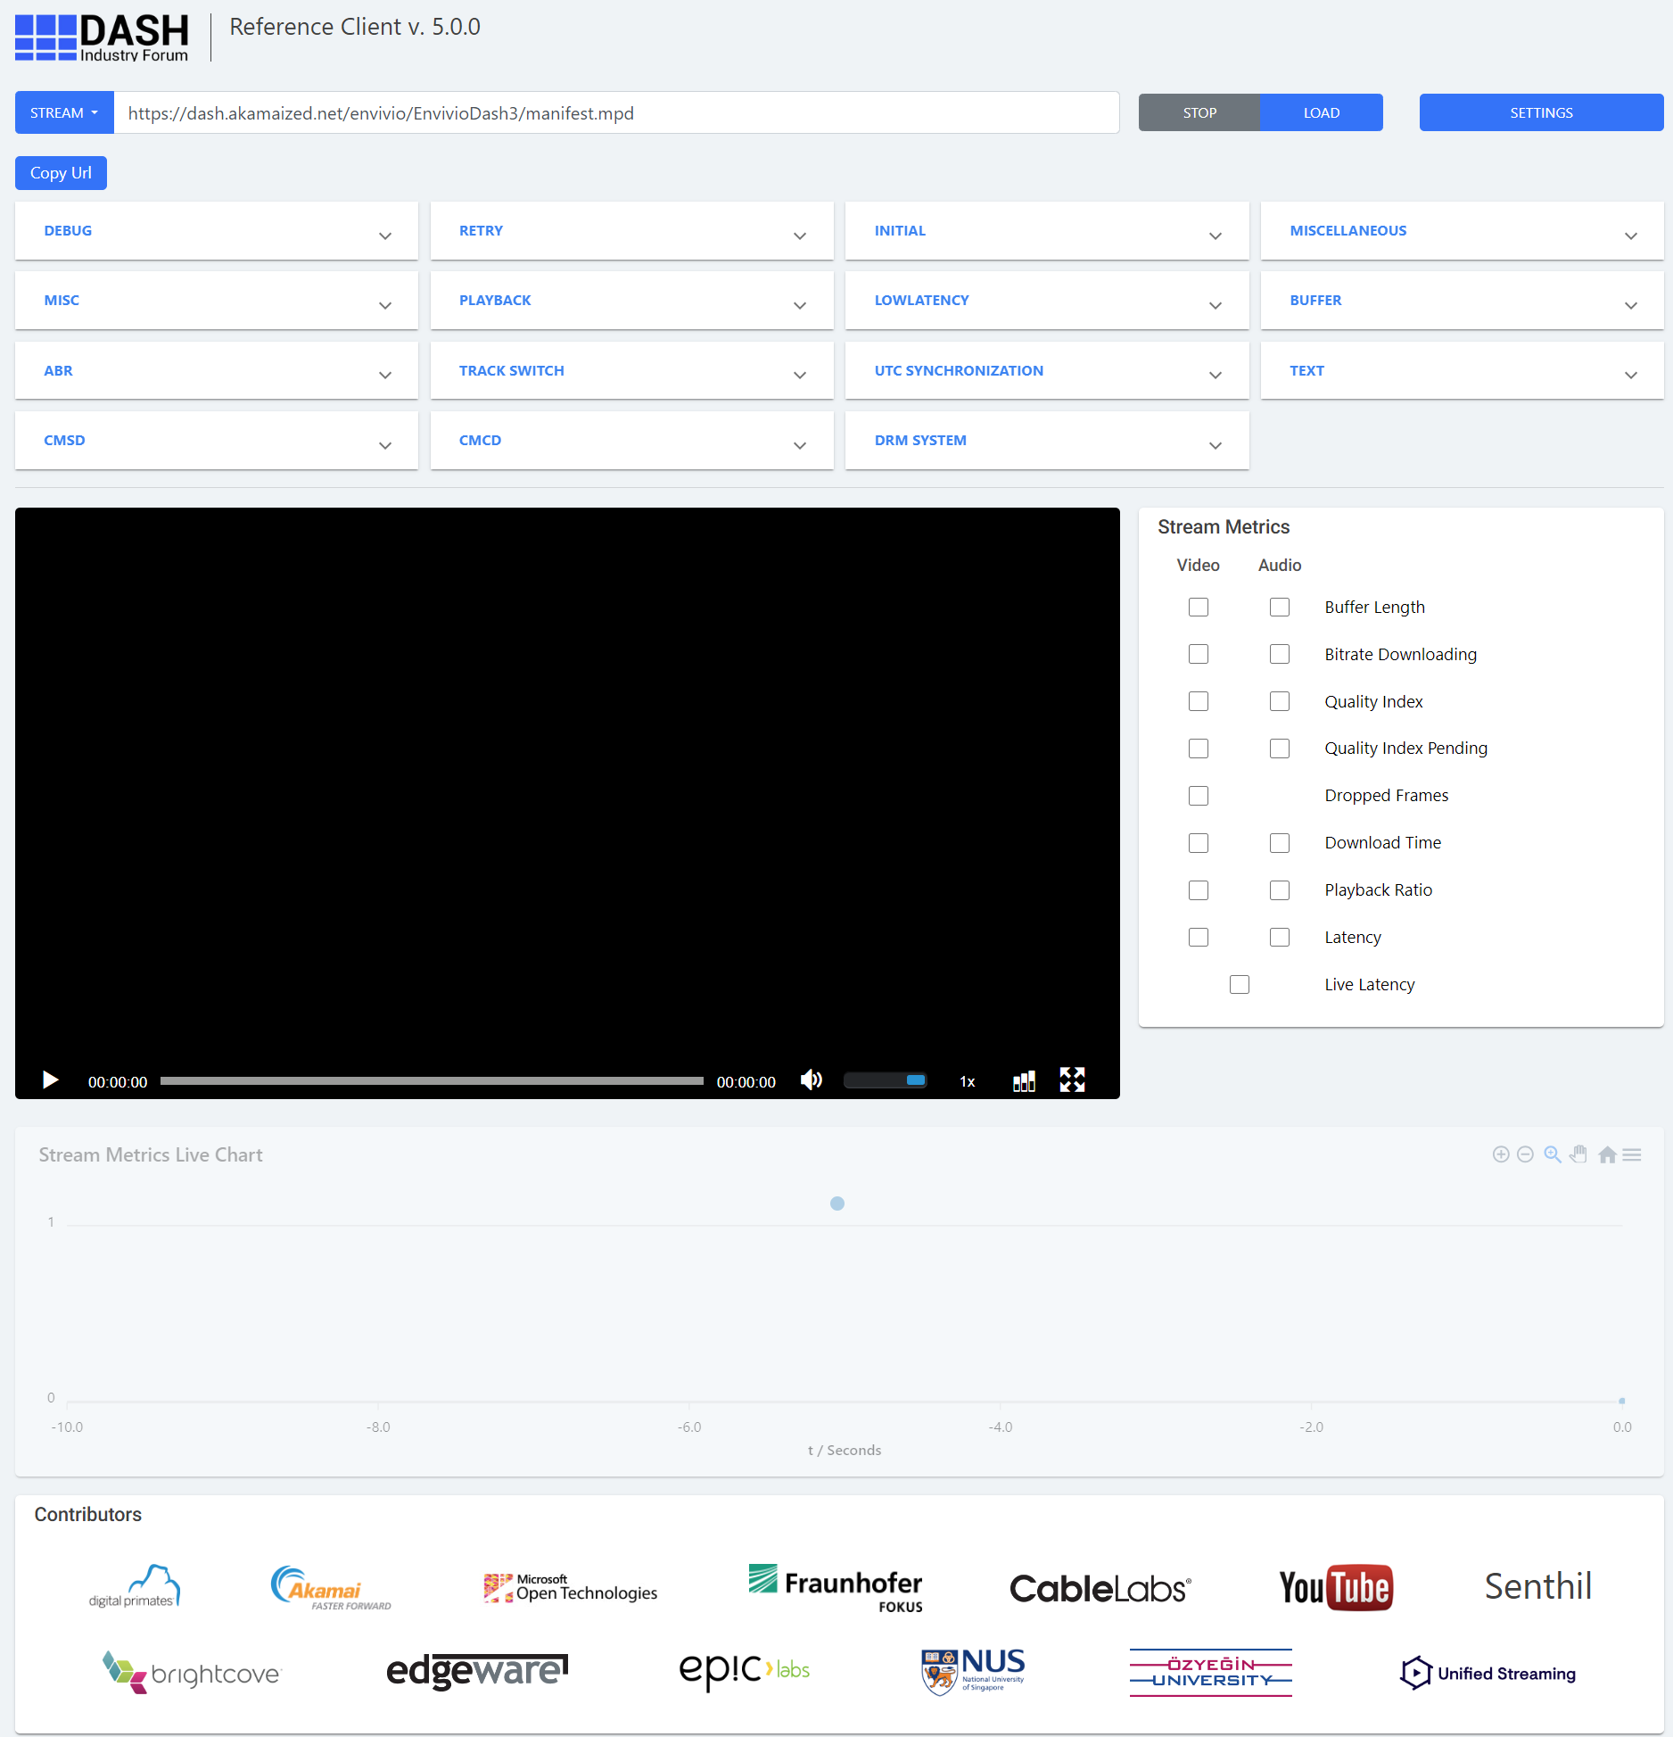
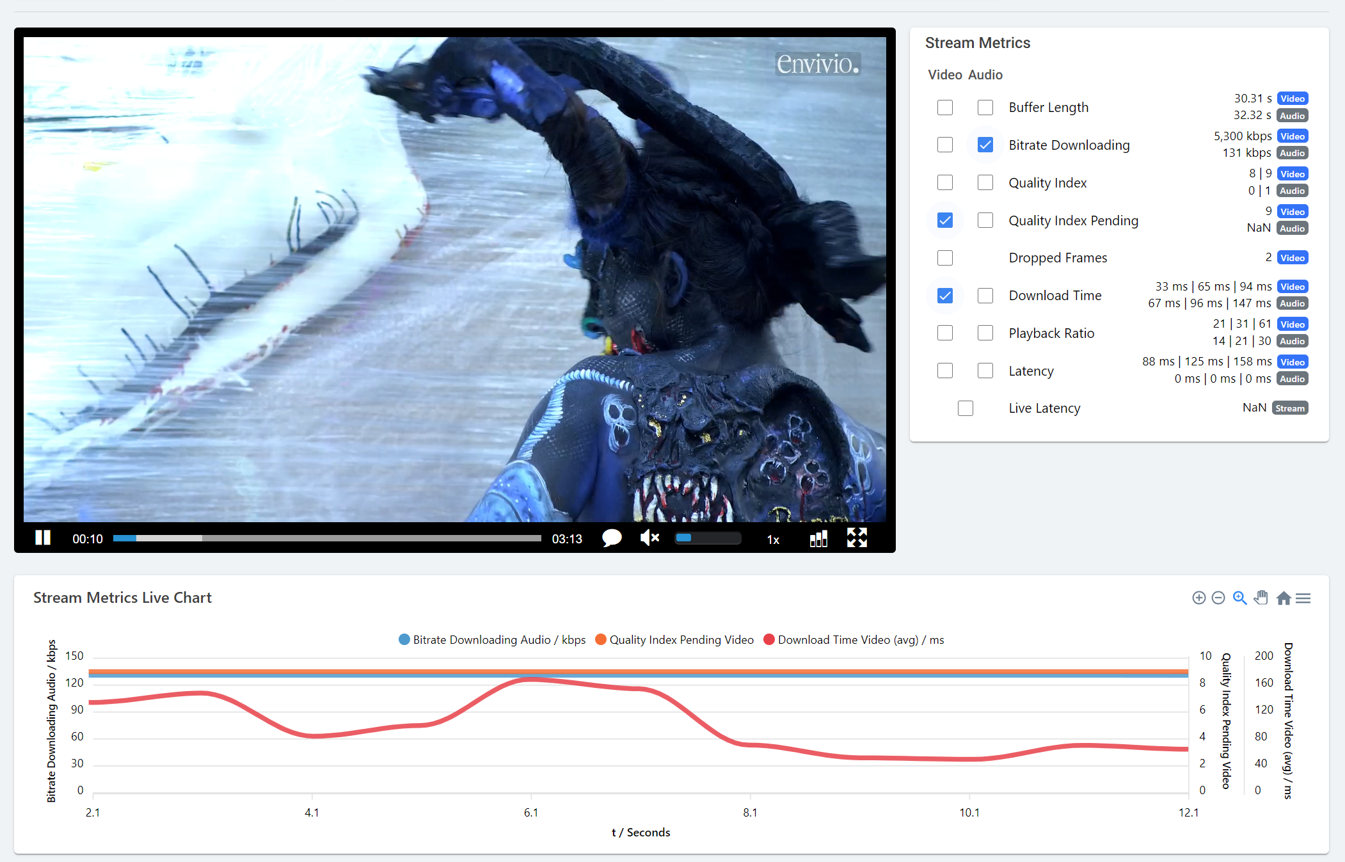
New Reference UI
UI based on Angular JS
Live charting using Apex Charts
Retains all of the old functionality (e.g. Settings as query)
Automatically parses Settings.js and builds the view and relevant setter-methods based on it

Slide 59
Other Features and changes #1
Support for Content Protection@ref and @refId
https://github.com/Dash-Industry-Forum/dash.js/pull/4380
Support for Common Access Token
https://github.com/Dash-Industry-Forum/dash.js/pull/4419
Cleanup and update dependencies
https://github.com/Dash-Industry-Forum/dash.js/pull/4469
Move completely to ECMAScript modules
https://github.com/Dash-Industry-Forum/dash.js/pull/4261
Output ESM via webpack
https://github.com/Dash-Industry-Forum/dash.js/pull/4538
https://github.com/Dash-Industry-Forum/dash.js/pull/4543

Slide 60
Other Features and changes #2
Use Descriptor Types for track selection
https://github.com/Dash-Industry-Forum/dash.js/pull/4250
HDR and Media Capabilities API
https://github.com/Dash-Industry-Forum/dash.js/pull/4471
Use keySystemConfiguration and Media Capabilities API to filter unsupported codecs
https://github.com/Dash-Industry-Forum/dash.js/pull/4548
Functional test execution on Lambdatest
https://github.com/Dash-Industry-Forum/dash.js/pull/4472
Support for LCEVC
https://github.com/Dash-Industry-Forum/dash.js/pull/4491

Slide 61
Version 5
Open Issues, Planning and next steps

Slide 62
Missing v5 main features
For a detailed overview check: https://github.com/orgs/Dash-Industry-Forum/projects/8/views/2
Low latency throughput calculation
https://github.com/Dash-Industry-Forum/dash.js/issues/3538
Documentation : Migration guide version 4 to version 5
https://github.com/Dash-Industry-Forum/dash.js/issues/4422

Slide 63
Long term planning
Main features

Slide 64
Planning 1/4
Status | Item | Description | Effort | Type
In Progress | Version 5 features | See slides on v5 before | High | Feature, Improvement
not important | Support for xlink:actuate=“onRequest” | https://github.com/Dash-Industry-Forum/dash.js/issues/4482 | High | Feature
high importance | Support Annex I: Flexible Insertion of URL Parameters | https://github.com/Dash-Industry-Forum/dash.js/issues/4440 CAT, MPD Insertion | Medium/High | Feature

Slide 65
Planning 2/4
Status | Item | Description | Effort | Type
Low Priority | Support for Initialization Set | https://github.com/Dash-Industry-Forum/dash.js/issues/4401 | Low/ Medium | Feature
Low | Support for dashif-Authzurl | https://github.com/Dash-Industry-Forum/dash.js/issues/4233 | Medium | Feature
Qualabs started working on this | Support for media presentation insertion | https://github.com/Dash-Industry-Forum/dash.js/issues/4232 | High | Feature

Slide 66
Planning 3/4
Status | Item | Description | Effort | Type
Medium / High | Support for SegmentTimeline@Pattern | https://github.com/Dash-Industry-Forum/dash.js/issues/4493 Do together with LiveSim2 | Low/Medium | Feature
Medium | L3D-DASH | Identify what needs to be done exactly Informal reference content by Alex | High | Feature
High | Content Steering v1.0.0 | Adjust current implementation to exclude AdaptationSets which are not part of the steering manifest Possible teststream by Yuriy (Brightcove) | Medium / High | Improvement

Slide 67
Planning 4/4
Status | Item | Description | Effort | Type
Medium Prio | CMCD V2 | Qualabs working on this
Medium | Robustness Level signaled in MPD
Low | C2PA | Requires box parser integration (dispatch UUID box information) Potential implementation by Adobe

Slide 68
SVTA related discussions
Close cooperation between Common Media Library and dash.js development
Add dash.js to existing SVTA testbeds: Important feedback for dash.js development
Use dash.js as the reference client for future SVTA projects
Anything to do related to
dash.js Github and license? Anything to move or change?
Feedback agreement for new developers?
Keep DASH-IF slack channel?
Create new SVTA dash.js Slack channel?

Slide 69
Participation
Github project: https://github.com/Dash-Industry-Forum/dash.js
Reference client: https://reference.dashif.org/dash.js/nightly/samples/dash-if-reference-player/index.html
Samples: https://reference.dashif.org/dash.js/nightly/samples/index.html
Documentation: https://dashif.org/dash.js/
API documentation: http://cdn.dashjs.org/latest/jsdoc/module-MediaPlayer.html
Slack Channel: https://dashif-slack.azurewebsites.net/
Google Groups: https://groups.google.com/g/dashjs

Slide 70
Presentation from Tobbe

Slide 71
The DASH-IF Conformance Tool : a popular yet underestimated tool
Presenter: romain.bouqueau@motionspell.com
Notes:
Hi, my name is Romain Bouqueau. I am a long-time sw dev, oss advocate, in the streaming industry. And today I’m going to talk about the DASH-IF conformance tool. And especially the giant effort that’s going about its refactoring.

Slide 72
What this presentation is about:
The importance and popularity of conformance
How the standardization process interacts with conformance
Leveraging open-source to support new technology
Notes:
I want to illustrate the power of doing things right.

Slide 73
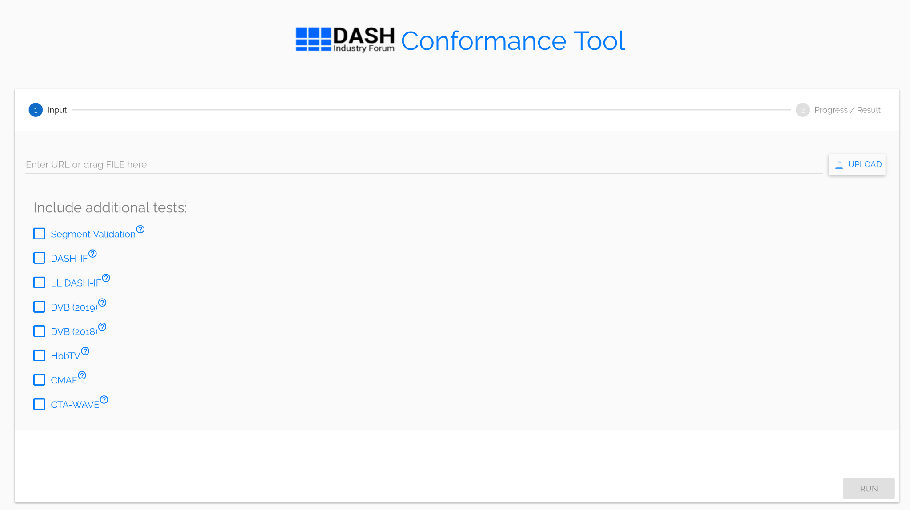
Overview of the DASH-IF Conformance Tool
Well known tool
Mostly used online
Popular: ~180 input per day
Mostly funded by DASH-IF
Industry contributions through consortia: DVB, HbbTV, CMAF (by the CTA WAVE initiative)
Maintained by Motion Spell, the commercial company behind GPAC
Licensed as GPLv3:
+ other dependencies
In practice not an issue as it is deployed on servers
Notes:
First what is this tool?
It is made of a front-end and a back-end. It is mostly used online from the DASH-IF public Website.
It is pretty popular, with approx two hundred requests everyday. People know it, people use… although they do have some concerns. And that’s why we are here today.
Historically the development has started within DASH-IF. But over time DASH took off and some other industry consortium such as DVB, HbbTV, CTA WAVE also sponsored modifications.
Last but not least the tool itself is licensed as GPLv3, it has some dependencies, but in practice this is not an issue as it runs on servers or locally on developers premises.

Slide 74
More slides on conformance

Slide 75
Conformance: why?
MPEG specifications describe the client behaviour [1]
Typically a decoder
How to you know that the content you create is conform?
Conformance is key for interoperability
Enforce a common understanding
Diverging can be very costly
Handle more complex technology
Faster time-to-market
[1] https://www.motionspell.com/2013/10/14/standard-cover-mpeg-dash-case-study/
Notes:
First I’d like to digress on the available tools for doing conformance.

Slide 76
Conformance: who?
Spec editor
Writes normative statements.
Wants to illustrate the specification with test vectors.
Wants to enforce the specification with a conformance checker.
Solution: may want to annotate the document with a link to the code of the check + associated test vectors.
Test material
Which normative statement does it test?
Positive or negative
Which spec?
Complies with which rule or spec or profile? (result from the conformance checker)
Solution: can be either manually generated, industry provided
Solution: the person/entity pushing a feature in the spec is responsible for providing the test vectors
Unit Test
Conformance checker
Coverage of spec normative statements.
Robust. Unit tested.
May aggregate reports from several specs (codecs, container, manifests, etc.)
Solution: each check associated with metadata
Industry content
Reference implementation (e.g. dash.js for DASH)

Slide 77
Conformance: how?
Conformance can take several forms:
Specification: normative statements (shall/should/may keywords)
Test vectors
Reference software implementations e.g. a client (dash.js)
/!\ Robustness principle: be liberal in what you accept /!\
Conformance tool:
Code coverage of the tool ⇔ coverage of the specification
/!\ Doesn’t test about the presence of features, just consistency /!\
Test vectors are correct and don’t provide good code coverage

Slide 78
Thank you !
romain.bouqueau@motionspell.com

Slide 79
Test Vectors
Responsibilities
Preparing new test vectors to support new features in the IOP, MPEG DASH, CMAF
Conformance testing the test vectors
Uploading test vectors to the Akamai server
Adding entries in the test vectors database for the new test vectors
Addressing incoming requests (new test vectors from other companies, this would mean doing the above two procedures for these test vectors)
Supporting dash.js development (by providing test vectors)
Adding new informational things on the database (like FAQ section, etc)
Preparing presentations on updates done to the database (periodically for each F2F meeting)
Maintaining the Akamai server (reviewing existing test vectors, removing old test vectors)
Meetings with Thomas and Daniel (bi-weekly currently)
Coordination with CTA WAVE and other organization
Github
https://github.com/Dash-Industry-Forum/Test-Vectors
https://github.com/Dash-Industry-Forum/Test-Assets-Dataset-Public
https://github.com/Dash-Industry-Forum/Test-Assets-UI-public

Slide 80
DASH-IF Test Streams based on CMAF content
MPD
Conforming and annotated CMAF content

Slide 81
Generation of CMAF content – done in CTA WAVE
CTA Original Content Pool
Web Front End with search and filter
Options
Content Annotation
No
Content Verifier
Yes
CMAF conforming content
CTA Mezzanine Content Pool
Options
CMAF Media Profile
CMAF Packaging
Options
Options

Slide 82
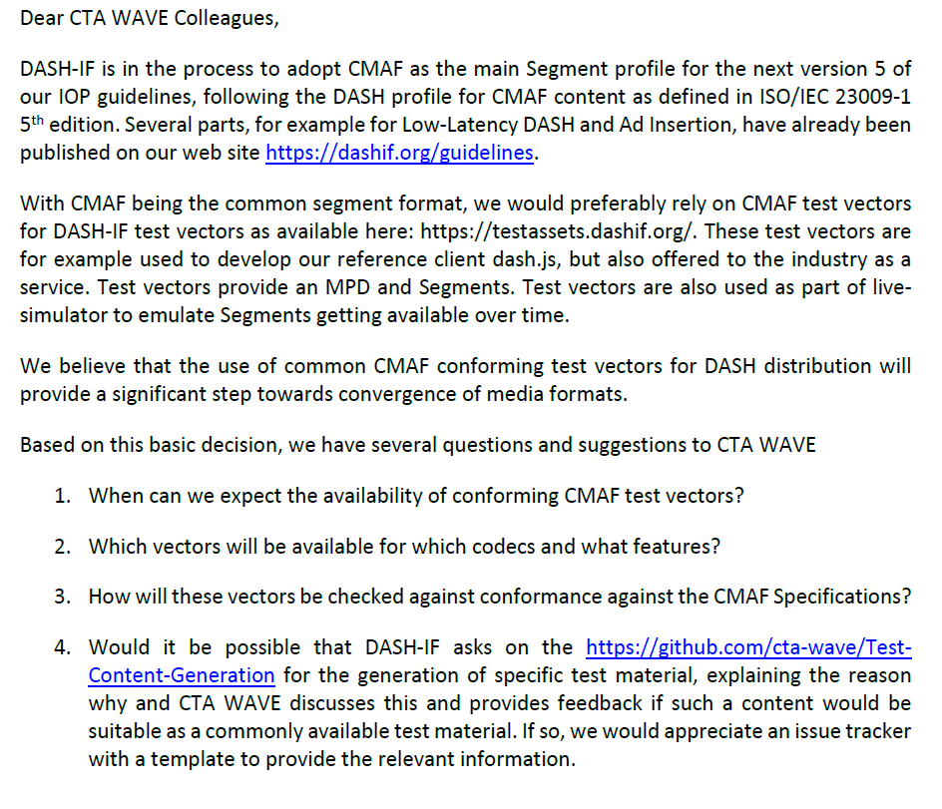
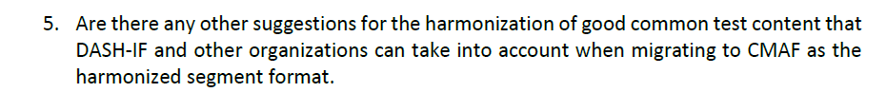
What is needed
Original Content => proper rights and formats
Mezzanine Content => annotation
Encoding work flow => transparent
Content validation
Workflow for contribution and extension
DASH-IF sent an LS to CTA WAVE

Slide 83
Identifiers
Access:
https://dashif.org/identifiers/introduction/
Submission
https://bit.ly/dash-identifier-submission
Will be reviews for consistency
Will be published on the DASH-IF Web site
Identifier catalog
This catalogue is informative. The normative aspects of the identifiers are included the references along with the identifiers. This catalogue will be updated with the submission and approval of new identifiers.
Profiles, Interoperability Points and Extensions
Content Protection
Output Protection
Video Source Metadata
Audio Source Metadata
Role and Accessibility
Content Rating
Event Schemes
Authentication and Authorization
Functionality

Slide 84
14:55 Coffee Break
15:10 Emerging Topics
Media/QUIC/DASH (Will, 10min)
C2PA (Thomas)

Slide 85
Presentation of Will Law

Slide 86
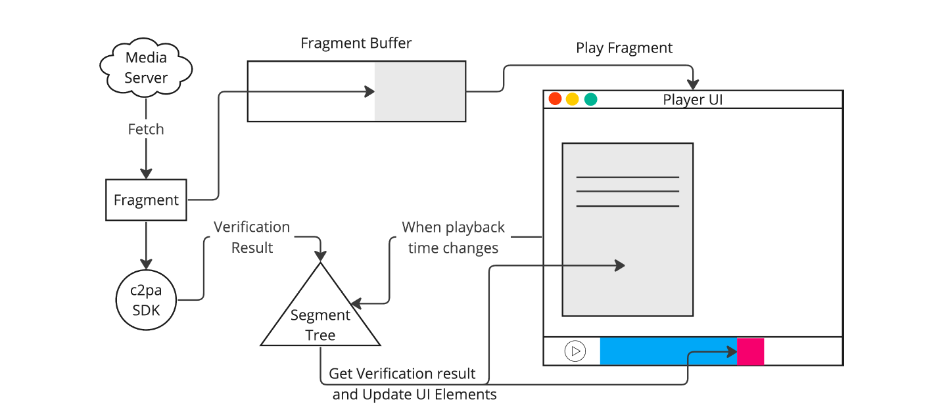
C2PA: Special Session – Adobe presented DASH integration

Slide 87
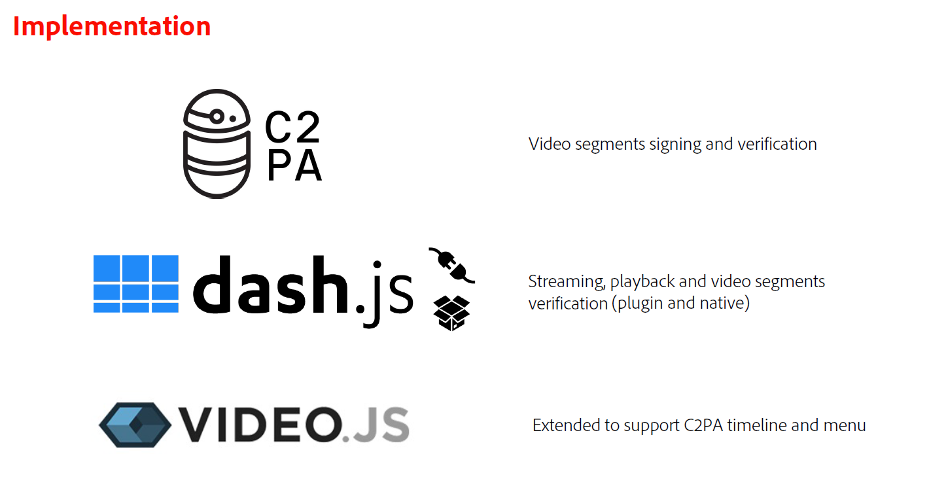

Slide 88
15:00 Task Force Overview
Content Protection Work (Laurent, 30min)
Live and Ad Insertion (Alex/Thomas/Zach, 20min)
Media: Video and Audio (Stephan/Thomas, 15min)
Ingest, Events, etc. (10min)

Slide 89
Content Protection and Security Task Force
September 17, 2024
Laurent Piron

Slide 90
Activities of the Task Force
Task force active since the beginning of DASH-IF
First focused on DASH IOP guideline then extended to Content Security
What was produced
DASH IOP
Guidelines for DRM signaling, content protection, security
Definition of Enhanced Clear Key Content Protection (ECCP)
CPIX for content key and DRM signaling exchange
Generic XML document design
Packager – Key Server interface
Watermarking
DASH-IF Forensic A/B Watermarking end to end architecture
Encoder/Pre-Processor API
Token-based Access Control for DASH (TAC)

Slide 91
Content Protection Information Exchange Format - CPIX
CPIX 2.3
ETSI TS 103 799 V1.1.1 (2021-04)
https://www.etsi.org/deliver/etsi_ts/103700_103799/103799/01.01.01_60/ts_103799v010101p.pdf
CPIX 2.3.1
Published in August 2023
Not sent to ETSI
CPIX 2.4
Community Review done
No comments
Next steps
Start ETSI approval process
Publish the HTML version

Slide 92
DASH-IF Forensic A/B Watermarking
ETSI TS 104 002 V1.1.1 (2023-08)
Available from https://www.etsi.org/deliver/etsi_ts/104000_104099/104002/01.01.01_60/ts_104002v010101p.pdf
End-to-end workflows for A/B watermarking
CWT token definition
Data flows from encoder to CDN edges
No work foreseen except if defects are reported

Slide 93
Watermarking API
Document to be ready for Comminity Review by end of September 2024
ABR Encoder(s)
OTT distribution
Device
WM pre-processor
There are two versions (A and B) of each ABR segment: one watermarked with 0 and the other with 1
The video delivery mechanism is personalized so that each user receives a unique sequence of A/B segments that encode the desired forensic information

Slide 94
IOP v5 Part 6
No work done since last F2F
4 known issues and few typos
https://github.com/Dash-Industry-Forum/DASH-IF-IOP/issues/193
https://github.com/Dash-Industry-Forum/DASH-IF-IOP/issues/300
https://github.com/Dash-Industry-Forum/DASH-IF-IOP/issues/338
https://github.com/Dash-Industry-Forum/DASH-IF-IOP/issues/400

Slide 95
Next steps
Finalize CPIX and Watermarking API
Scalability of key rotation
Avoid having all devices requesting a key at exactly the same moment
Define end to end support
Signaling in the content
Best practices for content preparation
IOP v5 updates

Slide 96
Overview of features and support in DASH-IF
Features (5th and 6th edition) | IOP Status | Dash.js status | Test/Live Sim status
CMAF Profile | Part of DASH-IF v5, part 2, 4, 5 | Handled through MSE/browser | CTA WAVE Test content
Low-Latency DASH | Part of DASH-IF v5, part 4 | Supported | Supported in live sim
MPD Patching | Started with feature based documentation | Supported | Supported
Event Streams | DASH-IF v5 part 10 | Supported | Rudementary in Live sim, more work needed. No MPD Events
Advanced Content Protection | Not yet in part 6 | refID supported, not robustness | Not yet supported
Alternative MPD Event | Considered for part 5, not yet started | No | no
Content Steering | ETSI spec completed, started with feature based documentation | Basic support Service description | Brightcove test streams Update to 1.0.0 needed
CMCD | CTA spec, started with feature based documentation | Supported in v1 MPD parsing completed | Nothing available
L3D and Segment Sequences | In progress for v5.1 part 4, will initial feature based development | Not yet started | Not yet started
Pattern signaling | Not yet stated | Not yet stated | Not yet stated
ARI Track | Not yet stated | Not yet stated | Not yet stated
C2PA in DASH | Special Session, not in IOP | Adobe has pull request | Not yet started

Slide 97
Features
Documentation started
Live to VoD Conversion
MPD Patch
Content Steering
Lower Latency and Switching Delay DASH (L3D)
Common Media Client Metadata (CMCD) in DASH
Common Media Server Data (CMSD)

Slide 98
Low-delay mode: theory of operation
Partial Segments
Segment broken into sequence of partial segments (“segment sequence”)
Partial segments start with IDR
Special-purpose representations for fine-grain random access
Segment Sequences are templated
”this segment sequence contains k partial sequences”
Normal representation
S(i)
S(i+1)
Low-delay 1
S(i,0)
S(i,1)
S(i,2)
S(i,3)
S(i,4)
S(i+1,0)
S(i+1,1)
S(i+1,2)
S(i+1,3)
S(i+1,4)
Segment Sequence
Low-delay 0
98

Slide 99
L3D: Low-Latency Low-Delay DASH
Beyond low-latency and low-delay
Efficient use of HTTP/3
Each HTTP/3 response is a QUIC stream
Parallelize transmission of extremely short partial segments
… some of the MoQ goodness using ye aulde DASH
Compression efficiency
Enables scene-boundary aligned segments
Mini-GOP-sized partial segments for random access and events
Trick modes
Small partial segments can be used for smoother trick play
99

Slide 100
Discussion at DASH-IF f2f June 13, 2024
Next Steps
Status MPEG, IOP, SCTE
Collaboration SVTA/DVB/DASH-IF
DASH-IF/DVB Report on Low-Latency Live Service with DASH
We create a new/extension to the report
DVB can create high-level CRs for this purpose
Technical Solution to be developed in DASH-IF IOP Live with invitation to DVB and SCTE
DVB can reference/re-use (likely trailing)
We develop the needed tools in dash.js, live-sim and FFMPEG
Next steps - procedurally:
(Alex/Nicolas/Thomas/Will) Document a short report with expected KPIs to 1-2 seconds, join time, HLS compatibility, Ad insertion.
(Thomas) will bring the proposal to DVB in CM/CM-I - invitation to joint calls under liaison agreement
(Thomas) IOP regular meetings
(Daniel/Tobbe) What are the efforts to get this to Reference Tools?

Slide 101
DASH-IF Media TaskForces
Thomas Stockhammer - tsto@qti.qualcomm.com
Stephan Schreiner - stephan.schreiner@dolby.com

Slide 102
DASH-IF Interoperability Documents
Goal:
“facilitate a common interoperability of media and media services at key points of the delivery chain from the server to the client”
Latest version: “IOP v5.0”
Usage of MPEG-DASH for CMAF-formatted media
Multi-part document
Part 7: CMAF media profiles and DASH signaling for video tracks
Part 8: audio interoperability points for the DASH-IF ecosystem, incl audio coding profiles, ISOBMFF packaging and MPD parameters

Slide 103
DASH Interoperability – Addition of a Media Profile
For an external media profile to be documented in this IOP, the following information MUST be provided:
The name of the media profile
The specification where the media profile is defined
The static mapping of parameters to a DASH MPD, in particular to the MPD parameters, such as @mimeType, @codecs, etc.
The dynamic mapping of parameters to a DASH MPD from a CMAF Principal Header, in particular to the MPD parameters, such as @width, @height, etc.
For an external media profile to be documented in this IOP, the following information is recommended to be provided:
The typical content options for this media profile, for example bitrates, resolutions, etc.
A list of test vectors that conform to the CMAF Media profiles and also cover the content options. Based on this, the test vector can directly be mapped to DASH and added to the DASH Test Vector base.
A content validator for the CMAF Profiles. Based on this, the content validator can directly be mapped to DASH and added to the DASH conformance tool.
Encryption requirements and recommendations.
Capability discovery options, for example mapping to HTML-5, MSE and media capability APIs.
Source Buffer Initialization Requirements.
Playback Requirements, for example by referencing CTA WAVE Specifications
Additional useful information: Encoding and Decoding Guidelines, Availability of the decoder, Relation to other specifications, such as in DVB, ATSC, MPEG, ETSI, etc.

Slide 104
Audio
CMAF Audio Profiles
MPEG
MPEG-4 HE-AAC (stereo/multichannel), MPEG-D USAC (xHE-AAC), MPEG-H 3D Audio
Dolby
(Enh.) AC-3, AC-4
DTS
HD / UHD
NGA (Next-generation Audio) and Preselections
Recent update (2024-03):
Added client recommendations for track selection, aligned with:
updates in reference client, and
established prioritization rules from TV specifications (NorDig)

Slide 105
Video
CMAF Media Profiles
AVC, HEVC, VVC, EVC
Content Requirements and Source Metadata Signaling
Enhancements
Improve guidance on “HDR video source metadata signalling”
Add client recommendations for track selection
Under consideration:
MV-HEVC (Qualcomm)
LC-EVC (V-NOVA)

Slide 106
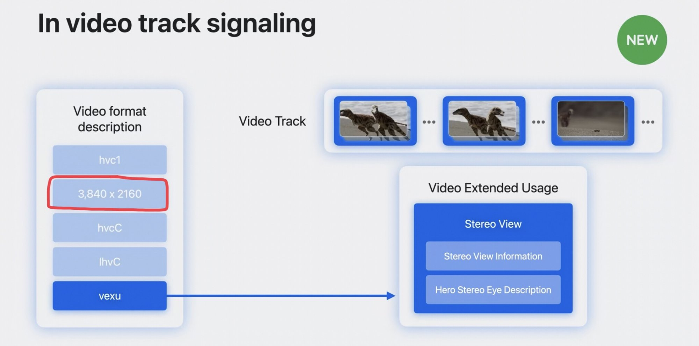
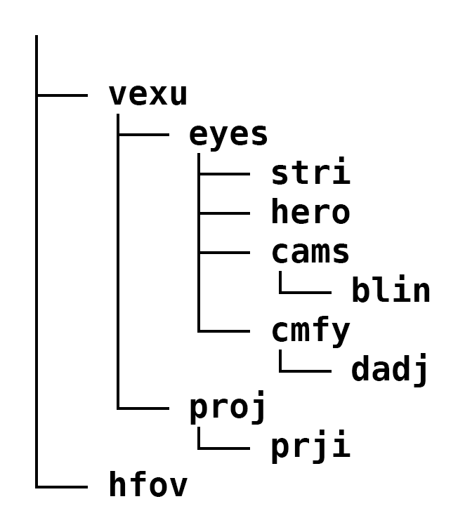
Apple's Spatial Video Format
https://blog.mikeswanson.com/post/744337392062873601/spatial-video
Apple has decided to use the multiview extensions of the HEVC codec, known as MV-HEVC. This format encodes multiple views (one for each eye) using the well-known and efficient HEVC codec.
CMAF media profile is defined in MPEG-CMAF.
On CMAF, we created an updated working draft of Amendment 2 of the 3rd edition in WG03N1195 that includes a draft text for a CMAF profile for MV-HEVC. The envisaged timeline is the creation of a Committee Draft by 07/24, Draft Amendment by 11/24 and publish by 05/25
Core aspects
It includes a base layer for HEVC to decode and present only one eye
It is a single track file – no delivery scalability
Is based on the video track signaling seen on the right
Should allow metadata tracks in the single CMAF tracks as well

Slide 107
DASH-IF plans
Follow the work in MPEG and 3GPP
01
Support any interoperability efforts for MV-HEVC
02
Eventually add MV-HEVC to our video part
03

Slide 108
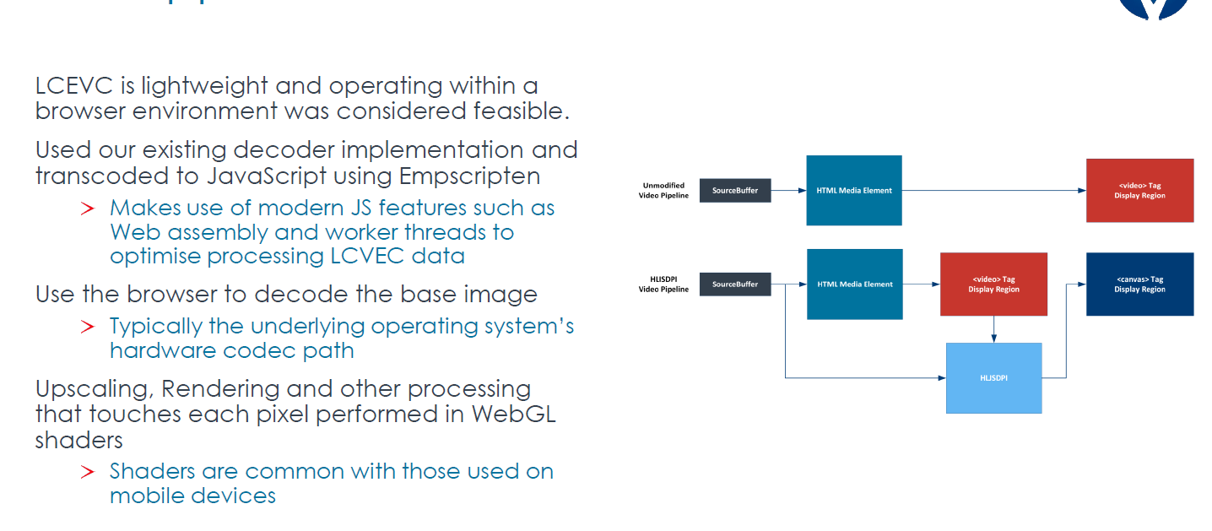
LC-EVC

Slide 109
16:15 AOB and Wrap up 16:30 Close of Session Break 17:00 Start of MPEG DASH AHG Session 19:00 End for MPEG-DASH AHG Session

Slide 110
Actions and next steps
Feature development in DASH-IF WG – please join us
Development of tools – we need to get consistent funding and task definition – please support us
Collaboration with/Integration into SVTA groups

Slide 111

Thank you

