Slide 1
3GPP Update
Thomas Stockhammer, 3GPP SA4 Rapporteur, Qualcomm Incorporated
Frédéric Gabin, SA4 Chair, Dolby Laboratories Inc.

Slide 2
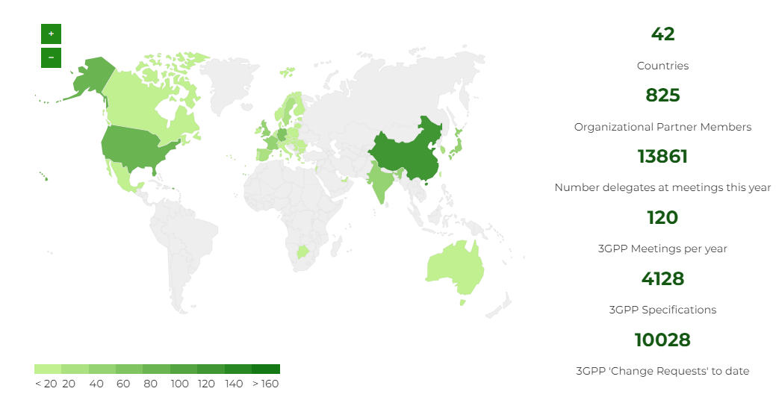
3GPP Global Membership

Slide 3
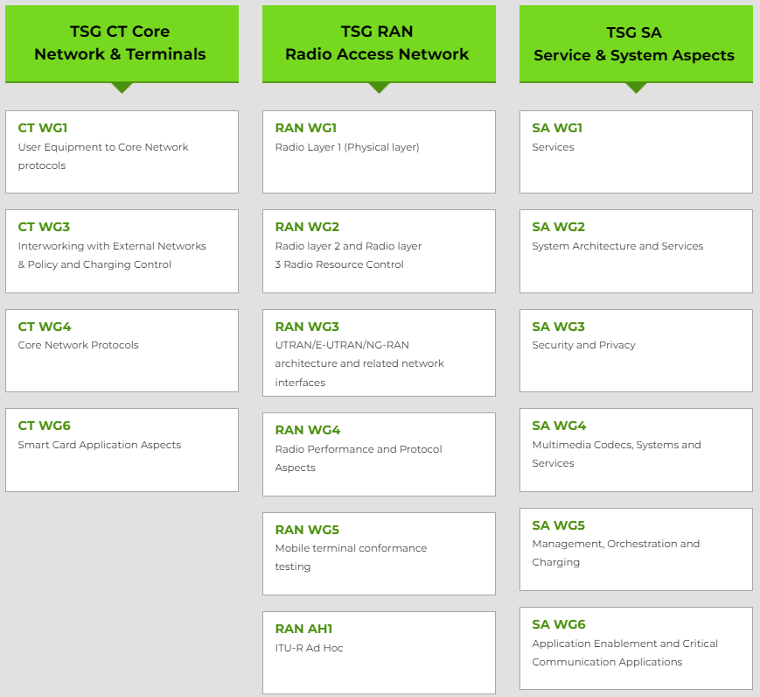
Plenaries and Working Groups

Slide 4
3GPP Timeline - overall
2021
2022
2023
2024
2025
2026
TSG#92
TSG#94
TSG#96
TSG#98e
TSG#100
TSG#102
TSG#104
TSG#106
TSG#108
TSG#110
TSG#112
TSG#114
TSG#93
TSG#95
TSG#97
TSG#99
TSG#101
TSG#103
TSG#105
TSG#107
TSG#109
TSG#111
TSG#113
SA1 Stage 1
Note: All starting dates are indicative
RAN Content def.*
Stage 2 Normative
Release 18
RAN Completion**
Maint.*
Stage 3 (CT & SA)
ASN.1 & Open APIs
*: +3 months for RAN4
**: - 3 months for RAN1, + 3 months for RAN4 perf
ASN.1
1st review
SA1 Stage 1
RAN Content Def*
SA St.2 Content Def
Release 19
Stage 2 Normative
RAN Completion**
Stage 3 (CT & SA)
Now
ASN.1 & Open APIs

Slide 5
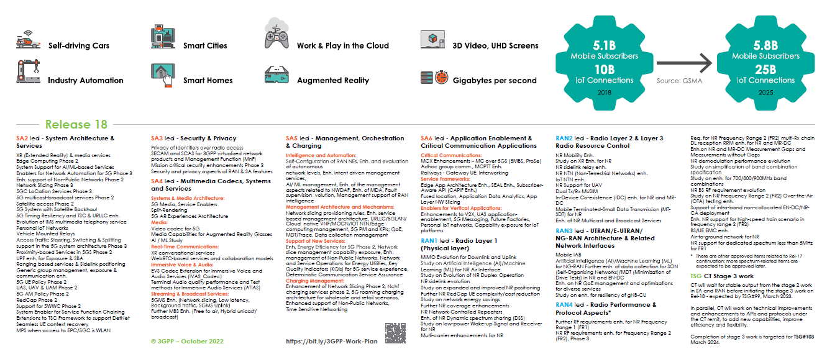
3GPP Rel-18 Topics

Slide 6
Rel-18 5G Media Streaming feature overview
Extensive studies documented in TR26.804 result in the following updates
Consistent support for uplink streaming
End-to-end low latency live streaming with dynamic policies
5GMS over MBS and 5GMS hybrid unicast/MBS services.
Based on development in CTA WAVE in context of DASH/HLS interop specification in CTA-5005, it was identified that the same media service may be available in multiple formats, and 5GMS media is expected to offer the same service with different entry points in order for the device to select the service based on its capabilities, for example using a DASH player, or and HLS player, or using a progressive download system.
The 5G System offers different solutions for traffic identification and traffic detection. Traffic identification is essential so that the 5G System can detect application flows to which, for instance, an appropriate Policy and Charging Rule (PCC) is applied. 5GMS is extended to support the configuration of ToS values for the identification of traffic associated with a Dynamic Policy. and study use-cases with IPsec and the usage of the security parameter index for traffic identification.
The Quick UDP Internet Connection (QUIC) [43] and HTTP/3 protocols are among the most recent developments in the IETF, with the goal of combining flexibility, extensibility, and performance to web applications. The 5GMS specifications are updated to allow the use of HTTP/3 at relevant reference points in the 5GMS architecture.
Background data transfer (BDT)
Specification of the usage of Oauth 2.0 for 5GMS protocols based on the conclusions to address use-cases, when a UE hosts multiple 5GMS-Aware Applications from different 5GMS Application Providers.
Specifications for the 3GPP Service Handler and URL including the necessary functions on UE and device to support automatic launch of 5G System services in the context of 5G Media Streaming. It was identified that it is essential to provide a URL form for media services in order to automatically launch client and network functions without disrupting existing app workflows.
Specification of a RESTful API at reference point M3, for the configuration of 5GMS AS instances by 5GMS AF. M3 was undefined until now, but based on deployment experience it was identified that it is necessary to define this reference point more details.
Specification of data types for data reporting of ANBR-based Network Assistance invocations and specification of data types for exposure of events relating to invocation of AF-based and ANBR-based Network Assistance.
Enhancements based on feedback from 5G-MAG Reference tool developments. The support of 5G-MAG reference tools created essential inputs to the spec development and continuous exchange will result in additional updates.
this functionality is needed for media production services, but also for contributing user generated media to operator and third-party services. Different collaboration scenarios between the MNO and the service provider are addressed in an updated specification – bringing uplink streaming on par with downlink streaming.
is of crucial support to meet the TV industry needs in order to bring 5G on par with other distribution means. Live TV services are characterized by at least the following aspects: (1) scalability (in terms of concurrent users), (2) consistent quality, (3) high bandwidth requirements, (4) target latency constraints, and advanced TV Experiences. Primarily, updated DASH tools, QoE monitoring and QoS support for low-latency in 5G media streaming are specified in order to meet the requirements defined in TR 26.804.
This functionality is expected to allow scaling media services using multicast and point-to-multipoint distribution within the operators network.
Multiple Service Entry Points
Traffic Identification
QUIC and HTTP/3
enables mobile network operators to incentivize the offloading of traffic into off-peak hours with the aim of reducing network congestion during peak hours. Applications may register their interest in receiving content using BDT. The 5GMS specifications will be updated with the necessary parameter extensions to the M1, M5, and M6 reference points to provide access to BDT.
Oauth 2.0
3GPP Service URL Handling
Application Server Configuration
EVEX data types for ANBR-based Network Assistance
Support for 5G-MAG Reference Tools

Slide 7












Rel-18 Media Capabilities for XR/AR
Eye Tracking + Camera/Sensor Aggregator
SoC Media
Defining baseline requirements for an AR lightweight and XR device
Connectivity
Hinge
Requirements include
OpenXR Core APIs
rendering capabilities
capturing capabilities
audio and video codecs
scene description
Wire formats for metadata
Profiles for split rendering and stand-alone rendering

Slide 8



A distributed compute architecture enables rich XR user experience
Application
Perception algorithms
Post processing (ATW, error concealment, …)
6DoF HMD pose, controller, eye/hand tracking
Game engine
Motion-to-render-to-photon latency
M2R2P
How to standardize split rendering?
Encoder
Decoder
Compressed rendered frames
M2R2P = Edge processing + 5G round-trip time + Device processing
Notes:
A distributed compute architecture enables rich XR user experience
So how does boundless XR work in reality? Boundless XR distributes the computation between edge cloud server and device to deliver truly immersive XR over 5G.
The XR headset provides power-efficient, latency-sensitive on-device rendering and tracking.
The Edge cloud server provides computationally intensive processing and graphics rendering.
5G provides the high bandwidth and low latency connectivity.

Slide 9

AR Call
Extend existing IMS and WebRTC-based telephony services
Multi-party calls and conferencing with AR
Users join with realistic avatars and contribute 2D/3D content
Create shared spaces where call participants can interact

Slide 10


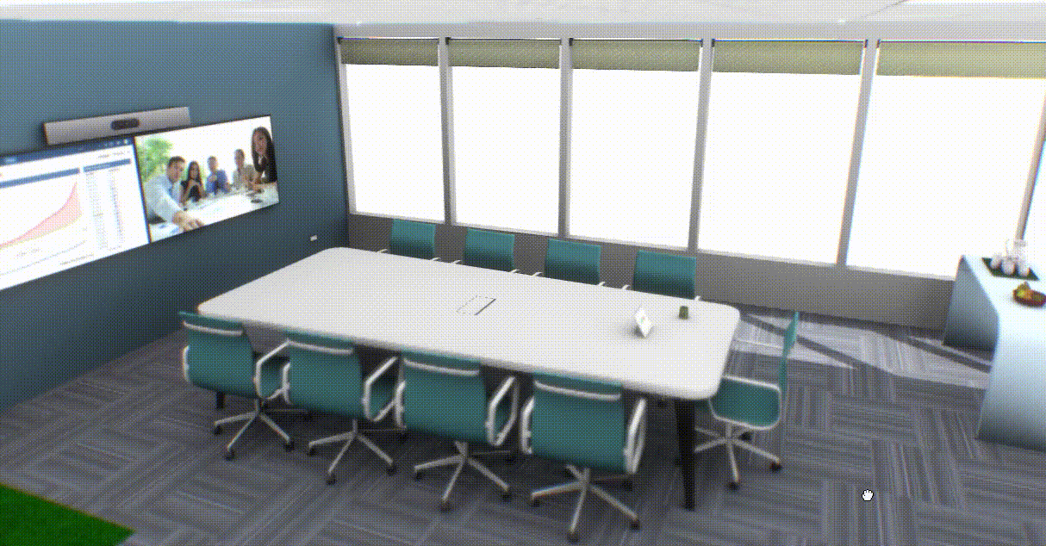
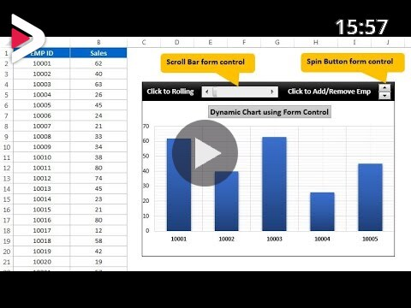



High Level Procedure
Scene of shared space
Scene of shared space
Add nodes to scene
Add nodes to scene
Send scene updates
Send scene updates
Pose and animation updates
Pose and animation updates
Update
Loop
Send scene updates
Send scene updates

Slide 11
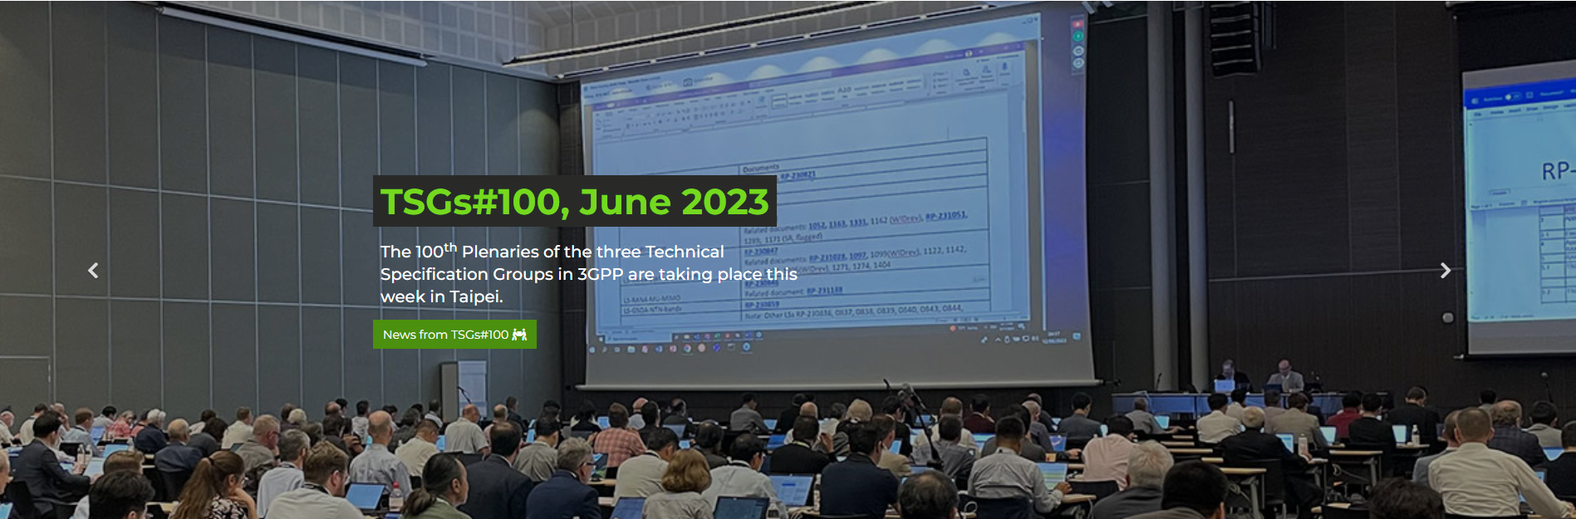
TSGs#100 and Rel-19 WS this week

Slide 12

Categorization of Rel-19 RAN WS Input
AI/ML Air Interface
MIMO Evolution
Duplex Evolution
Ambient IoT
Network Energy Saving Enhancements
Mobility Enhancements
NTN Evolution
XR Evolution
AI/ML for NG-RAN
SON/MDT
Channel Modeling (& possibly additional aspects e.g. for ISAC) for further evolution
Additional RAN1-led Candidate Topics
LP-WUS/WUR
Multi-carrier Enhancements
Coverage Enhancements
Positioning Enhancements
SL Evolution
Additional RAN2-led Candidate Topics
NCR
SL Relay Enhancements
UAV/UAM
MU-SIM
Broadcast/multicast
UE aggregation, collaboration, and backup
Additional RAN3-led Candidate Topics
Topological enhancements
QoE
Others
Lean protocol stack/High speed packetization/Layer 2 UP enhancements
RAN architectural enhancements/AS Security Enhancements
Network/Outer coding
RedCap Enh./High reliability and low complexity IoT
Combination w/ SL or NTN can be discussed in the SL/NTN topics, respectively)
TaaS (Timing as a service)/High Accuracy Timing Service
SDT enhancements
LTE enhancements
Dynamic UE capability update
Others (e.g.,, Idle/Inactive enhancements, RAN slicing enhancements, etc.)

Slide 13
SA4 WG Input to Rel-19 Workshop - 2
SA/SA2/RAN2 to let SA4 do stage-3 on media related topics. Early indication of potential impact to SA4 is nice-to-have.
SA4 is currently focused on Rel-18 Work and Rel-17 maintenance
SA4 hasn’t started Rel-19 planning. Several topics mentioned but no detailed discussions and conclusions. Example of potential larger work topics for SA4:
SA4#124 agreed to start Rel-19 discussions from December 2023:
Build on leftovers from Rel-18, studies from Rel-18, work topics related to RAN and SA2 work
Identify substantial new work topics for Rel-19.
Work with requirements and inputs from the industry: 5G-MAG, Metaverse Standards Forum, etc.
New Video Codecs
Avatars
XR Extensions
5GMS and MBS Extensions
AI/ML for Media

Slide 14



Candidate 3GPP 6G timeline – Qualcomm vision
WRC-23
WRC-27
Key dates:
1st 6G Release: Dec ’28
6G commercial launches 2029/2030
3GPP Technical work starts Q3-25
3GPP 6G Workshop March ’25
Before this date 3GPP 6G scope limited to high level 6G requirements (MNOs, verticals)
These dates expected to be acceptable by most major 3GPP players
2021 |  |  |  | 2022 |  |  |  | 2023 |  |  |  | 2024 |  |  |  | 2025 |  |  |  | 2026 |  |  |  | 2027 |  |  |  | 2028 |  |  |  | 2029 |  |  |  | 2030
1 | 2 | 3 | 4 | 1 | 2 | 3 | 4 | 1 | 2 | 3 | 4 | 1 | 2 | 3 | 4 | 1 | 2 | 3 | 4 | 1 | 2 | 3 | 4 | 1 | 2 | 3 | 4 | 1 | 2 | 3 | 4 | 1 | 2 | 3 | 4 | 1 | 2 | 3 | 4
Rel-17
5G Advanced
L1 L2/L3 ASN.1
Rel-18
Rel-19
Rel-20
IMT-2030 submission
3GPP 6G Workshop
Rel-21
L1 L2/L3 ASN.1
Rel-22
6G Study
6G Standard
We are here
6G
1st 6G Release
2nd 6G Release

Slide 15
6G technology design targets – Qualcomm view
Communication
AI & compute
System resiliency
Integrated sensing
Green network
Key Performance Indicators
Capacity
Data rate
Mobility
Coverage
Connection density
…
Inference accuracy
Model transfer latency
AI service roundtrip time
Compute capacity
Scalability / adaptability
…
Confidentiality
Integrity
Availability
Mean time to detect / resolve / contain
…
Range
Confidence level
Sensing accuracy
Resolution
Latency
…
Network energy efficiency
Network carbon intensity
Carbon neutrality
ECO rating
Battery requirement
…
Qualcomm Webinar - what you need to know about 6G and why
Qualcomm Whitepaper - market-drivers and research directions on the path to 6G

Slide 16

Thank You!
For details visit https://3gpp.org
Working Groups: https://www.3gpp.org/3gpp-groups
Specifications: https://www.3gpp.org/specifications-technologies
Get involved: https://www.3gpp.org/get-involved

