Slide 1

5G-Advanced Media Delivery, Audio & Video Services
Frédéric Gabin (Dolby Laboratories)
Outgoing Chair of 3GPP SA4 (Multimedia Codecs, Systems and Services)
25th June 2025
12th FOKUS Media Web Symposium

Slide 2

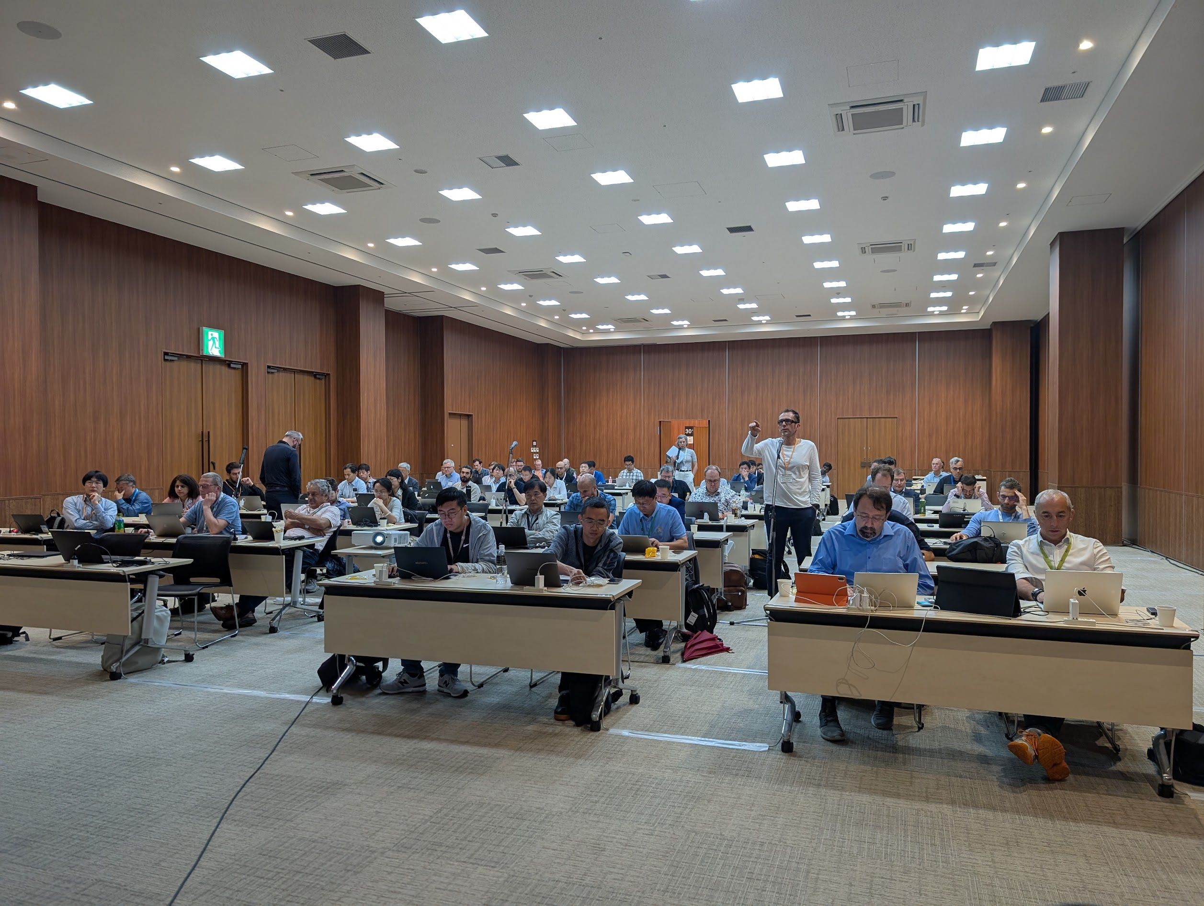

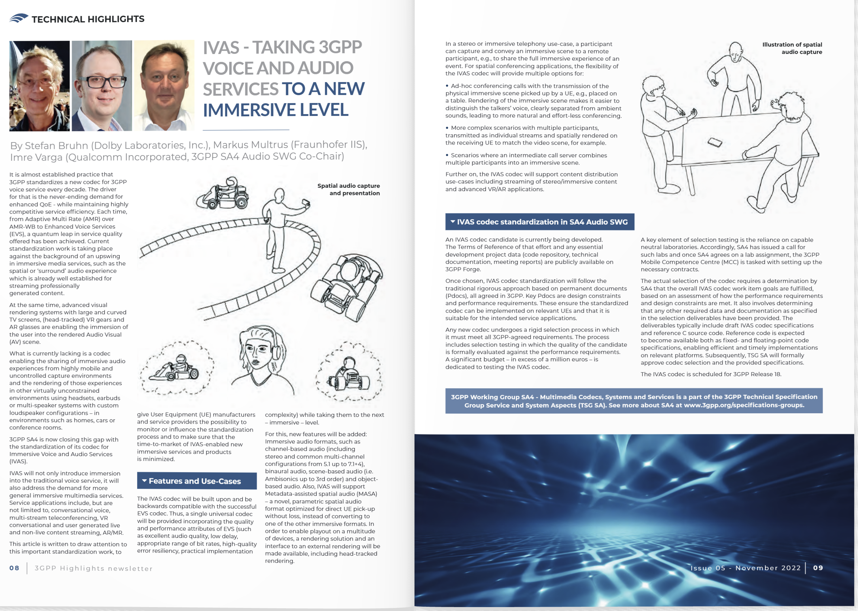

Being Chair of 3GPP SA4 (Multimedia Codecs, Systems and Services)

Slide 3
5G-Advanced Audio & Video Media
IVAS (Immersive Voice and Audio Service) is a new codec designed for real-time immersive voice and audio applications.
MV-HEVC (Multiview High Efficiency Video Coding) is an extension of the HEVC (H.265) standard, designed for efficient encoding of multiview videos—that is, multiple perspectives of the same scene, such as in 3D or immersive content with stereoscopic video.
Also included are Avatar Communications for real-time communications using avatars, xHE-AAC for high-quality stereo audio, and glTF 2.0 scenes for 3D objects used in messaging (e.g., GSMA RCS).
There are also studies on topics such as Beyond 2D/Volumetric/Gaussian Splat for volumetric video and images.
ULBC (Ultra Low Bitrate Codec) is a new speech codec currently under study and planned to be specified in Rel-20 (March 2027) for 5G-Advanced for satellite communications.

Slide 4
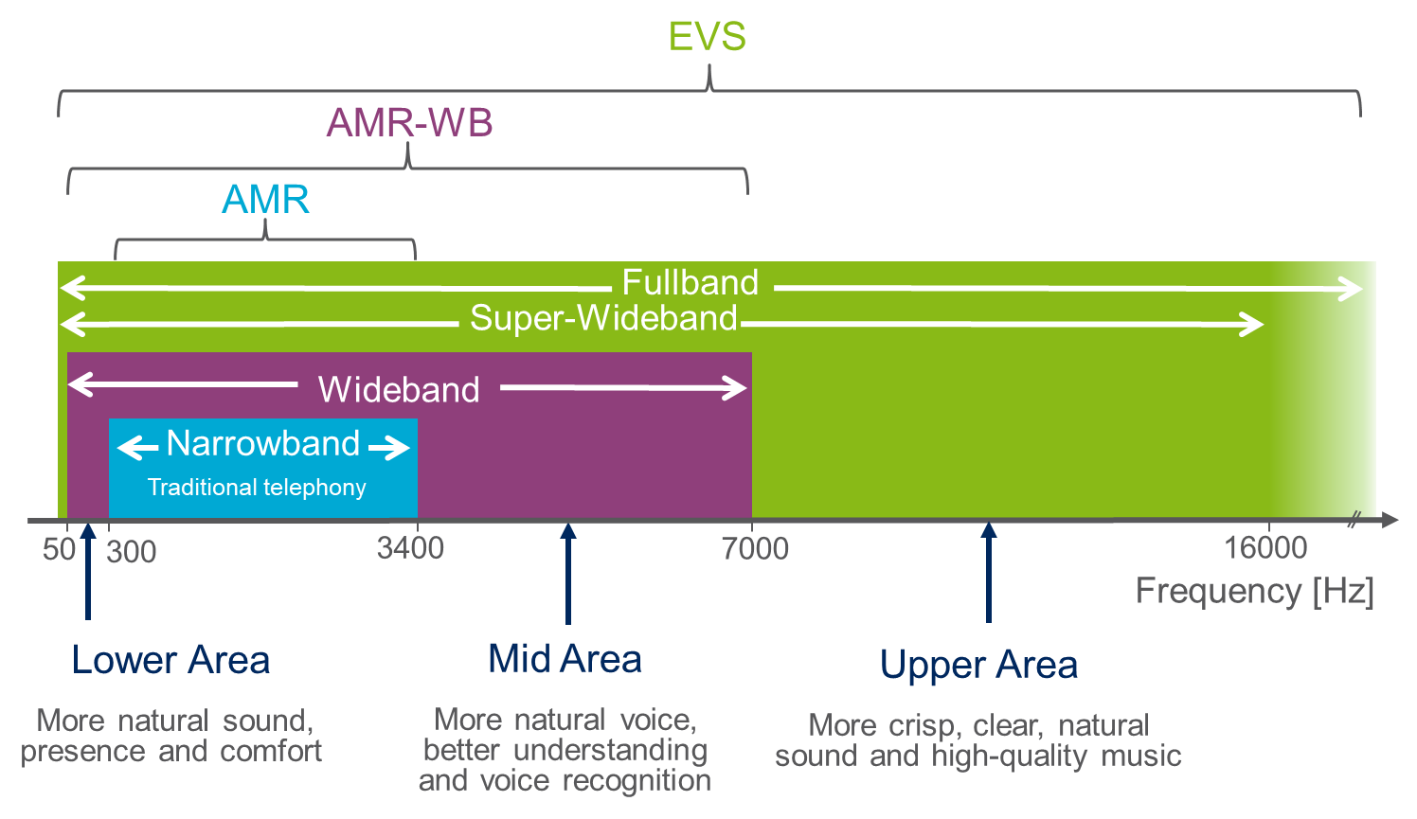
Voice service evolution
3G: circuit-switched voice service
  Mandatory AMR (narrowband) codec (1999)
  AMR-WB codec (2001)
  EVS codec (2016)
4G: packet-switched voice service (VoLTE)
  Mandatory AMR, AMR-WB codecs
  EVS codec (2014) – mandatory for super-wideband
5G: packet-switched voice service (VoNR)
  Mandatory AMR, AMR-WB, EVS codecs
Driver of voice codec evolution was demand for
  Flexible coding solutions – trading system capacity (bitrate) against service quality
  Enhanced Quality of Experience (QoE)
  Increased robustness for jitter and frame losses in packet-switched networks
Quantum leaps of service quality with each new codec generation

Slide 5

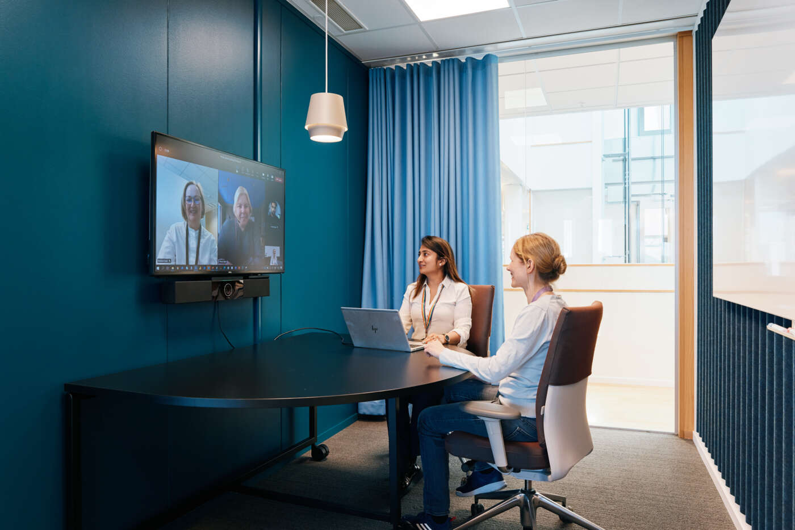




IVAS use cases
Immersive audio is widely deployed in streaming/broadcast and storage applications. IVAS focuses on immersive audio for conversational applications
Conversational telephony
  Stereo and immersive telephony/conferencing (immersive VoLTE/VoNR/ViLTE)
  Mono interoperability with 3GPP EVS Codec (VoLTE/VoNR)
XR (VR/AR/MR) communication
  XR telephony and conferencing
  XR virtual conference - remote participants meeting in a virtual environment - Metaverse
Live and non-live streaming
  User-generated immersive and XR content
  Messaging (e.g. RCS)
Verticals
  Telemedicine, Industrial IoT, Emergency Handling,
  Gaming, Education

Slide 6

IVAS codec architecture and formats
Supported input formats
  Mono (100% EVS compatible mode)
  Stereo/binaural
  SBA (Scene Based Audio, 1st-3rd order Ambisonics)
  MASA (Metadata-assisted spatial audio)
  Multichannel (5.1 to 7.1.4, flexible layouts)
  Object Audio (ind. streams, 1-4 objects)
  SBA + Objects (OSBA)
  MASA + Objects (OSBA)
Supported output formats
  Mono
  Stereo
  Multichannel, including arbitrary loudspeaker setups (up to 16 channels)
  Ambisonics up to 3rd order
  Binaural Audio including support for real-time head-tracking
  “EXTERNAL“ output mode for pass-through operation, to allow use of external renderers

Slide 7
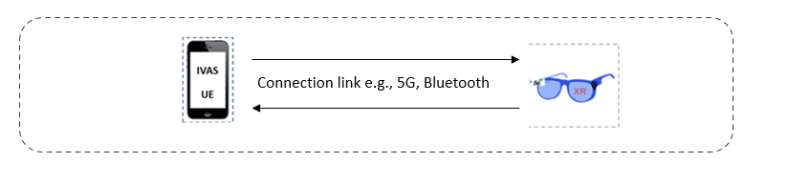
IVAS codec features
Discontinuous Transmission (DTX)
Error concealment mechanisms
Bitrate switching at any frame boundaries
Jitter Buffer Management (JBM) mechanism
Real-time Transport Protocol (RTP) support
High performances
Split-rendering for high quality XR experience
  Splits the complex head-tracked rendering process between a highly capable device (e.g. a smartphone) and a reduced compute capability device (e.g. glasses)
  Low motion-to-sounds latency
  Very low complexity requirements for playback device
Bitrates
  5.9 - 128kbps (EVS/mono)
  13.2 - 256kbps (Stereo/binaural)
  13.2 – 512kbps (Immersive)
Algorithmic codec delay 32-38ms
Audio bandwidth NB to FB
3GPP Rel-18 (aka 5G-Advanced) floating point c code available under 3GPP Forge.

Slide 8
3GPP Media Services – Selected Topics
Media Web Symposium 2025
June 2025
Thomas Stockhammer, Qualcomm Incorporated

Slide 9
Video Topics
Advanced Media Delivery
5G Media Streaming
5G Broadcast and MBS

Slide 10
Selected Technologies for Media Services
3GPP is addressing the issue to profile technologies for 3GPP Services and Media Service Enablers
Codecs and Formats
Content Delivery Protocols
Access and Distribution Technologies
Security, Content Protection and Provenance
Rendering and Presentation
Quality-of Service and Quality-of-Experience
Data collection and Intelligence

Slide 11
Video Topics

Slide 12

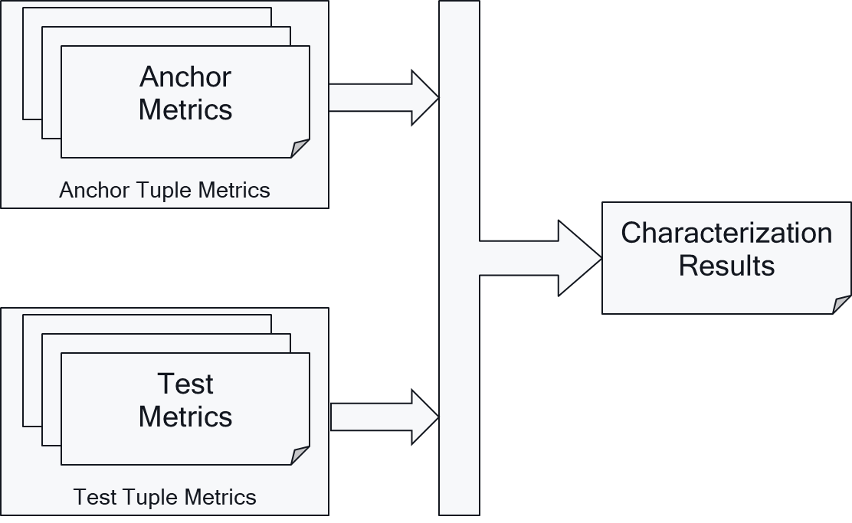




Characterization and Traffic Characteristics
Supporting industry and other working groups
Among others, SA4 is responsible to guide other 3GPP groups concerning required QoS parameters, traffic characteristics and other system implications of media services
  TR 26.925, primarily literature research was conducted and collected to get static bitrates
  TR 26.926, a pseudo evaluation framework was built to get to traffic patterns, but this was already partially supported by collected traces.
Moving forward, plans to work with real-world traffic patterns, either by
  directly measuring services, or
  by measuring traffic from well defined frameworks
The impact of 3GPP QoS to services needs to be mapped to QoE
Under well-defined typical mobile test conditions, codecs are evaluated for potential improvements and results are documented
2D video (TR 26.955), Beyond 2D (TR 26.956)

Slide 13
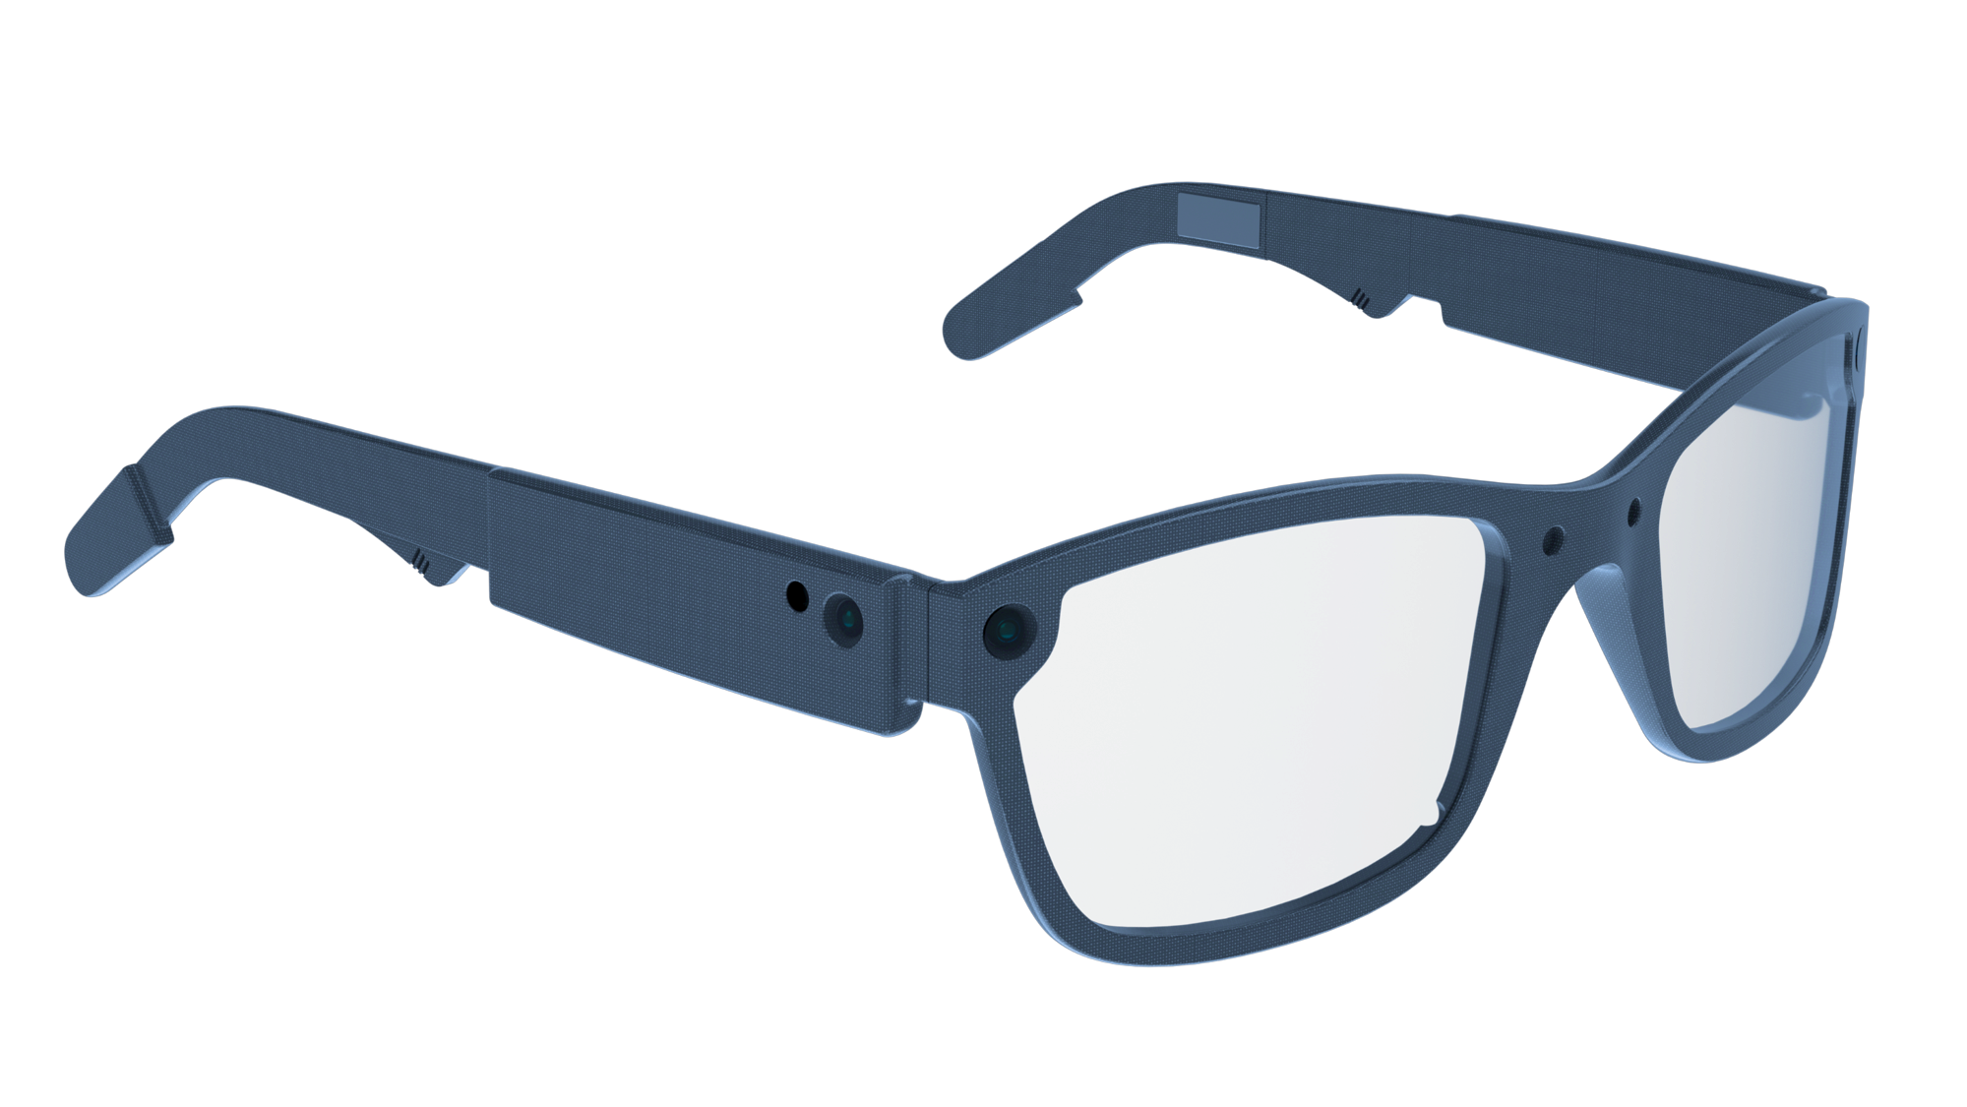


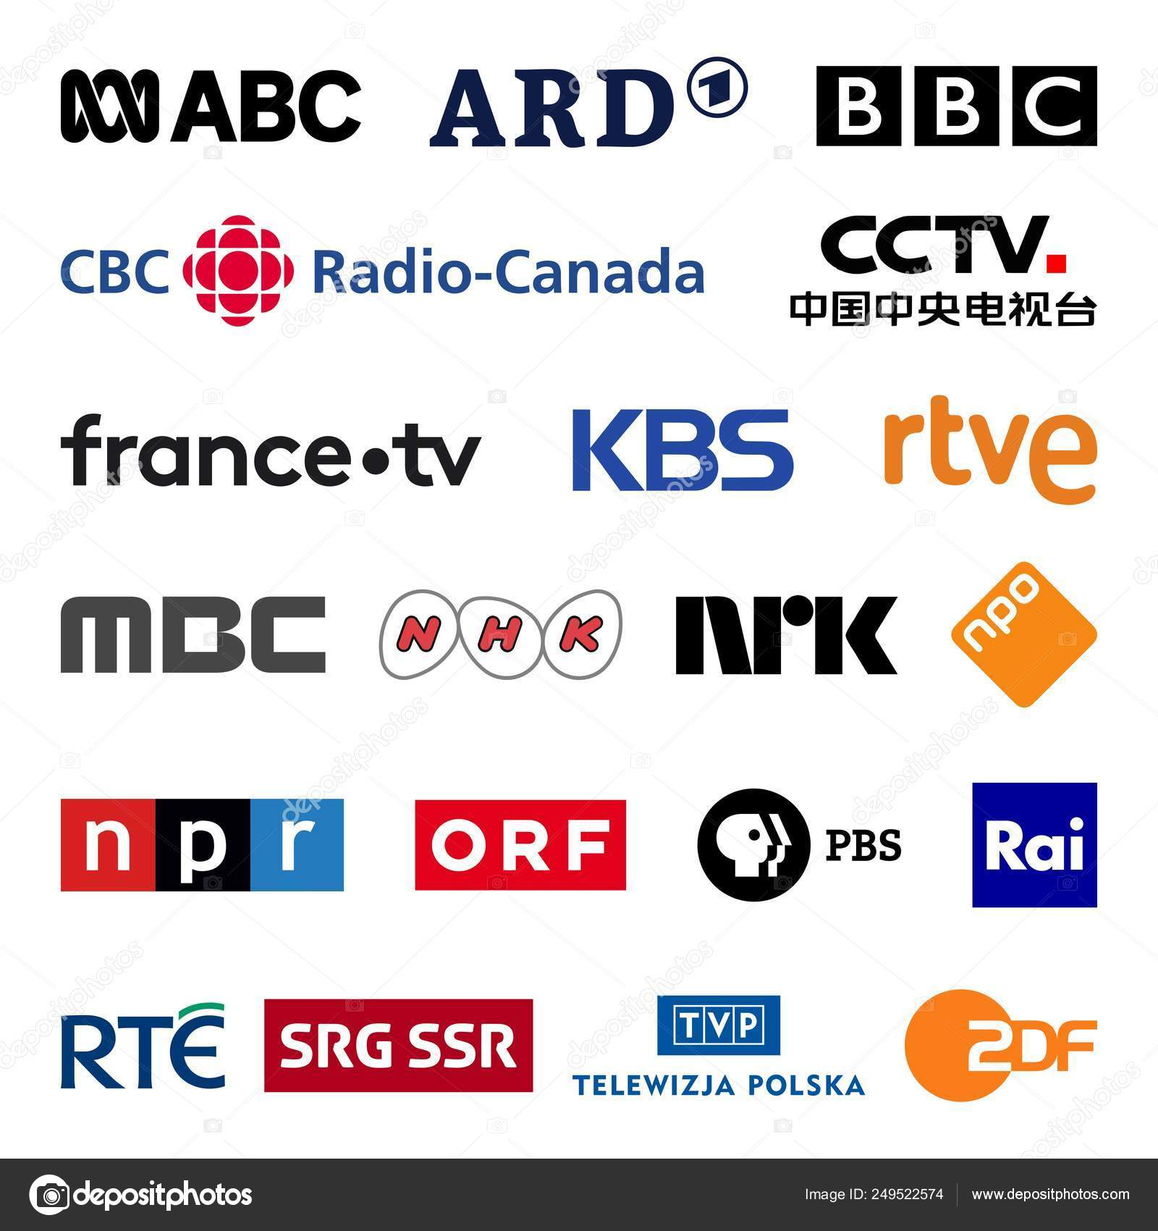

Format Interoperability and profiling
Global, different services, different devices, across ecosystem
UCG
Services
Messaging
Streaming
Communication
Pre-render
Internet
Cloud/Edge
Deliver via
3GPP
Encode and Format
Access and Decode
Pre-render
Formats and Codecs Examples:
Spatial Video with MV-HEVC (Rel-19)
Volumetric Video
Gaussian Splats ? (6G)
How?
Specs, primarily profiles
Conformance tools
Pre-render?
Professional

Slide 14
5G Media Streaming

Slide 15
Rel-16 5G Media Streaming – The Idea
Collaboration of MNOs and Media Service Providers
Approach:
  Framework aligned with today‘s OTTmedia distribution practices
  Supplementing MNO and third-party media services to easily access 5GS and 5GMS features
  Concrete instantiation for subset of recommended technologies (e.g. codecs, formats, etc.)

Slide 16
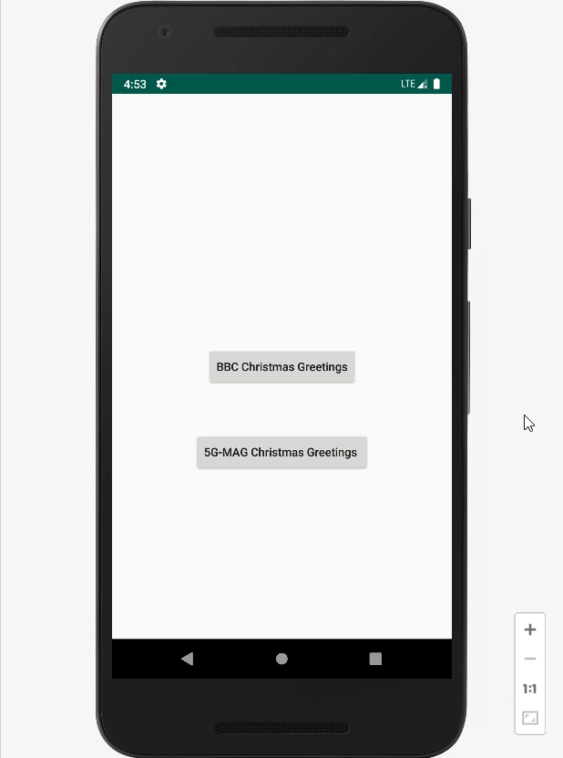
5G UE in China
5G Content Provider UK
5GMS-aware Application
Media Session Handler
Media Player
5GMS
AS
5GMS AF
Select BBC
Access:
http://5gms.bbc.uk/3gpp-m5/v2/service-access-information/d54a1fcc-d411-4e32-807b-2c60dbaeaf5f
JSON Response
{
"provisioningSessionId": "d54a1fcc-d411-4e32-807b-2c60dbaeaf5f",
"provisioningSessionType": "DOWNLINK",
"streamingAccess": {
"mediaPlayerEntry": "http://5gms.bbc.uk/m4d/provisioning-session-d54a1fcc-d411-4e32-807b-
2c60dbaeaf5f/Christmas-Greetings-to-5G-MAG.mpd"
}
}
Play BBC
GET X-MAS MPD
MPD Response
Notes:
Hello, my name is Weiyu from Qualcomm China. I explain you the first handshake we did just a few days ago with the BBC 5GMS Network components you saw earlier.
We implemented initial functions of Media Session Handler and Media Player.
Here is our test app. Let us check the BBC Christmas Greetings.
[Click]
We send a 5GMS RESTful API call to the AF and get a 5G conforming JSON response.
The Media Session Handler instructs the media player to play the video and the Media Player gets the MPD from the AS.
[Click]

Slide 17
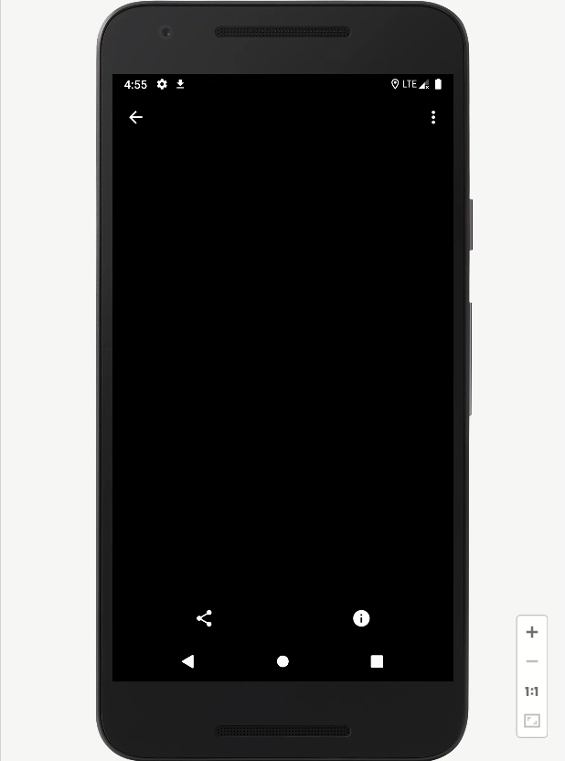
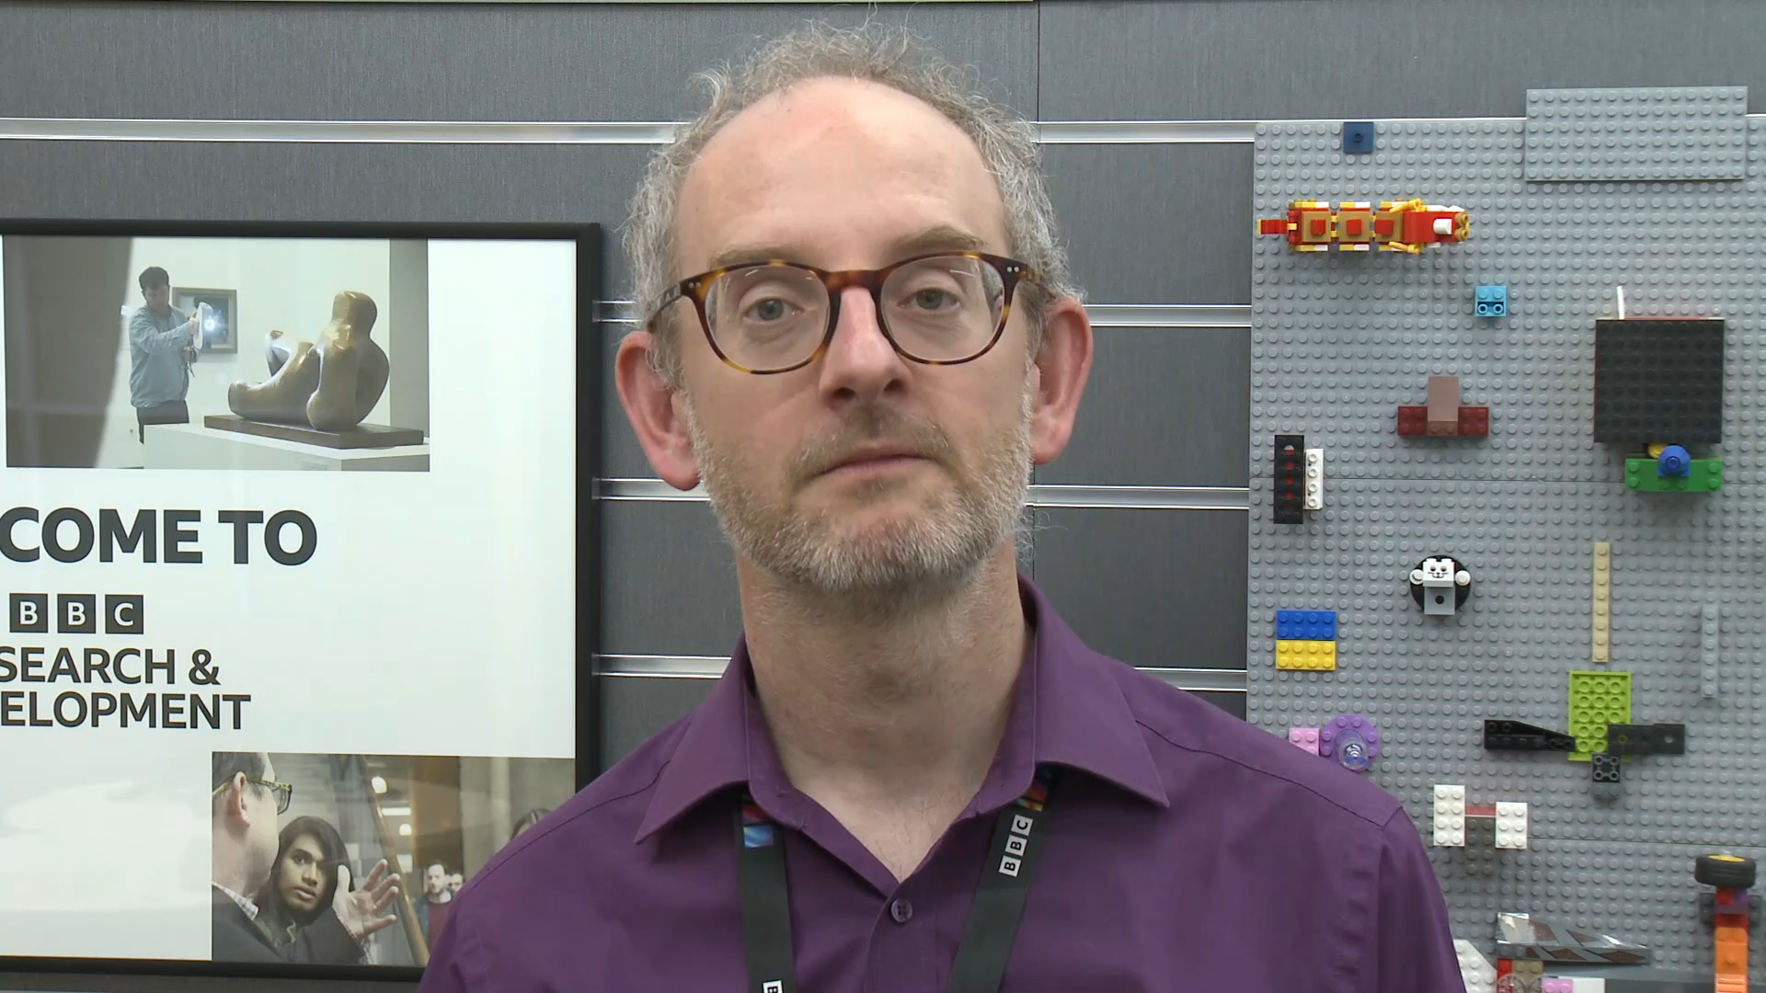
5G UE in China
5G Content Provider UK
5GMS-aware Application
Media Session Handler
Media Player
5GMS
AS
5GMS AF
MPD Response
<?xml version="1.0" ?>
<!-- MPD file BBC Christmas Greetings -->
<MPD xmlns="urn:mpeg:dash:schema:mpd:2011" minBufferTime="PT2S" type="static" mediaPresentationDuration="PT0H0M30S" maxSegmentDuration="PT0H0M2S" profiles="urn:mpeg:dash:profile:isoff-live:2011 ">
<Period duration="PT0H0M30.000S">
<AdaptationSet segmentAlignment="true" maxWidth="1920" maxHeight="1080" maxFrameRate="25" par="16:9" lang="und" startWithSAP="1" contentType="video" containerProfiles="'cmf2', 'cfhd'">
<SegmentTemplate media="1/$Time$.m4s" initialization="1/init.mp4" timescale="12800">
<SegmentTimeline>
<S t="0" d="25600" r="14"/>
</SegmentTimeline>
</SegmentTemplate>
<Representation id="1" mimeType="video/mp4" codecs="avc1.640028" width="1920" height="1080" frameRate="25" sar="1:1" bandwidth="5100000">
</Representation>
</AdaptationSet>
</Period>
</MPD>
GET X-MAS Segments
Segment Response
Monitor and Support
Notes:
So let‘s unpack our Christmas present.
[Click]
We got a voucher for some Segments and we request those while 5GMS Control functions monitor the session.
[wait until the end of Richard‘s message]
Thank you Richard
[END]

Slide 18
5G Media Streaming Features
Primarily downlink features
Dynamic Policies
Content Hosting
Consumption Reporting
Metrics
Reporting
Network
Assistance
Data collection, reporting and exposure
Service URLs

Slide 19
Also, 5G defines two modes of multicast/broadcast communication
5G broadcast (MBMS)
Mixed-mode multicast (MBS)
Broadcast spectrum (e.g. UHF)
No unicast. Downlink – only traffic.
Delivery of linear content (e.g. TV) or IP file delivery
Dedicated broadcast infrastructure (can be high power)
Operator spectrum (IMT)
Integration with unicast network
Efficient delivery of multicast/broadcast traffic (vs unicast)
Reuse of cellular infrastructure (low power).
Single Frequency Network (SFN) for downlink broadcast only
Dynamic switching between broadcast and unicast, e.g., SC-PTM¹
Addressing diverse ecosystem, deployment, and use case requirements

Slide 20
Harmonizing Service Layers – 5GMS, MBS, 5G Broadcast
Rel-16 Combining MBS and MBMS into single service layer
5GMS via Rel-17 for MBMS and Rel-18 for MBS
Making broadcast/multicast fit for purpose for modern streaming content

Slide 21
Rel-19 Advanced Media Delivery
Advanced Media Delivery
Common Client Metadata.
Common Server-and Network-Assisted Streaming.
Multi-Access Media Delivery.
Media Delivery from multiple service endpoints/location.
Modem Usage Optimized Media Streaming.
DASH/HLS Interoperability.
Further harmonization of RTC and Streaming for Advanced Media Delivery.
Improved QoS support for Media Streaming services.
QUIC-based segmented media delivery.
In-band signalling of QoS for 5G Media Streaming.
Dynamic content generation from multiple sources.
In-session Unicast Repair for MBS Object Distribution.
MBS User Service and Delivery Protocols for eMBMS.
Time Synchronization for MBS
Combined Unicast/Broadcast
Enhance 5GMS and Broadcast
to be fit for purpose for
and benefit from
modern streaming technologies
FS_AMD
Study completed in Dec ‘25 (stage 2) and Mar ‘25
Identified normative work
AMD-ARCH-MED
Stage-2 work for Streaming and MBS/MBMS
Completed also in Mar 25
AMD_PRO-MED
Stage-3 Protocol work ongoing
Completion expected by Sep 25, open API Dec 25
Identified more study topics for future Releases

Slide 22
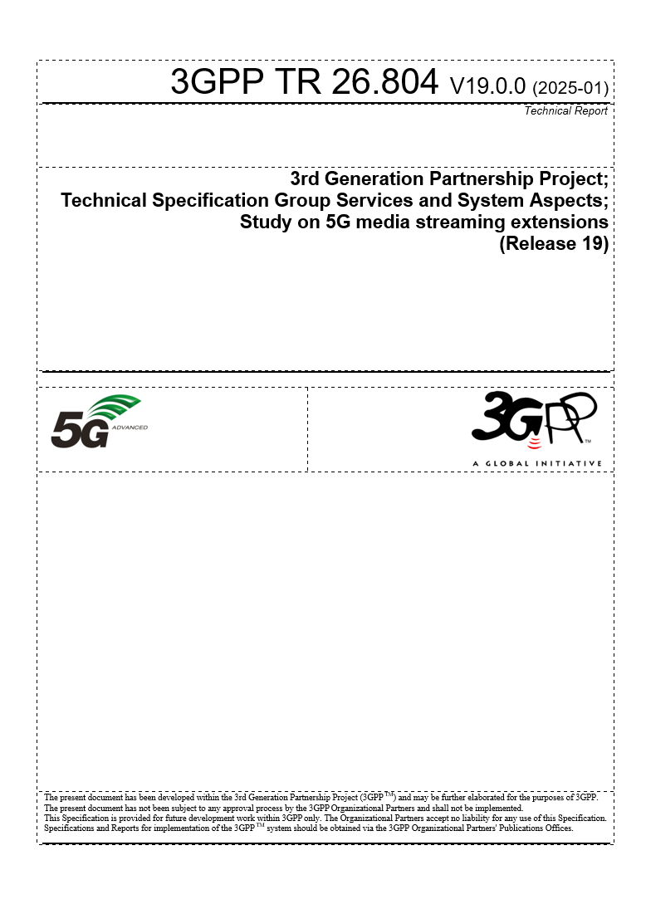
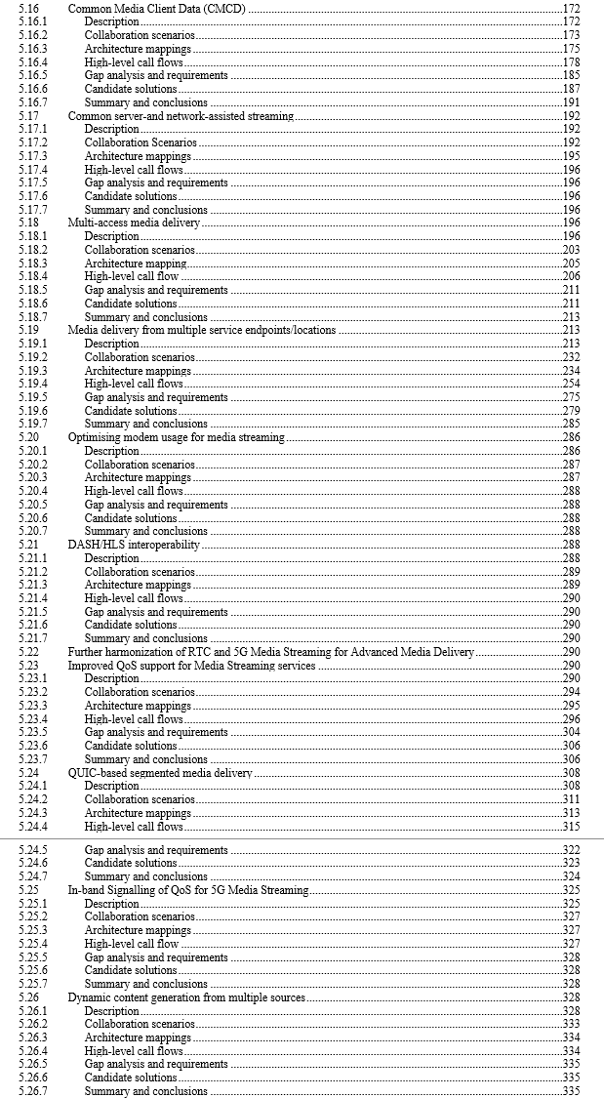
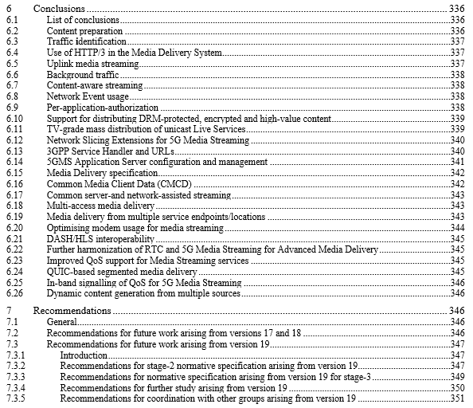

Slide 23
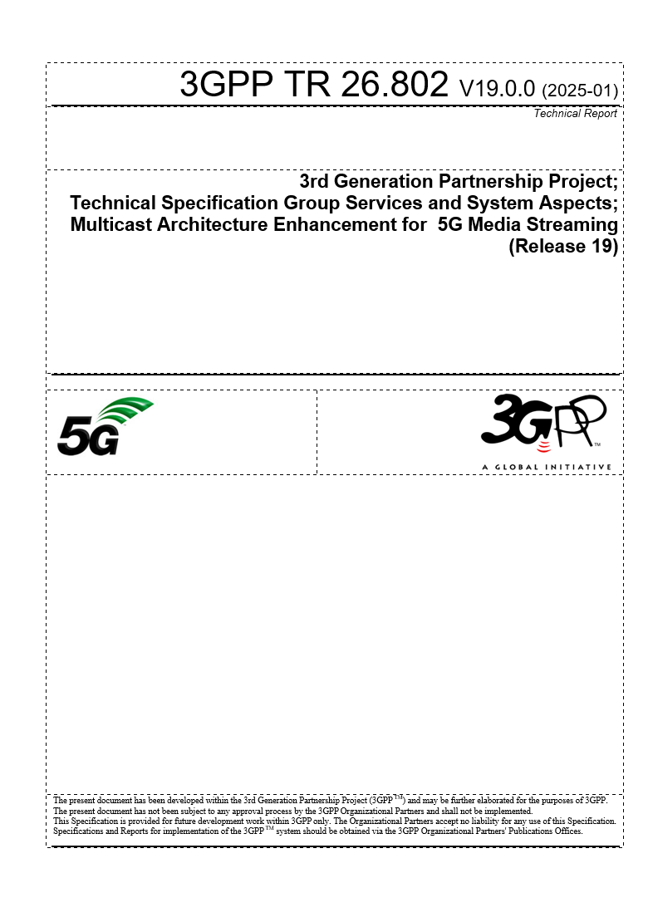
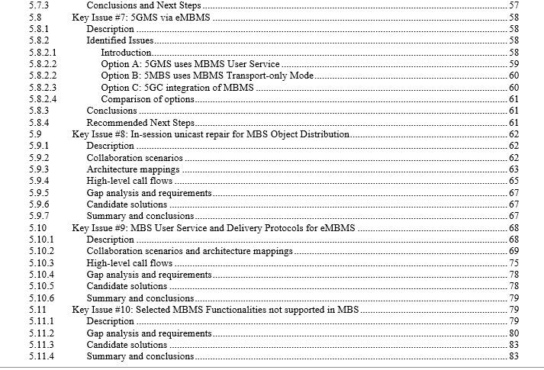
5.12 Combined unicast broadcast

Slide 24
Example #1: Common Client Metadata

Slide 25
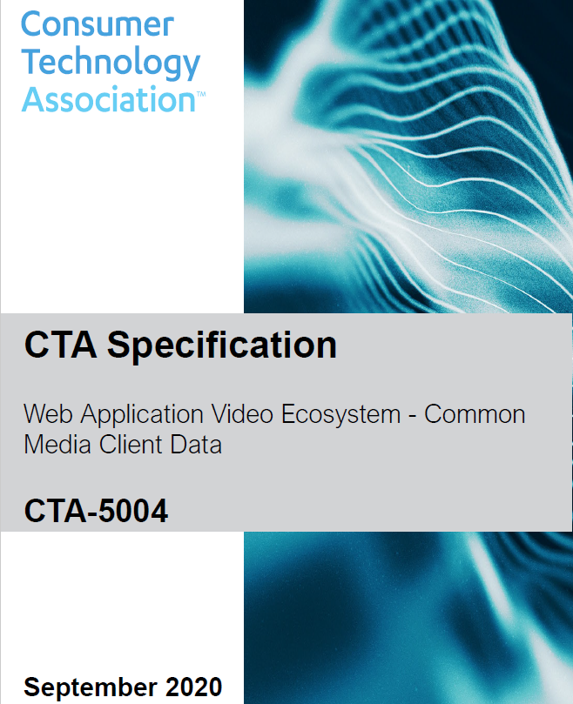
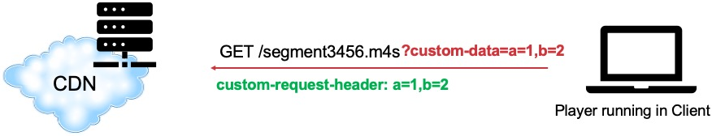
What is CMCD?
A defined set of structured key/value pairs communicating mutually beneficial media-related information from a player to a CDN via either
  A set of custom headers
  A query arg
  A JSON object
Common because the same data structure can be used across all players and all CDNs.
Resources
  Available for free at https://tinyurl.com/cta5004spec
  DASH-IF Special Session available from Will Law
Lot of discussion during MWS on version 2

Slide 26
Selected Use Cases in 5G Media Streaming
Based on clause 5.16.
The use cases which CMCD enables are broad – including robust pre-fetching of content, analytics solutions, forensic debugging, CDN delivery optimisation, alerting and monitoring systems, low latency optimisations, server-side switching, research analytics and content steering decision-making.
In the context of 5G Media Streaming, the CMCD information may be used for several purposes that are elaborated further in the remainder of this clause:
1) Operational optimisation of the 5GMSd AS: The Application Server uses CMCD information to optimise its operation. For example, the 5GMSd AS may choose to pre-fetch content from the 5GMSd Application Provider based on the value of the CMCD Next object request key signalled by the Media Player.
2) Operational optimisation of the 5GMSd AF and 5G Media Streaming: The Application Function uses CMCD information in order to configure the 5G System for optimised media delivery across the User Plane. For example, the 5GMSd AF may invoke service operations on the PCF in order to effect a delivery boost if the CMCD Buffer starvation flag is set by the Media Player.
3) UE data collection on media playback and 5GMS reception, reporting and event exposure by 5GMS System: The Application Function uses the data collection and reporting framework to provide CMCD information to the 5G System or to external 5GMS Application Providers. This could, for example, take the form of a time series event log for audit purposes. Such data could, for example, be useful to determine the quality of reception and to identify anomalies or errors that can occur on players.

Slide 27
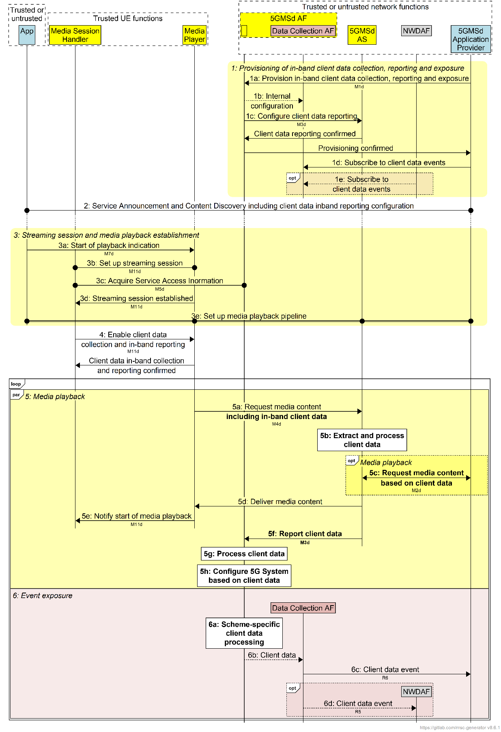
Option 1: In-band reporting of CMCD information via reference point M4d and M3d
Option 3: Out-of-band reporting of CMCD information at M11d and M5d
The preferred solution is Option 1 "In-band reporting of CMCD information via reference points M4d and M3d", for the following reasons:
- In-band reporting reference point M4d is broadly implemented in common media clients nowadays.
- In-band reporting permits operational optimizations by the 5GMSd AS, which is not the case with Option 3 Out-of-band reporting of CMCD information via reference points M11d and M5d. Solely on the basis of this issue, Option 1 and Option 2 would remain valid candidates.
- Passing the CMCD information to the 5GMS AF at reference point M3d (Option 1) permits operational optimisations by the 5GMSd AF, which is not the case with Option 2 In-band reporting of CMCD information via reference points M5d and R4 where the CMCD information is handed directly to the Data Collection AF instantiated in the 5GMS AF, but is not visible to the latter.
All envisaged use cases can be supported by Option 1.
We may revisit this decision after the availability if v2 of CMCD

Slide 28
Example #2: Multi-CDN (Service Location)
Media Delivery

Slide 29
Multi-Service Location
Multi-CDN Technologies
DNS-based switching
MPEG-DASH client-side switching
Content steering driven switching
SAND4M-based switching
CMMF-based multi-source delivery
Multi-CDN Client
M13d

Slide 30
Multi-Service Location – 5GMS AS/MNO offers several locations
CDN/Service Location 2
Locations differ by dynamic policies,
slices, 3GPP access networks, etc.
Multi-CDN
Processor
Multi-CDN Client
CDN/Service Location 1
M13d

Slide 31
Multi-Service Location – 5GMS AS/MNO is one of several locations
Locations differ by access networks
or other type of business decisions
CDN/Service Location 2
Multi-CDN
Processor
Multi-CDN Client
CDN/Service Location 1
M13d

Slide 32
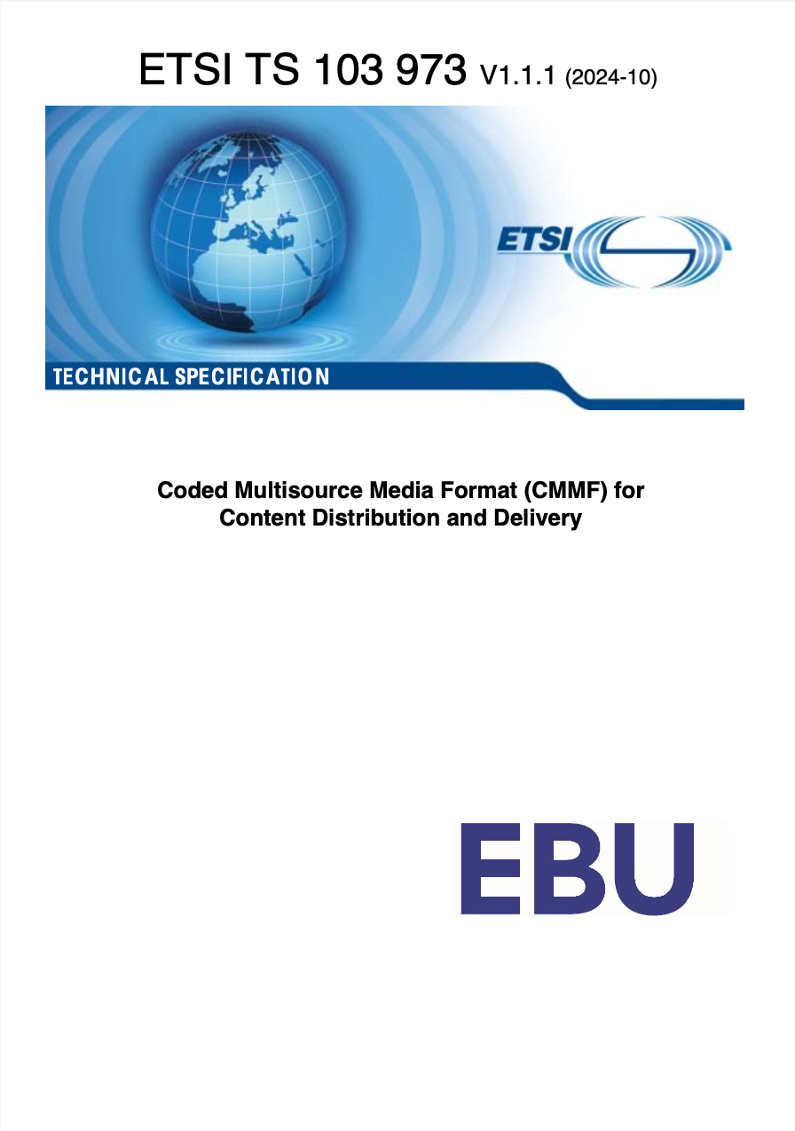
Coded Multi-Source Media Format (CMMF)
ETSI TS 103 973
CMMF is a media delivery standard format that enables simultaneous streaming from multiple sources (e.g., CDNs) using coded media segments. It improves reliability, reduces latency, and enhances playback quality over single-source or multi-CDN switching.
Integrated into 3GPP Release 19 for 5G Media Streaming (5GMS) Multi-service locations.
Media segments are encoded into redundant coded symbols using e.g. AL-FEC RaptorQ.
These symbols are distributed across multiple CDNs.
The player downloads any subset of symbols sufficient to reconstruct the original segment - no need to orchestrate / know which CDN will respond fastest.

Slide 33
Example #3: Unicast Broadcast Combinations

Slide 34
Unicast Broadcast Combinations
Local Gateway or proxy on device is a service location
Application
Multicast Broadcast Client
MBMS-API
Multicast Broadcast Network functions
Policy Function
Configuration
Application
Providers
DASH
or HLS Client
(including multiple service locations)
Configuration
Service Location Steering Policy
Request Application Service Document
Media Server
SL1
MC/BC Distribution
Network Media Server (SL2)
Push resources
Potentially Request Data
Unicast requests
The selective requests may combine information in
  http headers, query strings, or based on a pattern in the request URL
  With information provided in the configuration information, for example a filter when to issue unicast requests
  Unicast requests may also be issued based on certain randomization
The selective requests may be forwarded as is, or may be modified by the MC/BC client
The configuration needs to take into account the ability to scale the unicast traffic

Slide 35
Example: CMCD Adaptation to Multicast/Broadcast
Application
Multicast Broadcast Client
MBMS-API
Multicast Broadcast Network functions
Request and response function collecting CMCD data
Configuration
(incl. CMCD data)
Application
Providers
MPD URL
M3U8
Configuration
DASH
or HLS Client
Media Server
MC/BC Distribution
Network Media Server
Request Data
including CMCD
Push resources
Provided aggregated CMCD data to network, for example NWDAF
Manifest
(incl. CMCD data collection configuration)
Example for other use cases: Ad Insertion, Tracking, DRM, Broadcast-unicast seamless switching, in-session repair, A/B Watermarking

Slide 36

Latest Updates on
5G Broadcast
Media Web Symposium
June 2025
@qualcomm_tech
Dr. Thomas Stockhammer
Senior Director Technical Standards
Qualcomm Technologies

Slide 37

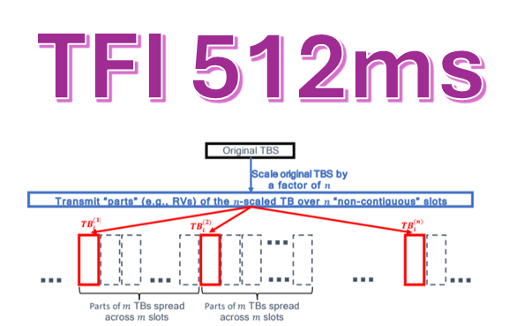
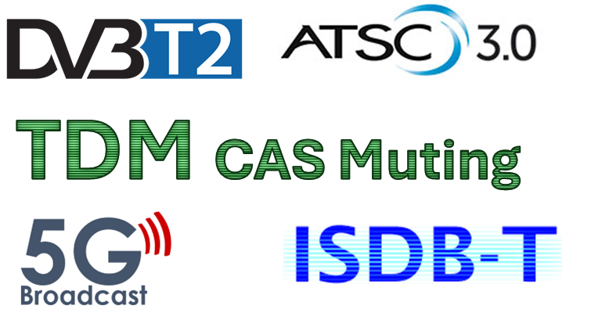

3GPP UPDATES for 5G Broadcast in Rel-19
3
2

Slide 38



Standards Status
Modem
Service Layer
Feature complete with Rel-19
Continuous work
Profiling
Launch Profile stabilizing
Basic features very stable
Test Specs needed now

Slide 39






Business model
Infra vendor
Some of these relationships didn’t exist before!
Broadcaster needs to assess how to appeal to mobile consumers
BNOs need complete network planning
OEMs need to study how 5GB aligns with business objectives
Complex picture presenting challenges and also opportunities!
SOC vendor
BNO
Consumer
Anticipating leading Android OEMs to be in market with H1/2028 models, Qualcomm plans to support OEMs to meet their commercialization goals
Device vendor
Broadcaster
Content Owner
Notes:
Ok,, we talked about a growing level of interest and increased confidence in the technology itself.
This is all good however for successful adoption and commercialization of 5G broadcast of we are looking at a complex interaction diagram between different stakeholders and consumers
This diagram is not meant to be precise or complete. It is only meant to highlight we need a full alignment between many parties involved
One major challenge we needed to tackle early on was some of these stakeholders not even having relationship with mobile OEMs. I believe with 5G Broadcast Strategy TaskForce formed in Europe this particular concern is largely improved and I want to say we made big progress educating and evangelizing 5G Broadcast with mobile OEM partners. Our job is not done but big milestones are achieved in last few months.
Moving forward we still have work that needs to be completed.
Broadcaster needs to find out how to appeal to mobile consumers, how to monetize with these new customer segment who hasn’t been serviced before
BNOs need complete their network planning studies so they will know what it takes to reach targeted coverage and at what cost
OEMs need to study what 5GB could mean to consumers, how it could be presented and how this would align with OEMs business objectives
Overall this presents itself as a complex picture with challenges but also significant opportunities for the broadcast world

Slide 40
What’s next – 6G!!!

Slide 41
6G Core themes
Sustainability: Energy efficiency, green communications, and carbon footprint reduction.
Security: Quantum-resistant cryptography, privacy protection, and secure AI agent interactions.
Resilience: Zero-outage networks, disaster recovery, and fast provisioning.
AI Integration: AI for network optimization, AI-as-a-service, and collaborative AI agents.
Immersive Communication: XR, holographic telepresence, and real-time VR/AR applications.

Slide 42
6G media related use cases (ongoing work)
1. Immersive Guided Tour
  Personalized XR experiences with avatars, spatial audio, and real-time translation.
  Group synchronization and AI-enhanced navigation.
2. XR Gaming Acceleration
  Offloading rendering to edge/cloud for lightweight XR devices.
  Real-time interaction with reduced latency.
3. AI-Generated XR City Tours
  Generative AI creates immersive sightseeing experiences.
  Tailored content based on user preferences and network conditions.
4. Holographic Concert Viewing
  Real-time fusion of performances from different cities.
  Volumetric video and immersive audio for remote audiences.
5. Avatar-Based Virtual Meetings
  Realistic avatars and 3D object collaboration.
  Used in design, education, and remote teamwork.
Key enablers:
AR glasses, XR headsets, haptic wearables, immersive audio, split rendering, Gen AI, Holographic rendering, volumetric video, Avatars, holograms, 3D object manipulation.

Slide 43






Overall 3GPP 6G Workplan
2024
Stage-1 workshop on IMT2030 use cases
Workshop Summary: SWS-240025
Workshop Presentations: Link
WG SA1
Rotterdam, Netherland, May 8 – 10, 2024
SP-241391 : SA1 6G study item on use cases and service requirements (FS_6G_REQ) approved at TSG SA#105.
First 3GPP TSG-wide 6G Workshop
To discuss vision & priorities for next generation radio technology, system architecture, core networks and protocols.
TSGs#107
Incheon, S. Korea, March 10 – 11, 2025
Studies for 6G
    RP‑243327 : The 6G RAN Study (part I: ITU focused) was approved at TSG RAN#106
    See next slide for the 6G studies timelines
from Release 20
Release 21 is expected to produce the 1st set of 3GPP 6G technical specifications and will be the release for IMT-2030 submission before 2030 and is expected to be delivered with a single drop (i.e., a single code freeze).
Rel-21 timeline is to be decided no later than June 2026
However, ASN.1/OpenAPI freeze date is no earlier than March 2029
from Release 21
Normative work for 6G
2030

Slide 44

Release 20: 6G Timeline
2024
2025
2026
2027
TSGs
#113
#114
#102
#103
#104
#105
#106
#107
#108
#109
#110
#111
#112
#115
#116
Dec.
Mar.
Jun.
Sep.
Dec.
Mar.
Jun.
Sep.
Dec.
Mar.
Jun.
Sep.
Dec.
Mar.
Jun
SA1 6G SID def.
SA1 6G Study
Workshop IMT-2030 use cases
RP IMT-2030 disc.
RP ITU Study
RP 6G Study
Workshop on 6G
SA2 & RAN WGs 6G SID def.
SA2 6G Study(ies)
or
SA3/4/5/6 SID def. and compl. TBD
RAN1 6G Study(ies)
RAN2/3/4 6G Study(ies)
Stage 3 6G SID def.
Stage 3 6G Study(ies)
TBD
IMT-2030 Technical Performance Requirements
Requirements, evaluation criteria and submission templates
Tech proposals
Workshop on technology proposals

Slide 45
Releases 19 to 21 timelines
Note: All starting dates are indicative
2024
2025
2026
2027
2028
2029
TSGs
#103
#104
#105
#106
#107
#108
#109
#110
#111
#112
#113
#114
#115
#116
#117
#118
#119
#120
#121
#122
#123
#124
#125
#126
Mar.
Jun.
Sep.
Dec.
Mar.
Jun.
Sep.
Dec.
Mar.
Jun.
Sep.
Dec.
Mar.
Jun.
Sep.
Dec.
Mar.
Jun.
Sep.
Dec.
Mar.
Jun.
Sep.
Dec.
Stage 2
SA1 St.1, Content Definition (RAN & SA St.2): completed Dec. 2023
RAN Completion**
ASN.1
&
Open
APIs
*: +3 months for RAN4
**: - 3 months for RAN1 &
+ 3 months for RAN4 perf
Release 19
Stage 3 (CT & SA)
5GA Stage 1
Release 20 5GA
5GA Stage 2
5GA RAN Completion**
Chart showing Normative dates
(timeline for 5GA studies not shown)
5GA Stage 3
ASN.1
FS_6G Stage 1
Release 20 FS_6G
FS_6G RAN P
FS_6G Stage 2
or
Chart showing Studies dates
(no 6G normative work in Rel-20)
FS_6G RAN WG**
FS_6G Stage 3
TBD
Rel-21 timeline to be decided no later than June 2026
ITU deadlines for 6G: March 2029 for technology proposal, mid-2030 for specifications
Release 21 6G
Now

