Slide 1

5G Broadcast – Latest on Standards, Technologies and Devices
Based on IBC 2024 Info
October 2024
@qualcomm_tech
Dr. Thomas Stockhammer
Senior Director Technical Standards
Qualcomm Technologies

Slide 2
5G defines two modes of broadcast communication
Focus of this presentation
5G broadcast
Mixed-mode multicast
Broadcast spectrum (e.g. UHF)
No unicast. Downlink – only traffic.
Delivery of linear content (e.g. TV) or IP file delivery
Dedicated broadcast infrastructure (can be high power)
Operator spectrum (IMT)
Integration with unicast network
Efficient delivery of multicast/broadcast traffic (vs unicast)
Reuse of cellular infrastructure (low power).
Single Frequency Network (SFN) for downlink broadcast only
Dynamic switching between broadcast and unicast, e.g., SC-PTM¹
Addressing diverse ecosystem, deployment, and use case requirements

Slide 3
General technology introduction
5G broadcast and 3GPP
“5G broadcast” is a broadcasting standard defined by 3GPP (Release 16 - 2020)
3GPP is the industry group responsible for defining global cellular tech standards (e.g. 4G / 5G)
In the last few years 3GPP has expanded to new verticals (e.g. broadcast, automotive, satellite, etc.) hence it should not be regarded as a surprise that a broadcasting tech is coming out of 3GPP
Even though 5G Broadcast has been standardized by 3GPP, it is a broadcasting technology
I.e. meant to be used by broadcasting operators, in broadcasting spectrum
No need of supporting a unicast network. 5G Broadcast does not have anything to do with unicast
The main design target & “reason for being” of 5G broadcast is to enable operation of a broadcast network where the receivers are hardware-compatible with cellular modems
“Hardware compatible” means lower barrier to adoption in mobile devices compared to other broadcasting technologies
This is because several 5G Broadcast building blocks are already there in a 4G/5G modem, hence the additions are marginal.
For other technologies, a separate piece of silicon / die area would be required
To be clear, 5G Broadcast has nothing to do with “cellular operators trying to take over from broadcasters”

Slide 4
5G Broadcast – Core Features for multiple use cases
SIM-less reception with simplified architecture
Receive-Only Mode (ROM) & Free-to-Air (FTA)
Different spectrum options (e.g. UHF, SDL), as well as SFN/MFN
Various deployment possibilities (e.g. MNOs, BNOs)
Using existing infrastructure (HPHT, MPMT and LPLT)
Highly flexible velocities (up to 250 KM/h Vs up to 300 µS)
Can be combined with existing 4G and 5G features (unicast, PWS)

Slide 5
Business use cases, trial experiences, new requirements

Slide 6
Significant interests towards 5G broadcast deployment worldwide
Denmark
Tour de France 22 powered by 5GB
Italy
Germany
2018-23: TV delivery with Rel-14/16 HPHT in Aosta and Turin
Russia
2024: European Championship
2020-22: 5G Media2Go Stuttgart/Heilbronn
2017-20: 5G Today in Bavaria
Finland
2022+: 5G Broadcast under investigation as latest broadcast technology
Belgium
2019-22: TV delivery with Rel-14/16 HPHT in 3 sites
CZ
2022-24: 5G BC imec.icon project with 2 HPHT sites
2020-23: Distribution of TV/Radio in Prague
South Korea
UK
Austria
Late 2021: Distribution of live TV using Rel-16 enTV near Seoul
2020-22: VISTA Project with O2 Virgin Media
2020-23: Distribution of TV/Radio with 5G BC Rel-14/16 , with eMBB in Vienna
Europe
France
2023: European broadcasters ink 5G Broadcast MoU
2024: European profile for 5G Broadcast receivers
2018-2022: Live testing of 5G BC in Paris
2024: Olympics
Greece
US
2021-23: Live TV/Radio with 5G BC Rel-14/16 , with 3MHz in Athens
2020+: Growing interest in 5G BC in addition to ATSC 3.0
2023: FCC Approves A Low Power TV Station To Broadcast Over 5G Networks
2023: First 5G Broadcast in the US and first 24/7 5G Broadcast globally
2024: Foundation of 5G Broadcast Collective
Croatia
2022-24: Live 5G BC Rel-14/16
Philippines
2019-22: Direct to mobile Live TV/Radio in Manilla
Spain
Algeria
2020: Distribution of free-to-air linear radio and TV using Rel-14 enTV with HPHT in Barcelona
2022 & 2023: MWC demos
Malaysia
Brazil
2022: Interest towards 5G BC during Mediterranean Games
2024: Report completed – next steps are trials
2020-23: TV 3.0 project calling for proposals
2019-24: AIB project based on 5G Broadcast under the administration of NRTA¹ and ABS²
2023: 5G Broadcast Chengdu pilot project formally kicked off on July 20th
GATIS' Global 5G Broadcast Summit
Colombia
India
2020-21: Delivery of TV and radio with Rel-14 broadcast trial deployment in Santiago de Tolú
South Africa
2020+: Growing interest in latest broadcast³ technologies
2023: Discussion on DTM strategy based on market feedback
2019-20: Live testing of Rel-14 in Johannsburg
China
¹ National Radio and Television Administration ² Academy of Broadcast and Science commercia potential ³ Prasar Bharti working jointly with IIT Kanpur on Next Generation Broadcast Technology

Slide 7
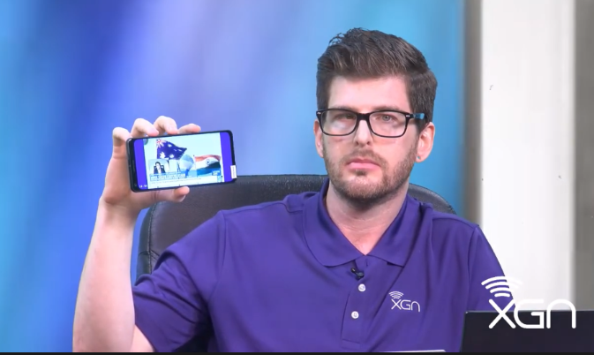

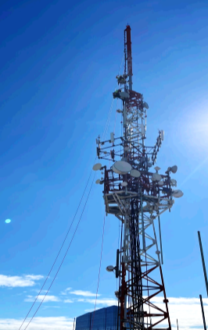
First 5G Broadcast in US
July 14th 2023 - FCC granted experimental license for 5G broadcast
Sep 13th 2023 – Station went on air and started 24/7 re-broadcast of FranceTV
Full leverage of existing infrastructure with no change in freq, antenna, power output
Successful indoor –stationary and outdoor – stationary and mobile reception with 8650 QRD units
Next steps: presentation to FCC, additional licenses for another 5-10 stations
Also emergency notification, first responder live trial, datacasting use cases
NAB 2024: Foundation of 5G Broadcast collective https://5gbc.tv/

Slide 8
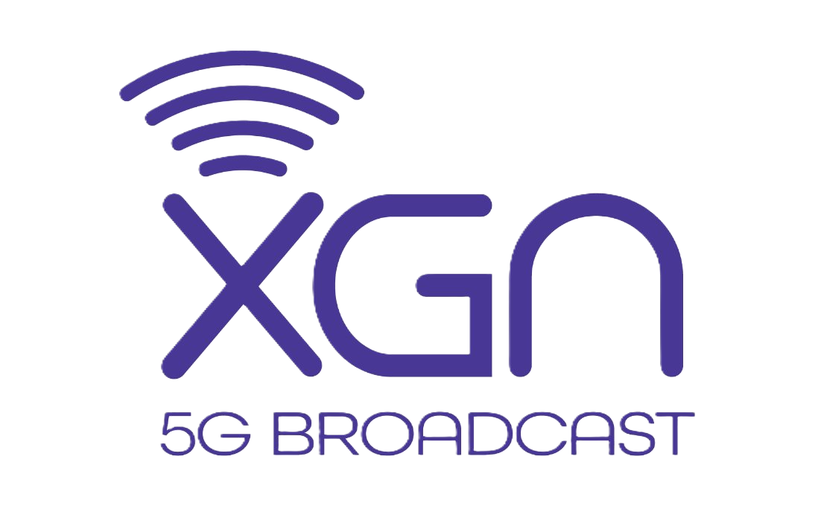
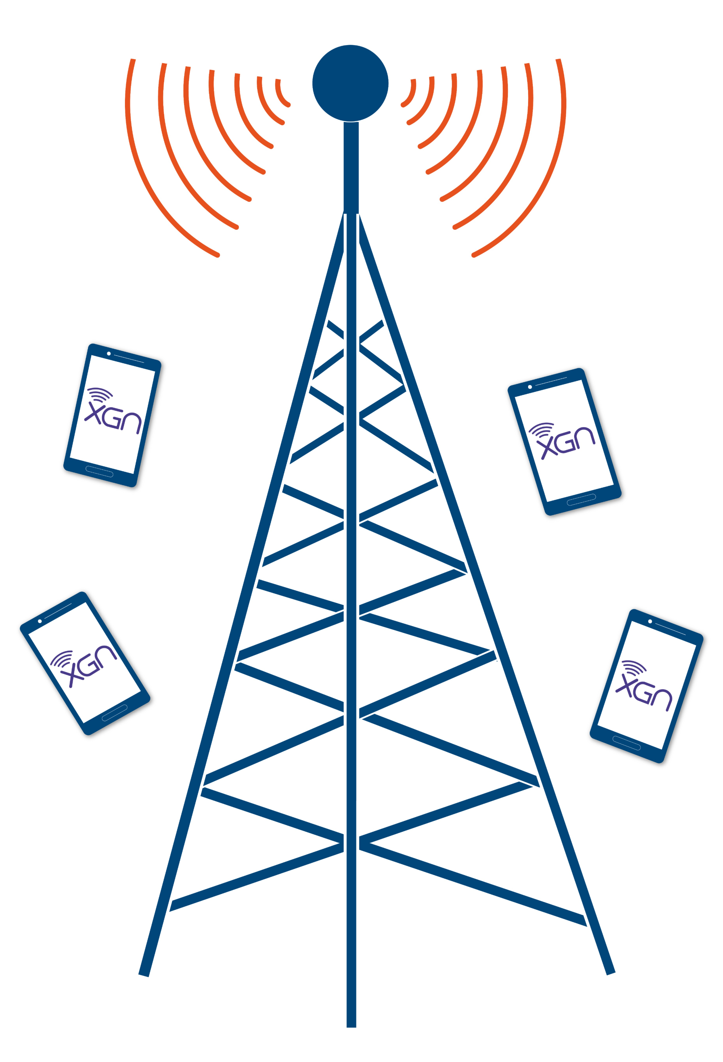
Priorities
Emergency Alerts/First Responder Solutions
Ancillary data delivery to road signs, particularly in emergencies
United States 5G Broadcast Proof of Concept 2
Visit us at Booth 14.B18
XGen Network LLC

Slide 9

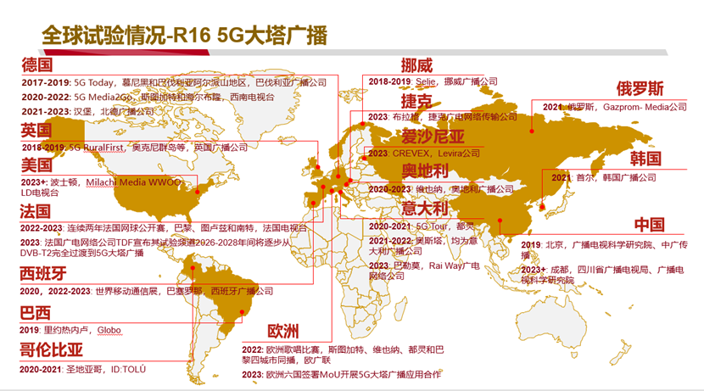
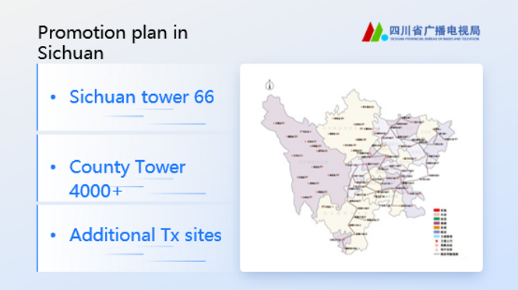
China Status
https://www.5g-mag.com/post/27-10-23-5g-mag-participates-at-gatis-summit
Chinese and international experts and scholars from Beihang University, Communication University of China (CUC), 5G-MAG, EBU, ORS, TDF, XGN, Rohde & Schwarz (R&S), Qualcomm, Xiaomi, vivo, Chengdu Kaiteng Sifang and Beijing BBEF Science & Technology
Sichuan has initiated the first trials and deployment of 5G Broadcast.
Regional broadcasters show great interests to duplicate the demo to verify & demo the 5GB services in their own network. Guangdong already asked, Guangxi is in the line, Shanxi also asked during the meeting, more requests are on the way.
ABS supports them together with domestic infra vendors and OEMs to launch pre-commercial trials

Slide 10
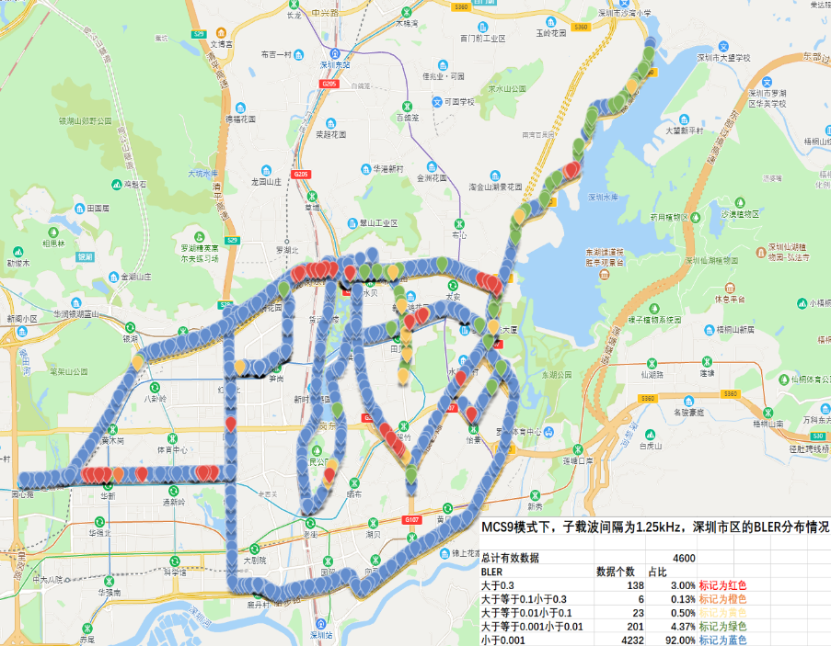
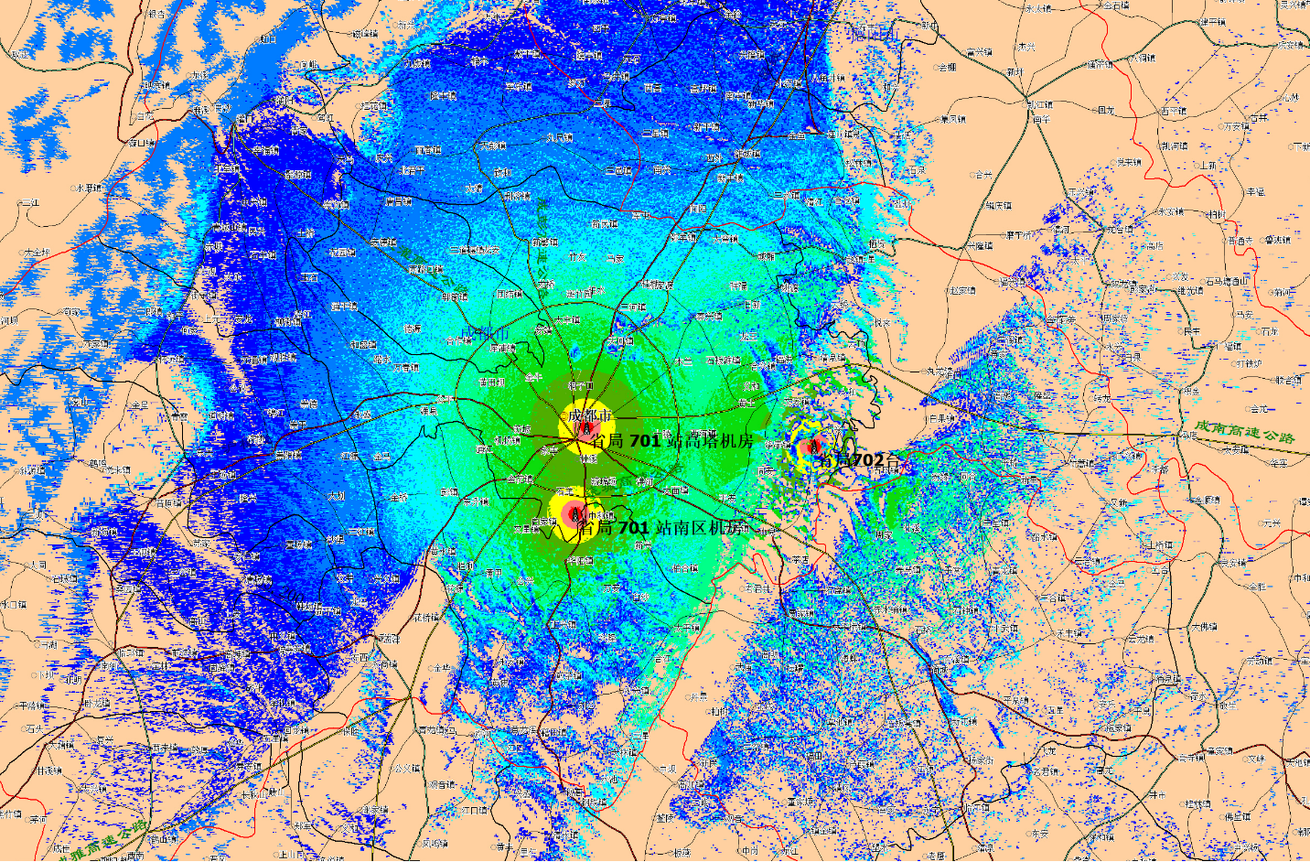

What we have done for 5G Broadcasting
Field Test in Shenzhen
Trial Network in Chengdu
Individual receiver chip
显示处理
West Pearl Tower
Receiver Chip
Sichuan Radio and Television Bureau 702
Sichuan Radio and Television
NERC-DTV is working with some chip companies for the development of Individual receiver chip
Successful Reception: 96%
(MCS9, 1 bit/s/Hz)
NRTA has approved to set a trial network in Chengdu City, Sichuan Province
Location: setup at the top of Wutong Mountain
Power: 260W (four directions, about 65W for each one)

Slide 11









5G Cellular
Network
5G Broadcast
Network
5G Cellular and
5G Broadcast
Converged Network
ATSC Broadcast
Network
5G Cellular and
ATSC Broadcast
Converged Network
Internet
Linear TV
Radio
Internet
Linear TV
Radio
Linear TV
Radio
Internet
Linear TV
Radio
5G Phone
5G Phone
5G Phone
ATSC TV
5G Phone
UHF band support
UHF band support
UHF band support
ATSC receiver
India
Supports:
Free-To-Air
No SIM operation
Rel-19 Work on non-3GPP Broadcast interworking
Samsung, Qualcomm, And Other Tech Giants Raise Concerns Over India’s Plan For Live TV On Smartphones
News

Slide 12





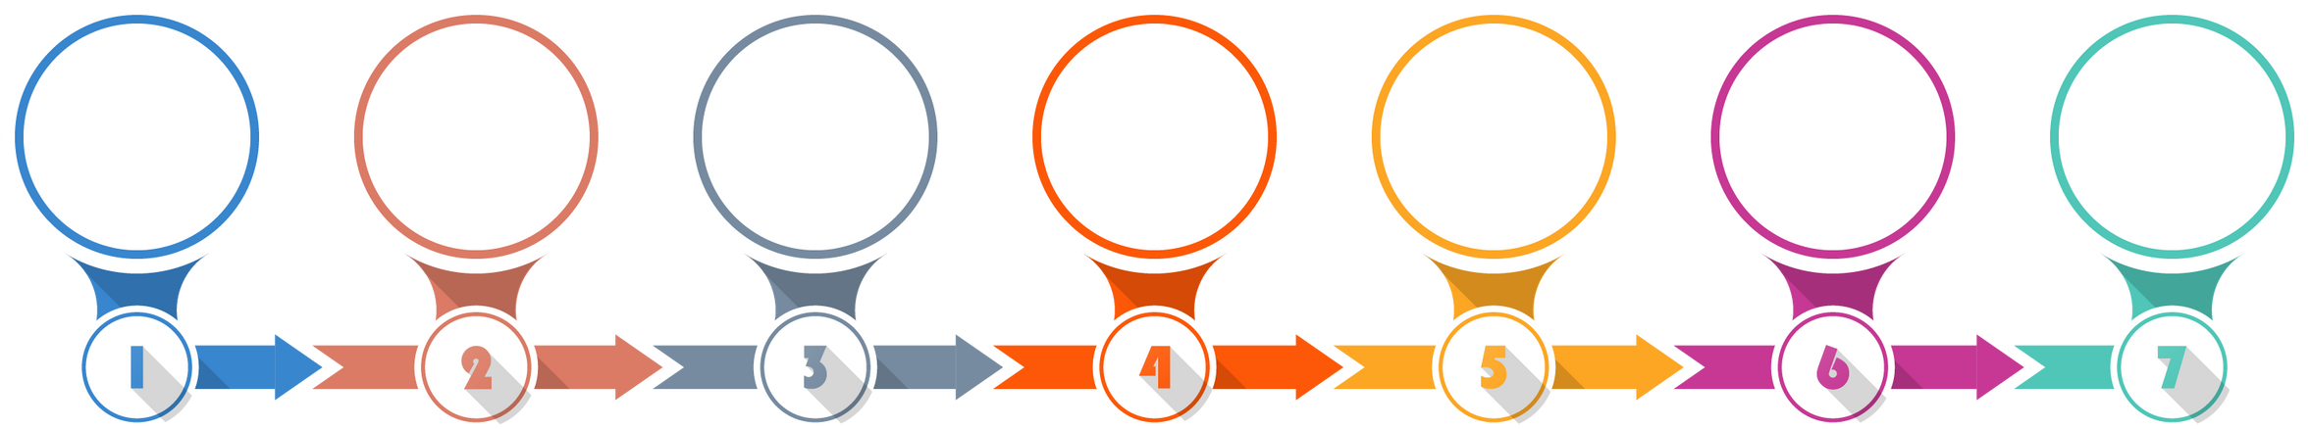

Malaysia
FUTURE BROADCASTING STUDY WORKPLAN
1
JAN - DEC 2023
2
JAN - DEC 2024
Establishment of the study group for the Future Broadcasting Study
To conduct a Test-bed facility to validate the use-cases
To publish a comprehensive report on the Future Broadcasting Study
To publish report on the outcomes of the Test-bed facility
Collaboration Partner :
PHASE 1
PHASE 2
STAGE 1:
TERM OF REFERENCE (TOR)
STAGE 2:
ESTABLISHED STUDY GROUP
STAGE 3:
PUBLISH INDUSTRY
STUDY REPORT
STAGE 4:
ENGAGEMENT WITH INDUSTRY
STAGE 5:
TEST-BED SESSION
STAGE 6:
5G BROADCAST DAY SHOWCASE
STAGE 7:
ESTABLISH FINAL REPORT
2023
2024
Mar 2025

Slide 13
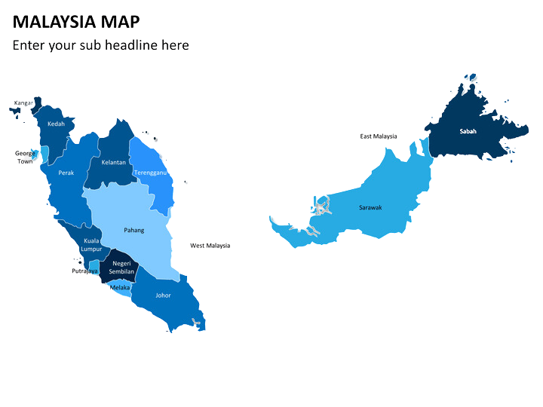




WAY FORWARD OF 5G BROADCAST ACTIVITY
2025 -2026
TO CONDUCT POC FOR 5G BROADCAST BUT SUBJECT TO THE SUCCESSFUL OUCTOMES OF TEST-BED SESSION
CENTRAL REGION
NOTE: Proposal only, subject to change
SITES

Slide 14
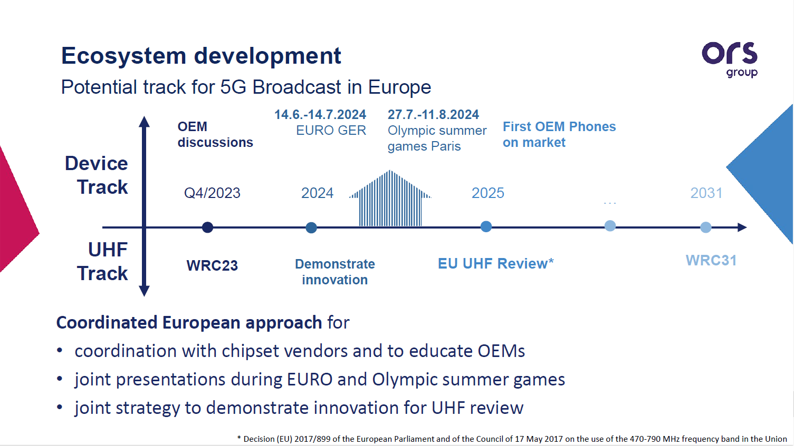

Slide 15
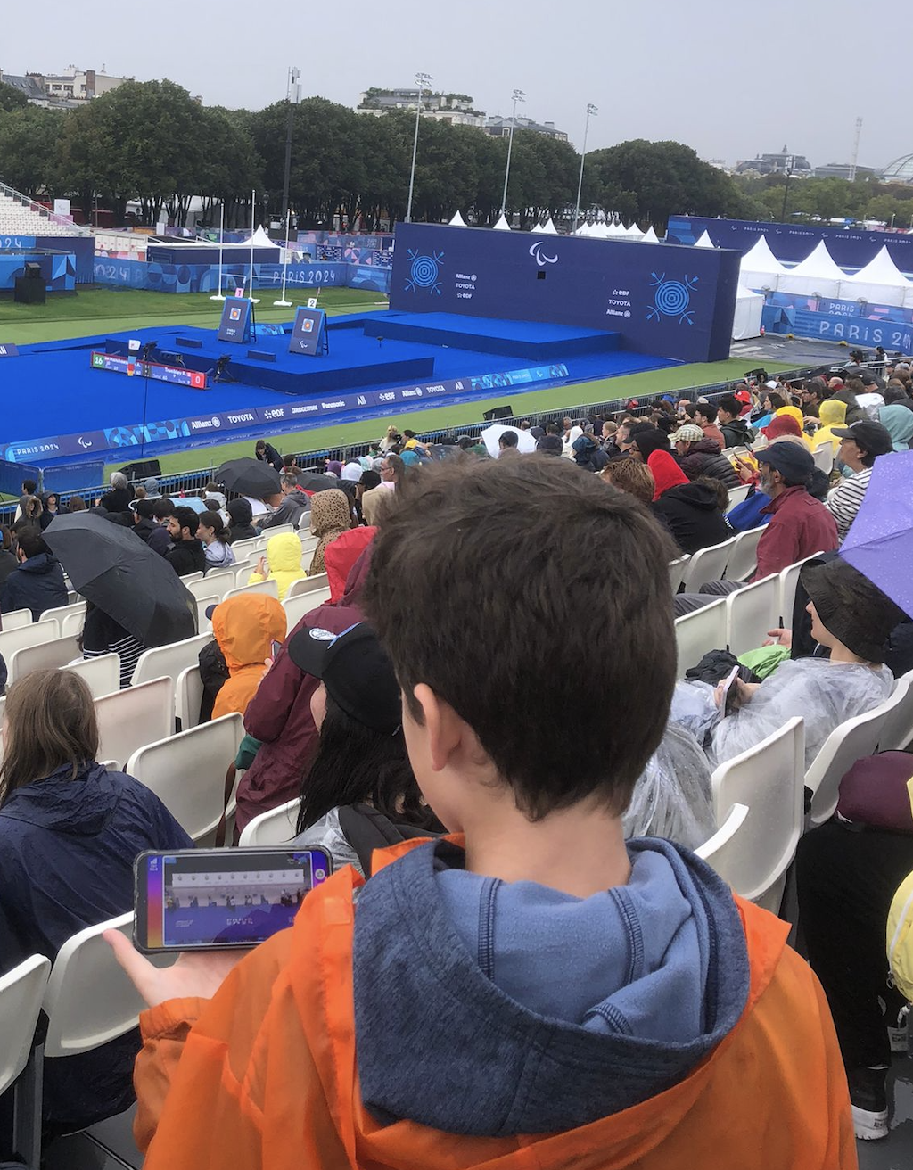

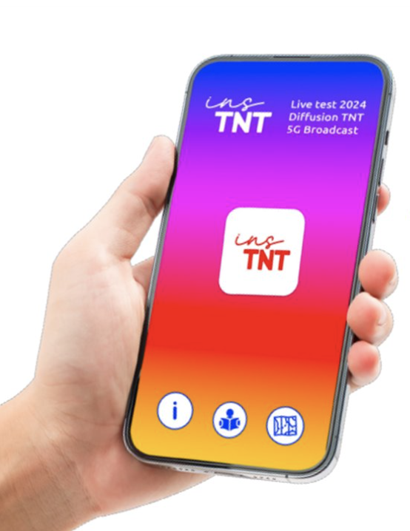



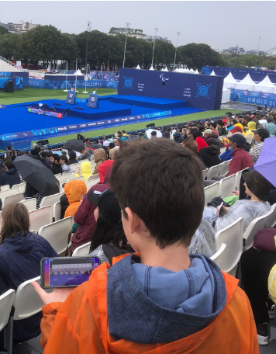
A France premiere… and a world premiere too !
Friendly users
1
A running Live Test during Olympics with several objectives :
A large coverage: Paris, Bordeaux, Nantes
An end-to-end architecture
~150 Xiaomi smartphones distributed to the ecosystem
The brand insTNT
150
0
devices
Return in
Sept./Oct.
2
Pop up store
devices
20
Street
demo

Slide 16







TDF roadmap for France
UHD roll out in 2024 with adoption driven by Olympics Games
5G Broadcast roll out from 2028 in Exp. MUX then in another MUX to scale up with market adoption
2023
2024
2025
2026
2027
2028
2029
2030
SWITCH MUX
EXPERIMENTAL
MULTIPLEX
Free TV
channels
UHD T2/HEVC
Free TV channels
5G Broadcast
SWITCH MUX
1 PAY TV
MULTIPLEX
Pay TV channels
SD/HD
Free TV channels
5G Broadcast
5 Free TV
MULTIPLEX
Free TV channels
HD
Free TV channels
HD+ / UHD
SWITCH MUX

Slide 17
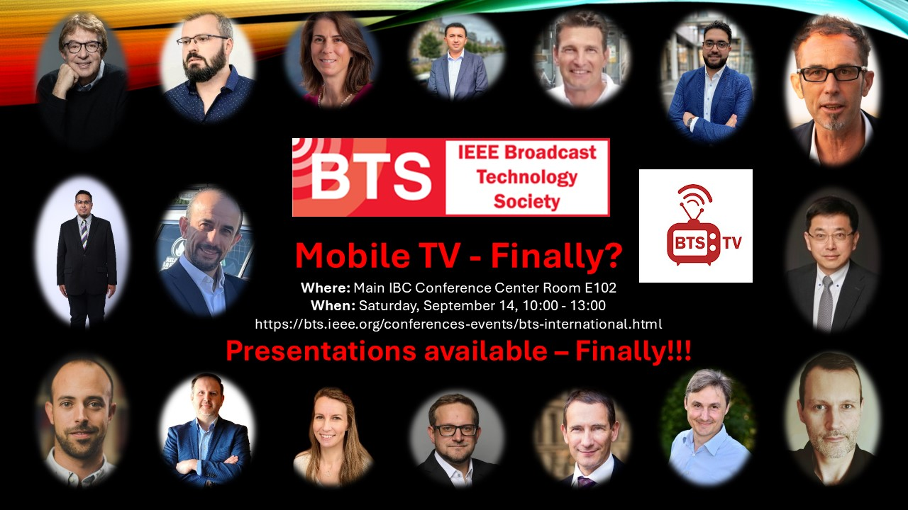
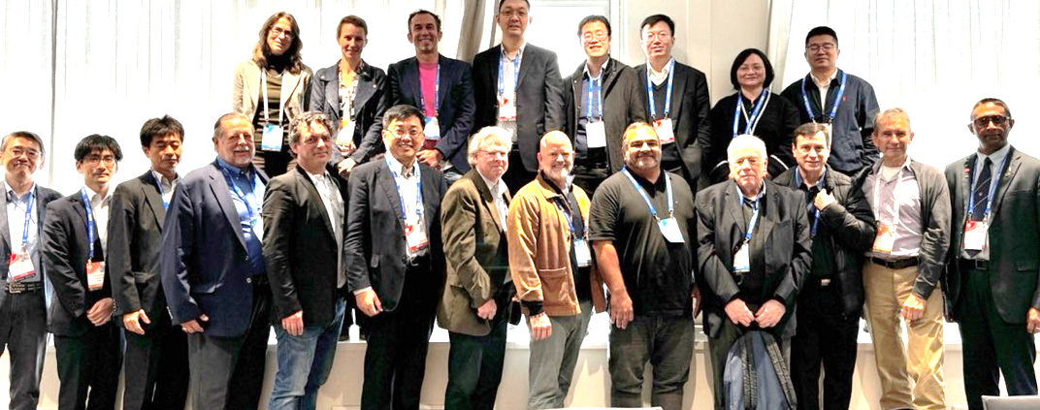
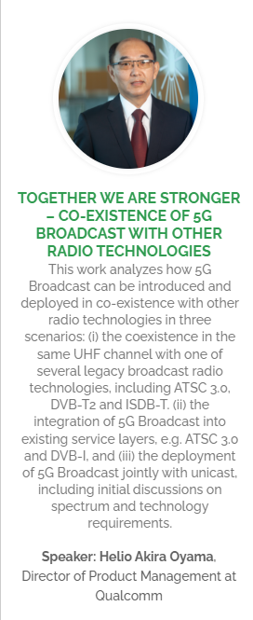
Promotion and other activities
detailed review tomorrow
IBC September 2024
Demos
Demos to showcase 5G Broadcast use cases (using current SW/HW in Qualcomm devices and rooted Xiaomi/OnePlus devices)
DVB-I over 5G Broadcast demo at DVB booth (youtube.com)
Significant interest from multiple companies for future technology demps: ATEME, XGeN Network, ORS, Sofia Digital Ltd., TDF, R&S, castLabs, Alicloud
IBC Conference - Qualcomm involvement with 2 paper presentations and member of paper/program committee:
Smart Introduction Of 5G Broadcast In Co-existence With Legacy Broadcast Systems (Javier Rodriguez Fernandez, Ayan Sengupta, Alberto Rico Alverino (Qualcomm Technologies Inc., San Diego, USA), Thomas Stockhammer (Qualcomm CDMA Technologies Gmbh, Munich, Germany))
DVB-I Extensions and 3GPP Service URLs - Modernising Service Announcement and Discovery (Thomas Stockhammer (Qualcomm, Munich, Germany), Frederic Gabin (Dolby, Paris, France), Richard Bradbury (British Broadcasting Corporation, UK), Marc Hoffrichter (ZDF, Mainz, Germany), Daniel Silhavy (Fraunhofer FOKUS, Berlin, Germany))
IEEE BTS "Mobile TV – Finally?" with focus on 5G Broadcast
Program and presentations are available: https://bts.ieee.org/conferences-events/bts-international.html
In Part 1, presentations from ATSC, DVB, TDF, 5G-MAG, Media Broadcast, Telecom Italia, et al.
Part 2 round table discussion with implementers, regulators, BNOs, OEMs.
Qualcomm involvement: Thomas organizer and panel moderator, Aytac part of panel
FOBTV Meeting: update from around the world on broadcast
Rohde &Schwarz partner event
5G-MAG Insights with a dedicated session on 5G-Broadcast
SET Expo August 2024 Rio de Janeiro: Demo, Paper, Presentation, Panel
Further promotion expected in 2025 for MWC, NAB, IBC

Slide 18
Summary Latest 5GBC Market & Ecosystem status
 | Recent developments
Europe | Summer Olympics trial by TDF 5G Broadcast receiver profile for EU released Media Broadcast 5GB signal on air in 5 German cities Communication with Xiaomi and Samsung PdM
China | China receiver profile from ABS Neuron 5GB SOC announcement RnS Broadcast core running on Alibaba cloud
India | Sinclair & Saankya announced development of devices with ATSC 3.0 for trials Engaged with TRAI, TEC for 5GB promotion Aligning with MNOs and mobile OEMs on the technology choice Newly formed group with MIB, DOT to deliberate and finalize D2M policy
Brazil | Briefed Ministry of Communication staff with 5GB 5GB demo, presentation/paper and panel at Set Expo Clear message that ATSC3.0 is not for mobile
USA | Handheld Nautiz X21 (QCM6490) will be enabled on B71 for XGN trials
Other regions | Trials in Mexico, Puerto Rico (Q1/25), Malaysia and Indonesia (H1/25)
OEM engagements | Enabled Xiaomi Mi13, Moto Edge, Moto Razor for demos New interest from Samsung Germany Enable Samsung S24 for demo at MWC25 Drive interest to Samsung HQ through local offices in France, Italy, Brazil and India
Infra engagements | Good number of broadcast core vendors claiming to be ready for commercial deployment: Syes, Tredess, Nakolos Engagement with Enensys and Digicap for ATSC 3.0 & 5GB harmonization

Slide 19
Standardization – Where do we stand

Slide 20
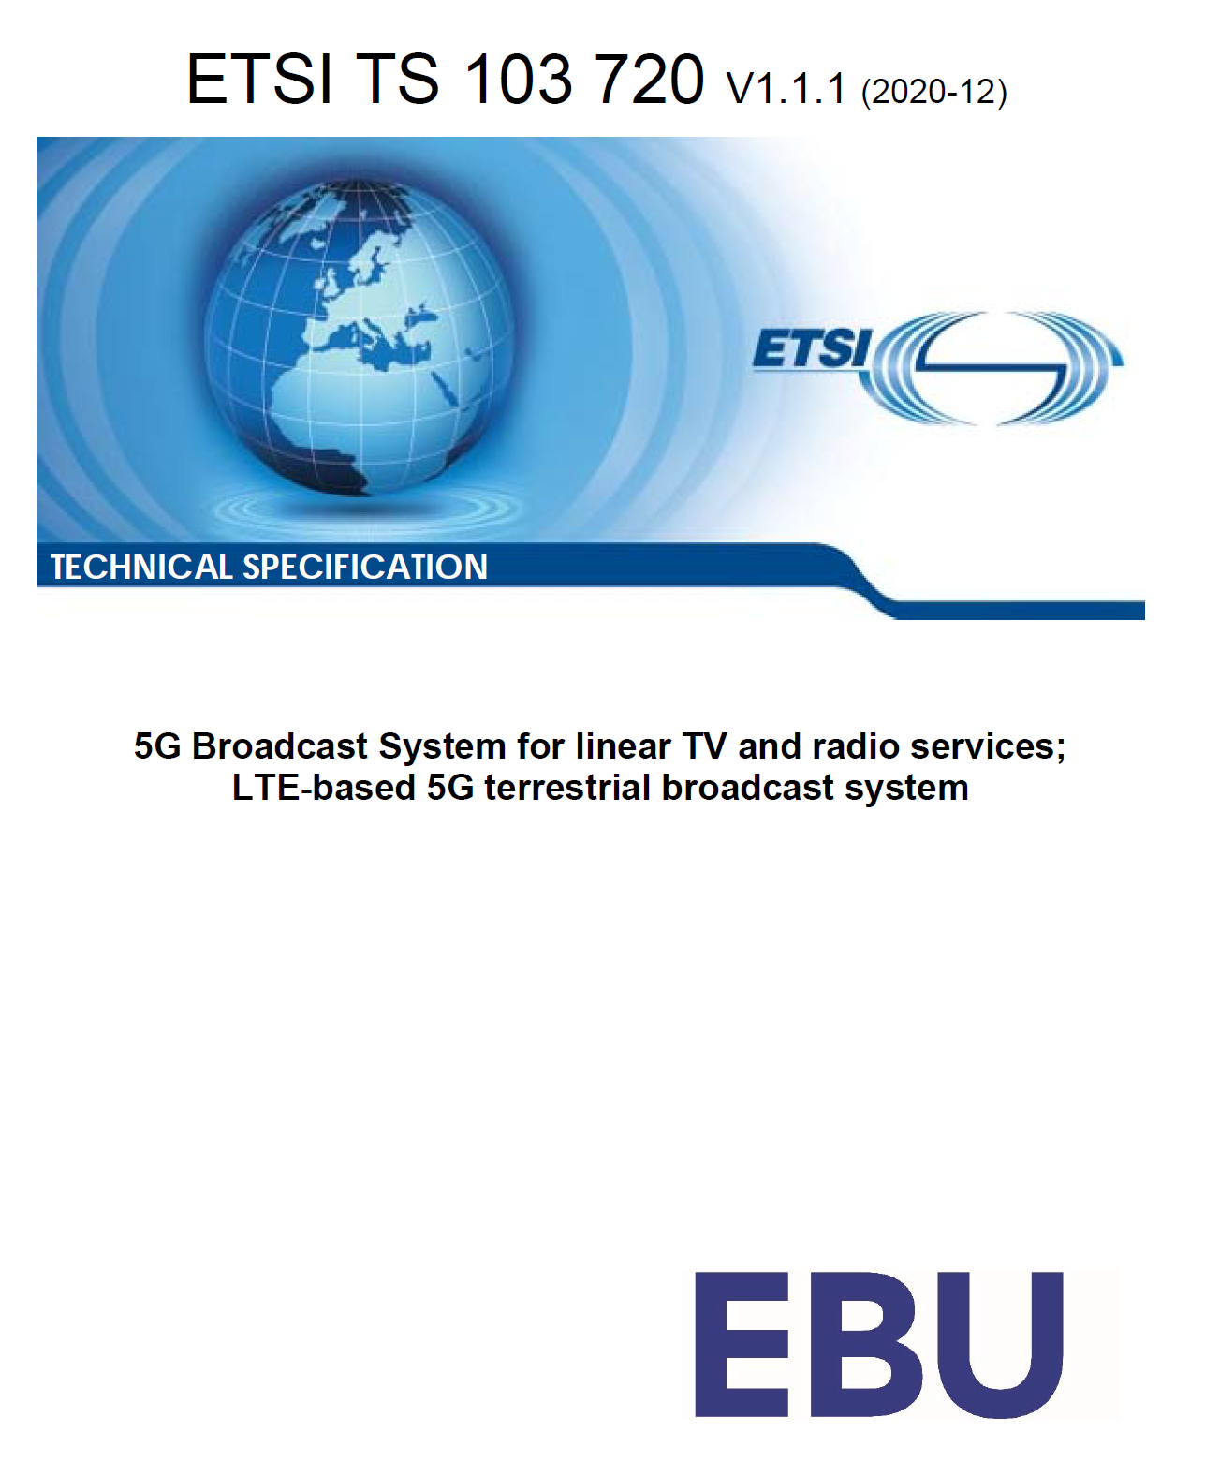
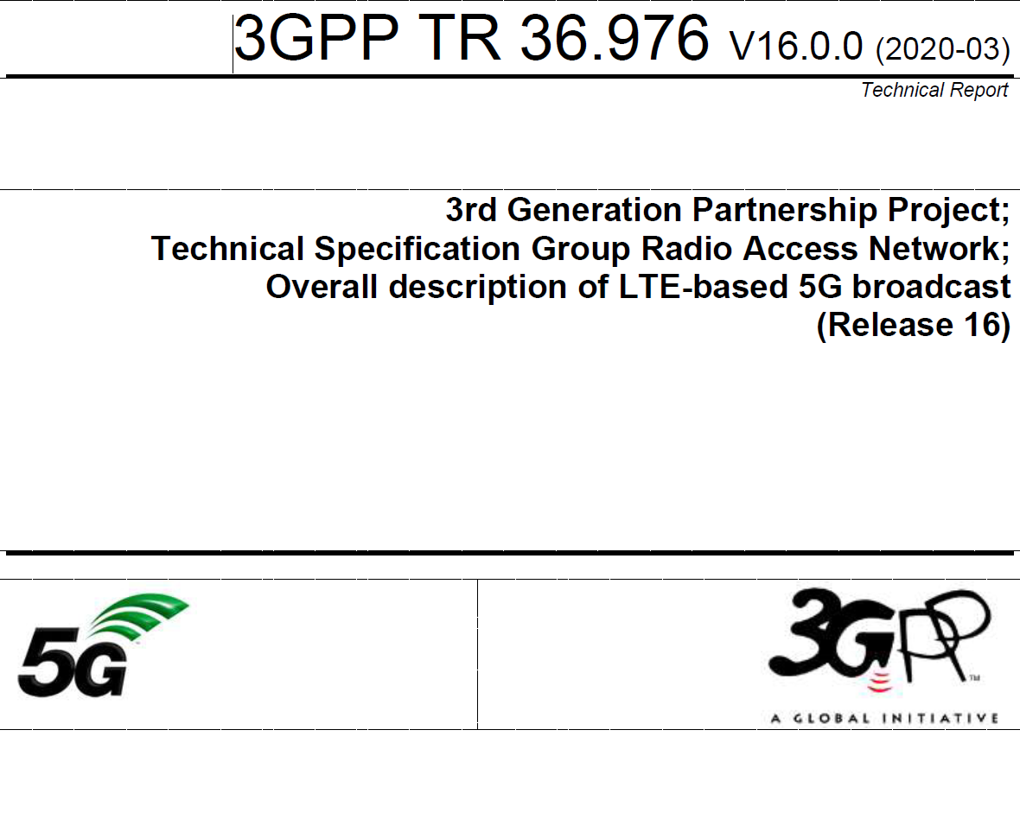
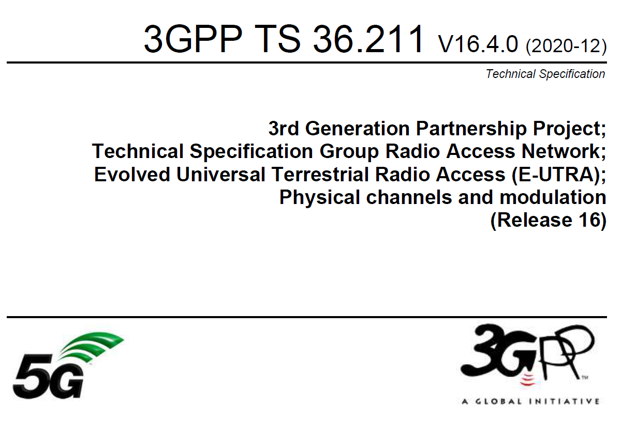
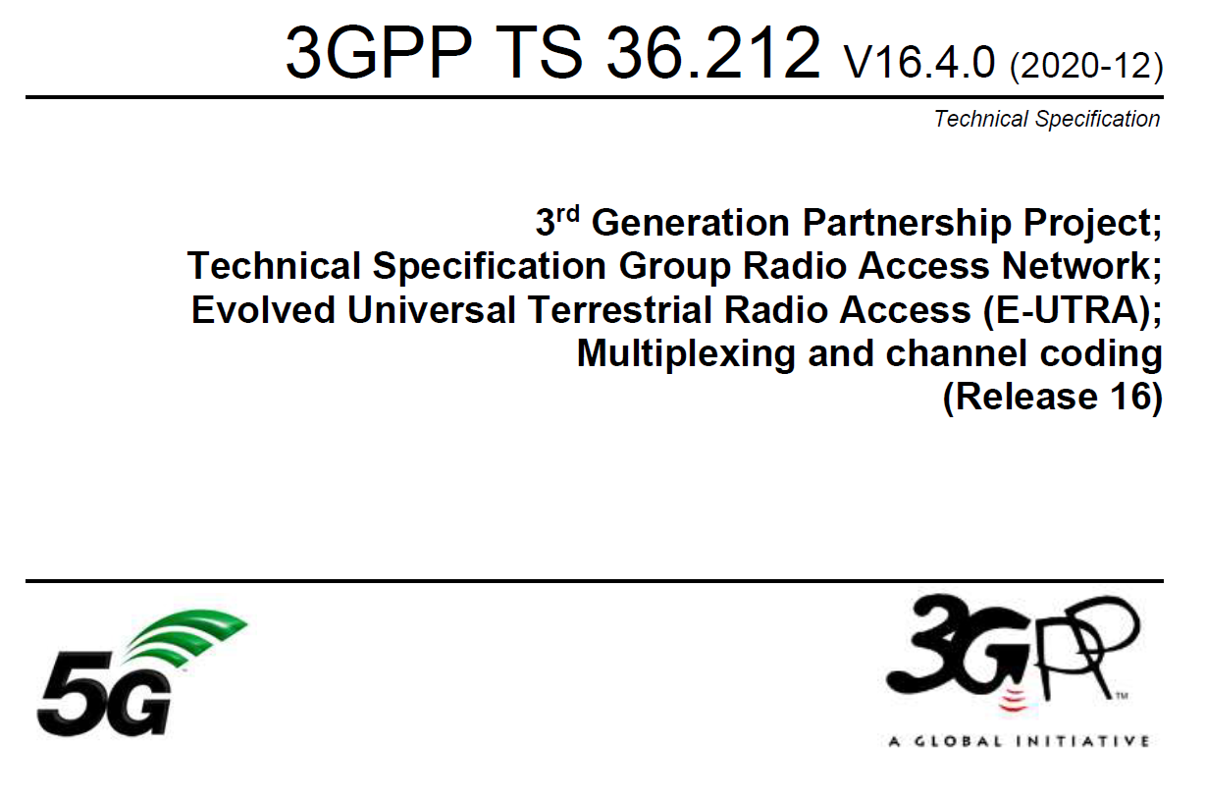
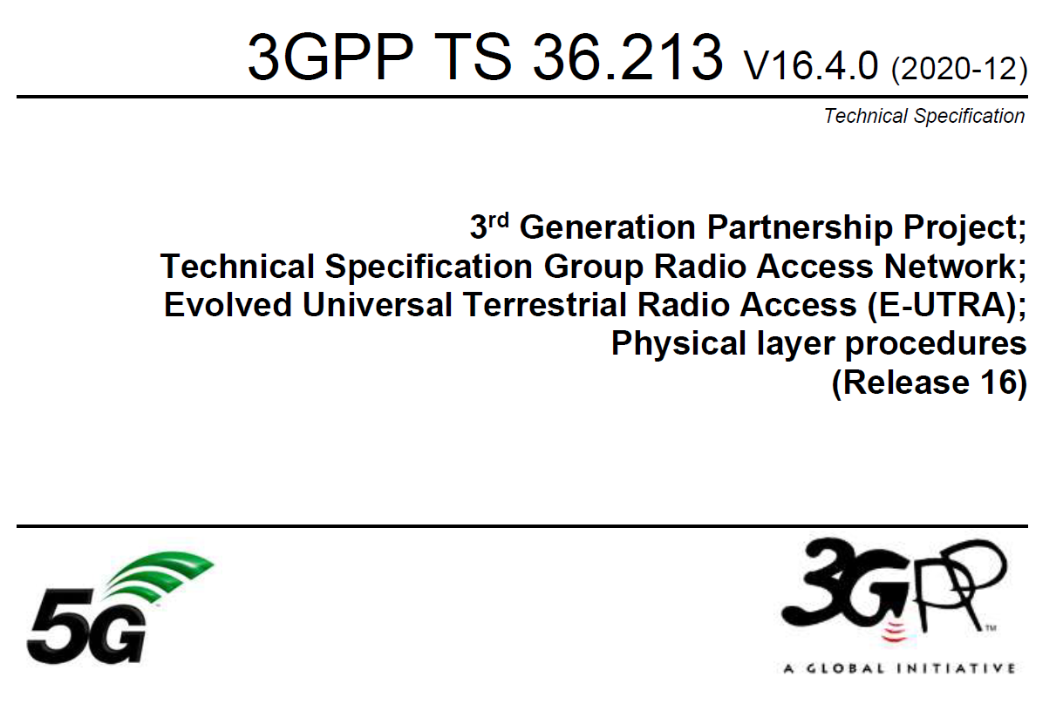
ETSI TS 103 720: Profile of 3GPP specification containing the necessary parts to deploy 5G broadcast
TR 36.976: Overall description of enhanced TV (enTV) for 5G broadcast
For more information on 5G broadcast standards…
Various specifications of 5G PHY supporting broadcast together with unicast in TS 36.211, 36.212, 36.213

Slide 21
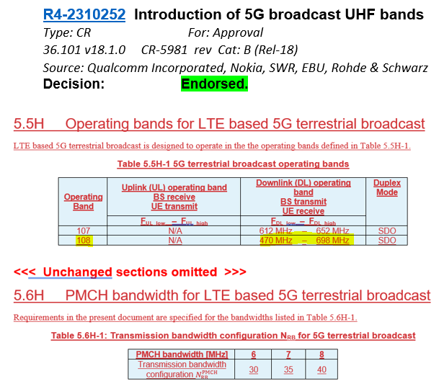
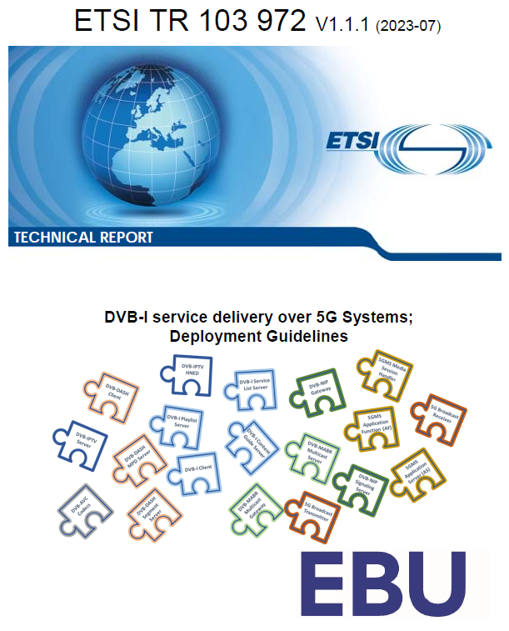
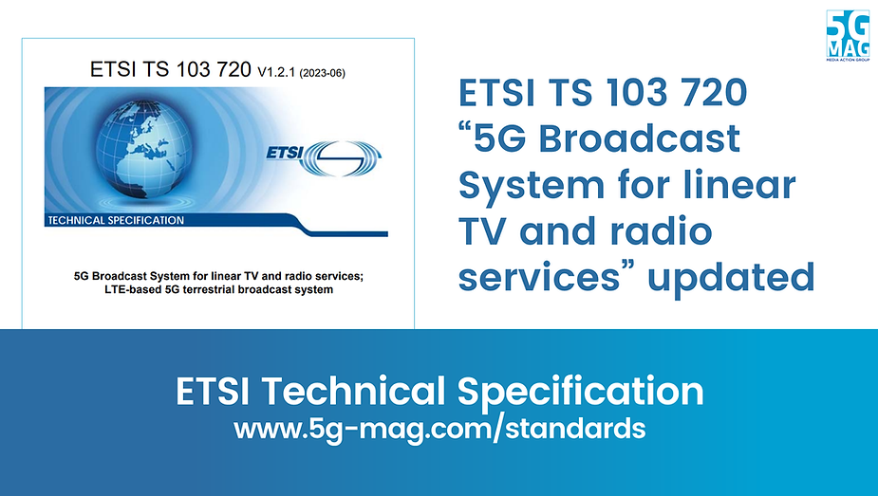
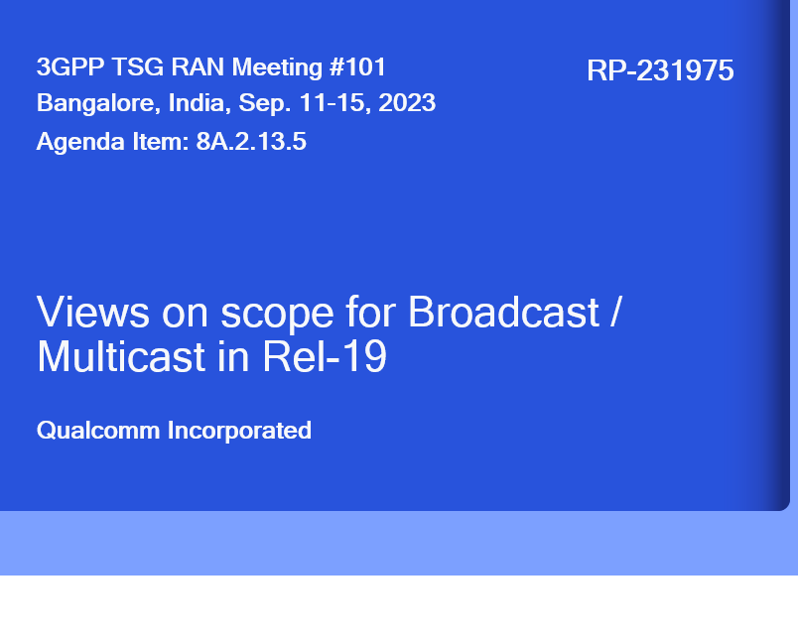
5G Broadcast Standards Evolution
Rel-14
SCS1.25KHz/ CP=200µs Mobility up to 120 km/h
5G BC worldwide standard
TG6/1 and WP6A
Rel-16
Rooftop Mobility up to 250 km/h
5G BC is an EU standard (ETSI TS 103 720)
Rel-17 Enhanced BW= 6/7/8 MHz for UHF
Enhanced Version of ETSI TS 103 720v.1.2.1
Enhanced Version of ETSI TS 103 720v.1.3.1
Rel-18 Requirements for UHF band, URL Handling
Rel-19 work in planning (TFI, Co-existence, Low-Latency)
Where do we stand?
ETSI 5G-MAG
ETSI 5G-MAG
3GPP
ITU
3GPP
ETSI
3GPP
3GPP
3GPP
2017
2019
2020
2020
06/22
06/23
12/23
12/24
06/25

Slide 22

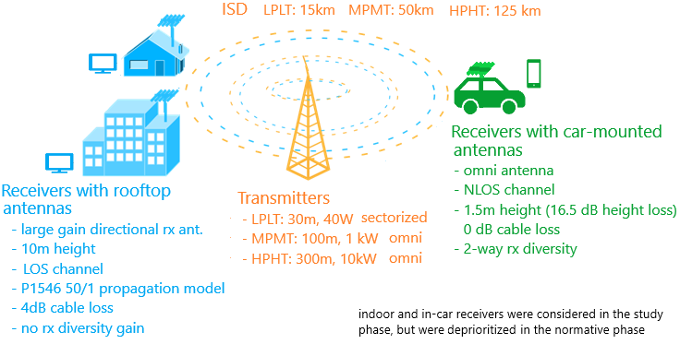
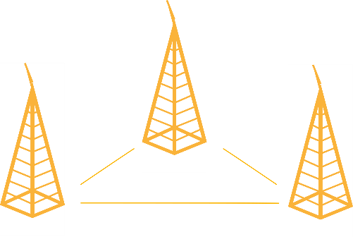

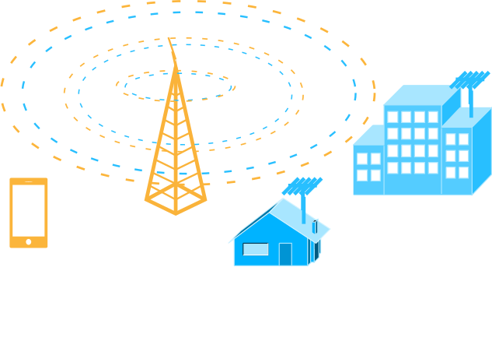
RAN: MBMS ➔ 5G Broadcast Evolution
Release 17/18
Release 16
6/7/8 MHz channel bandwidth to support common global channel bandwidth for broadcast systems
Introduction of UHF Band 108 to address RF transmitter and receiver requirements
Release 14
New numerologies to target rooftop reception with up to 125 km ISD
High mobility reception: fixed, portable and mobile receivers up to 250 km/h
Enhancements to CAS—increased PDCCH agg. Level, PBCH repetition, CFI in MIB
Release 13
Longer cyclic prefixes for support of larger ISD
Up to 100% of subframes for MBSFN transmission on a dedicated carrier
Subframes fully dedicated to MBSFN transmission
Targeting rooftop and car-mounted antennas, handheld receivers
Release 9
Single-cell transmission (SC-PTM)
Transmission on PDSCH with new group identities
Non-synchronized transmitters
Mixed unicast/MBMS carrier
15 kHz numerology
Extended CP of 16.7us
Multi-cell transmission only (MBSFN)
Up to 60% of subframes for MBSFN transmission
> 15 km
“Operator controlled” MBMS
“Broadcaster controlled” MBMS

Slide 23





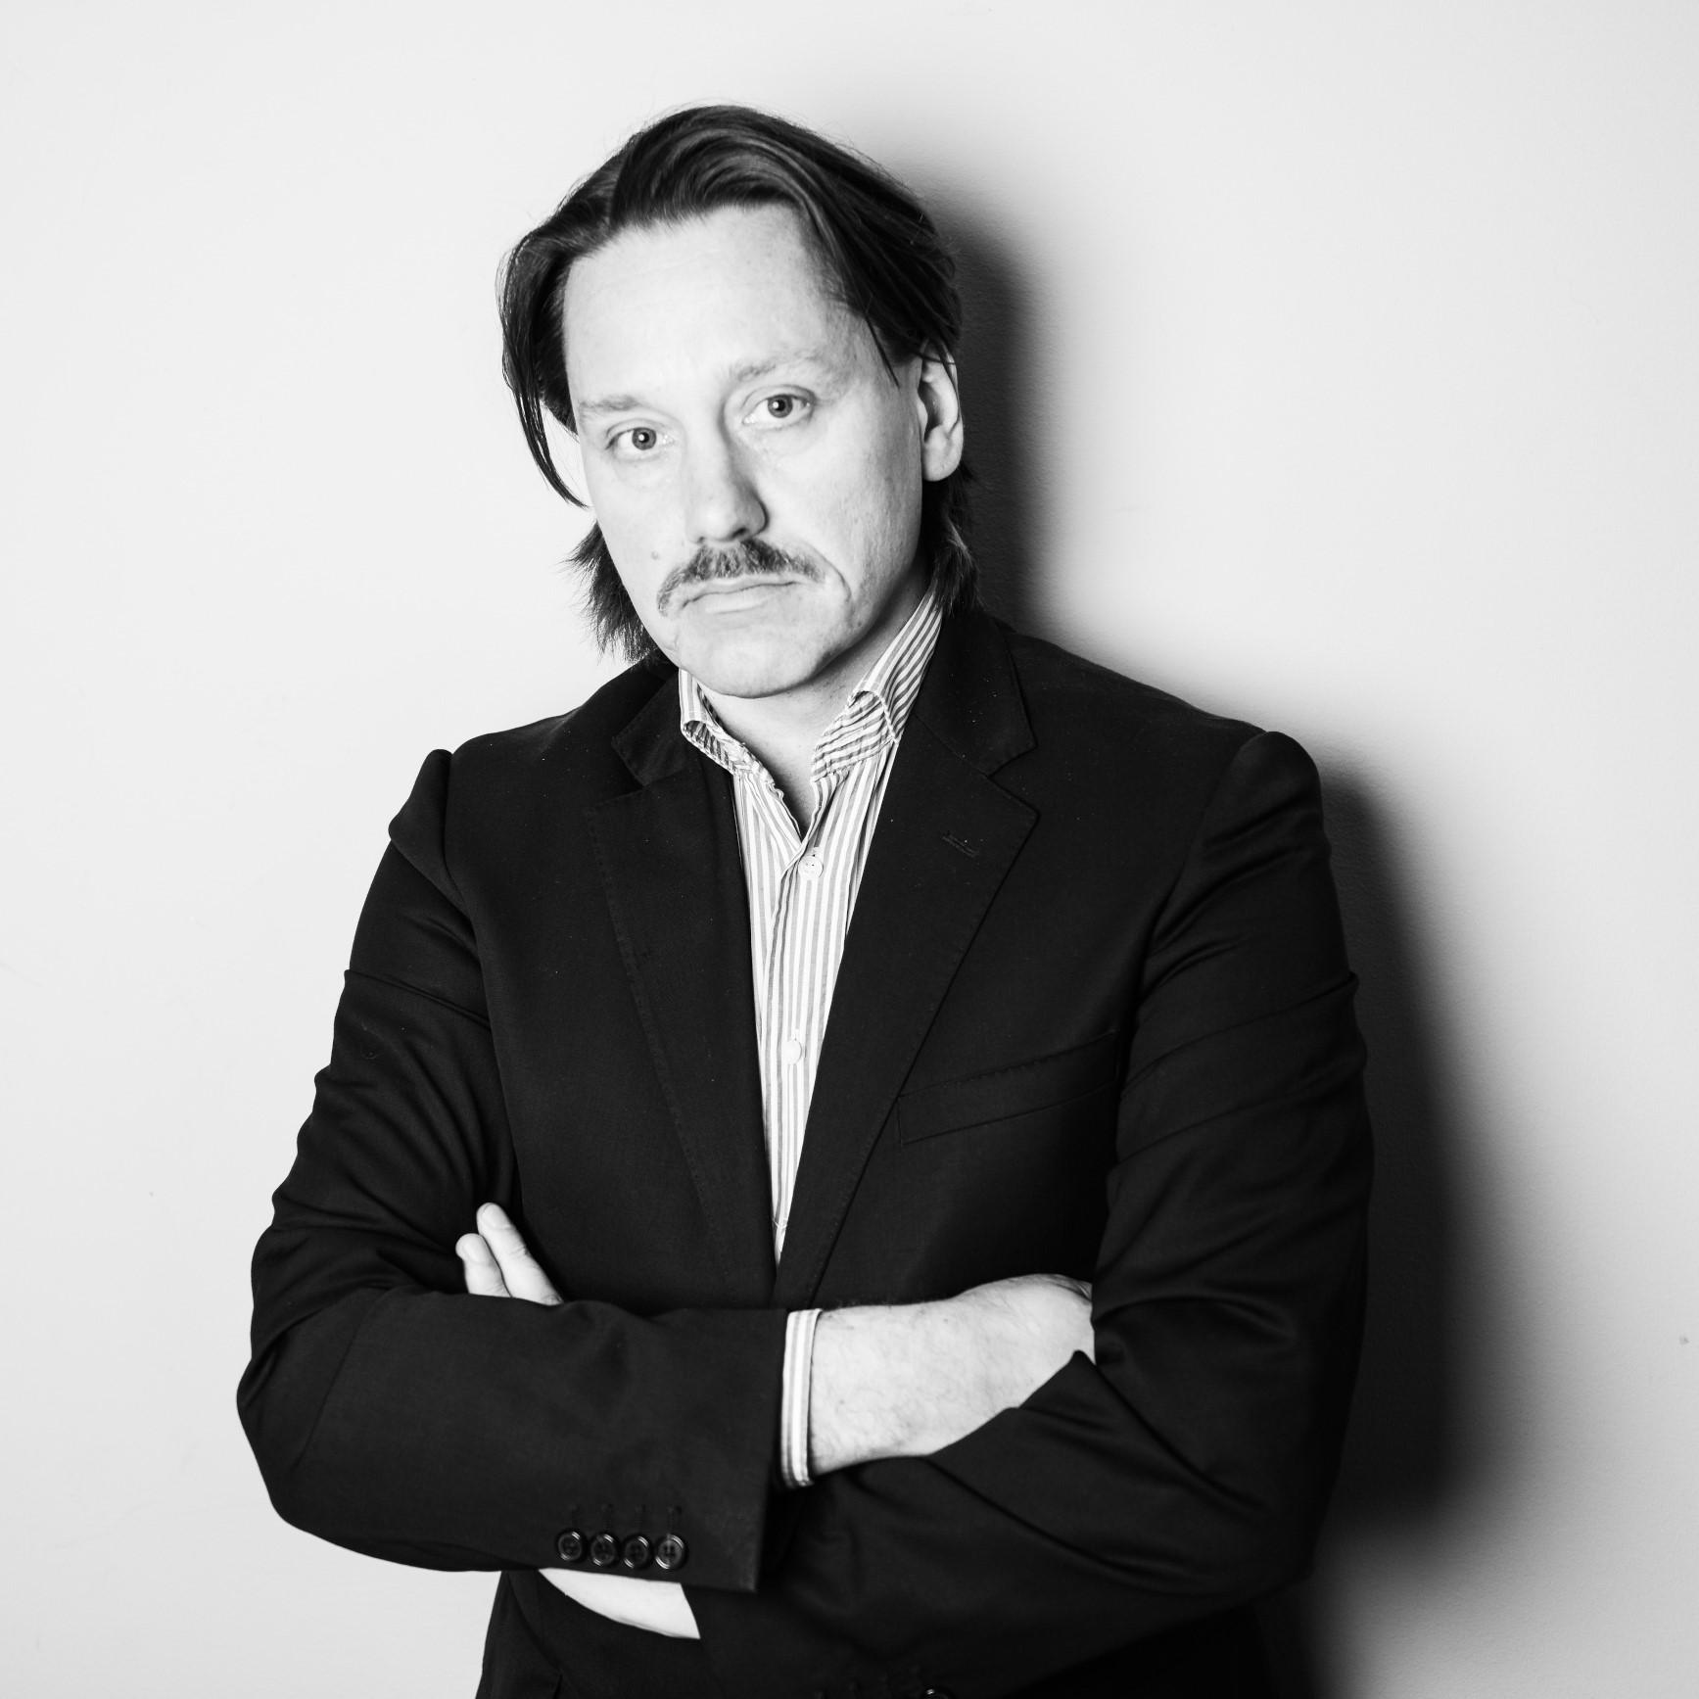

ATSC3.0 the only reasonable course as the underlying nature of D2M
I may have a regulator requirement to distribute some ATSC signal on my broadcast carrier
How can we launch 5G Broadcast emergency services?
B107 is not sufficient, I need the entire UHF band defined in 3GPP
I want to re-use my existing app/player
5G Broadcast and unicast combined is a MUST including low latency
I am building a DVB-I large scale trial. How can we add 5G Broadcast?
What features will be included in the first set of commercial chipsets?

Slide 24





Target Organizations
Qualcomm is engaged in global standardization ecosystem

Slide 25

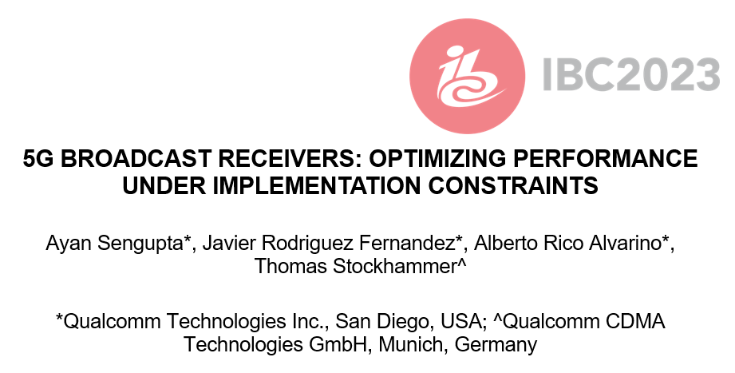


Details of the paper
Session and Recording

Slide 26
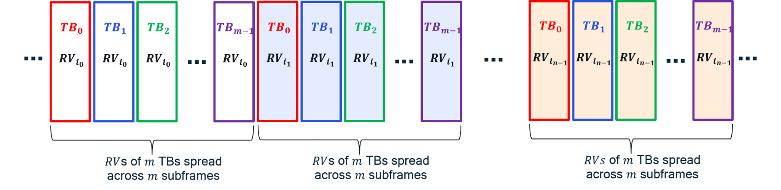
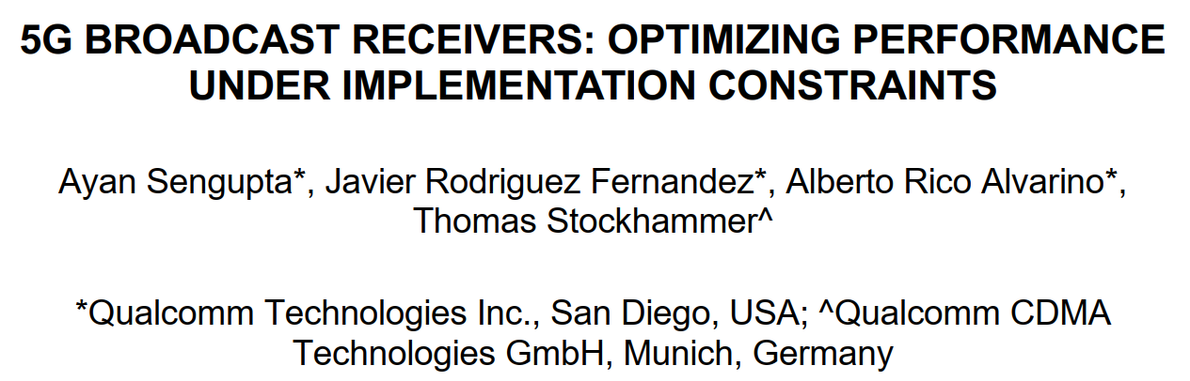






Recap IBC 2023: 5G Broadcast, 3GPP and cellular modems
Not specified for Rel. 19, may be standardized in the future in 3GPP or somewhere else
The big picture
Broadcasting technologies traditionally use time & frequency interleavers to harness diversity
3GPP cellular technologies “don’t need to” rely on interleavers due to additional diversity sources (e.g. HARQ feedback/retransmissions, spatial diversity, etc.)
Last year, we focused on
1- How we could create “3GPP-modem-friendly” time and frequency interleavers
2- How interleavers improve 5G Broadcast performance in different mobility scenarios
Time interleaver
Frequency interleaver
3GPP Modem
CP
CB $C$
Write row-wise
Read
col-wise
CP
Block $B/C$
…
…
UHF band support
CB 3
Block 2
CB 2
$C$ rows
Block 2
CB 1
$M$ input tones
Block 1
$M/C$ columns
$M$ interleaved OFDM tones

Slide 27
Summary and Conclusions of Paper
5G BROADCAST RECEIVERS: OPTIMIZING PERFORMANCE UNDER IMPLEMENTATION CONSTRAINTS
Broadcast networks and usage of configurations needs to be done for worst-case scenario.
For example, gains achieved in the 120 kmph scenario may not relevant, if such a planning would fail to serve a large number of receivers moving at lower speeds.
In this case, comparison between 5G broadcast and ATSC3.0 is provided for NLOS for different speeds and configurations
The main design target & “reason for being” of 5G broadcast is to enable operation of a broadcast network where the receivers are hardware-compatible with cellular modems
“Hardware compatible” means lower barrier to adoption in mobile devices compared to other broadcasting technologies
Several 5G Broadcast building blocks are already there in a 4G/5G modem, hence the additions are marginal.
For other technologies, a separate piece of silicon / die area would be required
In comparison with unconstrained broadcast designs, 5G Broadcast Rel-18 is only marginally worse
Address remaining gaps in Rel-19 without compromising the design goals implementing a Time-Frequency Interleaver re-using HARQ procedures
SNR for | ATSC 3.0 + 1Rx | ATSC 3.0 + 2Rx | 5G + 2Rx | 5G + 2Rx + TFI
3 kmph | 14.4 dB | 8.7 dB | 10.7 dB | 8.9 dB
40 kmph | 11.2 dB | 6.6 dB | 10.9 dB | 7.3 dB
120 kmph | 10.8 dB | 6.2 dB | 11.4 dB | 7 dB
Worst case | 14.4 dB | 8.7 dB | 11.4 dB | 8.9 dB

Slide 28
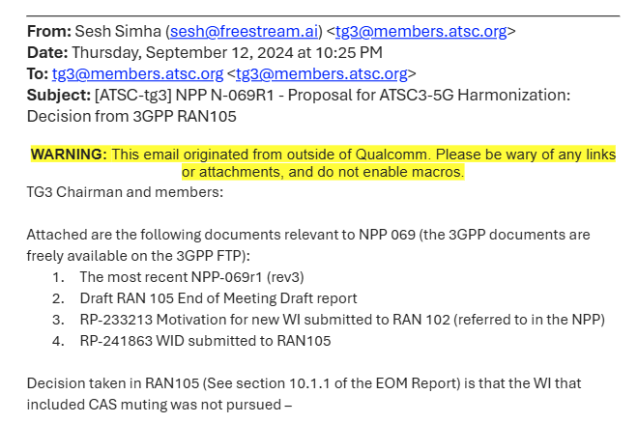
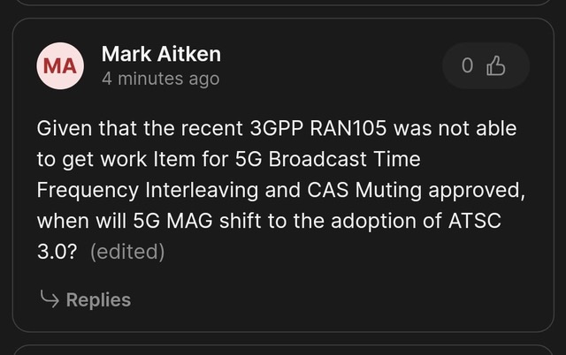
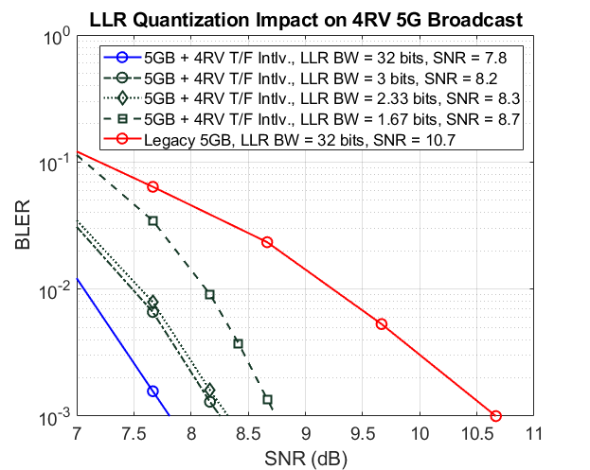
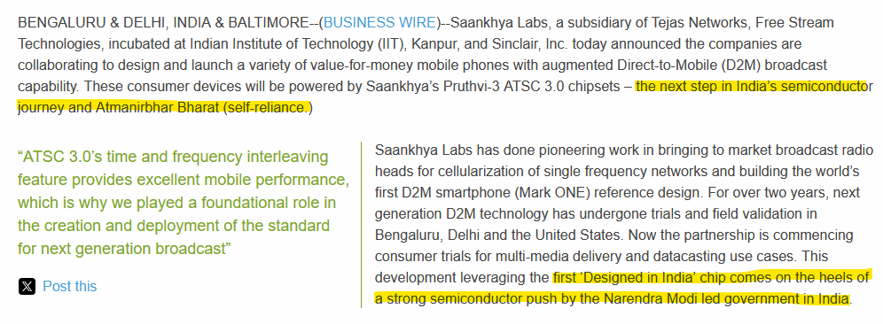
Broadcast – 3GPP
Previously planned scope for Rel-19:
Time-frequency interleaving
“CAS muting”
Rel-19 work item rejected in September plenary due to objections of mainly Huawei and Samsung.
Current plan:
Get more vocal supporters (XGN, BNE)
Do pre-standard work in 5G-MAG (draft specs internally virtually completed - here) + LS to 3GPP
Offline discussion with Samsung and Huawei
Resubmit to December plenary for Rel-19
On the technical side, we also get infra vendors already implementing the feature in their products

Slide 29
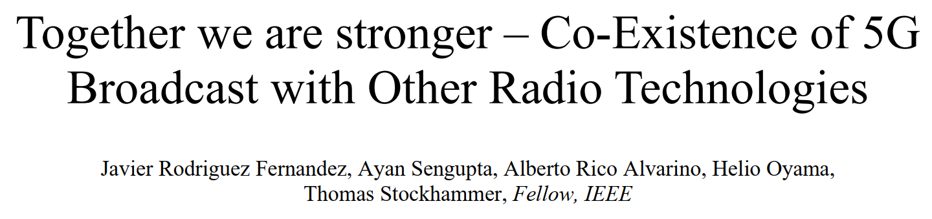

SET EXPO Paper August 2024

Slide 30
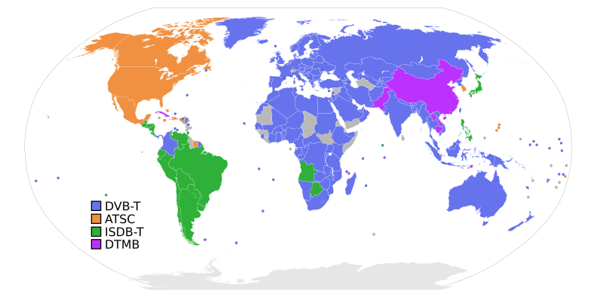
5G Broadcast and other radio technologies
Cellular and
5G Broadcast
Converged – Apps and Devices
5G Broadcast is generally not expected to be deployed as greenfield or as standalone technology
Internet
Linear TV
Radio
Cellular Modem
UHF band support
Technical aspects and opportunities of co-existence presented in the following
Notes:
Motivation
However, when introducing a new broadcast technology, the co-existence with and the migration from existing broadcast technologies is one of the most challenging efforts – also taking into account spectrum scarcity, the need to support legacy receivers, and regulatory constraints.
Secondly, in the modern world of apps and software-based service layers, there exists a huge opportunity to share service layers across transport technologies including stationary and cellular unicast delivery, providing a unified and enhanced user experience. As 5G broadcast is decoupled from a specific service layer, unique and exciting co-existence scenarios exist.
A third aspect is the deployment of 5G Broadcast jointly with unicast, including initial discussions on spectrum and technology requirements.

Slide 31
#1: Sharing UHF Resources with legacy broadcast systems
Frequency Division Multiplex (FDM) on different carriers (see paper) or Time Division Multiplex (TDM) on the same carrier
min_time_to_next = [50ms; 5300ms]
ATSC3.0 supports blanking
Bootstrap | Preamble | ATSC Frame |  | Bootstrap | Preamble | ATSC Frame
DVB-T2 support Future Extension Frames
1st FEF frame
(up to 250 ms T2-Base / 1s T2-Lite)
1st DVB-T2 frame
2nd DVB-T2 frame
P1
P2
# 0
Data
# 0
Data
# 1
Data
# 3
P1
FEF Data
P1
P2
# 0
Data
# 0
Data
# 1
Data
# 3
P1
FEF Data
FEF frame starting with P1 symbol
5G Broadcast Rel-19 expected to support CAS muting
5GB
CAS-muted region
CAS
PMCH
# 0
PMCH
# 1
…
CAS
CAS-muted region
CAS
PMCH
# 0
…
SIB-indication

Slide 32
ATSC 3.0 and 5G Broadcast in-band coexistence (NPP in ATSC)
A novel opportunity to leverage the best of both technologies – with lots of deployment flexibility
Note: TV supports ATSC, mobile 5GB
min_time_to_next
ATSC 3.0
B | P | ATSC Frame |  | B | P | ATSC Frame
Blanked for ATSC 3.0
Blanked for ATSC 3.0
SIB-indication
5GB
CAS-muted region
CAS
PMCH
# 0
PMCH
# 1
…
CAS
CAS-muted region
CAS
PMCH
# 0
…
ATSC3.0
5G Broadcast
ATSC3.0
5G Broadcast
Addresses regulatory constraints, i.e. the need to distribute a subset of services with ATSC
Flexible allocation of carrier bandwidth over different time spans across ATSC/5GB, for example:
Over deployment maturity: gradually increasing the share for the new technology when new receivers get available
Over time of the day. During commute morning and afternoon hours more mobile 5GB, evenings stationary TV users.
based on consumption/metrics reporting: the share mobile vs stationary reception can dynamically be adjusted.
Coordinated transmission needed, proof-of-concepts and standards work ongoing

Slide 33
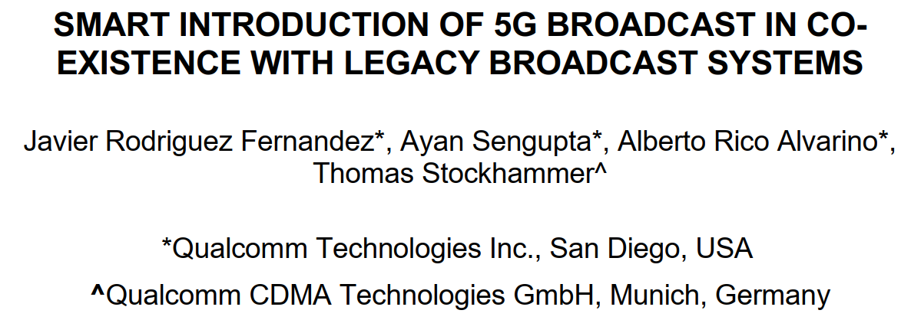
5G Technology – convergence with broadcast
Sunday 15th 16:00-17:00 @ Conference Room 2

Slide 34
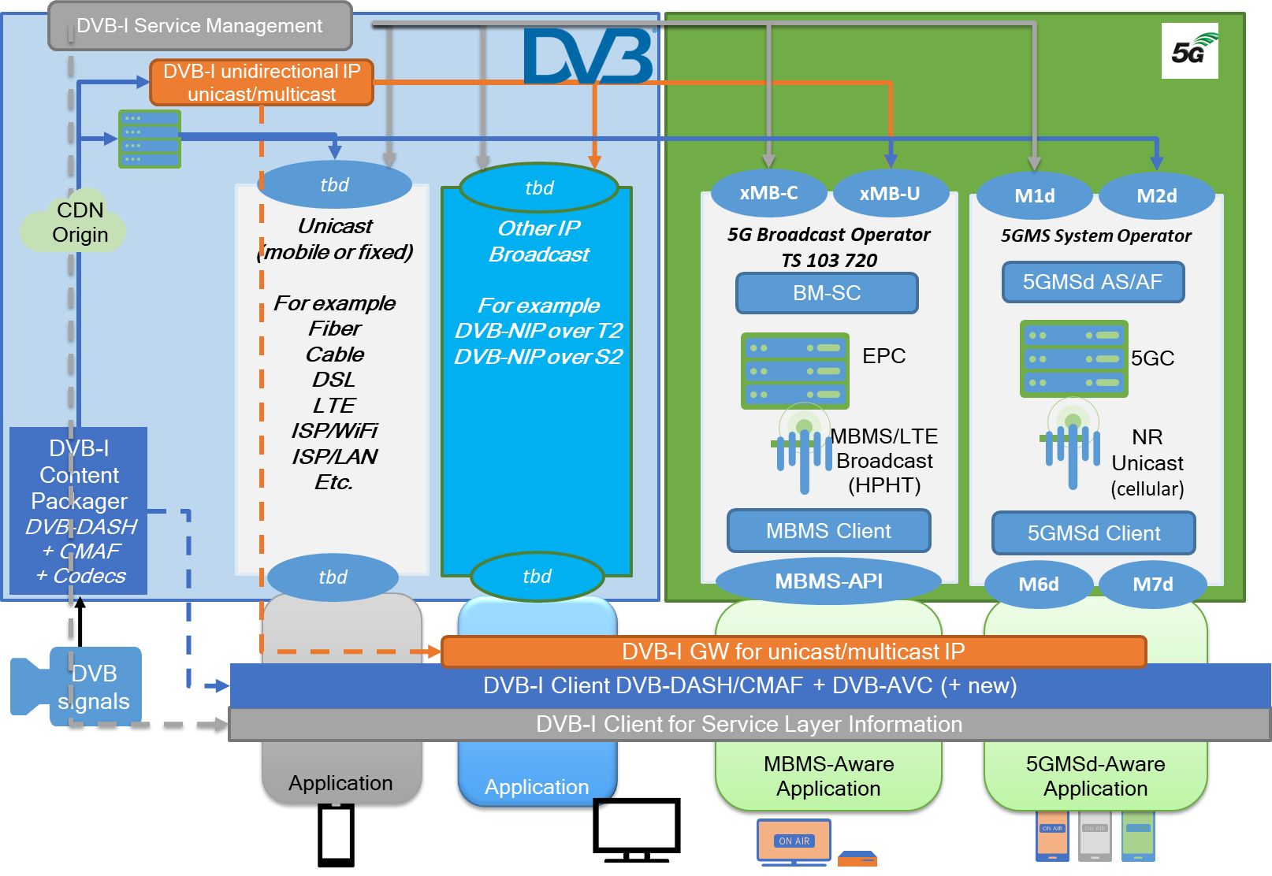
#2: Unified Service Layer
5G Broadcast as transport-only technology can be integrated into existing service layers and apps => DVB-I + 5G Broadcast
Vision: DVB Service Layer (Codecs, Packaging, DRM, Service Announcement and Discovery, IP-based protocols) runs on top of any transport network, in particular 5G Unicast and 5G Broadcast
ETSI TR 103 972 (07/23): Deployment Guidelines for DVB-I services over 5G Systems ➔ mostly plug and play leveraging DVB-I and 5G Broadcast APIs and reference points (see figure on the right-hand side)
specs completed in 3GPP, DVB, 5G-MAG, ETSI
Successful over-the-air demonstrations in 2024:
DVB World (03/24): standalone DVB-I list over 5G Broadcast
Media Web symposium (06/24): integrated into German DVB-I Pilot list as one service instance, fallback to unicast if out of coverage
IBC 2024 – see DVB booth
Similar efforts started for ATSC3.0 integration

Slide 35
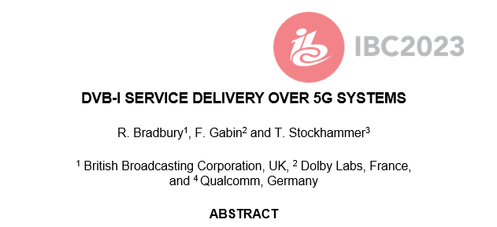


DVB-I via 5G Broadcast
Joint DVB/5G-MAG task force
Using MBMS/5G Broadcast Reference Points and APIs
Different options are considered
Using file download services for carouselling metadata
Using segment streaming for DVB-DASH
Using transparent mode for DVB-I multicast distribution
Combinations with unicast, hybrid services also under development
See details in ETSI TR 103 972
Expected to be supported by reference tools

Slide 36
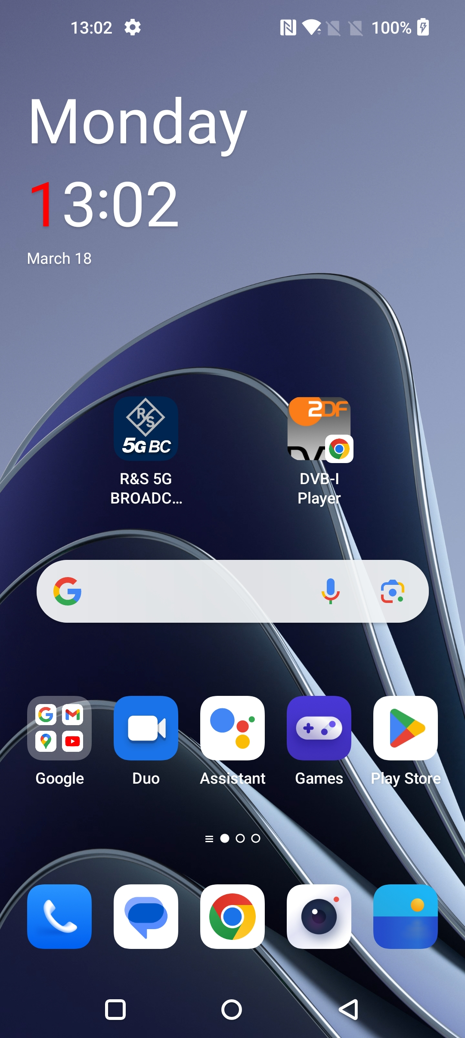
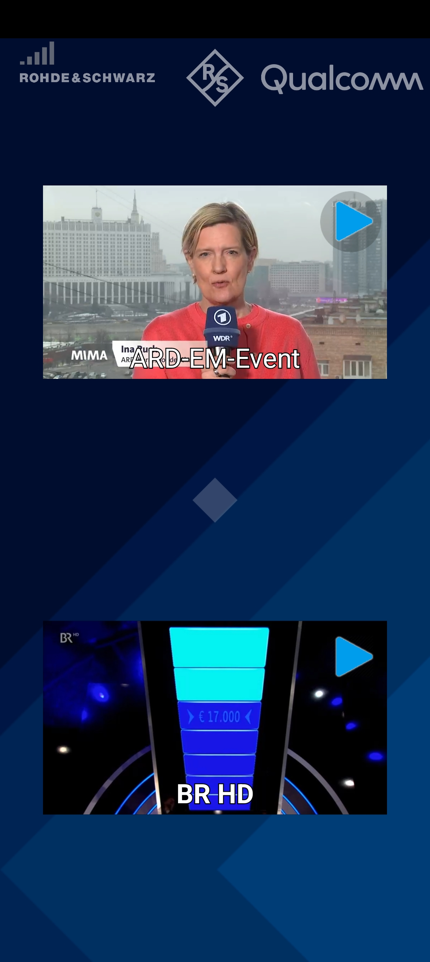
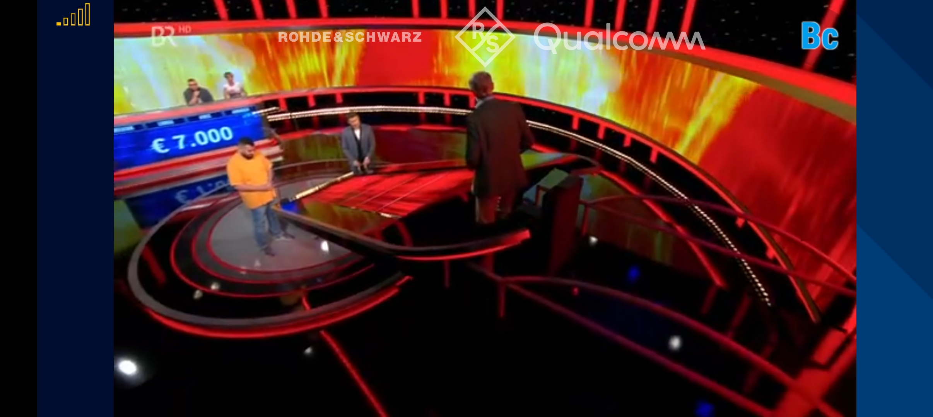
Qualcomm and Rohde & Schwarz show the world’s first standards-conforming demo of 5G Broadcast integrated into the DVB-I service framework on a commercial smartphone. 5G Broadcast transmissions from the Ismaning/Munich broadcast tower are added as service instance to a DVB-I service list and the DVB-I client is updated to select services included in the 5G Broadcast signals. The 5G Broadcast signals are integrated in the service list of the German DVB-I Pilot, whereby the instances for 5G Broadcast get highest priority and will hence be selected by the 5G Broadcast capable receivers, but ignored by regular TV sets or smartphones.
Joint demo of Rohde & Schwarz, Qualcomm and the colleagues from ZDF and ARD

Slide 37

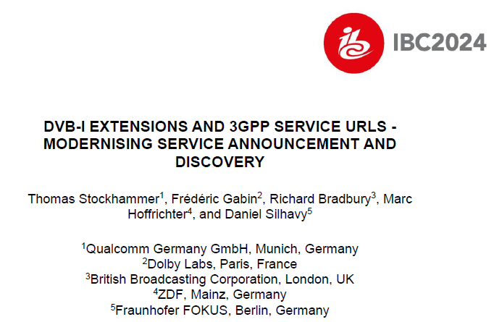

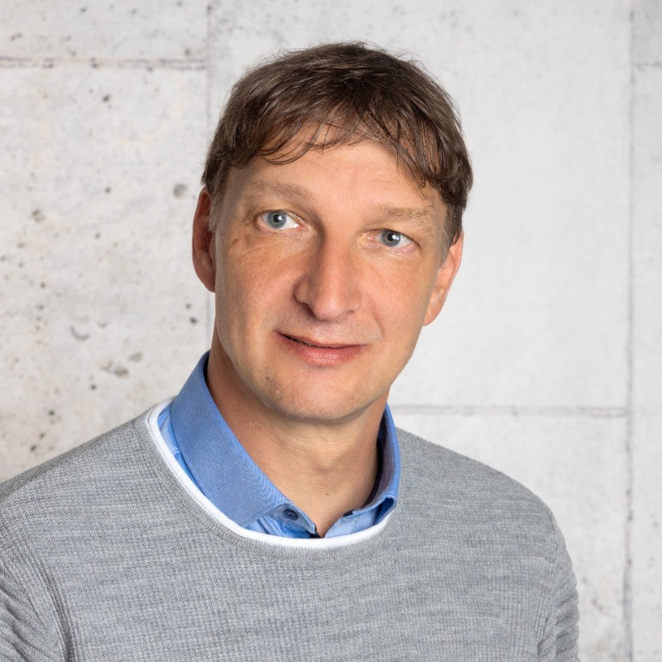
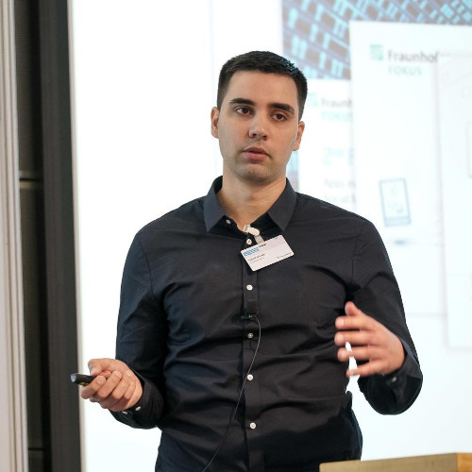
5G Technology – convergence with broadcast
Sunday 15th 16:00-17:00 @ Conference Room 2

Slide 38
#3: 5G Broadcast combined with cellular unicast
5G Broadcast is expected to be available as a new feature in mainstream mobile devices w/o comprising existing features
TV Application/Service Provider
Technical Enablers
5G Broadcast (as a fully defined 3GPP technology) allows the coordination of frequency bands in uplink and downlink, and the concurrent processing of broadcast and unicast spectrum in same modem.
Current commercial 3GPP modems already support simultaneous operation in multiple bands (dual-SIM and dual connectivity)
Concurrent operation of 5G Broadcast and unicast is realized by leveraging the same mechanisms
difference that one of the bands is a receive-only broadcast band (UHF is 3GPP Band 108).
Selected Opportunities
Seamless coverage extension with unicast fallback (indoor, rural, etc.)
Broadcast-on-demand: consumption and QoE metrics reporting allow a user-centric allocation of radio resources to specific programs
User-targeted features: interactivity, DRM-protected content, targeted ads, personalization, accessibility, advanced media capabilities (HDR, VR, etc.)
Re-use of existing apps – 5G Broadcast is a transport-only technology and supports improved quality, cost efficiency, and reliability.
More rapid development and deployments (upgrades, app systems, etc.)
Internet
Broadcast
High Power
High Tower
Cellular Modem
Cellular unicast
5G broadcast
TV/Media Application

Slide 39
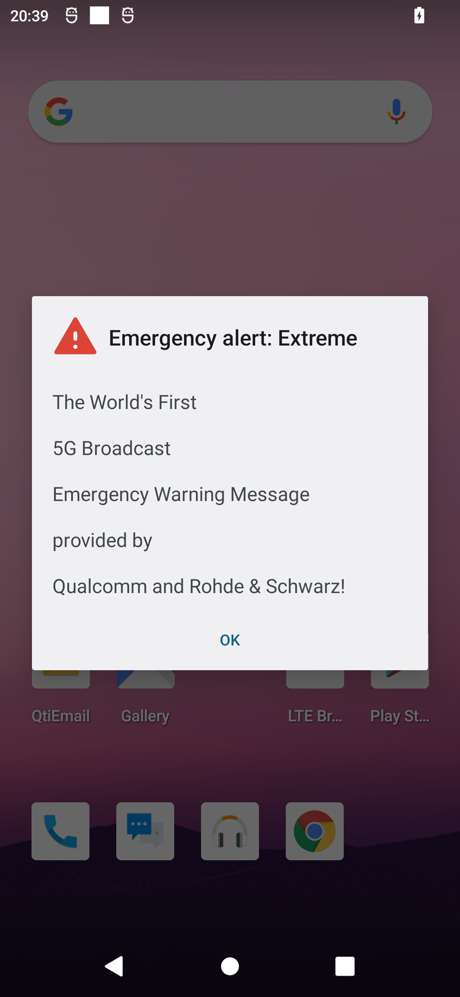



Selected use cases
One-way communication directly to handsets
More cost efficient than unicast (RAN and CDN)
Live sports, special events, general programming
Key for massive events (e.g. World Cup)
Emergency notifications to smartphones from broadcast infrastructure.
Possibility of sending text-only notifications and multimedia content
Linear TV and Radio
Emergency messages
Combine linear video with interactivity.
Linear content from broadcaster, unicast using mobile network.
Comments, ratings, e-commerce, advertising
Software / firmware upgrades.
Download and storage of popular content:
TV shows
“Viral” videos in social media.
Interactive media
General file download
IBC 2024, Amsterdam, The Netherlands
Enhanced broadcast use cases with 5G broadcast

Slide 40
Emergency alerts
5G broadcast inherits from 5G the public warning system capabilities.
The Cell Broadcast Service (CBS) does not require authentication with a PLMN. Hence, a ROM network is inherently compatible with CBS (see 3GPP TS 23 041).
CMAS (commercial mobile alert system) is available in current commercial devices.
Devices monitor periodically a low-duty cycle paging channel (low power)
CMAS over 5G broadcast has been demonstrated with R&S infrastructure
Additional capabilities of CMAS:
Geofencing (send notification to users within a given area)
Possibility of sending URL linking to emergency media

Slide 41

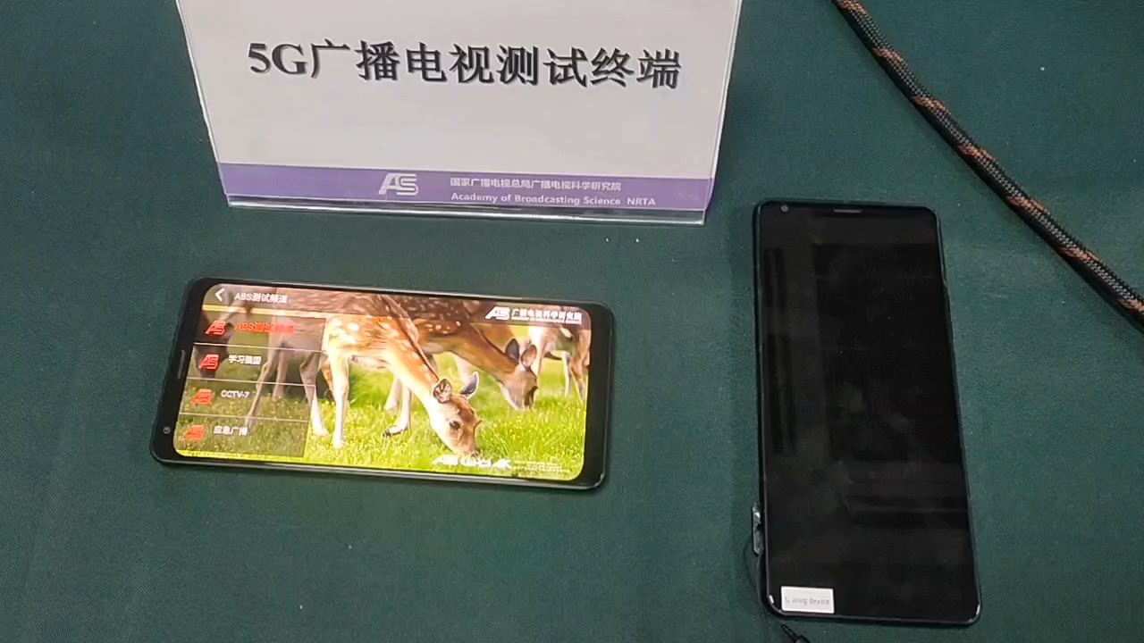
Emergency message demo with ABS
Self-contained emergency system (text + multimedia) without need of unicast.

Slide 42
New version of ETSI TS 103 720
5G-MAG milestone | Target date
Initial ETSI Draft work item with at least 4 supporters | 2024/06/30
Agreed initial feature set for next release of ETSI spec | 2024/07/31
Agreed ETSI Draft work item with at least 4 supporters | 2024/08/31
Initial draft change requests for TS 103 720 | 2024/11/30
Stable draft change requests for TS 103 720 | 2024/12/20
Integrated version of change requests | 2024/12/31
Qualcomm is rapporteur of work
Identified Work Topics by 5G-MAG
DVB-I over 5G - add details to TS 103 720
Band support for receivers including Band 108
5G Broadcast as PWS Improvement
Concurrent support of 5G Broadcast and 5G Unicast
ETSI TS 103 720 V1.2.1 - Delivery of Warning Messages from MME to eNodeB
Support of time-frequency interleaving (for improved performance in time/frequency selective channels)
Support of coexistence with other broadcast technology in the same radio channel by TDM (for “soft refarming” and regulatory requirements)
Clarification on features on handsets in Europe (Receiver profile)
distributed vs. centralized MCE architecture
Clarification on use of protocols and transparent mode
URL handling for bootstrap of services
Other Potential topics:
Service layer: low-latency, DRM, codecs, MBS Service layer, unicast repair
Implementations: device APIs and interfaces, player optimizations, app integration
Radio layer: RAN-only profile (transparent/group communication), Statistical multiplexing & power savings
Some of the work above relies on Rel-19 3GPP work in RAN and SA4
ETSI milestone | Target date
TB adoption of WI | 2024/10/10
Early Draft | 2024/12/31
Stable Draft | 2025/03/31
Draft for approval | 2025/04/15
TB approval | 2025/06/30
To be published as version: | V2.1.1 or v1.3.1

