Slide 1

Latest on 3GPP, 5G and 6G from our perspective
September 13-16, 2024
IBC 2024
@qualcomm_tech
Dr. Thomas Stockhammer
Senior Director Technical Standards
Qualcomm Technologies

Slide 2
Background and Logistics

Slide 3
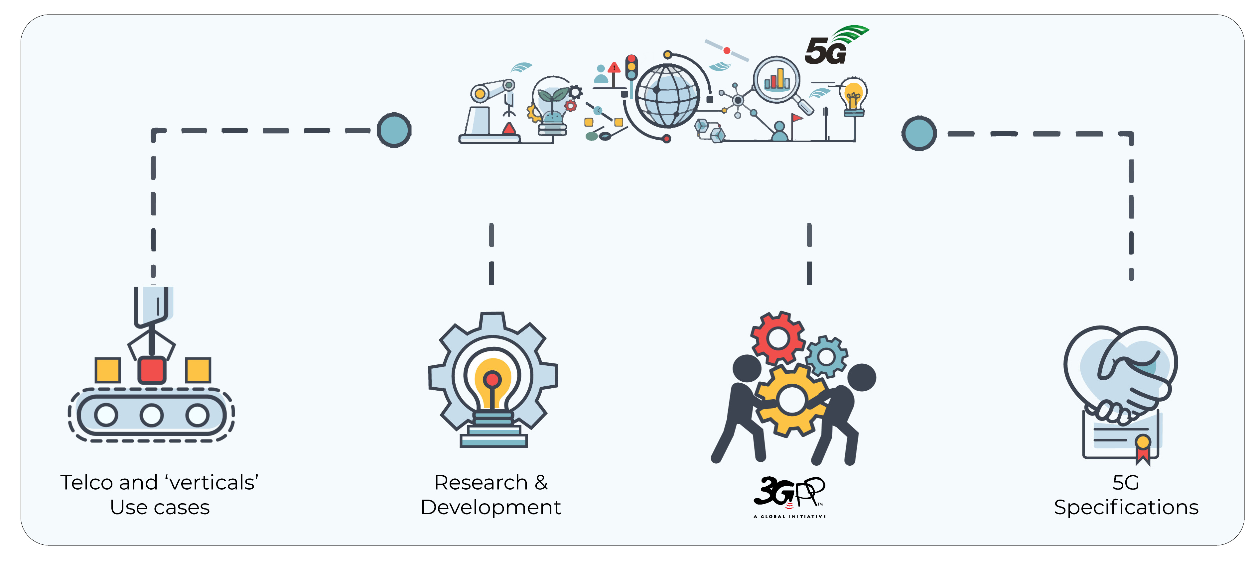

The role of 3GPP
Part of the invention, proof of concept, standardization, trials, commercialization …cycle
Specifications and Studies providing a complete system description for mobile telecommunications
The system description is characterized by a number of standardized interfaces. It is not a description of a standardized deployment
This standardization effort enables an interoperable, multi-vendor approach to deployment and generates mass market economies of scale, without stifling innovation

Slide 4
3GPP – How the project Works
3GPP works based on
  Participation in face-to-face meetings
  Pro-activity & Contributions – you need written proposals to get attention
  Consensus – nobody says “no” in order to progress
Work organization
  Study Items, Work Items
  Releases with fixed time-lines, which are partially overlapping
  Work Plan (good overview)
3 stages, often overlapping
  Stage 1: Requirements
  Stage 2: Architecture
  Stage 3: Protocols
Companies not individuals participate
  From all over the world
  All major telecommunication companies – operators, vendors, service providers
  Ministries, Regulators and government agencies actively engaged
  More and more vertical industry representatives bring their work directly to 3GPP
Amazing Track Record
  3GPP started 1998, since then all major standards projects were deployed
  Seamless migration from “old” to “new” mobile generations
A new Release every 15 to 24 months
  Allows for resonably fast standardization & deployment of new technologies
  Strong commitment to time-lines guarantees reliable planning

Slide 5
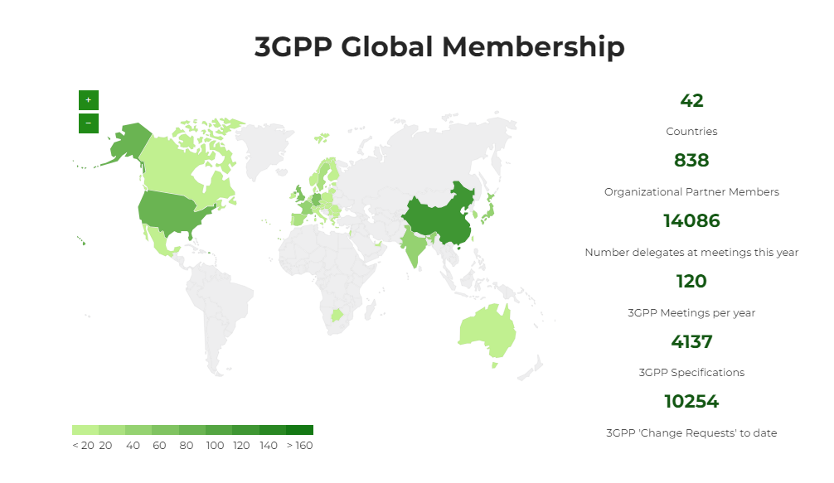







3GPP Membership
The 3GPP Organizational Partners – from Asia, Europe and North America – determine the general policy and strategy of 3GPP.
838 organizations have joined 3GPP via one of these seven OPs.
https://www.3gpp.org/about-us/partners

Slide 6
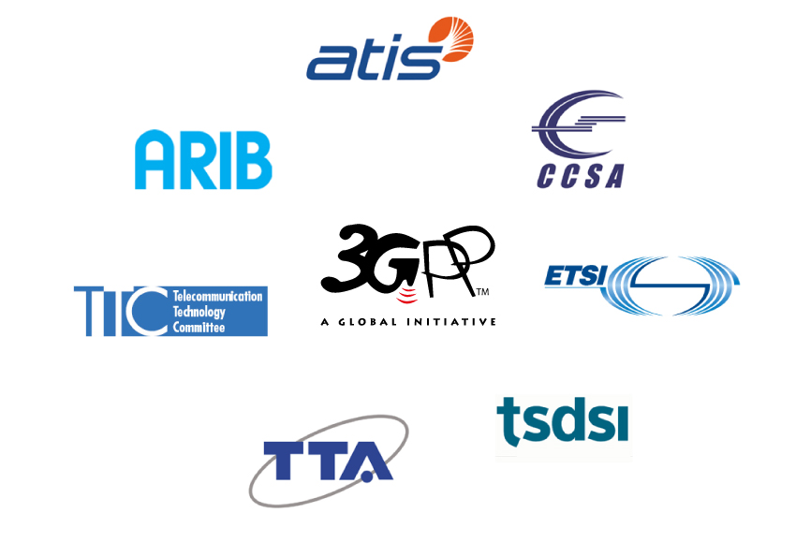




3GPP standards eco-system
3GPP Organizational Partners (OPs)
The 3GPP Organizational Partners (OP) - 7 Standards Organizations - from China, Europe, India, Japan, Korea and the United States.
Participation in 3GPP by companies and organizations becoming Members of one of these 7 OPs.
Inputs on market requirements may come in to the Project via 3GPP Market Representation Partners (MRP).
There is a lot of additional external liaison activity…SDOs, Industry bodies, projects…
Official Liaisons on specification work:
838 companies
450 MHz Alliance, AISG, Bluetooth, Broadband Forum (BBF), CableLabs, International Special Committee on Radio Interference (CISPR), CTIA, Digital Video Broadcasting (DVB) Project, Ecma, International, Expert Group for Emergency Access (EGEA), Eurescom, COST 273, European Radiocommunications Committee (ERC), Fixed Mobile Convergence Alliance (FMCA), GCF, Global TD-LTE Initiative (GTD), GPS Industry Council, GSM Association, HomeRF Forum, IDB Forum, IEEE, Internet Engineering Task Force (IETF), IrDA, International Multimedia Telecomunications Consortium (IMTC), Internet Streaming Media Alliance, ISO-ITU expert group, ISO MPEG / JPEG, ITU-T SG2, JAIN tm (Javatm APIs for Integrated Networks), The Java Community Process (JCP), Liberty Alliance Project, Metro Ethernet Forum (MEF), NENA, NGMN (Next Generation Mobile Networks), oneM2M, OMA (Open Mobile Alliance ), Open Networking Foundation (ONF), Open IPTV Forum, Object Management Group (OMG), PCS Type Certification Review Board (PTCRB), Portable Computer and Communications Association (PCCA), Presence and Availability Management (PAM) Forum, RSA Laboratories, SDR Forum, Sun Micro Systems Inc., Steerco, SyncML Initiative, Trusted Computing Group (TCG), TeleManagement Forum (TMF), TCCA, TIA /TR45, TIA/TR47, ITU, TV-anytime Forum, Voice eXtensible Mark-up Language (VXML) Forum, Wi-Fi Alliance, Wireless Broadband Alliance (WBA), WLAN Smart Card Consortium, Wireless World Research Forum (WWRF), World Wide Web Consortium (W3C)
(Source: extract from https://www.3gpp.org/about-3gpp/15-bodies-with-which-3gpp-has)
3GPP Market Representation Partners (MRPs)
Next Generation Projects
Certification Bodies
5G Projects
…

Slide 7
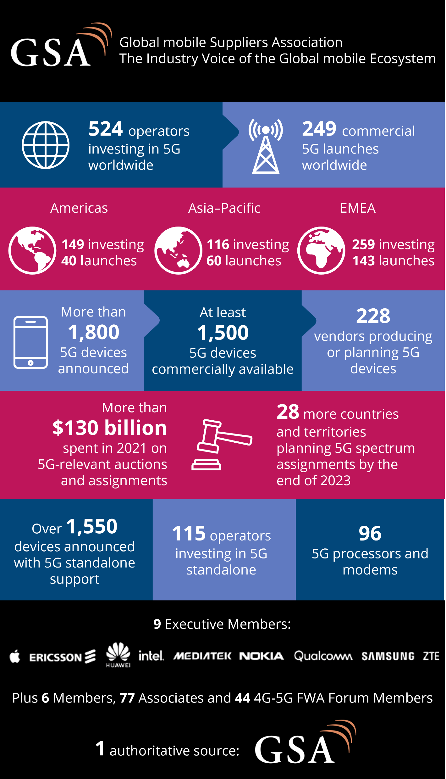
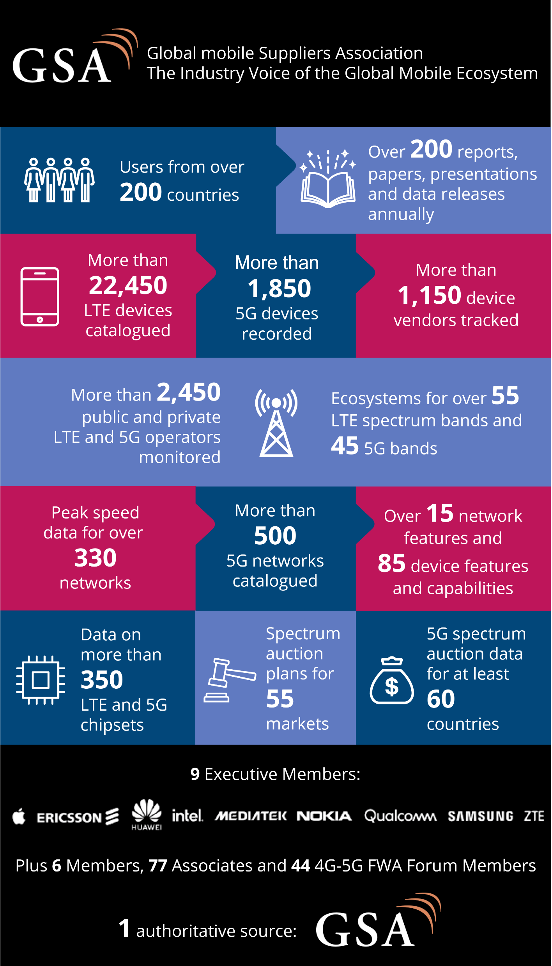

Market Statistics by 3GPP MRP:
The MRPs are a good source of data on the market.

Slide 8
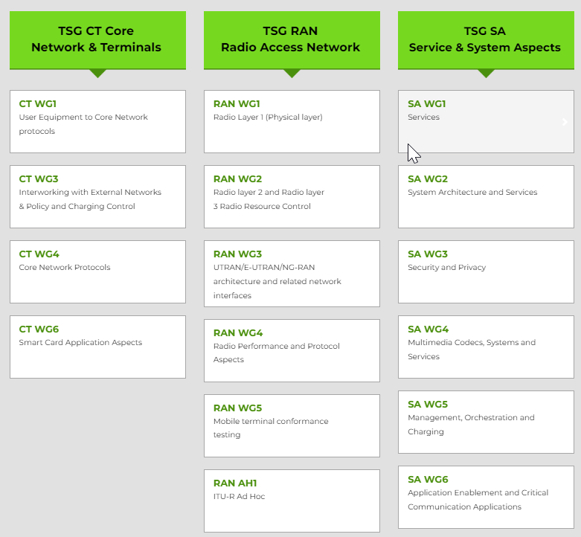
Technical Specification Groups
The TSGs prepare, approve and maintain the 3GPP Technical Specifications and Technical Reports.
They are responsible for the detailed time frame and management of the work’s progress;
  Management of work items;
  Technical Co-ordination;
  Proposal and approval of work items within the agreed scope and terms of reference of the TSG
The TSG Chair is responsible for the overall management of the technical work within the TSG and its Working Groups.
The WG Chair is responsible for the overall management of the technical work within the WG and its sub-groups.

Slide 9
3GPP productivity
Release-based work
  Releases are major packages of Features (There is a new 3GPP Release ~ every 15 – 24 months)
  A strong commitment to time-lines guarantees reliable planning and time-to-market
  The Work plan is built-up of Work Items that deliver the Features
  Work Items:
    WI may cover more than one specification
    WI may cover more than one TSG or WG
    WI Description document exists for each WI
  Multiple releases are maintained in parallel
See the 3GPP Work Plan for details of features:
    http://www.3gpp.org/Work-Plan
Number of specifications (frozen Releases)
December 2022

Slide 10
Three stage approach to Features, through Releases
time
Stage 1 Requirements: Overall service description from the user’s standpoint.
SA1
Requirements
RAN
Radio Access
Stage 2
Architecture: Overall description of the organization of the network functions to map service requirements into network capabilities.
SA2
Architecture
SA3
Security
SA4
Media
SA5
OAM
SA6
Apps/MC
Stage 3
Protocols: The definition of switching and signalling capabilities needed to support services defined in Stage 1.
CT – Protocols & Coding

Slide 11
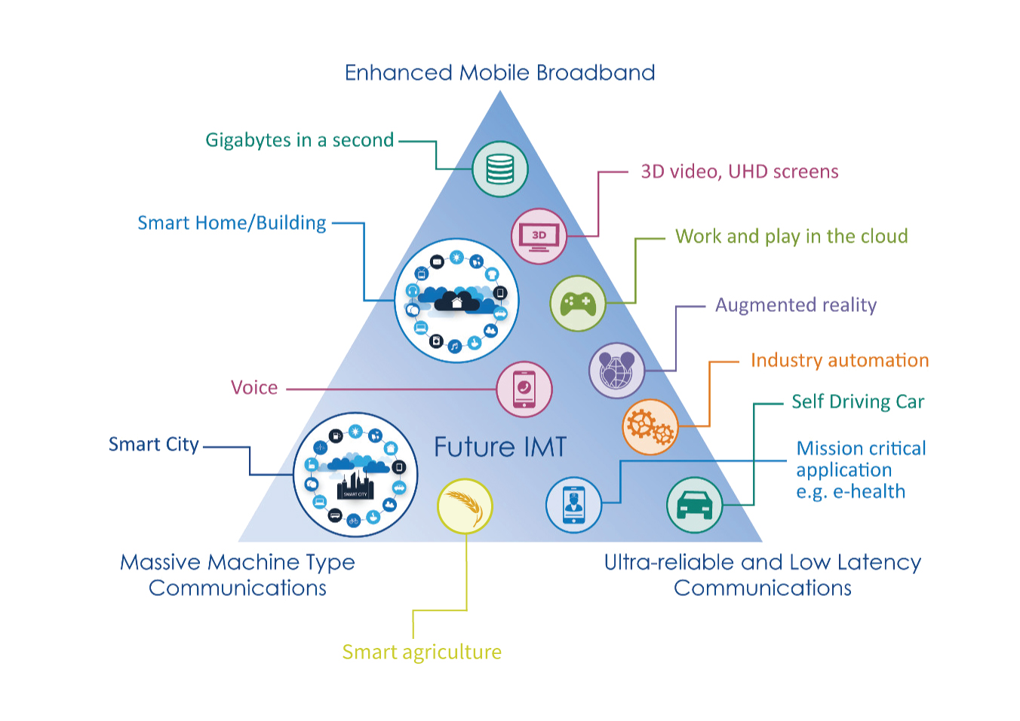
Bringing the work in to the groups
3GPP Specifications and Reports:
Requirements | 21 series
Service aspects ("stage 1") | 22 series
Technical realization ("stage 2") | 23 series
Signalling protocols ("stage 3") - user equipment to network | 24 series
Radio aspects | 25 series
CODECs | 26 series
Data | 27 series
Signalling protocols ("stage 3") -(RSS-CN) and OAM&P and Charging (overflow from 32.- range) | 28 series
Signalling protocols ("stage 3") - intra-fixed-network | 29 series
Programme management | 30 series
Subscriber Identity Module (SIM / USIM), IC Cards. Test specs. | 31 series
OAM&P and Charging | 32 series
Security aspects | 33 series
UE and (U)SIM test specifications | 34 series
Security algorithms | 35 series
LTE (Evolved UTRA), LTE-Advanced, LTE-Advanced Pro radio technology | 36 series
Multiple radio access technology aspects | 37 series
Radio technology beyond LTE | 38 series
3GPP Working Groups
Use Case diversity
High or Low data rates
Higher user mobility
Improved coverage
Overall System Goals
Enable new business
Greater efficiency
More flexibility – not one-size-fits-all

Slide 12
Timelines

Slide 13

Ongoing Release timelines
2021
2022
2023
2024
2025
2026
TSGs
#91-e
#92-e
#93-e
#94-e
#95-e
#96
#97-e
#98e
#99
#100
#101
#102
#103
#104
#105
#106
#107
#108
#109
#110
#111
#112
#113
#114
Mar.
Jun.
Sep.
Dec.
Mar.
Jun.
Sep.
Dec.
Mar.
Jun.
Sep.
Dec.
Mar.
Jun.
Sep.
Dec.
Mar.
Jun.
Sep.
Dec.
Mar.
Jun.
Sep.
Dec.
SA1 Stage 1
Note: All starting dates are indicative
RAN Content def.*
Stage 2 Normative
Release 18
RAN Completion**
Maint.*
Stage 3 (CT & SA)
Ex
ASN.1 & Open APIs
*: +3 months for RAN4
**: - 3 months for RAN1 &
+ 3 months for RAN4 perf
ASN.1
1st review
SA1 Stage 1
RAN Content Def*
SA St.2 Content Def
Release 19
Stage 2 Normative
RAN Completion**
Stage 3 (CT & SA)
Now
ASN.1 & Open APIs

Slide 14
Release 20 timeline
2024
2025
2026
2027
TSGs
#113
#114
#102
#103
#104
#105
#106
#107
#108
#109
#110
#111
#112
#115
#116
Dec.
Mar.
Jun.
Sep.
Dec.
Mar.
Jun.
Sep.
Dec.
Mar.
Jun.
Sep.
Dec.
Mar.
Jun
SA1 5GA SID definition
SA1 5GA Studies + Norm 80%
100%
St.2 SID def. TBD
St. 2 (SA2, SA6, …) 5GA St.+Norm 80%
100%
RP Content def.
RAN4 C.def.
RAN1
Rel-20 - 5GA part
RAN Completion (RAN2/3/4core)
RAN4 Perf
St.3 SID def. TBD
Stage 3 5GA St + Norm
5GA ASN.1 & Open APIs
SA1 6G SID def.
SA1 6G Study(ies)
Workshop IMT-2030 use cases
RP IMT-2030 disc.
RP ITU Study
RP 6G Study(ies)
Workshop 6G TSGs
SA2 & RAN WGs 6G SID def.
SA2 6G Study(ies)
or
RAN1 6G Study(ies)
SA3/4/5/6 SID def. and compl. TBD
Rel-20 - 6G part
RAN2/3/4 6G Study(ies)
Stage 3 6G SID def.
Stage 3 6G Study(ies)
Now
TBD

Slide 15

5G Advanced evolution towards 6G
6G Foundational Technology Explorations
6G pre-commercial interoperability testing and trials
    Foundational
    research
    Vision
    forming
    Service
    requirements
    Specifications
    Interoperability testing
    Trials
    Rel-22+
    Rel-21 (6G Work)
    3GPP 6G
    Workshop
    (Mar’25)
    Rel-20 (6G Study)
Next technology leap for new capabilities and efficiencies
Rel-20
Rel-19
5G Advanced
2nd wave of 5G
innovations
Continued 5G evolution in the 6G era
Rel-18
    WRC-23
    WRC-27
    WRC-31
2023
2024
2025
2026
2027
2028
2029
2030+
Notes:
3GPP 6G Workshop is projected to be at March 2025, followed by the study item. SA1 will study the requirements throughout Rel-19/20.

Slide 16
Next-generation broadband
Enhanced mobile broadband
Immersive platform and services
Societal sustainability
A smarter wireless platform to
support enhanced services and
new use cases
Mission-critical services
Massive IoT
Real-time control
Pervasive access
Spatial perception
Evolutionary dimension
Revolutionary dimension
Notes:
Make new vertices stand out more

Slide 17
System design targets for expanded 6G capabilities
Communication
AI & compute
System resiliency
Integrated sensing
Green network
Key Performance Indicators
Capacity
Data rate
Mobility
Coverage
Connection density
…
Inference accuracy
Model transfer latency
AI service roundtrip time
Compute capacity
Scalability / adaptability
…
Confidentiality
Integrity
Availability
Mean time to detect /
resolve / contain
…
Range
Confidence level
Sensing accuracy
Resolution
Latency
…
Network energy efficiency
Network carbon intensity
Carbon neutrality
ECO rating
Battery requirement
…
6G will be designed to meet enhanced traditional communication requirements as well as KPIs for new capabilities

Slide 18
3GPP SA4
Multimedia Codecs, Systems and Services

Slide 19
3GPP TSG SA WG4 (SA4)
SA WG4 – Multimedia Codecs, Systems and Services
Within the 3GPP Technical Specification Group Service and System Aspects (SA), the main objectives of the 3GPP TSG SA WG4 (SA4) are the specifications of codecs for speech, audio, video, graphics and other media types related to emerging services such as extended realities (XR) and gaming, as well as the system and delivery aspects of such contents.
These objectives includes defining content formats and delivery protocols for unicast, multicast and broadcast streaming, cloud and edge computing architectures, media APIs, media handling in multimedia telephony, terminal acoustics requirements and performance testing, end-to-end service performance, objective and subjective quality testing, quality of experience (QoE) metrics, definition of traffic characteristics for media services, reporting for all services involving media aspects, and the use of artificial intelligence and machine learning models for multimedia.
SA WG4 is currently responsible for the XR-based services and traffic characteristics, Next Generation Video for 5G, Media Distribution over 5G unicast/multicast and broadcast, Media Cloud and Edge Processing in 5GS, Glass-based Augmented Reality, VR conferencing, Immersive Voice and Audio Services and Extension for headset interface tests of UE.

Slide 20
SA4 participants (Nov. 2023)
Operators/Service providers: AT&T, Facebook/Meta, NTT, BBC, Verizon, Vodafone, Tencent, China Mobile, Orange, Telecom Italia, KPN, China Unicom, China Telecom, Rogers, USDoD, Deutsche Telekom, Douyin.
OEM/Chipset vendors: Qualcomm, Samsung, Xiaomi, MediaTek, Vivo, Apple, Panasonic, Futurewei, Lenovo, LG, Motorola, Oppo.
Network vendors: ATEME, Nokia, Ericsson, ZTE, Huawei, Intel, Convida, CableLabs.
Tech providers: Dolby, Interdigital, Fraunhofer IIS & HHI, ETRI, VoiceAge,
Labs/Test: Mesaqin, Head acoustics, DTS/Xperi, Philips, Pencheng labs.

Slide 21
Rel-18 Highlights for Specs
Immersive Codecs
  New 3GPP codec for Immersive Voice and Audio Services (IVAS)
  Media Capabilities for Augmented Reality (MeCAR)
Messaging, Streaming and Broadcast Delivery
  5G Media Streaming Phase 2 (Features and Protocols)
  5G-Advanced media PROfiles for MessagIng Services (PROMISE)
Communication Services
  IMS-based AR Conversational Services (IBACS)
  Immersive Real-time Communication for WebRTC (iRTCW)
  5G Real-time Transport Protocols (5G_RTP)
Split Rendering Technologies
  Split Rendering Media Service Enabler (SR_MSE)
  Immersive Audio for Split Rendering Scenarios (ISAR)
On top several studies have started that span into Rel-19

Slide 22
Initial Rel-19 Package for SA4
Acronym | Work item | Name | Rapporteur
FS_AI4Media | SP-220328 | Feasibility Study on Artificial Intelligence (AI) and Machine Learning (ML) for Media | Samsung, Tencent
FS_AVATAR | SP-230544 | Feasibility Study on Avatars for Real-Time Communication | Qualcomm
FS_DaCED | SP-221330 | Feasibility Study on Diverse audio Capturing system for End-user Devices | Xiaomi
FS_FGS | SP-230539 | Feasibility Study on Film Grain synthesis | Dolby
FS_AMD | SP-240514 | New Feasibility Study on Advanced Media Delivery | Qualcomm, Tencent
FS_MeMe | SP-240477 | New Feasibility Study on Media Messaging | Qualcomm
VOPS | SP-240060 | New WID on immersive HEVC profiles and operating points | Apple, Qualcomm
FS_MediaEnergyGREEN | SP-240481 | New Feasibility Study on Media enerGy consumption exposuRE and EvaluatioN framework | Orange
SR_IMS | SP-240061 | WID on Split Rendering over IMS | Nokia
FS_5G_RTP_Ph2 | SP-240482 | SID on 5G Real-time Transport Protocol Configurations, Phase 2 (FS_5G_RTP_Ph2) | Nokia
FS_ACAPI | SP-240480 | New SID on Audio Codec APIs | Fraunhofer
FS_Beyond2D | SP-240479 | Draft New SID on Beyond 2D Video | China Mobile

Slide 23
5G-MAG and 5G Broadcast updates

Slide 24
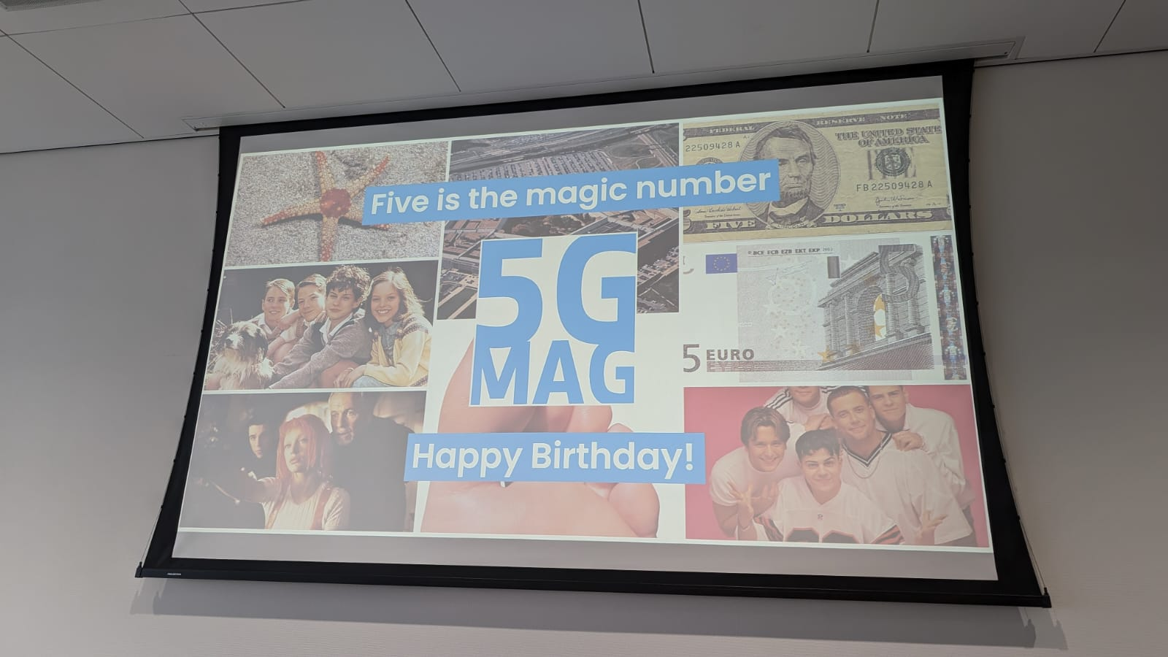

Slide 25



















Mobile TV - Finally?
Where: Main IBC Conference Center Room E102
When: Saturday, September 14, 11:45 - 13:00
https://bts.ieee.org/conferences-events/bts-international.html

Slide 26
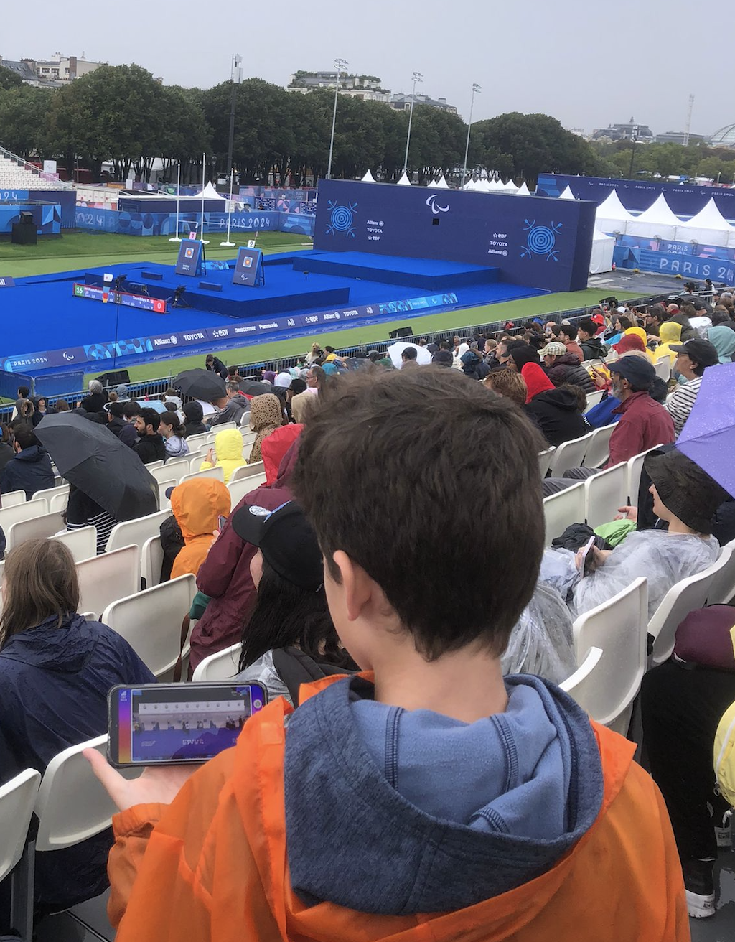

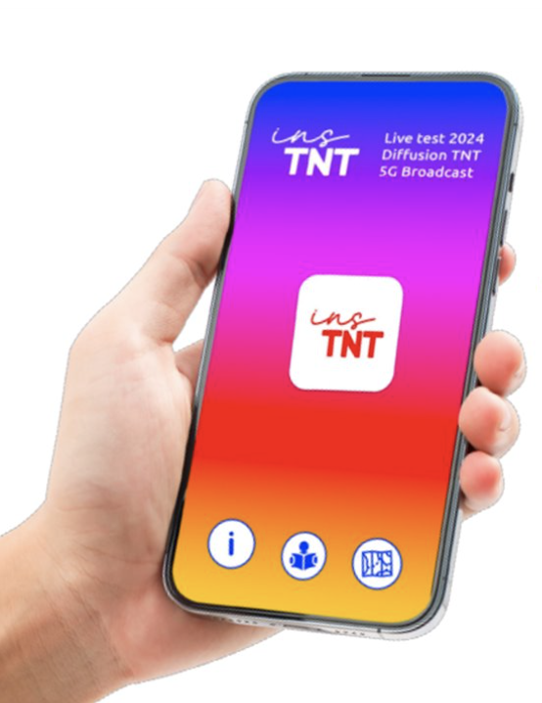



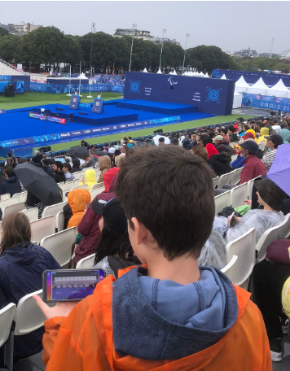
A France premiere… and a world premiere too !
Friendly users
1
A running Live Test during Olympics with several objectives :
  A large coverage: Paris, Bordeaux, Nantes
  An end-to-end architecture
  ~150 Xiaomi smartphones distributed to the ecosystem
  The brand insTNT
150
0
devices
Return in
Sept./Oct.
2
Pop up store
devices
20
Street
demo

Slide 27







TDF roadmap for France
UHD roll out in 2024 with adoption driven by Olympics Games
5G Broadcast roll out from 2028 in Exp. MUX then in another MUX to scale up with market adoption
2023
2024
2025
2026
2027
2028
2029
2030
SWITCH MUX
EXPERIMENTAL
MULTIPLEX
Free TV
channels
UHD T2/HEVC
Free TV channels
5G Broadcast
SWITCH MUX
1 PAY TV
MULTIPLEX
Pay TV channels
SD/HD
Free TV channels
5G Broadcast
5 Free TV
MULTIPLEX
Free TV channels
HD
Free TV channels
HD+ / UHD
SWITCH MUX

Slide 28
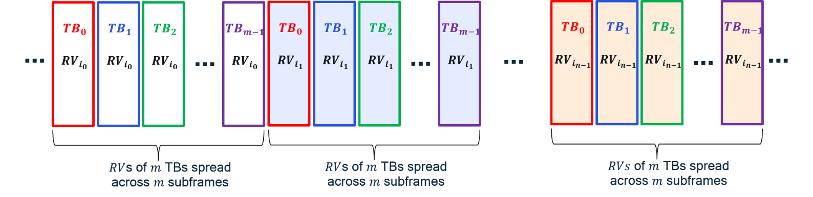
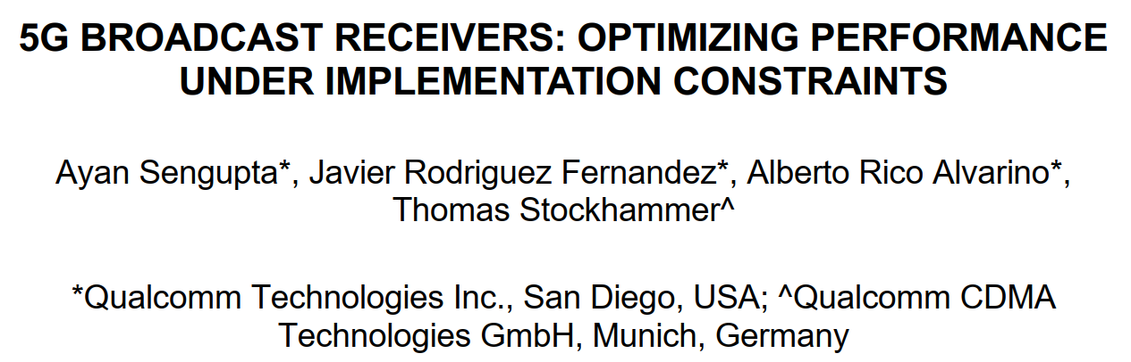







Recap IBC 2023: 5G Broadcast, 3GPP and cellular modems
Not approved in Sep RAN105 plenary due to other prioritization in 3GPP – but expect specs by end of the year
The big picture
Broadcasting technologies traditionally use time & frequency interleavers to harness diversity
  3GPP cellular technologies “don’t need to” rely on interleavers due to additional diversity sources (e.g. HARQ feedback/retransmissions, spatial diversity, etc.)
Last year, we focused on
  1- How we could create “3GPP-modem-friendly” time and frequency interleavers
  2- How interleavers improve 5G Broadcast performance in different mobility scenarios
Time interleaver
Frequency interleaver
3GPP Modem
CP
CB $C$
Write row-wise
Read
col-wise
CP
Block $B/C$
…
…
UHF band support
CB 3
Block 2
CB 2
$C$ rows
Block 2
CB 1
$M$ input tones
Block 1
$M/C$ columns
$M$ interleaved OFDM tones

Slide 29
IBC 2024: Sharing UHF Resources with legacy broadcast systems
Frequency Division Multiplex (FDM) on different carriers (see paper) or Time Division Multiplex (TDM) on the same carrier
min_time_to_next = [50ms; 5300ms]
ATSC3.0 supports blanking
Bootstrap | Preamble | ATSC Frame |  | Bootstrap | Preamble | ATSC Frame
DVB-T2 support Future Extension Frames
1st FEF frame
(up to 250 ms T2-Base / 1s T2-Lite)
1st DVB-T2 frame
2nd DVB-T2 frame
P1
P2
# 0
Data
# 0
Data
# 1
Data
# 3
P1
FEF Data
P1
P2
# 0
Data
# 0
Data
# 1
Data
# 3
P1
FEF Data
FEF frame starting with P1 symbol
TS 103 720 v1.3.1 expected to support CAS muting
5GB
CAS-muted region
CAS
PMCH
# 0
PMCH
# 1
…
CAS
CAS-muted region
CAS
PMCH
# 0
…
SIB-indication

Slide 30
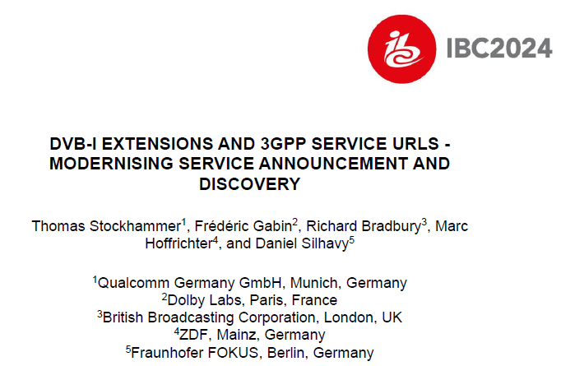



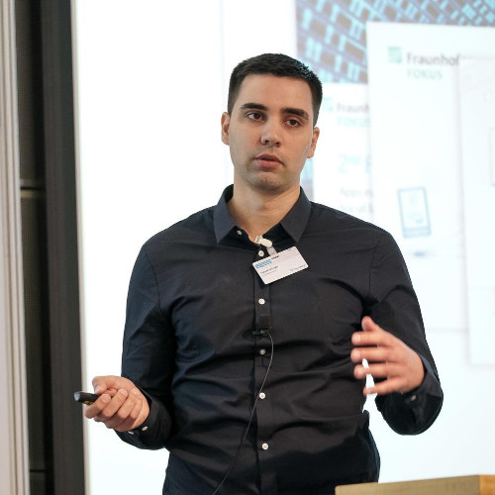

Slide 31
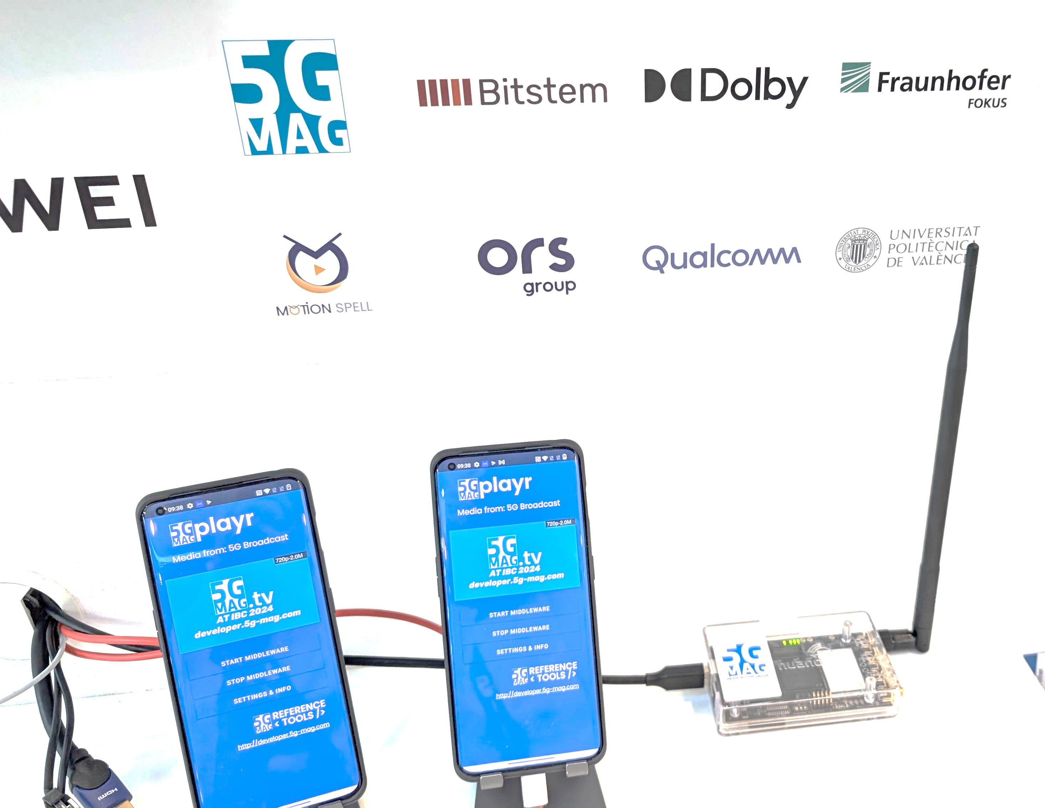
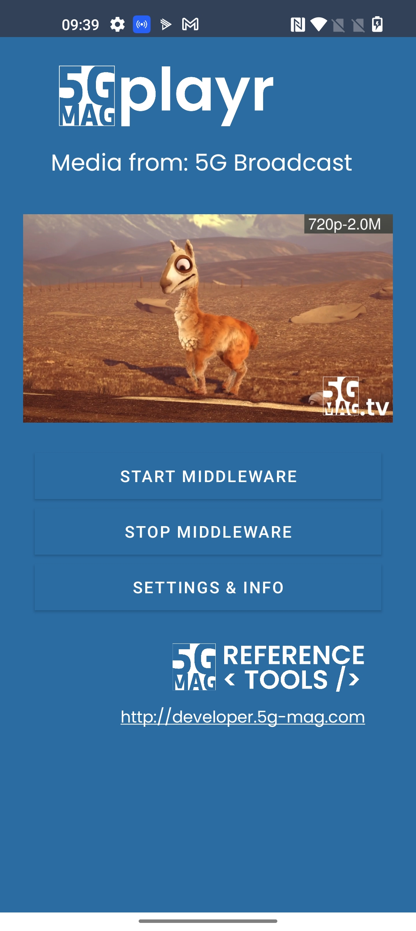
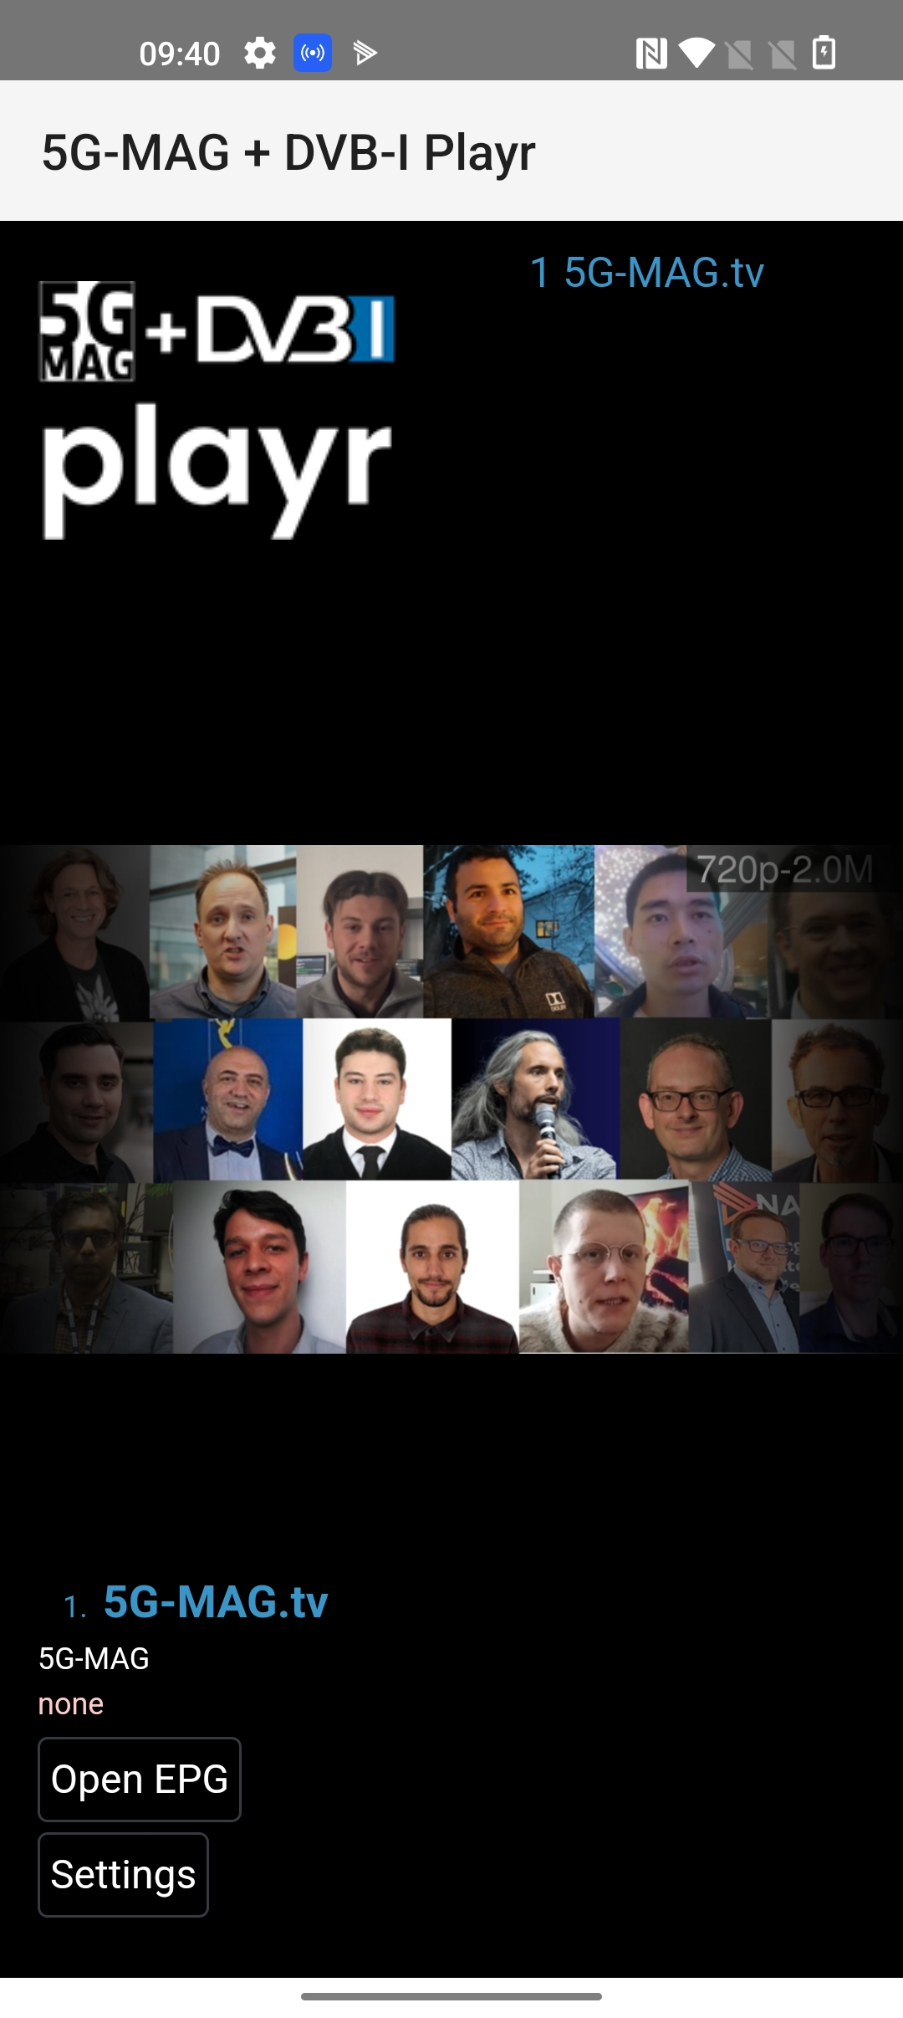
DVB-I over 5GBC
Booth 1.B71
5G Broadcast as part of the internet delivery chain

Slide 32


Next Version of ETSI TS 103 720
Milestone name | Target date
TB adoption of WI | 2024/08/31
Early Draft | 2024/12/31
Stable Draft | 2025/03/31
Draft for approval | 2025/04/15
TB approval | 2025/06/30
To be published as version: | V2.1.1 or v1.3.1
Expected to include
  bugfixes and corrections based on feedback from implementors.
  extensions to address new developments in 3GPP and the industry.
Corrections and bugfixes
  Encourage submission of issues here: https://github.com/5G-MAG/Standards/issues
  https://github.com/5G-MAG/Standards/issues?q=is%3Aopen+label%3A%22ETSI+TS+103+720%22+sort%3Aupdated-desc
New functionalities
  Identified through work items from 5G-MAG
  New 3GPP developments, in particular as part of Rel-18
Identified Work Topics by 5G-MAG
  DVB-I over 5G - add details to TS 103 720
  Band support for receivers including Band 108.
  5G Broadcast as PWS Improvement
  Concurrent support of 5G Broadcast and 5G Unicast
  ETSI TS 103 720 V1.2.1 - Delivery of Warning Messages from MME to eNodeB
  Support of time-frequency interleaving (for improved performance in time/frequency selective channels)
  Support of coexistence with other broadcast technology in the same radio channel by TDM (for “soft refarming” and regulatory requirements)
  Clarification on features on handsets in Europe
Other Potential topics: Service URL, low-latency, DRM, device APIs and interfaces, combination with unicast
Other candidates: TFI, CAS muting, MBS Service layer, Unicast enhancements, player optimizations

Slide 33
Next-generation broadband
Enhanced mobile broadband
Immersive platform and services
Societal sustainability
Green network
Integrated sensing
System resiliency
AI & compute
Communication
A smarter wireless platform with
new capabilities that expand beyond communication
Real-time control
Mission-critical services
Massive IoT
Pervasive access
Spatial perception
Evolutionary dimension
Revolutionary dimension
Notes:
AI / Compute – TOPS, life cycle mgmt., Adaptability

Slide 34








Fundamental 6G motivation
Operators networks
Increasing revenue with new use cases/services
Reducing network TCO (total cost of ownership)

Slide 35


Enhanced and New Experiences
Sustainability
Advancements in underlying technology, new services enabled by them & a holistic look at sustainability will drive the 6G design

Slide 36
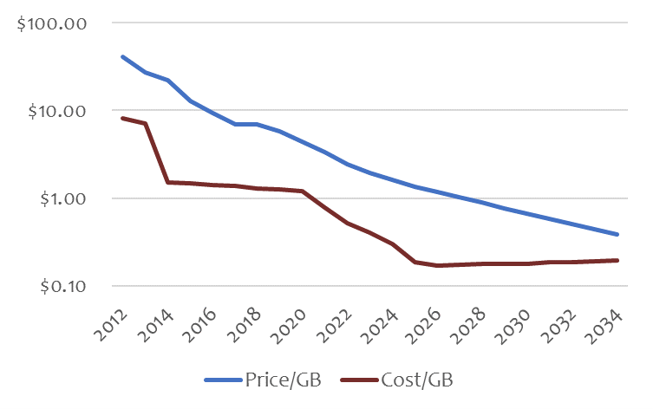
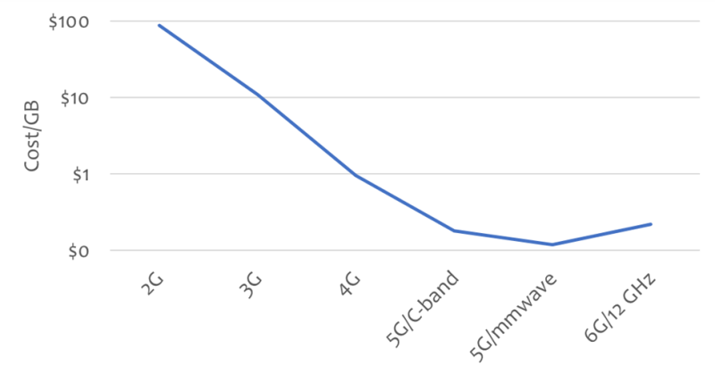
Trouble ahead: 6G cost per GB may pose problems
https://www.fiercewireless.com/tech/trouble-ahead-6g-cost-gb-may-pose-problems-madden
In 2014, after the introduction of LTE, the American telcos spent about $0.96 per GB to deliver data, but charged more than $10 per GB....a 10:1 ratio ➔ allowed the operators to offer ‘unlimited’ plans because the cost of delivery was so much smaller than the revenue created
Today, the cost has dropped to $0.30 but the retail price per GB is down to $2. By 2028, the retail price will drop below $1/GB, but the operators will have very few ways to reduce cost, and their costs are likely to remain in the range of $0.30 ➔ 3:1 ratio

Slide 37
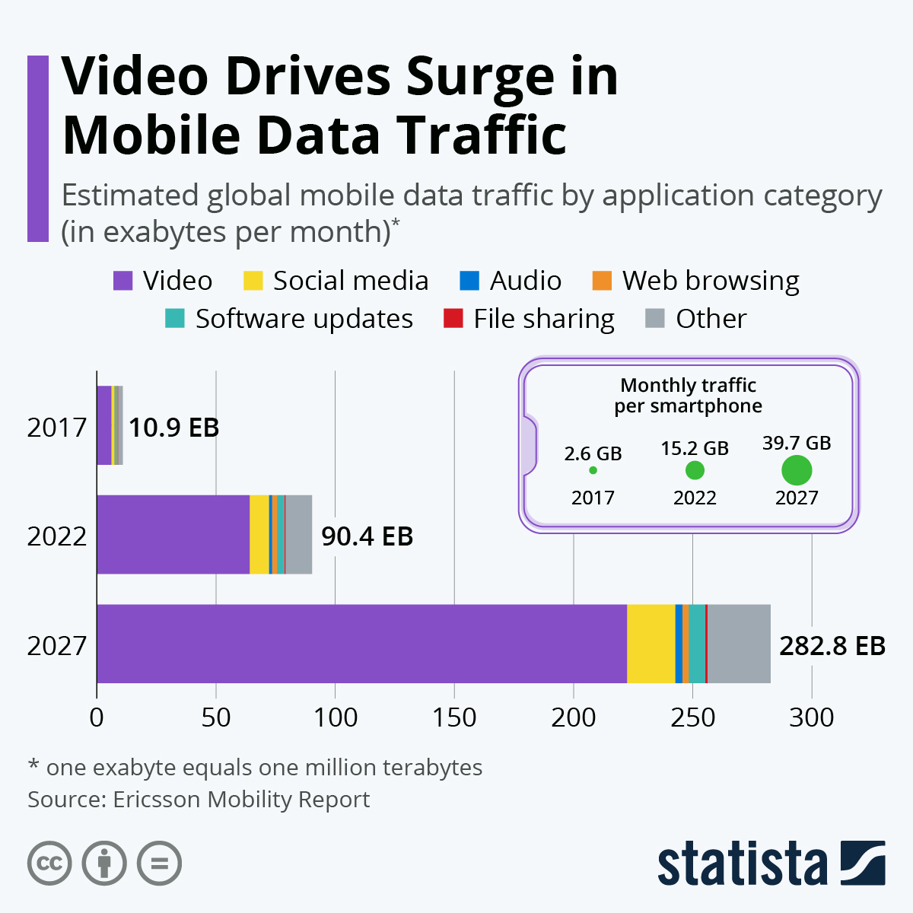
Cost Reduction Example 1: Video Delivery
Provide technologies for operators and service provider to invest in cost saving technologies
Data points
  At the end of 2023, video traffic is estimated to account for 73 percent of all mobile data traffic (Ericsson Report)
  With 97 percent, video traffic has significantly more downlink than uplink traffic (Ericsson Traffic Analysis)
  Video content to account for almost 80 percent of mobile traffic, which is projected to triple in the next five years.
The cost of video delivery needs to be reduced
Potential objective for 6G
Potential Technologies:
  New codecs, AI, Smart delivery, Monetization, New KPIs, Energy Saving
Collaboration between Media Service provider and MNO
Amortization of the MNO loss on Gbyte 10:1 ➔ 3:1 needs to be addressed for video delivery (80% of all traffic)

Slide 38






Cost Reduction Example 2: Global universal Media Delivery Platform
Continue and accelerate the integration of Media Verticals to 3GPP global delivery platform – economy of scale
Unified technology – many emitters can access many devices
Media Service providers focus on services rather than delivery
6G Platform
(including previous G technologies)
FWA

Slide 39
Lessons learned from 5G: verticals
Important to avoid duplication of work vs what already exists
(1) Focus on requirements first
  Identify very specific requirements for the 6G version of a new vertical
(2) Once requirements are identified, perform a gap analysis vs the 5G/5G-Advanced version
  What is missing?
    Are there commercially available products for the 5G/5G-A version?
    Does the extent of what is missing / gain in performance justify a redesign from scratch?
    Could one just evolve the “5G version” of that vertical (thus preserving compatibility) and rebrand it “6G”?
(3) Consider stickiness & replacement rate of the vertical
  Verticals work under different timelines compared to smartphone industry (vs. 3GPP Releases cycle)
Concrete examples based on 4G-5G transition to learn from
  5G Massive IOT and 5G Broadcast were “based” on solutions developed during the 4G era following a gap analysis => duplication was avoided
  NR V2X was developed very rapidly, before LTE V2X could gain adoption => Some perception of fragmentation was created

Slide 40
Some more thoughts wrt to Media & 5G-MAG
To be refined and improved
Verticals & RAN
  Early RAN design consideration for verticals such as Broadcast, NTN, Production
  – even if not addressed in first release, ensure extensibility, not an afterthought
  Examples: Time Frequency Interleaver, Multiplexing with legacy broadcast, UHF band support, channel bandwidth
3GPP should be well-recognized for important media-related specifications, including
  Developer-friendly: APIs, code, examples, git-environments, exchange with developers
  Implementability of the specifications (test, evaluation, code, reference software)
  addressing market needs, deployment feasibility, sustainability, innovation platform, monetization opportunities, cost-conscious
  Timeliness: allow things to do quicker, do things at the right time, leave time to address essential work
  Develop specifications against meaningful KPIs for media services
  Collaboration with the industry and market representation partners
  Generally, build on the principles established in the 5G era and evolve based on experiences and learning
Media Delivery Architecture and Services
  build on existing architectures: 5G Media Delivery Architecture and IMS
  No revolution, but evolution and adaptation to 6G core, radio and design principles
  Support foundational technologies such as cloud, AI, virtualization, orchestration, split processing ➔ develop more use cases
  Create enablers for richer media experiences (Media Service Enablers), but not full services

Slide 41
Based on our thoughts we look forward to collaborate on shaping requirements for 6G

Slide 42
You are in safe waters with 3GPP

