Slide 1

Latest on 5G Broadcast and Media Delivery Standardization
June 11, 2024
Media Web Symposium, Berlin, Germany
@qualcomm_tech
Dr. Thomas Stockhammer
Senior Director Technical Standards
Qualcomm Technologies

Slide 2




Today’s agenda
# 5G Broadcast – where do we stand
# Triggers for new Standardization Projects
# Rel-18 and Rel-19 News
# Early thoughts on 6G
Presenter
Dr. Thomas Stockhammer
Senior Director, Technical Standards
Qualcomm Europe, Inc., IEEE Fellow
Leading and driving among others
DVB: 5G TF, DVB-I
MPEG: MPEG-I, CMAF and DASH
3GPP: XR over 5G, 5G Video, 5GMS
DASH-IF: Interop WG, Test
ETSI & 5G-MAG: 5G Broadcast and 5GMS
CTA WAVE: CMAF Device PB, Test
Metaverse Standards Forum: Chair, Board

Slide 3
5G Broadcast – Core Features for multiple use cases
SIM-less reception with simplified architecture
Receive-Only Mode (ROM) & Free-to-Air (FTA)
Different spectrum options (e.g. UHF, SDL), as well as SFN/MFN
Various deployment possibilities (e.g. MNOs, BNOs)
Using existing infrastructure (HPHT, MPMT and LPLT)
Highly flexible velocities (up to 250 KM/h Vs up to 300 µS)
Can be combined with existing 4G and 5G features (unicast, PWS)

Slide 4
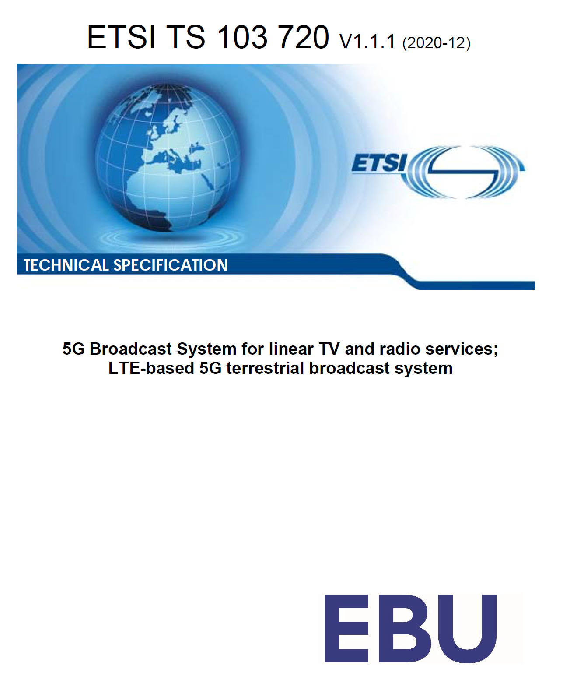
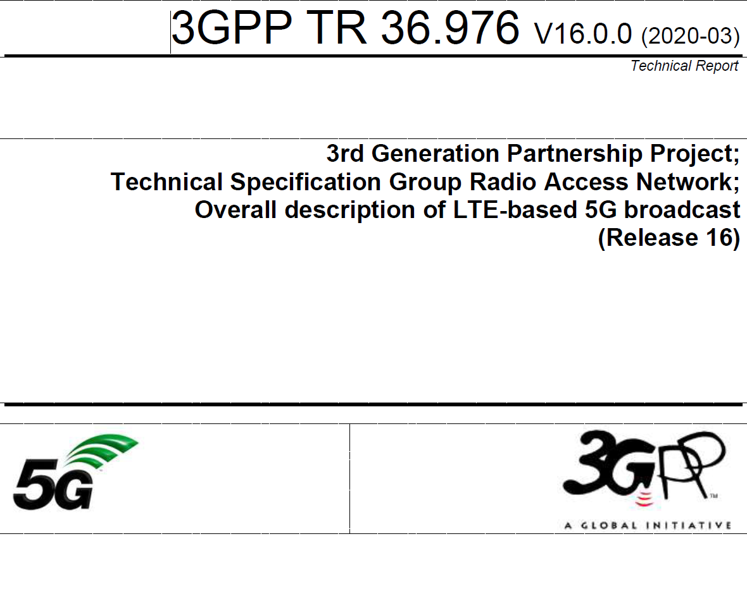
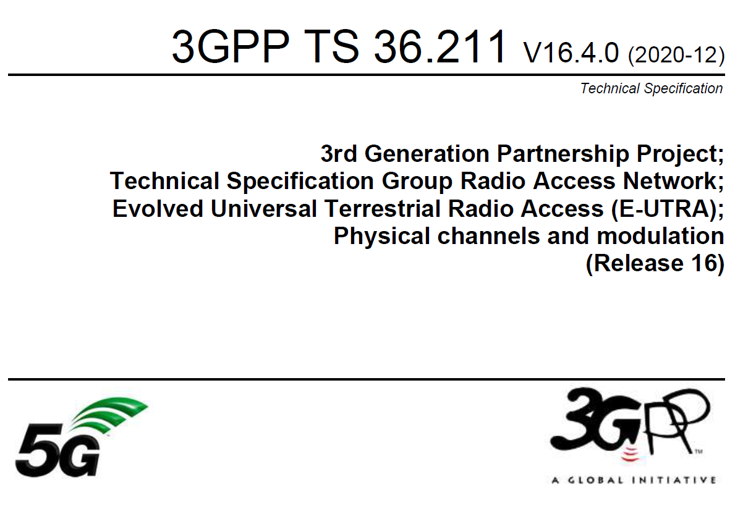
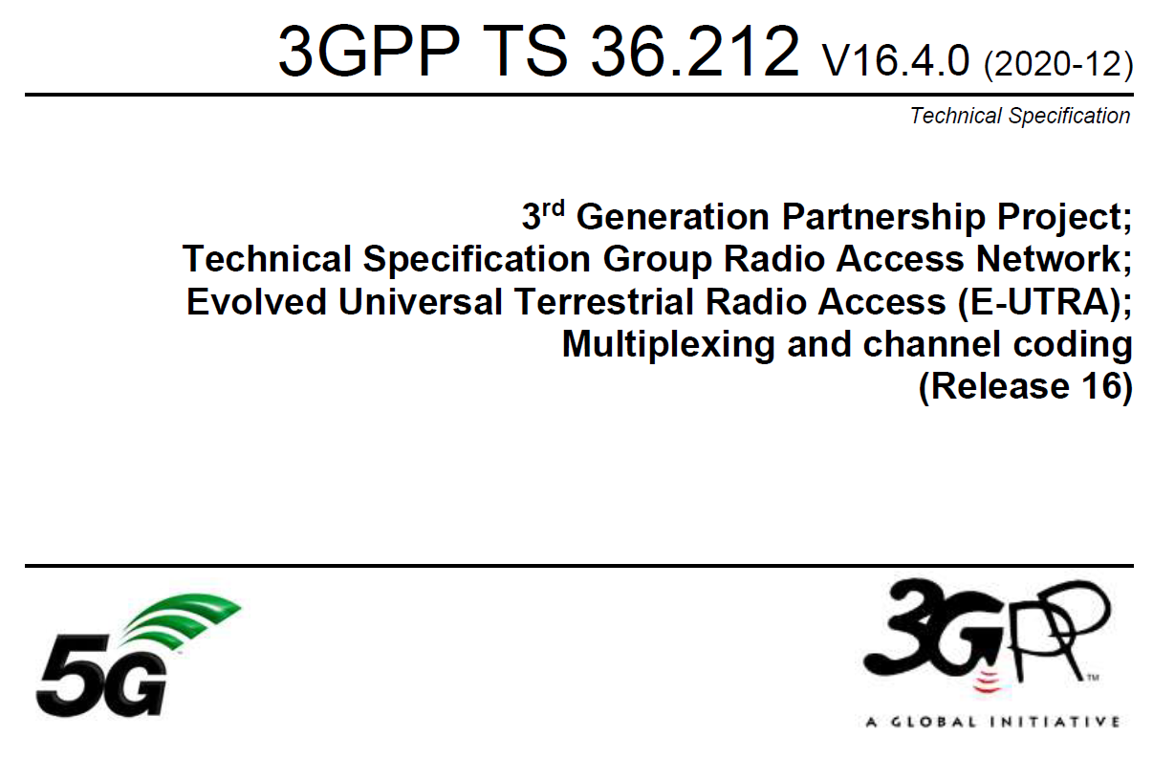
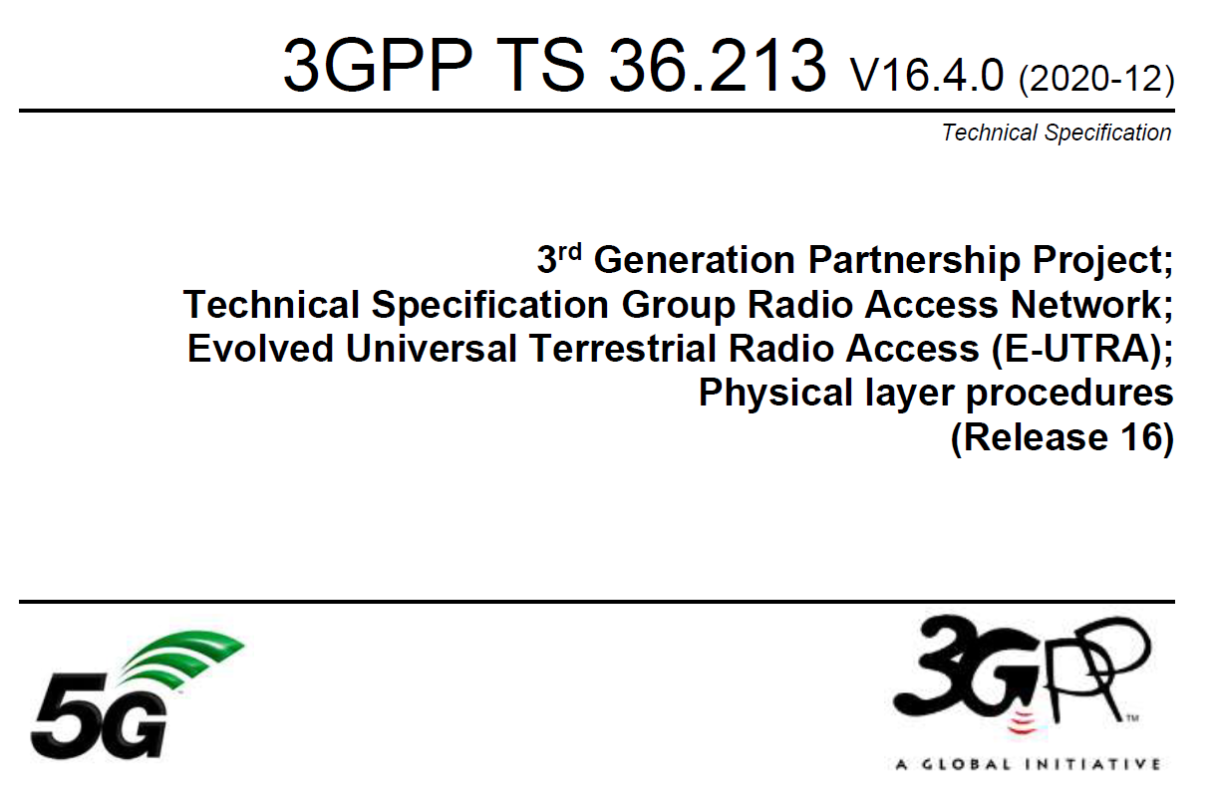
ETSI TS 103 720: Profile of 3GPP specification containing the necessary parts to deploy 5G broadcast
TR 36.976: Overall description of enhanced TV (enTV) for 5G broadcast
For more information on 5G broadcast standards…
Various specifications of 5G PHY supporting broadcast together with unicast in TS 36.211, 36.212, 36.213

Slide 5
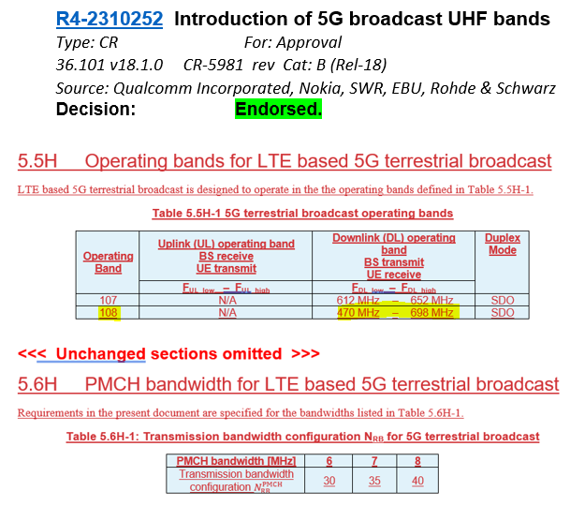
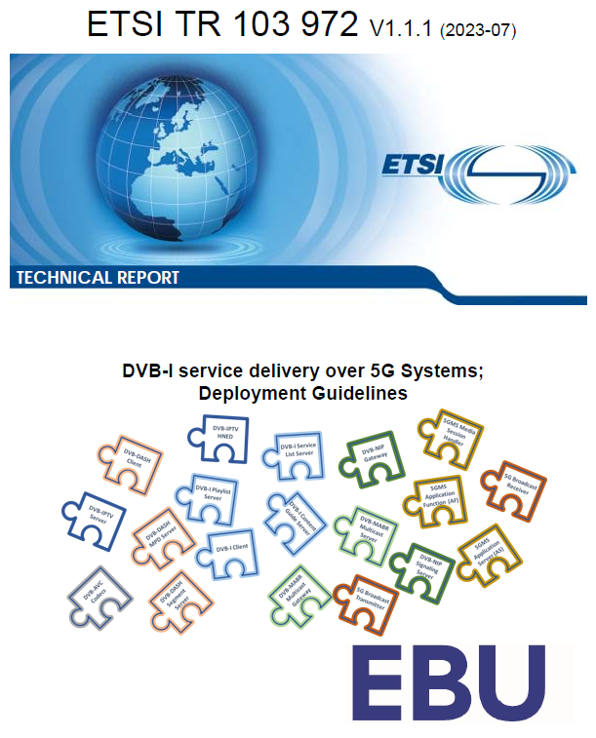
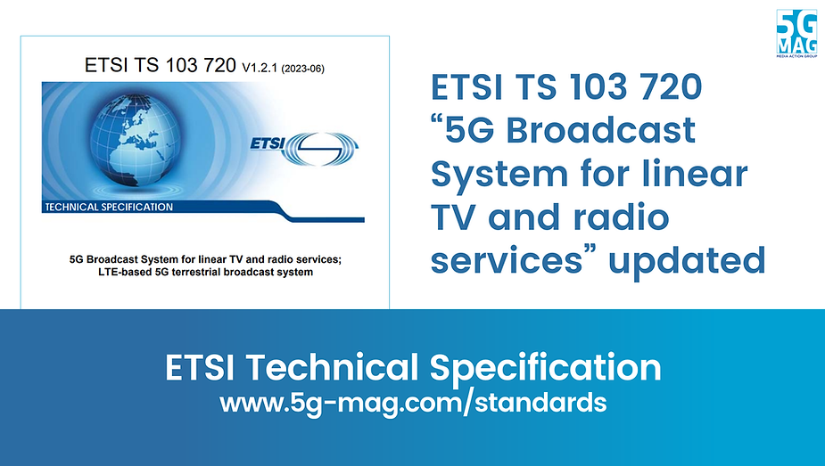
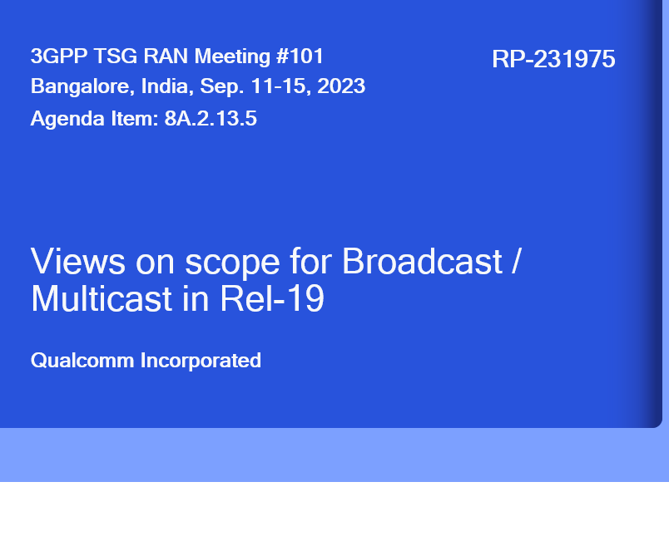
5G Broadcast Standards Evolution
Rel-14
SCS1.25KHz/ CP=200µs Mobility up to 120 km/h
5G BC worldwide standard
TG6/1 and WP6A
Rel-16
Rooftop Mobility up to 250 km/h
5G BC is an EU standard (ETSI TS 103 720)
Rel-17 Enhanced BW= 6/7/8 MHz for UHF
Enhanced Version of ETSI TS 103 720v.1.2.1
Where do we stand?
ETSI 5G-MAG
3GPP
ITU
3GPP
ETSI
3GPP
2017
2019
2020
2020
06/22
06/23

Slide 6
Some triggers for new standardization efforts

Slide 7
Significant interests towards 5G broadcast deployment worldwide
Denmark
Tour de France 22 powered by 5GB
Italy
Germany
2018-23: TV delivery with Rel-14/16 HPHT in Aosta and Turin
Russia
2024: European Championship
2020-22: 5G Media2Go Stuttgart/Heilbronn
2017-20: 5G Today in Bavaria
Finland
2022+: 5G Broadcast under investigation as latest broadcast technology
Belgium
2019-22: TV delivery with Rel-14/16 HPHT in 3 sites
CZ
2022-24: 5G BC imec.icon project with 2 HPHT sites
2020-23: Distribution of TV/Radio in Prague
South Korea
UK
Austria
Late 2021: Distribution of live TV using Rel-16 enTV near Seoul
2020-22: VISTA Project with O2 Virgin Media
2020-23: Distribution of TV/Radio with 5G BC Rel-14/16 , with eMBB in Vienna
Europe
France
2023: European broadcasters ink 5G Broadcast MoU
2018-2022: Live testing of 5G BC in Paris
2024: Olympics
Greece
US
2021-23: Live TV/Radio with 5G BC Rel-14/16 , with 3MHz in Athens
2020+: Growing interest in 5G BC in addition to ATSC3.0
2023: FCC Approves A Low Power TV Station To Broadcast Over 5G Networks
2023: First 5G Broadcast in the US and first 24/7 5G Broadcast globally
2024: Foundation of 5G Broadcast Collective
Croatia
2022-24: Live 5G BC Rel-14/16
Philippines
2019-22: Direct to mobile Live TV/Radio in Manilla
Spain
Algeria
2020: Distribution of free-to-air linear radio and TV using Rel-14 enTV with HPHT in Barcelona
2022 & 2023: MWC demos
Malaysia
Brazil
2022: Interest towards 5G BC during Mediterranean Games
2024: Report completed – next steps are trials
2020-23: TV 3.0 project calling for proposals
2019-24: AIB project based on 5G Broadcast under the administration of NRTA¹ and ABS²
2023: 5G Broadcast Chengdu pilot project formally kicked off on July 20th
GATIS' Global 5G Broadcast Summit
Colombia
India
2020-21: Delivery of TV and radio with Rel-14 broadcast trial deployment in Santiago de Tolú
South Africa
2020+: Growing interest in latest broadcast³ technologies
2023: Discussion on DTM strategy based on market feedback
2019-20: Live testing of Rel-14 in Johannsburg
China
¹ National Radio and Television Administration ² Academy of Broadcast and Science commercia potential ³ Prasar Bharti working jointly with IIT Kanpur on Next Generation Broadcast Technology

Slide 8


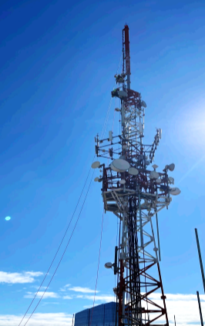
First 5G Broadcast in US
July 14th 2023 - FCC granted experimental license for 5G broadcast
Sep 13th 2023 – Station went on air and started 24/7 re-broadcast of FranceTV
Full leverage of existing infrastructure with no change in freq, antenna, power output
Successful indoor –stationary and outdoor – stationary and mobile reception with 8650 QRD units
Next steps: presentation to FCC, additional licenses for another 5-10 stations
Also emergency notification, first responder live trial, datacasting use cases
NAB 2024: Foundation of 5G Broadcast collective https://5gbc.tv/

Slide 9

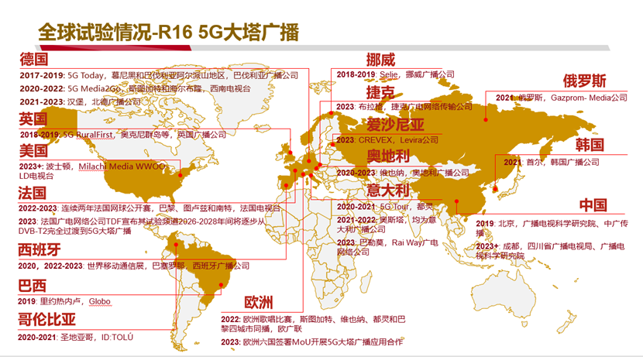
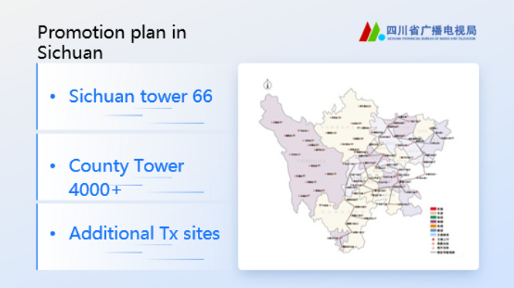
China Status
https://www.5g-mag.com/post/27-10-23-5g-mag-participates-at-gatis-summit
Chinese and international experts and scholars from Beihang University, Communication University of China (CUC), 5G-MAG, EBU, ORS, TDF, XGN, Rohde & Schwarz (R&S), Qualcomm, Xiaomi, vivo, Chengdu Kaiteng Sifang and Beijing BBEF Science & Technology
Sichuan has initiated the first trials and deployment of 5G Broadcast.
Regional broadcasters show great interests to duplicate the demo to verify & demo the 5GB services in their own network. Guangdong already asked, Guangxi is in the line, Shanxi also asked during the meeting, more requests are on the way.
ABS supports them together with domestic infra vendors and OEMs to launch pre-commercial trials

Slide 10
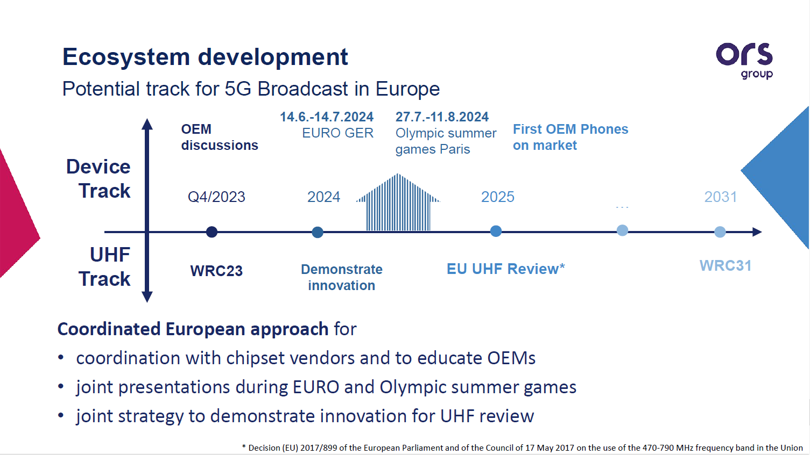
ARD tests 5G Broadcast during Euro 2024 and Olympic Games
Media Broadcast to run 5G Broadcast pilot project in Halle

Slide 11






ATSC3.0 the only reasonable course as the underlying nature of D2M
I have a regulatory requirement to distribute some ATSC signal on my broadcast carrier
How can we launch 5G Broadcast emergency services?
B107 is not sufficient, I need the entire UHF band defined in 3GPP
5G Broadcast and unicast combined is a MUST including low latency
I am building a DVB-I large scale trial. How can we add 5G Broadcast?
What features will be included in the first set of commercial chipsets?

Slide 12






Target Organizations

Slide 13
Next Version of ETSI TS 103 720
Milestone name | Target date
TB adoption of WI | 2024/08/31
Early Draft | 2024/12/31
Stable Draft | 2025/03/31
Draft for approval | 2025/04/15
TB approval | 2025/06/30
To be published as version: | V2.1.1 or v1.3.1
Expected to include
bugfixes and corrections based on feedback from implementors.
extensions to address new developments in 3GPP and the industry.
Corrections and bugfixes
Encourage submission of issues here: https://github.com/5G-MAG/Standards/issues
https://github.com/5G-MAG/Standards/issues?q=is%3Aopen+label%3A%22ETSI+TS+103+720%22+sort%3Aupdated-desc
New functionalities
Identified through work items from 5G-MAG
New 3GPP developments, in particular as part of Rel-18
Identified Work Topics by 5G-MAG
DVB-I over 5G - add details to TS 103 720
Band support for receivers including Band 108.
5G Broadcast as PWS Improvement
Concurrent support of 5G Broadcast and 5G Unicast
ETSI TS 103 720 V1.2.1 - Delivery of Warning Messages from MME to eNodeB
Other Potential topics: Service URL, updated receiver requirements, deployment receiver profile, RAN-only profile, low-latency distribution, DRM
Be aware of ongoing and discussed work for Rel-19: TFI, CAS muting, MBS Service layer, Unicast enhancements

Slide 14
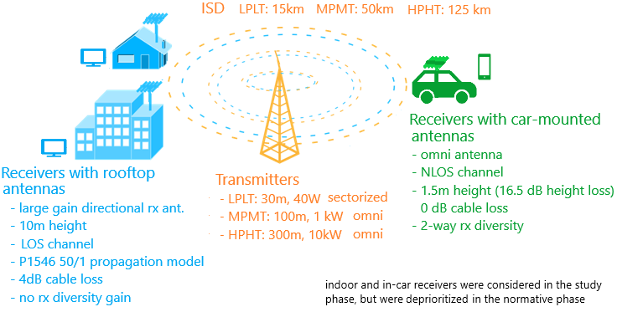



RAN: MBMS ➔ 5G Broadcast Evolution
Release 17/18
Release 16
6/7/8 MHz channel bandwidth to support common global channel bandwidth for broadcast systems
Introduction of UHF Band 108 to address RF transmitter and receiver requirements
Release 14
New numerologies to target rooftop reception with up to 125 km ISD
High mobility reception: fixed, portable and mobile receivers up to 250 km/h
Enhancements to CAS—increased PDCCH agg. Level, PBCH repetition, CFI in MIB
Release 13
Longer cyclic prefixes for support of larger ISD
Up to 100% of subframes for MBSFN transmission on a dedicated carrier
Subframes fully dedicated to MBSFN transmission
Targeting rooftop and car-mounted antennas, handheld receivers
Release 9
Single-cell transmission (SC-PTM)
Transmission on PDSCH with new group identities
Non-synchronized transmitters
Mixed unicast/MBMS carrier
15 kHz numerology
Extended CP of 16.7us
Multi-cell transmission only (MBSFN)
Up to 60% of subframes for MBSFN transmission
> 15 km
“Operator controlled” MBMS
“Broadcaster controlled” MBMS

Slide 15

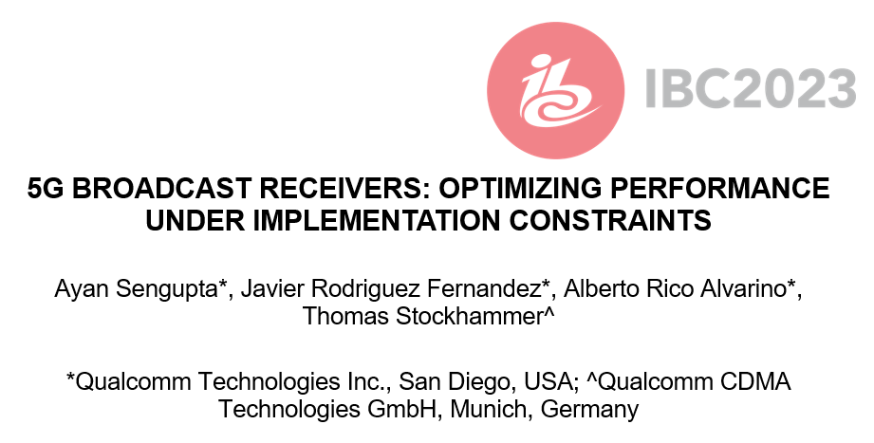


Details of the paper
Session and Recording

Slide 16
Summary and Conclusions of Paper
5G BROADCAST RECEIVERS: OPTIMIZING PERFORMANCE UNDER IMPLEMENTATION CONSTRAINTS
Broadcast networks and usage of configurations needs to be done for worst-case scenario.
For example, gains achieved in the 120 kmph scenario may not relevant, if such a planning would fail to serve a large number of receivers moving at lower speeds.
In this case, comparison between 5G broadcast and ATSC3.0 is provided for NLOS for different speeds and configurations
The main design target & “reason for being” of 5G broadcast is to enable operation of a broadcast network where the receivers are hardware-compatible with cellular modems
“Hardware compatible” means lower barrier to adoption in mobile devices compared to other broadcasting technologies
Several 5G Broadcast building blocks are already there in a 4G/5G modem, hence the additions are marginal.
For other technologies, a separate piece of silicon / die area would be required
In comparison with unconstrained broadcast designs, 5G Broadcast Rel-18 is only marginally worse
Address remaining gaps in Rel-19 without compromising the design goals implementing a Time-Frequency Interleaver re-using HARQ procedures
SNR for | ATSC 3.0 + 1Rx | ATSC 3.0 + 2Rx | 5G + 2Rx | 5G + 2Rx + TFI
3 kmph | 14.4 dB | 8.7 dB | 10.7 dB | 8.9 dB
40 kmph | 11.2 dB | 6.6 dB | 10.9 dB | 7.3 dB
120 kmph | 10.8 dB | 6.2 dB | 11.4 dB | 7 dB
Worst case | 14.4 dB | 8.7 dB | 11.4 dB | 8.9 dB

Slide 17
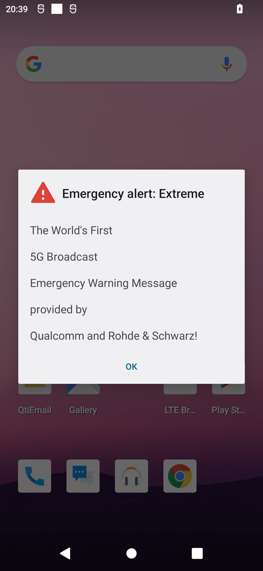
Emergency alerts
5G broadcast inherits from 5G the public warning system capabilities.
The Cell Broadcast Service (CBS) does not require authentication with a PLMN. Hence, a ROM network is inherently compatible with CBS (see 3GPP TS 23 041).
CMAS (commercial mobile alert system) is available in current commercial devices.
Devices monitor periodically a low-duty cycle paging channel (low power)
CMAS over 5G broadcast has been demonstrated with R&S infrastructure
Additional capabilities of CMAS:
Geofencing (send notification to users within a given area)
Possibility of sending URL linking to emergency media

Slide 18

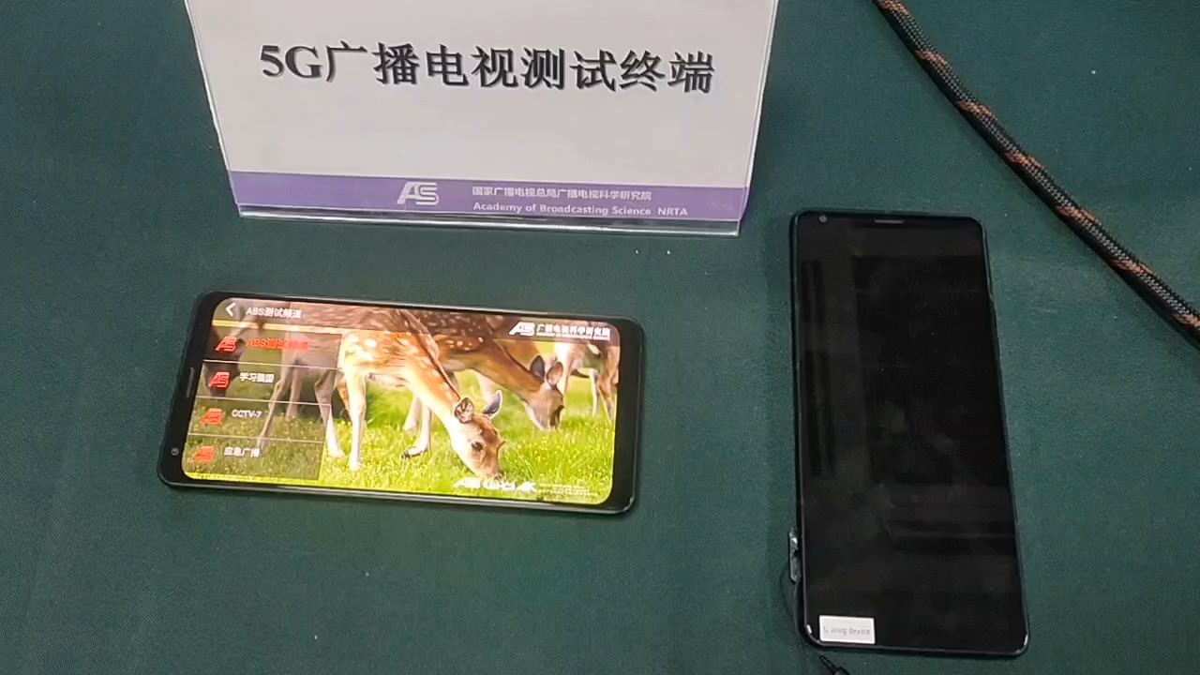
Emergency message demo with ABS
Self-contained emergency system (text + multimedia) without need of unicast.

Slide 19
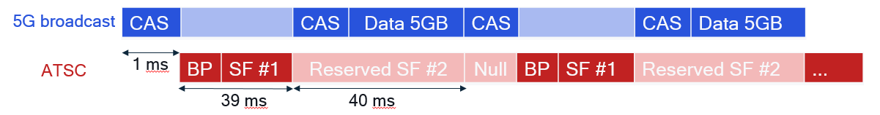
Coexistence of ATSC 3.0 & 5G Broadcast
ATSC 3.0 & 5G Broadcast can coexist: it does not have to be a either/or
5G Broadcast can be deployed by broadcasters in the exact same way as ATSC, and it greatly lowers the barrier to adoption in mobile devices since it is “only” an incremental feature to the 4G/5G modem
Native broadcasting technologies like ATSC or DVB were never successfully incorporated in mobile devices at scale because their inclusion requires a separate piece of silicon (similar to, say, WiFi or GPS) and the ecosystem never took off
We could make use of the “reserved” frames of ATSC 3.0 to “superimpose” 5G Broadcast, thus achieving coexistence on the same channel
An alternative would be for ATSC 3.0 and 5G Broadcast to coexist on two different frequencies, i.e. one MUX for each
The same broadcaster could thus deploy & operate both technologies at the same time
ATSC 3.0 for fixed devices
5G Broadcast for mobile devices
Documented in ATSC TG3-11
Rel-19 candidate work for 3GPP

Slide 20
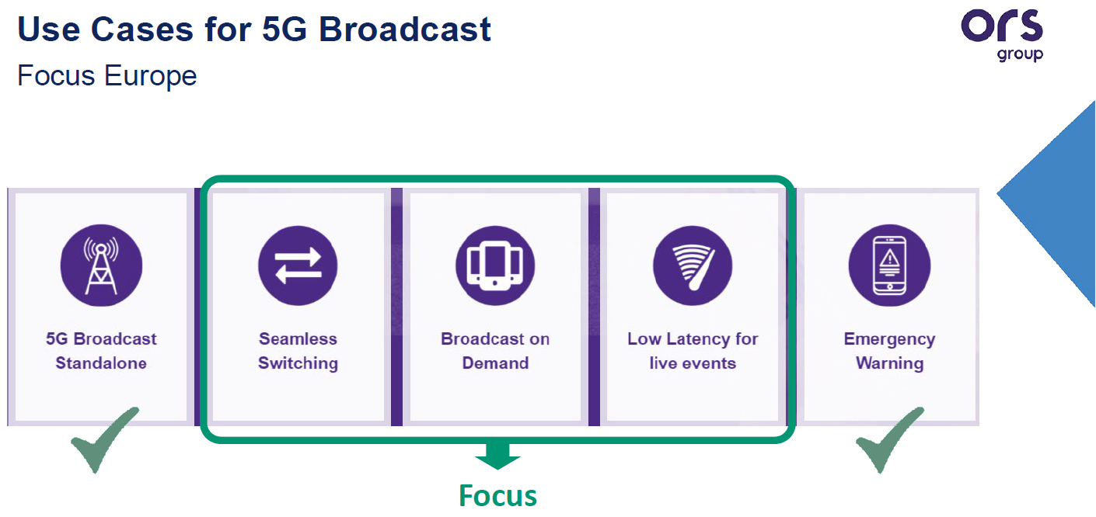
Hybrid Unicast Broadcast
5G MNO
Content Provider
Architectures, Collaboration Models and Use Cases
Content Provider may leverage 5G Unicast systems, 5G Broadcast systems, and 5G devices to build efficient and innovative applications
Supported by well defined network and client-side APIs
Examples:
Hybrid Services
Universal Coverage
Broadcast on Demand
Integrated into 3GPP 5G specs, ETSI TS 103 720 and TR 103 972 (DVB over 5G)
See also Rel-19 work
5G Broadcast Operator

Slide 21
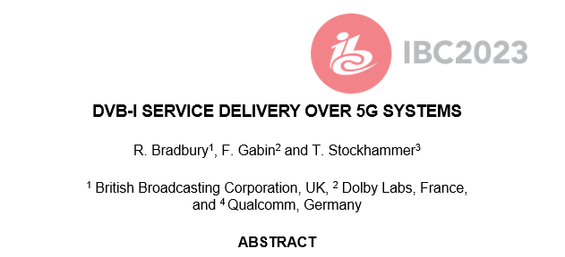


DVB-I via 5G Broadcast
Joint DVB/5G-MAG task force
Using MBMS/5G Broadcast Reference Points and APIs
Different options are considered
Using file download services for carouselling metadata
Using segment streaming for DVB-DASH
Using transparent mode for DVB-I multicast distribution
Combinations with unicast, hybrid services also under development
See details in ETSI TR 103 972
Expected to be supported by reference tools

Slide 22
DVB-I over 5G – combining the best of two worlds
DVB Service layer with 5G Broadcast distribution – specification work
DVB Commercial Requirements in Bluebook C100 (07/21)
ETSI TS 103 720 (06/23): LTE-based 5G Broadcast
ETSI TR 103 972 (07/23): Deployment Guidelines for DVB-I services over 5G Systems
ETSI TS 103 770 DVB-I Service Discovery (11/20)
Latest version used in trials is A177r4 (09/22)
Latest published version is the bluebook A177r6 (02/24)
ETSI TS 103 285 DVB-DASH (Dynamic Adaptive Streaming over HTTP)
3GPP TS 26.501 (12/23), TS 26.510 (06/24) TS 26.512 (06/24)

Slide 23
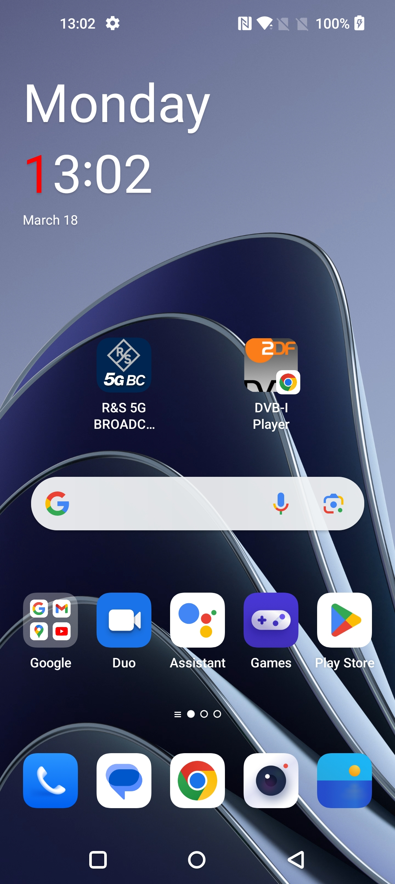
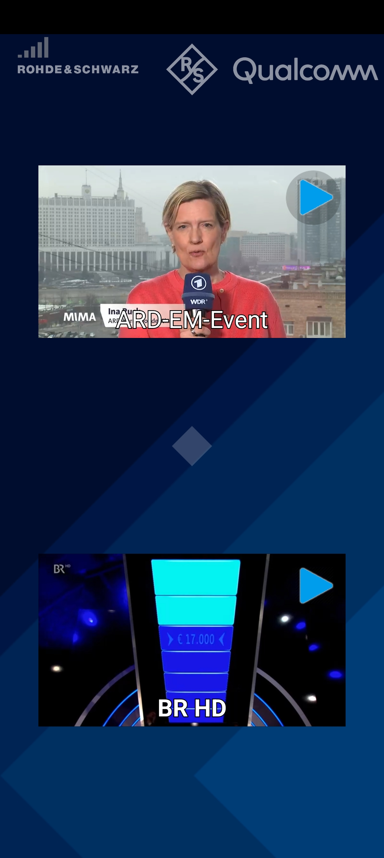
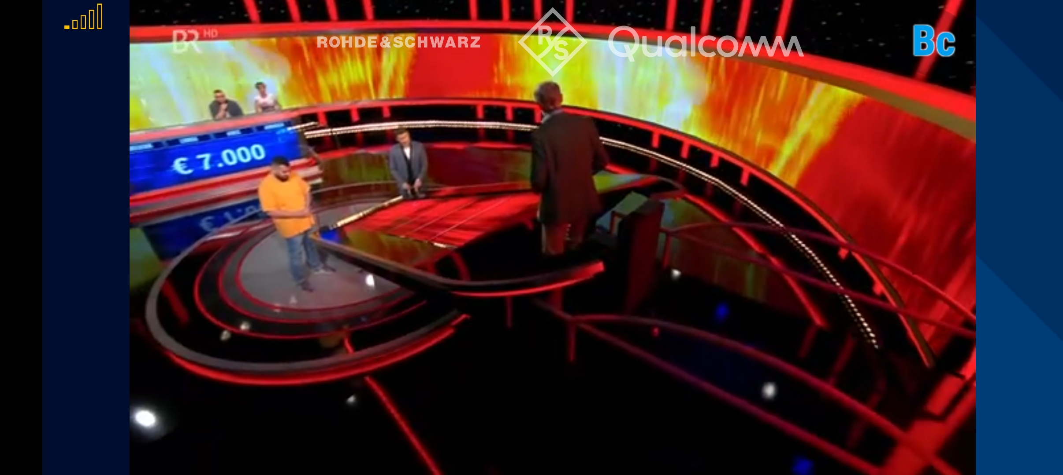
Qualcomm and Rohde & Schwarz show the world’s first standards-conforming demo of 5G Broadcast integrated into the DVB-I service framework on a commercial smartphone. 5G Broadcast transmissions from the Ismaning/Munich broadcast tower are added as service instance to a DVB-I service list and the DVB-I client is updated to select services included in the 5G Broadcast signals. The 5G Broadcast signals are integrated in the service list of the German DVB-I Pilot, whereby the instances for 5G Broadcast get highest priority and will hence be selected by the 5G Broadcast capable receivers, but ignored by regular TV sets or smartphones.
Joint demo of Rohde & Schwarz, Qualcomm and the colleagues from ZDF and ARD

Slide 24
5G Media Streaming Extensions ➔ Advanced media Delivery
Rel-18 and Rel-19 work
TS 26.510 (Rel-18)
TS 26.51x
TS 26.51x (Rel-19)
TS 26.51x

Slide 25

Consistent support for uplink streaming
Support for end-to-end low latency live streaming
Support for 5GMS over MBS and 5GMS hybrid services
Support for multiple media service entry points:
Extensions to 5GMS protocols to support traffic identification
Background Data Traffic
Oauth 2.0 (according to the SA3 guidelines) for 5GMS protocols
3GPP Service Handler and URL
AS Configuration
Network Assistance Extensions
this functionality is needed for media production services, but also for contributing user generated media to operator and third-party services. Different collaboration scenarios between the MNO and the service provider are addressed in an updated specification – bringing uplink streaming on par with downlink streaming.
and combining this with dynamic policies is of crucial support to meet the TV industry needs in order to bring 5G on par with other distribution means. Live TV services are characterized by at least the following aspects: (1) scalability (in terms of concurrent users), (2) consistent quality, (3) high bandwidth requirements, (4) target latency constraints, and advanced TV Experiences.
Based on development in CTA WAVE in context of DASH/HLS interop specification in CTA-5005, it was identified that the same media service may be available in multiple formats, and 5GMS media is expected to offer the same service with different entry points in order for the device to select the service based on its capabilities, for example using a DASH player, or and HLS player, or using a progressive download system
Addition of necessary parameter extensions to the M1, M5, and M6 reference points to provide access to Background data transfer (BDT). BDT enables mobile network operators to incentivize the offloading of traffic into off-peak hours with the aim of reducing network congestion during peak hours. Applications may register their interest in receiving content using BDT.
including the necessary functions on UE and device to support automatic launch of 5G System services in the context of 5G Media Streaming. It was identified that it is essential to provide a URL form for media services in order to automatically launch client and network functions without disrupting existing app workflows.
Specification of a RESTful API at reference point M3, for the configuration of 5GMS AS instances by 5GMS AF. M3 was undefined until now, but based on deployment experience it was identified that it is necessary to define this reference point more details.
Specification of data types for data reporting of ANBR-based Network Assistance invocations and specification of data types for exposure of events relating to invocation of AF-based and ANBR-based Network Assistance.

Slide 26
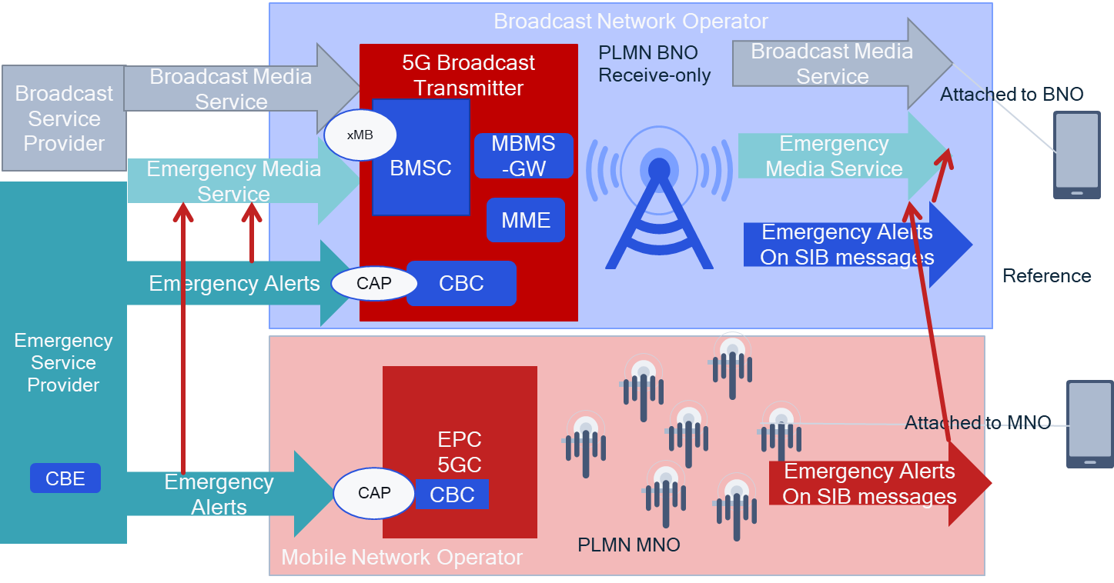
Specific case: 5G Broadcast + CMAS Alert
Scenario

Slide 27
Common Client Metadata
Common Server-and Network-Assisted Streaming
Multi-CDN and Multi-Access Media Delivery
Modem Usage Optimized Media Streaming
DRM and Conditional Access
In-session Unicast Repair for MBS Object Distribution
MBS User Service and Delivery Protocols for eMBMS
Selected MBMS Functionalities not supported in MBS
DASH/HLS Interoperability
Further harmonization of RTC and Streaming for Advanced Media Delivery
Improved QoS support
Impacts and opportunities of QUIC for segmented content delivery:
CTA WAVE has developed: CTA-5004: Web Application Video Ecosystem Common-Media-Client-Data (CMCD. It is worthwhile to study the benefits of integrating commonly supported metrics and client data reporting in 5GMS workflows.
MPEG-DASH supports Server and Network Assisted DASH (SAND). Certain profiles of SAND were adopted in TS 26.247, but the industry has generalized the concepts in SAND in efforts such as Content Steering (see ETSI TS 103 998), Web Application Video Ecosystem (WAVE) specification for Common Media Server Data (CMSD), or Addressable Resource Index (ARI) Tracks in MPEG. The study and integration of these technologies into the Media Delivery System and MBS/MBMS workflows is of significant interest, in particular also in combination with existing QoS mechanisms.
Content distributors often use multiple Content Delivery Networks (CDNs) or multiple access networks to distribute their content to end-users. As an example, they may upload a copy of their catalogue to each CDN, or more commonly have all CDNs pull the content from a common origin.
Enhancements to Background Data Transfer to support preload as well as functionality of what is defined in W3C Managed Media Source Extension to minimize active network connections are relevant topics to study with the aim of limiting battery consumption in the UE resulting from media delivery.
DRM and Conditional Access are commonly used by third-party streaming services. However, in case streaming is done through MBS or MBMS, a more careful management of the keys needs to be checked. Scalability of key delivery is an issue.
For live and low-latency live services using the Object Distribution Method in MBS, in certain cases the transmission of an object is not successful. In this case, unicast repair for individual MBS Clients can improve the service quality.
In completing TS 26.502 and TS 26.517, it is obvious that only a subset of the MBMS functionalities is supported in Rel-17. While many MBMS functionalities are likely not important to be supported for MBS, a systematic analysis of MBMS User Services features and their potential relevance for MBS should be completed and recommendations made on which ones to migrate to MBS User Services specifications and how best to achieve this.
DASH/HLS interoperability is a key issue to support highly scalable distribution systems for CDN-based distribution as well as for MBS/MBMS distribution. Offering common CMAF segments that can be consumed by both DASH and HLS media players promises to address these issues.
With the creation of TS 26.510 in Rel-18, Media delivery across the 5G Media Streaming (5GMS) System and the Real-time media Communication (RTC) System was harmonized. Study of further harmonization is encouraged to fully implement common Media Delivery functions.
In Rel-18, SA2 has defined a number of new features in the 5G System, especially in the PCF, from which media delivery may benefit. Examples documented in TS 23.501 include the use of Explicit Congestion Notification (ECN) to support Low Latency, Low Loss, Scalable Throughput (L4S) services (clause 5.37.3), PDU Set handling (clause 5.37.5) and QoS Monitoring (clause 5.45), and there are likely others. The impact and usefulness of selected features is preferably studied.
Since the finalisation of the QUIC protocol by the IETF in May 2021, there has been significant deployments of QUIC driven by the usage of HTTP/3 for streaming services. In the IETF, the working group on Media Over QUIC (MOQ) is working towards an extensible protocol for publishing media for ingest and distribution.
In order for MBMS and LTE-based 5G broadcast to leverage MBS User Service technologies, a study is warranted to identify the gaps to fully support this functionality.

Slide 28



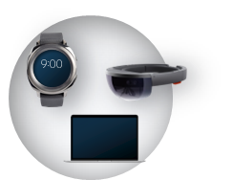
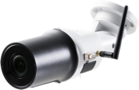
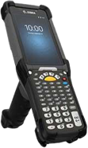


Fundamental 6G motivation
Operators networks
Increasing revenue with new use cases/services
Reducing network TCO (total cost of ownership)

Slide 29


Enhanced and New Experiences
Sustainability
Advancements in underlying technology, new services enabled by them & a holistic look at sustainability will drive the 6G design

Slide 30
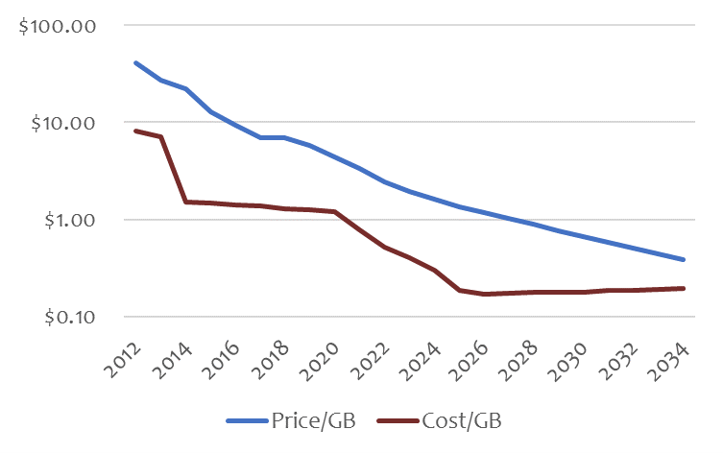
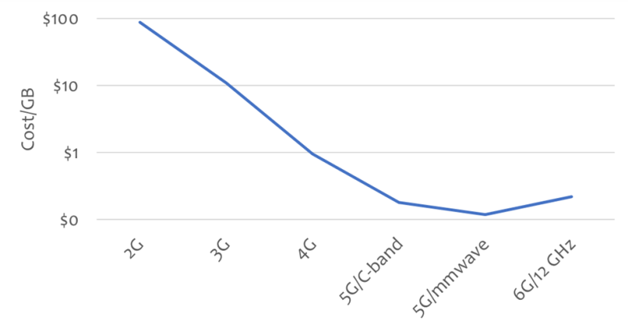
Trouble ahead: 6G cost per GB may pose problems
https://www.fiercewireless.com/tech/trouble-ahead-6g-cost-gb-may-pose-problems-madden
In 2014, after the introduction of LTE, the American telcos spent about $0.96 per GB to deliver data, but charged more than $10 per GB....a 10:1 ratio ➔ allowed the operators to offer ‘unlimited’ plans because the cost of delivery was so much smaller than the revenue created
Today, the cost has dropped to $0.30 but the retail price per GB is down to $2. By 2028, the retail price will drop below $1/GB, but the operators will have very few ways to reduce cost, and their costs are likely to remain in the range of $0.30 ➔ 3:1 ratio

Slide 31
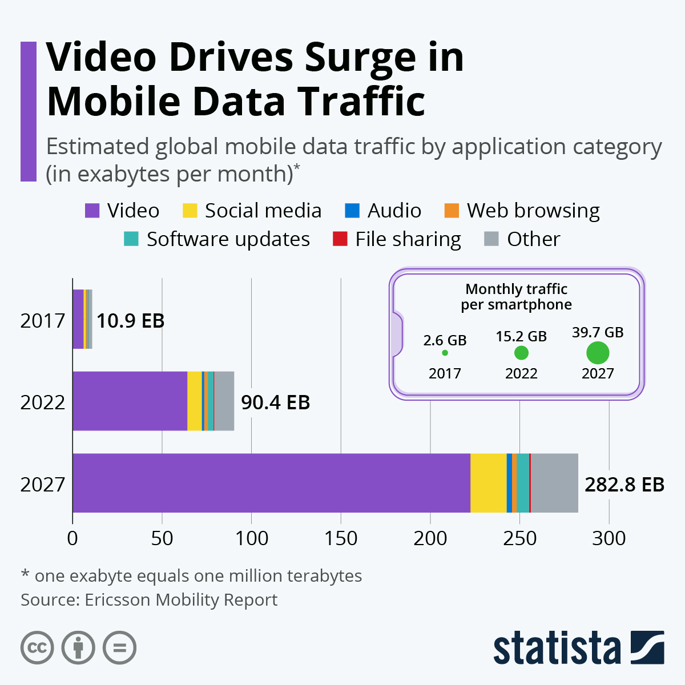
Cost Reduction Example 1: Video Delivery
Provide technologies for operators and service provider to invest in cost saving technologies
Data points
At the end of 2023, video traffic is estimated to account for 73 percent of all mobile data traffic (Ericsson Report)
With 97 percent, video traffic has significantly more downlink than uplink traffic (Ericsson Traffic Analysis)
Video content to account for almost 80 percent of mobile traffic, which is projected to triple in the next five years.
The cost of video delivery needs to be reduced
Potential objective for 6G
Potential Technologies:
New codecs, AI, Smart delivery, Monetization, New KPIs, Energy Saving
Collaboration between Media Service provider and MNO
Amortization of the MNO loss on Gbyte 10:1 ➔ 3:1 needs to be addressed for video delivery (80% of all traffic)

Slide 32






Cost Reduction Example 2: Global universal Media Delivery Platform
Continue and accelerate the integration of Media Verticals to 3GPP global delivery platform – economy of scale
Unified technology – many emitters can access many devices
Media Service providers focus on services rather than delivery
6G Platform (including previous G technologies)
FWA

Slide 33
Lessons learned from 5G: verticals
Important to avoid duplication of work vs what already exists
(1) Focus on requirements first
Identify very specific requirements for the 6G version of a new vertical
(2) Once requirements are identified, perform a gap analysis vs the 5G/5G-Advanced version
What is missing?
Are there commercially available products for the 5G/5G-A version?
Does the extent of what is missing / gain in performance justify a redesign from scratch?
Could one just evolve the “5G version” of that vertical (thus preserving compatibility) and rebrand it “6G”?
(3) Consider stickiness & replacement rate of the vertical
Verticals work under different timelines compared to smartphone industry (vs. 3GPP Releases cycle)
Concrete examples based on 4G-5G transition to learn from
5G Massive IOT and 5G Broadcast were “based” on solutions developed during the 4G era following a gap analysis => duplication was avoided
NR V2X was developed very rapidly, before LTE V2X could gain adoption => Some perception of fragmentation was created

Slide 34
Some more thoughts wrt to Media & 5G-MAG
To be refined and improved
Verticals & RAN
Early RAN design consideration for verticals such as Broadcast, NTN, Production – even if not addressed in first release, ensure extensibility, not an afterthought
Examples: Time Frequency Interleaver, Multiplexing with legacy broadcast, UHF band support, channel bandwidth
3GPP should be well-recognized for important media-related specifications, including
Developer-friendly: APIs, code, examples, git-environments, exchange with developers
Implementability of the specifications (test, evaluation, code, reference software)
addressing market needs, deployment feasibility, sustainability, innovation platform, monetization opportunities, cost-conscious
Timeliness: allow things to do quicker, do things at the right time, leave time to address essential work
Develop specifications against meaningful KPIs for media services
Collaboration with the industry and market representation partners
Generally, build on the principles established in the 5G era and evolve based on experiences and learning
Media Delivery Architecture and Services
build on existing architectures: 5G Media Delivery Architecture and IMS
No revolution, but evolution and adaptation to 6G core, radio and design principles
Support foundational technologies such as cloud, AI, virtualization, orchestration, split processing ➔ develop more use cases
Create enablers for richer media experiences (Media Service Enablers), but not full services

Slide 35
Based on our thoughts we look forward to collaborate on shaping requirements for 6G

Slide 36

3GPP SA4 Chair
3GPP SA4 Vice Chair
You are in safe waters with 3GPP

Slide 37
5G Broadcast Standards Evolution
Rel-14
SCS1.25KHz/ CP=200µs Mobility up to 120 km/h
5G BC worldwide standard
TG6/1 and WP6A
Rel-16
Rooftop Mobility up to 250 km/h
5G BC is an EU standard (ETSI TS 103 720)
Rel-17 Enhanced BW= 6/7/8 MHz for UHF
Enhanced Version of ETSI TS 103 720v.1.2.1
Rel-19 work in planning (TFI, Co-existence, Low-Latency)
Enhanced Version of ETSI TS 103 720v.1.3.1
Where do we stand?
ETSI 5G-MAG
ETSI 5G-MAG
3GPP
ITU
3GPP
ETSI
3GPP
3GPP
3GPP
2017
2019
2020
2020
06/22
06/23
12/23
12/24
06/25

