Slide 1

5G Broadcast - Standards, Technologies and Market Updates
May 8, 2024
5G Broadcasting Workshop, Bled, Slovenia
@qualcomm_tech
Dr. Thomas Stockhammer
Senior Director Technical Standards
Qualcomm Technologies

Slide 2




Today’s agenda
# What is 5G Broadcast
# Standards
# Technologies
# Trials and deployments
# Opportunities and Selected Use Cases
# Next Steps
Presenter
Dr. Thomas Stockhammer
Senior Director, Technical Standards
Qualcomm Europe, Inc., IEEE Fellow
Leading and driving among others
DVB: 5G TF, DVB-I
MPEG: MPEG-I, CMAF and DASH
3GPP: XR over 5G, 5G Video, 5GMS
DASH-IF: Interop WG, Test
ETSI & 5G-MAG: 5G Broadcast and 5GMS
CTA WAVE: CMAF Device PB, Test
Metaverse Standards Forum: Chair, Board

Slide 3
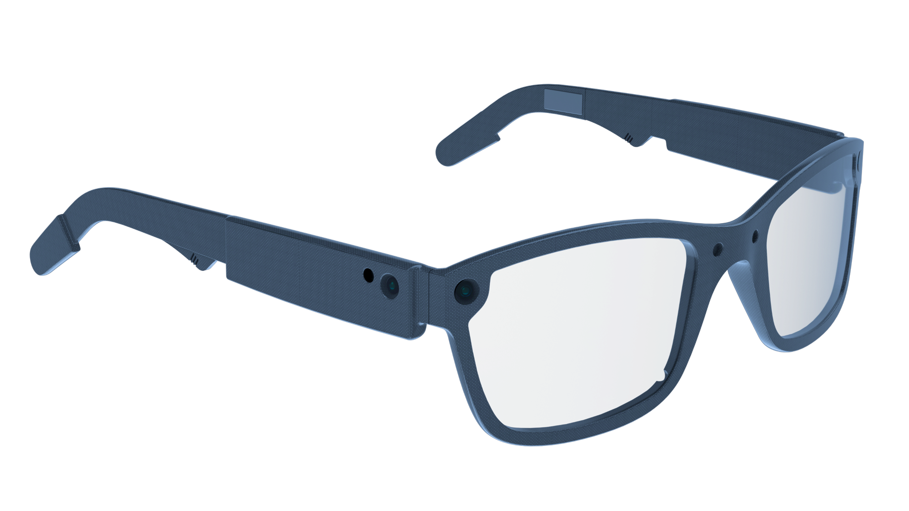





Challenges for Broadcasters: Devices, Formats, Users
UHD/8K
Social
3D
Immersive
Personalized
Interactive
Gaming-like
Short & long
Live
On-Demand
User Generated
AI-supported
Location
Global
Secure
Time-shift
…
Internet
Cloud/Edge
Broadcasters
and Content Provider
UHF
Cellular
WiFi
Quality
Cost
Scalability

Slide 4
5G defines two modes of broadcast communication
Focus of this presentation
5G broadcast
Mixed-mode multicast
Broadcast spectrum (e.g. UHF)
No unicast. Downlink – only traffic.
Delivery of linear content (e.g. TV) or IP file delivery
Dedicated broadcast infrastructure (can be high power)
Operator spectrum (IMT)
Integration with unicast network
Efficient delivery of multicast/broadcast traffic (vs unicast)
Reuse of cellular infrastructure (low power).
Single Frequency Network (SFN) for downlink broadcast only
Dynamic switching between broadcast and unicast, e.g., SC-PTM¹
Addressing diverse ecosystem, deployment, and use case requirements

Slide 5
General technology introduction
5G broadcast and 3GPP
“5G broadcast” is a broadcasting standard defined by 3GPP (Release 16 - 2020)
  3GPP is the industry group responsible for defining global cellular tech standards (e.g. 4G / 5G)
  In the last few years 3GPP has expanded to new verticals (e.g. broadcast, automotive, satellite, etc.) hence it should not be regarded as a surprise that a broadcasting tech is coming out of 3GPP
Even though 5G Broadcast has been standardized by 3GPP, it is a broadcasting technology
  I.e. meant to be used by broadcasting operators, in broadcasting spectrum
  No need of supporting a unicast network. 5G Broadcast does not have anything to do with unicast
The main design target & “reason for being” of 5G broadcast is to enable operation of a broadcast network where the receivers are hardware-compatible with cellular modems
  “Hardware compatible” means lower barrier to adoption in mobile devices compared to other broadcasting technologies
    This is because several 5G Broadcast building blocks are already there in a 4G/5G modem, hence the additions are marginal.
    For other technologies, a separate piece of silicon / die area would be required
  To be clear, 5G Broadcast has nothing to do with “cellular operators trying to take over from broadcasters”

Slide 6
5G Broadcast – Core Features for multiple use cases
SIM-less reception with simplified architecture
Receive-Only Mode (ROM) & Free-to-Air (FTA)
Different spectrum options (e.g. UHF, SDL), as well as SFN/MFN
Various deployment possibilities (e.g. MNOs, BNOs)
Using existing infrastructure (HPHT, MPMT and LPLT)
Highly flexible velocities (up to 250 KM/h Vs up to 300 µS)
Can be combined with existing 4G and 5G features (unicast, PWS)

Slide 7
Significant interests towards 5G broadcast deployment worldwide
Denmark
Tour de France 22 powered by 5GB
Italy
Germany
2018-23: TV delivery with Rel-14/16
HPHT in Aosta and Turin
Russia
2024: European Championship
2020-22: 5G Media2Go Stuttgart/Heilbronn
2017-20: 5G Today in Bavaria
Finland
2022+: 5G Broadcast under investigation as latest broadcast technology
Belgium
2019-22: TV delivery with Rel-14/16
HPHT in 3 sites
CZ
2022-24: 5G BC imec.icon project with 2 HPHT sites
2020-23: Distribution of TV/Radio in Prague
South Korea
UK
Austria
Late 2021: Distribution of live TV using Rel-16 enTV near Seoul
2020-22: VISTA Project with O2 Virgin Media
2020-23: Distribution of TV/Radio with 5G BC Rel-14/16 , with eMBB in Vienna
Europe
France
2023: European broadcasters ink 5G Broadcast MoU
2018-2022: Live testing of 5G BC in Paris
2024: Olympics
Greece
US
2021-23: Live TV/Radio with 5G BC Rel-14/16 , with 3MHz in Athens
2020+: Growing interest in 5G BC in addition to ATSC3.0
2023: FCC Approves A Low Power TV Station To Broadcast Over 5G Networks
2023: First 5G Broadcast in the US and first 24/7 5G Broadcast globally
2024: Foundation of 5G Broadcast Collective
Croatia
2022-24: Live 5G BC Rel-14/16
Philippines
2019-22: Direct to mobile Live TV/Radio in Manilla
Spain
Algeria
2020: Distribution of free-to-air linear radio and TV using Rel-14 enTV with HPHT in Barcelona
2022 & 2023: MWC demos
Malaysia
Brazil
2022: Interest towards 5G BC during Mediterranean Games
2024: Report close to completion – next steps are trials
2020-23: TV 3.0 project calling
for proposals
2019-24: AIB project based on 5G Broadcast under the administration of NRTA¹ and ABS²
2023: 5G Broadcast Chengdu pilot project formally kicked off on July 20th
GATIS' Global 5G Broadcast Summit
Colombia
India
2020-21: Delivery of TV and radio with Rel-14 broadcast trial deployment in Santiago de Tolú
South Africa
2020+: Growing interest
in latest broadcast³ technologies
2023: Discussion on DTM strategy based on market feedback
2019-20: Live testing of Rel-14 in Johannsburg
China
¹ National Radio and Television Administration ² Academy of Broadcast and Science commercia potential ³ Prasar Bharti working jointly with IIT Kanpur on Next Generation Broadcast Technology

Slide 8



First 5G Broadcast in US
July 14th 2023 - FCC granted experimental license for 5G broadcast
Sep 13th 2023 – Station went on air and started 24/7 re-broadcast of FranceTV
Full leverage of existing infrastructure with no change in freq, antenna, power output
Successful indoor –stationary and outdoor – stationary and mobile reception with 8650 QRD units
Next steps: presentation to FCC, additional licenses for another 5-10 stations
Also emergency notification, first responder live trial, datacasting use cases
NAB 2024: Foundation of 5G Broadcast collective https://5gbc.tv/

Slide 9

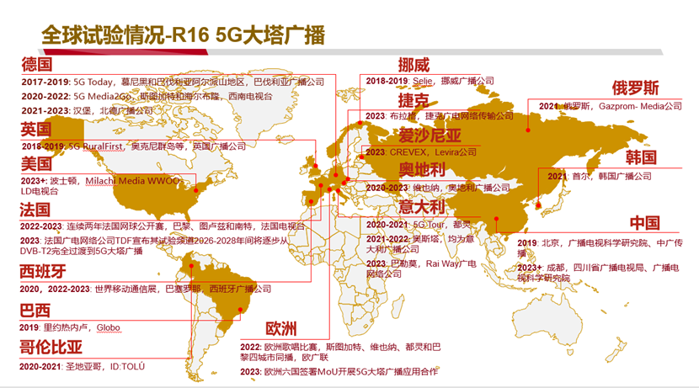
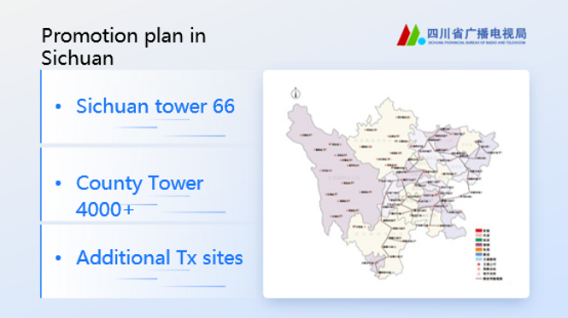
China Status
https://www.5g-mag.com/post/27-10-23-5g-mag-participates-at-gatis-summit
Chinese and international experts and scholars from Beihang University, Communication University of China (CUC), 5G-MAG, EBU, ORS, TDF, XGN, Rohde & Schwarz (R&S), Qualcomm, Xiaomi, vivo, Chengdu Kaiteng Sifang and Beijing BBEF Science & Technology
Sichuan has initiated the first trials and deployment of 5G Broadcast.
Regional broadcasters show great interests to duplicate the demo to verify & demo the 5GB services in their own network. Guangdong already asked, Guangxi is in the line, Shanxi also asked during the meeting, more requests are on the way.
ABS supports them together with domestic infra vendors and OEMs to launch pre-commercial trials

Slide 10
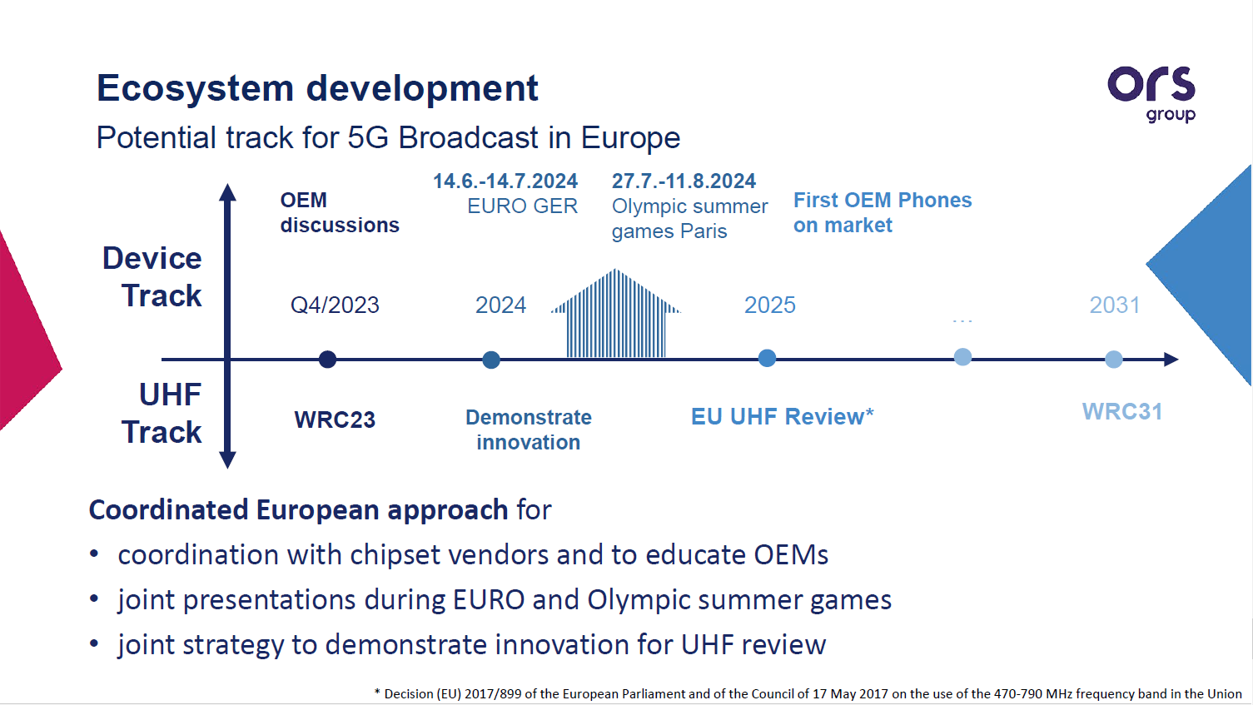

Slide 11
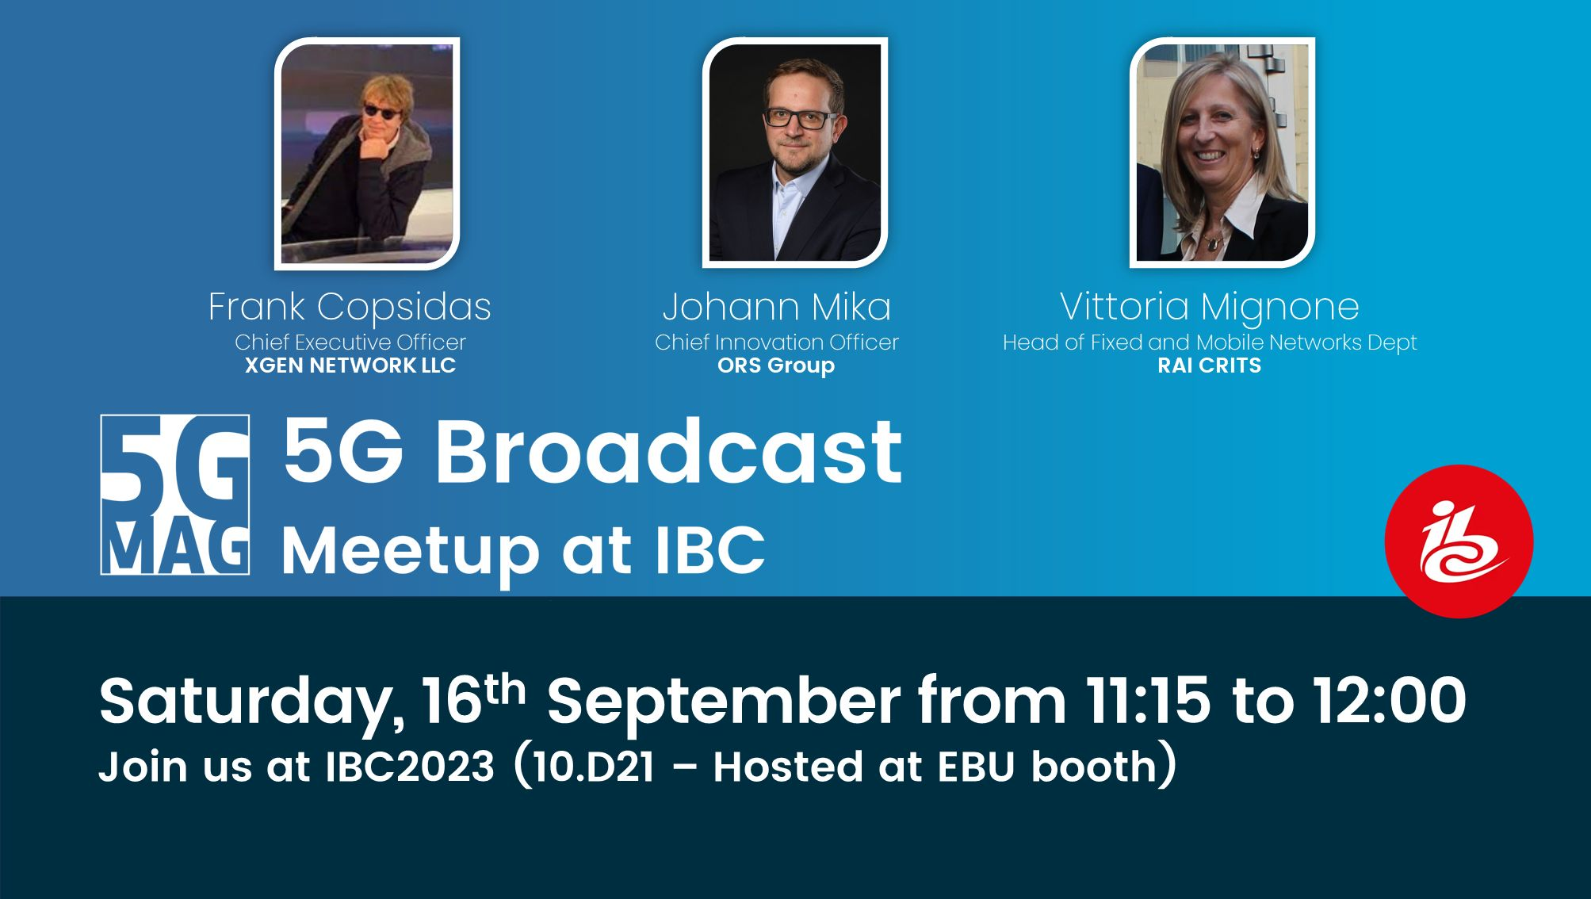
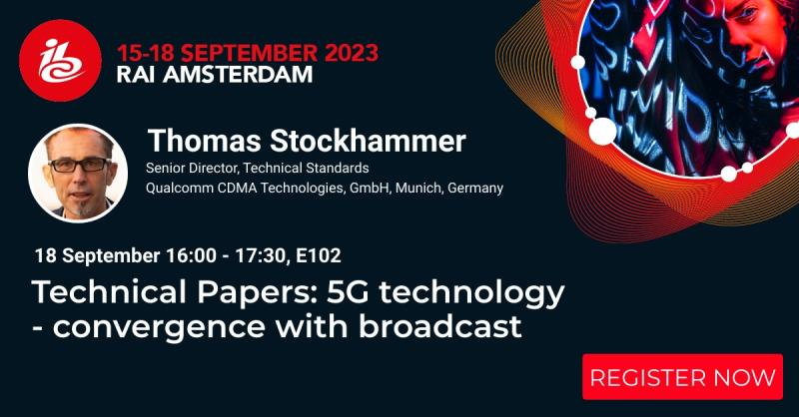
5G Broadcast at IBC 2023
To our best knowledge
Rohde & Schwarz and Qualcomm to demonstrate 5G Broadcast ecosystem readiness at IBC2023
  At IBC2023 Rohde & Schwarz will demonstrate the latest innovative features, including seamless service continuity between broadcast and broadband, and low latency content distribution. Thanks to the software architecture of the TH1 transmitter family, all these and future enhancements can be readily added in the field on-demand.
https://www.nakolos.com/ibc2023/
  XGen Networks (Hall 1.D90)
  5G-MAG (5G MEDIA ACTION GROUP) @ EBU (Hall 10.D21)
  SYES - System Engineering Solutions (Hall 8.F46)
  Media Coding Industry Forum (Hall 8.B45)
  Plisch/RFMondial (Hall 8.C61)
5G-MAG Meetup
IBC Conference

Slide 12
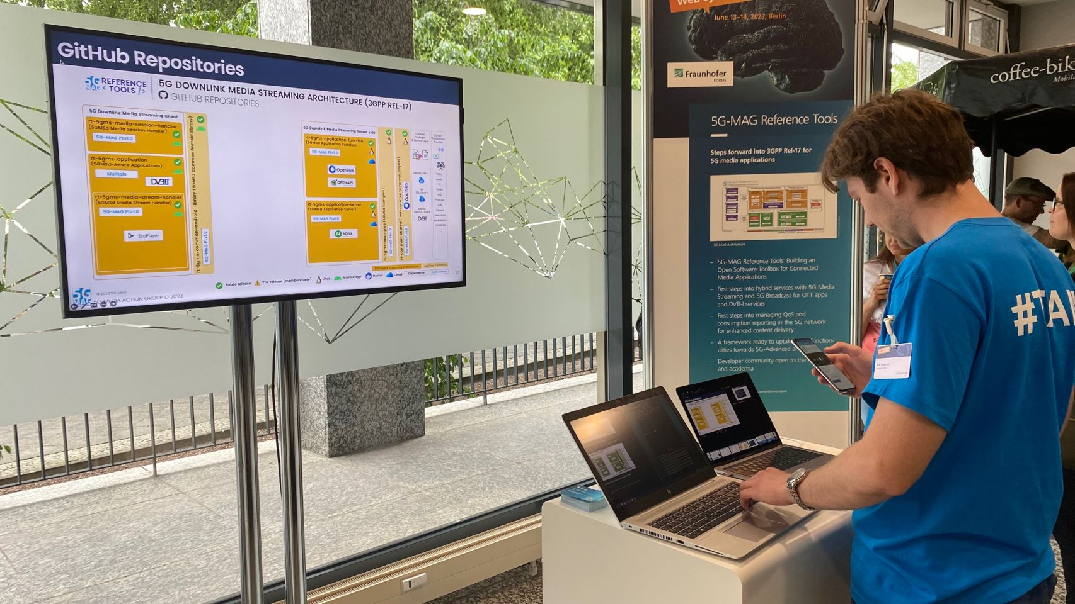
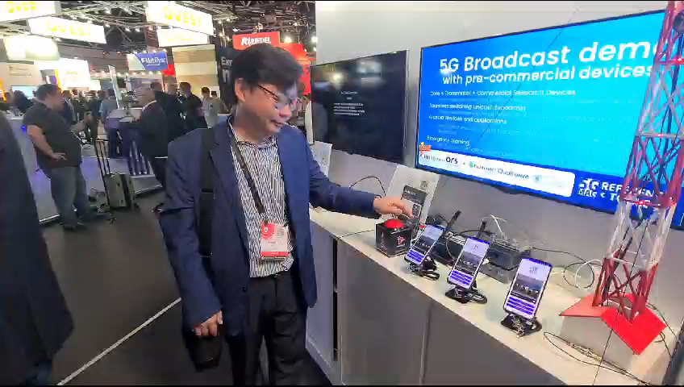
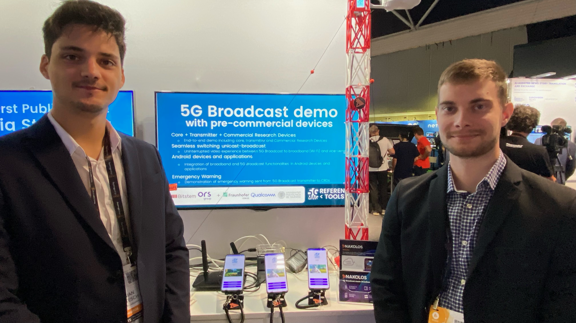
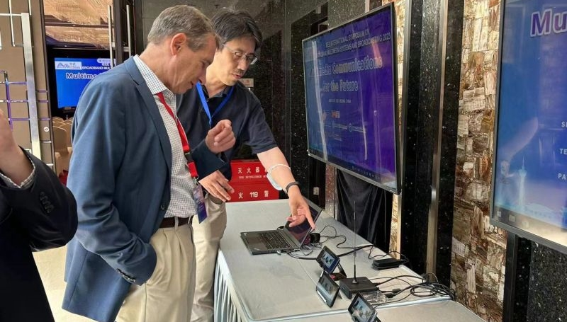
Demos 2023 – QRDs and CRDs are real phones

Slide 13
Standardization

Slide 14
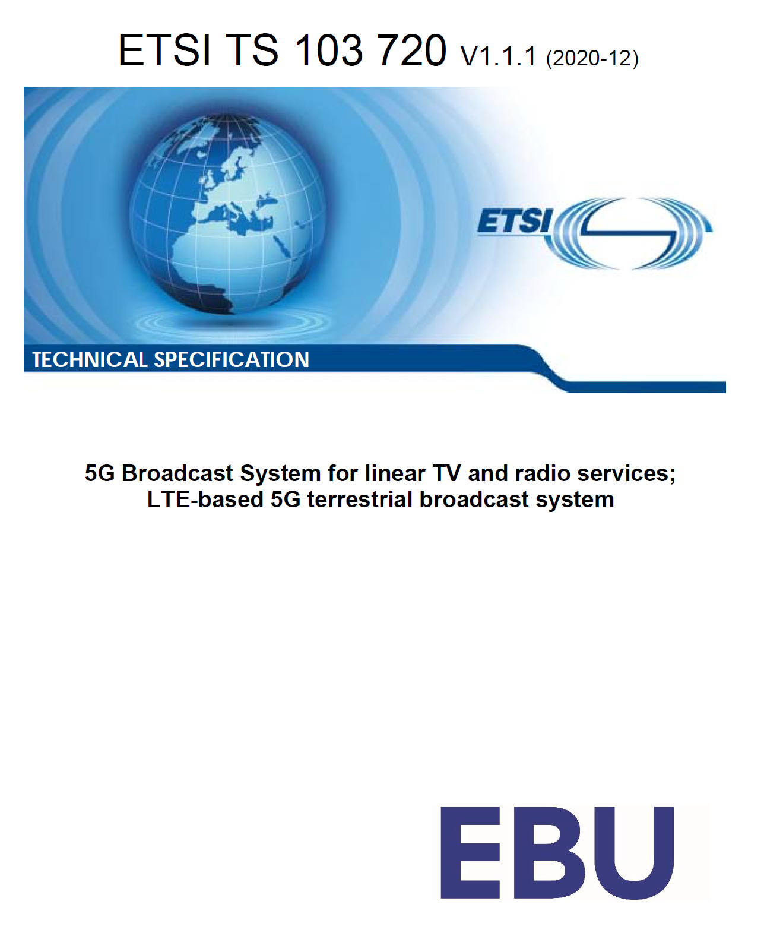
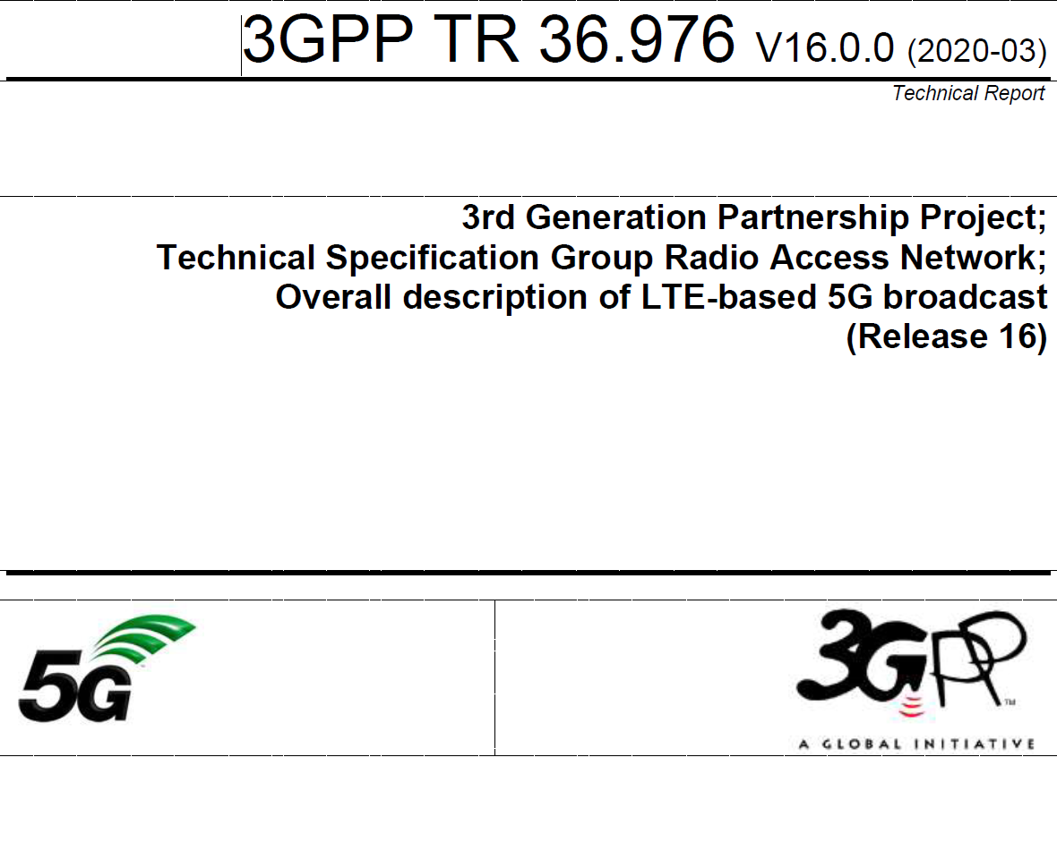
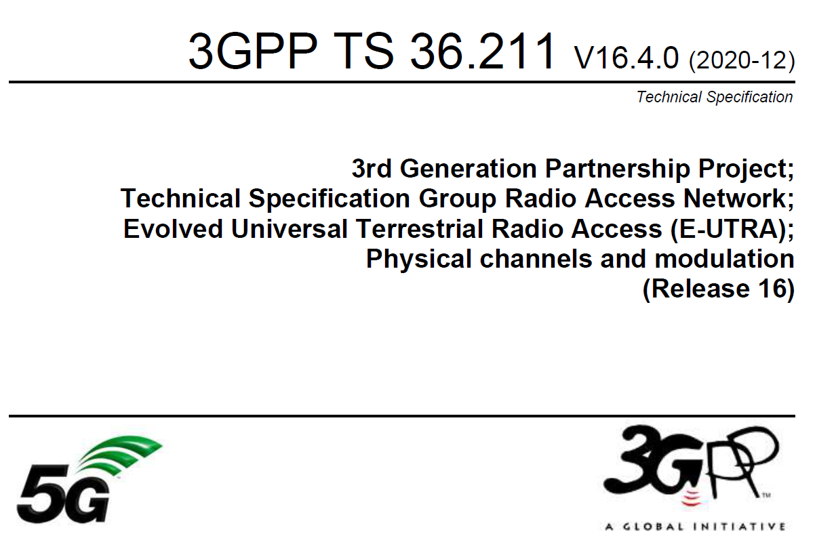
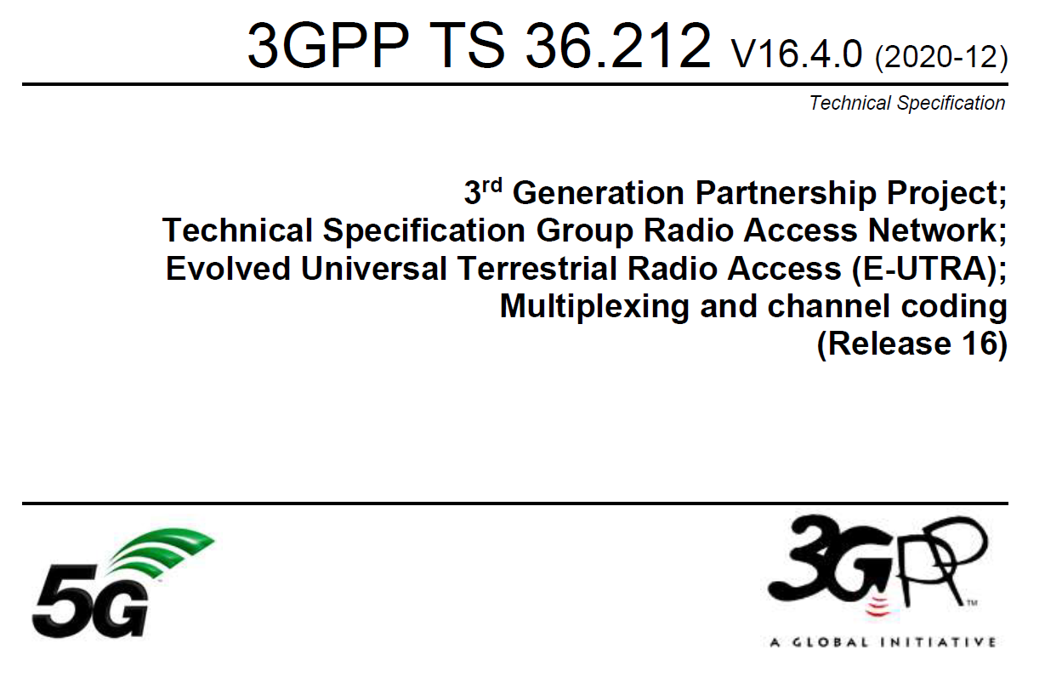
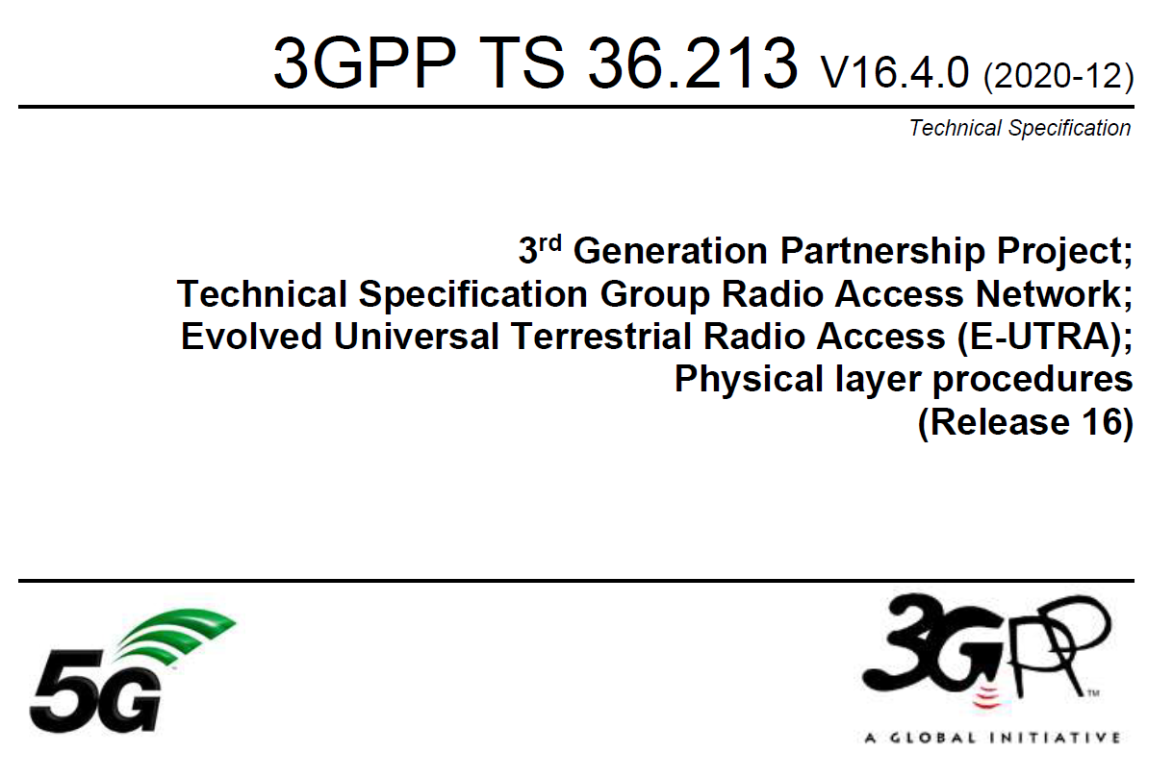
ETSI TS 103 720: Profile of 3GPP specification containing the necessary parts to deploy 5G broadcast
TR 36.976: Overall description
of enhanced TV (enTV) for
5G broadcast
For more information on 5G broadcast standards…
Various specifications
of 5G PHY supporting broadcast together
with unicast in TS 36.211, 36.212,
36.213

Slide 15
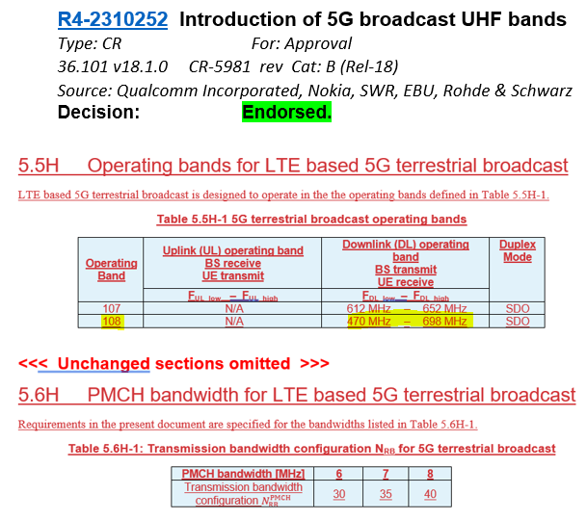
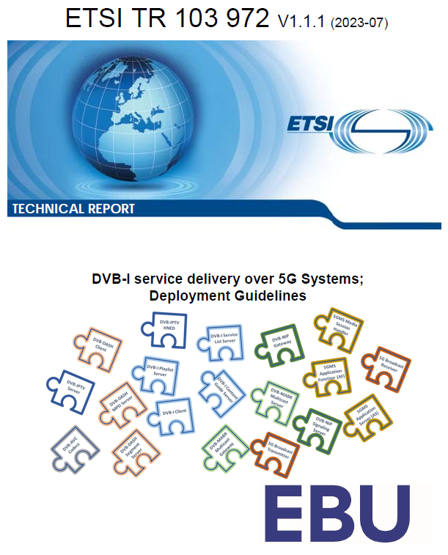
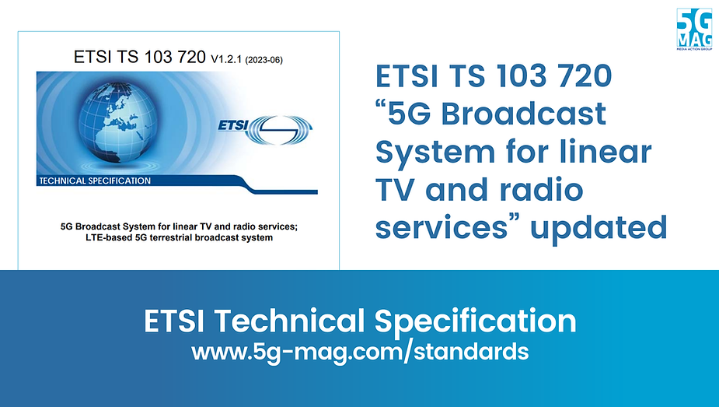
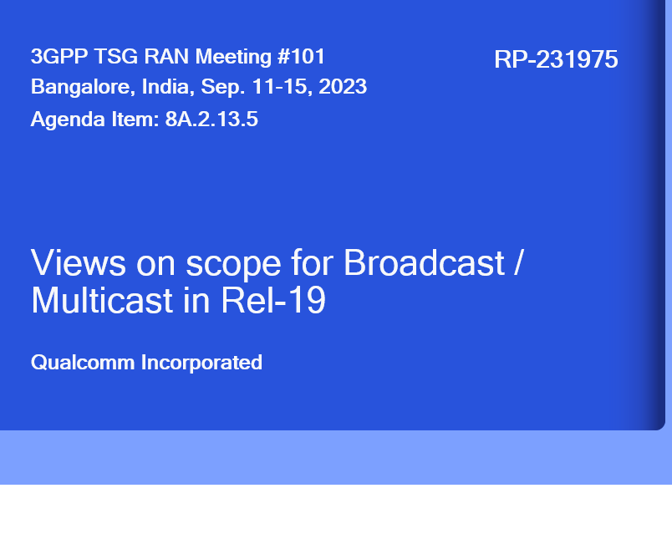
5G Broadcast Standards Evolution
Rel-14
SCS1.25KHz/ CP=200µs Mobility up to 120 km/h
5G BC worldwide standard
TG6/1 and WP6A
Rel-16
Rooftop Mobility up to 250 km/h
5G BC is an EU standard (ETSI TS 103 720)
Rel-17
Enhanced BW= 6/7/8 MHz for UHF
Enhanced Version of ETSI TS 103 720v.1.2.1
Enhanced Version of ETSI TS 103 720v.1.3.1
Rel-18
Requirements for UHF band, URL Handling
Rel-19 work in planning (TFI, Co-existence, Low-Latency)
Roadmap towards WRC23
ETSI
5G-MAG
ETSI
5G-MAG
3GPP
ITU
3GPP
ETSI
3GPP
3GPP
3GPP
2017
2019
2020
2020
06/22
06/23
12/23
12/24
06/25

Slide 16
Technology Evolution

Slide 17



MBMS/LTE eMBMS/5G broadcast History
3GPP could have taken a radical approach to define a clean slate radio system to meet the broadcasters’ requirements, instead a more pragmatic route was chosen. Experiences from the past with dedicated modems such as MediaFLO or DVB-H, and the need for easy integration into mainstream mobile devices, led to the decision to evolve eMBMS to LTE-based 5G Broadcast instead of any radical new designs.
Building upon a strong 3GPP technology foundation
5G
Further enhancements⁵
to fully satisfy 5G
broadcast requirements
LTE
LTE-A
LTE eMBMS/enTV
in 3GPP Rel-14
eMBMS defined for LTE starting in Rel-8/Rel-9, improving coverage and efficiency
eMBMS enhancements in Rel-12 include MOOD and expansion to MCPTT
Enabling terrestrial broadcast and expanding to new services; Meeting 7/10 5G Broadcast requirements in Rel-14
Enabling terrestrial broadcast and expanding to new services; Meeting all 5G Broadcast requirements in Rel-16
3GPP Rel-14 (completed)
3GPP Rel-16 (completed)
Target market focused on
Cellular operators
Target market expanded to
Broadcasters
5G broadcast is a “broadcast standard” (same target as DVB or ATSC) based on 3GPP silicon and ecosystem.

Slide 18
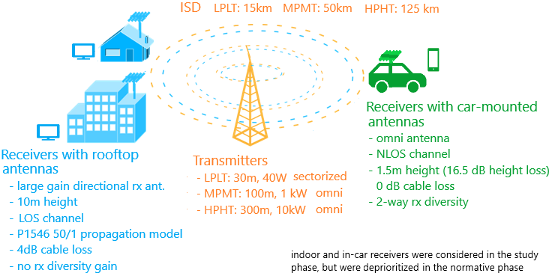


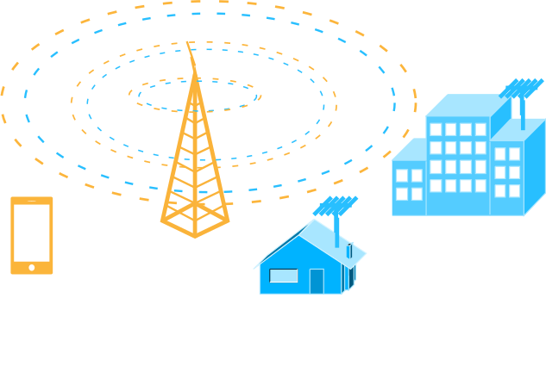
RAN: MBMS ➔ 5G Broadcast Evolution
Release 17/18
Release 16
6/7/8 MHz channel bandwidth to support common global channel bandwidth for broadcast systems
Introduction of UHF Band 108 to address RF transmitter and receiver requirements
Release 14
New numerologies to target rooftop reception with up to 125 km ISD
High mobility reception: fixed, portable and mobile receivers up to 250 km/h
Enhancements to CAS—increased PDCCH agg. Level, PBCH repetition, CFI in MIB
Release 13
Longer cyclic prefixes for support of larger ISD
Up to 100% of subframes for MBSFN transmission on a dedicated carrier
Subframes fully dedicated to MBSFN transmission
Targeting rooftop and car-mounted antennas, handheld receivers
Release 9
Single-cell transmission (SC-PTM)
Transmission on PDSCH with new group identities
Non-synchronized transmitters
Mixed unicast/MBMS carrier
15 kHz numerology
Extended CP of 16.7us
Multi-cell transmission only (MBSFN)
Up to 60% of subframes for MBSFN transmission
> 15 km
“Operator controlled” MBMS
“Broadcaster controlled” MBMS

Slide 19

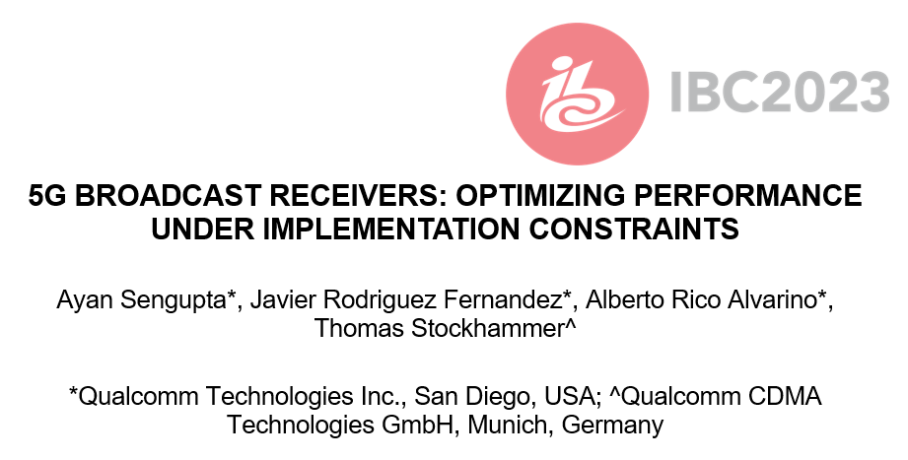


Details of the paper
Session and Recording

Slide 20
Summary and Conclusions
5G BROADCAST RECEIVERS: OPTIMIZING PERFORMANCE UNDER IMPLEMENTATION CONSTRAINTS
Broadcast networks and usage of configurations needs to be done for worst-case scenario.
For example, gains achieved in the 120 kmph scenario may not relevant, if such a planning would fail to serve a large number of receivers moving at lower speeds.
In this case, comparison between 5G broadcast and ATSC3.0 is provided for NLOS for different speeds and configurations
The main design target & “reason for being” of 5G broadcast is to enable operation of a broadcast network where the receivers are hardware-compatible with cellular modems
  “Hardware compatible” means lower barrier to adoption in mobile devices compared to other broadcasting technologies
    Several 5G Broadcast building blocks are already there in a 4G/5G modem, hence the additions are marginal.
    For other technologies, a separate piece of silicon / die area would be required
In comparison with unconstrained broadcast designs, 5G Broadcast Rel-18 is only marginally worse and there are expectations to address remaining gaps in Rel-19 without compromising the design goals
5G Broadcast is a transport system and has been successfully combined with unicast service layers – seamless unicast fallback successfully demonstrated
SNR for | ATSC 3.0 + 1Rx | ATSC 3.0 + 2Rx | 5G + 2Rx | 5G + 2Rx + TFI
3 kmph | 14.4 dB | 8.7 dB | 10.7 dB | 8.9 dB
40 kmph | 11.2 dB | 6.6 dB | 10.9 dB | 7.3 dB
120 kmph | 10.8 dB | 6.2 dB | 11.4 dB | 7 dB
Worst case | 14.4 dB | 8.7 dB | 11.4 dB | 8.9 dB

Slide 21
Technologies and Trials

Slide 22
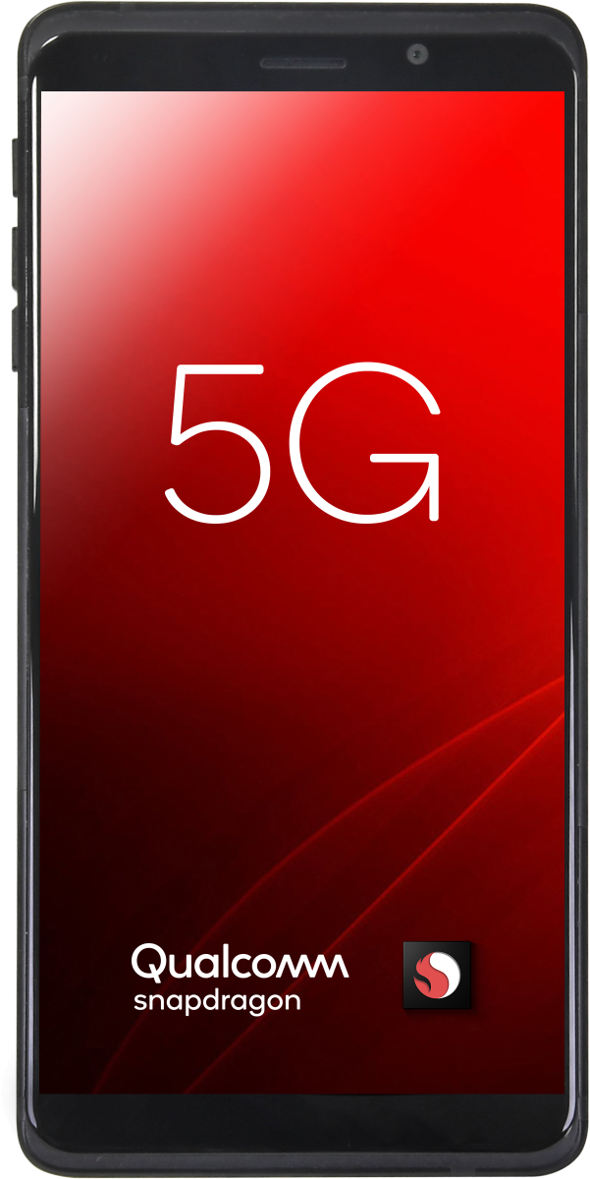
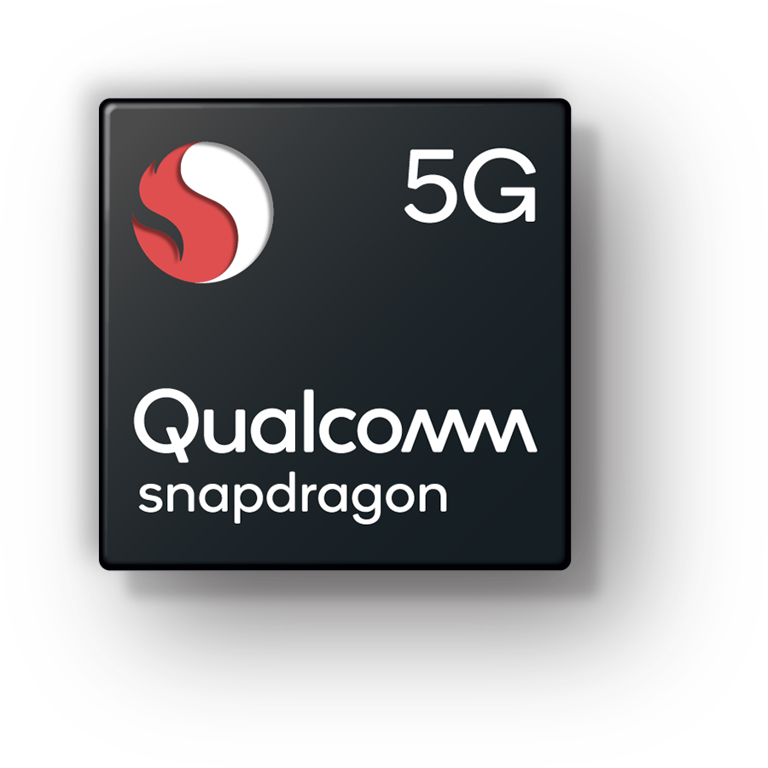
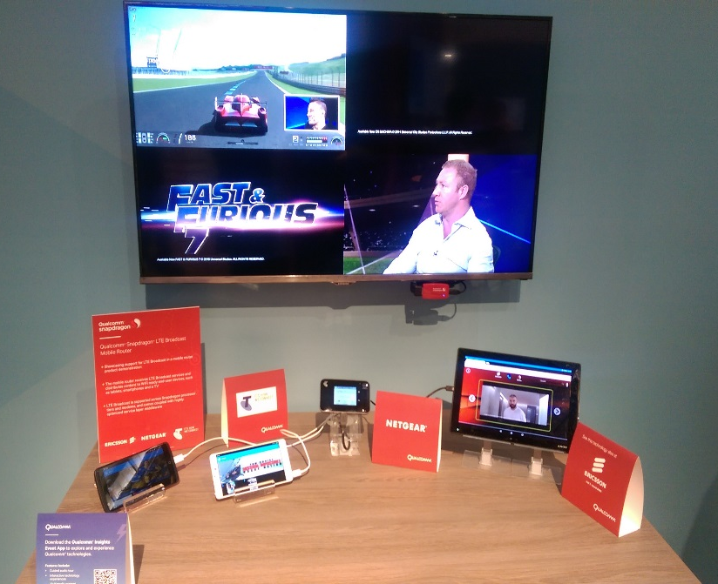
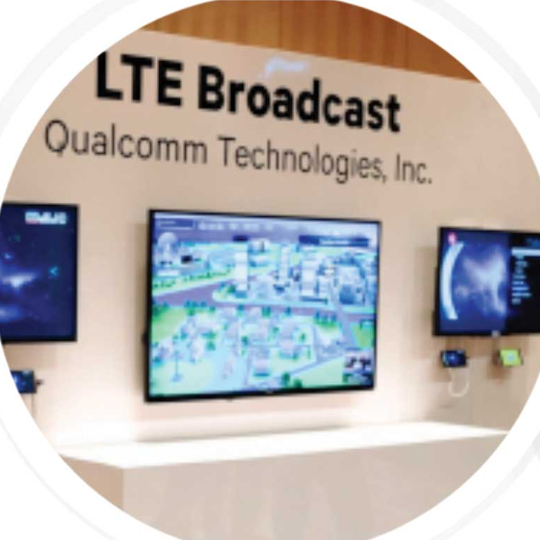
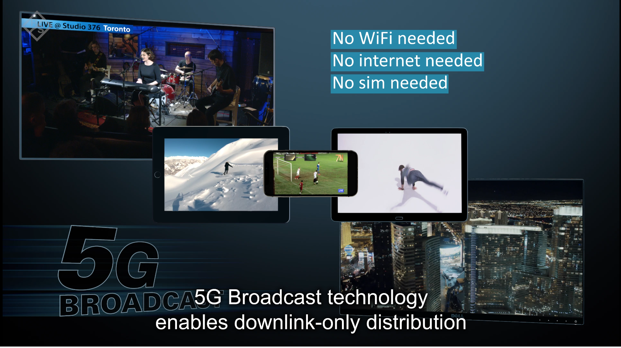
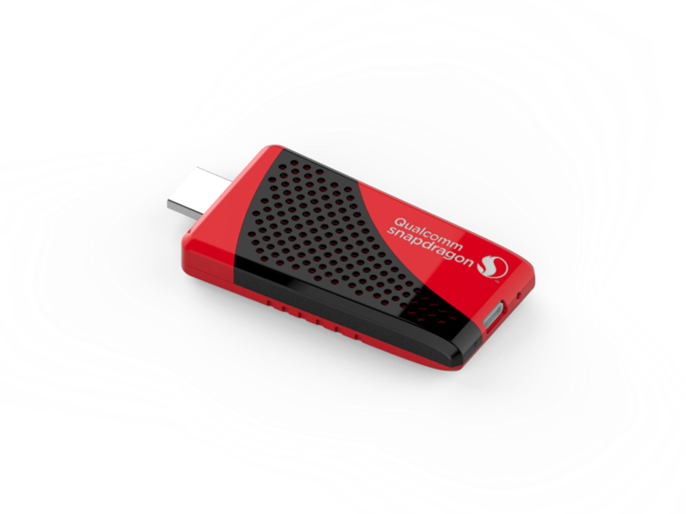
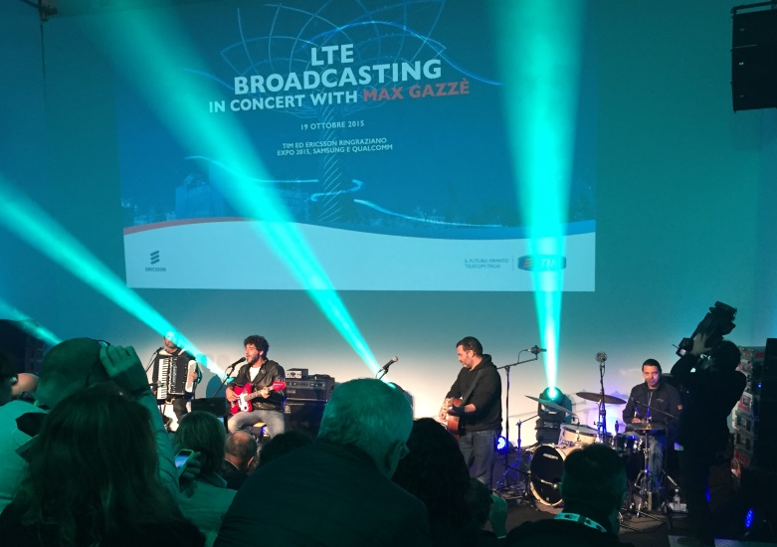
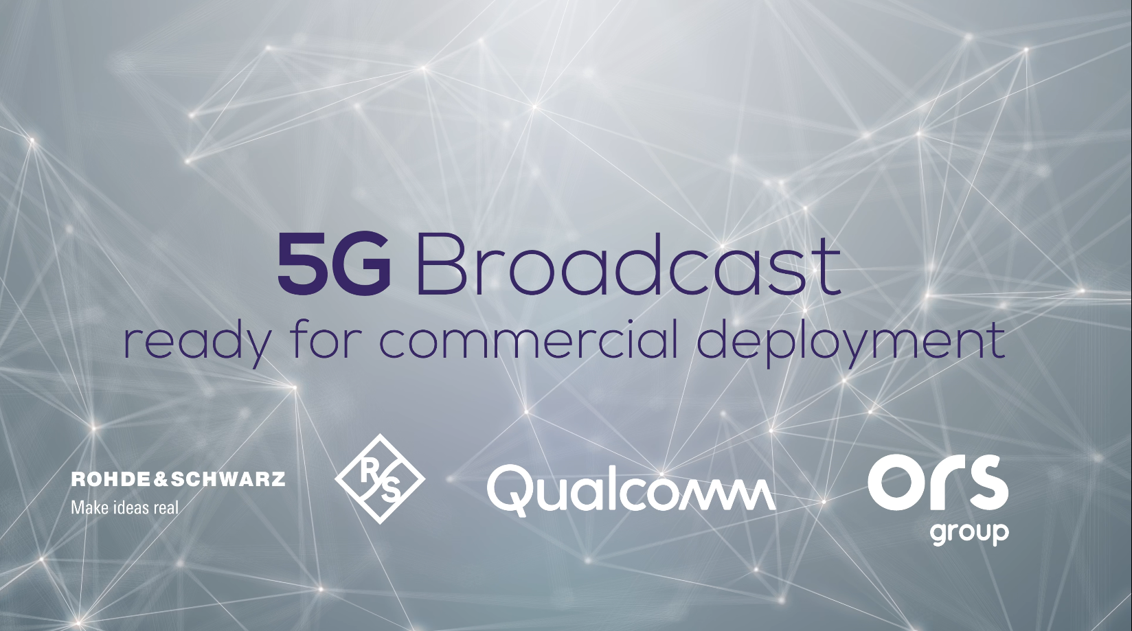
Taking a system approach to technology innovations
Invention
Inventing new technologies and
end-to-end system architecture
We pioneered key cellular broadcast
technologies for 3G, 4G, and 5G
Standardization
Leading ecosystem towards new projects and driving new system designs
We led the mobile and broader industries to standardize cellular broadcast
Commercialization
Engaging with global ecosystems to deploy new products and services
Successfully productize cellular broadcast in our products
1
2
3
4
5
6
Vision
Identifying a problem or need, and establishing system requirements
We envisioned a more efficient
way to deliver mass media over
cellular networks
Proof-of-concept
Delivering end-to-end prototypes
and impactful demonstrations
We showcased cellular broadcast
technologies at various industry events
System Trials
Collaborating on field trials that track standards development, preparing for commercialization
We worked with mobile operators, device manufacturer and content providers on trials
Joint demo at MWC’23
Making cellular broadcast a reality

Slide 23


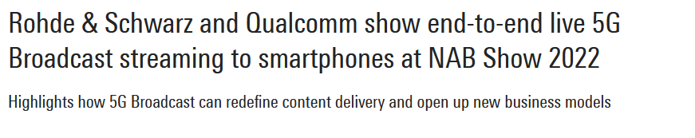
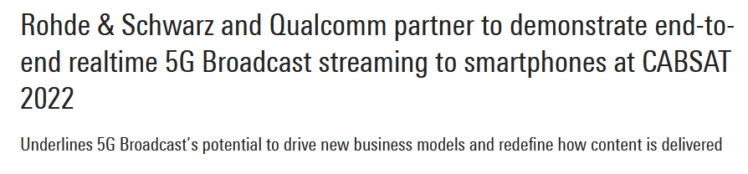
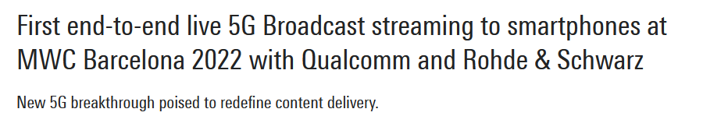
Proof of concept in 2022:
Objective: confirm feasibility and move ecosystem towards commercial deployments.
Summary of features:
  Reception from broadcast transmitter
  Reception in broadcast UHF spectrum
  Operation without SIM card
  Reuse of cellular hardware (smartphone)

Slide 24
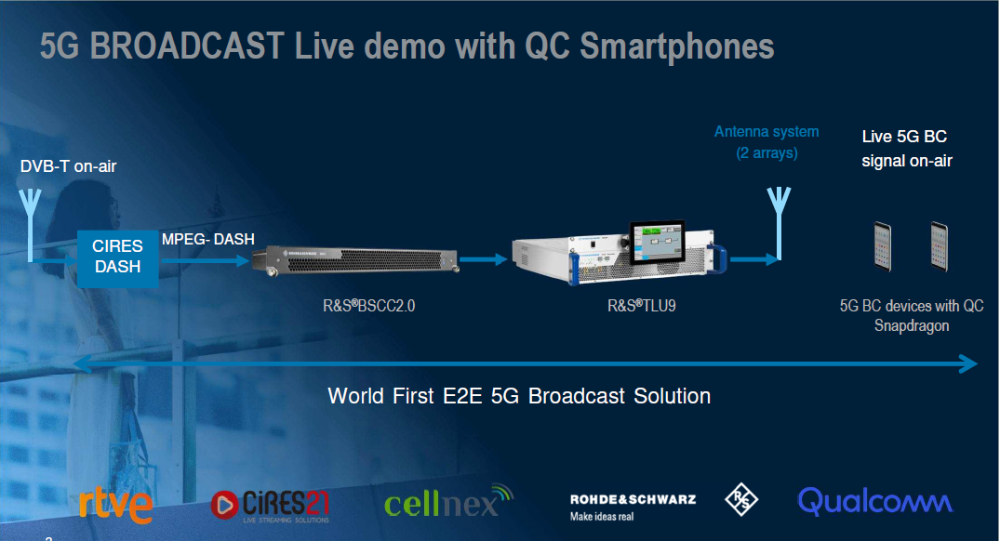
Spanish public
broadcaster
Streaming
solutions
Tower company
Network & transmitter
Smartphone / chipset

Slide 25
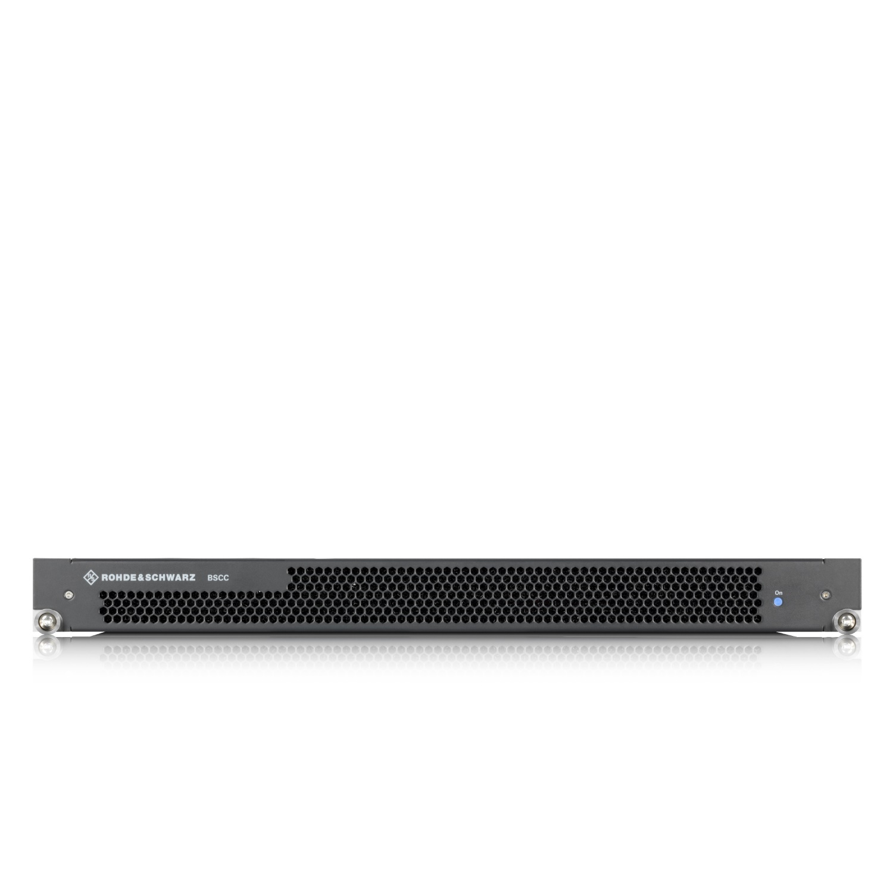



BSCC2.0 – Internal architecture
MBMS-GW
BM-SC
IP Multicast Allocation
Premium Content Synchronization
Bearer Management
SGi-mb
Packet Routing/Forwarding
SYNC
3GP DASH
TMGI Allocation
SG-mb
MPEG DASH
FLUTE
M1
ROUTE*
Content Provider
x-MB
SNYC / FLUTE
MCE
Diameter
SFN
MFN
FEC
RESTfull API
TSoIP
DASH
HLS
DTLS*
CMAF*
Multi-MCH
M2
Dynamic Radio Resource Management for Broadcast/Multicast
Service Announcement
Multimedia Content Multiplexing
Tx/eNB
M2AP
Carrier Management
MBMS Service Area Management
Dynamic Resources Scheduling & MCS
Carrier Aggregation
R&S Internal Interface
* In development

Slide 26
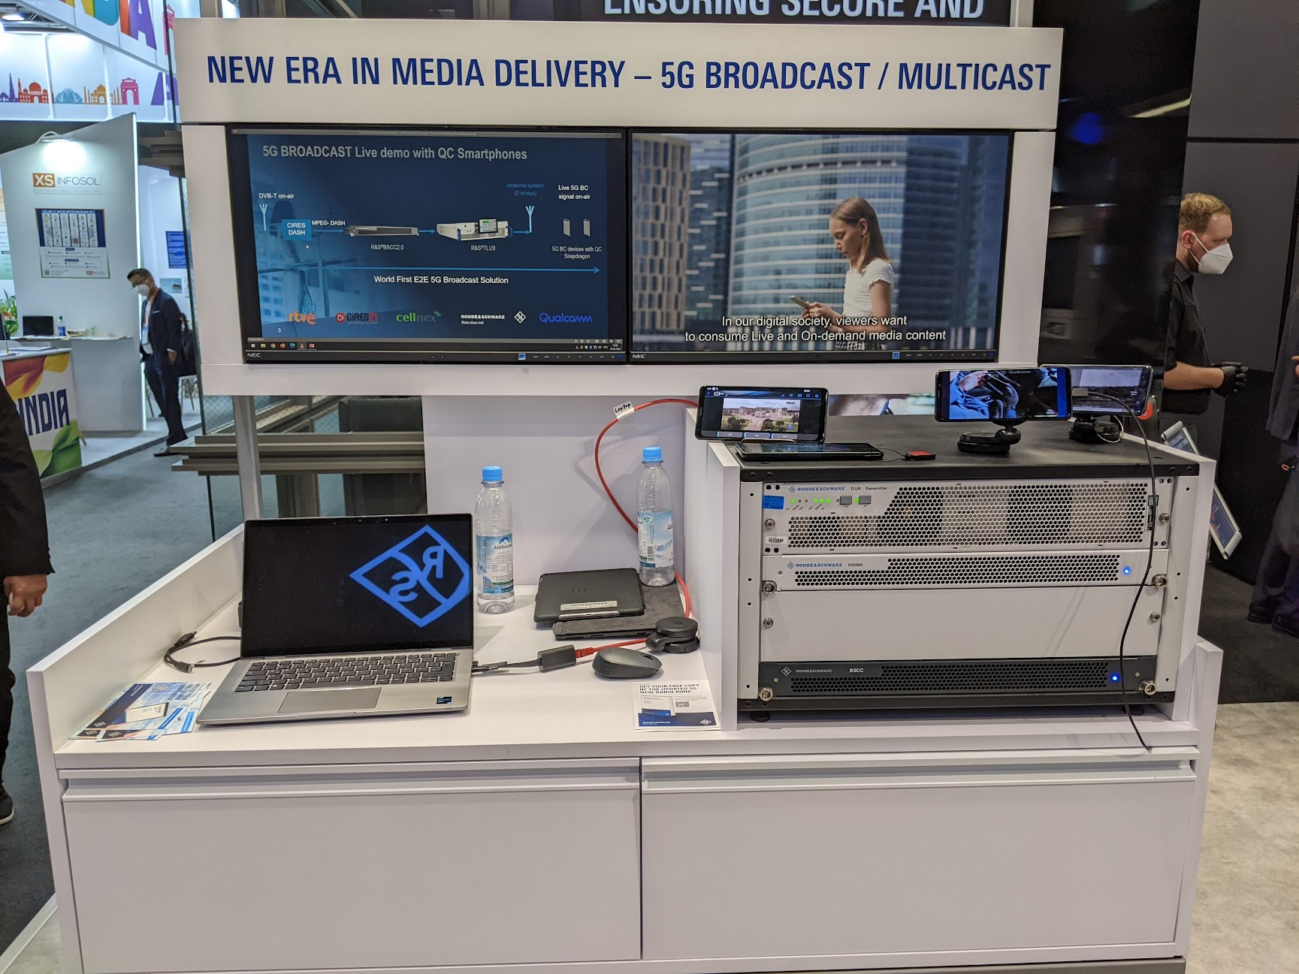
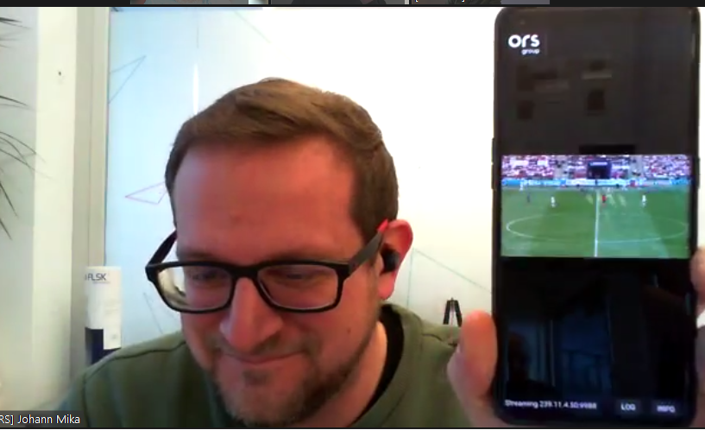
Qualcomm devices
QRDs based on Snapdragon 8 Gen 1 initially, now Gen 2 (8450 / 8550).
Modified (non-commercial) changes to enable a subset of 5G-broadcast features.
Meanwhile, Qualcomm supported enabling 5G Broadcast trials on Commercial devices by applying some firmware upgrades ➔ Commercial Research Devices (CRDs)
Additional trial features are expected in next release of QRDs and CRDs.

Slide 27
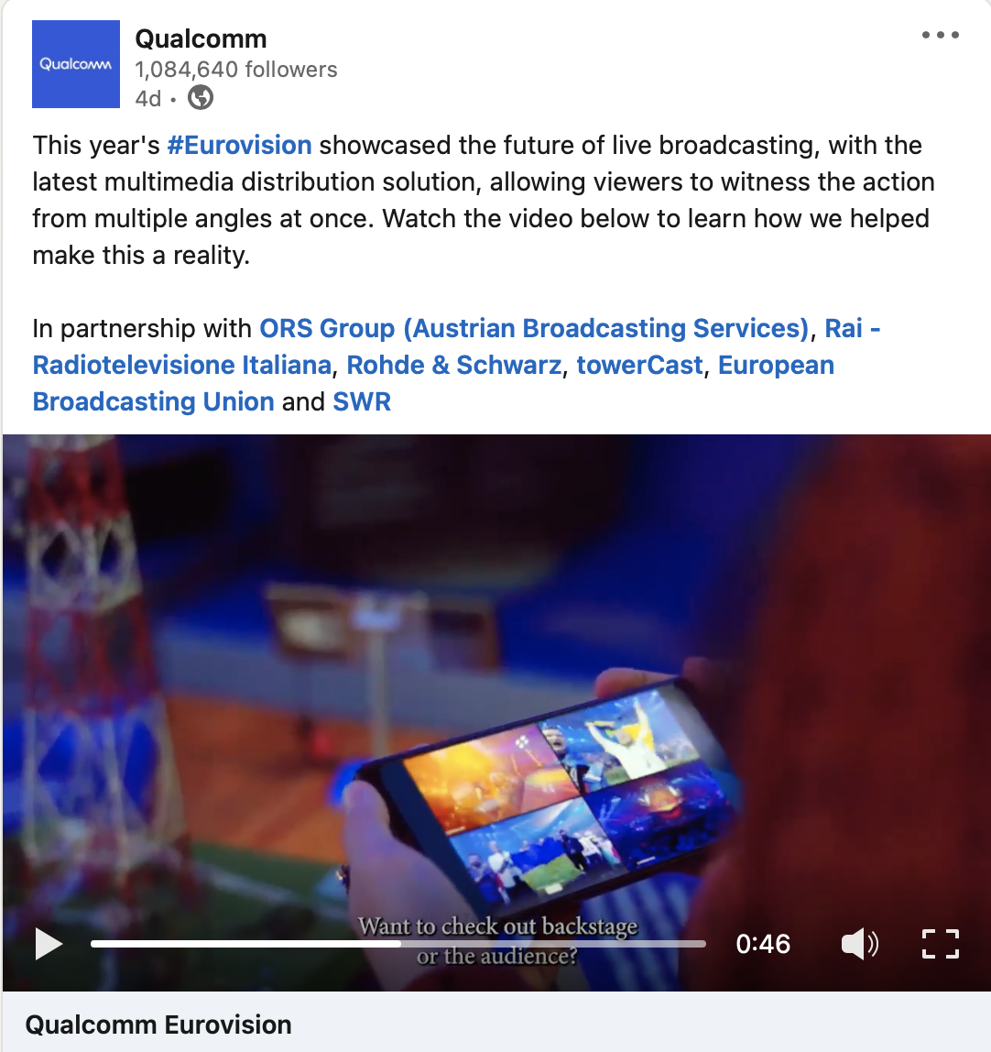
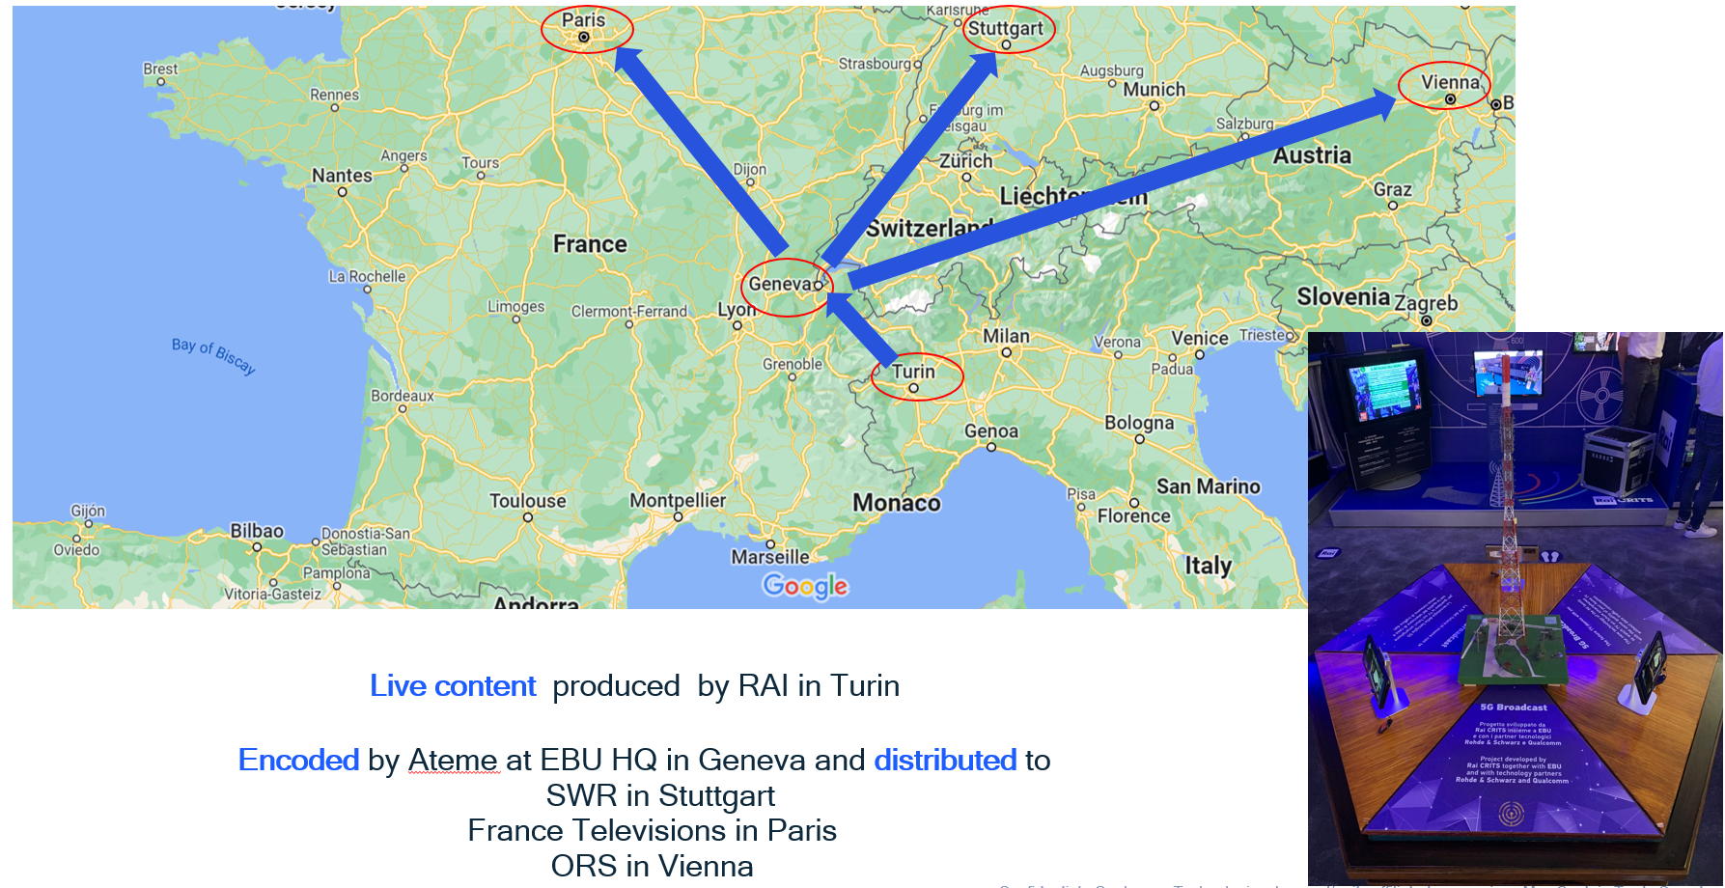
Eurovision Song contest
5G Broadcast demoed live in multiple cities
Link

Slide 28
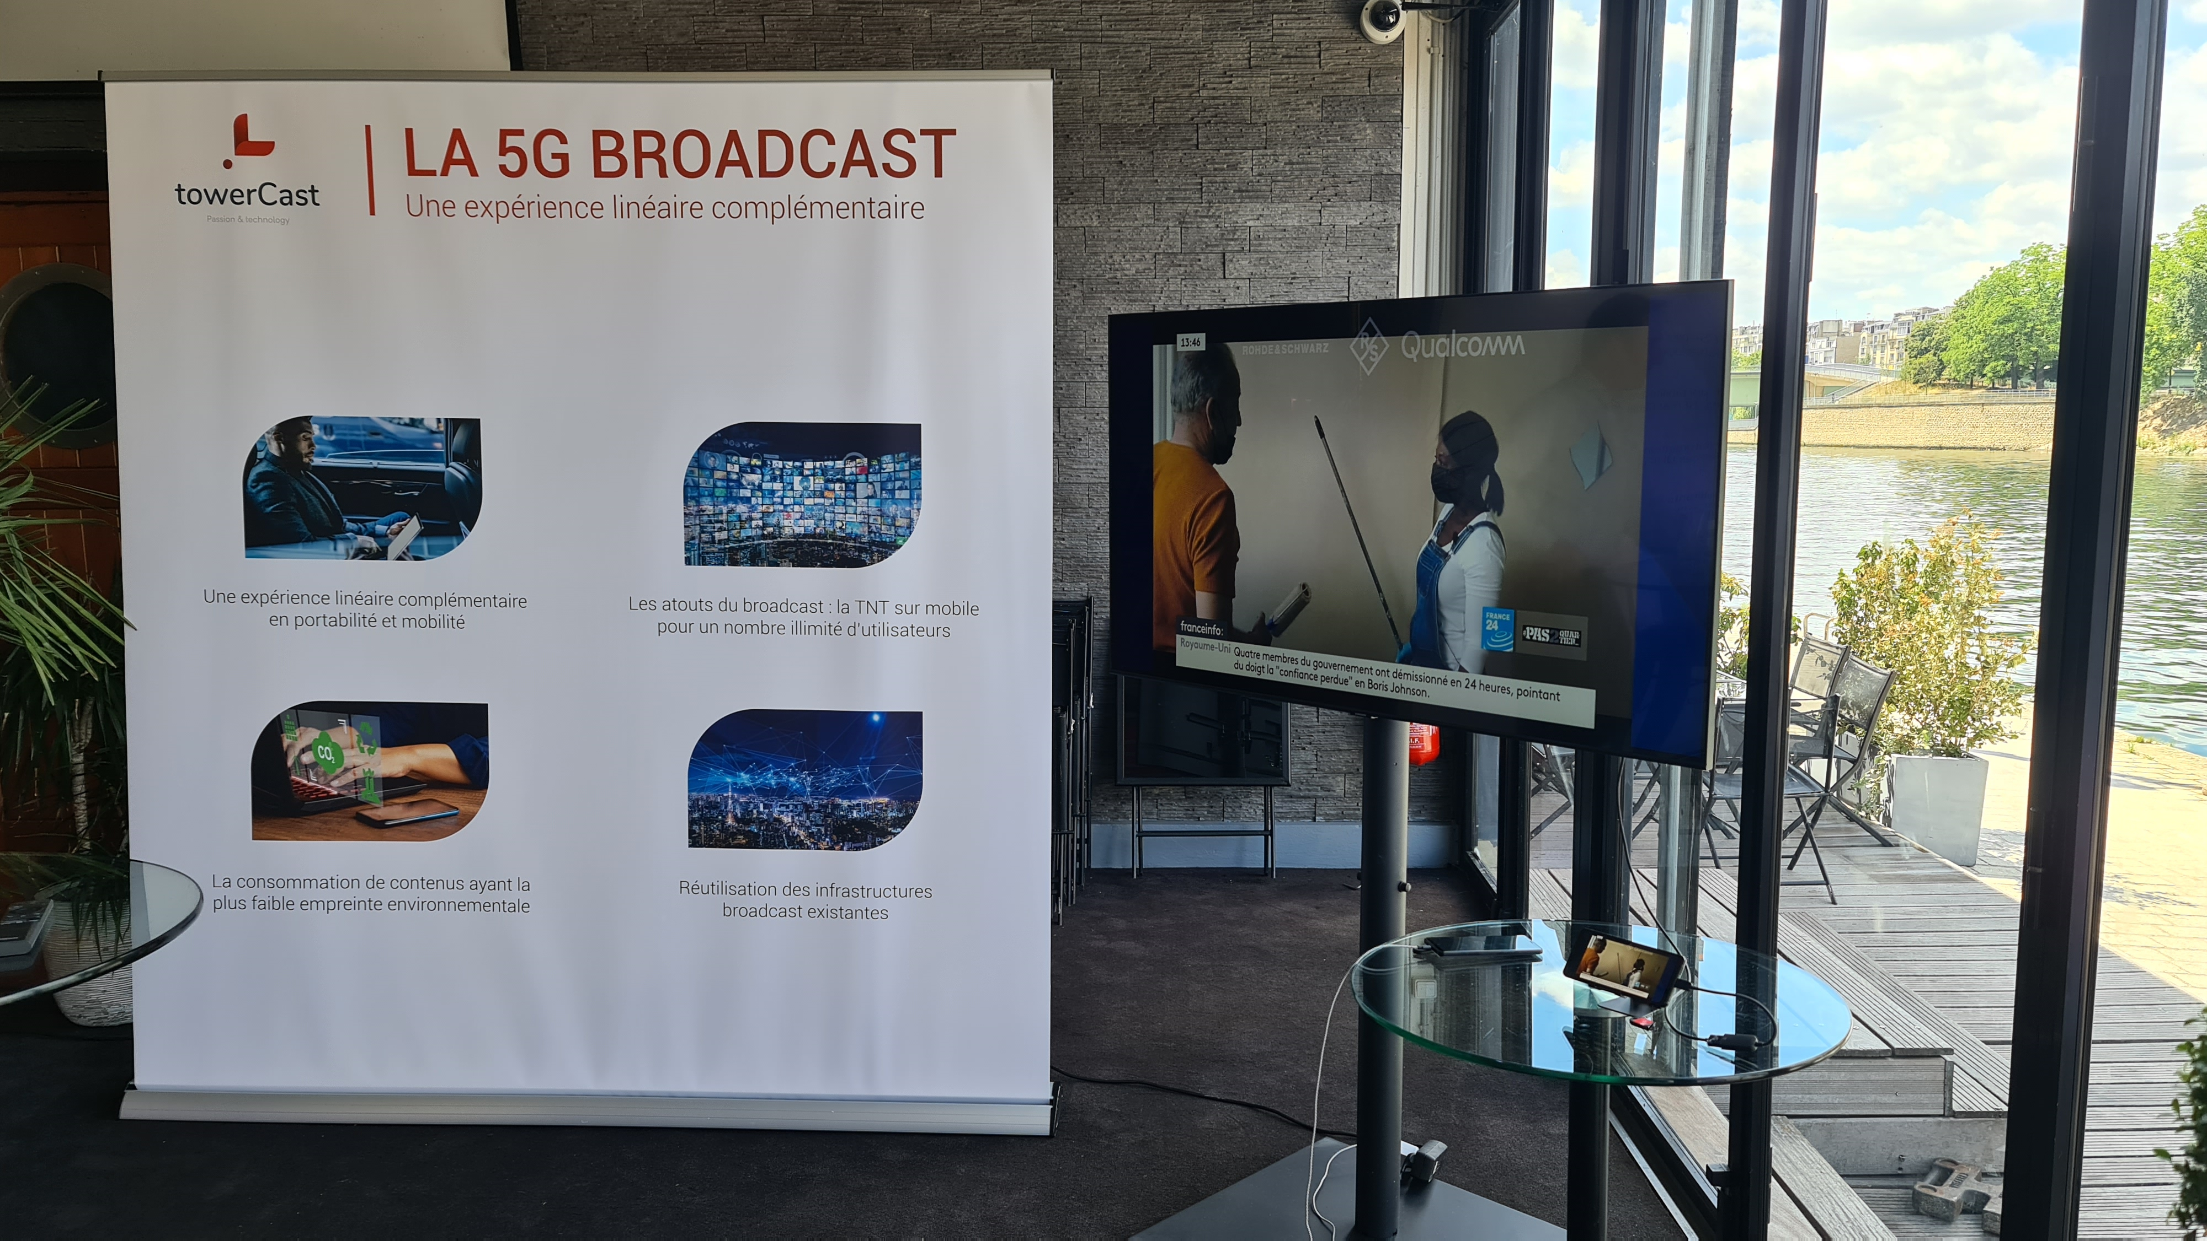

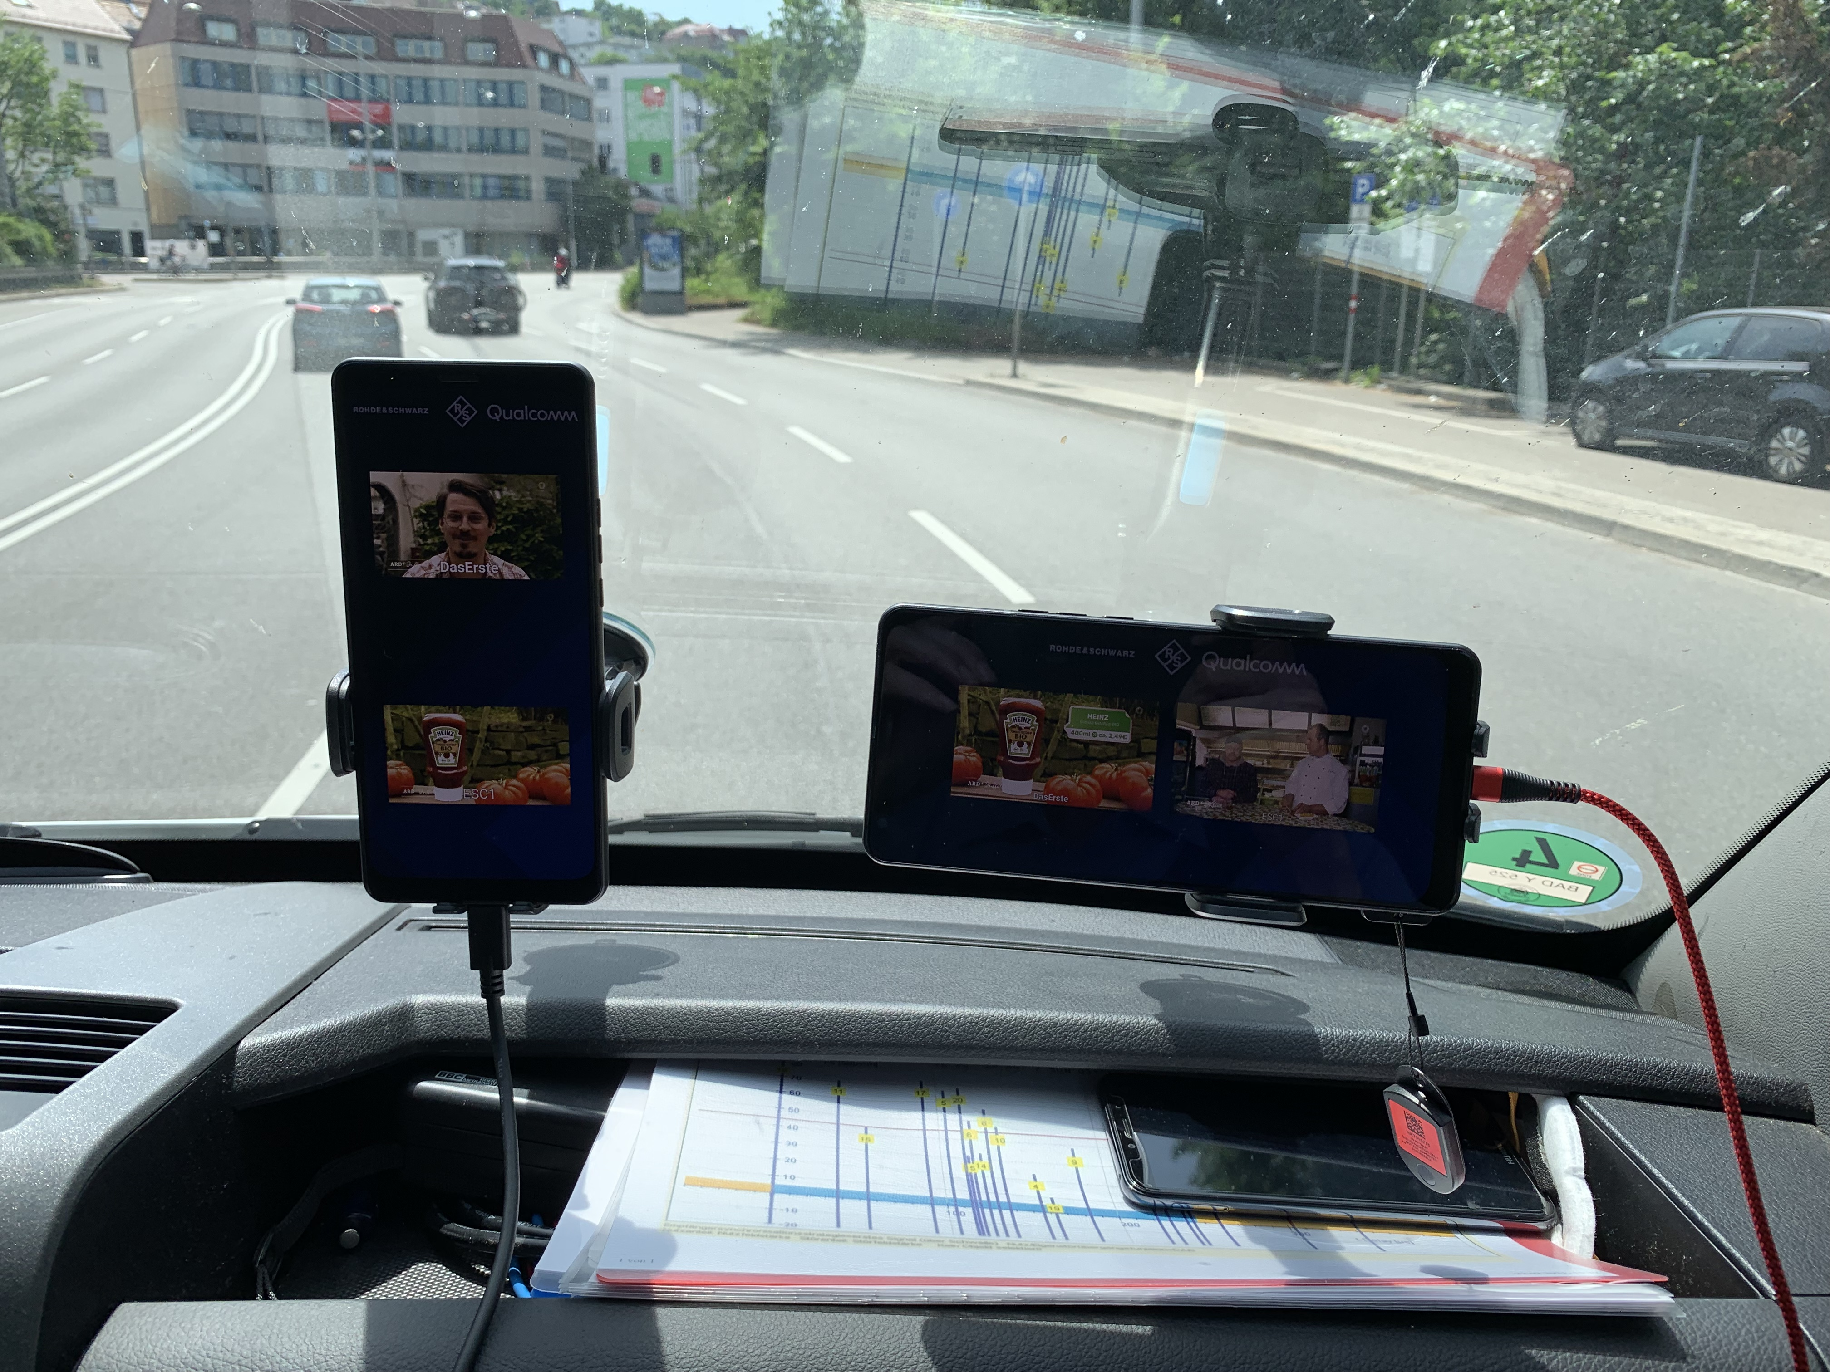
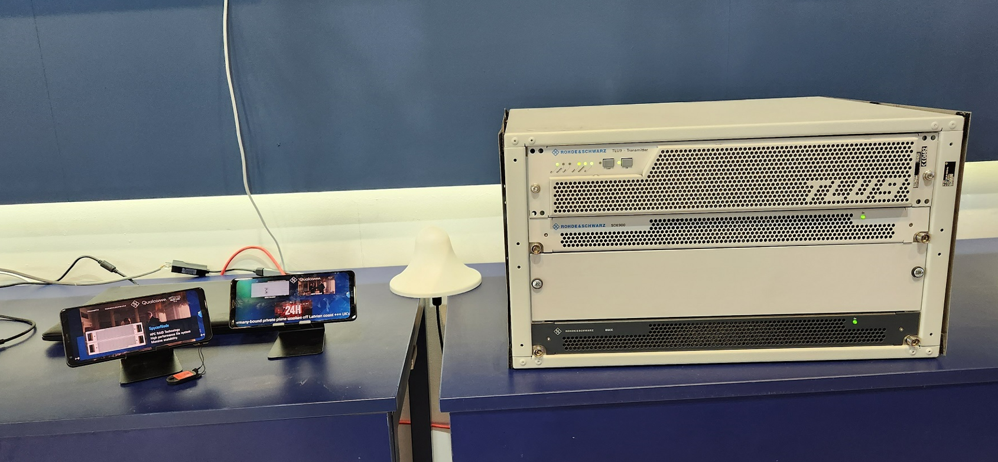
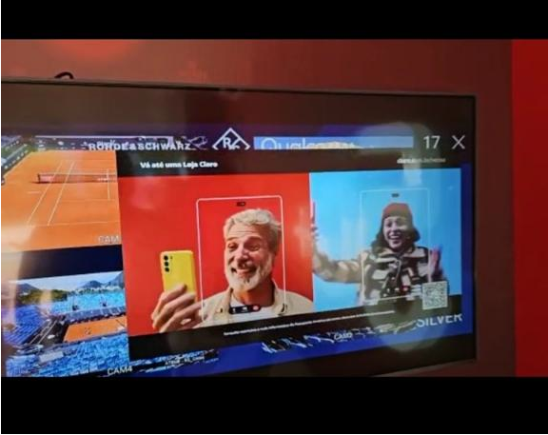
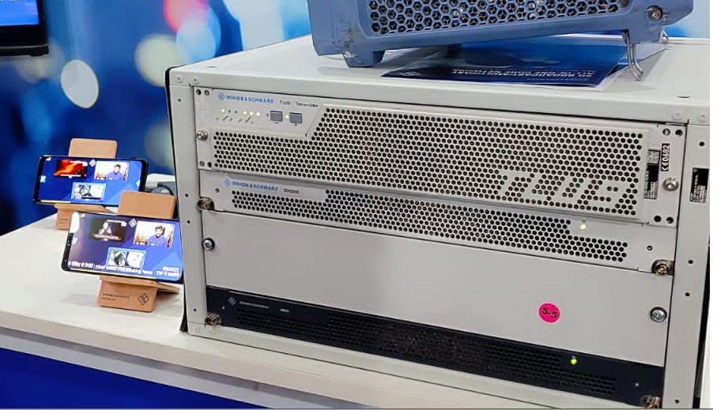
Other demos / trials
TowerCast event in Paris
MWC ‘23
Stuttgart (test drive)
IMC’22
CABSAT’22
Rio open ‘23 (BR)
BES expo (Delhi)

Slide 29

Selected use cases
One-way communication directly to handsets
More cost efficient than unicast (RAN and CDN)
Live sports, special events, general programming
Key for massive events (e.g. World Cup)
Emergency notifications to smartphones from broadcast infrastructure.
Possibility of sending text-only notifications and multimedia content
Linear TV and Radio
Emergency messages
Combine linear video with interactivity.
Linear content from broadcaster, unicast using mobile network.
Comments, ratings, e-commerce, advertising
Interactive media
Software / firmware upgrades.
Download and storage of popular content:
  TV shows
  “Viral” videos in social media.
General file download
Enhanced broadcast use cases with 5G broadcast

Slide 30
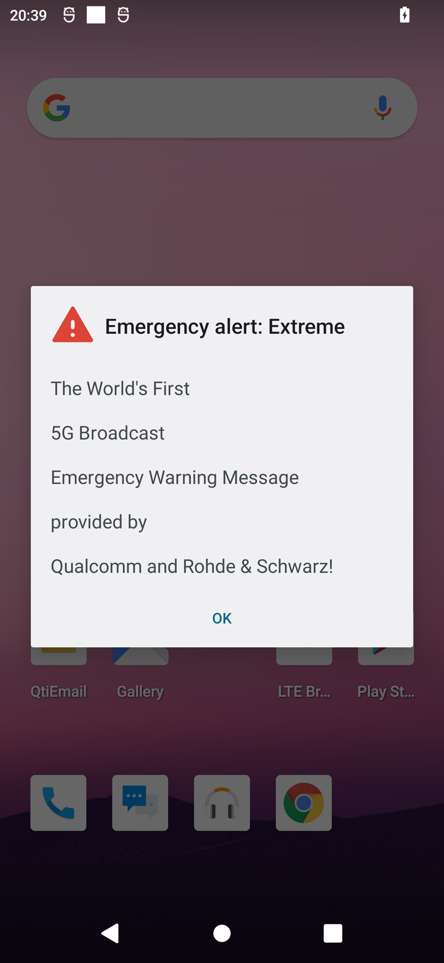
Emergency alerts
5G broadcast inherits from 5G the public warning system capabilities.
The Cell Broadcast Service (CBS) does not require authentication with a PLMN. Hence, a ROM network is inherently compatible with CBS (see 3GPP TS 23 041).
CMAS (commercial mobile alert system) is available in current commercial devices.
  Devices monitor periodically a low-duty cycle paging channel (low power)
  CMAS over 5G broadcast has been demonstrated with R&S infrastructure
Additional capabilities of CMAS:
  Geofencing (send notification to users within a given area)
  Possibility of sending URL linking to emergency media

Slide 31

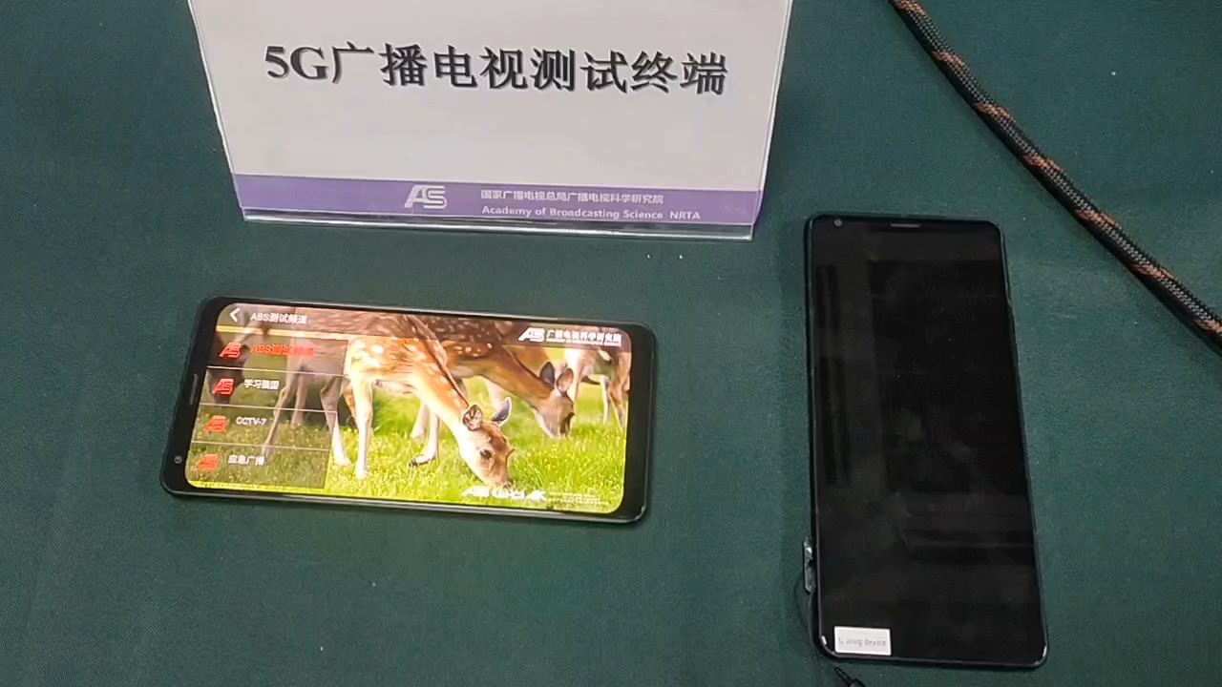
Emergency message demo with ABS
Self-contained emergency system (text + multimedia) without need of unicast.

Slide 32
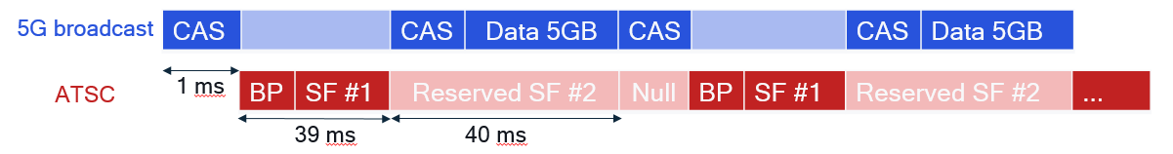
Coexistence of ATSC 3.0 & 5G Broadcast
Work Item in ATSC approved and 3GPP under preparation
ATSC 3.0 & 5G Broadcast can coexist: it does not have to be a either/or
5G Broadcast can be deployed by broadcasters in the exact same way as ATSC, and it greatly lowers the barrier to adoption in mobile devices since it is “only” an incremental feature to the 4G/5G modem
  Native broadcasting technologies like ATSC or DVB were never successfully incorporated in mobile devices at scale because their inclusion requires a separate piece of silicon (similar to, say, WiFi or GPS) and the ecosystem never took off
We could make use of the “reserved” frames of ATSC 3.0 to “superimpose” 5G Broadcast, thus achieving coexistence on the same channel
  An alternative would be for ATSC 3.0 and 5G Broadcast to coexist on two different frequencies, i.e. one MUX for each
The same broadcaster could thus deploy & operate both technologies at the same time
  ATSC 3.0 for fixed devices
  5G Broadcast for mobile devices
Documented in ATSC TG3-11
Rel-19 candidate work for 3GPP

Slide 33
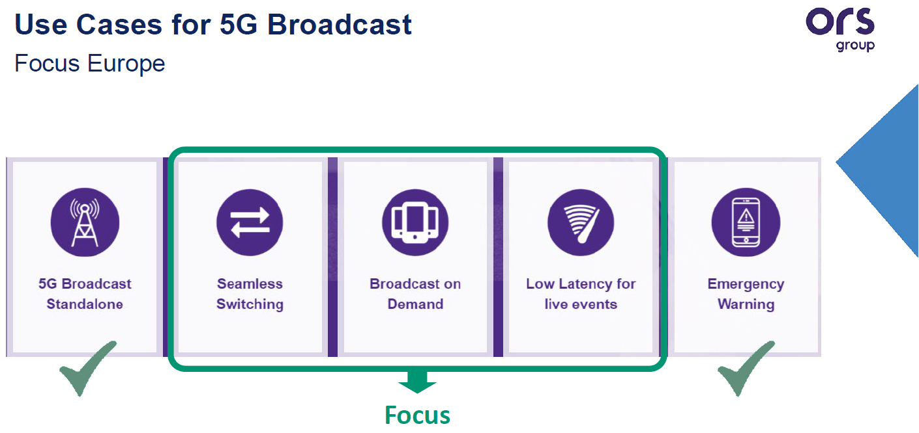
Hybrid Unicast Broadcast
5G MNO
Content Provider
Architectures, Collaboration Models and Use Cases
Content Provider may leverage 5G
Unicast systems, 5G Broadcast
systems, and 5G devices to build
efficient and innovative applications
Supported by well defined network
and client-side APIs
Examples:
  Hybrid Services
  Universal Coverage
  Broadcast on Demand
Integrated into 3GPP 5G specs, ETSI TS 103 720 and TR 103 972 (DVB over 5G)
5G Broadcast Operator

Slide 34
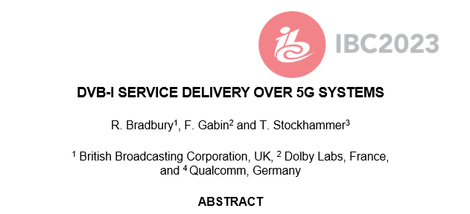


DVB-I via 5G Broadcast
Joint DVB/5G-MAG task force
Using MBMS/5G Broadcast Reference Points and APIs
Different options are considered
  Using file download services for carouselling metadata
  Using segment streaming for DVB-DASH
  Using transparent mode for DVB-I multicast distribution
Combinations with unicast, hybrid services also under development
See details in ETSI TR 103 972
Expected to be supported by reference tools

Slide 35




DVB-I over 5G – combining the best of two worlds
DVB Service layer with 5G Broadcast distribution – specification work
DVB Commercial Requirements in Bluebook C100 (07/21)
ETSI TS 103 720 (06/23): LTE-based 5G Broadcast
ETSI TR 103 972 (07/23): Deployment Guidelines for DVB-I services over 5G Systems
ETSI TS 103 770 DVB-I Service Discovery (11/20)
  Latest version used in trials is A177r4 (09/22)
  Latest published version is the bluebook A177r6 (02/24)
ETSI TS 103 285 DVB-DASH (Dynamic Adaptive Streaming over HTTP)
3GPP TS 26.501 (12/23), TS 26.510 (06/24) TS 26.512 (06/24)

Slide 36
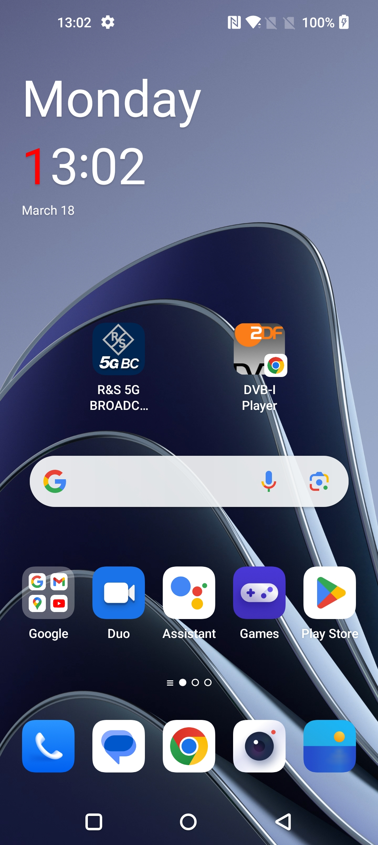


Qualcomm and Rohde & Schwarz show the world’s first standards-conforming demo of 5G Broadcast integrated into the DVB-I service framework on a commercial smartphone. 5G Broadcast transmissions from the Ismaning/Munich broadcast tower are added as service instance to a DVB-I service list and the DVB-I client is updated to select services included in the 5G Broadcast signals. The 5G Broadcast signals are integrated in the service list of the German DVB-I Pilot, whereby the instances for 5G Broadcast get highest priority and will hence be selected by the 5G Broadcast capable receivers, but ignored by regular TV sets or smartphones.
Joint demo of Rohde & Schwarz, Qualcomm and the colleagues from ZDF and ARD

Slide 37



5G-MAG Reference Tools?
  Developer Space
  https://developer.5g-mag.com
Current list of official contributors

Slide 38
Summary & Next Steps
Join the community of open standards, innovation and development
5G is a platform for Broadcasters and Content Providers with features including 5G broadcast, Public Warning and many others
3GPP Standards are global and address billions of devices – from smart phones to many more verticals (automotive, IOT, etc.)
Qualcomm contributes, supports and drives open systems through technologies, standards and reference tools

