Slide 1

5G Broadcast –Technologies, Standards and Productization
September 17, 2023
IBC 2023, FOBTV
@qualcomm_tech
Dr. Thomas Stockhammer
Senior Director Technical Standards
Qualcomm Technologies

Slide 2
5G defines two modes of broadcast communication
Focus of this presentation
5G broadcast
Mixed-mode multicast
Broadcast spectrum (e.g. UHF)
No unicast. Downlink – only traffic.
Delivery of linear content (e.g. TV) or IP file delivery
Dedicated broadcast infrastructure (can be high power)
Operator spectrum (IMT)
Integration with unicast network
Efficient delivery of multicast/broadcast traffic (vs unicast)
Reuse of cellular infrastructure (low power).
Single Frequency Network (SFN) for downlink broadcast only
Dynamic switching between broadcast and unicast, e.g., SC-PTM¹
Addressing diverse ecosystem, deployment, and use case requirements

Slide 3
General technology introduction
5G broadcast and 3GPP
“5G broadcast” is a broadcasting standard defined by 3GPP (Release 16 - 2020)
3GPP is the industry group responsible for defining global cellular tech standards (e.g. 4G / 5G)
In the last few years 3GPP has expanded to new verticals (e.g. broadcast, automotive, satellite, etc.) hence it should not be regarded as a surprise that a broadcasting tech is coming out of 3GPP
Even though 5G Broadcast has been standardized by 3GPP, it is a broadcasting technology
I.e. meant to be used by broadcasting operators, in broadcasting spectrum
No need of supporting a unicast network. 5G Broadcast does not have anything to do with unicast
The main design target & “reason for being” of 5G broadcast is to enable operation of a broadcast network where the receivers are hardware-compatible with cellular modems
“Hardware compatible” means lower barrier to adoption in mobile devices compared to other broadcasting technologies
This is because several 5G Broadcast building blocks are already there in a 4G/5G modem, hence the additions are marginal.
For other technologies, a separate piece of silicon / die area would be required
To be clear, 5G Broadcast has nothing to do with “cellular operators trying to take over from broadcasters”

Slide 4
5G Broadcast – Core Features for multiple use cases
SIM-less reception with simplified architecture
Receive-Only Mode (ROM) & Free-to-Air (FTA)
Different spectrum options (e.g. UHF, SDL), as well as SFN/MFN
Various deployment possibilities (e.g. MNOs, BNOs)
Using existing infrastructure (HPHT, MPMT and LPLT)
Highly flexible velocities (up to 250 KM/h Vs up to 300 µS)
Can be combined with existing 4G and 5G features (unicast, PWS)

Slide 5
Significant interests towards 5G broadcast deployment worldwide
Denmark
Tour de France 22 powered by 5GB
Italy
Germany
2018-23: TV delivery with Rel-14/16 HPHT in Aosta and Turin
Russia
2020-22: 5G Media2Go Stuttgart/Heilbronn
2017-20: 5G Today in Bavaria
Finland
2022+: 5G Broadcast under investigation as latest broadcast technology
Belgium
2019-22: TV delivery with Rel-14/16 HPHT in 3 sites
CZ
2022-24: 5G BC imec.icon project with 2 HPHT sites
2020-23: Distribution of TV/Radio in Prague
South Korea
UK
Austria
Late 2021: Distribution of live TV using Rel-16 enTV near Seoul
2020-22: VISTA Project with O2 Virgin Media
2020-23: Distribution of TV/Radio with 5G BC Rel-14/16 , with eMBB in Vienna
Europe
France
2023: European broadcasters ink 5G Broadcast MoU
2018-2022: Live testing of 5G BC in Paris
Greece
US
2021-23: Live TV/Radio with 5G BC Rel-14/16 , with 3MHz in Athens
2020+: Growing interest in 5G BC in addition to ATSC3.0
2023: FCC Approves A Low Power TV Station To Broadcast Over 5G Networks
2023: First 5G Broadcast in the US and first 24/7 5G Broadcast station in the world on WWOO, Boston, MA!
Croatia
2022-24: Live 5G BC Rel-14/16
Philippines
2019-22: Direct to mobile Live TV/Radio in Manilla
Spain
Algeria
2020: Distribution of free-to-air linear radio and TV using Rel-14 enTV with HPHT in Barcelona
2022 & 2023: MWC demos
Malaysia
Brazil
2022: Interest towards 5G BC during Mediterranean Games
2023: Workshop on future of Broadcast
2020-23: TV 3.0 project calling for proposals
2019-24: AIB project based on 5G Broadcast under the administration of NRTA¹ and ABS²
2023: 5G Broadcast Chengdu pilot project formally kicked off on July 20th
Colombia
India
2020-21: Delivery of TV and radio with Rel-14 broadcast trial deployment in Santiago de Tolú
South Africa
2020+: Growing interest in latest broadcast³ technologies
2019-20: Live testing of Rel-14 in Johannsburg
China
¹ National Radio and Television Administration ² Academy of Broadcast and Science commercia potential ³ Prasar Bharti working jointly with IIT Kanpur on Next Generation Broadcast Technology

Slide 6
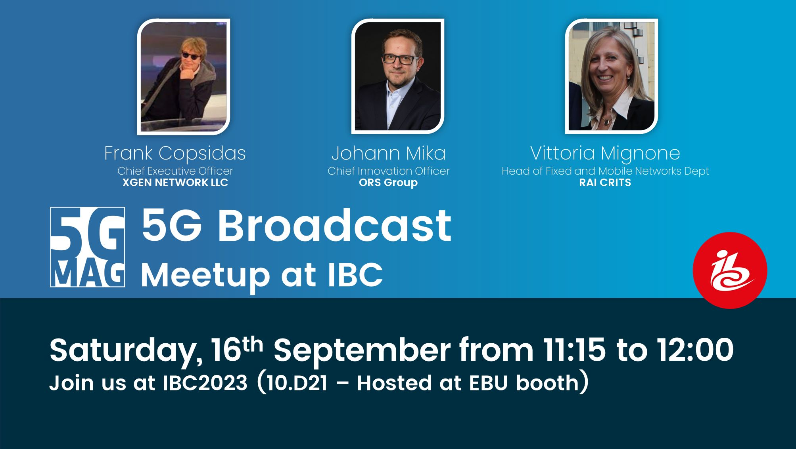
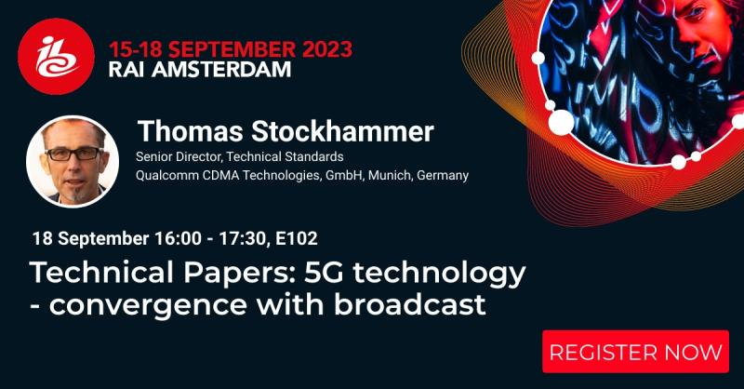
5G Broadcast at IBC 2023
To our best knowledge
Rohde & Schwarz and Qualcomm to demonstrate 5G Broadcast ecosystem readiness at IBC2023
At IBC2023 Rohde & Schwarz will demonstrate the latest innovative features, including seamless service continuity between broadcast and broadband, and low latency content distribution. Thanks to the software architecture of the TH1 transmitter family, all these and future enhancements can be readily added in the field on-demand.
https://www.nakolos.com/ibc2023/
XGen Networks (Hall 1.D90)
5G-MAG (5G MEDIA ACTION GROUP) @ EBU (Hall 10.D21)
SYES - System Engineering Solutions (Hall 8.F46)
Media Coding Industry Forum (Hall 8.B45)
Plisch/RFMondial (Hall 8.C61)
5G-MAG Meetup
IBC Conference

Slide 7
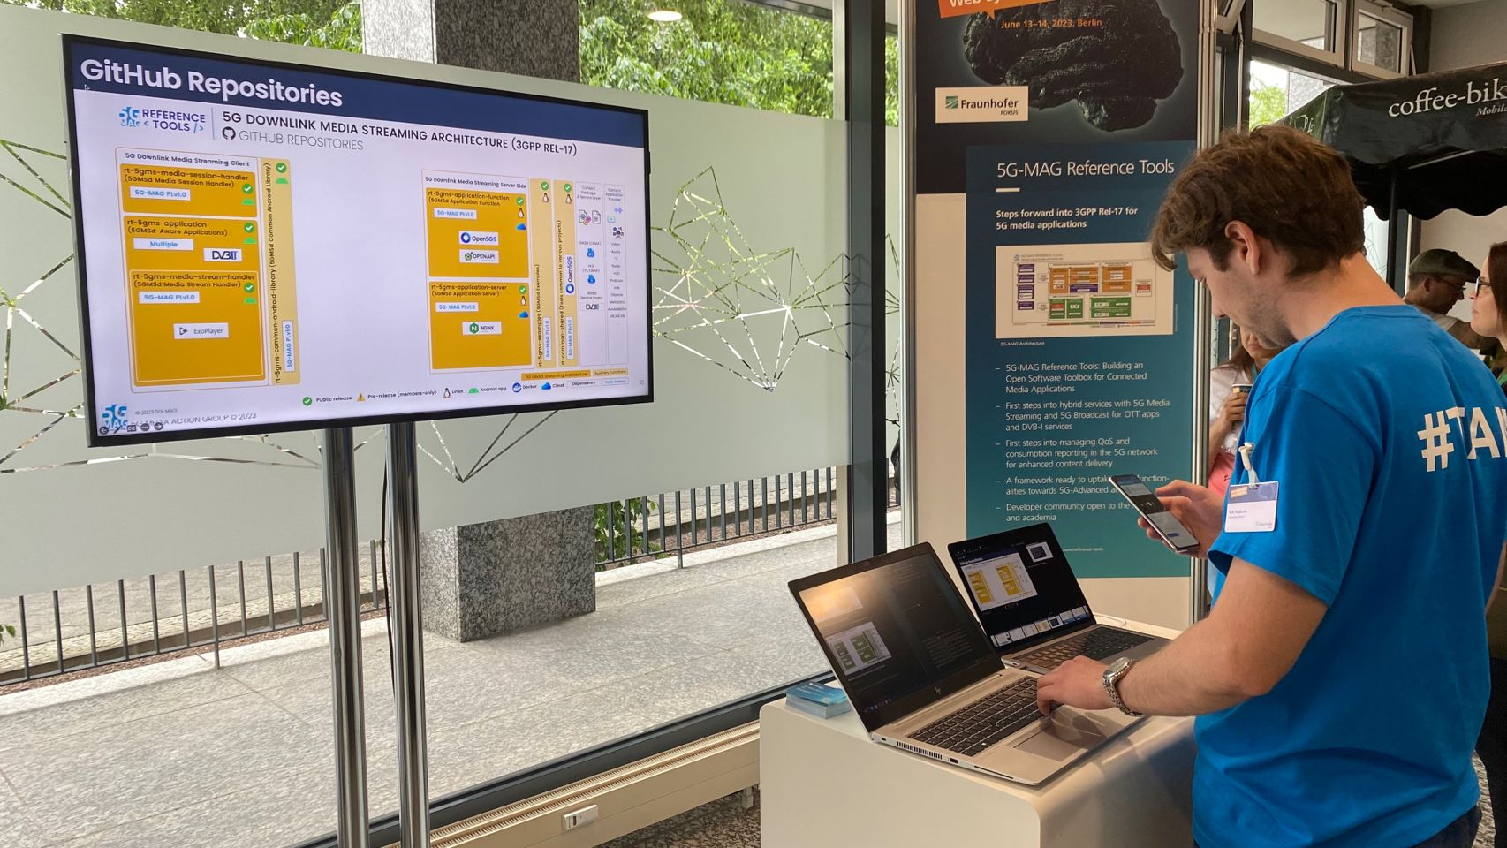

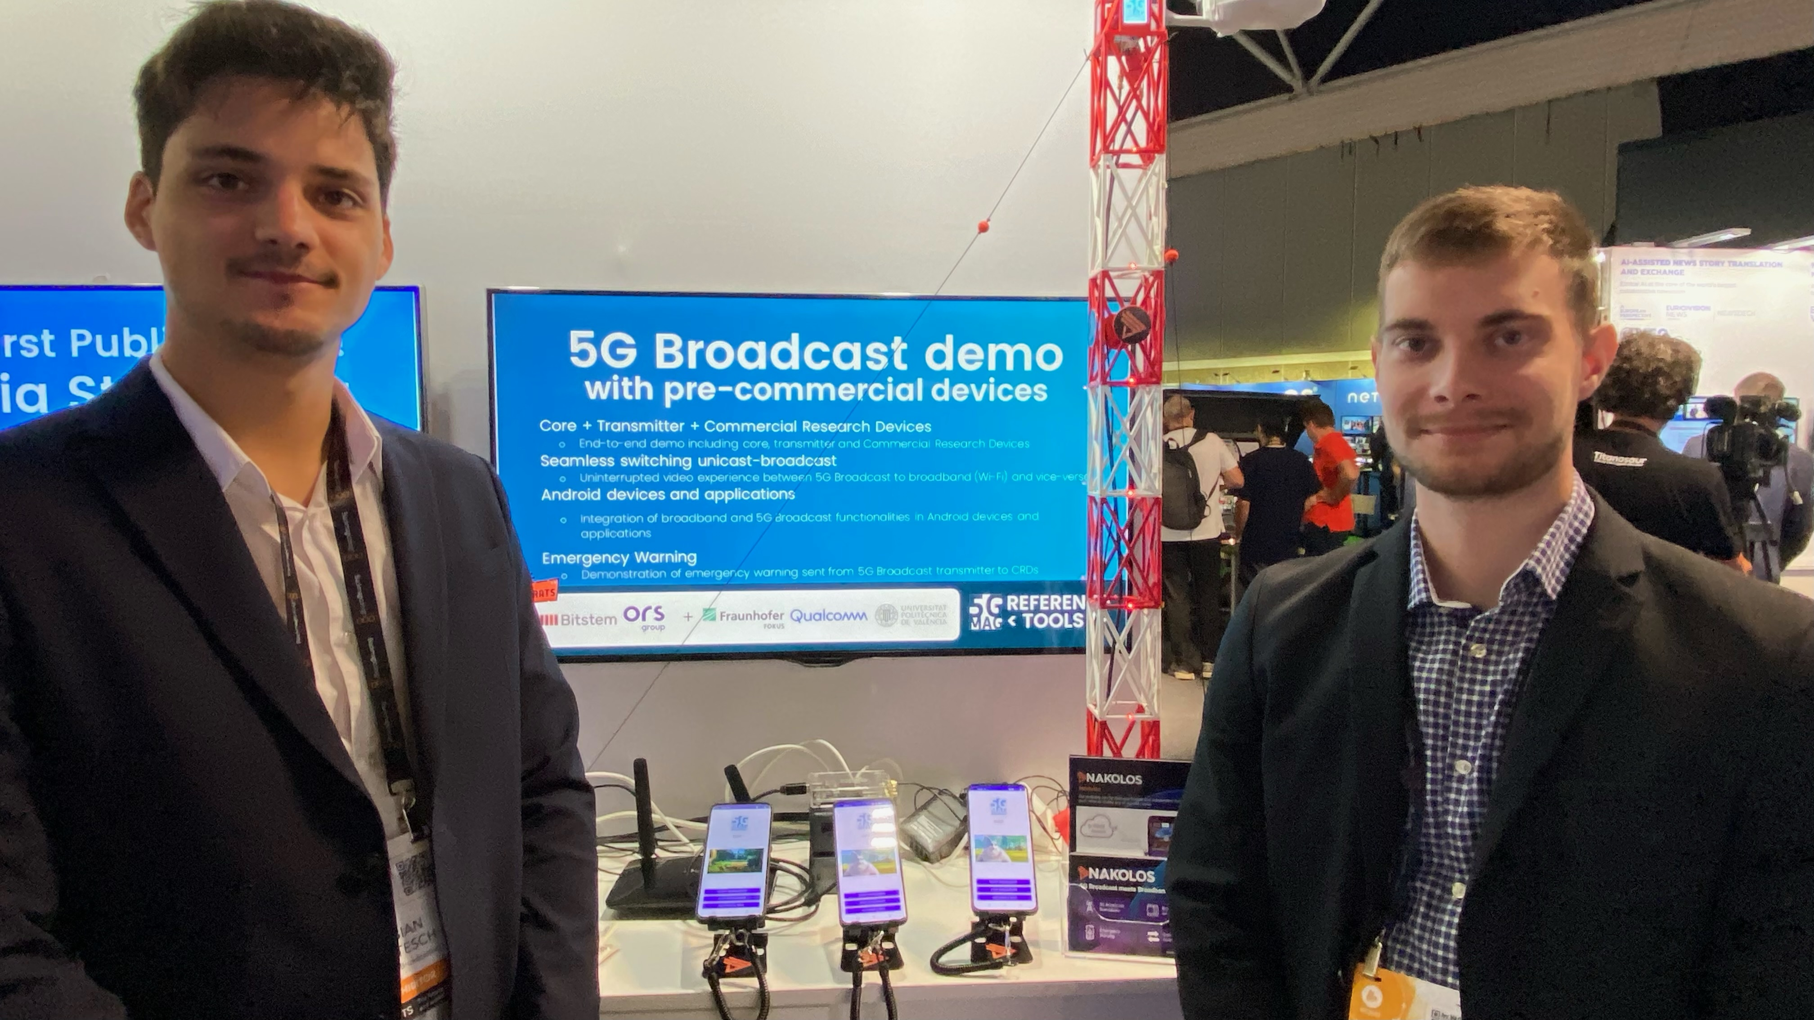
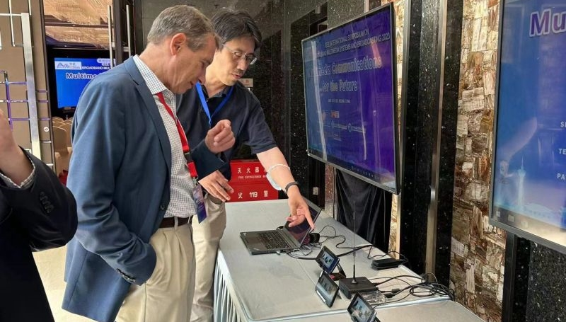
Demos 2023 – QRDs and CRDs are real phones

Slide 8
Standardization

Slide 9
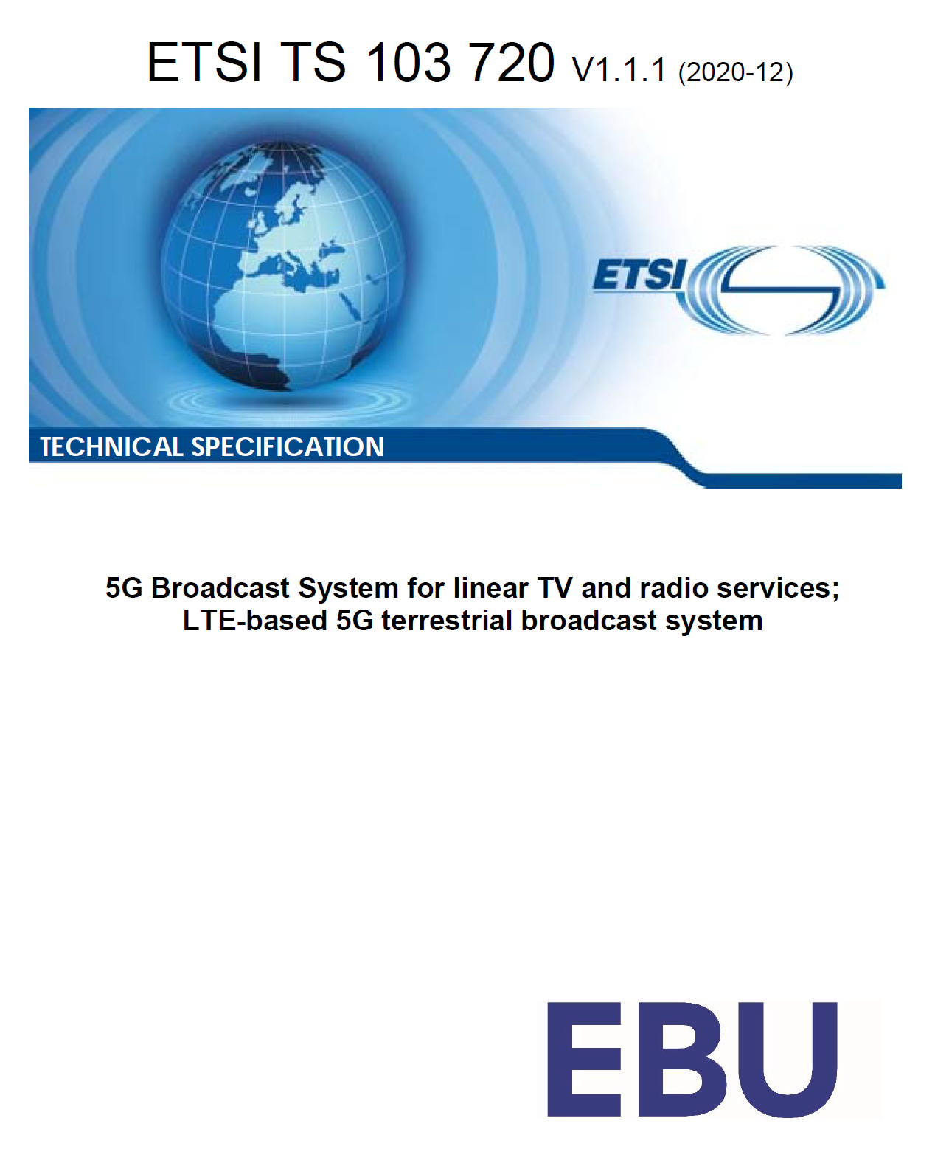
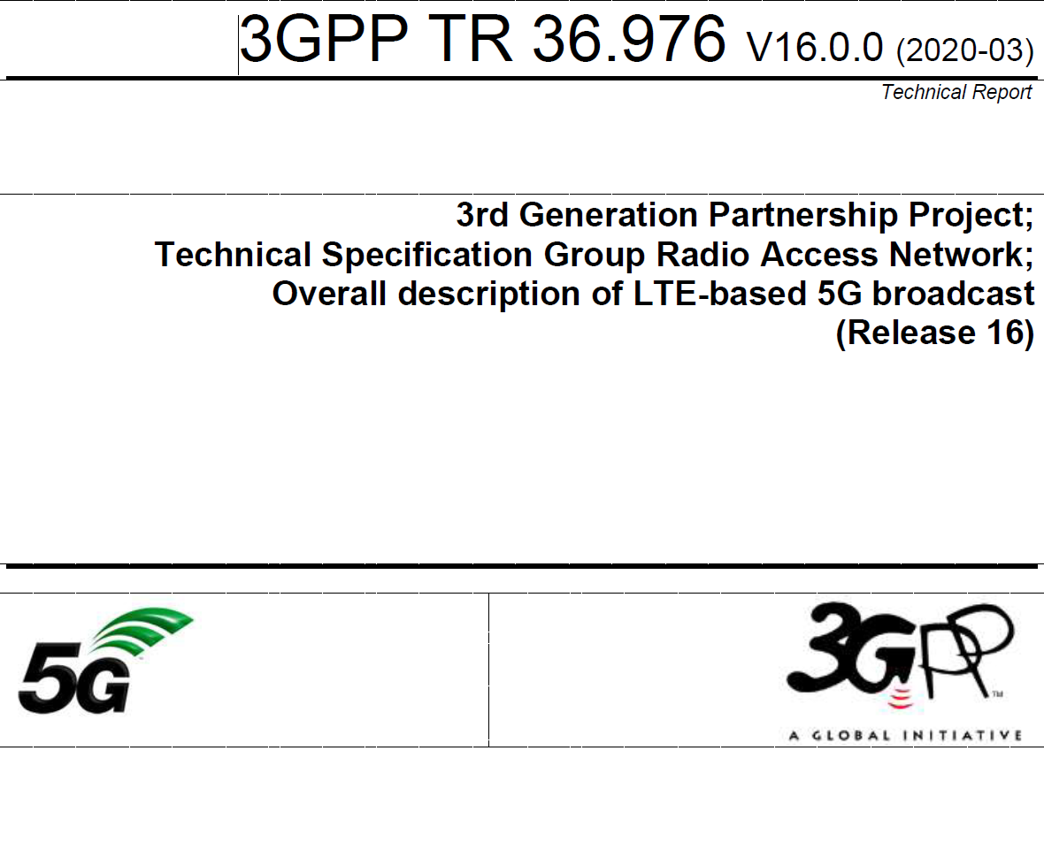
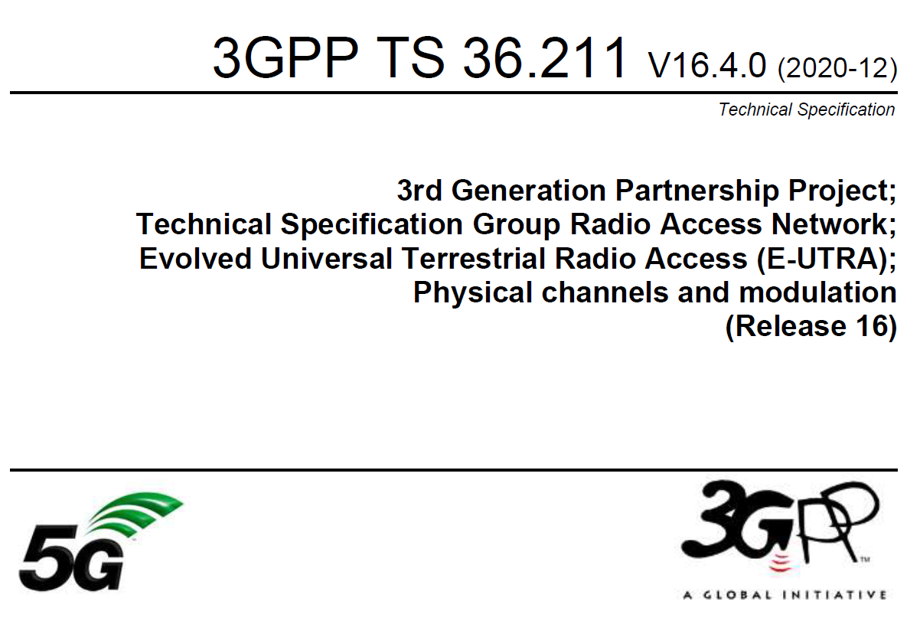
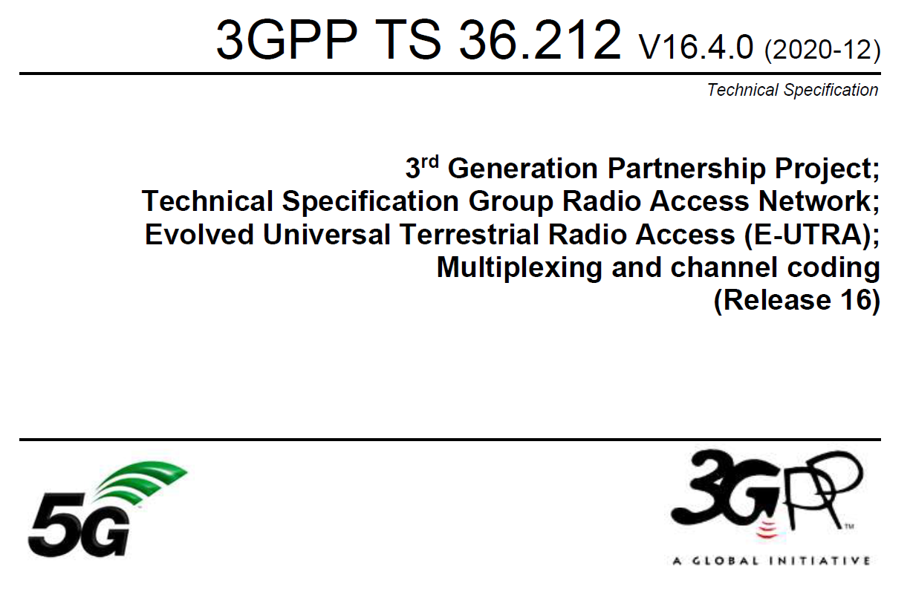
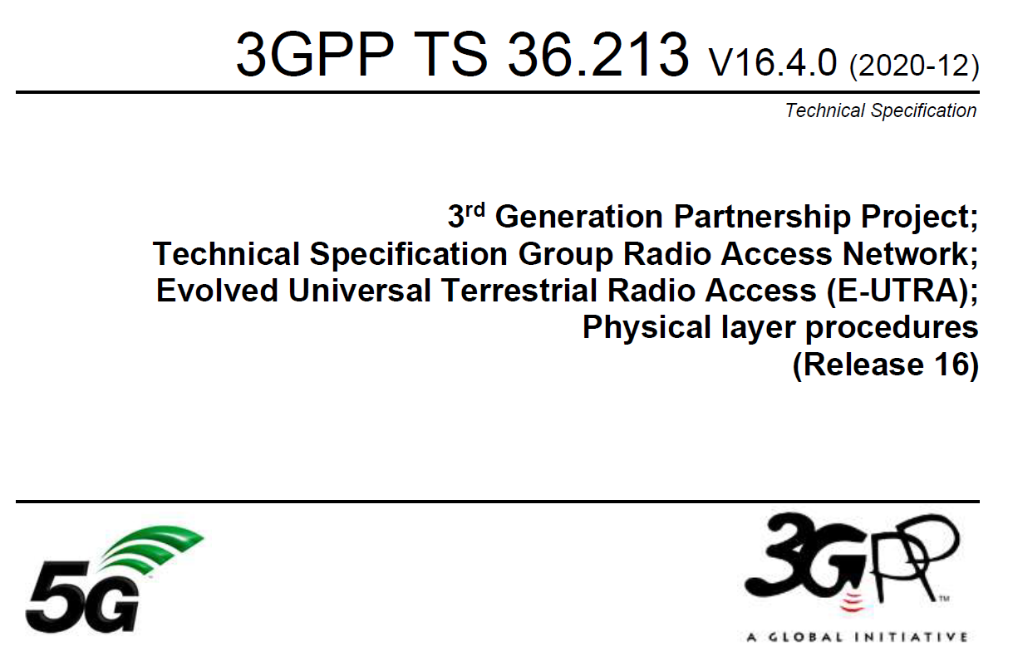
ETSI TS 103 720: Profile of 3GPP specification containing the necessary parts to deploy 5G broadcast
TR 36.976: Overall description of enhanced TV (enTV) for 5G broadcast
For more information on 5G broadcast standards…
Various specifications of 5G PHY supporting broadcast together with unicast in TS 36.211, 36.212, 36.213

Slide 10
5G Broadcast Standards Evolution
Rel-14
SCS1.25KHz/ CP=200µs Mobility up to 120 km/h
5G BC worldwide standard
TG6/1 and WP6A
Rel-16
Rooftop Mobility up to 250 km/h
5G BC is an EU standard (ETSI TS 103 720)
Rel-17 Enhanced BW= 6/7/8 MHz for UHF
Enhanced Version of ETSI TS 103 720
AI1.5 WRC23
Rel-18 Requirements for UHF band, URL Handling
Roadmap towards WRC23
ETSI 5G-MAG
3GPP
ITU
3GPP
ETSI
3GPP
3GPP
ITU
2017
2019
2020
2020
06/22
06/23
09/23
2023
Bug fixes and clarifications from trials & Rel-17
Adding bandwidth information, including 6/7/8 MHz
5G Media Streaming: integrated unicast & broadcast
Consistent codecs and formats
Support of Public Warning System & Emergency Alerts

Slide 11
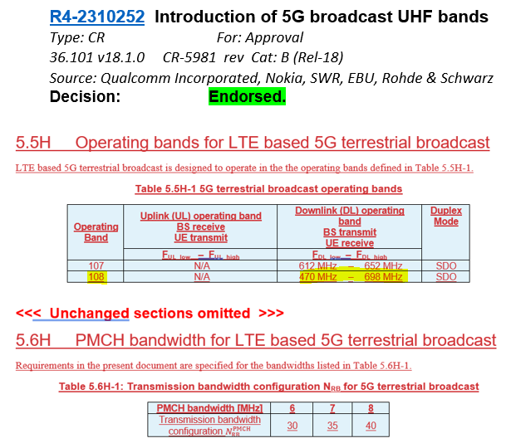
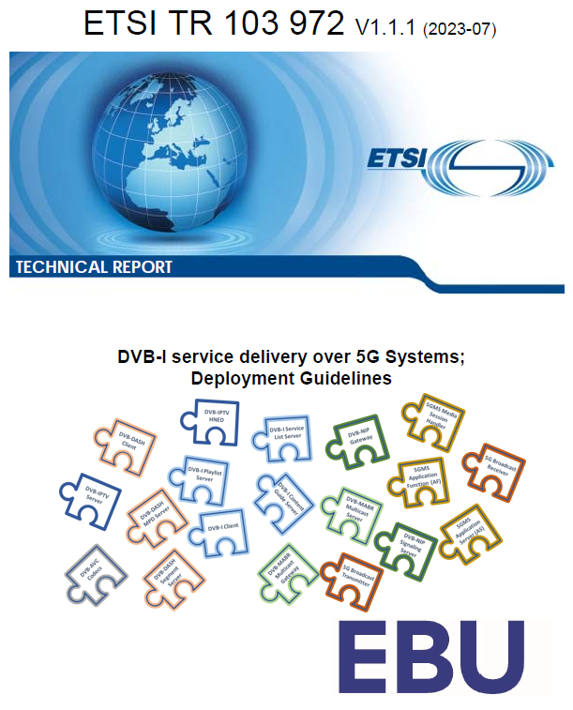
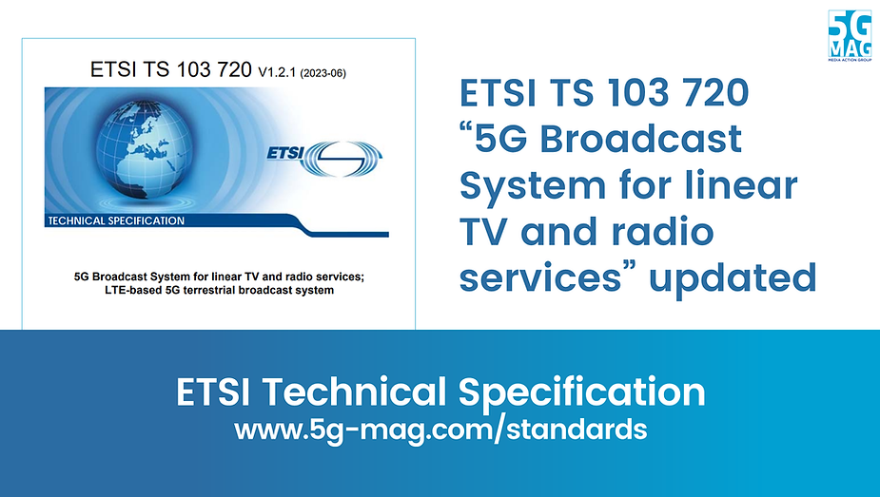
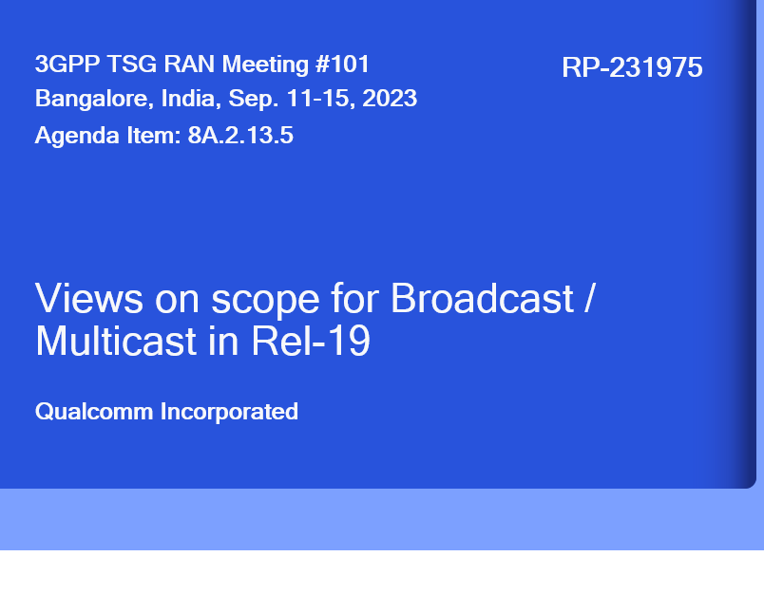
Latest Updates
5G Broadcast will evolve with 3GPP pace

Slide 12
Technology Evolution

Slide 13



MBMS/LTE eMBMS/5G broadcast History
3GPP could have taken a radical approach to define a clean slate radio system to meet the broadcasters’ requirements, instead a more pragmatic route was chosen. Experiences from the past with dedicated modems such as MediaFLO or DVB-H, and the need for easy integration into mainstream mobile devices, led to the decision to evolve eMBMS to LTE-based 5G Broadcast instead of any radical new designs.
Building upon a strong 3GPP technology foundation
5G
Further enhancements⁵
to fully satisfy 5G
broadcast requirements
LTE
LTE-A
LTE eMBMS/enTV
in 3GPP Rel-14
eMBMS defined for LTE starting in Rel-8/Rel-9, improving coverage and efficiency
eMBMS enhancements in Rel-12 include MOOD and expansion to MCPTT
Enabling terrestrial broadcast and expanding to new services; Meeting 7/10 5G Broadcast requirements in Rel-14
Enabling terrestrial broadcast and expanding to new services; Meeting all 5G Broadcast requirements in Rel-16
3GPP Rel-14 (completed)
3GPP Rel-16 (completed)
Target market focused on
Cellular operators
Target market expanded to
Broadcasters
5G broadcast is a “broadcast standard” (same target as DVB or ATSC) based on 3GPP silicon and ecosystem.

Slide 14
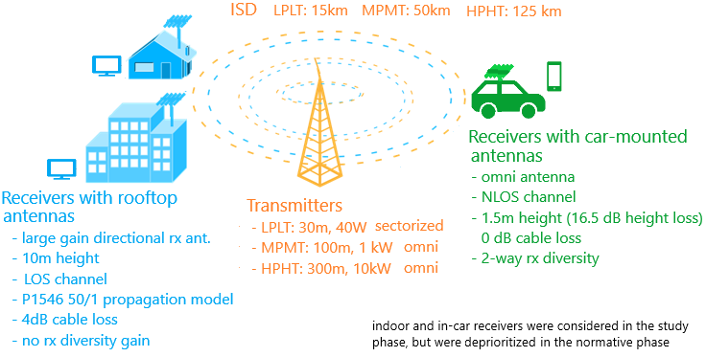


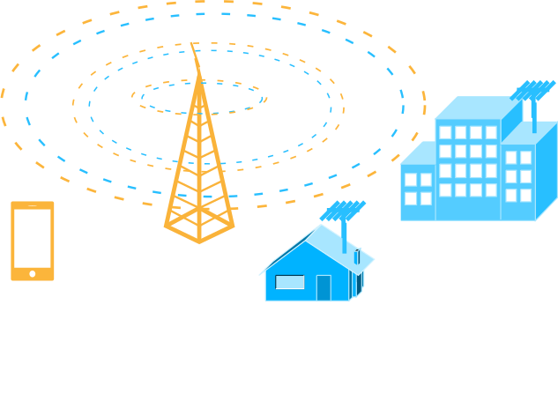
RAN: MBMS ➔ 5G Broadcast Evolution
Release 17/18
Release 16
6/7/8 MHz channel bandwidth to support common global channel bandwidth for broadcast systems
Introduction of UHF Band 108 to address RF transmitter and receiver requirements
Release 14
New numerologies to target rooftop reception with up to 125 km ISD
High mobility reception: fixed, portable and mobile receivers up to 250 km/h
Enhancements to CAS—increased PDCCH agg. Level, PBCH repetition, CFI in MIB
Release 13
Longer cyclic prefixes for support of larger ISD
Up to 100% of subframes for MBSFN transmission on a dedicated carrier
Subframes fully dedicated to MBSFN transmission
Targeting rooftop and car-mounted antennas, handheld receivers
Release 9
Single-cell transmission (SC-PTM)
Transmission on PDSCH with new group identities
Non-synchronized transmitters
Mixed unicast/MBMS carrier
15 kHz numerology
Extended CP of 16.7us
Multi-cell transmission only (MBSFN)
Up to 60% of subframes for MBSFN transmission
> 15 km
“Operator controlled” MBMS
“Broadcaster controlled” MBMS

Slide 15

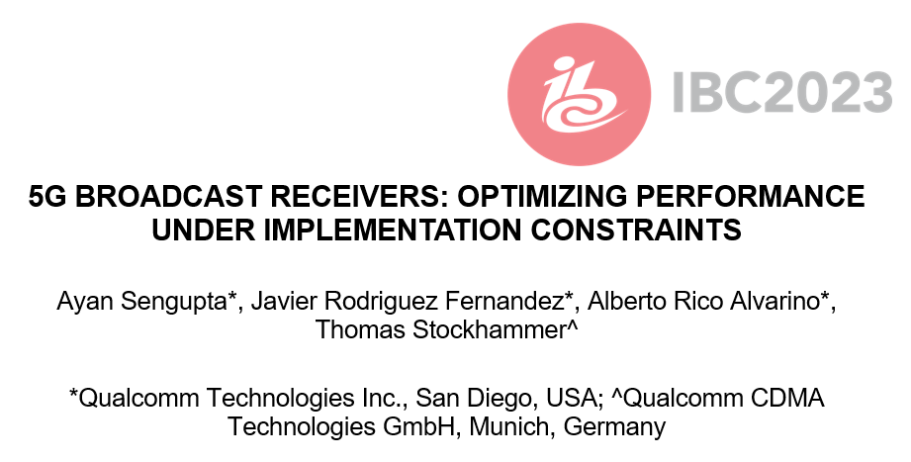



Slide 16
Summary and Conclusions
5G BROADCAST RECEIVERS: OPTIMIZING PERFORMANCE UNDER IMPLEMENTATION CONSTRAINTS
Broadcast networks and usage of configurations needs to be done for worst-case scenario.
For example, gains achieved in the 120 kmph scenario may not relevant, if such a planning would fail to serve a large number of receivers moving at lower speeds.
In this case, comparison between 5G broadcast and ATSC3.0 is provided for NLOS for different speeds and configurations
The main design target & “reason for being” of 5G broadcast is to enable operation of a broadcast network where the receivers are hardware-compatible with cellular modems
“Hardware compatible” means lower barrier to adoption in mobile devices compared to other broadcasting technologies
Several 5G Broadcast building blocks are already there in a 4G/5G modem, hence the additions are marginal.
For other technologies, a separate piece of silicon / die area would be required
In comparison with unconstrained broadcast designs, 5G Broadcast Rel-18 is only marginally worse and there are expectations to address remaining gaps in Rel-19 without compromising the design goals
5G Broadcast is a transport and is successfully combined with unicast service layers – seamless unicast fallback has been successfully demonstrated
SNR for | ATSC 3.0 + 1Rx | ATSC 3.0 + 2Rx | 5G + 2Rx | 5G + 2Rx + TFI
3 kmph | 14.4 dB | 8.7 dB | 10.7 dB | 8.9 dB
40 kmph | 11.2 dB | 6.6 dB | 10.9 dB | 7.3 dB
120 kmph | 10.8 dB | 6.2 dB | 11.4 dB | 7 dB
Worst case | 14.4 dB | 8.7 dB | 11.4 dB | 8.9 dB

Slide 17
Support the 5G Broadcast Community in 3GPP RAN Rel-19 Planning
Come to RAN#102 to Edinburgh and co-sign the initial proposal from Qualcomm and 5G-MAG input
For Rel-19, we propose to have a small work item on necessary enhancements for 5G Broadcast (5GB) that are essential for its deployment.
The scope of the proposed enhancements is limited to coexistence with other broadcast systems (mainly ATSC 3.0) due to regulatory constraints, and standardizing one mechanism already discussed in Rel-16 (time-frequency interleavers).
The main proposals are:
Proposal 1: Standardize “CAS muting” for 5G Broadcast, i.e., the CAS can be dropped with some pattern that is known to the UE.
Proposal 2: Standardize time-frequency interleavers for 5G Broadcast, taking as baseline the mechanism in R1-1913439.

Slide 18

Selected use cases
One-way communication directly to handsets
More cost efficient than unicast (RAN and CDN)
Live sports, special events, general programming
Key for massive events (e.g. World Cup)
Emergency notifications to smartphones from broadcast infrastructure.
Possibility of sending text-only notifications and multimedia content
Linear TV and Radio
Emergency messages
Combine linear video with interactivity.
Linear content from broadcaster, unicast using mobile network.
Comments, ratings, e-commerce, advertising
Interactive media
Software / firmware upgrades.
Download and storage of popular content:
TV shows
“Viral” videos in social media.
General file download
Enhanced broadcast use cases with 5G broadcast

Slide 19
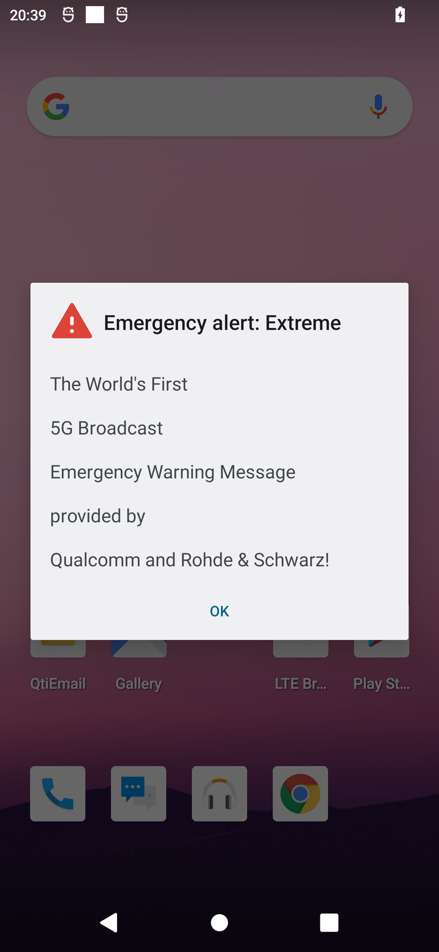
Emergency alerts
5G broadcast inherits from 5G the public warning system capabilities.
The Cell Broadcast Service (CBS) does not require authentication with a PLMN. Hence, a ROM network is inherently compatible with CBS (see 3GPP TS 23 041).
CMAS (commercial mobile alert system) is available in current commercial devices.
Devices monitor periodically a low-duty cycle paging channel (low power)
CMAS over 5G broadcast has been demonstrated with R&S infrastructure
Additional capabilities of CMAS:
Geofencing (send notification to users within a given area)
Possibility of sending URL linking to emergency media

Slide 20

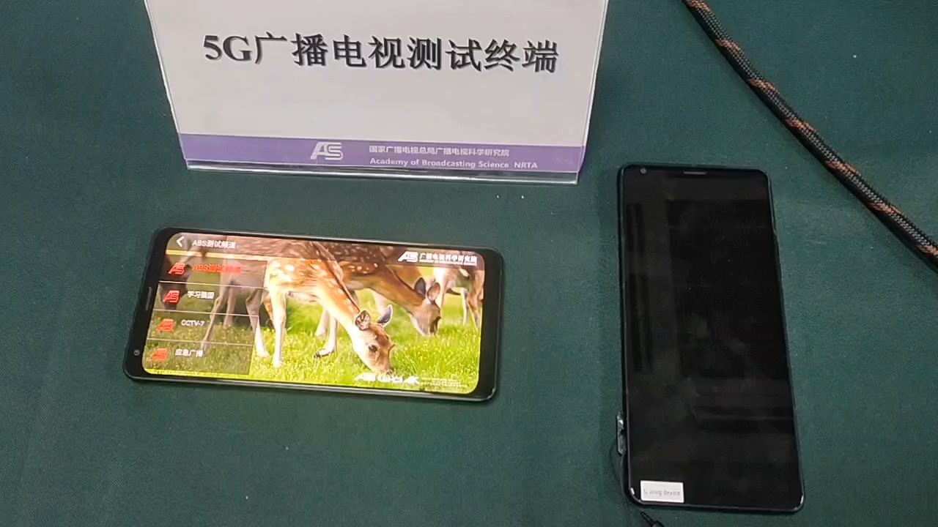
Emergency message demo with ABS
Self-contained emergency system (text + multimedia) without need of unicast.

Slide 21
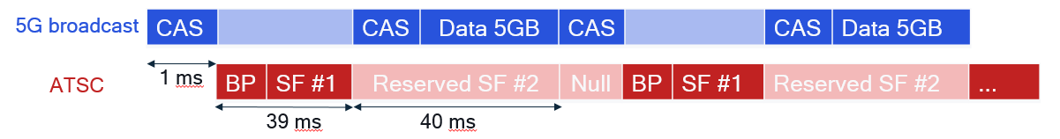
Coexistence of ATSC 3.0 & 5G Broadcast
Work Item in ATSC und 3GPP under preparation
ATSC 3.0 & 5G Broadcast can coexist: it does not have to be a either/or
5G Broadcast can be deployed by broadcasters in the exact same way as ATSC, and it greatly lowers the barrier to adoption in mobile devices since it is “only” an incremental feature to the 4G/5G modem
Native broadcasting technologies like ATSC or DVB were never successfully incorporated in mobile devices at scale because their inclusion requires a separate piece of silicon (similar to, say, WiFi or GPS) and the ecosystem never took off
We could make use of the “reserved” frames of ATSC 3.0 to “superimpose” 5G Broadcast, thus achieving coexistence on the same channel
An alternative would be for ATSC 3.0 and 5G Broadcast to coexist on two different frequencies, i.e. one MUX for each
The same broadcaster could thus deploy & operate both technologies at the same time
ATSC 3.0 for fixed devices
5G Broadcast for mobile devices
Documented in ATSC TG3-11
Rel-19 candidate work for 3GPP

Slide 22
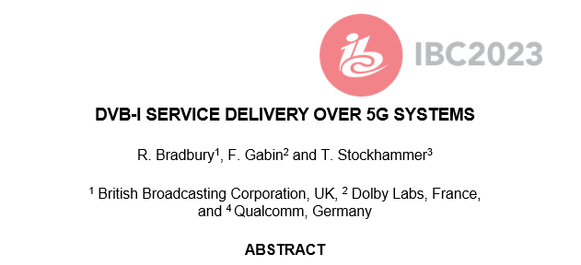


DVB-I via 5G Broadcast
Joint DVB/5G-MAG task force
Using MBMS/5G Broadcast Reference Points and APIs
Different options are considered
Using file download services for carouselling metadata
Using segment streaming for DVB-DASH
Using transparent mode for DVB-I multicast distribution
Combinations with unicast, hybrid services also under development
See details in ETSI TR 103 972
Expected to be supported by reference tools

Slide 23
Hybrid Unicast Broadcast
Architectures, Collaboration Models and Use Cases
Content Provider may leverage 5G Unicast systems, 5G Broadcast systems, and 5G devices to build efficient and innovative applications
Supported by well defined network and client-side APIs
Examples:
Hybrid Services
Universal Coverage
Broadcast on Demand
Integrated into 3GPP 5G specs, ETSI TS 103 720 and TR 103 972 (DVB over 5G)
5G MNO
Content Provider
5G Broadcast Operator

Slide 24
Summary & Next Steps
Join the community of open standards, innovation and development
5G is a platform for Broadcasters and Content Providers with features including 5G broadcast, Public Warning and many others
3GPP Standards are global and address billions of devices – from smart phones to many more verticals (automotive, IOT, etc.)
Qualcomm contributes, supports and drives open systems through technologies, standards and reference tools

