Slide 1
IEEE BTS Workshop at IBC24
Mobile TV – Finally?
Aytac Biber

Slide 2
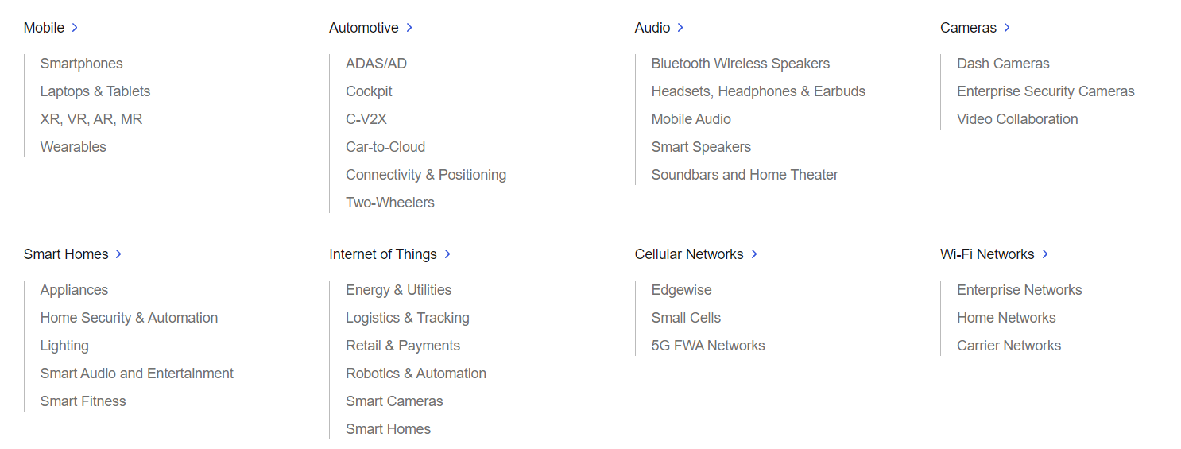
About Qualcomm
US based company with over 50K employees worldwide
Semiconductor and software solutions for various connected products

Slide 3

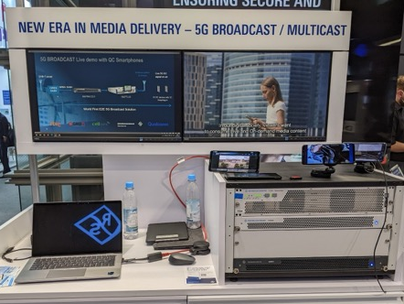
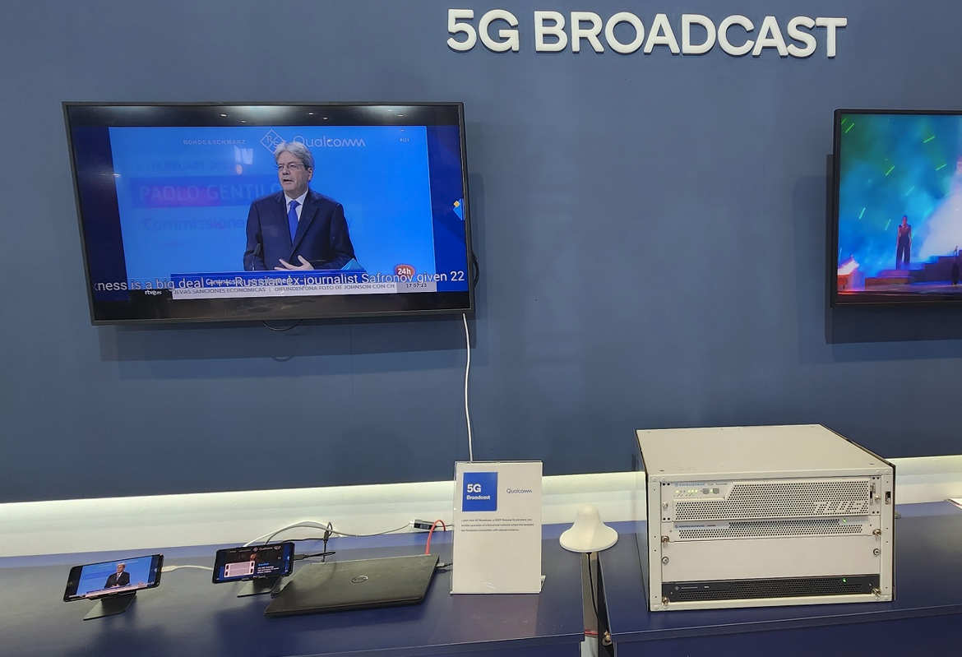
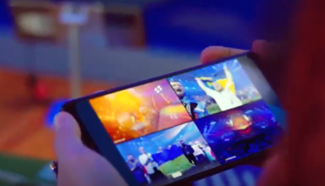
What Qualcomm have done for 5G broadcast?
Key role for defining 5G Broadcast specification with 3GPP Release 16 in 2020
Together with Rohde & Schwarz developed PoC with linear TV and emergency notifications
Numerous trials and demos in several countries to showcase variety of use cases

Slide 4
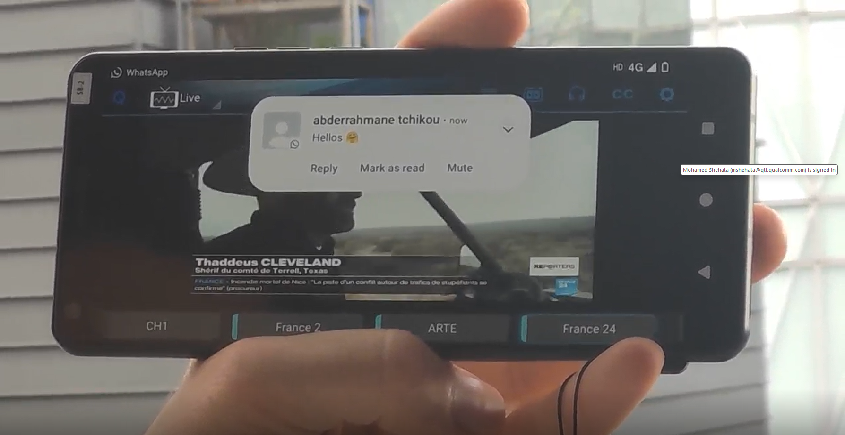
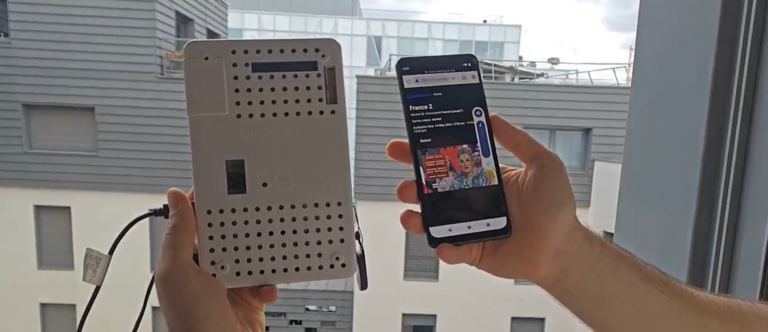
Next steps
Finalize 5G Broadcast receiver profile
Enhancements with time & frequency interleaver
Larger trials and test beds in additional countries involving mobile OEMs

Slide 5



Challenges
Broadcasters
  Additional investment in infra
  Spectrum re-allocation
Device OEMs
  How they benefit from technology?
  How to present and market feature to consumers?
  How 5G Broadcast would integrate with existing services?

