Slide 1

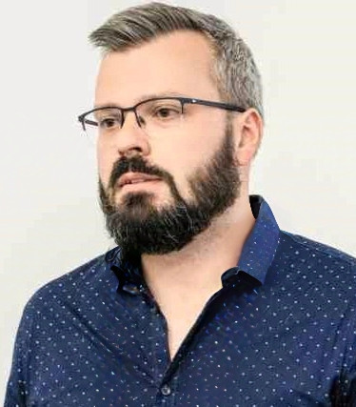
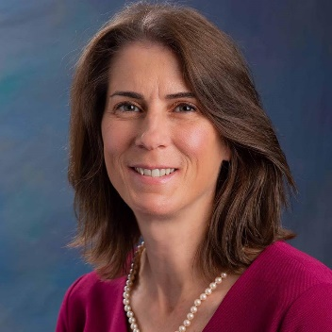
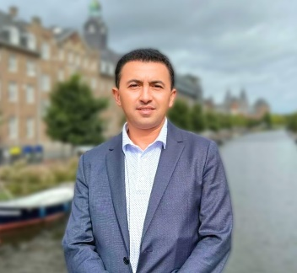
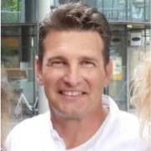
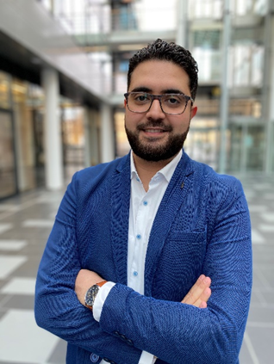
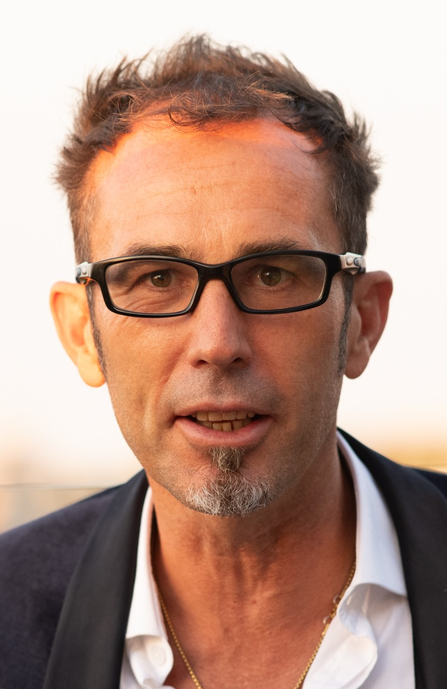

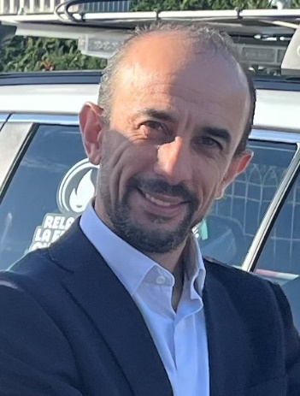
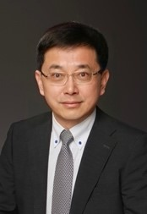
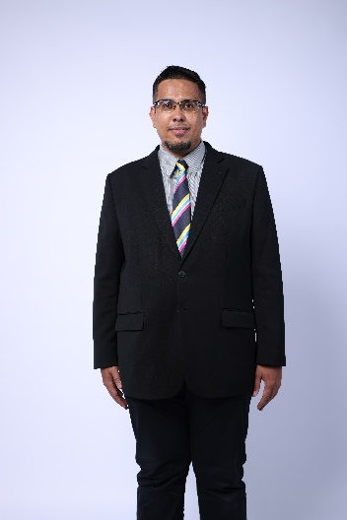

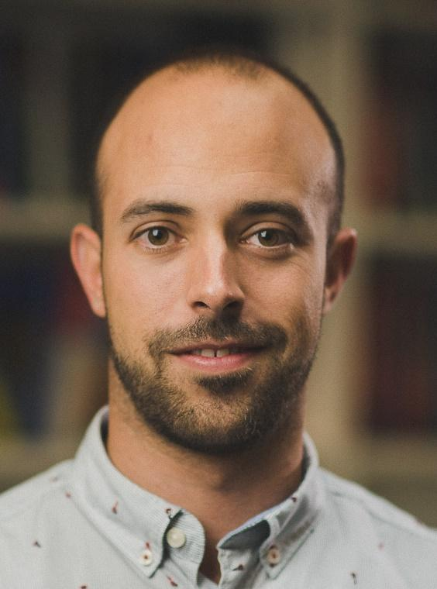
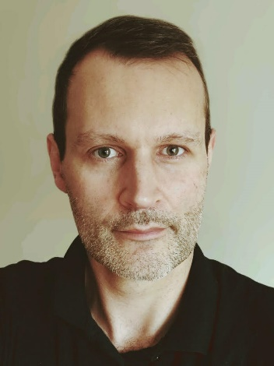
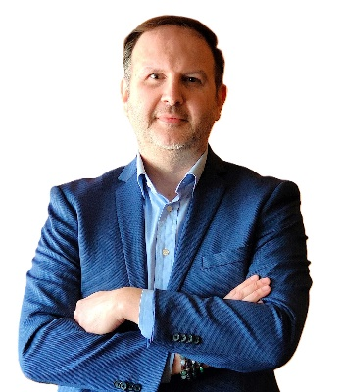
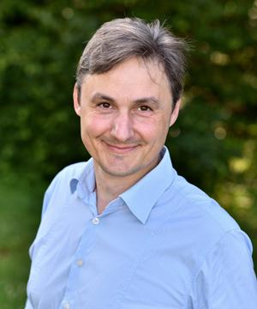
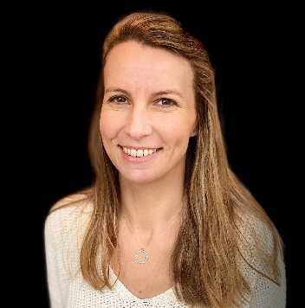
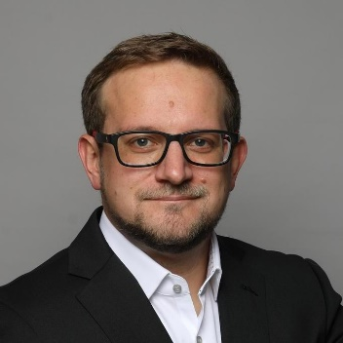
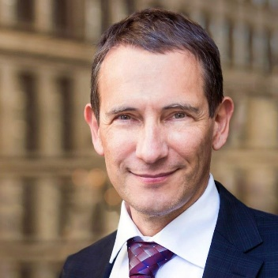
Mobile TV - Finally? Session 2 - Panel
Where: Main IBC Conference Center Room E102
When: Saturday, September 14, 11:45 - 13:00

Slide 2
Europe
Aziz Taga (Rohde & Schwarz)
Johann Mika (ORS Group)
Christophe Burdinat (ATEME)
Asia
Ts. Mohammad Hafiz Halal, Malaysian Communications and Multimedia Commission (MCMC)
Prof Wenjun Zhang (Shanghai Jiao Tong University/ NERC DTV)
Emmanuel Thomas (Xiaomi)
North America
Aytac Biber (Qualcomm)
SuperFrank Copsidas, XGEN
11:45 Introduction to Session
Panel Discussion
13:00 Close of Session

Slide 3


Join Slido.COM #IBC

Slide 4
Introduction
Who you are and what you represent?
Status of 5G Broadcast
Next Steps and Plans
Discussion Points, Challenges, Opportunities

Slide 5

Mohamed Aziz Taga
Biog. Mohamed Aziz Taga takes care of the product management for Broadcast & 5G Media Business at Rohde & Schwarz. Based in Munich, Germany, Mohamed leads the global business development activities and worldwide strategic projects as well. Together with his global team, Aziz is responsible for strategic partnerships. He constantly monitors associated market movements and related technological progress aiming at providing guidance towards overall product and solution’s strategy.
After obtaining his master’s degree in computer Networking and Telecommunications, Aziz became a Mobile Core Network Specialist within Nokia Networks with an extensive Cellular Core Network technical background before joining Rohde & Schwarz in 2018.

Slide 6

Johann Mika
Chief Innovation Officer at the Austrian Broadcasting Services (ORS Group) is responsible for analysing technologies and innovations that will become relevant for the company in the coming years. He has been working intensively with 5G Broadcast for the last six years, was project leader of the first phase of the Vienna trial and is responsible for ORS Group's strategic initiative on 5G Broadcast. Prior to this he has several years of experience in the planning, development and operation of OTT services and content delivery networks. Johann enjoys experimenting with new technologies and pushes to apply them in real-life scenarios.

Slide 7

About ORS
Broadcast network operator, located in Austria, Europe
Focused on audio/video distribution
Terrestrial
Satellite
Streaming
> 400 high-power-high-tower (HPHT) transmitters
Operating 6x DVB-T2 Mux and 2x 5G BC (Test) Mux in band n108
3GPP member since 2022

Slide 8
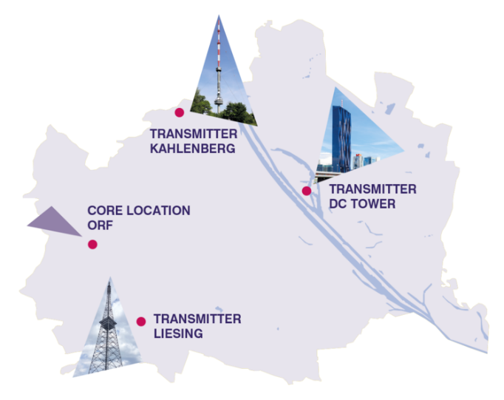
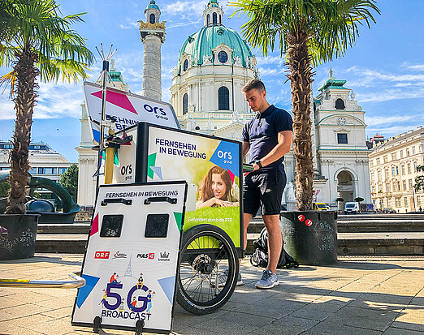
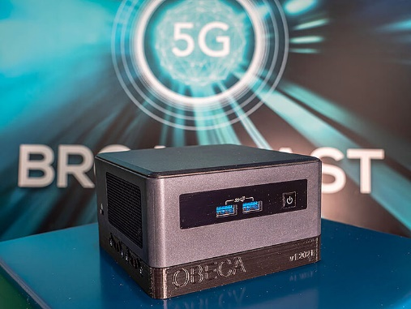
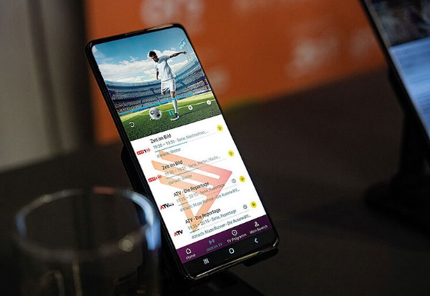
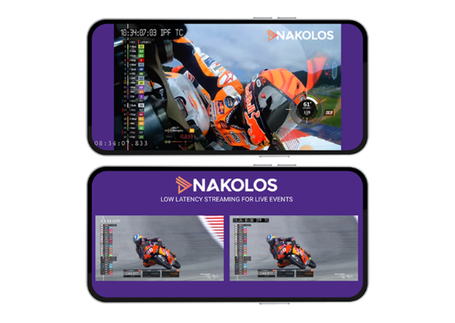

Role of ORS in 5G Broadcast
Since 2020, ORS group is a pioneer in the research and development of the new broadcasting standard.
ORS is running the worlds longest 5G Broadcast testbed in Vienna and supports companies and organizations in the further development.
2020
2021
2022
2023
Physical layer, measurements
OBECA: worlds smallest open-source 5G Broadcast receiver
First 5G Broadcast capable smartphone & founding
Optimized low latency for live events, e.g. MotoGP
Next step for ORS is a roll-out of 5G Broadcast for whole Austria
*IBC booth 7.P46
Notes:
ORS started as pioneer in the field implementation and development of 5G Broadcast* in 2019 including
Open-source implementation for early tests and adaption of 3GPP specifications
Operation of the longest continuous testbed (since 2020 until now)
Demonstration of various use cases including public warning and seamless integration of unicast and broadcast in mobiles to increase consumer experience etc

Slide 9
5G Broadcast ecosystem evolution
Key Achievements
Bandwidth 8 MHz
Mobile band for Standalone Downlink Only
Standardization
Vendor diversity
Infrastructure
Pre-commercial devices
Mobile handsets

Slide 10

5G Broadcast ecosystem evolution
Key Achievements
Future Challenges
Bandwidth 8 MHz
Time Frequency Interleaving
Mobile band for Standalone Downlink Only
Standardization
CAS Muting
Vendor diversity
Infrastructure
Bandwidth optimization
Pre-commercial devices
Mobile handsets
Market introduction

Slide 11
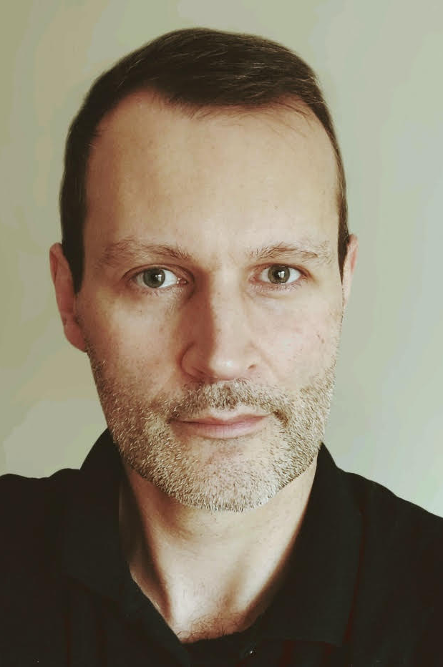
Christophe Burdinat
Director - Technologies and Standard at Ateme. With more than 15 years of experience in the Mobile Broadcast Industry, from DVB-H/ATSC-MH/ISDBT-MM to LTE-Broadcast and 5G-Broadcast, in his different roles, he drives the product development, R&D collaborative projects and standardization management. He is a regular delegate and contributor at 3GPP, DVB and SVA. His expertise covers content delivery protocols, mission critical/public safety services over mobile networks, multicast ABR, DVB-I, 5G broadcast, and OTT service distribution.”

Slide 12
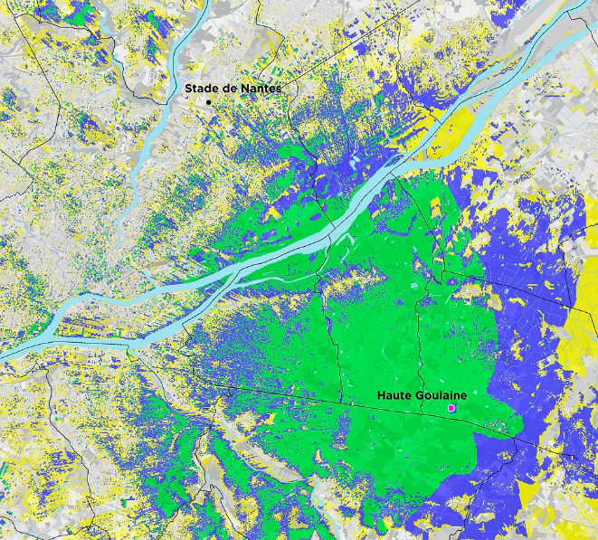

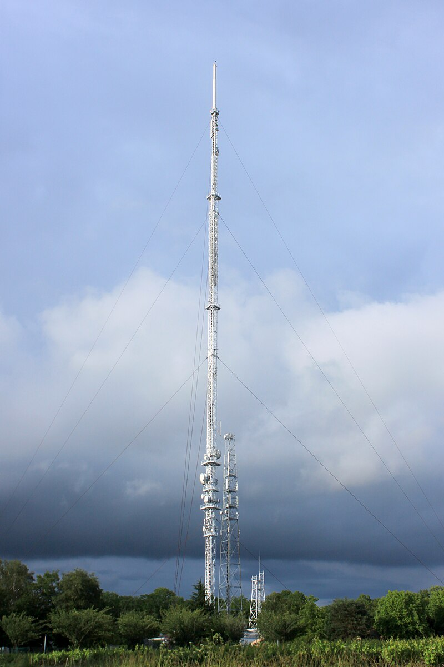





5G Broadcast trial with TDF
NextGen codecs over 5G Broadcast
Nantes – August 2024
HEVC / VVC
DASH
5G Broadcast Core
Haute Goulaine Transmitter CF 640.5 MHz 10 Mhz bandwidth
CDN

Slide 13
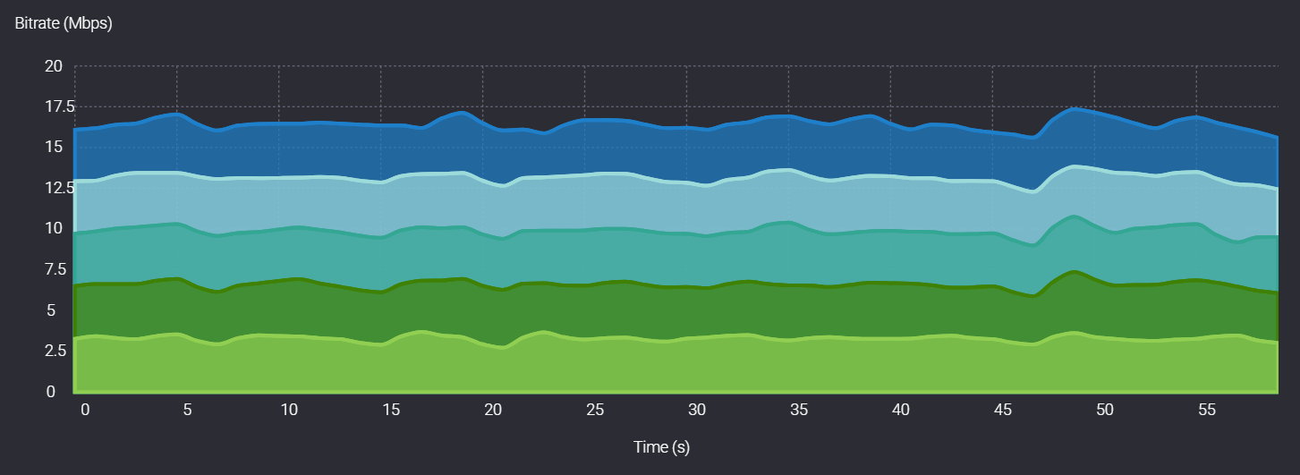

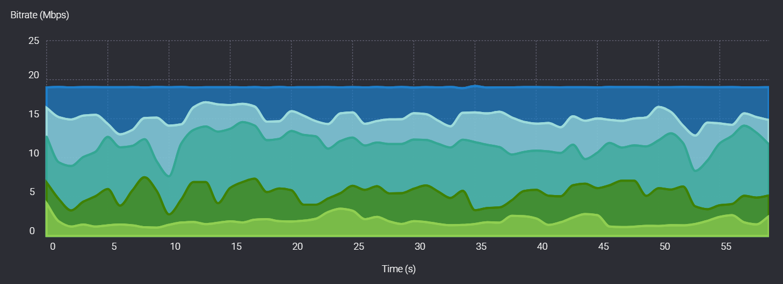
NextGen statMux for 5G Broadcast
BEFORE
Use all the available bandwidth, improve video quality and save ressources!
CBR versus VBR using NextGen Statmux with
bandwidth optimization by up to 20%!
CBR with Padding
NOW
VBR NextGen statmux with no padding

Slide 14
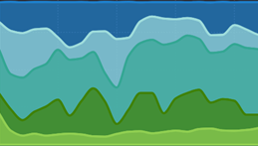






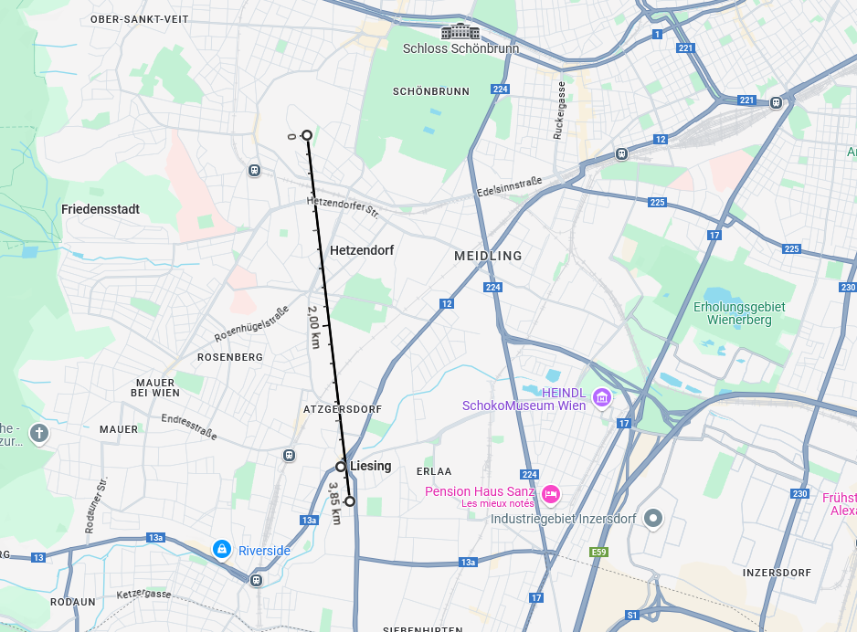


5G Broadcast statmux trial with ORS Group
Vienna – July 2024
StatMux
ROUTDASH
Dash player
DASH
OTTCaster
NextGen statmux
ROUTGPAC
(HEVC 720p)
ROUTE
ROUTE gateway
CF 640.5 MHz 5 Mhz bandwidth
1 kW
SDR 5G Broadcast receiver
Reference tools
1 PMCH (5G-Broadcast Physical Channel),
transporting 5 statmuxed TV services
MCS 15, GBR 4Mbps
CDN
ORF-Zentrum
Liesing Transmitter CF 640.5 MHz 5 Mhz bandwidth
1 kW

Slide 15
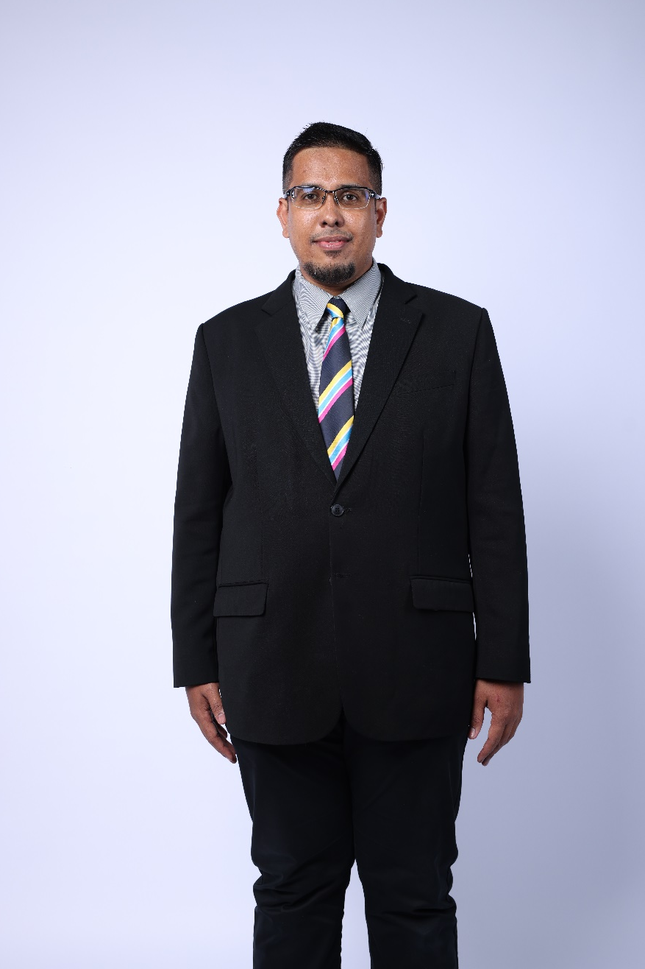
Ts. Mohammad Hafiz Halal
Deputy Director, MCMC Broadcasting Development Department, Digital Ecosystem Development Division
With 12 years of experience in TV Broadcasting Engineering field, Ts. Mohammad Hafiz Halal has a rich background in making things work seamlessly. He commenced his career as a Broadcast Engineer at Measat Broadcast Network Sdn Bhd (MBNS), widely recognized as Astro, where he dedicated five years to mastering the intricacies of Broadcast Operation systems. Beginning, he had started his career in Astro as Master Control Room (MCR) Engineer in monitoring the end-to end of Broadcast Operation system and he swiftly ascended his role as Broadcast Engineering Support in overseeing and maintaining seamless operations at. His purview extended across the entire broadcast system, encompassing headend, baseband, and transmission systems for IPTV, DTH, and OTT platforms.
Building on his time at Astro, Ts. Hafiz took charge of the Industry Working Group at the Malaysian Technical Standards Forum Bhd (MTSFB) for the Broadcast Technology Working Group together with IMT and Future Networks Working Group. As a Standardisation Engineer, he led the group in creating more than 15 Technical Codes which some of the Technical Codes had became important guides for the Analog Switch Off (ASO) and 5G Roll-out implementation in Malaysia. Spending more than 5 years at MTSFB, Hafiz skillfully led the Broadcast Technology Working Group. Later on, Hafiz brought his knowledge to MYTV Broadcasting Sdn. Bhd as a Technical Regulatory professional for six months, where he used his expertise in broadcast operations and regulations where he had leading on some of the technical regulatory matter including supporting for 2 new additional DTT sites at Negeri Sembilan and Perlis. His dual expertise in broadcast operations and regulatory affairs positioned him for a more significant role in shaping the trajectory of Malaysian initiatives for the success of the Broadcast Industry.
Currently at the Malaysian Communications and Multimedia Commission (MCMC), Ts. Hafiz Halal as a Deputy Director in Broadcasting Development Department under Digital Ecosystem Development Division, he serves as a pivotal role for the industry in leading the Future Broadcasting Technology Study, contributing to the evolution and advancement of the broadcasting landscape.

Slide 16

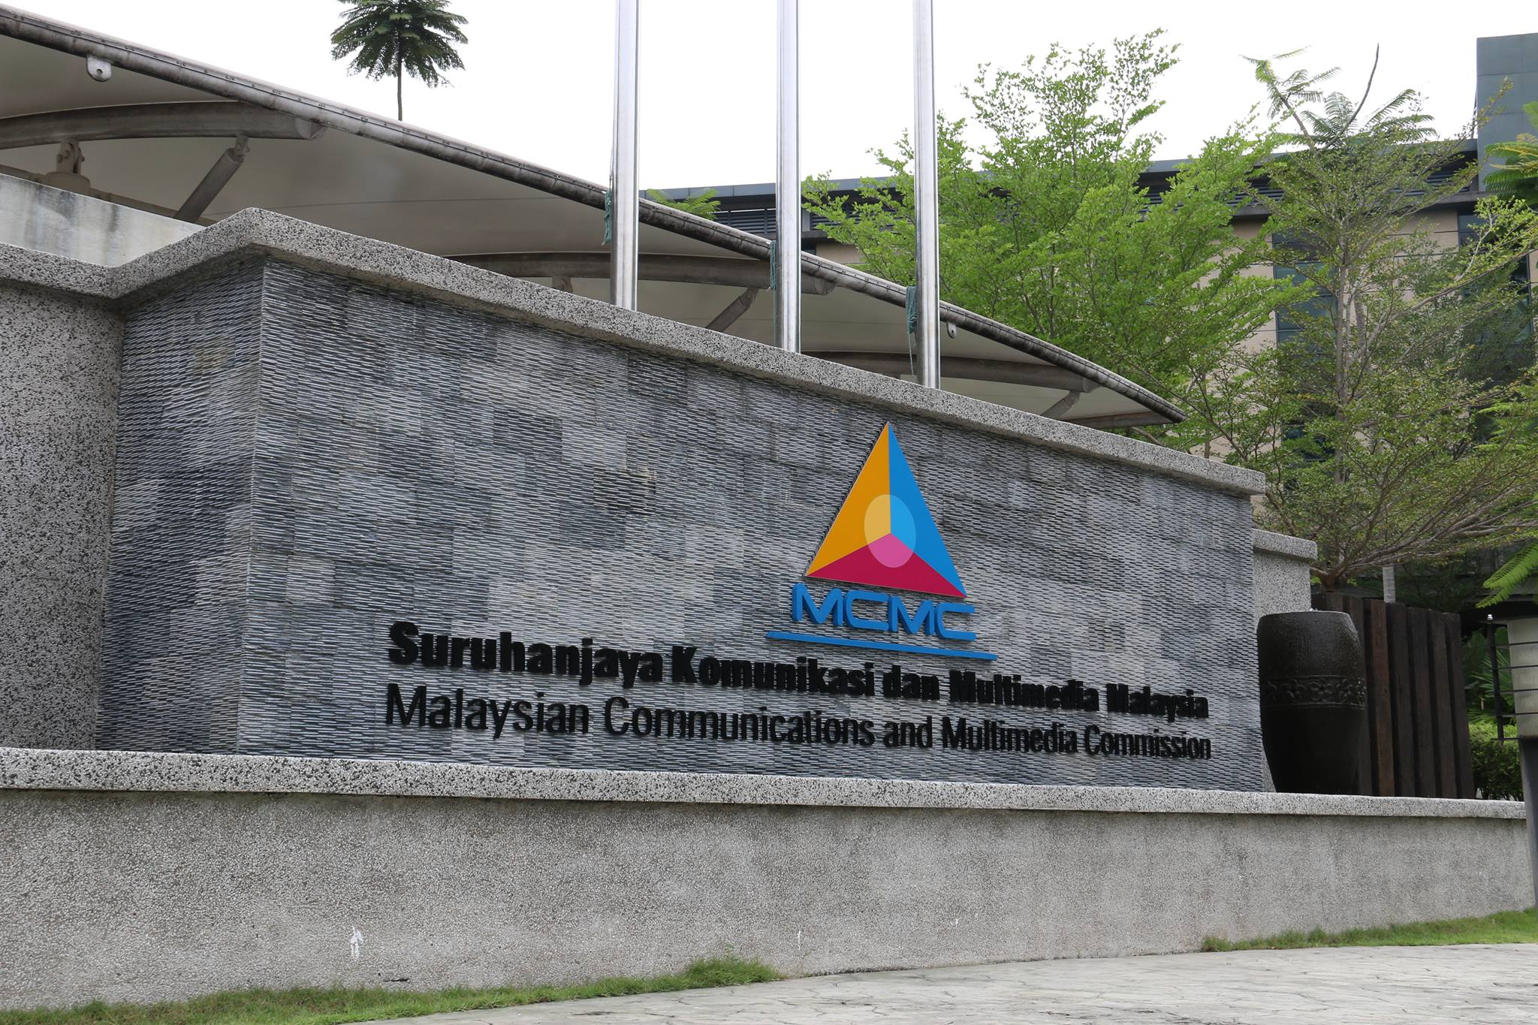

5G BROADCAST IN MALAYSIA:
JOURNEY TOWARDS
FUTURE BROADCASTING
IBC 2024 – IEEE BTS:
Mobile TV - Finally?
Ts. MOHAMMAD HAFIZ HALAL
Deputy Director, Broadcasting Development Department
RAI, Amsterdam
14 SEPTEMBER 2024 (Saturday)

Slide 17




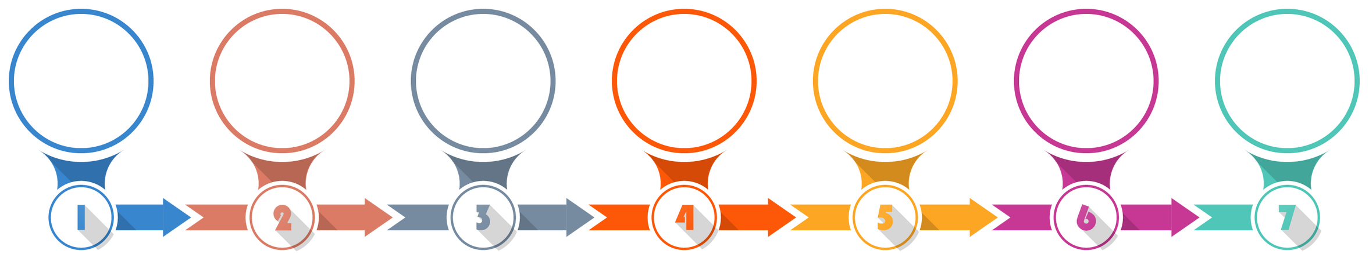

FUTURE BROADCASTING STUDY WORKPLAN
1
JAN - DEC 2023
2
JAN - DEC 2024
Establishment of the study group for the Future Broadcasting Study
To conduct a Test-bed facility to validate the use-cases
To publish a comprehensive report on the Future Broadcasting Study
To publish report on the outcomes of the Test-bed facility
Collaboration Partner :
PHASE 1
PHASE 2
STAGE 1:
TERM OF REFERENCE (TOR)
STAGE 2:
ESTABLISHED STUDY GROUP
STAGE 3:
PUBLISH INDUSTRY
STUDY REPORT
STAGE 4:
ENGAGEMENT WITH INDUSTRY
STAGE 5:
TEST-BED SESSION
STAGE 6:
5G BROADCAST DAY SHOWCASE
STAGE 7:
ESTABLISH FINAL REPORT
2023
2024
Mar 2025

Slide 18
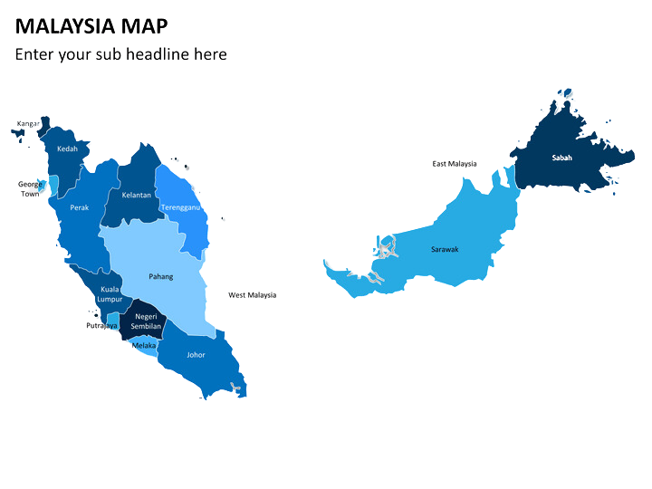




WAY FORWARD OF 5G BROADCAST ACTIVITY
2025 -2026
TO CONDUCT POC FOR 5G BROADCAST BUT SUBJECT TO THE SUCCESSFUL OUCTOMES OF TEST-BED SESSION
CENTRAL REGION
NOTE: Proposal only, subject to change
SITES

Slide 19
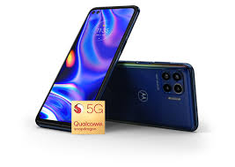
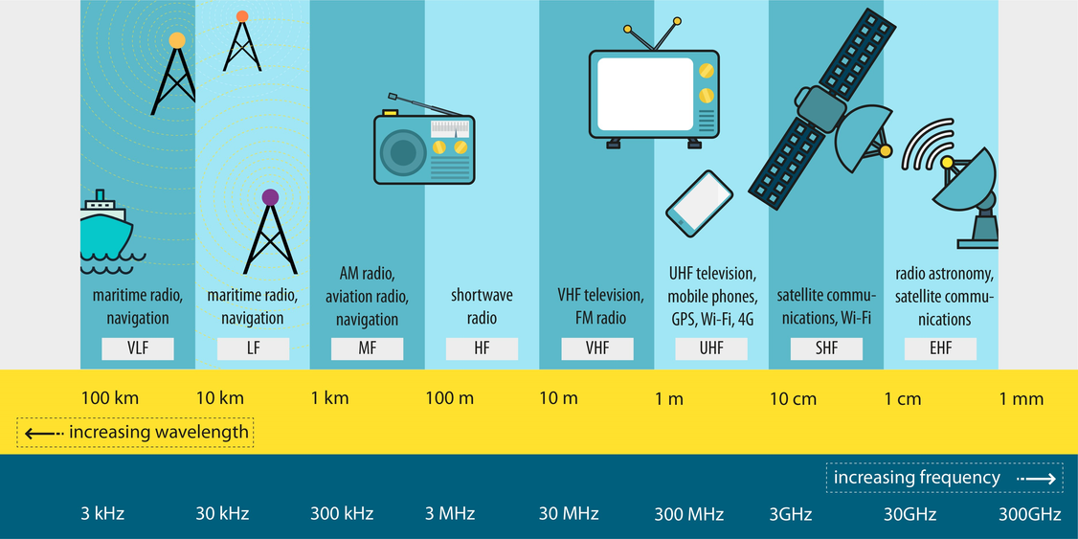
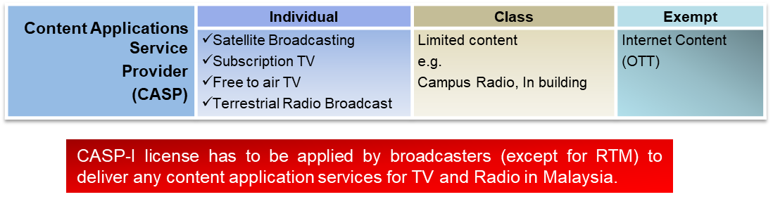
POTENTIAL REGULATORY & POLICY REVIEW
STANDARDISATION
To develop new Technical Codes on 5G Broadcast System and User Equipment (UE)
Spectrum review on 5G Broadcast Service;
ITU-R direction on Spectrum Plan
Standard Radio Spectrum Plan (SRSP);
Class Assignment
SPECTRUM REVIEW
LICENSING REVIEW
To review on License review for 5G Broadcast Service

Slide 20
KEY TAKEAWAY
5G Broadcast is a game-changer for the global broadcasting industry, offering the potential to reach wider audiences with high-quality content, even in remote areas.
Countries exploring or implementing this technology should focus on building strong collaboration between BNO and MNO and identifying business cases tailored to local demands.
Don’t wait for success stories from other countries—start exploring the potential of Future Broadcasting Technology now to ensure the success of your industry.

Slide 21


THANK YOU
For Your Attention!
Ts. MOHAMMAD HAFIZ HALAL
hafiz.halal@mcmc.gov.my

Slide 22
Dr. Wenjun Zhang
Received his B.S., M.S. and Ph.D. degrees in electronic engineering from Shanghai Jiao Tong University, Shanghai, China, in 1984, 1987 and 1989, respectively. After three years’ working as an engineer at Philips in Nuremberg, Germany, he went back to his Alma Mater in 1993 and became a full professor of Electronic Engineering in 1995. He was one of the main contributors of the Chinese DTTB Standard (DTMB) issued in 2006. He holds 238 patents and published more than 150 papers in international journals and conferences. He is the Chief Scientist of the Chinese Digital TV Engineering Research Centre (NERC-DTV), an industry/government consortium in DTV technology research and standardization, and the director of Cooperative Media Network Innovation Centre (CMIC)，an excellence research cluster affirmed by the Chinese Government. His main research interests include AI-based video coding and wireless transmission, multimedia semantic analysis and broadcast/broadband network convergence. He is a fellow of IEEE.

Slide 23
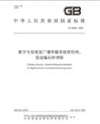
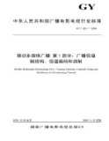
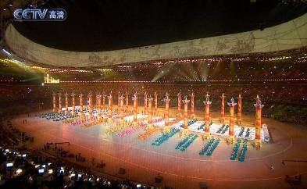

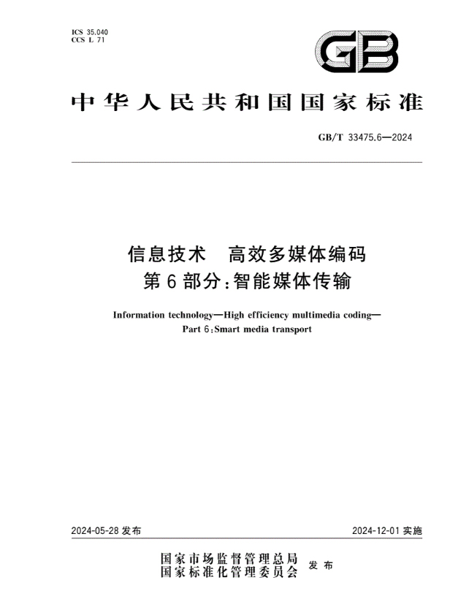
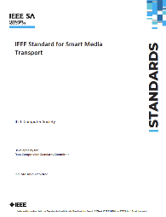
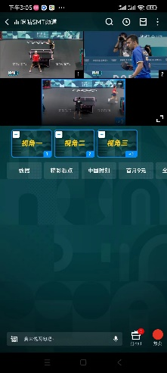
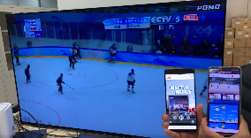

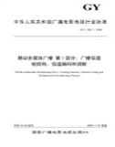

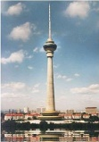
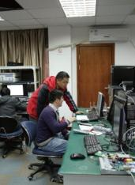
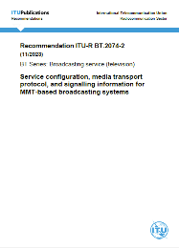
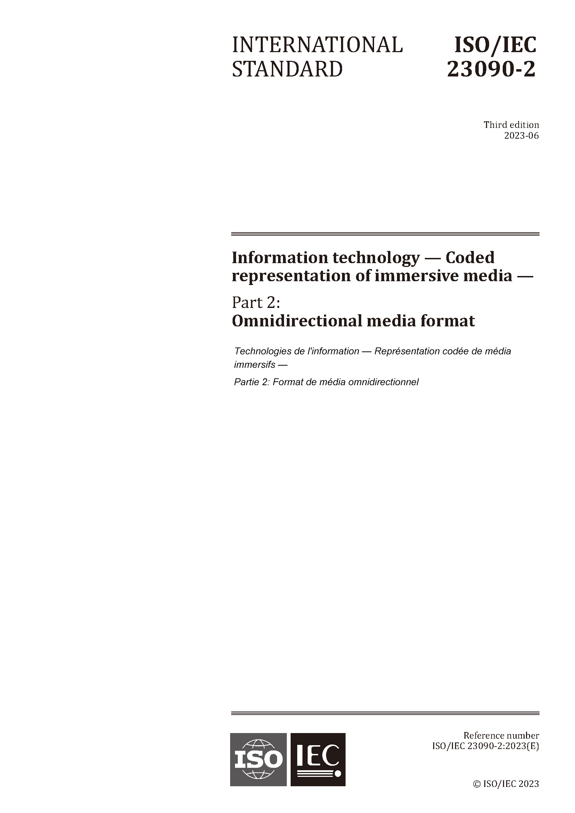
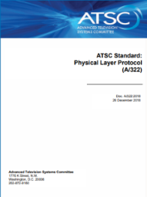
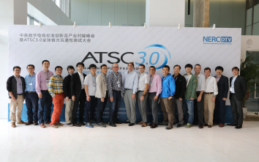

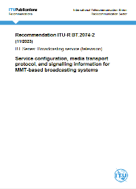




About SJTU & NERC-DTV
We have been working on digital broadcast technologies for over 25 years
Major contributors to Chinese Broadcast Standards including DTMB, ABS-S and AVS SMT and etc.,
One of the contributors to many international standards, including 3GPP 5G Broadcasting, ATSC3.0, ITU-R, MPEG and etc.,
Leading design house enables emerging standards ecosystem around the world
DTMB
CMMB
3GPP
3GPP
AVS SMT
UWA
IEEE
ABS-S
ITU-R
MPEG-I/H
ITU-R
ATSC 3.0
Chinese Broadcast Standards
Large Scale Deployments since Olympic Games
New Generation Broadcast Standards
International Collaborative Efforts and Deployment

Slide 24



What we have done for 5G Broadcasting
Field Test in Shenzhen
Trial Network in Chengdu
Individual receiver chip
显示处理
West Pearl Tower
Receiver Chip
Sichuan Radio and Television Bureau 702
Sichuan Radio and Television
NERC-DTV is working with some chip companies for the development of Individual receiver chip
Successful Reception: 96%
(MCS9, 1 bit/s/Hz)
NRTA has approved to set a trial network in Chengdu City, Sichuan Province
Location: setup at the top of Wutong Mountain
Power: 260W (four directions, about 65W for each one)

Slide 25



Opportunities for 5G broadcasting
Broadcast
to ALL Receivers
Broadcast
On Demand
Broadcast Generative Services
Successive Service
Off-loading Service
Collaborative Transport
High tower
offloading
2D Basic stream
(Broadcast)
High tower service (out of range)
Cellular
Service (impaired)
3D Enhancement stream (Cellular)
Cellular BS packet re-transmission

Slide 26
Emmanuel Thomas
Senior Media Engineer at Xiaomi since 2021 where he is technical lead for media delivery standardisation in the 3GPP SA4 and MPEG groups. After receiving his master’s degree in signal processing in 2010, he has been involved in media streaming and video coding research since then. His research work ranges from XR experiences, network assisted media streaming to enriched video experiences on mobile devices. Since 2013, he is an active member of the Motion Picture Experts Group (MPEG), for which he has held several chair and editor positions for standards such as MPEG-DASH, ISOBMFF, and more recently the MPEG-I standards Video Decoding Interface and Scene Description. Emmanuel is also a regular delegate in the 3GPP SA4 standardisation group and acts as rapporteur for the Media Capabilities for AR technical specification in 5G. He is co-author of more than 60 patents as well as several journal and conference papers.Director - Technologies and Standard at Ateme. With more than 15 years of experience in the Mobile Broadcast Industry, from DVB-H/ATSC-MH/ISDBT-MM to LTE-Broadcast and 5G-Broadcast, in his different roles, he drives the product development, R&D collaborative projects and standardization management. He is a regular delegate and contributor at 3GPP, DVB and SVA. His expertise covers content delivery protocols, mission critical/public safety services over mobile networks, multicast ABR, DVB-I, 5G broadcast, and OTT service distribution.”

Slide 27

Notes:
<Personal intro>
I’m excited to give you an overview of Xiaomi.
<CLICK>

Slide 28




About me
Emmanuel Thomas
Lead Media Systems Standardisation
Xiaomi
R&D and standardisation in media delivery since 2013
MPEG, 3GPP SA4, HTTP-based streaming, network optimisation, XR
Connecting products and standards

Slide 29
Our users are at
the heart of everything
Notes:
All of our efforts are done with our users in mind,
And it is thanks to their support that we have achieved so much.

Slide 30






Xiaomi Strategic Vision

Slide 31
As an end-user,
what (new) services or features will make 5G broadcast a must for me?

Slide 32

Aytac Biber
Aytac Biber is Director of Product Management at Qualcomm Technologies, Inc. He works on ecosystem development for emerging multimedia standards Qualcomm contributes to. He holds MBA degree from SDSU and Electronics and Telecommunications Engineering Degree from Istanbul Technical University

Slide 33
IEEE BTS Workshop at IBC24 Mobile TV – Finally?
Aytac Biber

Slide 34

About Qualcomm
US based company with over 50K employees worldwide
Semiconductor and software solutions for various connected products

Slide 35




What Qualcomm have done for 5G broadcast?
Key role for defining 5G Broadcast specification with 3GPP Release 16 in 2020
Together with Rohde & Schwarz developed PoC with linear TV and emergency notifications
Numerous trials and demos in several countries to showcase variety of use cases

Slide 36


Next steps
Finalize 5G Broadcast receiver profile
Enhancements with time & frequency interleaver
Larger trials and test beds in additional countries involving mobile OEMs

Slide 37



Challenges
Broadcasters
Additional investment in infra
Spectrum re-allocation
Device OEMs
How they benefit from technology?
How to present and market feature to consumers?
How 5G Broadcast would integrate with existing services?

Slide 39

SuperFrank CopsIdas
“SuperFrank” Copsidas is the enigmatic CEO of XGen Network (XGN), spearheading the revolution in 5G Broadcasting technology across the United States. As the visionary Founder and President of the 5G Broadcast Collective, he champions the global advancement of this groundbreaking technology.
Holding FCC licenses for nine LPTV Broadcast stations spanning from Boston to St. Louis, SuperFrank is also the dynamic Founder and President of the LPTV Broadcasters Association. His influence extends to the FCC/NAB “Future of TV Initiative” committee, where he plays a pivotal role in shaping the future of television.
SuperFrank’s storied career is a testament to his entrepreneurial spirit, with ventures that span ground and airline transportation, real estate, bottled water, radio stations, and even artist management, where he notably represented the legendary James Brown.
And the origin of the moniker “SuperFrank”? That remains shrouded in mystery, inviting you to conjure your own tales of its inception.

Slide 40


What is 5G Broadcast?
Visit us at Booth 14.B18
XGen Network LLC

Slide 41

Priorities
Emergency Alerts/First Responder Solutions
Ancillary data delivery to road signs, particularly in emergencies
United States 5G Broadcast Proof of Concept 2
Visit us at Booth 14.B18
XGen Network LLC

Slide 42
We Are One – Working Together
5G Broadcast Collective
Collaborate, Research, Educate, Lobby
FREE Proof of Concept*(* Plus travel expenses)
At your location, anywhere in the world
Working Together
Creating a global community
www.XGN.network​
contact@xgn.network
Visit us at Booth 14.B18
XGen Network LLC

Slide 43
Join Slido.COM #IBC

